Slide 1
Project 3 - Data Preparation
Yen LE & Adel Chahed
Cyberbullying in social media

Slide 2
Table of contents
Description of the dataset
Challenges faced
Process followed
Lessons learned
Potential improvements
Q&A session

Slide 3
Description of the dataset
Dataset Title: "cyberbullying_in_social_media"
Contains text data (turkish tweets) from Twitter
5000 rows × 27 columns
Features include:
Id, Text, Retweets, Favorites, Hashtags, Medias, Mentions
Sender Information: Id, Account years, Favorites, Followings, Followers, Statuses, Location
Text-related features: Emojis, Punctuations, Uppercase letters, Total letters, Symbols, Words, Total words, Unique words, Slang words, Average word length
Target variable: IsCyberbullying (Indicates if the text is cyberbullying or not)

Slide 4
2. Challenges faced
Missing values in certain columns
Presence of unconventional symbols, emojis, and punctuations that can lead to data skew or loss of information
No standardization in the presentation of columns such as sender location, leading to difficulties in grouping or aggregating data.
Data types not normalized in the columns
Problem with the outliers

Slide 5
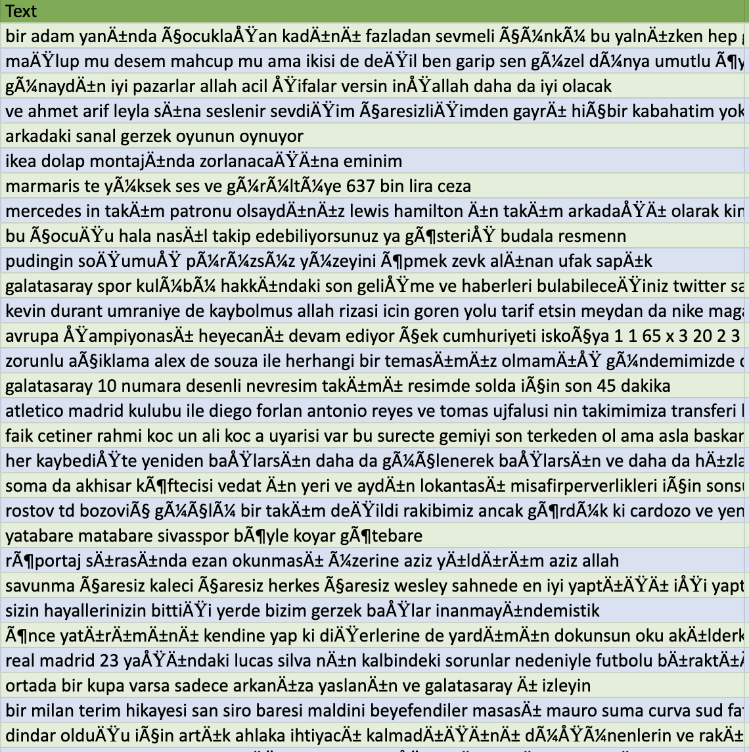
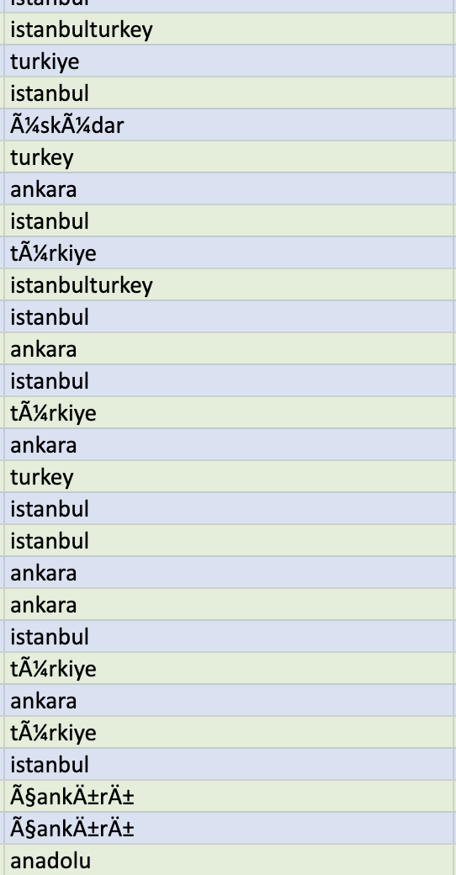
3. Process followed
Convert the data type of the columns
IsRetweet and IsSelfMentioned : object → bool
Id, Retweets#, SenderId', SenderFollowers#, Emojis# and AvgWordLength : Float64 → Int64
Drop the useless columns “text” and “SenderLocation” (text corrupted and useless)

Slide 6
3. Process followed
Drop the duplicate records (2 records)
Check low variances columns : 3 columns dropped : ['IsRetweet', 'IsSelfMentioned', 'Symbols#']
Check extreme values & outliers (nothing dropped)
Export a clean version of the new data as a CSV file using Pandas.
Analyze the dataset in MySQL through three tables.

Slide 7
4. Lessons learned
Learnings:
Understanding of data cleaning and its importance in data analysis.
Knowledge of using pandas library for data cleaning and data analysis.
Techniques for handling missing values
Detection and removal of duplicates in a data set.
Removing low variance columns to improve the analysis process.

Slide 8
5. Potential improvements
Improvements:
More in-depth analysis of the data set, such as handling extreme values or outliers, and the impact they have on the results.
Consideration of other imputation techniques for missing values.
Use of more sophisticated data cleaning techniques, such as data normalization, to ensure data consistency.
Further exploration of data visualization techniques to better understand the data set.

Slide 9
Q&A session

