Slide 1
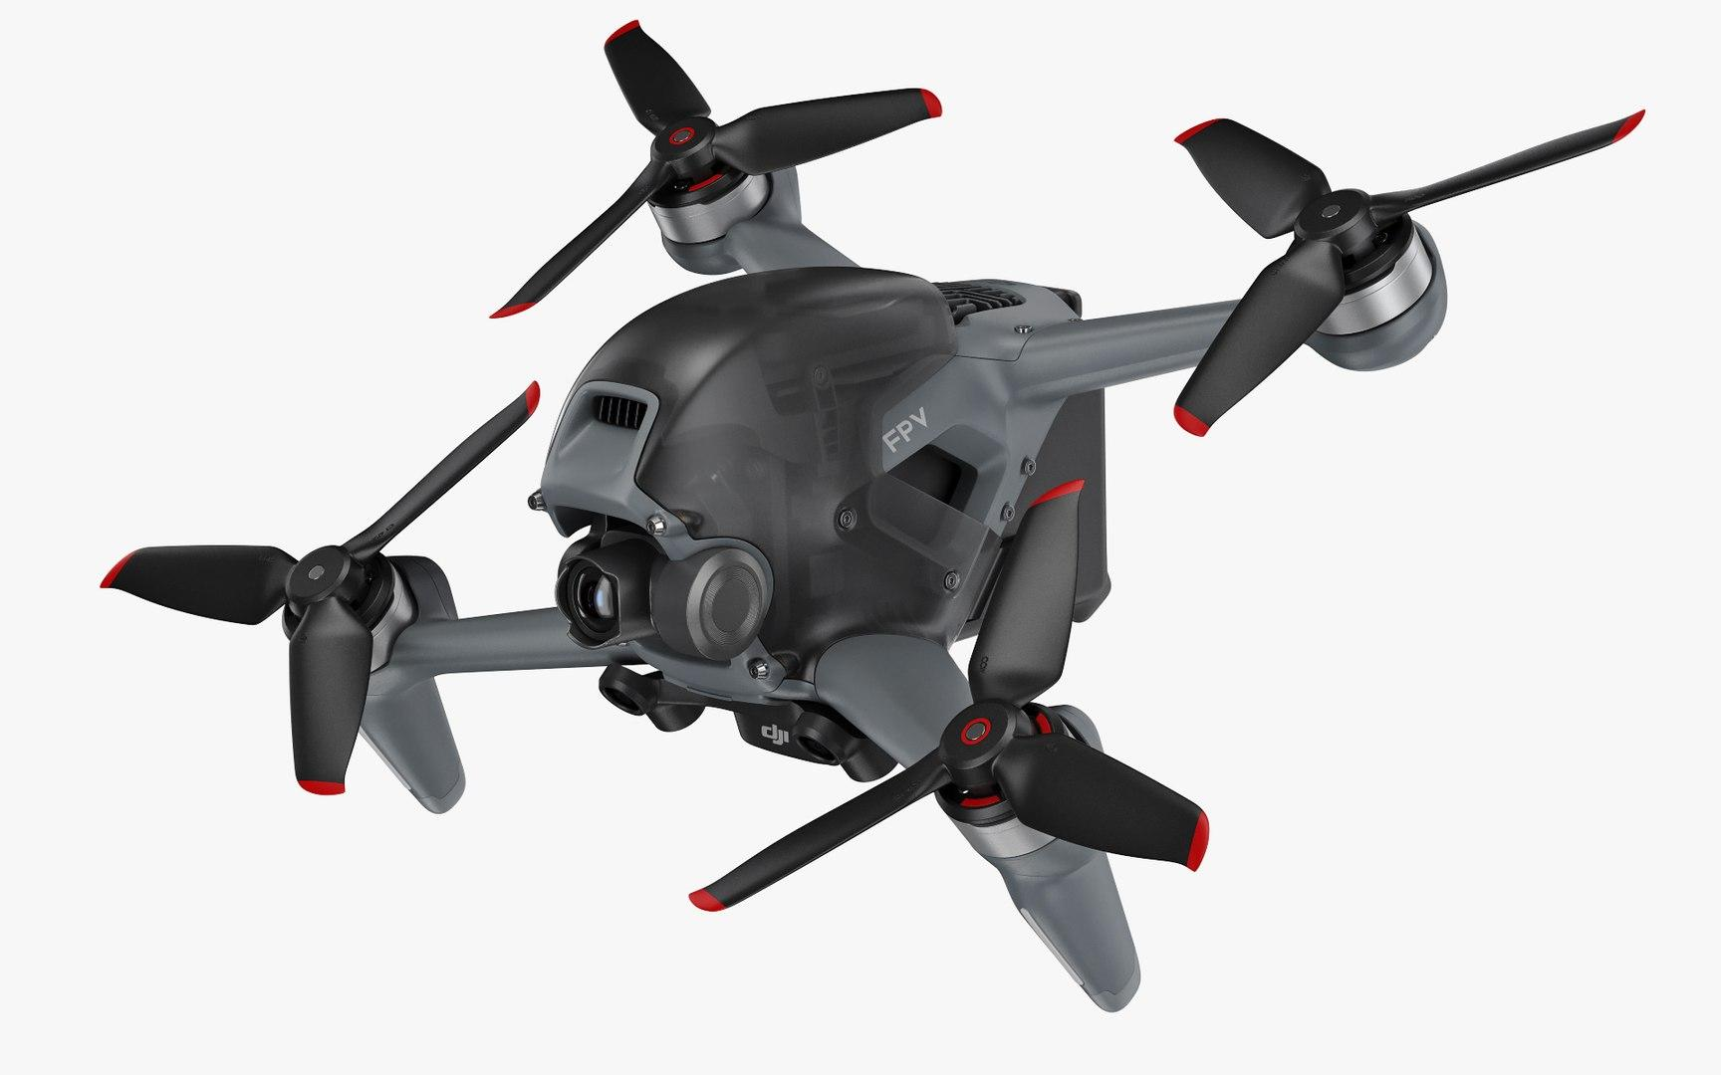
Exofly Innovations
22b2509
Uday
Your gateway to cutting -edge drone technology

Slide 2
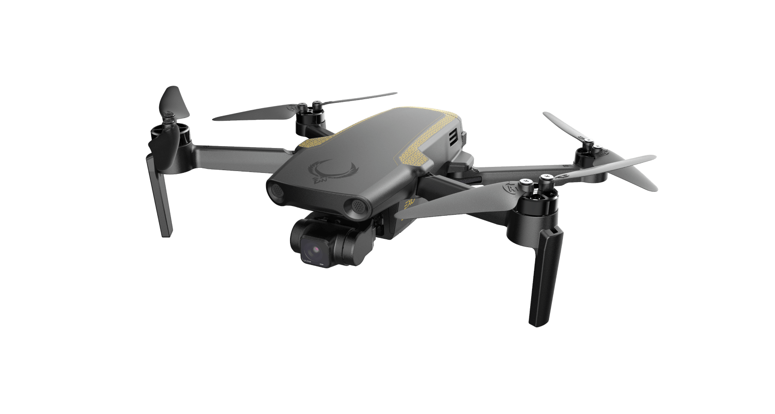
Introduction
Exofly Innovation takes flight as a pioneering force in the ever-evolving realm of drone technology. With a mission to redefine the boundaries of innovation and excellence, we are committed to shaping the future of unmanned aerial vehicles (UAV) and manned aerial vehicles (MAVs).

Slide 3

Navigation Menu
Home: The welcoming gateway to our world, offering an enticing glimpse into our innovations and accomplishments.
UAVs (Unmanned Aerial Vehicles): Embark on a journey through our diverse range of cutting-edge drones that redefine possibilities.
MAVs (Manned Aerial Vehicles): Experience the pinnacle of human-controlled flight with our MAVs, combining technology and piloting expertise.
About Us: Delve into our identity, values, and the journey that has led Exofly Innovations to the forefront of the drone industry.
Contact: Connect with us directly, whether you're an enthusiast, investor, or simply intrigued by the world of drones.

Slide 4
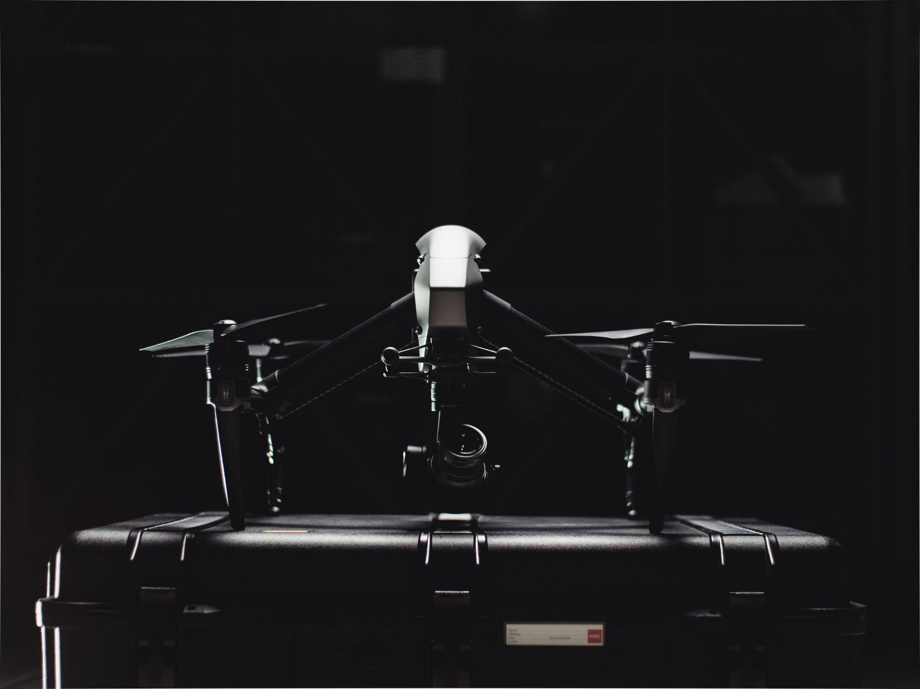
HOME
Created Navigation Bar with logo and menu items
slogan:Your gateway to cutting -edge drone technology
Brief introduction to Exofly Innovations
Showcase section highlighting key offerings
Search bar for finding the best drones
Call-to-action button for exploring innovations
About:"Exofly Innovations," a trailblazing force in drone technology, is seeking a fresh digital presence that mirrors their forefront position in unmanned aerial vehicles (UAVs) and manned aerial vehicles (MAVs).

Slide 5
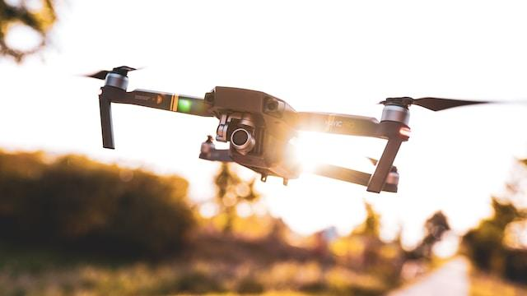
About Us
Introduction to Exofly Innovations' mission and values
History of the company and its founders
Overview of aerospace industry contributions
Commitment to innovation and excellence
Team of experts and their roles
Collaboration with Hubsan and 'D for DROAChHARYA 2' series
Focus on responsible drone use and initiatives
Future plans and vision for 2025

Slide 6
UAVs:
Explanation of Unmanned Aerial Vehicles (UAVs)
Importance of drones and their versatility
Overview of commercial, industrial, and military applications
Featured UAV products and specifications
Call-to-action buttons for more details on each product

Slide 7
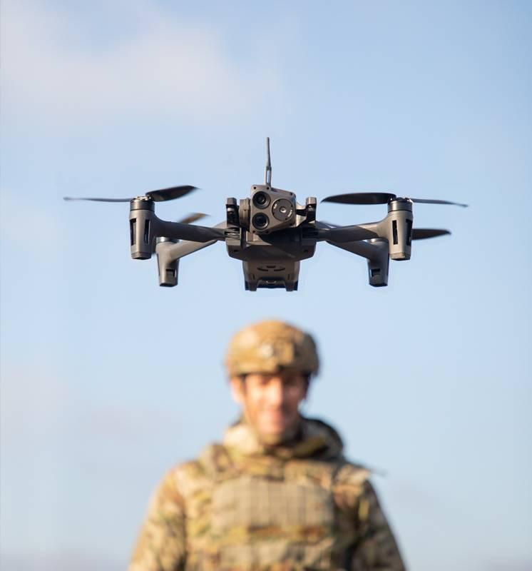
Innovations:
Overview of Exofly Innovations' cutting-edge drone technology
Features of innovative drone designs and advancements
Highlighting the 'D for DROAChHARYA 2' series
Emphasis on affordability, performance, and innovation
Call-to-action button for exploring the new product line

Slide 8
Expert Team:
Introduction to the expert team at Exofly Innovations
Profiles of key team members, including Elon Musk and others
Highlighting their roles and contributions
Emphasis on innovation, experience, and excellence
Links to social media profiles of team members

Slide 9
FAQs
Frequently Asked Questions section addressing common queries
Topics include drone safety, community concerns, consultations, warranties, and long-term vision
Answers provided with informative explanations
Collapsible accordion-style format for easy navigation

Slide 10
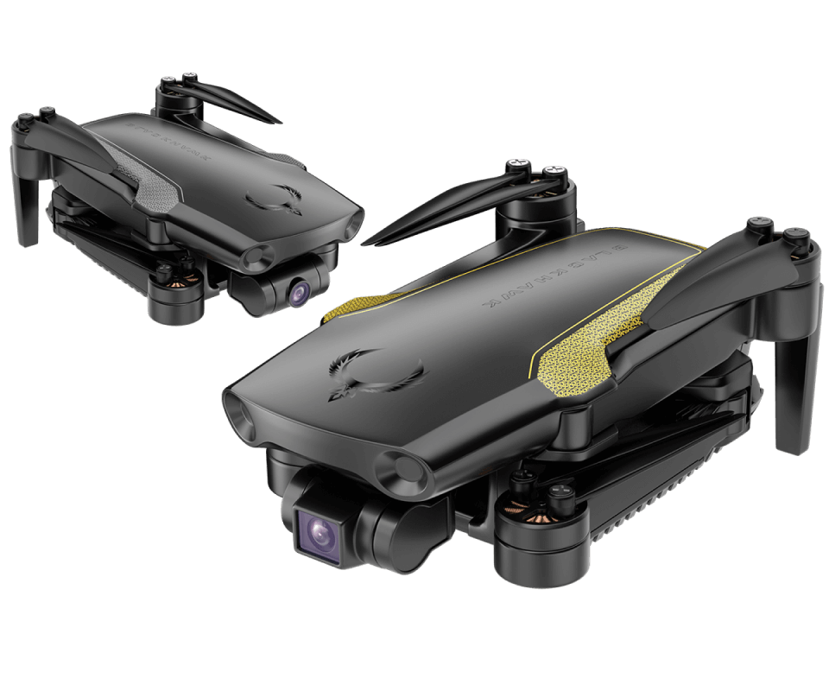
Footer:
Copyright information and acknowledgment of creators
Social media icons for connecting with Exofly on various platforms
Back-to-top arrow for easy navigation

Slide 11
Enrollment Modal:
Modal popup for users interested in enrollment
Form fields for capturing first name, last name, email, and phone
Submit button to send enrollment

Slide 12
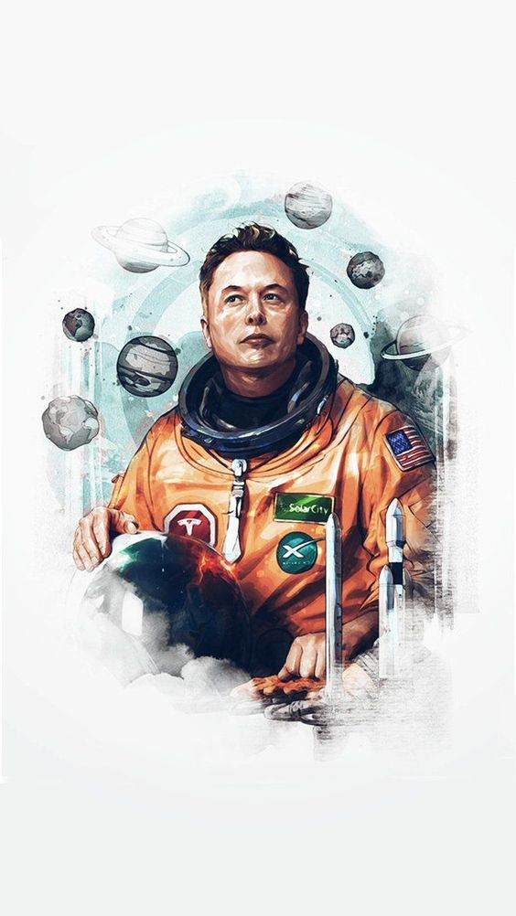
Uday
22b2509
THANK YOU

