Slide 1
SPACE INVADER
SAVE OUR PLANET

Slide 2
Table of contents
README.MD
01
03
CONCLUSION
02
04
REFERENCES
PACKAGES DEMO

Slide 3
README.MD
01

Slide 4
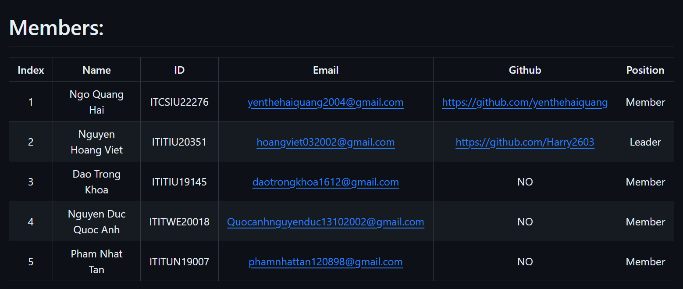
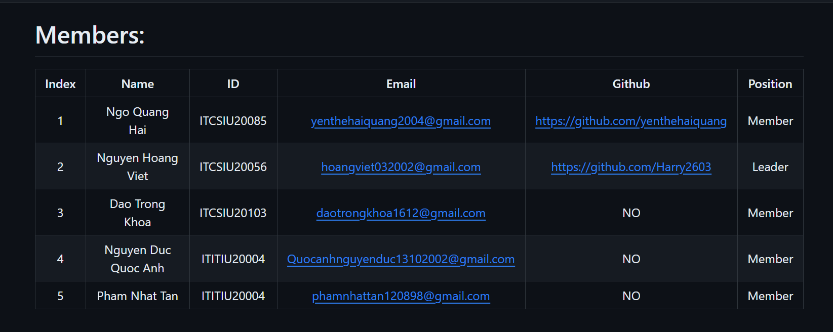
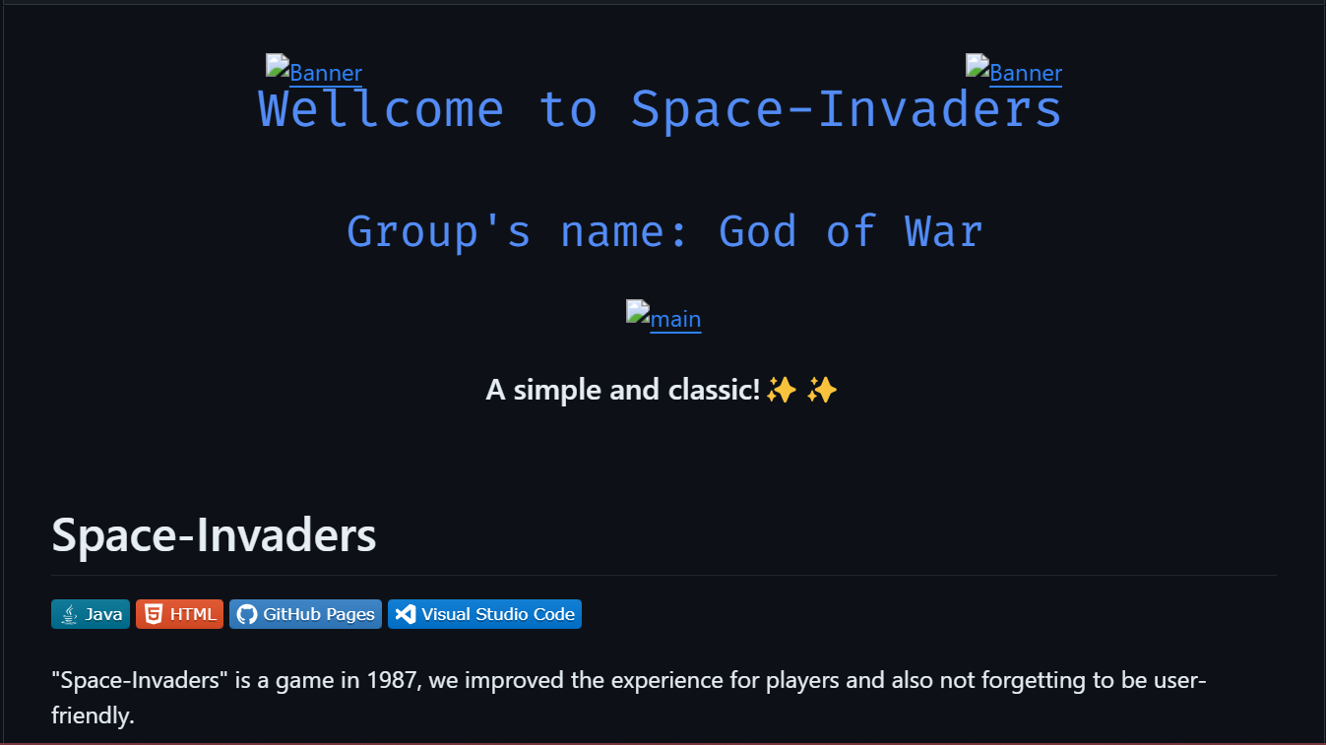
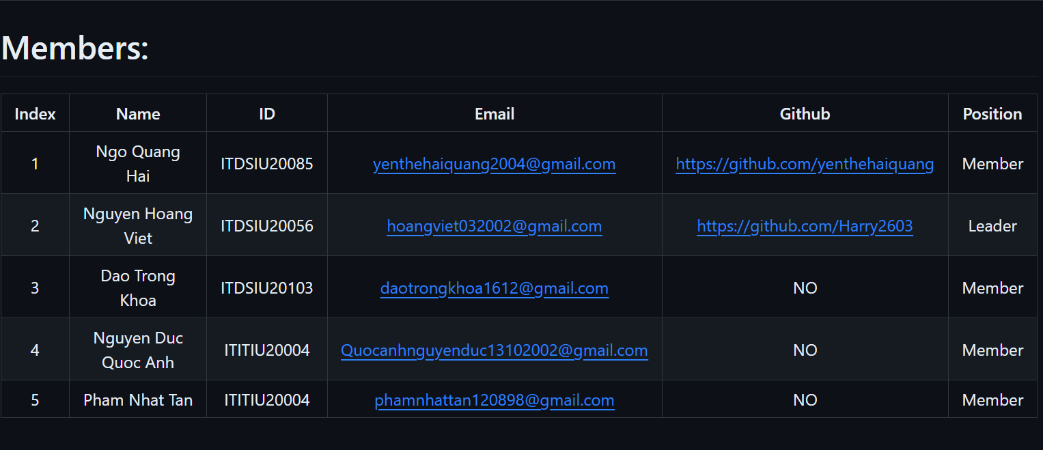
README.MD

Slide 5
02
PACKAGES & DEMO

Slide 6



OUR CLASSES
ALIEN
PLAYER
BOARD
BOMB

Slide 7


OUR CLASSES
LOOSE
WIN
SHOT
SPRITE

Slide 8
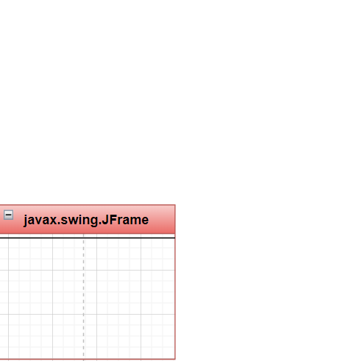
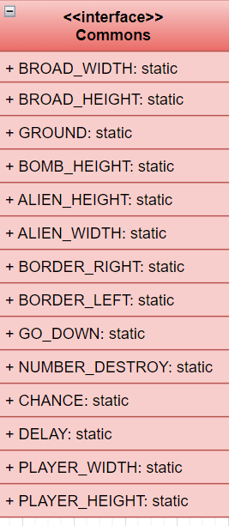
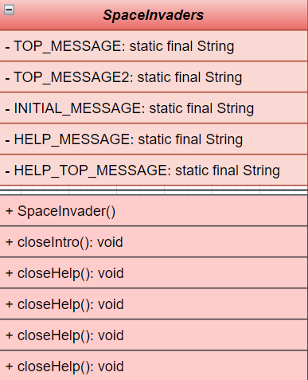
IMPLEMENTS
EXTENDS

Slide 9
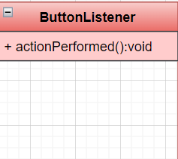
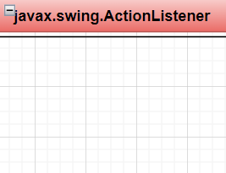
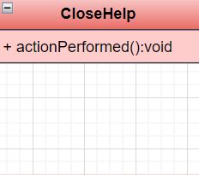
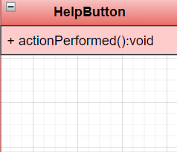
IMPLEMENTS
IMPLEMENTS
IMPLEMENTS

Slide 10

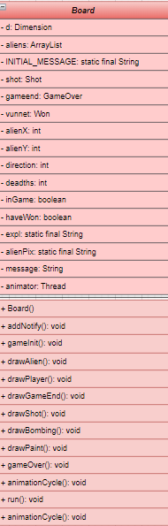
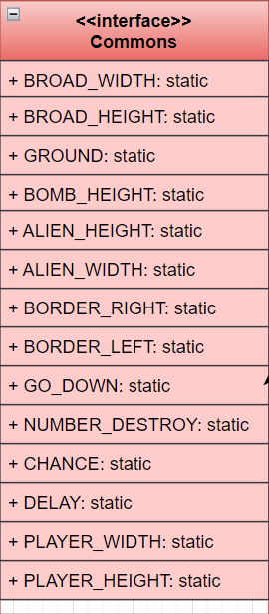


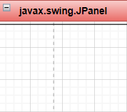

IMPLEMENTS
EXTENDS

Slide 11


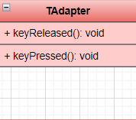
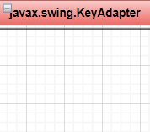
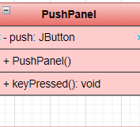
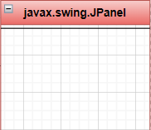
EXTENDS
EXTENDS

Slide 12
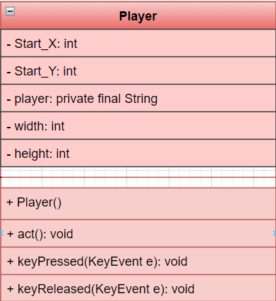
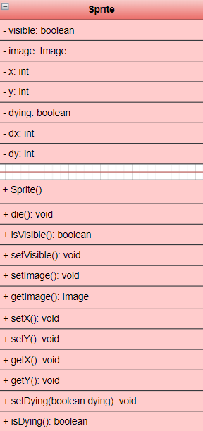
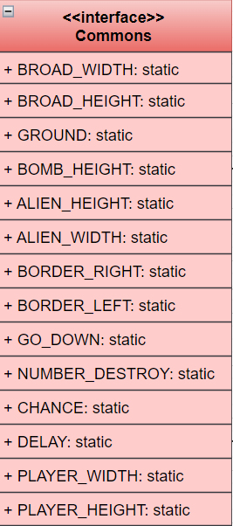
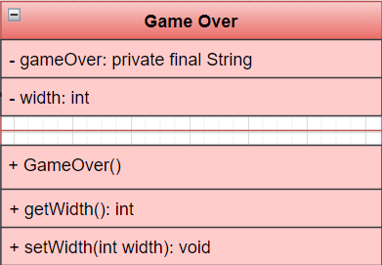
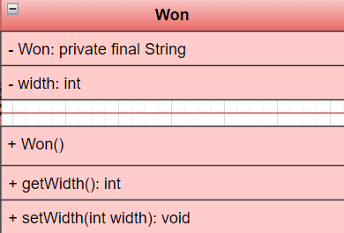
IMPLEMENTS
EXTENDS
IMPLEMENTS
IMPLEMENTS
EXTENDS
EXTENDS

Slide 13

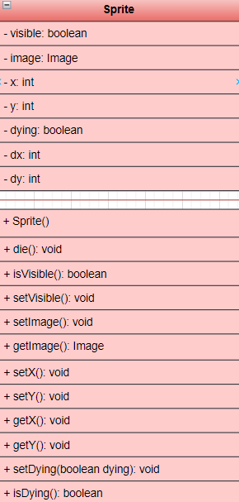

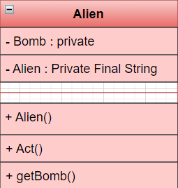
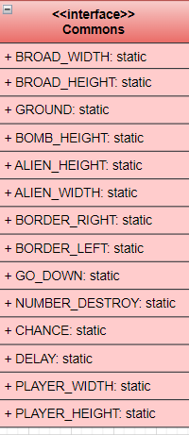
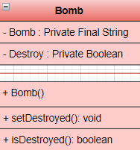
EXTENDS
IMPLEMENTS
EXTENDS
IMPLEMENTS

Slide 14
D E M O

Slide 15
03
CONCLUSION

Slide 16
CONCLUSION
Job division skills
Using Github effectively
Know more graphics libraries in java
Deep understanding of the properties of OOP

Slide 17
UNUPDATED FEATURES
1 ) Not so many characters to choose form
2 ) Need more levels
3) Need more music effects with UI/UX graphics

Slide 18
REFERENCES
04

Slide 19
REFERENCES
1) https://github.com/yenthehaiquang/OOP-Project-SpaceInvaders-Game
2) https://github.com/howuvebeen/space-invader
3) https://www.perlmonks.org/?node_id=171425

Slide 20



THANK YOU

Slide 21

Q & A

