Slide 2
Paper Name: Secure Communication and Dynamic Formation Control of Intelligent Drone Swarms Using Blockchain Technology
URL: https://www.mdpi.com/2078-2489/16/9/768

Slide 3
Outline
Introduction
Motivation of This Work
Proposed Method
Model Architecture
Smart Contracts for Drone Swarms
Leader and Follower Mechanism
Dynamic Formation Control Concept
Conclusion

Slide 4
Introduction
Inspired by natural swarming behaviors (birds, fish, insects)
Designed for autonomous decision-making and coordinated operations
Communication links are vulnerable to obstacles, poor coverage, and cyber threats
Increasing swarm size leads to higher control complexity and communication overhead
These challenges reduce reliability and adaptability in large-scale, dynamic environments

Slide 5
Motivation of This Work
The main motivation of this paper is to combine blockchain technology with the dynamic formation control and secure communication of drone swarms.
The purpose of this combination is to develop a more secure and smooth information exchange scheme.
The aim is to protect the drone swarm from common malicious attacks such as node tampering and deception, ensuring the stability and robustness of drones when they are in dynamic formation.

Slide 6
Proposed Method
Blockchain-based event-driven distributed UAV formation control architecture
  Smart contracts enable autonomous UAV registration
  Support task distribution and formation management
Parametric dynamic formation control algorithm
  Includes a conflict resolution mechanism
  Uses an angle–distance dual-parameter mathematical model
  Supports adaptive switching between different formations

Slide 7
Cont..
  Precise positioning and collision avoidance
    Haversine spherical coordinate transformation for large-scale positioning
    Euclidean distance calculation for local collision detection
    Blockchain-based position locking ensures collision-free formation reconfiguration

Slide 8
Model Architecture
Smart Contract (Blockchain Layer)
    Uses cryptography and consensus mechanisms
    Enables all nodes to maintain transaction records without a central authority
    Each block consists of header and body
Leader–Follower Architecture
    Leader generates global trajectory
    Followers maintain formation via relative position or attitude tracking
    Advantages: simple, efficient, highly scalable
    Supports dynamic addition/removal of nodes
    Ideal for resource-constrained drone clusters
    It acts as cluster admission controller

Slide 9
Smart Contracts for Drone Swarms
Ensure secure communication and dynamic formation control
Deployed on a blockchain network compatible with Ethereum Virtual Machine (EVM).
Formation types and tasks:
  Linear: crossing narrow terrain, uniform coverage, efficient scanning (e.g., pesticide spraying)
  Circular: 360° encirclement of a target (e.g., defensive encirclement)
  V-shaped: long-distance cruising, reduced energy for rear drones (e.g., border patrol)

Slide 10
Leader and Follower Mechanism
Member Management: Dynamically registers, deregisters followers, and stores drone addresses
Parameter Management: submits formation control parameters (mission type & coordinates)
Follower read mission and formation data from blockchain determine closest formation position relative to the leader

Slide 11
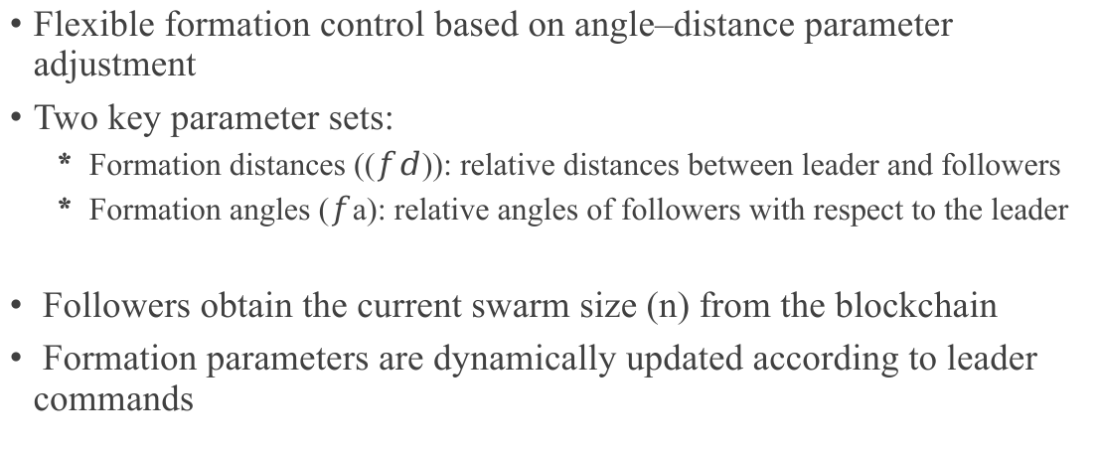
Dynamic Formation Control Concept
Flexible formation control based on angle–distance parameter adjustment
Two key parameter sets:
  Formation distances (($fd$)): relative distances between leader and followers
  Formation angles ($f$a): relative angles of followers with respect to the leader
Followers obtain the current swarm size (n) from the blockchain
Formation parameters are dynamically updated according to leader commands

Slide 12
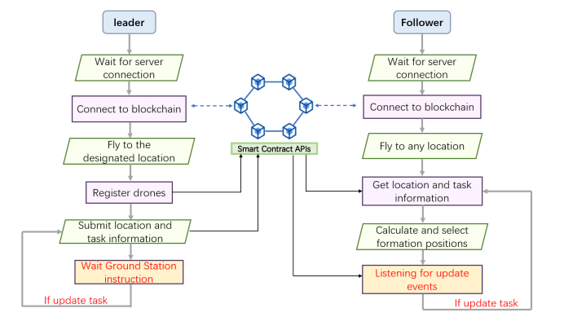
Cont...

Slide 13
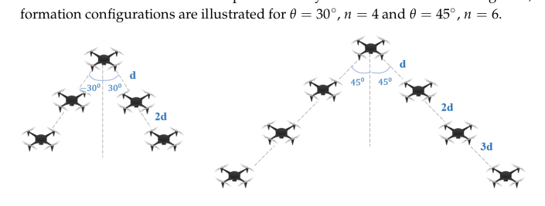
Cont...

Slide 14
Haversine vs Euclidean
The Haversine formula calculates distance between two GPS coordinates on the curved surface of the Earth.
The Euclidean distance is the normal straight-line distance of two drones in a flat coordinate system (x, y, z).

Slide 15
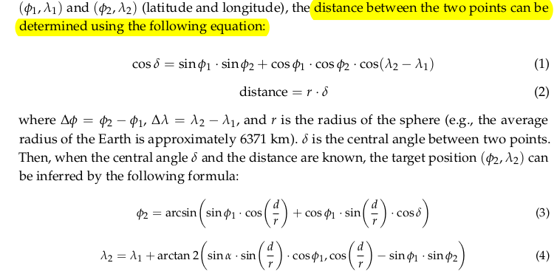
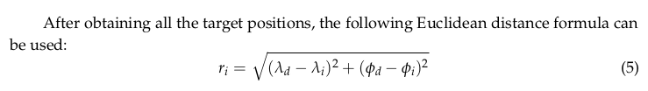

Slide 16
Conclusion
Introduced secure and intelligent swarm coordination mechanisms
Demonstrated improved reliability, scalability, and adaptability
Provides a new technical perspective for secure UAV swarm control
Applicable to military reconnaissance, emergency response, and logistics delivery
Future work:
  Optimize system modules
  Enhance adaptability and scalability

Slide 17
Thank you

