Slide 1
LAB 01
Exercise
2023.03.08
Presenter: Tzu-Yun, Yen

Slide 2
Outline
Architecture Overview
Sort
Signed/Unsigned
Ascending/Descending
Calculation

Slide 3
Architecture Overview
opt[1]
opt[0]
a
b
opt[2]
in_s0
sort
s_id0
in_s0
calculation
in_s1
s_id1
in_s1
out
…
…
…
in_s6
s_id6
in_s6

Slide 4
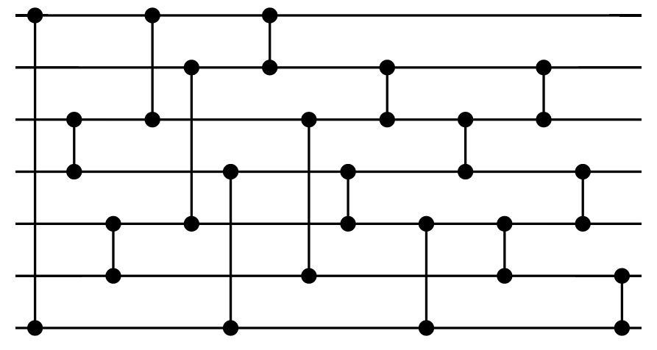
Sort
7elements → 16 comparators
lv0_s0
lv6_s0
lv0_s1
lv6_s1
lv0_s2
lv6_s2
lv0_s3
lv6_s3
lv0_s4
lv6_s4
lv0_s5
lv6_s5
lv0_s6
lv6_s6
Notes:
https://jix.one/proving-50-year-old-sorting-networks-optimal-part-1/

Slide 5
Signed/Unsigned
opt[0] = 1 : regarded as signed value
opt[0] = 0 : regarded as unsigned value
signed
unsigned
3
2
1
0
-1
-2
-3
-4
→
→
→
→
→
→
→
→
011
010
001
000
111
110
101
100
111
110
101
100
011
010
001
000
→
→
→
→
→
→
→
→
7
6
5
4
3
2
1
0
5-bit signed comparators
4-bit unsigned comparators

Slide 6
Ascending/Descending
opt[1] = 1 : descending order
opt[1] = 0 : ascending order
original structure
sort
reverse
complex control signals are needed to handle
the same score problem

Slide 7
Ascending/Descending
opt[1] = 1 : descending order
opt[1] = 0 : ascending order
descending
ascending
000
001
010
011
100
101
110
111
→
→
→
→
→
→
→
→
7
6
5
4
3
2
1
0
→
→
→
→
→
→
→
→
111
110
101
100
011
010
001
000
0
1
2
3
4
5
6
7
arrange scores in descending order
= arrange complement of scores in ascending order

Slide 8
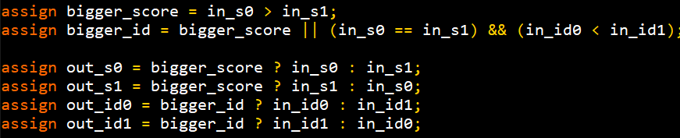
Merge Scores & IDs
original
optimized
← ID
← Score

Slide 9
Optimized Sort
opt[1]
opt[0]
descending
↓
ascending
signed
↓
unsigned
merge
scores
& IDs
sort
7-bit
↓
3-bit
in_s0
in_lv0_s0
lv0_s0[6:3]
lv0_s0
lv6_s0
s_id0

Slide 10
Calculation
passing score = μ - a
passing conditions (original)
score >= 0 → (score * (a + 1) + b) > passing_score
score < 0 → (score / (a + 1) + b) > passing_score
7 comparators
7 multipliers
7 dividers
14+1 adders
A
score
new_score
>
pass
x7
B
passing_score
score >= 0

Slide 11
Calculation
passing score = μ - a
passing conditions (optimized)
score >= 0 → score > (passing_score - b + a) / (a + 1)
score < 0 → score > (passing_score - b) * (a + 1) - a
14 comparators
1 multipliers
1 dividers
4 adders
> pos_passing_score?
score
pass
x7
> neg_passing_score?
score >= 0

Slide 12
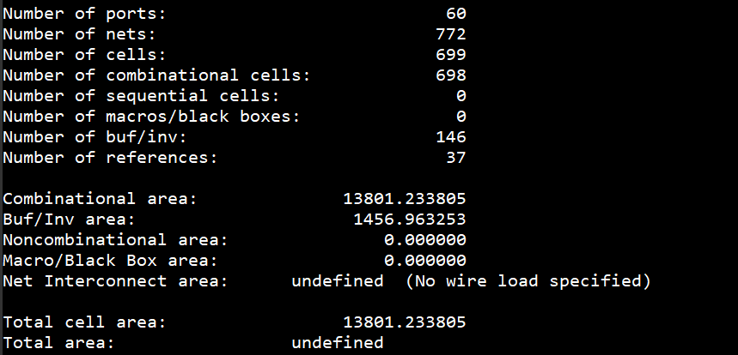
Area Report

Slide 13
The End
Thanks for listening :)

