Slide 1
ICLAB Lab05 EXERCISE
0810774 Cheng-Yen lo
2023/04/12

Slide 2
OUTLINE
Design Consideration
Data Flow
FSM States
Hardware Consideration
Optimization
Area
Cycle & Cycle Time
Reference

Slide 3
Design Consideration

Slide 4
data flow
Storage:
Get a matrix size
Get 32 matrices continuously at the beginning of each pattern
Calculation:
Get a mode for the transpose matrix
Get 3 matrices indices for multiplication
Finishing matrix multiplication & find its trace

Slide 5
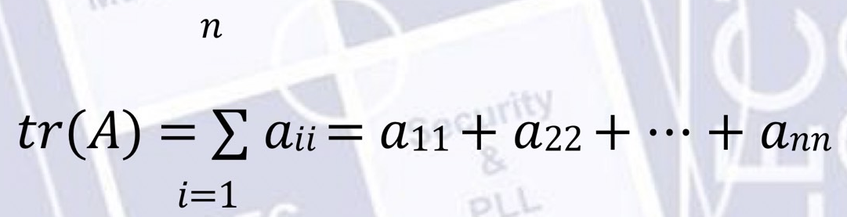
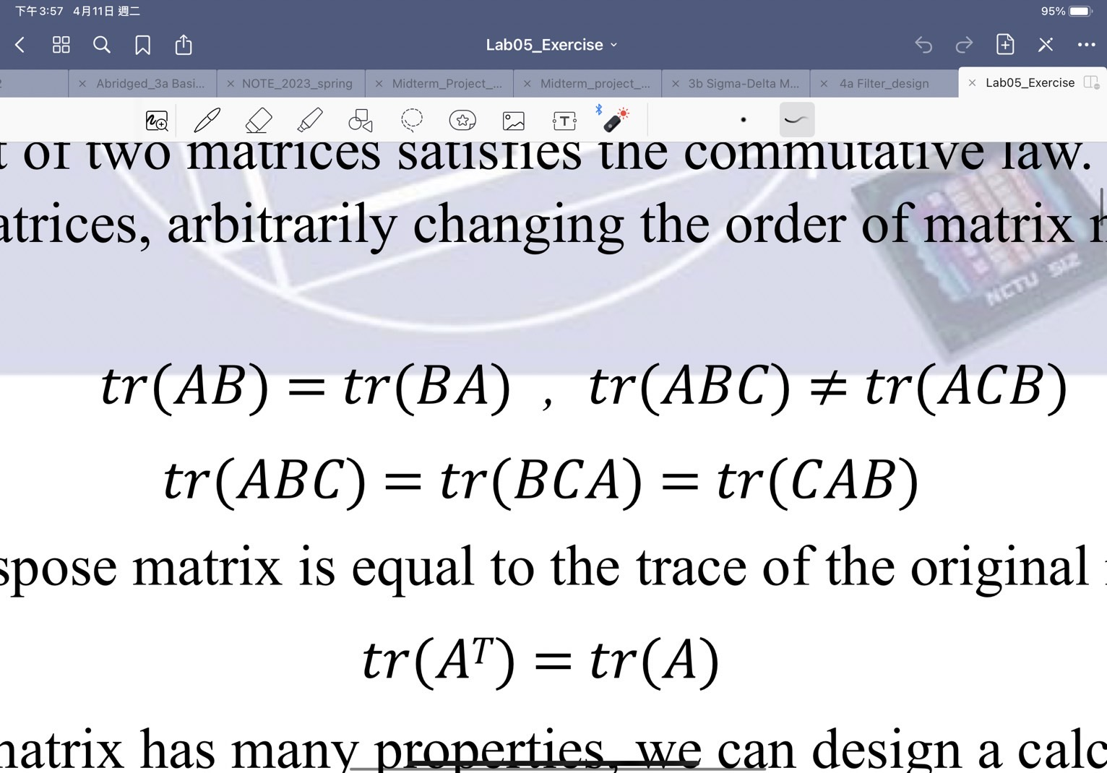
data flow
Trace: sum of the eigenvalues
Multiplication of matrices needs to maintain order
Trace of transpose matrix is equal to original one

Slide 6
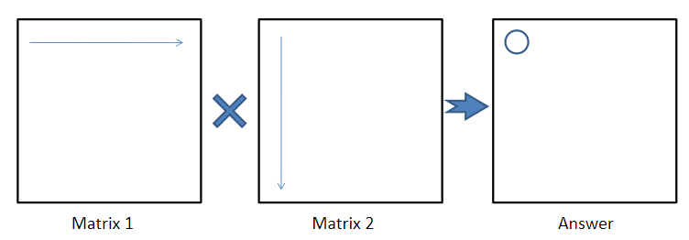
data flow
By commutative law, we can push the transpose one to last one
Row transpose = Column
Matrix B
Matrix C (transpose)
Matrix B * C

Slide 7
data flow
Matrix B
Matrix C (transpose)
Matrix B * C
Matrix B
Matrix C (transpose)
Matrix B * C

Slide 8
data flow
Matrix B
Matrix C (transpose)
Matrix B * C
Matrix A
Matrix B * C
Trace

Slide 9
Hardware Consideration
SRAM:
8 bits * 8192 word
128 bits * 512 word
Transpose Storage:
SRAM: 128bits * 16 * (32+1) words = 128bits * 528 words

Slide 10
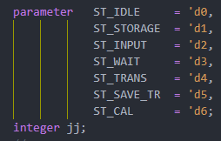
FSM States
IDLE:
In_valid1 -> Storage
In_valid2 -> Input
STORAGE: save 32 matrices & size -> IDLE
INPUT: save 3 matrices indices & mode -> WAIT
WAIT:
Mode = 0 -> TRANS
Mode = 1,2,3 -> CAL(contain output)
Mode = 0 & Transpose finish -> CAL(contain output)
TRANS: matrix transpose, finish -> SAVE_TR
SAVE_TR: save transpose matrix to SRAM , finish -> WAIT

Slide 11
OPtimization

Slide 12
Area
20 bits Reg * 16
Column of B*C multiply with Row of A
Need to storage column of Matrix B * C
Need 16 multipliers & 15 adders for matrix A*B*C
Multiplier: 28 bits
Adder: 36bits
Matrix B
Matrix C (transpose)
Matrix B * C
Matrix A
Matrix B * C
Trace

Slide 13
Area
Pipeline:
B*C multiply with A
Save storage column of Matrix B * C
20 bits Reg * 16
Save multipliers & adders
Prepare row of A first (needs to storage it)
Matrix B
Matrix C (transpose)
Matrix B * C
Matrix A
Matrix B * C
Trace

Slide 14
Cycle & Cycle Time
Critical path: DRAM to multipliers to adders(16 to 1, 4levels)
Pipeline:
Separate multipliers & adders
DRAM to multipliers: ~5ns
Adders (4levels): ~4ns
Transpose 2 rows same time
Save ½ cycles when mode = 0
Reuse the registers of A’s row storage register

Slide 15
Reference

Slide 16









維尼學長
PhD
2de 沒過
OT 沒用IP過了

Slide 17
Thanks for your listening

