Slide 1
ICLAB LAB08 EXCERSICE
0810890 CHIA-EN CHANG

Slide 2
OUTLINE
Review
Algorithm
Block Diagram
Optimization
Result

Slide 3
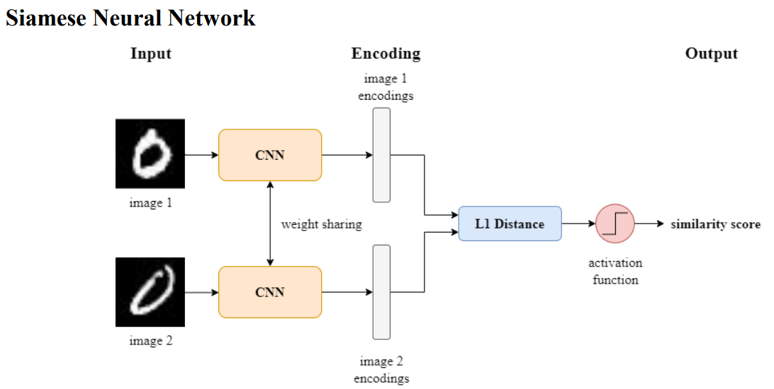
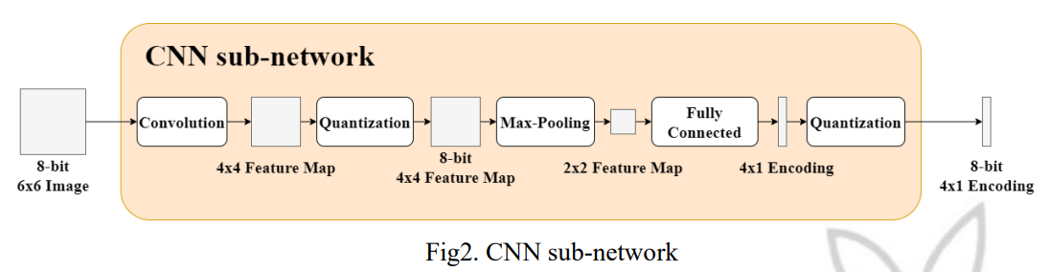
REVIEW
Siamese NN
Convolution
Quantization
Max-Pooling
Fully Connected
L1
Activation

Slide 4
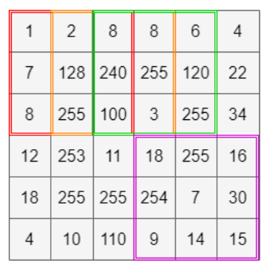
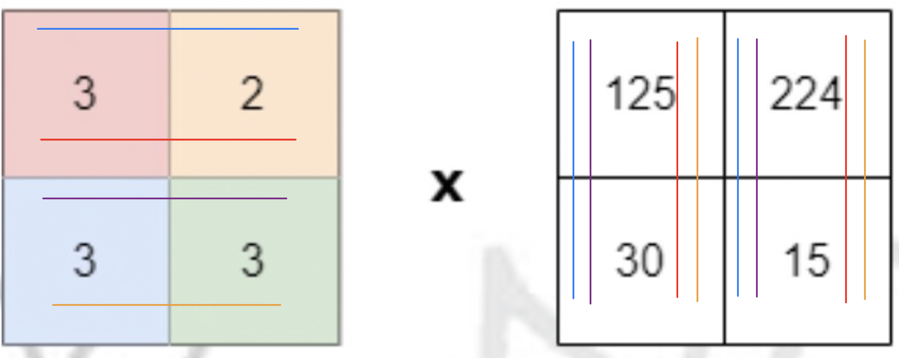
Algorithm
Save image: 6 * 3 register
Convolution: 9 multiplier + 8 adder
Quantization: 1 divider
Max-Pooling: 1 comparator
Fully Connected: 2 multiplier + 2 adder
Quantization: 2 divider
L1: 4 subtractor + 2 adder
Activation: 1 comparator

Slide 5
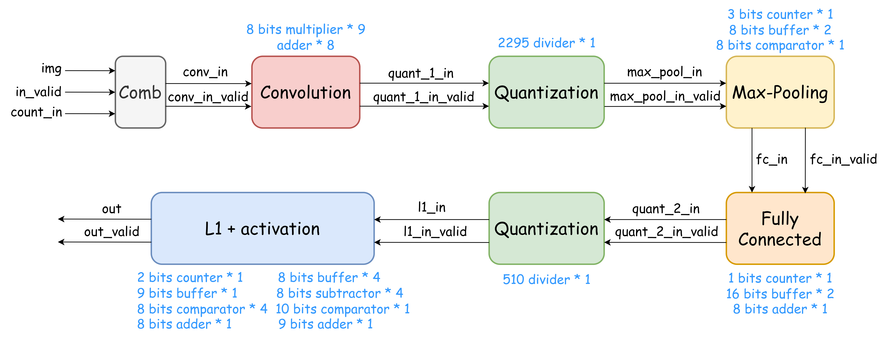
BLOCK DIAGRAM

Slide 6
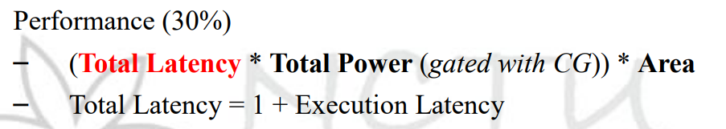
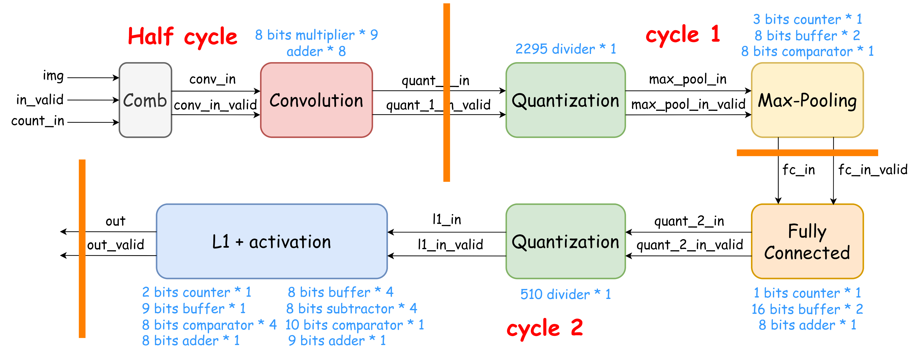
OPTIMIZATION
Pipeline
Fixed cycle time

Slide 7
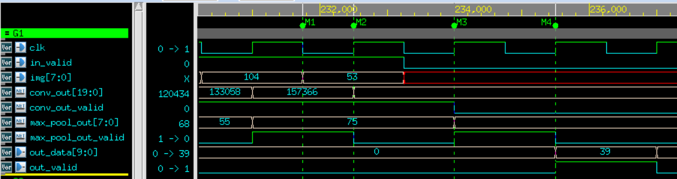
OPTIMIZATION
Waveform

Slide 8
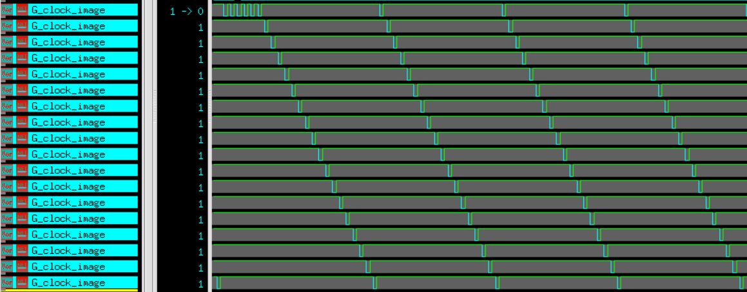
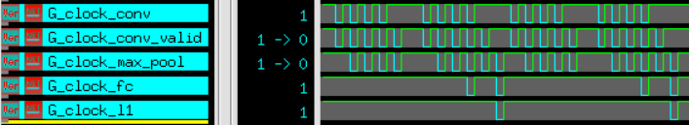
OPTIMIZATION
Clock gating(sequential circuit)

Slide 9
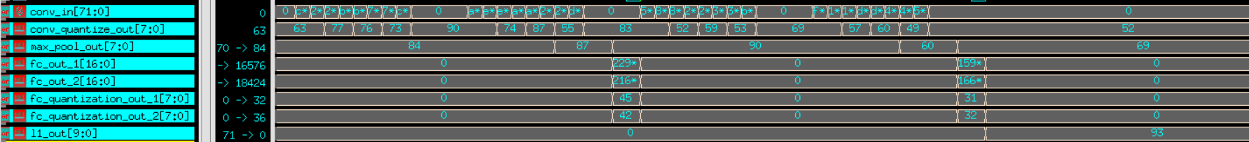
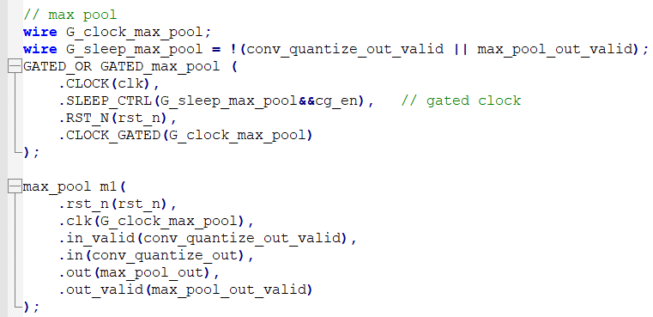
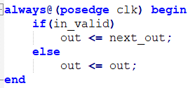
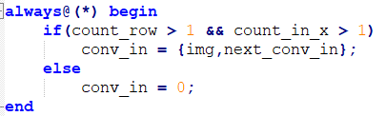
OPTIMIZATION
Input gating(combinational circuit) -> 0 or remain unchanged

Slide 10
RESULT
POWER | AREA | LATENCY | PERFORMANCE
2.76E-03 | 118280 | 6 | 1957.297
2.95E-03 | 122627 | 5 | 1811.201
2.99E-03 | 121919 | 4 | 1458.151
3.64E-03 | 119890 | 3 | 1309.918
6.45E-03 | 139449 | 2 | 1799.45
3.53E-03 | 120914 | 3 | 1279.028
3.42E-03 | 120788 | 3 | 1239.647
3.44E-03 | 120851 | 3 | 1245.37
3.35E-03 | 122384 | 3 | 1230.326
3.35E-03 | 121686 | 3 | 1224.039
3.31E-03 | 123046 | 3 | 1220.001

Slide 11
Thanks!

