Slide 1
Inventory – Possible Use Case
Neighbourhood shop
Require simple stocktake system
Infancy stage of technology adoption
Customer base not on e-commerce platform
Does not yet have any barcode system
Staff mainly seniors using mobile (i.e. app has to be simple and mobile responsive)

Slide 2
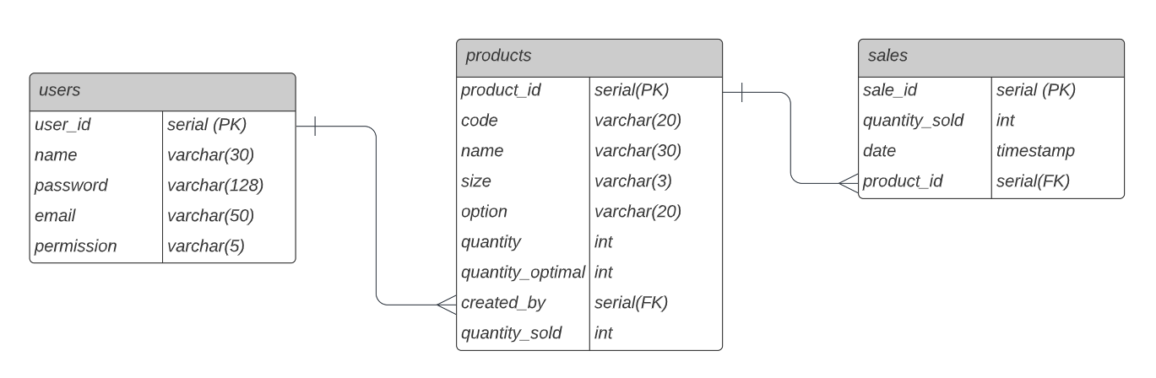
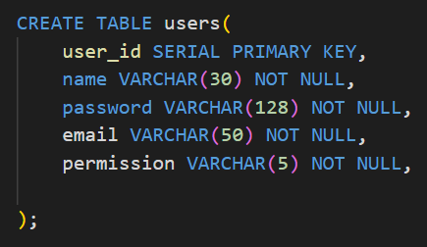
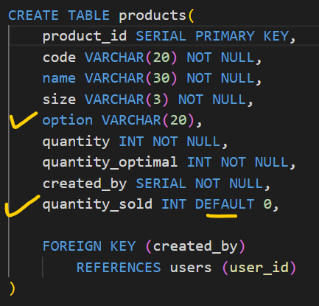
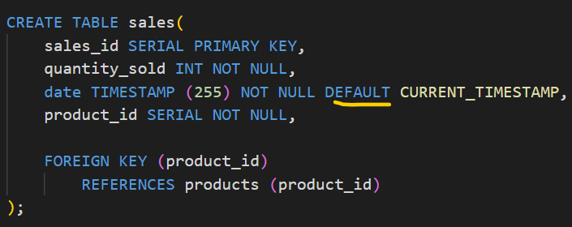
P
E
R
N

Slide 3
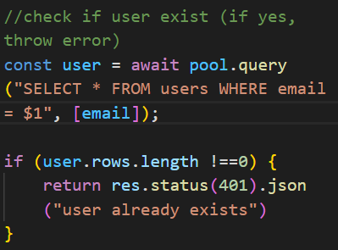
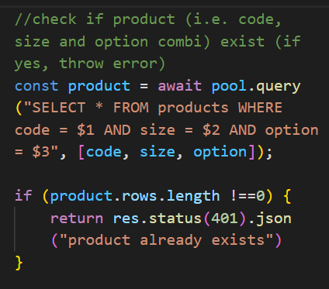
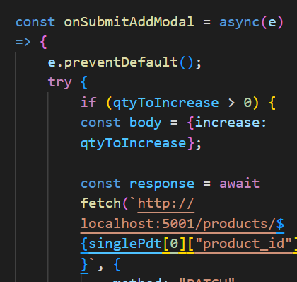
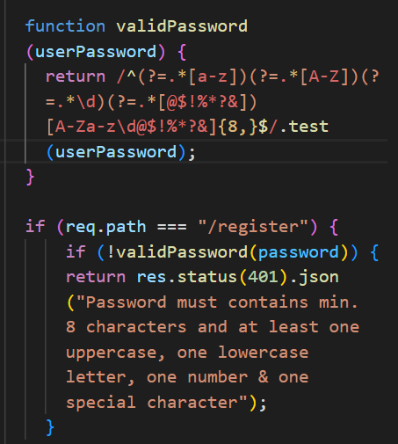
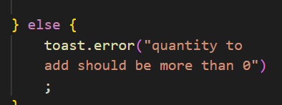
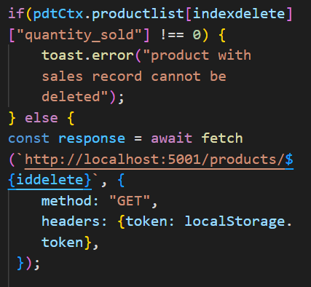
P
E
R
N
Validation
Register User
Create Product
Add Product Qty (frontend)
Delete Product (frontend)

Slide 4
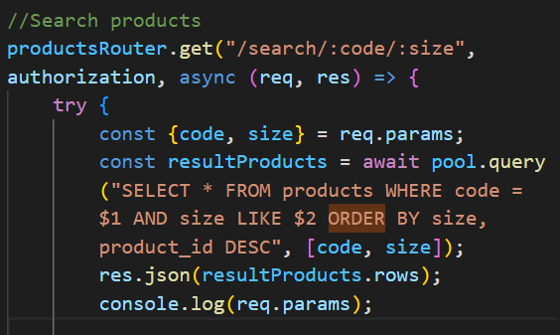
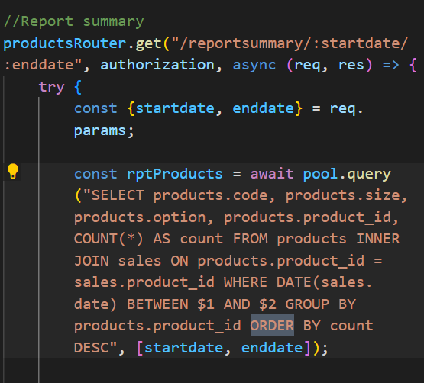
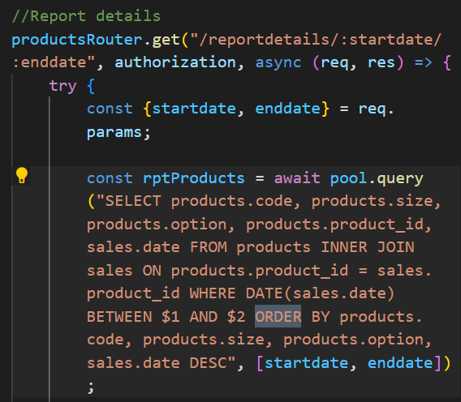
P
E
R
N
Sort data at backend using SQL instead of frontend
Search Result
Report Summary
Report Details

Slide 5
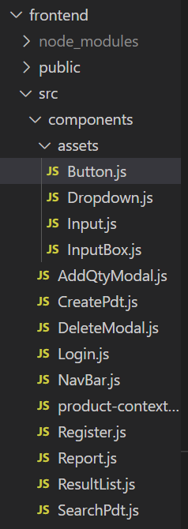
P
E
R
N

