Slide 1

Economic Resilience Assessment Using the
Dynamic Inoperability Input-Output Model
Final Year Project | Presented to DSO
Yeoh Yu Yong
Supervisor: Assoc Prof Santos
Nanyang Technological University, 2025
q(t) = A* [q(t) − q(t−1)] + c*(t)

Slide 2
The Problem
Introduction
>
DIIM Model
>
DIIM Results
>
Simplified Methods
>
Monte Carlo
>
Results
>
Recommendations
Singapore’s economy is interconnected — a shock to one sector cascades to all others.
COVID-19 shutdowns disrupted construction, which deprived building-material manufacturers of demand
Transport restrictions cascaded into logistics and food supply chains
Grey zone conflicts could trigger rapid foreign worker departures, disrupting labour-dependent sectors
Key Question How do we quickly identify which sectors to prioritise for intervention during a crisis?

Slide 3
Research Objectives
Introduction
>
DIIM Model
>
DIIM Results
>
Simplified Methods
>
Monte Carlo
>
Results
>
Recommendations
1
Apply the DIIM to two disruption scenarios: COVID-19 pandemic & Manpower disruption (grey zone conflict)
2
Benchmark five simplified sector-ranking methods against the full DIIM simulation
3
Determine when simplified methods are sufficient vs when the full DIIM is needed

Slide 4
Presentation Roadmap
Introduction
>
DIIM Model
>
DIIM Results
>
Simplified Methods
>
Monte Carlo
>
Results
>
Recommendations
01
02
03
04
05
06
DIIM Model
DIIM Results
Simplified Methods
Monte Carlo
Results
Recommend- ations
▶
▶
▶
▶
▶
Model construction & components
Inoperability & economic loss
5 alternative ranking approaches
2,000 trial robustness test
Close rates & performance
Decision framework

Slide 5
The DIIM Model
Introduction
DIIM Model
DIIM Results
Simplified Methods
Monte Carlo
Results
Recommendations
Part I
The DIIM Model
Construction of the Dynamic Inoperability Input-Output Model
DSO-DIIM Presentation
The DIIM Model
5 / 38

Slide 6
What is Inoperability?
Introduction
>
DIIM Model
>
DIIM Results
>
Simplified Methods
>
Monte Carlo
>
Results
>
Recommendations
Inoperability measures the normalised production loss of each sector
Planned Production (100%)
• Derived from the Leontief input-output model
• Measures how disruptions affect the functioning of each sector over time
• Values range from 0 (fully operational) to 1 (complete shutdown)
Degraded Production (60%)
Inoperability = (Planned - Degraded) / Planned = (100% - 60%) / 100% = 0.40

Slide 7
From IIM to DIIM
Introduction
>
DIIM Model
>
DIIM Results
>
Simplified Methods
>
Monte Carlo
>
Results
>
Recommendations
Static IIM → Dynamic DIIM
IIM (Static)
DIIM (Dynamic)
q = A*q + c*
➡
q(t+1) = q(t) + K[A*q(t) + c* − q(t)]
Equilibrium state only — no time dynamics
Adds time variable t and recovery matrix K
• K is a diagonal matrix — recovery depends only on each sector’s own capacity
• Larger diagonal elements = stronger recovery capacity
• t is discrete time; q(t) is the inoperability vector at time t

Slide 8
DIIM Formula: Components
Introduction
>
DIIM Model
>
DIIM Results
>
Simplified Methods
>
Monte Carlo
>
Results
>
Recommendations
q(t+1) = q(t) + K [ A* q(t) + c* − q(t) ]
q(t)
K
A*
c*
q(0)
Inoperability vector at time t
Recovery capacity (diagonal matrix)
Interdependency matrix (from IO table)
Demand perturbation vector
Initial shock (starting condition)
➡ We will now show how each component is obtained from real data.
Two phases: Lockdown (c* ≠ 0) → Recovery (c* = 0)

Slide 9
Obtaining A* — Interdependency Matrix
Introduction
>
DIIM Model
>
DIIM Results
>
Simplified Methods
>
Monte Carlo
>
Results
>
Recommendations
[Insert image]
A* = x⁻¹ A x where A is the technical coefficient matrix from the IO table and x is total output
• 15×15 Input-Output Table from Singapore’s Department of Statistics
• A = raw IO flows / total output of purchasing sector
• A* normalises A by sector size for inoperability space
• 2019 IO table used for COVID-19; 2022 IO table for Manpower scenario

Slide 10
Obtaining K — Recovery Capacity Matrix
Introduction
>
DIIM Model
>
DIIM Results
>
Simplified Methods
>
Monte Carlo
>
Results
>
Recommendations
[Insert image]
K is a diagonal matrix where each K_ii represents sector i’s recovery speed
• K is diagonal: sector recovery depends only on its own production capacity
• Larger K_ii = faster recovery from disruption
• Estimated from historical recovery patterns (Santos et al., 2009)
• Terminal condition: inoperability at end = 1% of initial inoperability

Slide 11
Obtaining q(0) — COVID-19 Initial Inoperability
Introduction
>
DIIM Model
>
DIIM Results
>
Simplified Methods
>
Monte Carlo
>
Results
>
Recommendations
[Insert image]
q(0) estimated from sector-level unemployment rates during COVID-19 lockdown
• Source: Ministry of Manpower unemployment data (19 years)
• Linear regression + 4-year moving average to estimate “normal” 2020 rate
• q(0) = (actual rate − expected rate) / expected rate
• Mapped from MOM sectors to IOT 15-sector classification

Slide 12
Obtaining c* — Demand Perturbation
Introduction
>
DIIM Model
>
DIIM Results
>
Simplified Methods
>
Monte Carlo
>
Results
>
Recommendations
[Insert image]
c* captures the demand-side shock during the lockdown period; c* = 0 during recovery
• Estimated from GDP decline data (SingStat Table Builder)
• c* represents reduced final demand during disruption
• Active only during lockdown phase; set to 0 during recovery
• For Manpower scenario: c* = 0 (pure supply-side shock, no demand perturbation)

Slide 13
Obtaining q(0) — Manpower Disruption
Introduction
>
DIIM Model
>
DIIM Results
>
Simplified Methods
>
Monte Carlo
>
Results
>
Recommendations
[Insert image]
q(0) based on foreign worker dependency ratios by sector (2022 data)
• Source: SG Foreign Manpower Dependency 2022
• Sectors with higher foreign worker share → higher initial inoperability
• 2022 IO table aggregated to 15 sectors for consistency
• Key difference from COVID: c* = 0 (pure supply shock from worker departures)

Slide 14
Timeline & Assumptions
Introduction
>
DIIM Model
>
DIIM Results
>
Simplified Methods
>
Monte Carlo
>
Results
>
Recommendations
Model Parameters & Assumptions
Lockdown 7 Apr – 1 Jun 2020 (55 days)
Recovery 2 Jun 2020 – 1 Feb 2023 (974 days)
• No further shocks after initial lockdown period
• Terminal inoperability = 1% of initial inoperability (Santos et al., 2009)
• Production distributed evenly over the year
• Lockdown phase: c* ≠ 0 (demand shock active)
• Recovery phase: c* = 0 (demand returns to normal)
Manpower Scenario Differences: • 2022 IO table (vs 2019) • c* = 0 throughout (pure supply shock) • q(0) from foreign worker dependency • Same recovery framework applies

Slide 15
Introduction
>
DIIM Model
>
DIIM Results
>
Simplified Methods
>
Monte Carlo
>
Results
>
Recommendations
02
DIIM Simulation Results
Inoperability propagation and economic loss across sectors

Slide 16
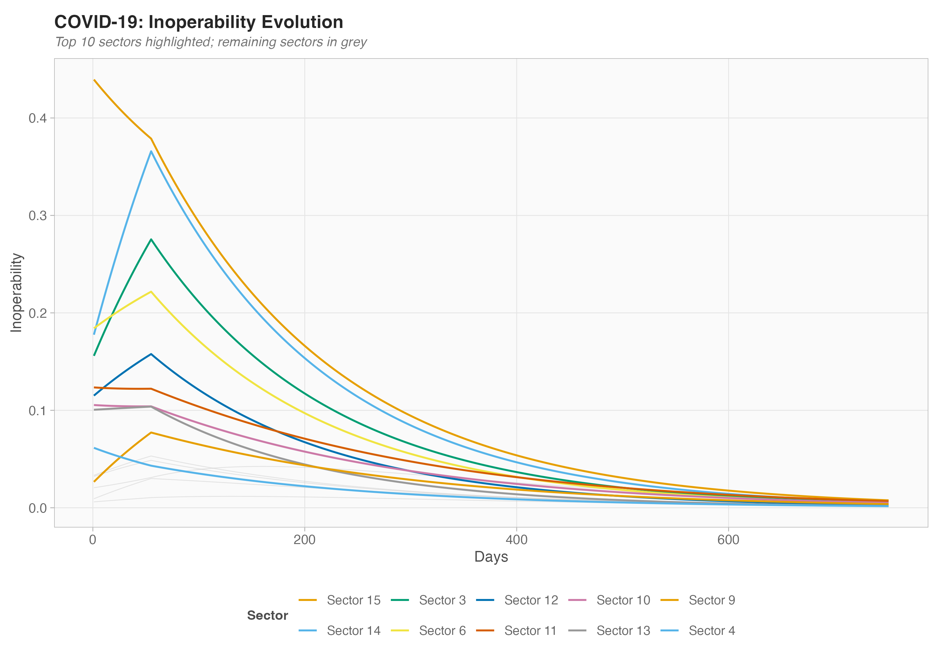
Inoperability Evolution — COVID-19
Introduction
>
DIIM Model
>
DIIM Results
>
Simplified Methods
>
Monte Carlo
>
Results
>
Recommendations
• Each line = one sector’s inoperability over time
• Sharp rise during lockdown (c* ≠ 0)
• Gradual recovery after lockdown ends (c* = 0)
• Some sectors recover faster (higher K_ii)
• DIIM captures the full cascade dynamics

Slide 17
Economic Loss Calculation
Introduction
>
DIIM Model
>
DIIM Results
>
Simplified Methods
>
Monte Carlo
>
Results
>
Recommendations
Economic loss per sector per time step:
Loss_i(t) = x_i × q_i(t) / 365
x_i
= Daily output of sector i under normal production
q_i(t)
= Inoperability of sector i at time t
365
= Days in a year (evenly distributed production)
Total economic loss = ∑ Loss_i(t) summed over all sectors and time steps

Slide 18
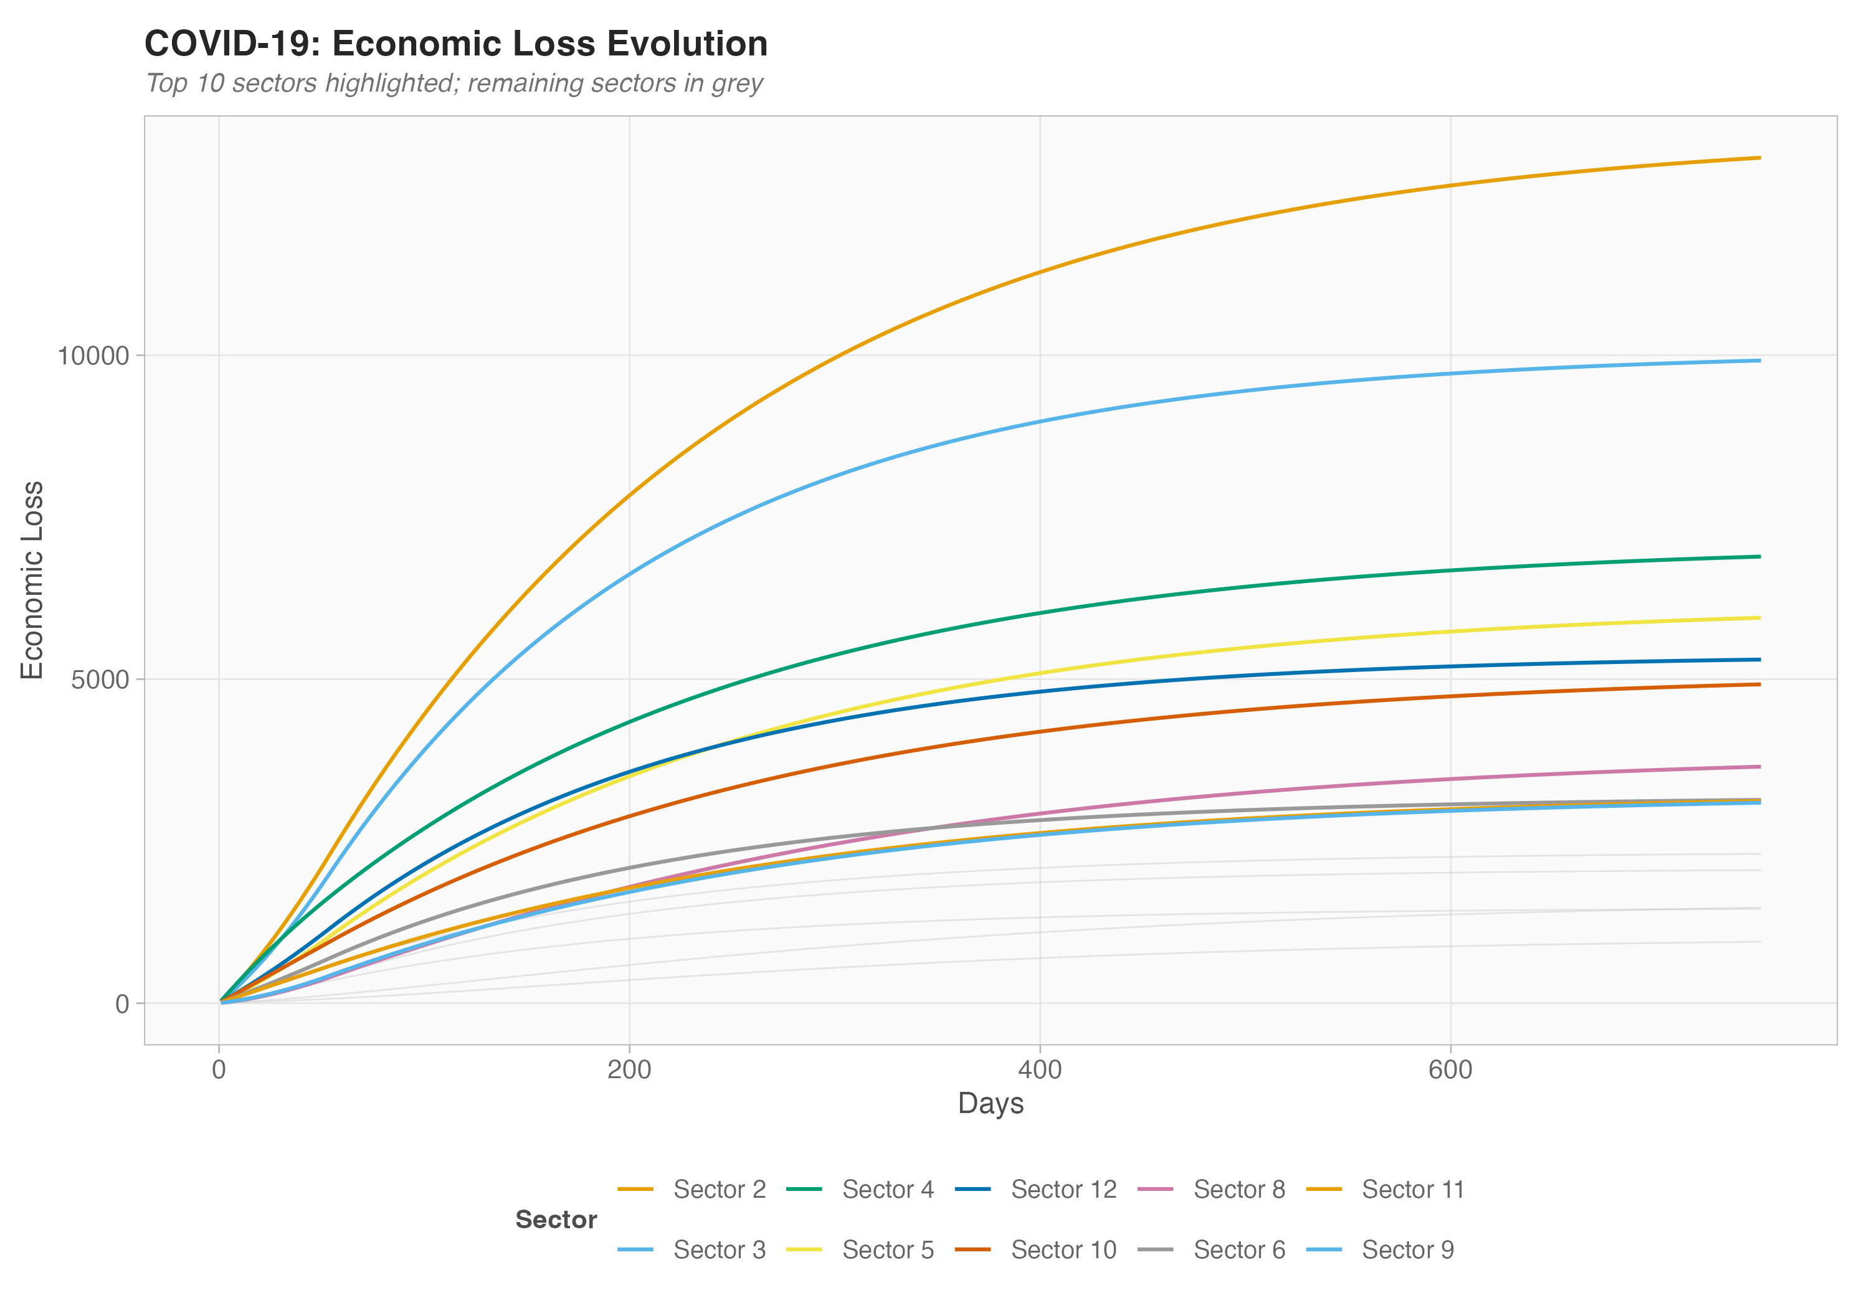
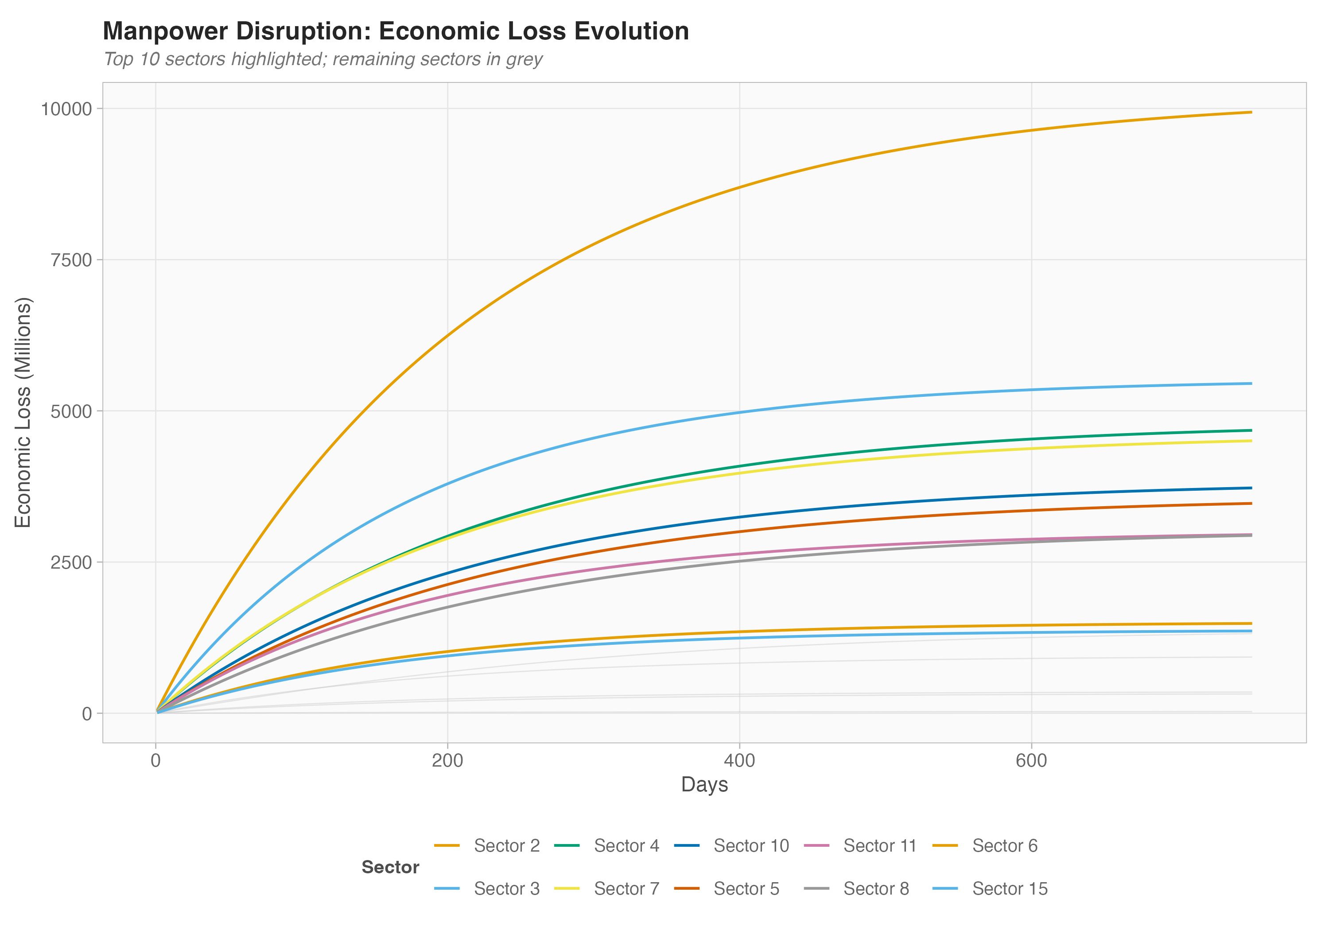
COVID-19 vs Manpower: Economic Loss
Introduction
>
DIIM Model
>
DIIM Results
>
Simplified Methods
>
Monte Carlo
>
Results
>
Recommendations
COVID-19 Scenario
Manpower Scenario
Parameter | COVID-19 | Manpower
IO Table | 2019 | 2022
Shock Type | Supply + Demand | Supply Only
c* | Non-zero (lockdown) | Zero
q(0) Source | Unemployment rates | Foreign worker dependency

Slide 19
The Challenge
Introduction
>
DIIM Model
>
DIIM Results
>
Simplified Methods
>
Monte Carlo
>
Results
>
Recommendations
?
Can we identify critical sectors WITHOUT running the full DIIM?
The DIIM requires crisis-time data (q(0), c*) that may not be available during an emergency. Simplified methods use only the IO table structure, which is always available.
If simplified methods match DIIM’s recommendations → faster, more practical decision-making in crisis

Slide 20
Introduction
>
DIIM Model
>
DIIM Results
>
Simplified Methods
>
Monte Carlo
>
Results
>
Recommendations
03
Simplified Sector-Ranking Methods
Five methods that use only the IO table to rank sectors

Slide 21
Five Simplified Methods
Introduction
>
DIIM Model
>
DIIM Results
>
Simplified Methods
>
Monte Carlo
>
Results
>
Recommendations
Method | Formula | Intuition
Total Output | rank by x_i | Biggest sectors matter most
PCA × x_i | PC distance × x_i | Structural influence + size
PageRank × x_i | PageRank centrality × x_i | Network importance + size
BL × x_i | Backward linkage × x_i | Demand-pull influence + size
FL × x_i | Forward linkage × x_i | Supply-push influence + size
💡 Key insight: All methods are weighted by total output (x_i) to reflect economic size. This means economic size is always a factor in the ranking.

Slide 22
Evaluation Pipeline
Introduction
>
DIIM Model
>
DIIM Results
>
Simplified Methods
>
Monte Carlo
>
Results
>
Recommendations
Step 1
Step 2
Step 3
Step 4
Compute Simplified Ranking
Select Top-k Sectors
Run DIIM with Intervention
Compare Loss Reduction
➡
➡
➡
Static, no simulation needed
Choose k most important sectors
Reduce inoperability for selected sectors
vs DIIM’s own top-k selection
Performance Metric: R_m = (Simplified reduction) / (DIIM reduction) R_m = 1.0 means the simplified method matches DIIM perfectly R_m < 0.8 means the simplified method misses >20% of DIIM’s benefit

Slide 23
Method Rankings — Side by Side
Introduction
>
DIIM Model
>
DIIM Results
>
Simplified Methods
>
Monte Carlo
>
Results
>
Recommendations
[Insert image]
Each column shows one method’s sector ranking. Arrows highlight where rankings agree or disagree.
• Rankings are fixed (computed once from IO table)
• These static rankings are then tested against 2,000 random disruption profiles
• Key observation: most methods agree on the top 2–3 sectors

Slide 24
Loss Reduction Algorithm
Introduction
>
DIIM Model
>
DIIM Results
>
Simplified Methods
>
Monte Carlo
>
Results
>
Recommendations
How intervention reduces economic loss:
The simplified ranking is fixed — it doesn’t change with q(0). But DIIM’s optimal ranking can change with each disruption profile. Question: How often does the simplified ranking still pick the “right” sectors?
• 1. For each selected sector i, reduce its inoperability: q_i(0) → q_i(0) × 0.5
• 2. Re-run DIIM with the modified q(0) vector
• 3. Compute total economic loss under intervention
• 4. Loss reduction = baseline loss − intervention loss
➡ Answer: Monte Carlo simulation with 2,000 random disruption profiles

Slide 25
Introduction
>
DIIM Model
>
DIIM Results
>
Simplified Methods
>
Monte Carlo
>
Results
>
Recommendations
04
Monte Carlo Evaluation
Testing robustness with 2,000 random disruption profiles

Slide 26
Monte Carlo Framework
Introduction
>
DIIM Model
>
DIIM Results
>
Simplified Methods
>
Monte Carlo
>
Results
>
Recommendations
1
Start with real q(0) baseline
Performance Metrics: • Mean Ratio (R̄_m): Average R_m across all 2,000 trials • 80% Close Rate: Fraction of trials where R_m ≥ 0.80 (simplified captures ≥80% of DIIM benefit)
2
Perturb: q(0)_rand = q(0) × exp(N(0, 0.5))
3
Run DIIM baseline + DIIM with simplified top-k
4
Compute R_m = simplified / DIIM reduction
5
Repeat 2,000 times

Slide 27
Three Performance Regimes
Introduction
>
DIIM Model
>
DIIM Results
>
Simplified Methods
>
Monte Carlo
>
Results
>
Recommendations
Small k (k=3)
Medium k (k=5–7)
Large k (k≥10)
Methods diverge significantly
Sweet spot for differentiation
All methods converge
R̄_m: 0.65–0.87
Close rate: 55–90%
Close rate: ~100%
Sector selection matters most
Best methods identifiable
Simplified sufficient
This is the central finding: the value of method selection depends on the intervention scale k

Slide 28
Introduction
>
DIIM Model
>
DIIM Results
>
Simplified Methods
>
Monte Carlo
>
Results
>
Recommendations
05
Results
Performance comparison across scenarios and intervention scales

Slide 29
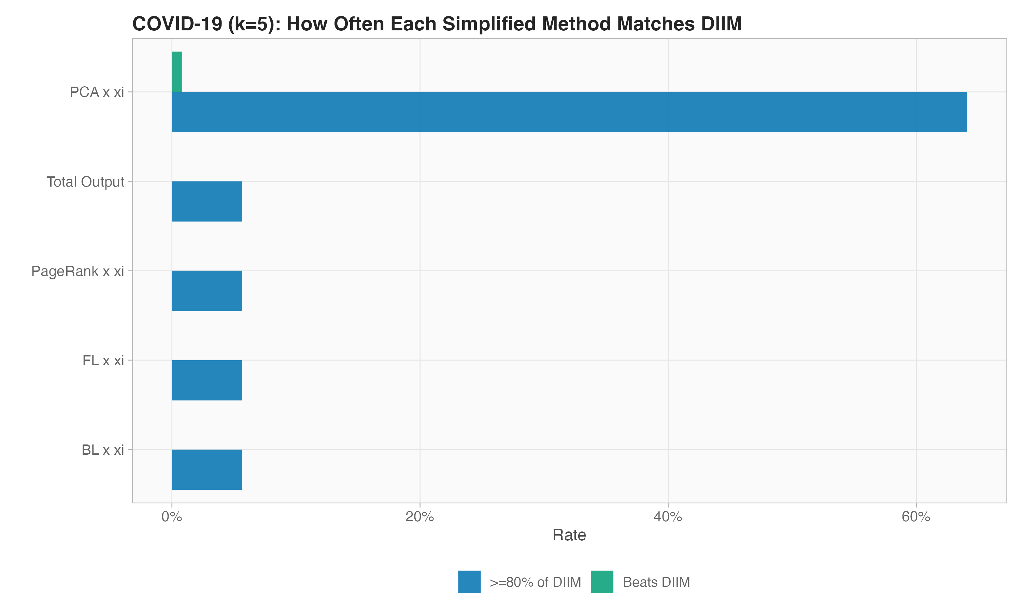
COVID-19: Close Rates by k
Introduction
>
DIIM Model
>
DIIM Results
>
Simplified Methods
>
Monte Carlo
>
Results
>
Recommendations
• Close rate = fraction of trials where R_m ≥ 0.80
• At k=5: best methods achieve 89.8% close rate
• At k≥10: all methods converge to ~100%
• PCA×x_i shows slight advantage at small k

Slide 30
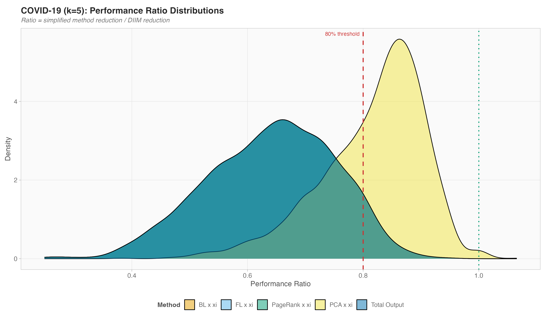
COVID-19: Ratio Distributions
Introduction
>
DIIM Model
>
DIIM Results
>
Simplified Methods
>
Monte Carlo
>
Results
>
Recommendations
• Distribution of R_m across 2,000 trials
• Tighter distributions = more consistent performance
• Most distributions cluster near 1.0 for k≥7

Slide 31
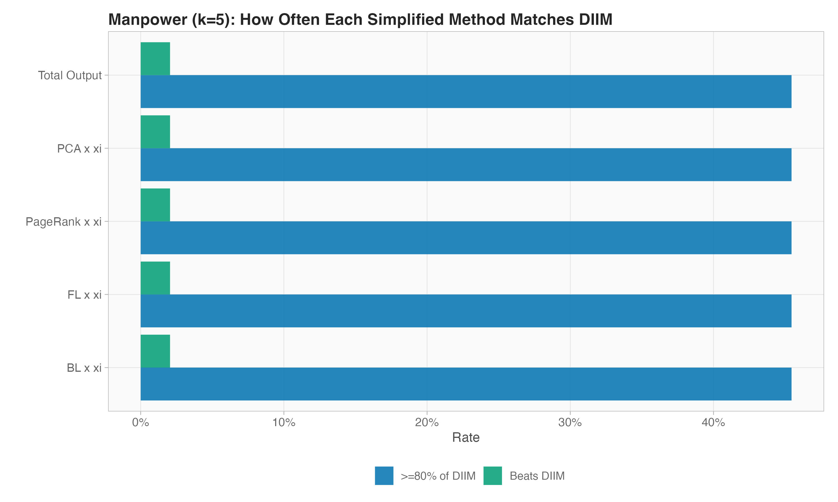
Manpower: Close Rates by k
Introduction
>
DIIM Model
>
DIIM Results
>
Simplified Methods
>
Monte Carlo
>
Results
>
Recommendations
• At k=5: FL×x_i and Total Output lead at 55.4%
• Supply-only shocks are harder to approximate
• Faster convergence: ~97% close rate by k=7
• c*=0 makes dynamics more predictable

Slide 32
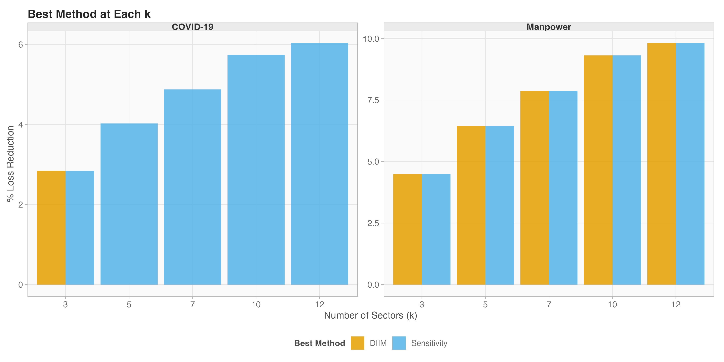
Head-to-Head: COVID vs Manpower
Introduction
>
DIIM Model
>
DIIM Results
>
Simplified Methods
>
Monte Carlo
>
Results
>
Recommendations
Best Method at Each k
Key Observations
• Economic size (Total Output) dominates both scenarios when weighted by x_i
• At large k: specific ranking is immaterial
• COVID-19 shows more method differentiation (due to c* ≠ 0)
• Manpower converges faster (pure supply dynamics more predictable)

Slide 33
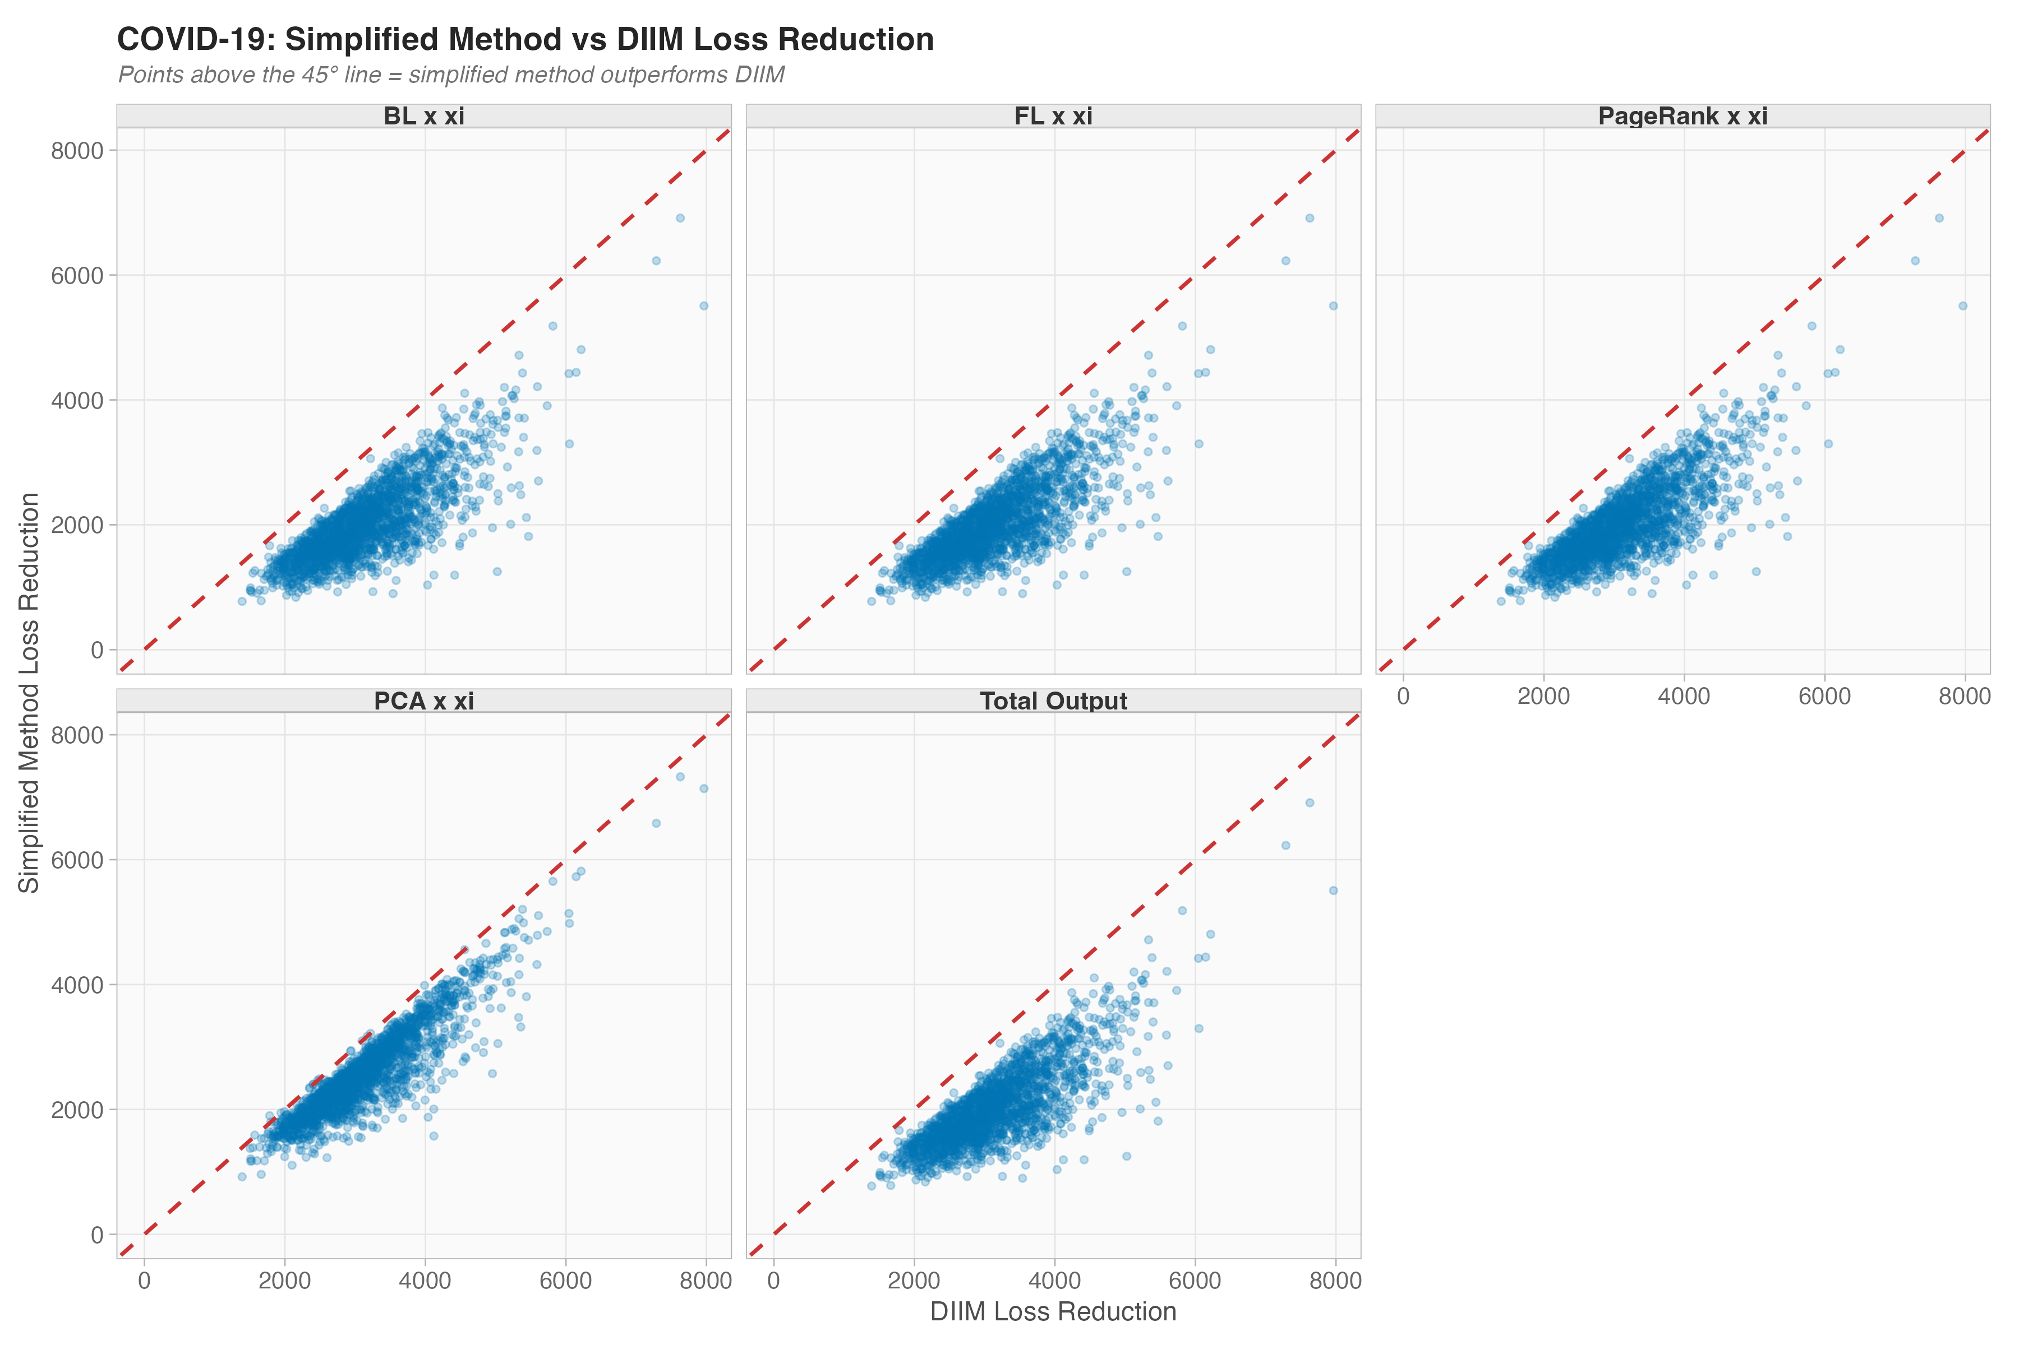
Scatter: Simplified vs DIIM Loss Reduction
Introduction
>
DIIM Model
>
DIIM Results
>
Simplified Methods
>
Monte Carlo
>
Results
>
Recommendations
• Each point = one Monte Carlo trial
• 45° line = perfect match with DIIM
• Points above line: simplified outperforms
• Points below: DIIM would have been better
• Clustering near the line = good agreement

Slide 34
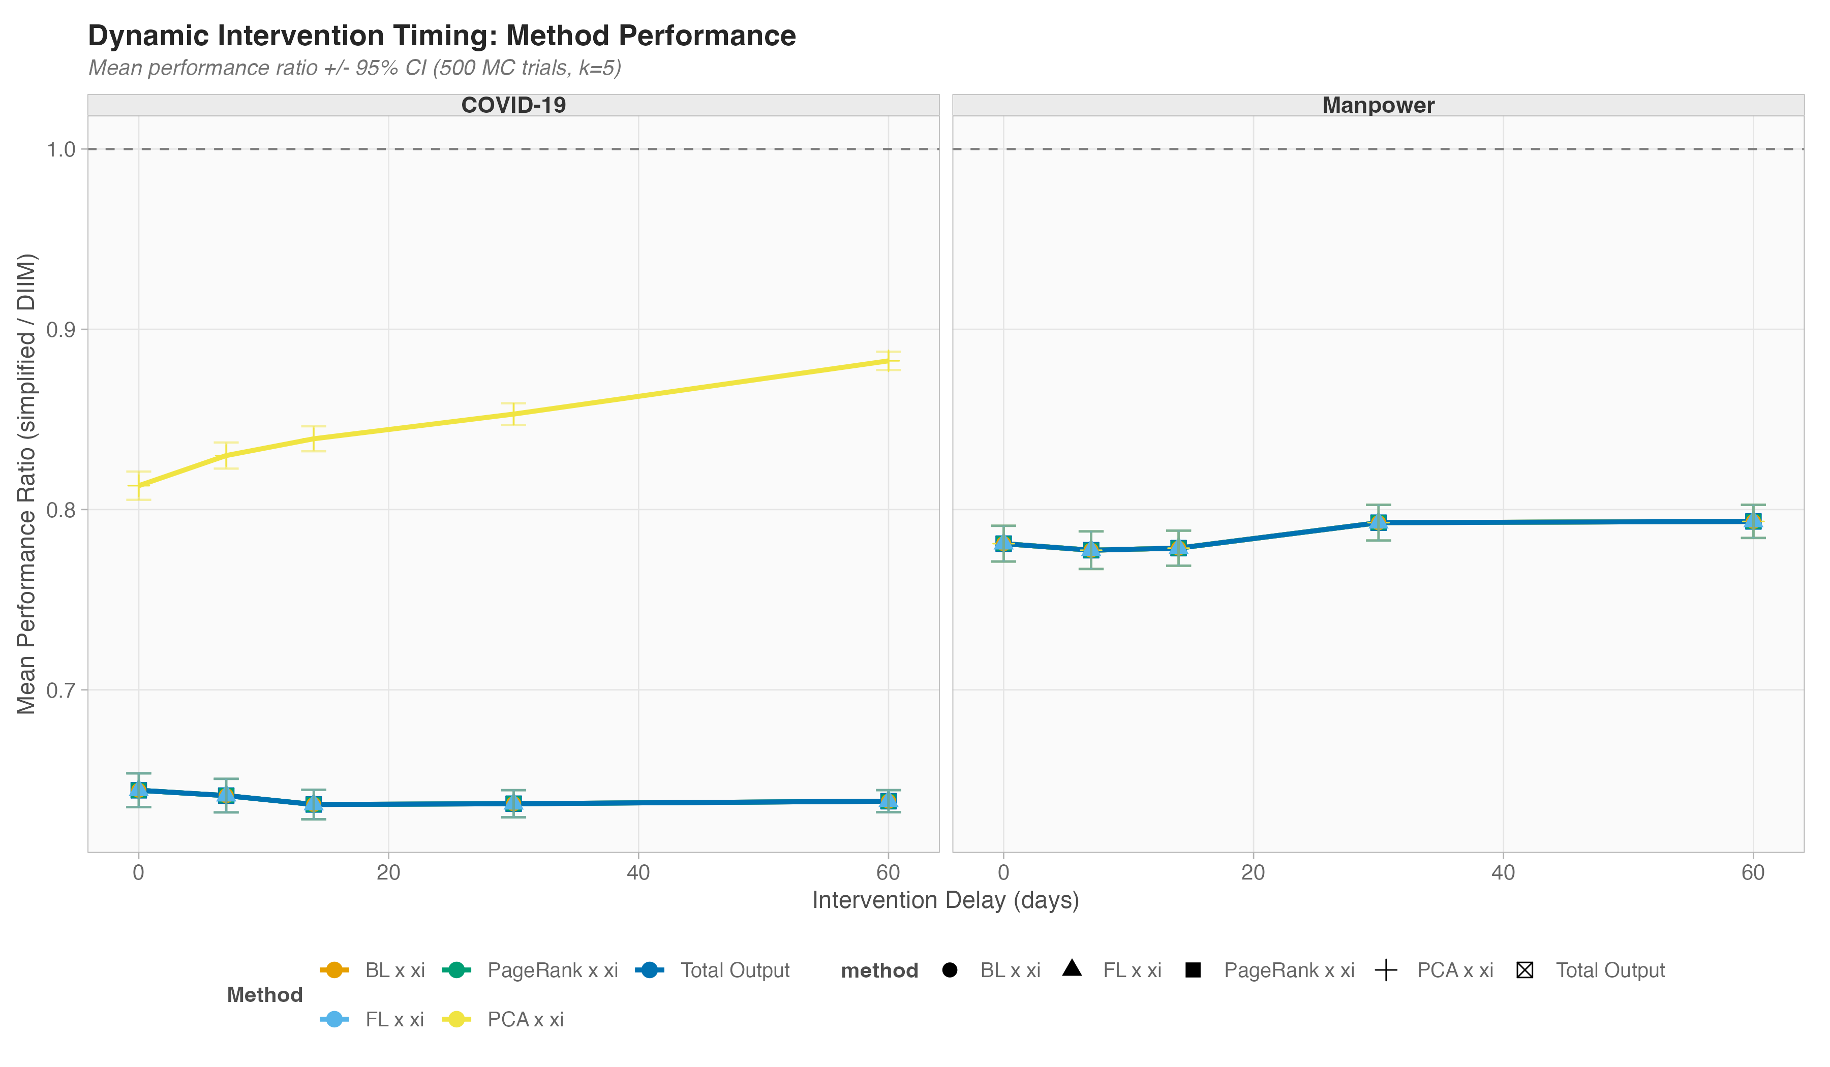
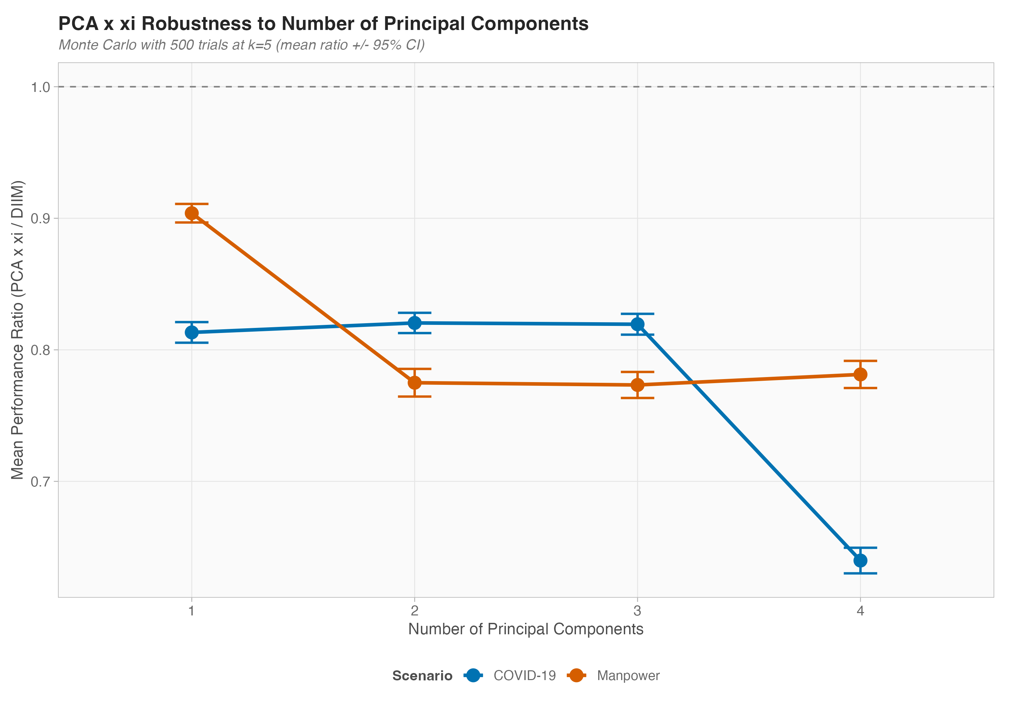
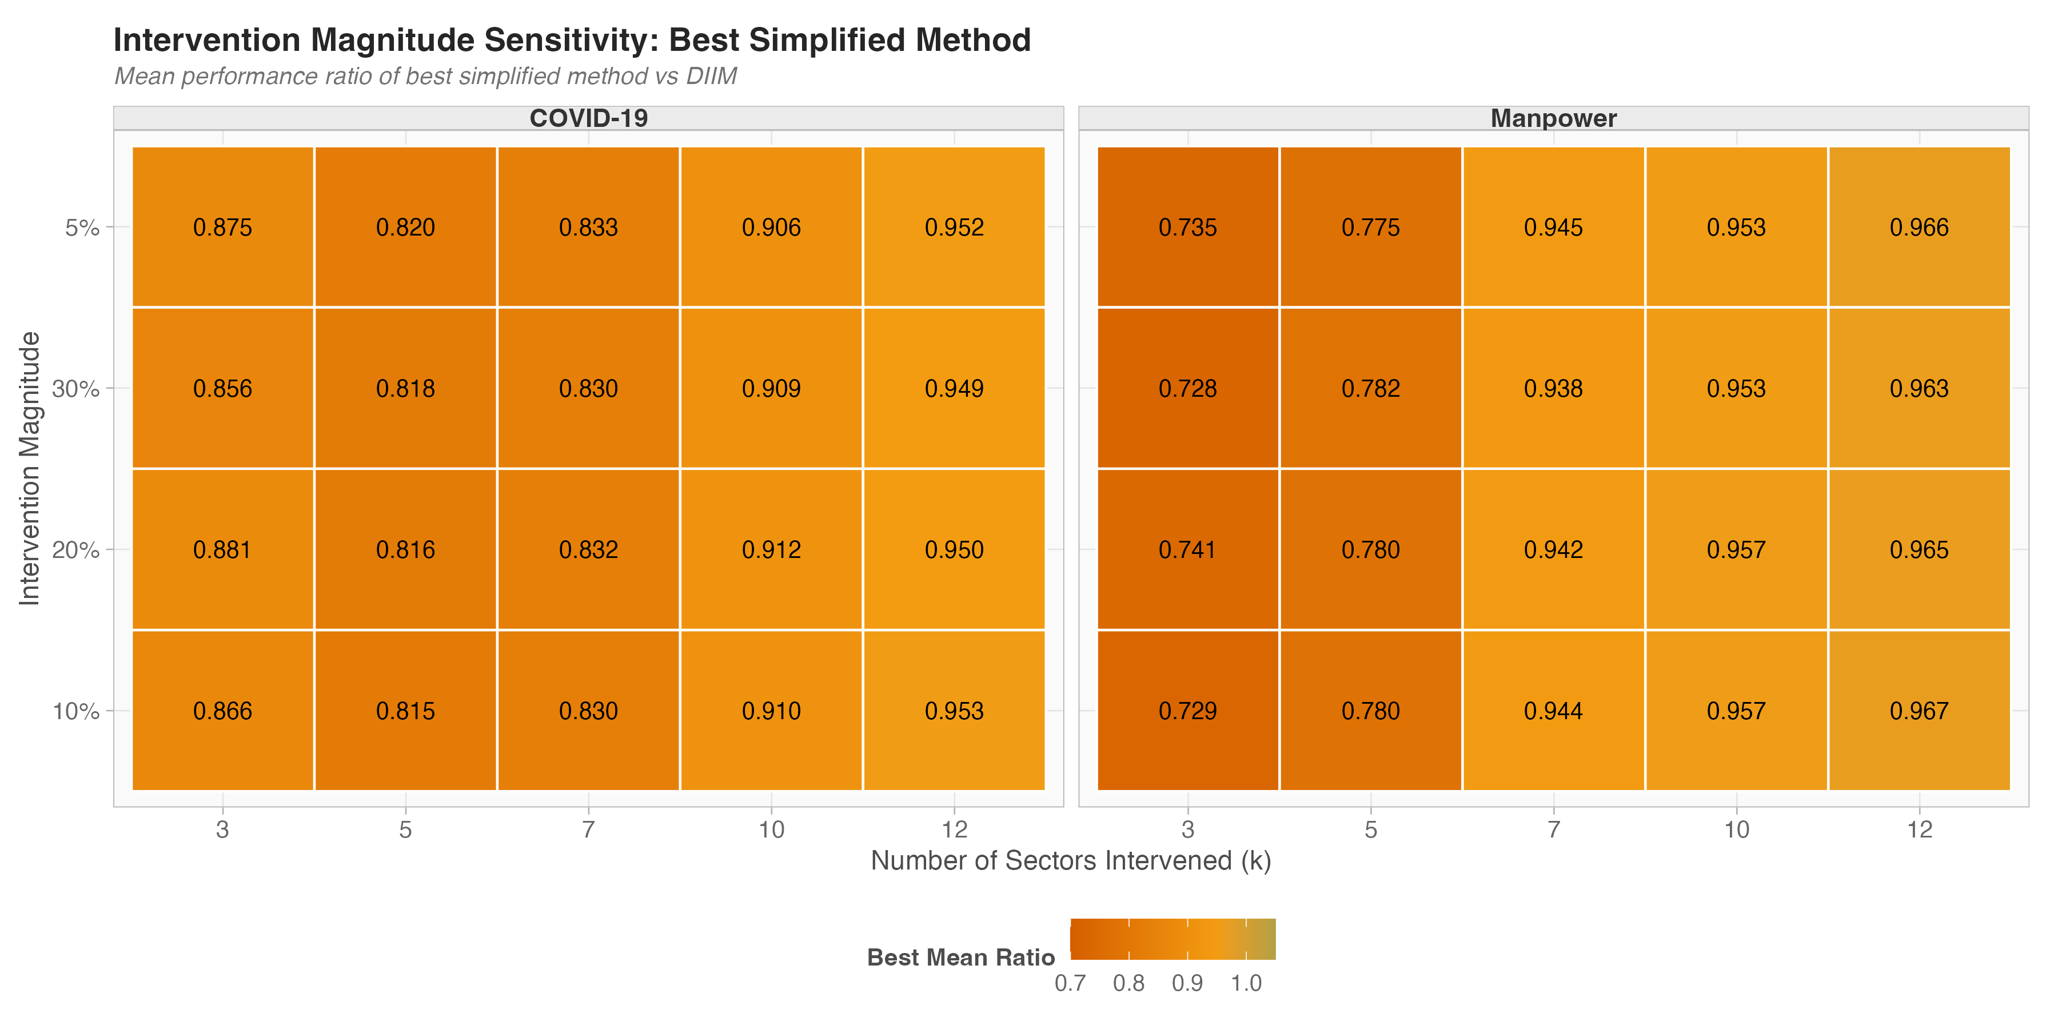
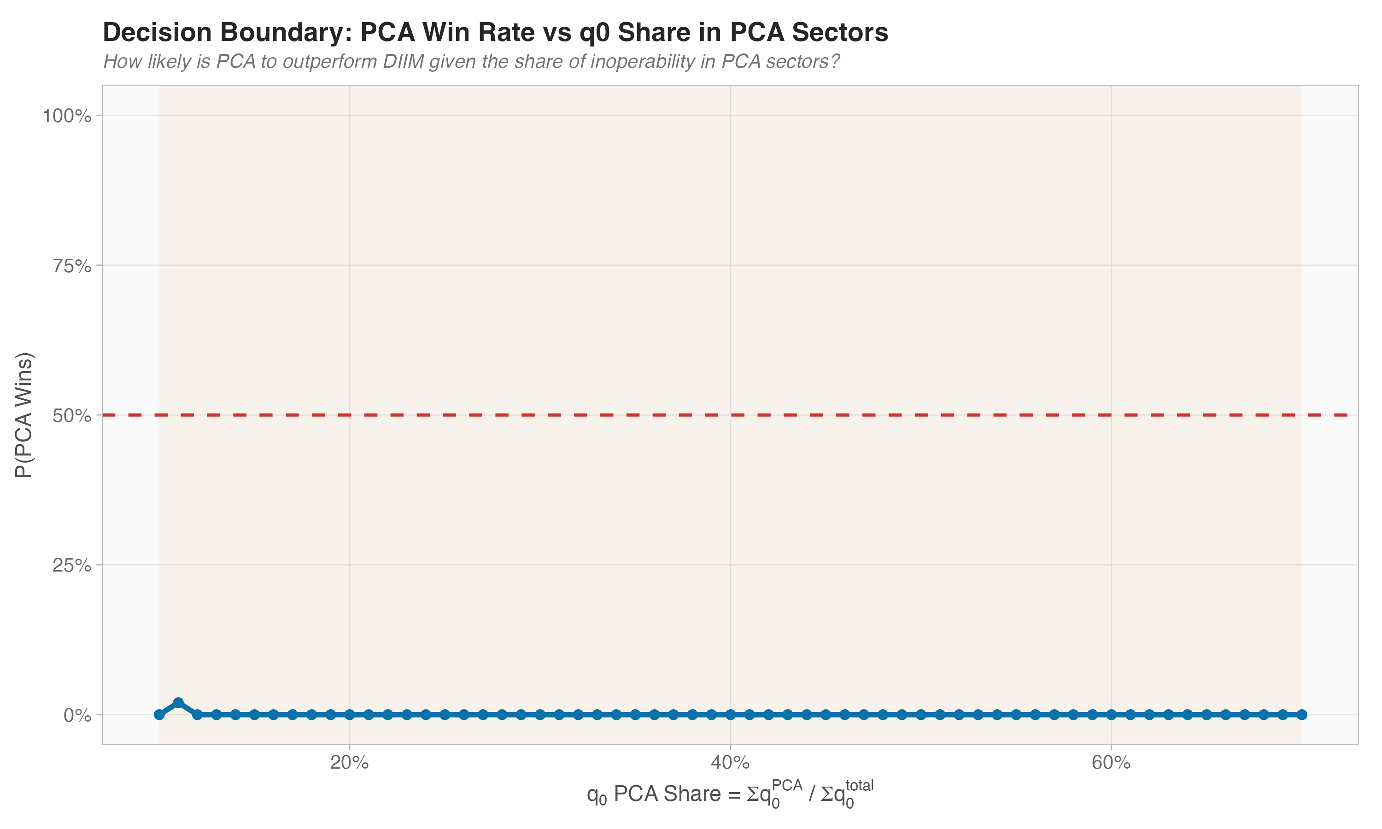
Robustness Evidence
Introduction
>
DIIM Model
>
DIIM Results
>
Simplified Methods
>
Monte Carlo
>
Results
>
Recommendations
Results hold across timing, parameter, and profile variations
Intervention Timing
PCA Robustness
Sensitivity Heatmap
Decision Boundary

Slide 35
Introduction
>
DIIM Model
>
DIIM Results
>
Simplified Methods
>
Monte Carlo
>
Results
>
Recommendations
06
Recommendations
When to use simplified methods vs full DIIM

Slide 36
Decision Framework
Introduction
>
DIIM Model
>
DIIM Results
>
Simplified Methods
>
Monte Carlo
>
Results
>
Recommendations
How many sectors to intervene in?
✓ k ≥ 10
⚠ k = 5–7
✗ k < 5
Use simplified method (any)
Use simplified, validate with DIIM
Run full DIIM
All methods converge — specific ranking is immaterial
Methods differ — validate for critical decisions
Simplified methods are insufficient — sector selection matters too much
Peacetime / large-scale planning → Simplified methods sufficient | Targeted / crisis response → Full DIIM required

Slide 37
Summary
Introduction
>
DIIM Model
>
DIIM Results
>
Simplified Methods
>
Monte Carlo
>
Results
>
Recommendations
Key Contributions
1
Extended DIIM to two distinct disruption scenarios
COVID-19 (supply + demand) and Manpower (pure supply)
2
Demonstrated three performance regimes
Small k: methods diverge | Medium k: sweet spot | Large k: convergence
3
Provided actionable decision framework
When to use simplified vs full DIIM based on intervention scale k

Slide 38
Future Work & Thank You
Introduction
>
DIIM Model
>
DIIM Results
>
Simplified Methods
>
Monte Carlo
>
Results
>
Recommendations
Future Directions
Thank You
• Broader disruption scenarios (supply chain, cyber, climate)
• Dynamic simplified methods that adapt to observed shocks
• Higher sector granularity (beyond 15 sectors)
• Cross-country comparison with other IO tables
Questions & Discussion
Yeoh Yu Yong Nanyang Technological University

