Slide 1
The Impacts of TSTC Programs on Earnings
Preliminary Estimates Using Digital Twins
October 2026
PRELIMINARY DATA -- DO NOT CITE

Slide 2
TSTC Programs
Largest Credit Division Within Each School
School | Division | Example Program
Business, Hospitality, and Global Trade | Management Careers | Human Resources Assistant
Health Sciences | Nursing | Associate Degree Nursing
Law and Public Service | Criminal Justice | Basic Criminal Justice Studies
Engineering, Technology, Math & Science | Computer Information Systems | Technology Support
Manufacturing and Industrial Technology | Automotive Technology | Automotive Repair
Creative Arts, Entertainment & Design | Digital Art and Design | Digital Media
Notes:
Program groups are the largest credit-program division within each school.

Slide 3
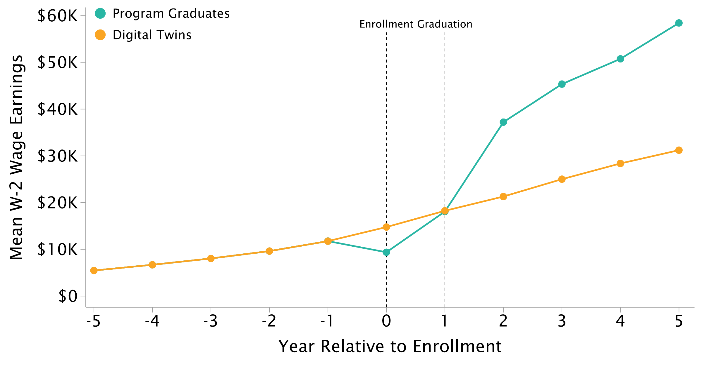
Impact of TSTC on Earnings: Construction Certificate
TSTC Enrollees who Graduate vs. Digital Twins -- $27K Increase
Notes:
Strongest result in the deck. ROI 33.8x, payback 0.6 years.

Slide 4
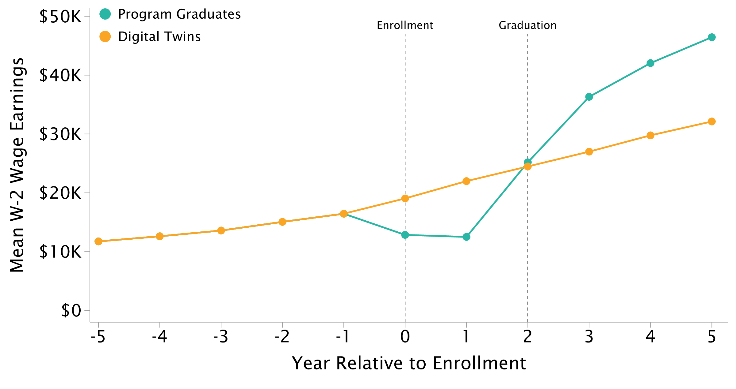
Impact of TSTC on Earnings: Engineering Associate's Degree
TSTC Enrollees who Graduate vs. Digital Twins -- $14K Increase
Notes:
ROI 8.4x on a cost of $14K.

Slide 5
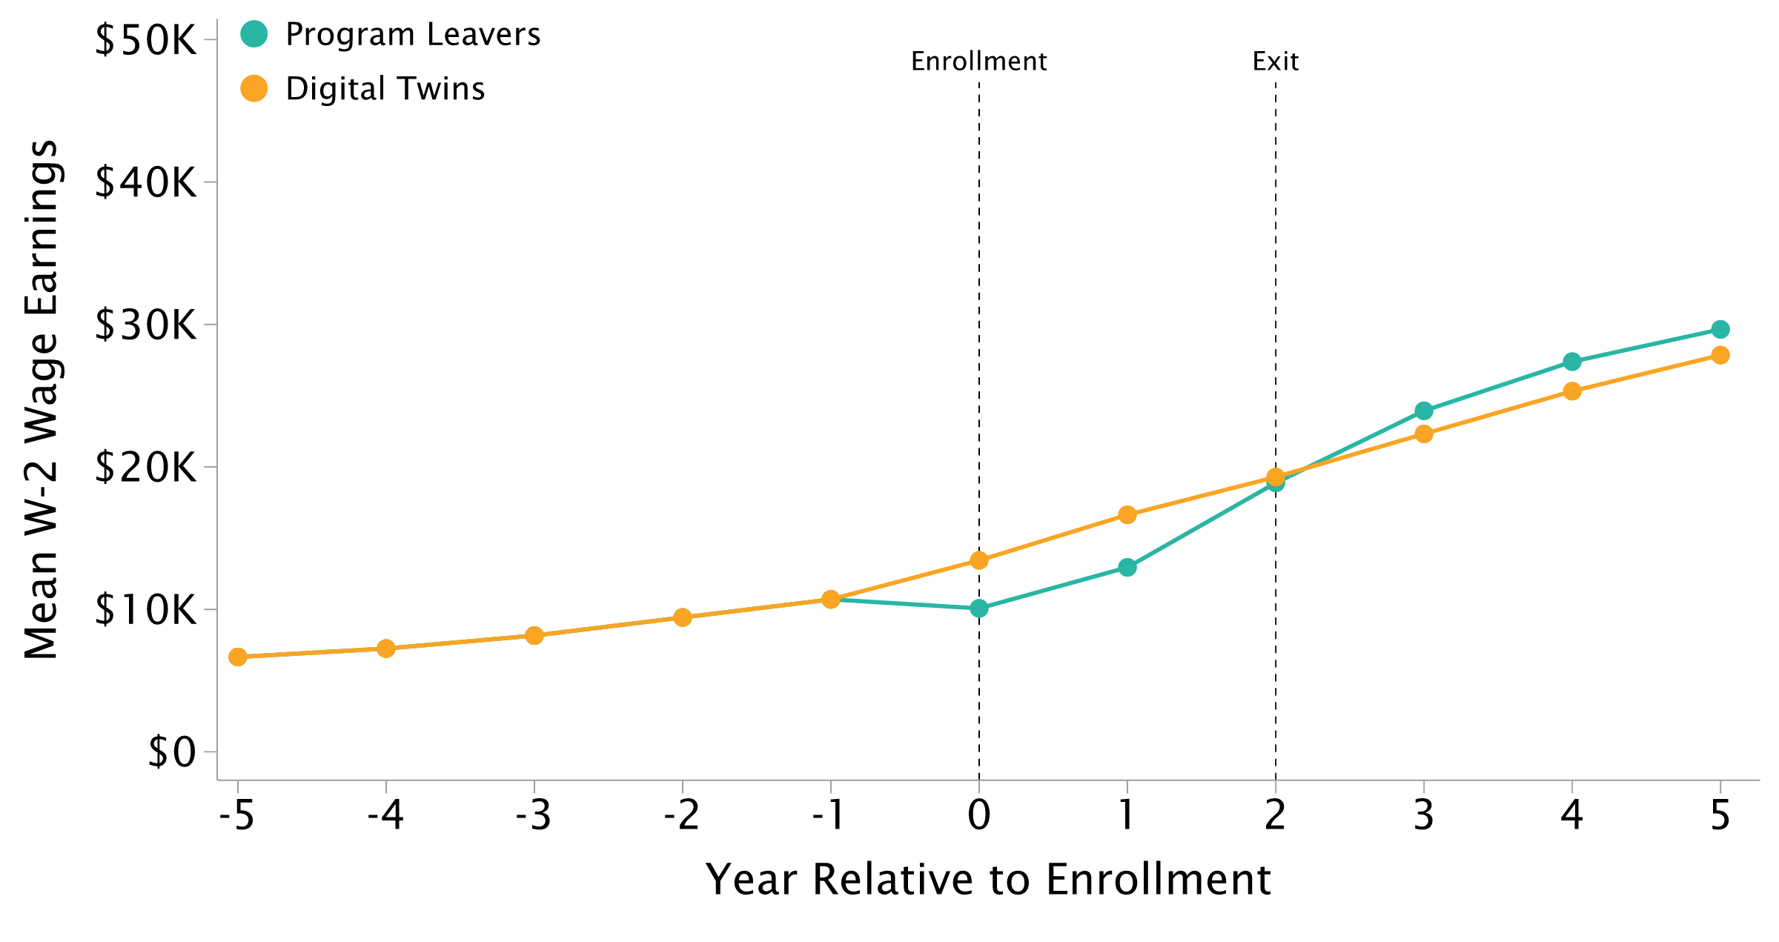
Impact of TSTC on Earnings: Engineering Associate's Degree
TSTC Enrollees who Leave vs. Digital Twins -- $2K Increase
Notes:
Leavers gain far less than graduates. The second dashed line marks expected completion, not an observed exit date.

Slide 6
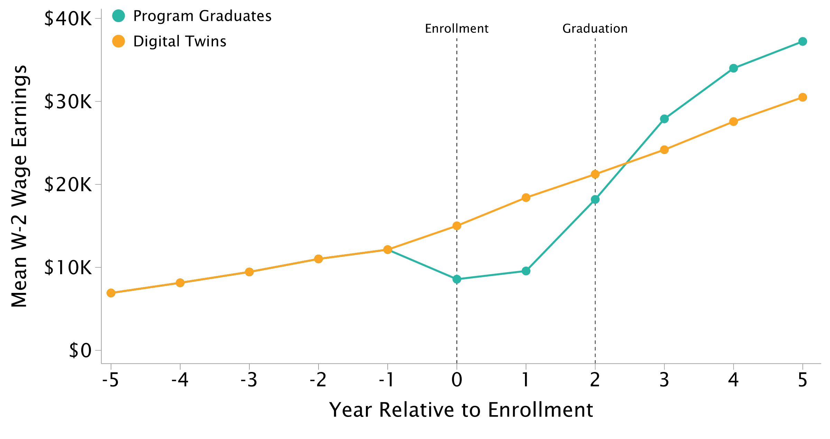
Impact of TSTC on Earnings: Automotive Associate's Degree
TSTC Enrollees who Graduate vs. Digital Twins -- $7K Increase
Notes:
CIP 47 is Mechanic and Repair Technologies and includes aviation and diesel, so the cost shown is above the automotive programs themselves.

Slide 7
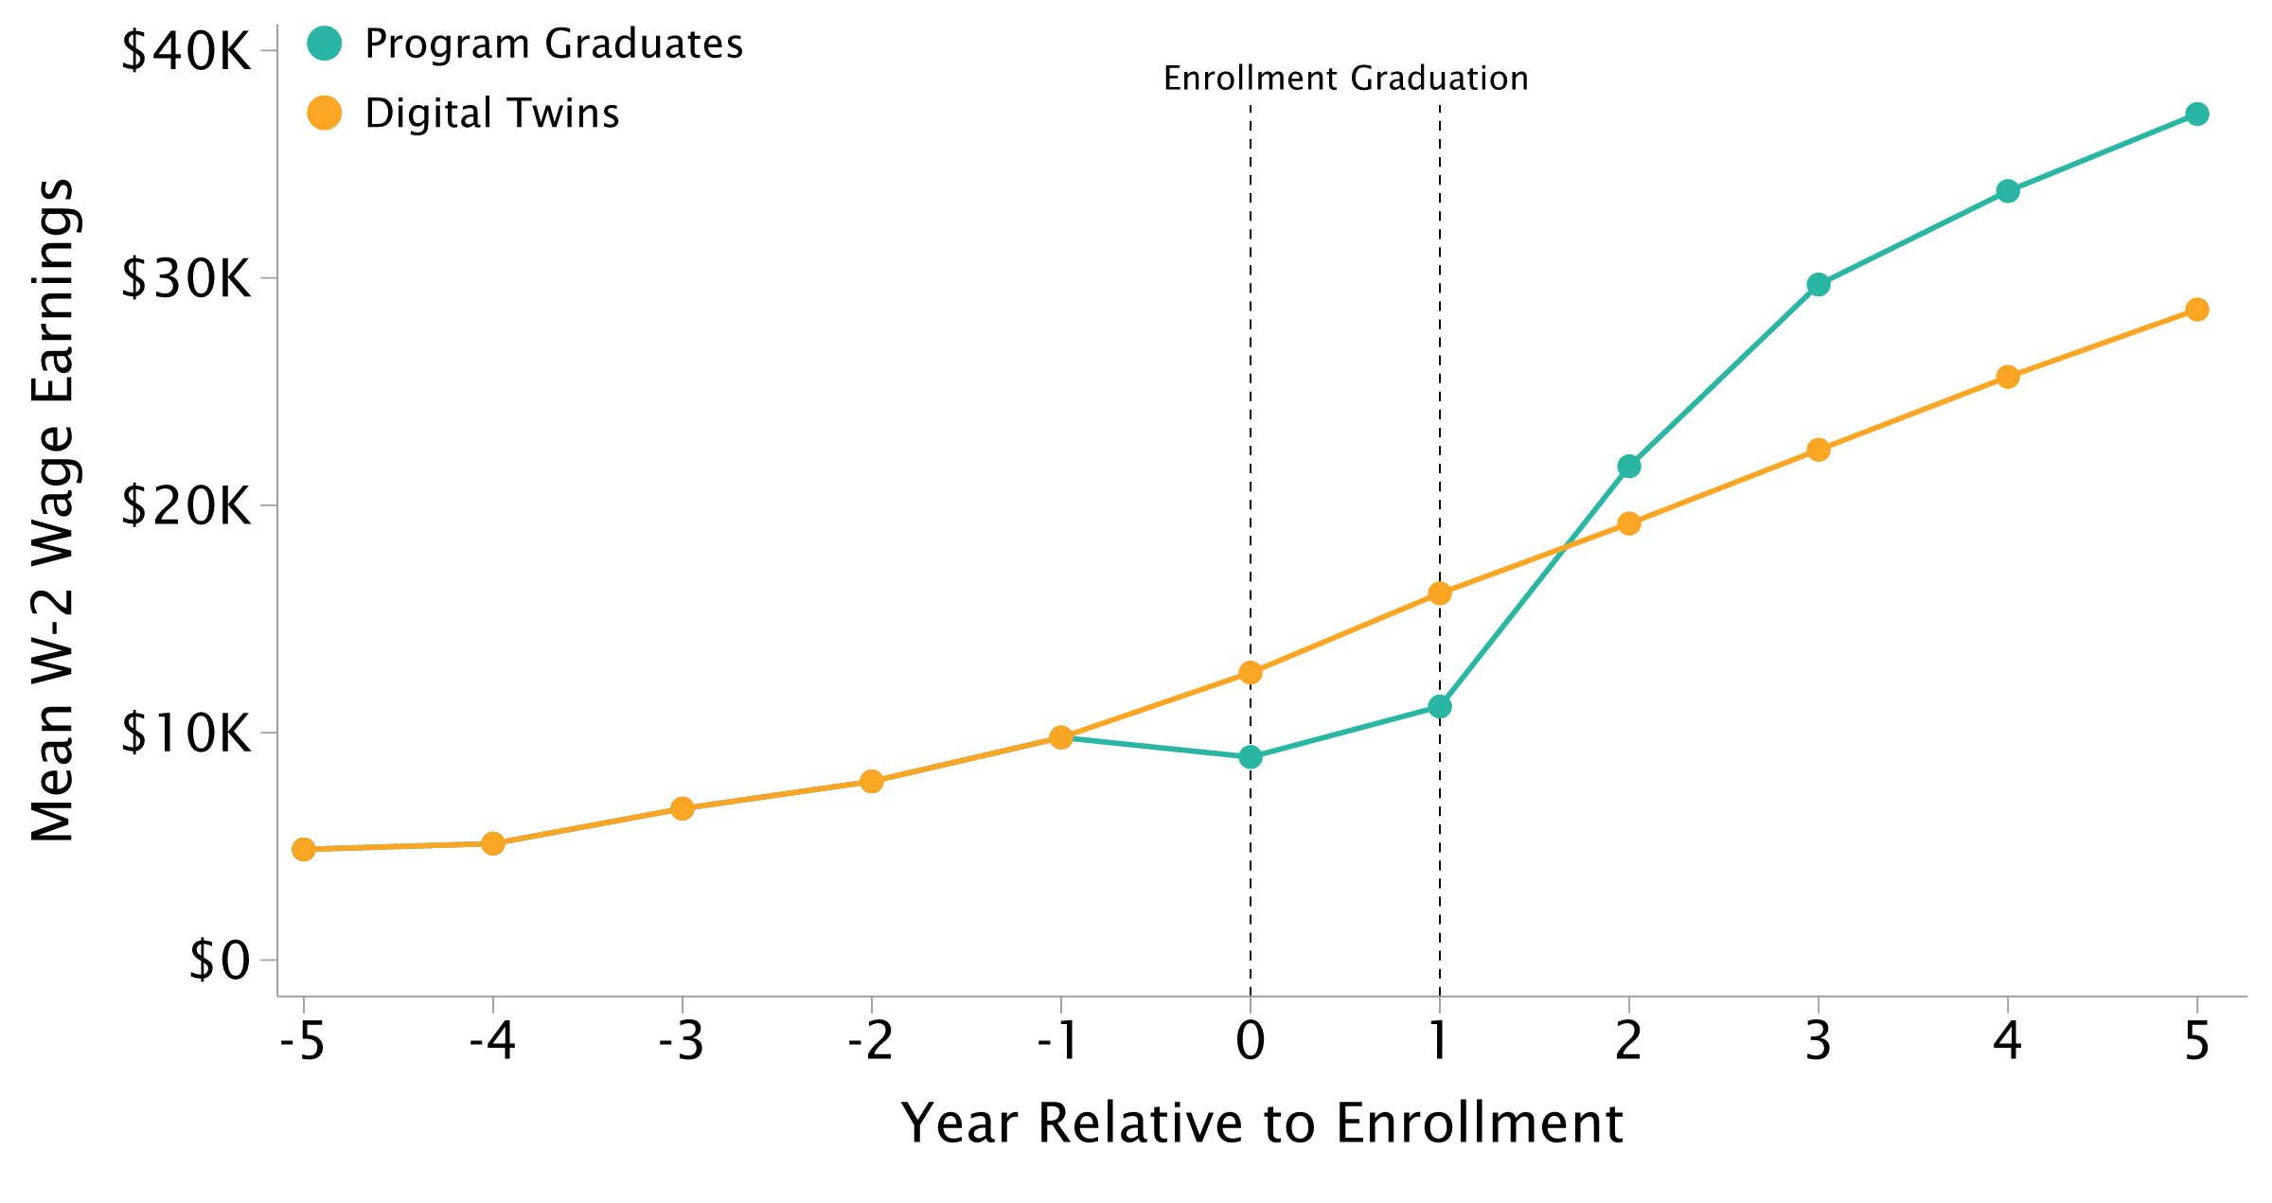
Impact of TSTC on Earnings: Automotive Certificate
TSTC Enrollees who Graduate vs. Digital Twins -- $9K Increase
Notes:
Certificates complete in 12 months, so the second dashed line sits at year 1.

Slide 8
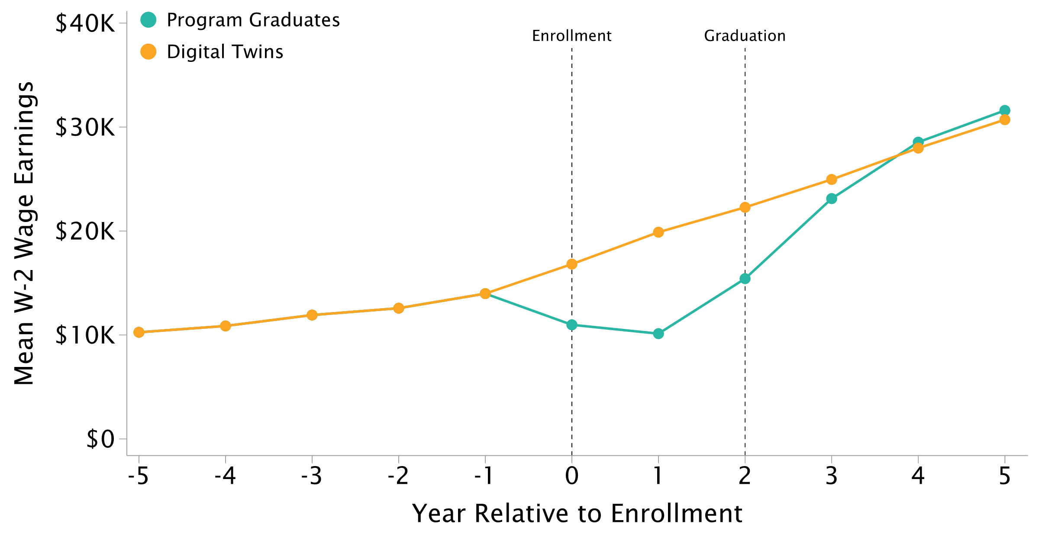
Impact of TSTC on Earnings: IT Associate's Degree
TSTC Enrollees who Graduate vs. Digital Twins -- $890 Increase
Notes:
Weakest result. $890 does not break even -- ROI 0.7x, payback 30.2 years.

Slide 9
Appendix
• Estimates use the September 2026 disclosure, statistic `mean`.
• The digital twins counterfactual is released for years 0-5 only; the pre-period is filled with the treated series plus uniform jitter.
  – Flagged in the data as `imputed_control_aipw`
• ROI assumes a 0.4 graduation rate over 20 years.

Slide 10
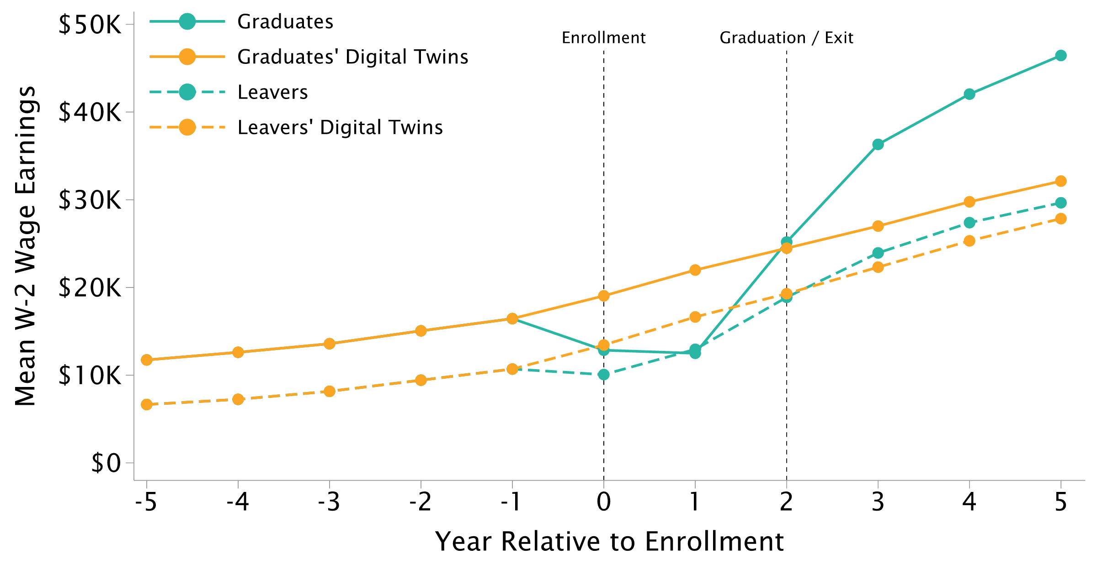
Impact of TSTC on Earnings: Engineering Associate's Degree
TSTC Enrollees who Graduate vs. Leave vs. Digital Twins
Notes:
Graduates and leavers on one axis. Replaces the hand-built slide whose subtitle said "Enrollees who Leave" under a chart showing both.

