Slide 1
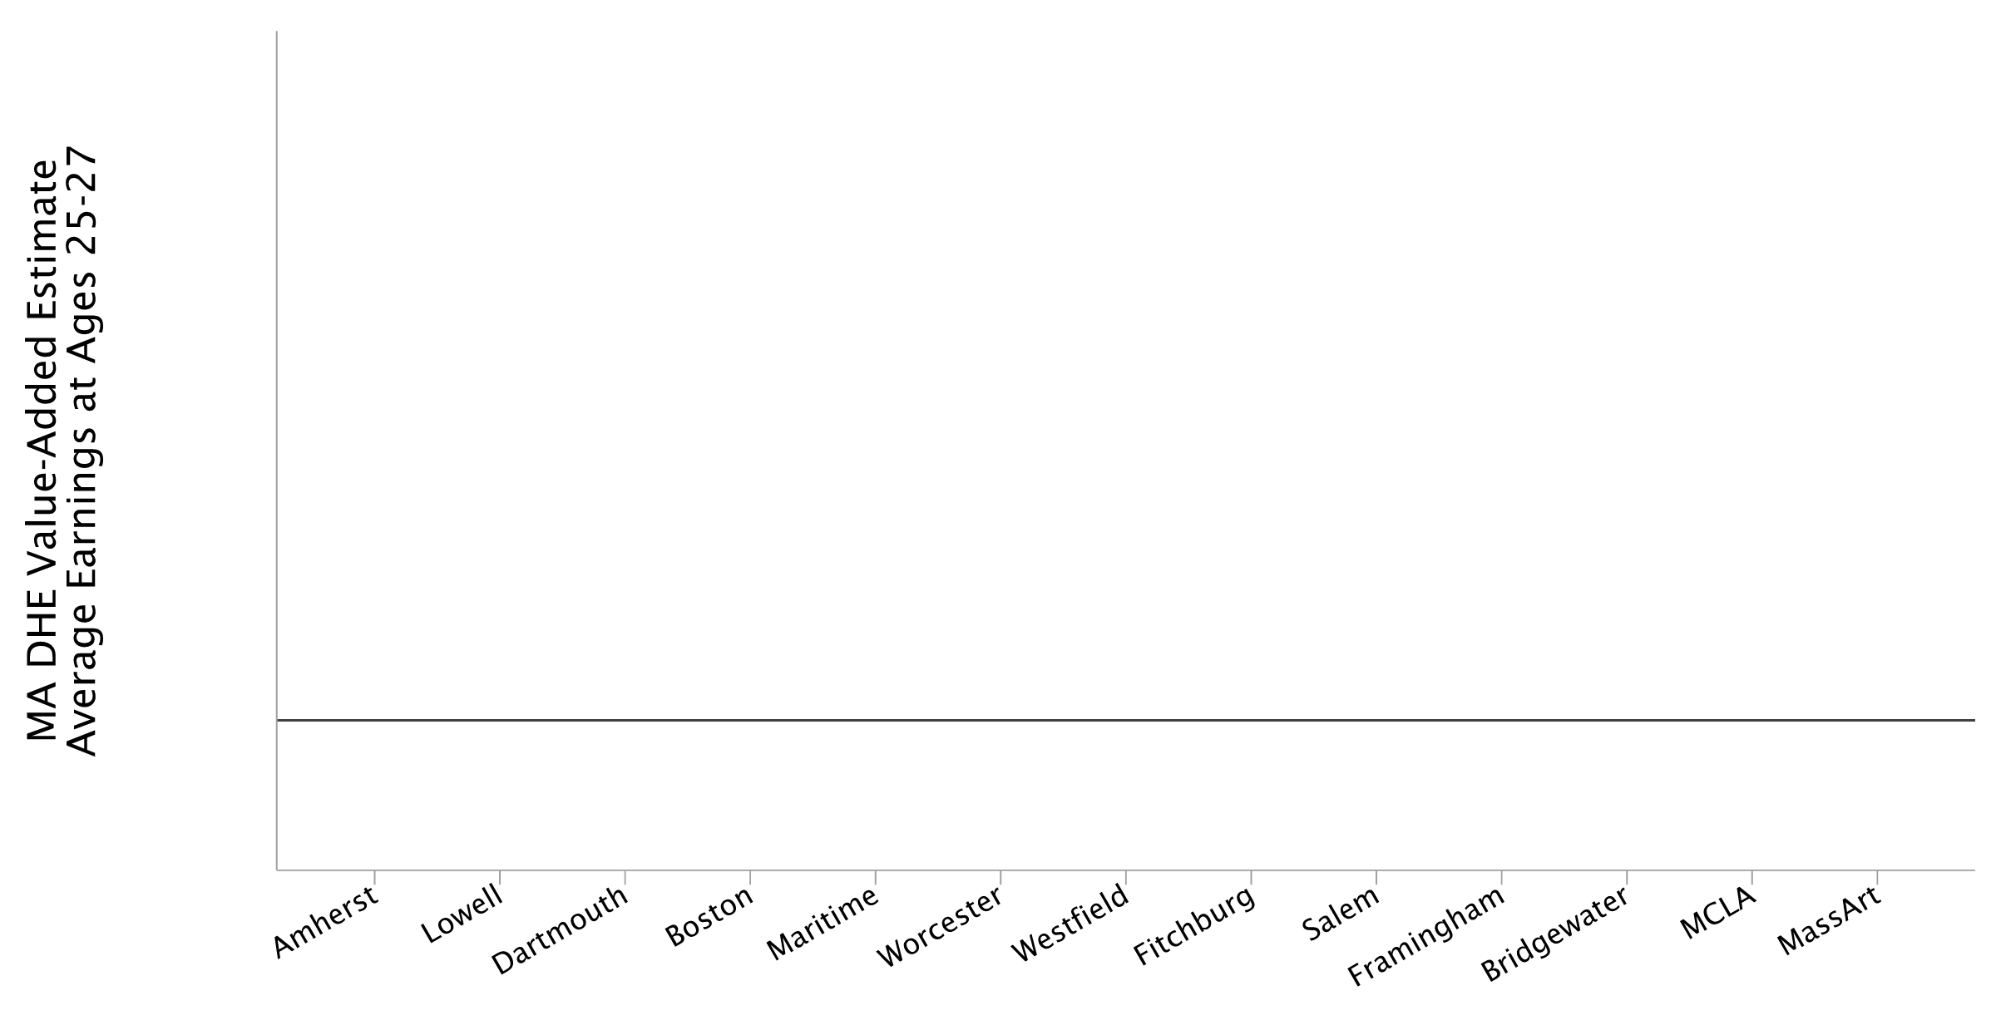
Institution-Level Earnings Relative to Non-Completers
Adjusted Earnings Levels at Ages 25–27

Slide 2
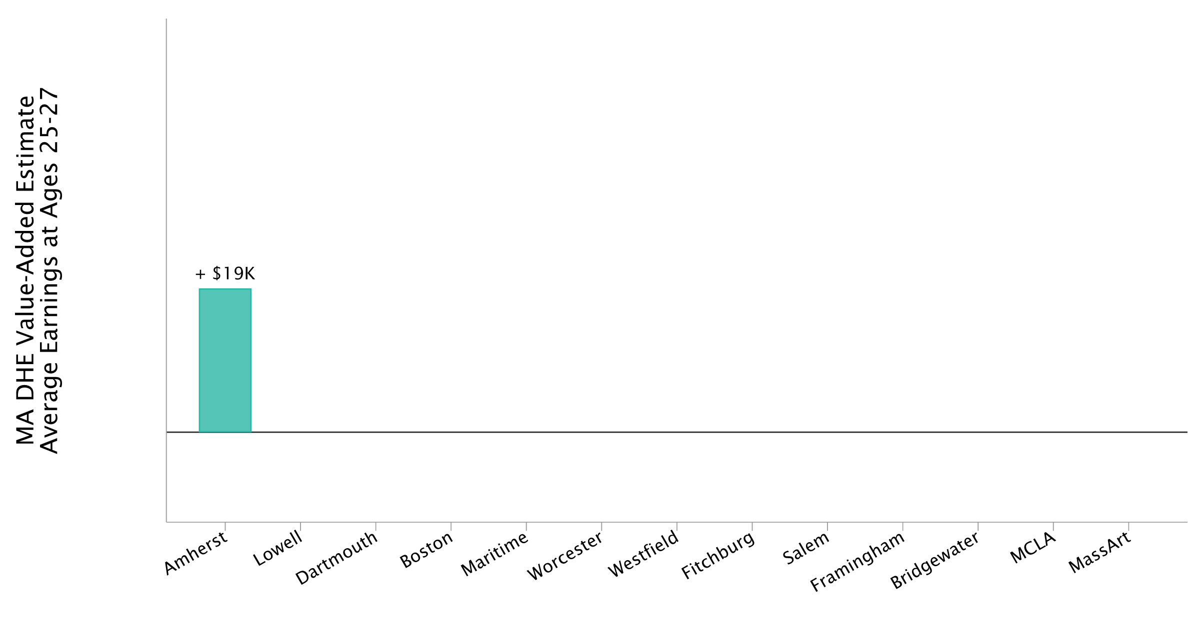
Institution-Level Earnings Relative to Non-Completers
Adjusted Earnings Levels at Ages 25–27

Slide 3
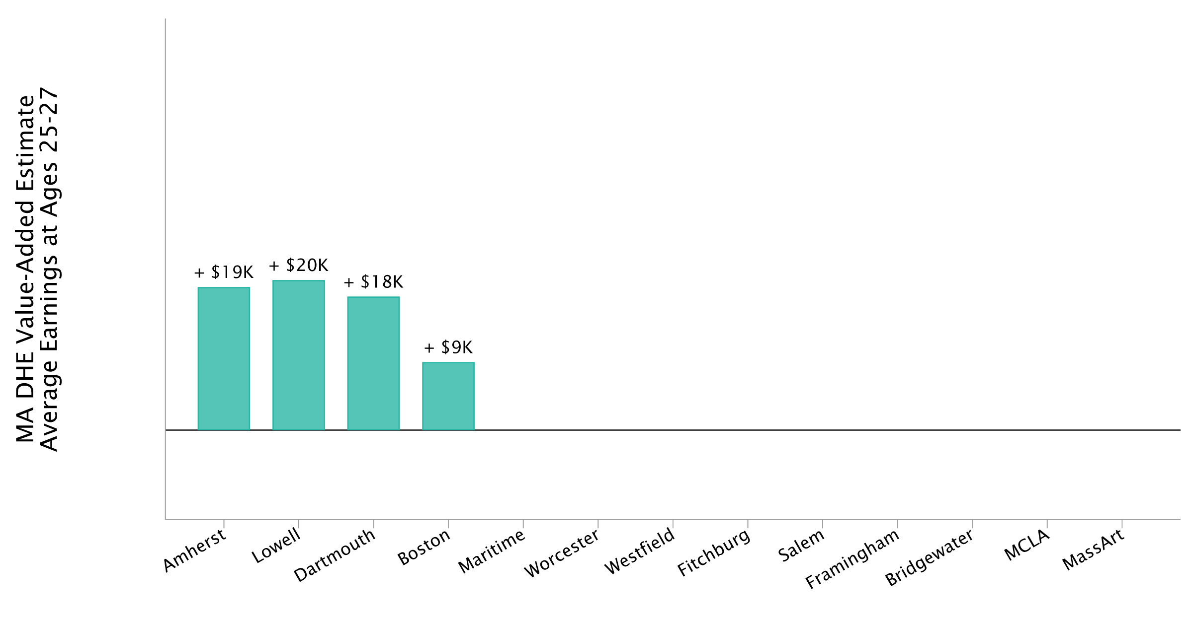
Institution-Level Earnings Relative to Non-Completers
Adjusted Earnings Levels at Ages 25–27

Slide 4
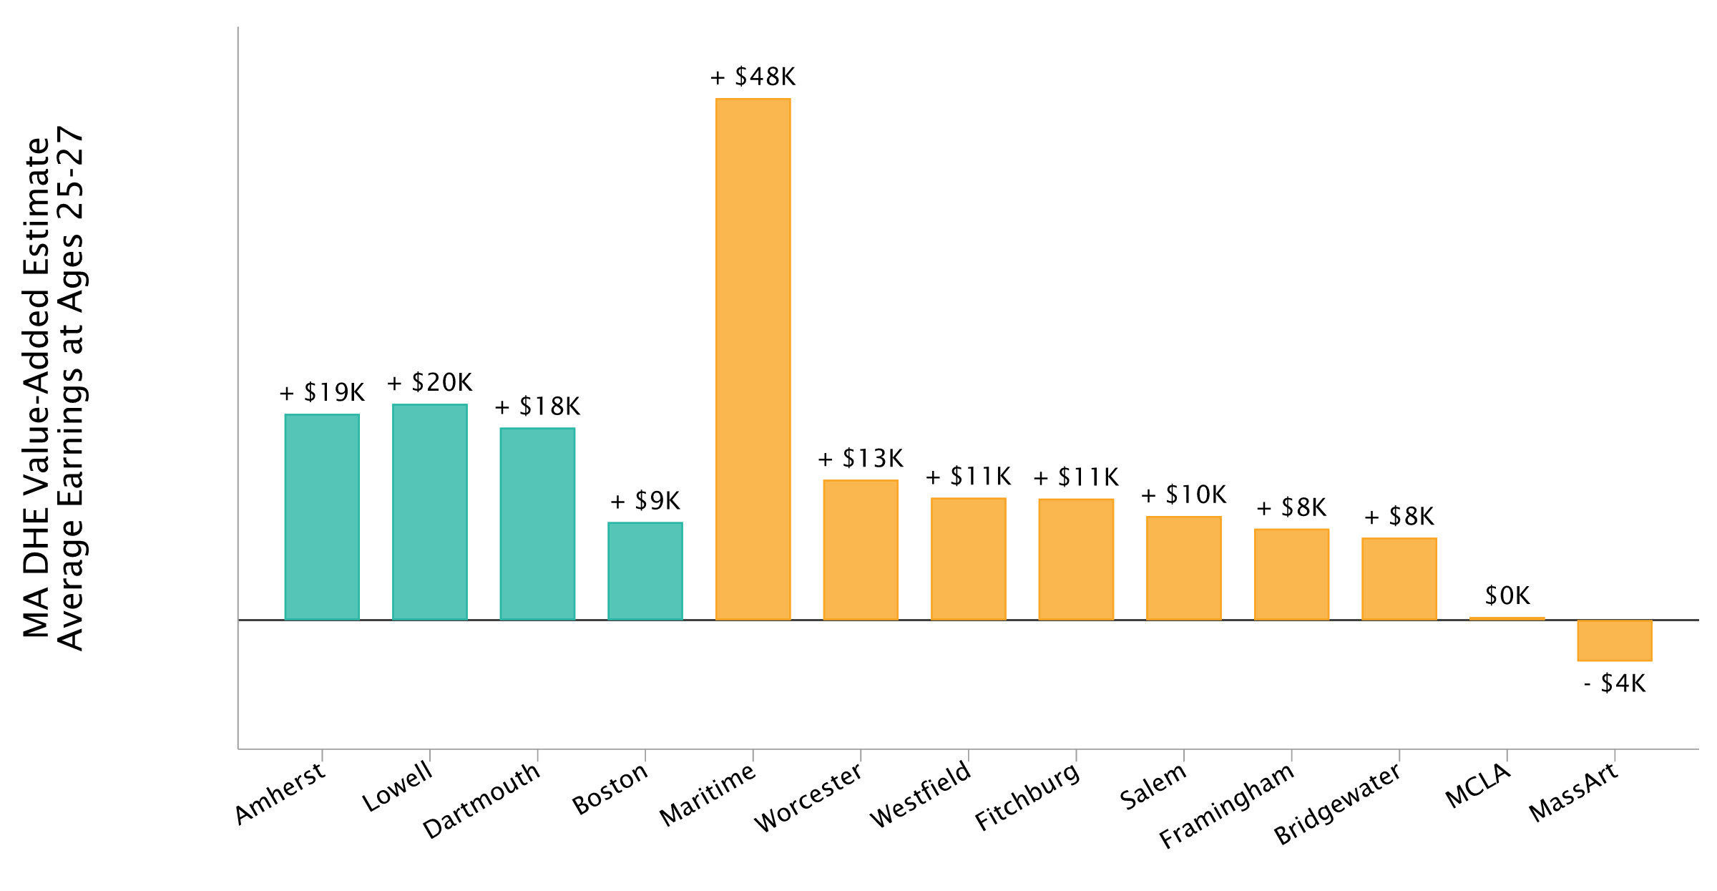
Institution-Level Earnings Relative to Non-Completers
Adjusted Earnings Levels at Ages 25–27

Slide 5

Institution-Level Earnings Relative to Non-Completers
Adjusted Earnings Levels at Ages 25–27

Slide 6
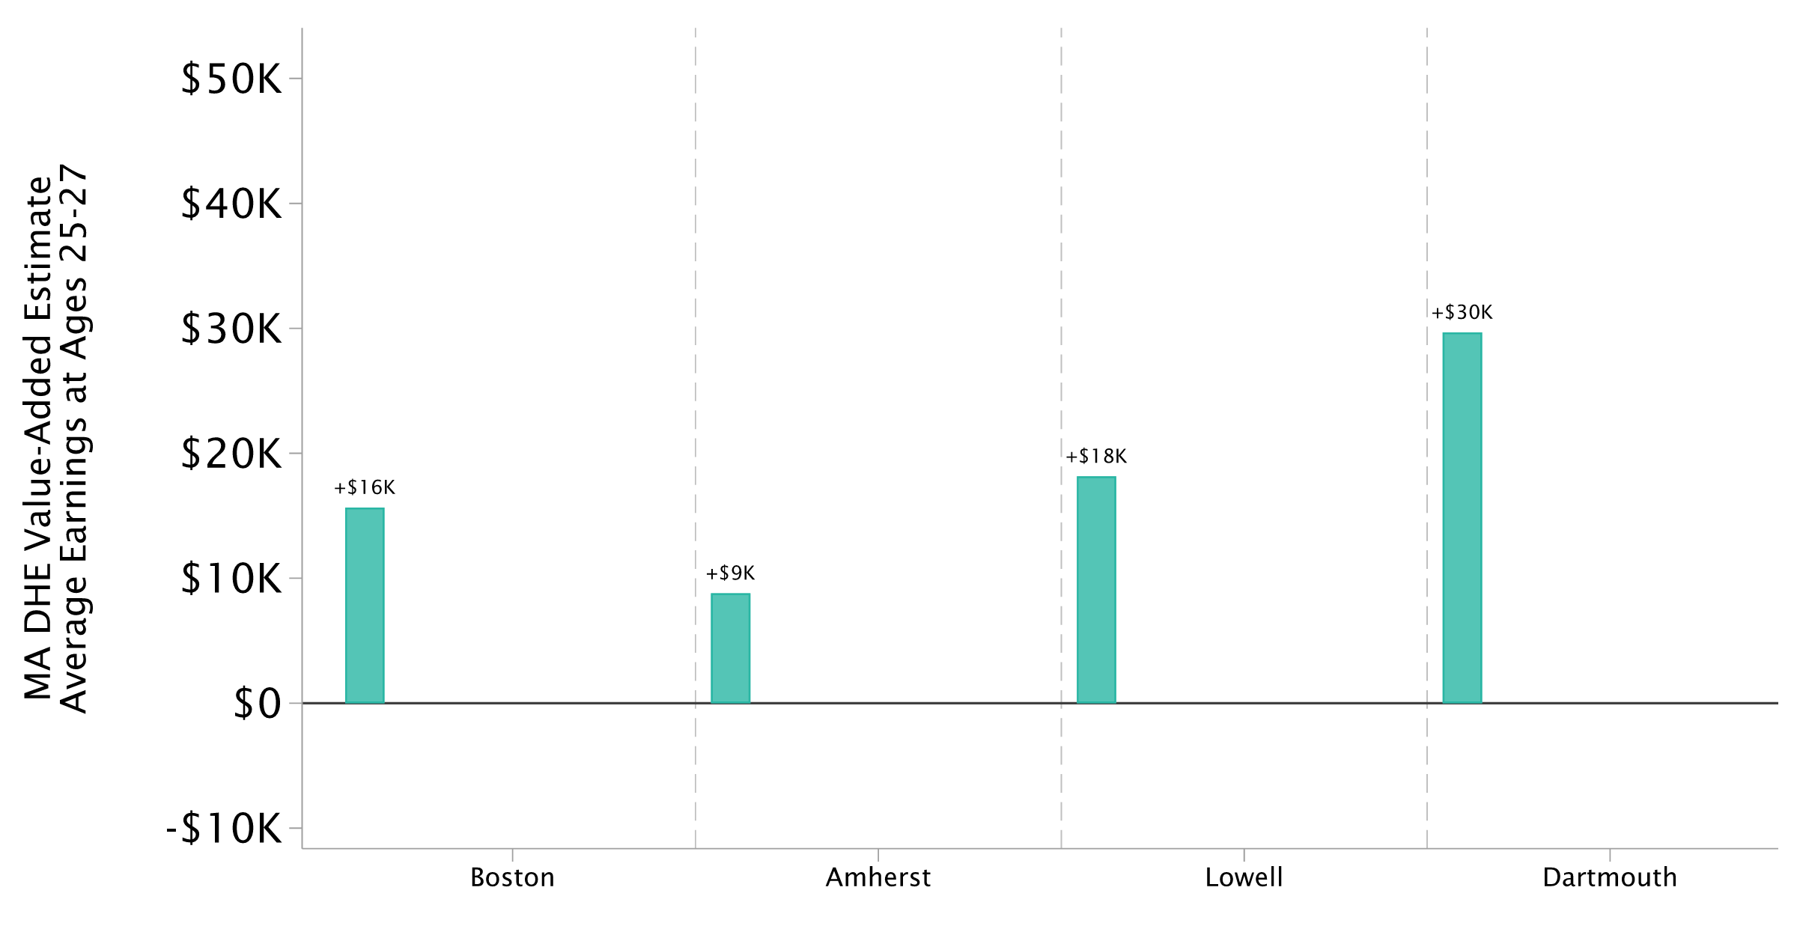
UMass Program-Level VA Relative to Non-Completers
Adjusted Earnings Differences at Ages 25–27

Slide 7
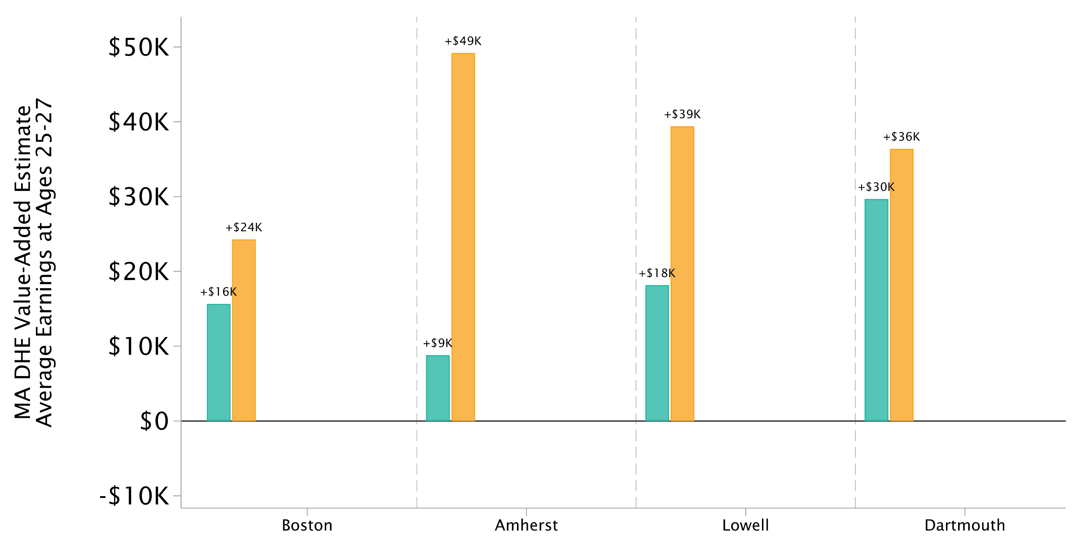
UMass Program-Level VA Relative to Non-Completers
Adjusted Earnings Differences at Ages 25–27

Slide 8
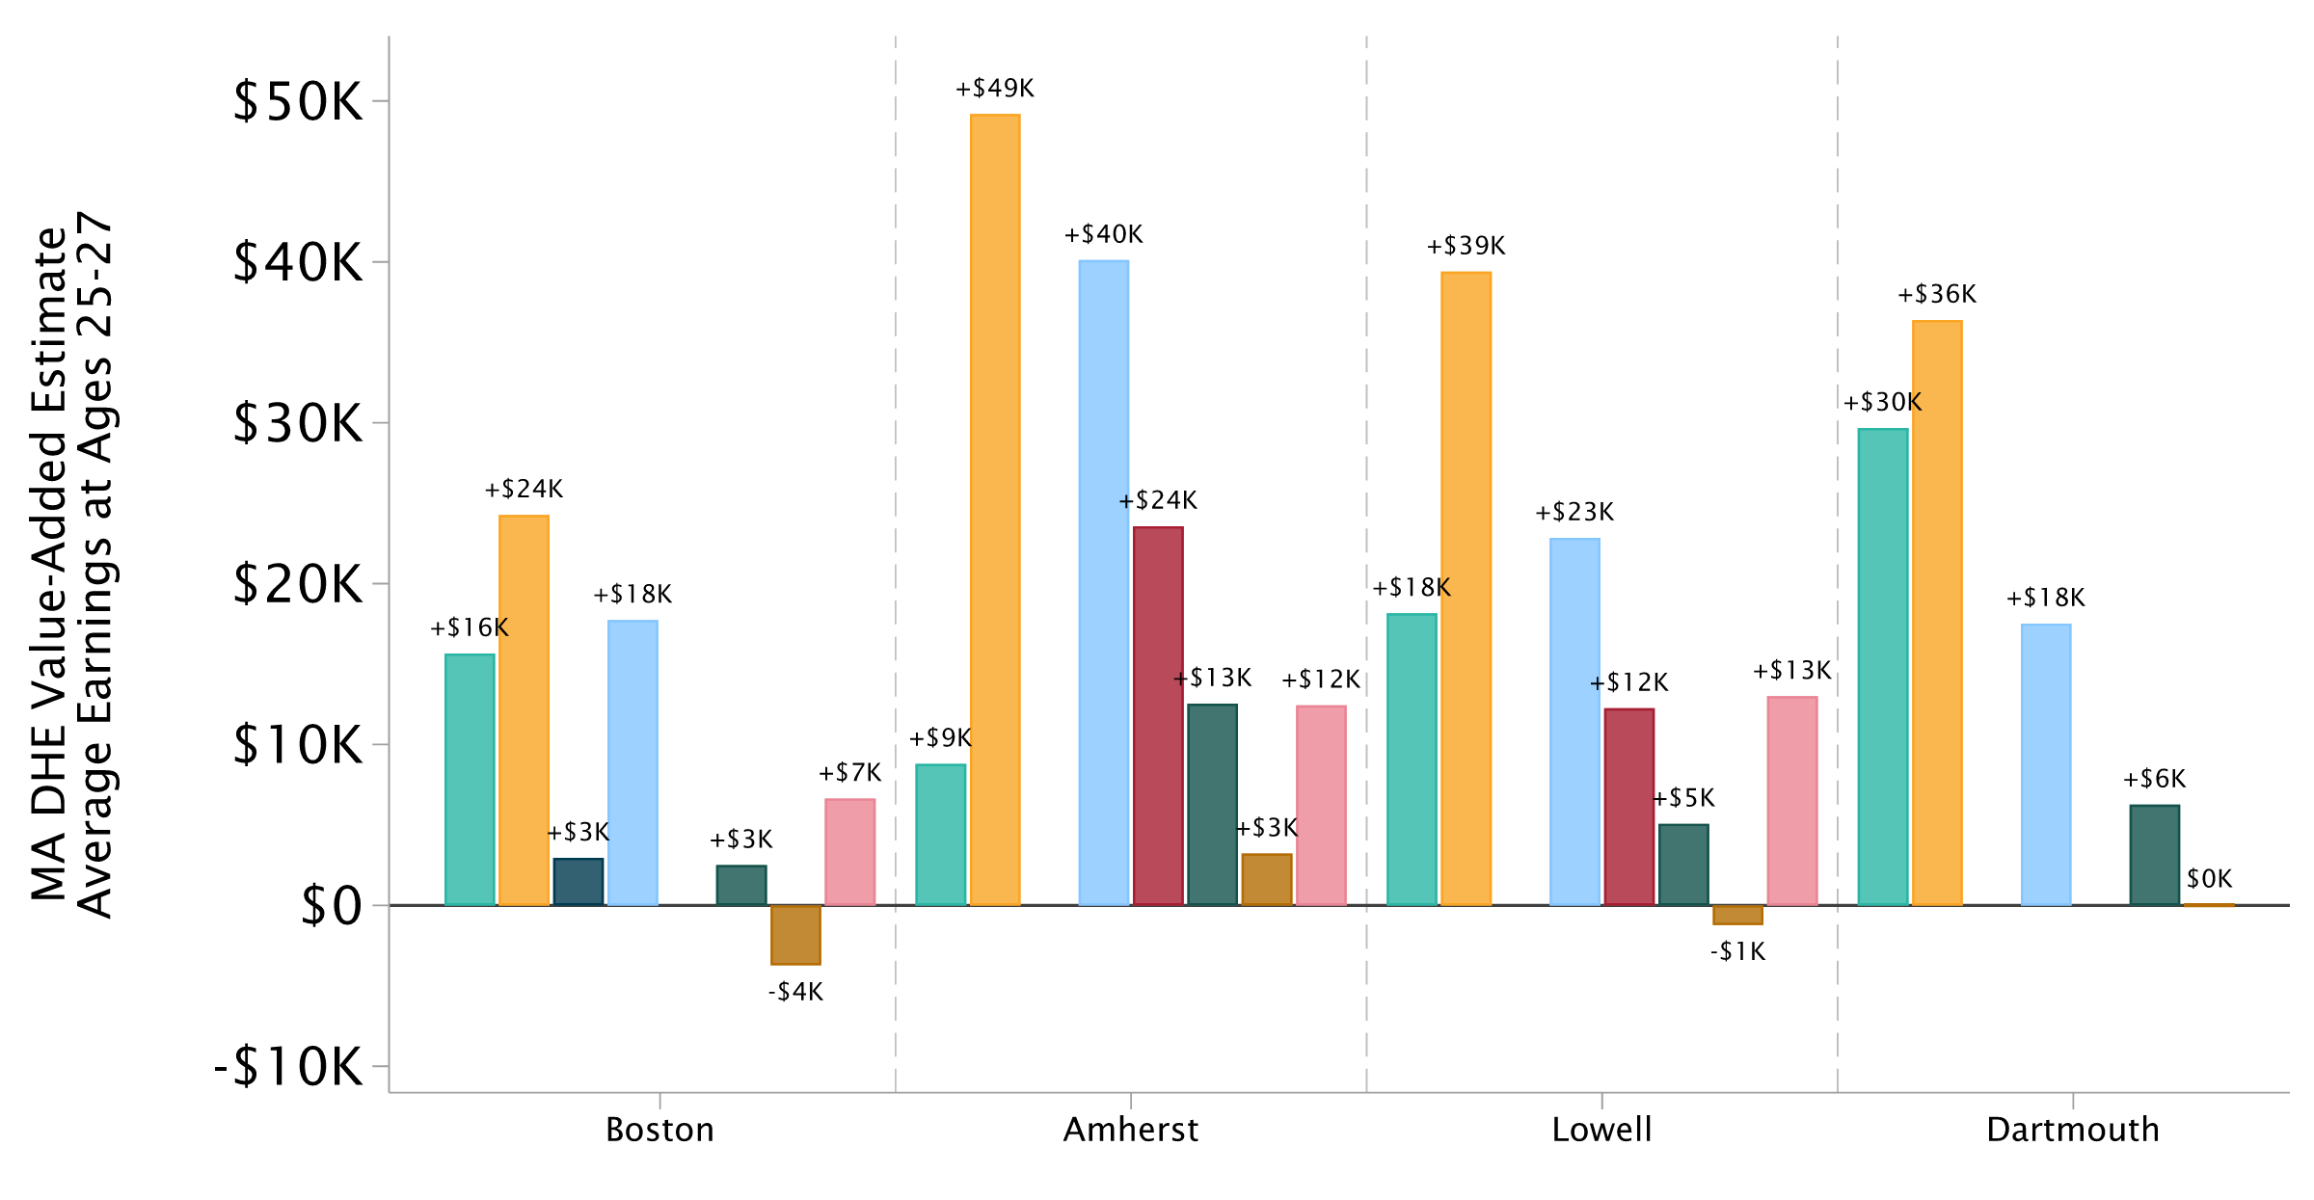
UMass Program-Level VA Relative to Non-Completers
Adjusted Earnings Differences at Ages 25–27

Slide 9
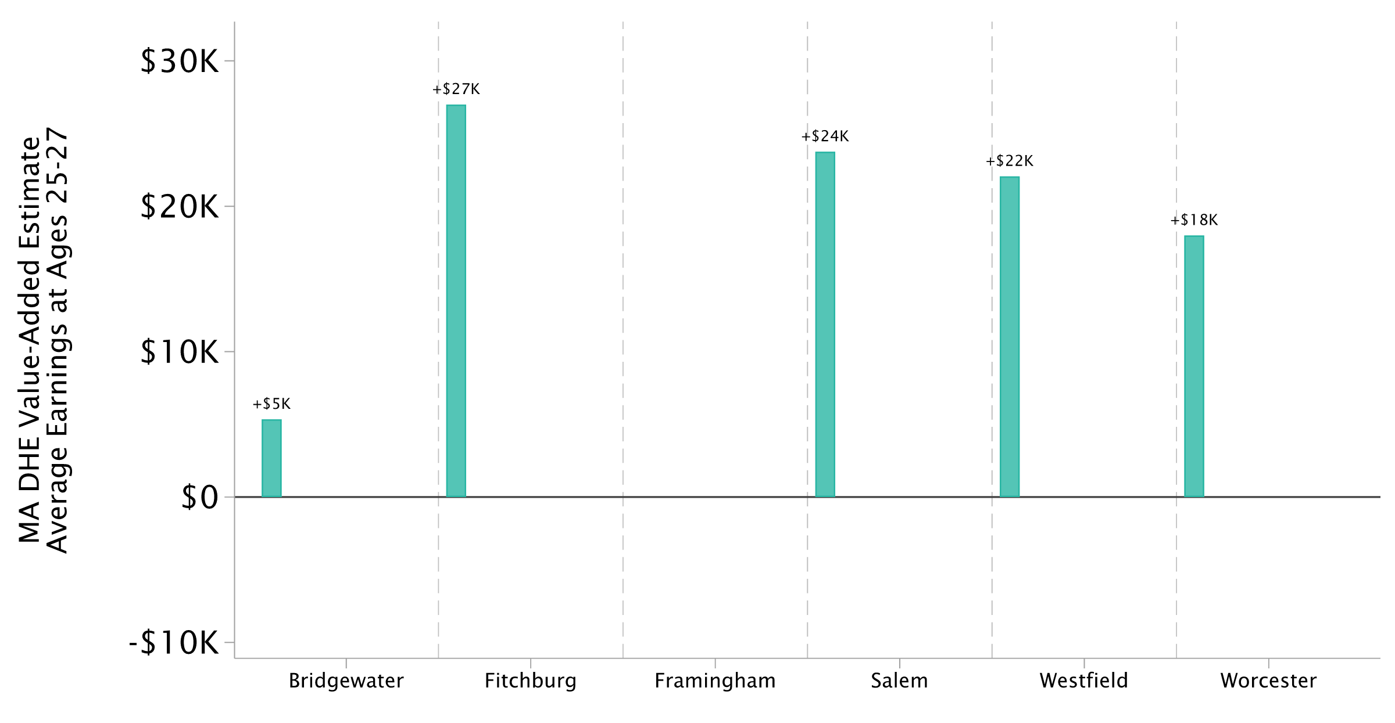
State University Program-Level VA Relative to Non-Completers
Adjusted Earnings Differences at Ages 25–27; Excluding Mass Maritime

Slide 10
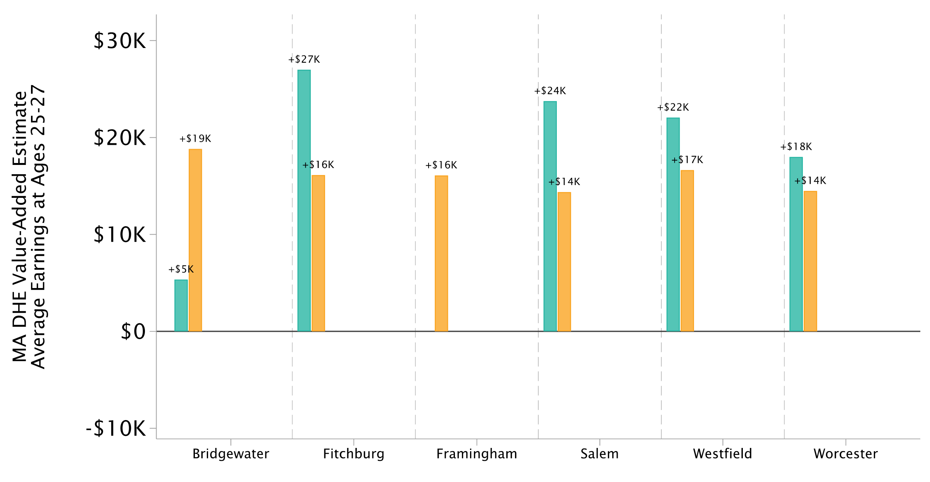
State University Program-Level VA Relative to Non-Completers
Adjusted Earnings Differences at Ages 25–27; Excluding Mass Maritime

Slide 11
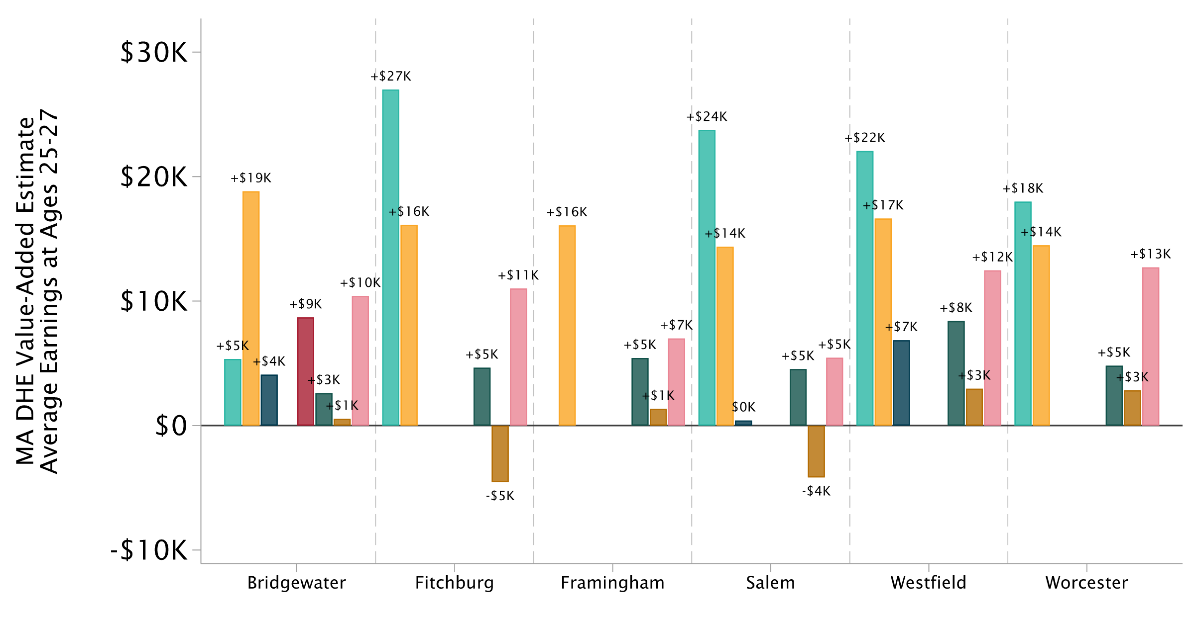
State University Program-Level VA Relative to Non-Completers
Adjusted Earnings Differences at Ages 25–27; Excluding Mass Maritime

Slide 12
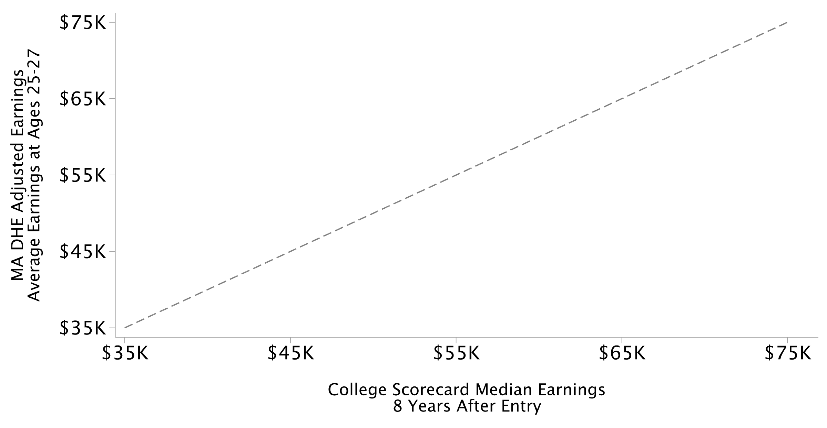
Institution-Level VA Relative to Non-Completers vs. Median Earnings
College Scorecard Median Earnings, 8 Years After Entry; Excluding Mass Maritime

Slide 13
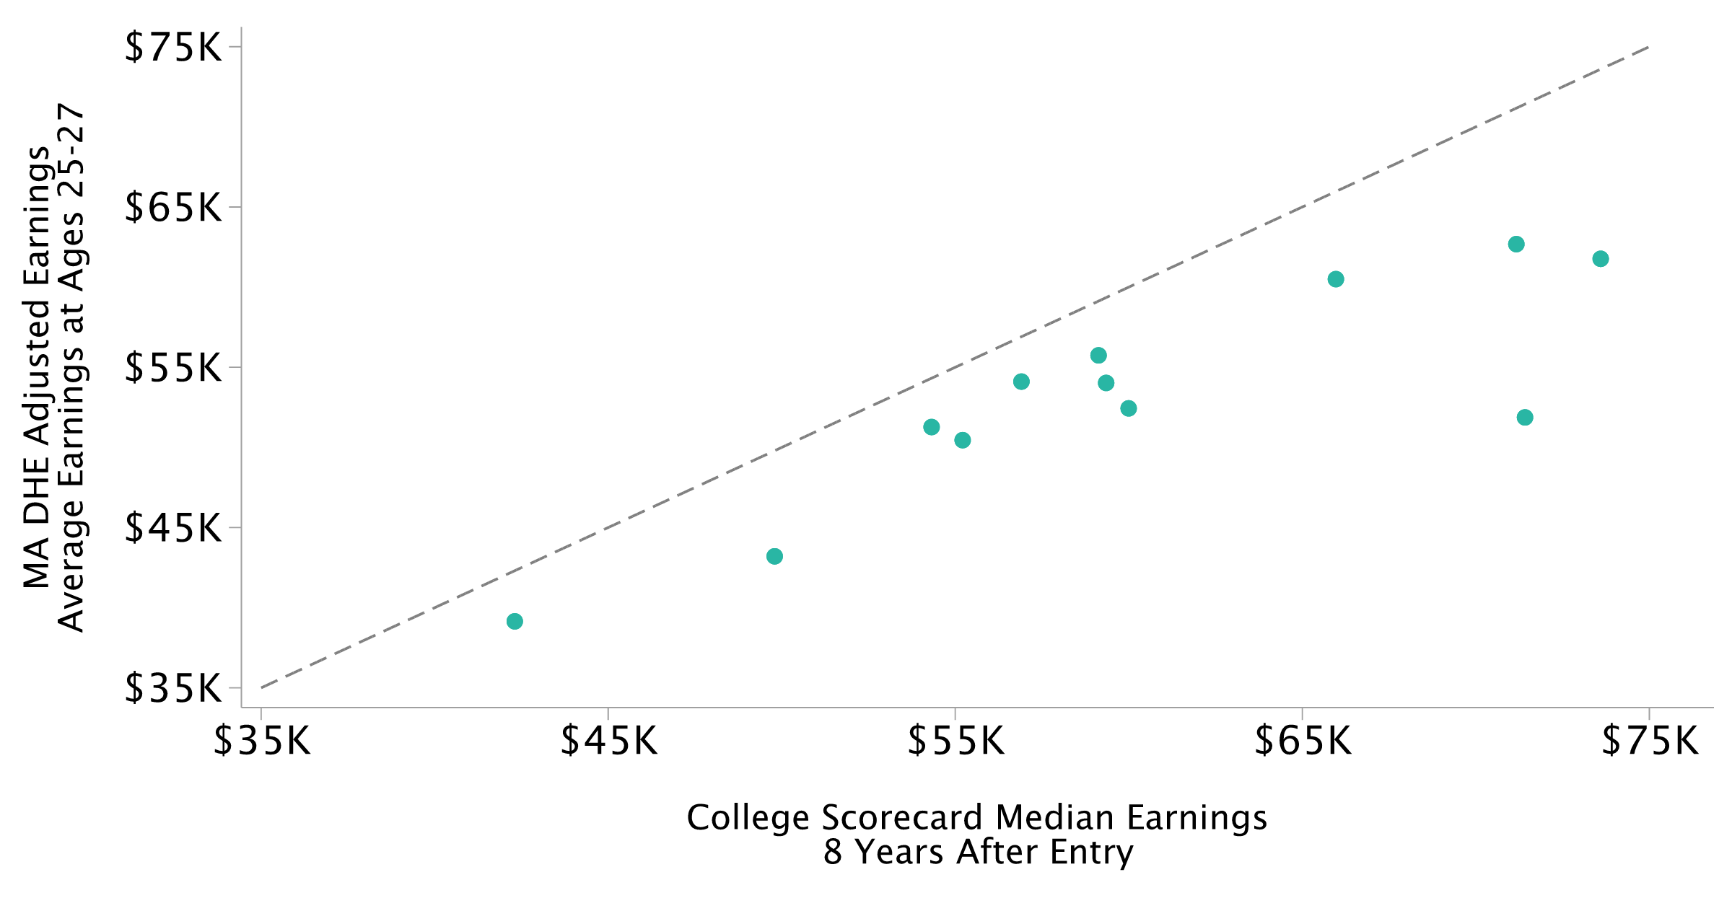
Institution-Level VA Relative to Non-Completers vs. Median Earnings
College Scorecard Median Earnings, 8 Years After Entry; Excluding Mass Maritime

Slide 14
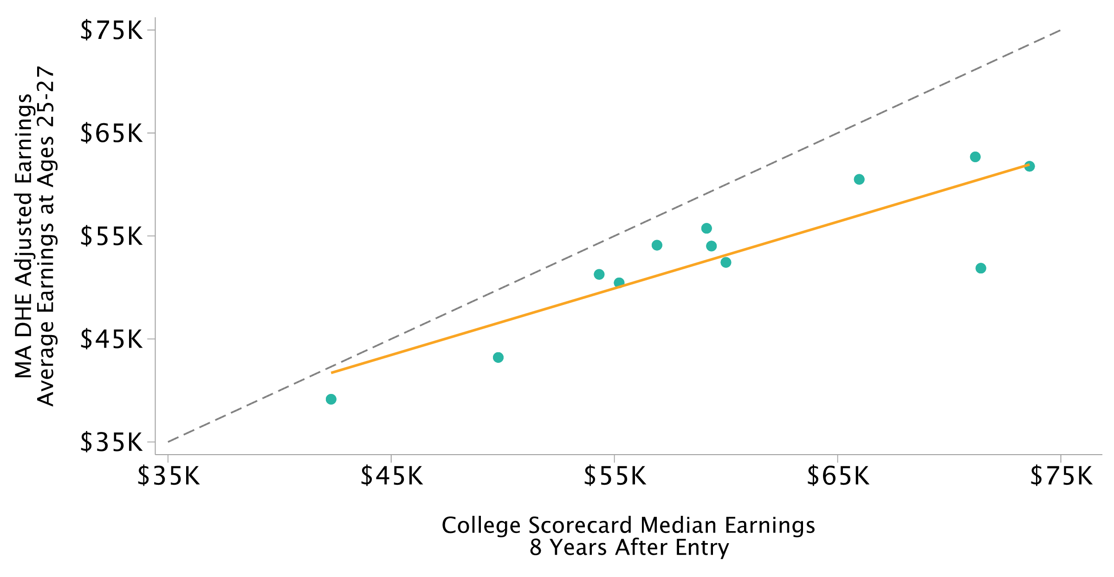
Institution-Level VA Relative to Non-Completers vs. Median Earnings
College Scorecard Median Earnings, 8 Years After Entry; Excluding Mass Maritime

Slide 15
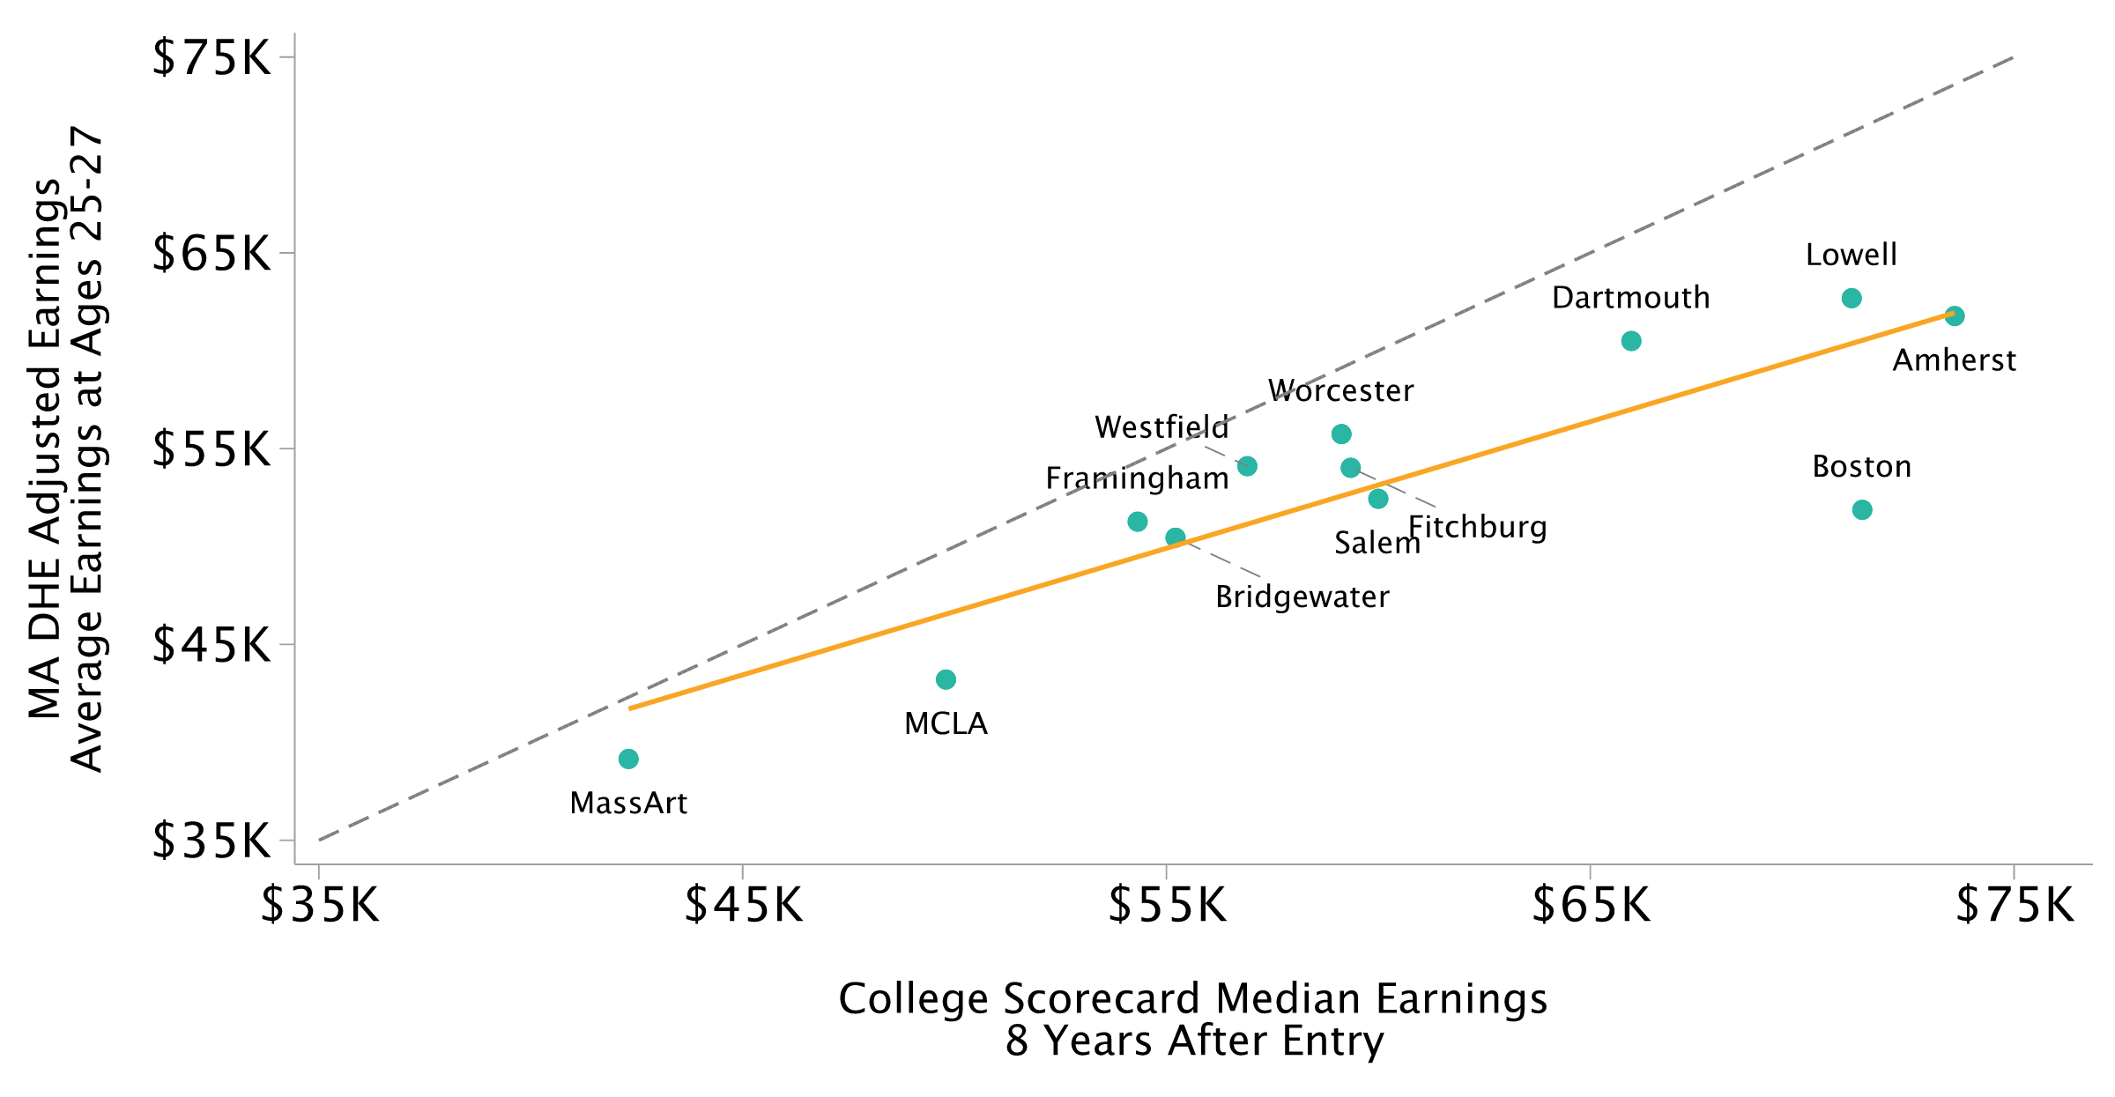
Institution-Level VA Relative to Non-Completers vs. Median Earnings
College Scorecard Median Earnings, 8 Years After Entry; Excluding Mass Maritime

Slide 16
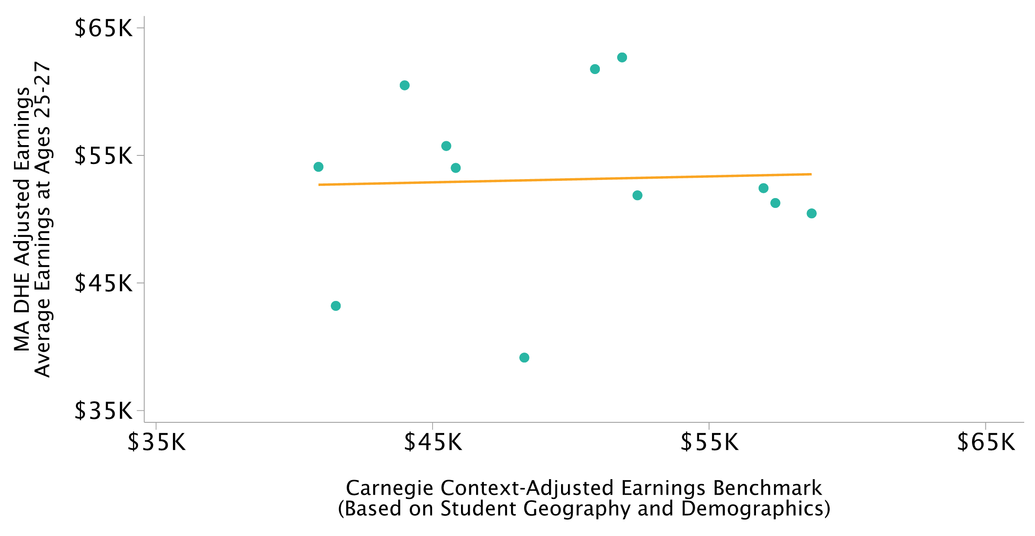
Institution-Level VA Relative to Non-Completers vs. Context-Adjusted Earnings
Carnegie Earnings Benchmark Adjusted for Student Demographics and Geography; Excluding Mass Maritime

Slide 17
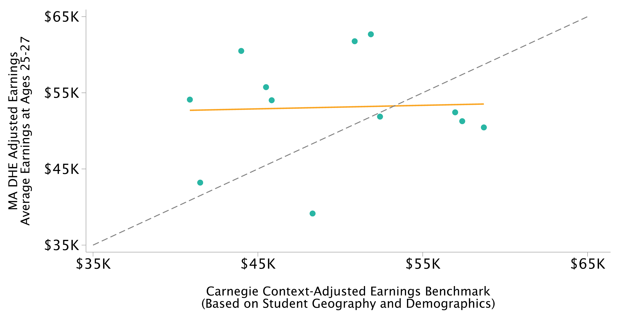
Institution-Level VA Relative to Non-Completers vs. Context-Adjusted Earnings
Carnegie Earnings Benchmark Adjusted for Student Demographics and Geography; Excluding Mass Maritime

Slide 18
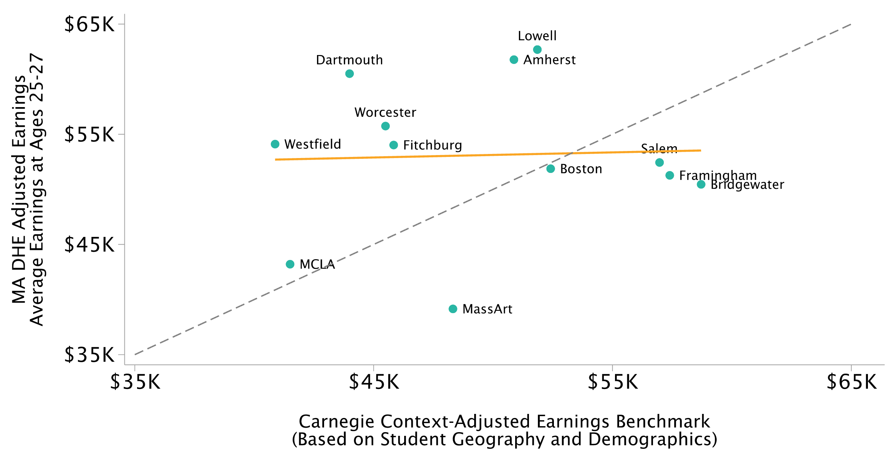
Institution-Level VA Relative to Non-Completers vs. Context-Adjusted Earnings
Carnegie Earnings Benchmark Adjusted for Student Demographics and Geography; Excluding Mass Maritime

Slide 19
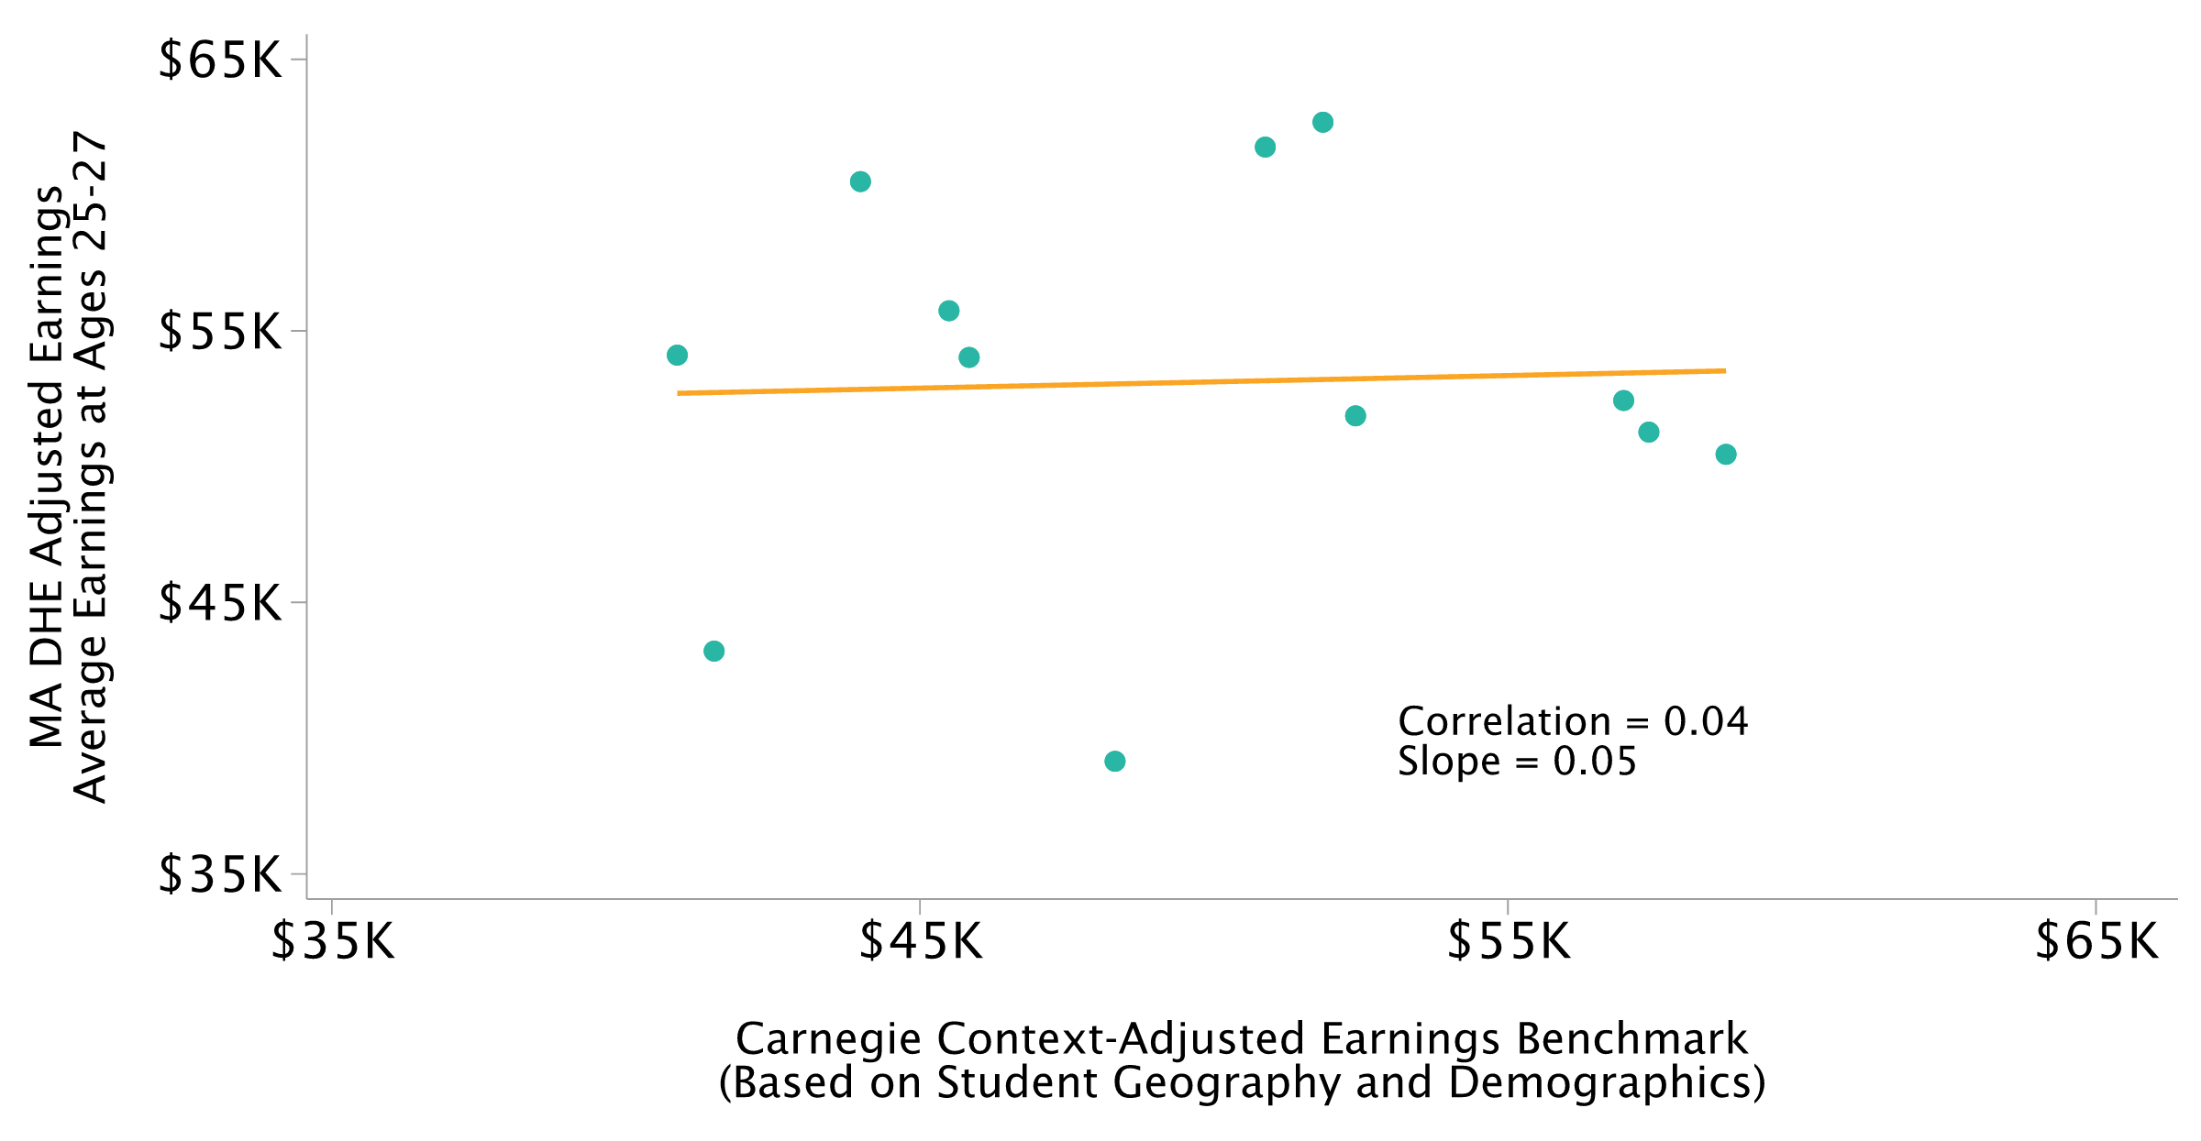
Institution-Level VA Relative to Non-Completers vs. Context-Adjusted Earnings
Carnegie Earnings Benchmark Adjusted for Student Demographics and Geography; Excluding Mass Maritime

Slide 20
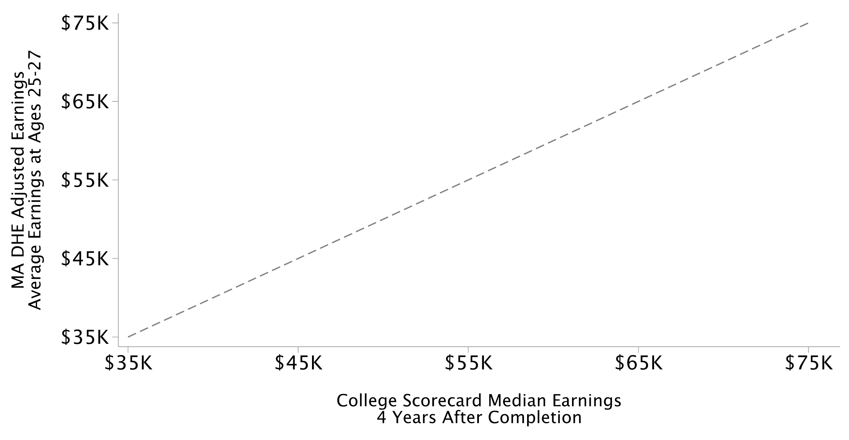
Program-Level VA Relative to Non-Completers vs. Median Earnings
College Scorecard Median Earnings, 4 Years After Completion; One Point per Institution-Field Program; Excluding Mass Maritime

Slide 21
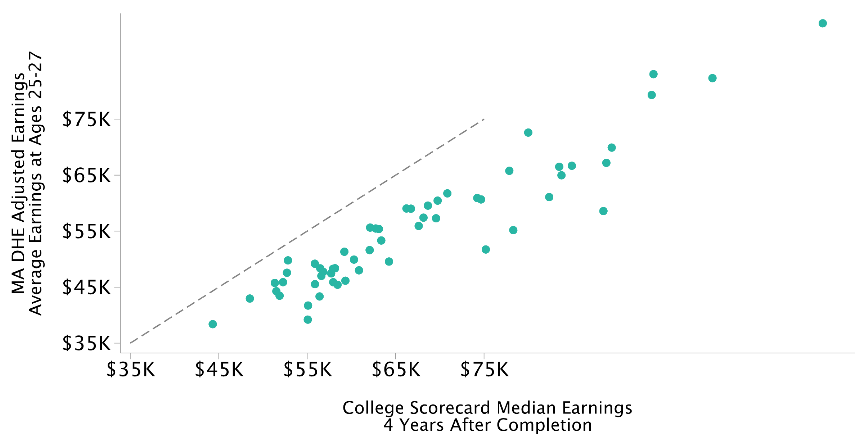
Program-Level VA Relative to Non-Completers vs. Median Earnings
College Scorecard Median Earnings, 4 Years After Completion; One Point per Institution-Field Program; Excluding Mass Maritime

Slide 22
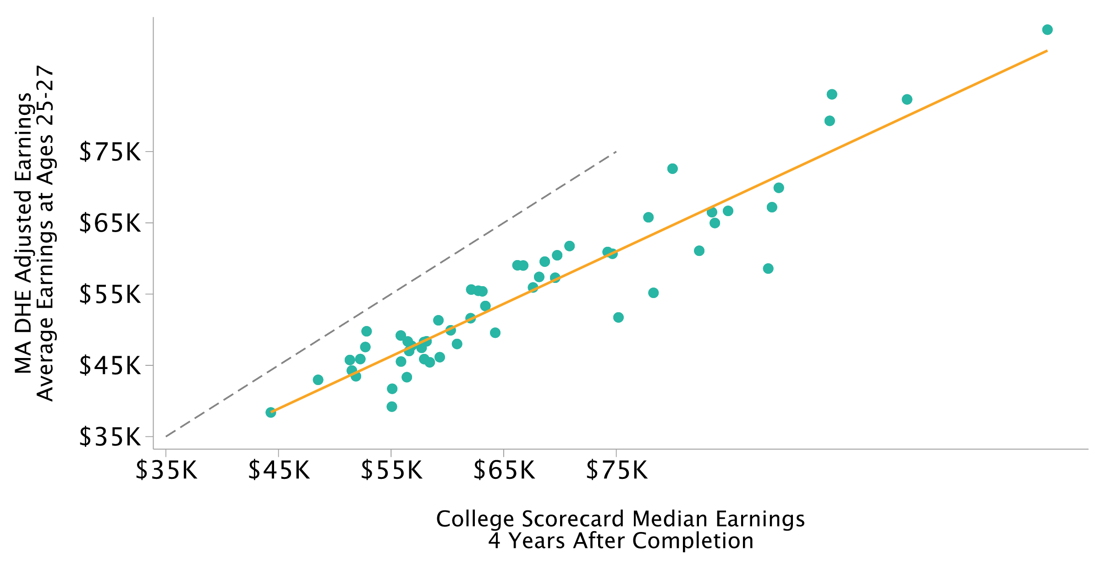
Program-Level VA Relative to Non-Completers vs. Median Earnings
College Scorecard Median Earnings, 4 Years After Completion; One Point per Institution-Field Program; Excluding Mass Maritime

Slide 23
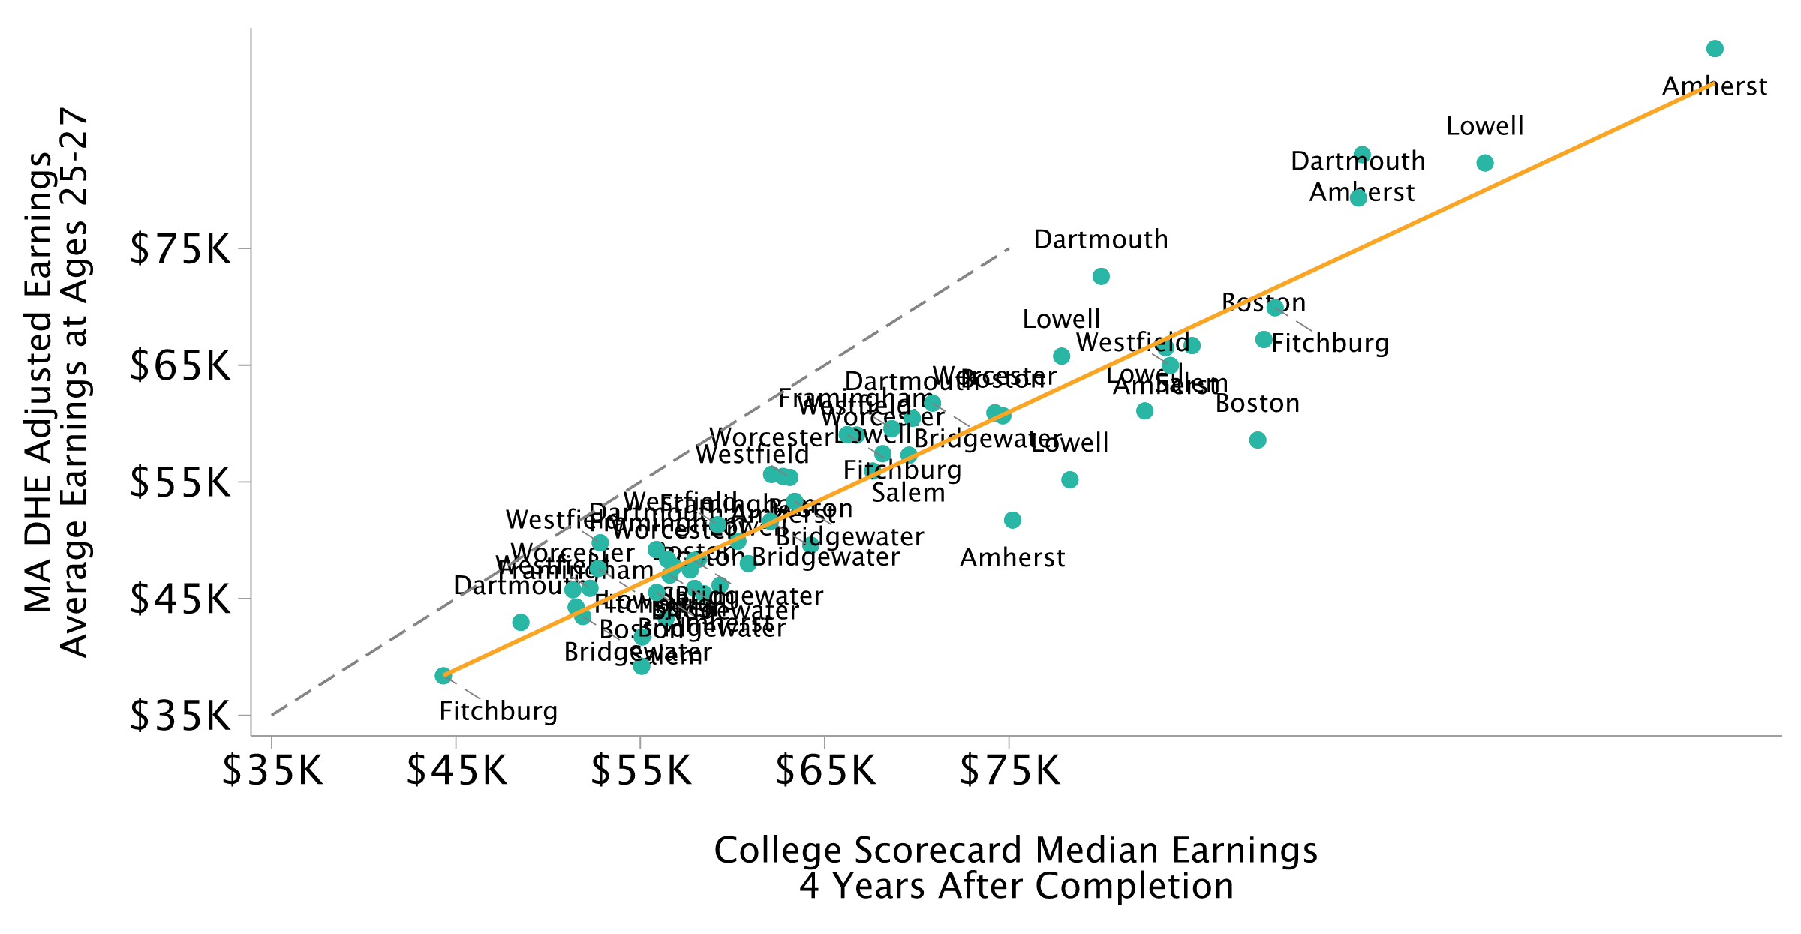
Program-Level VA Relative to Non-Completers vs. Median Earnings
College Scorecard Median Earnings, 4 Years After Completion; One Point per Institution-Field Program; Excluding Mass Maritime

Slide 24
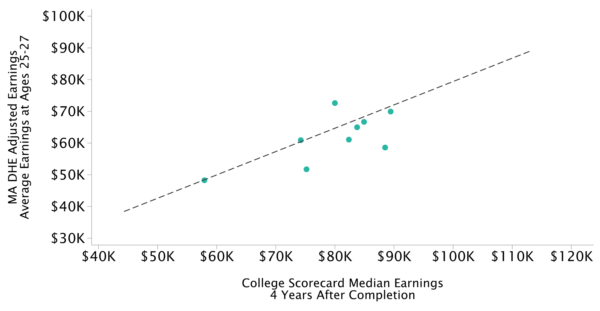
Program-Level VA Relative to Non-Completers vs. Median Earnings
College Scorecard Median Earnings, 4 Years After Completion; Adding Health

Slide 25
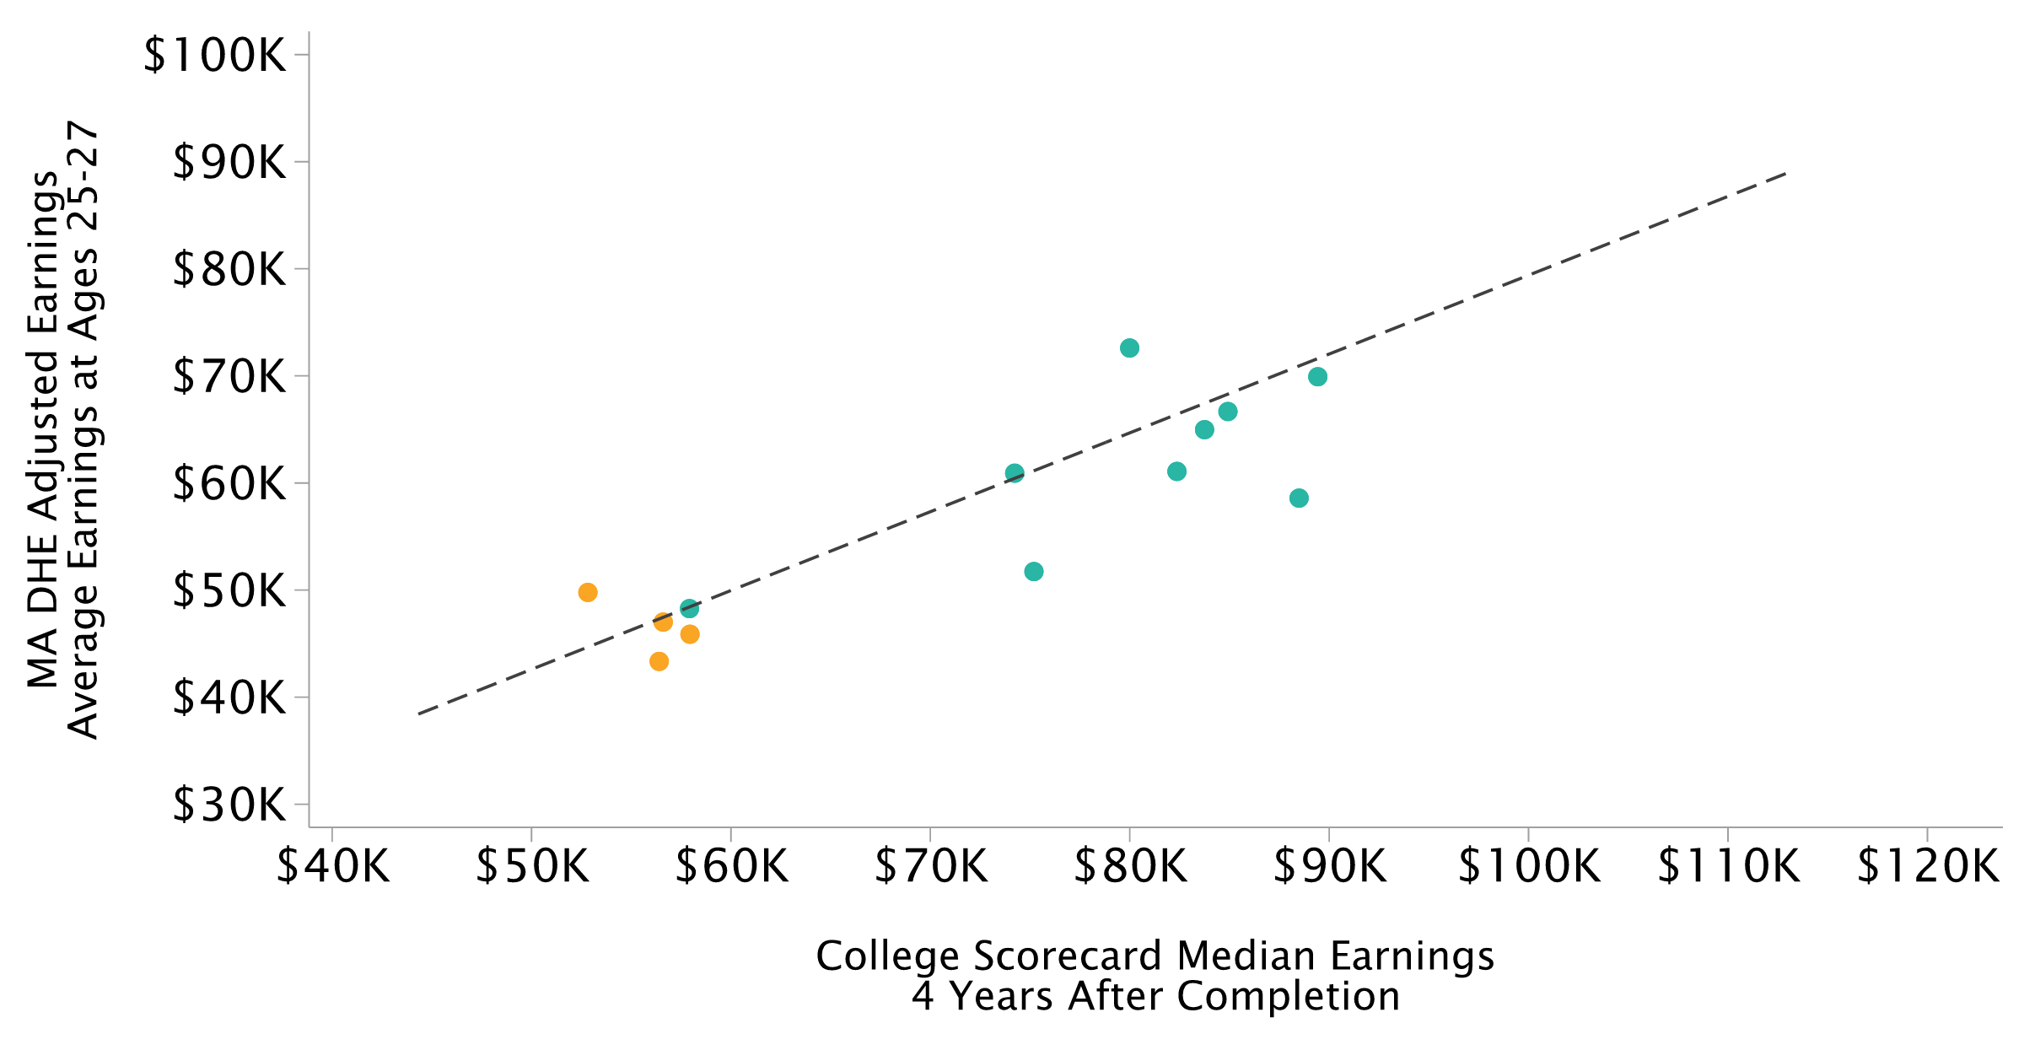
Program-Level VA Relative to Non-Completers vs. Median Earnings
College Scorecard Median Earnings, 4 Years After Completion; Adding Education

Slide 26

Program-Level VA Relative to Non-Completers vs. Median Earnings
College Scorecard Median Earnings, 4 Years After Completion; Adding CS & Engineering

Slide 27
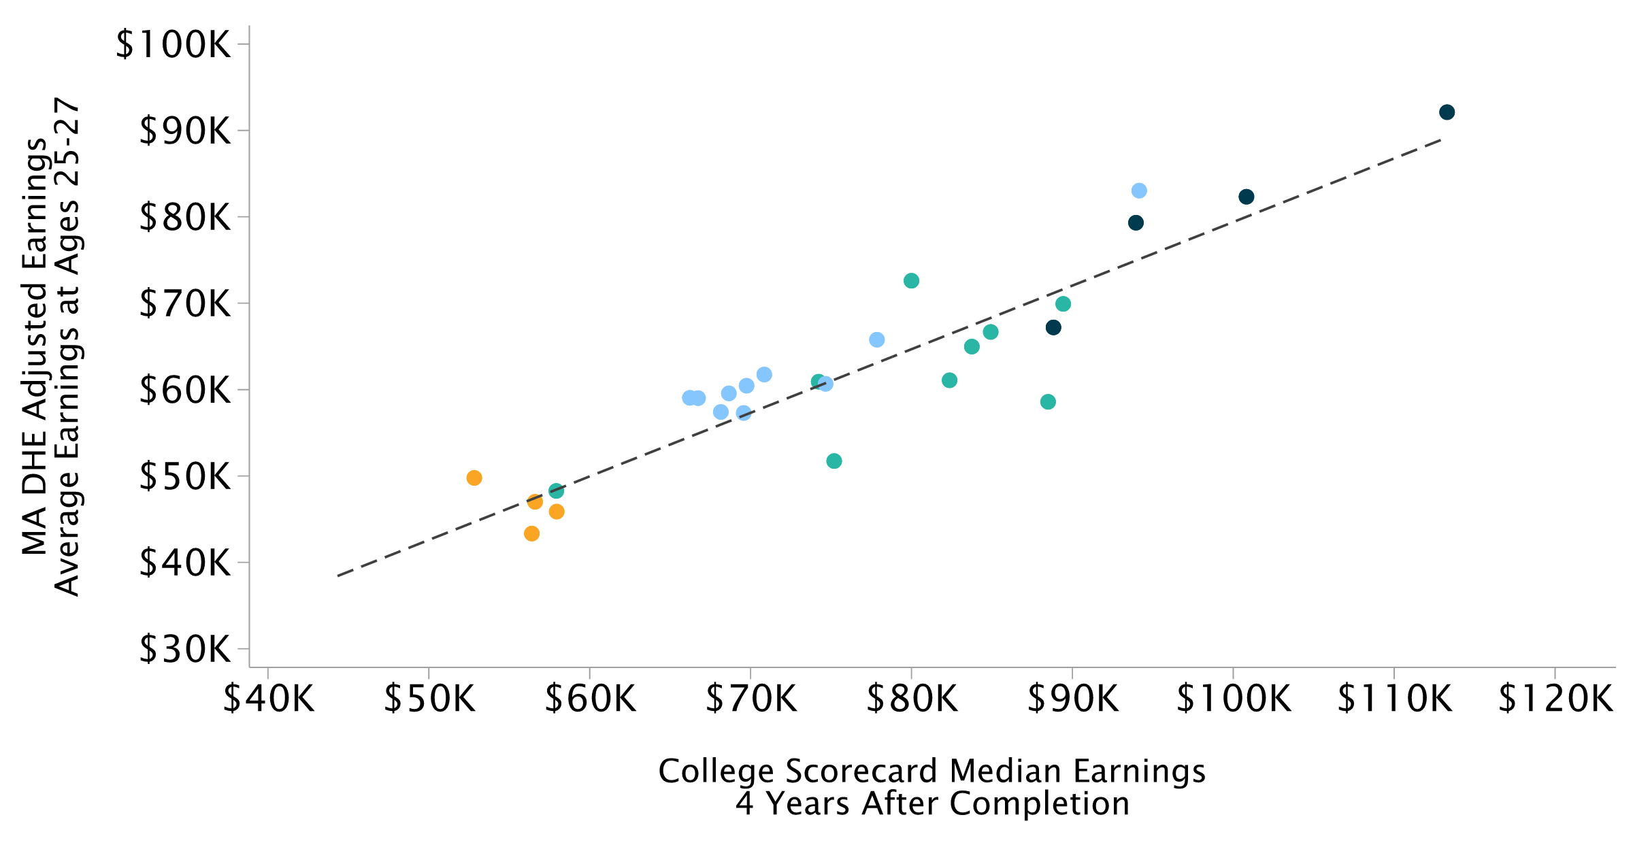
Program-Level VA Relative to Non-Completers vs. Median Earnings
College Scorecard Median Earnings, 4 Years After Completion; Adding Business

Slide 28

Program-Level VA Relative to Non-Completers vs. Median Earnings
College Scorecard Median Earnings, 4 Years After Completion; Adding Science & Math

Slide 29
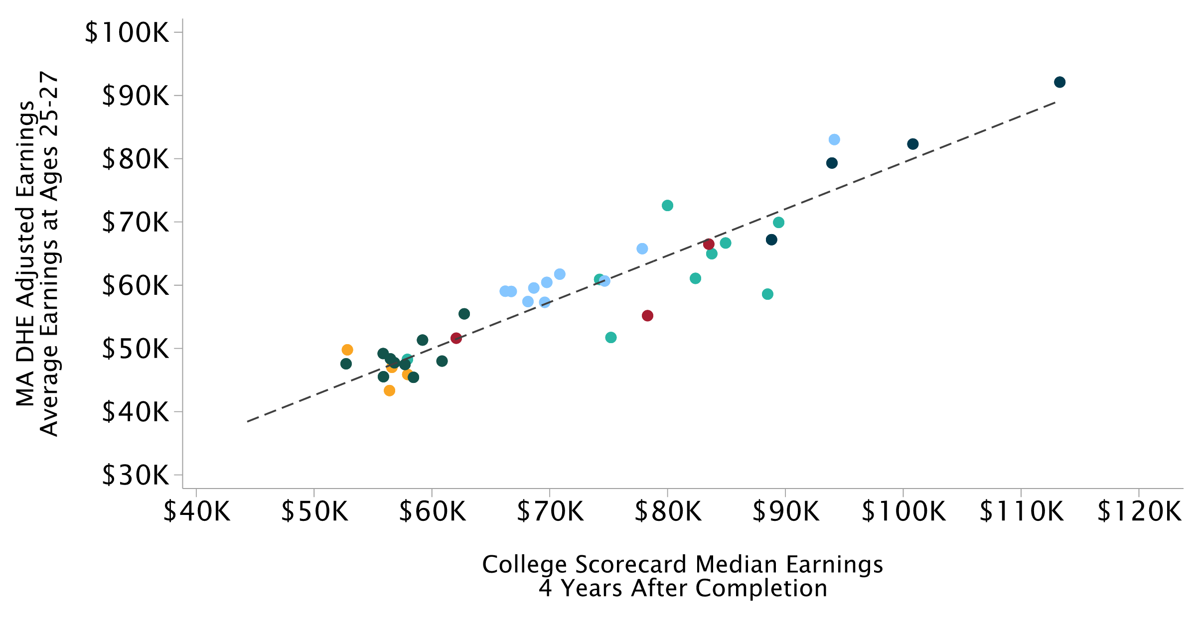
Program-Level VA Relative to Non-Completers vs. Median Earnings
College Scorecard Median Earnings, 4 Years After Completion; Adding Social Sciences

Slide 30
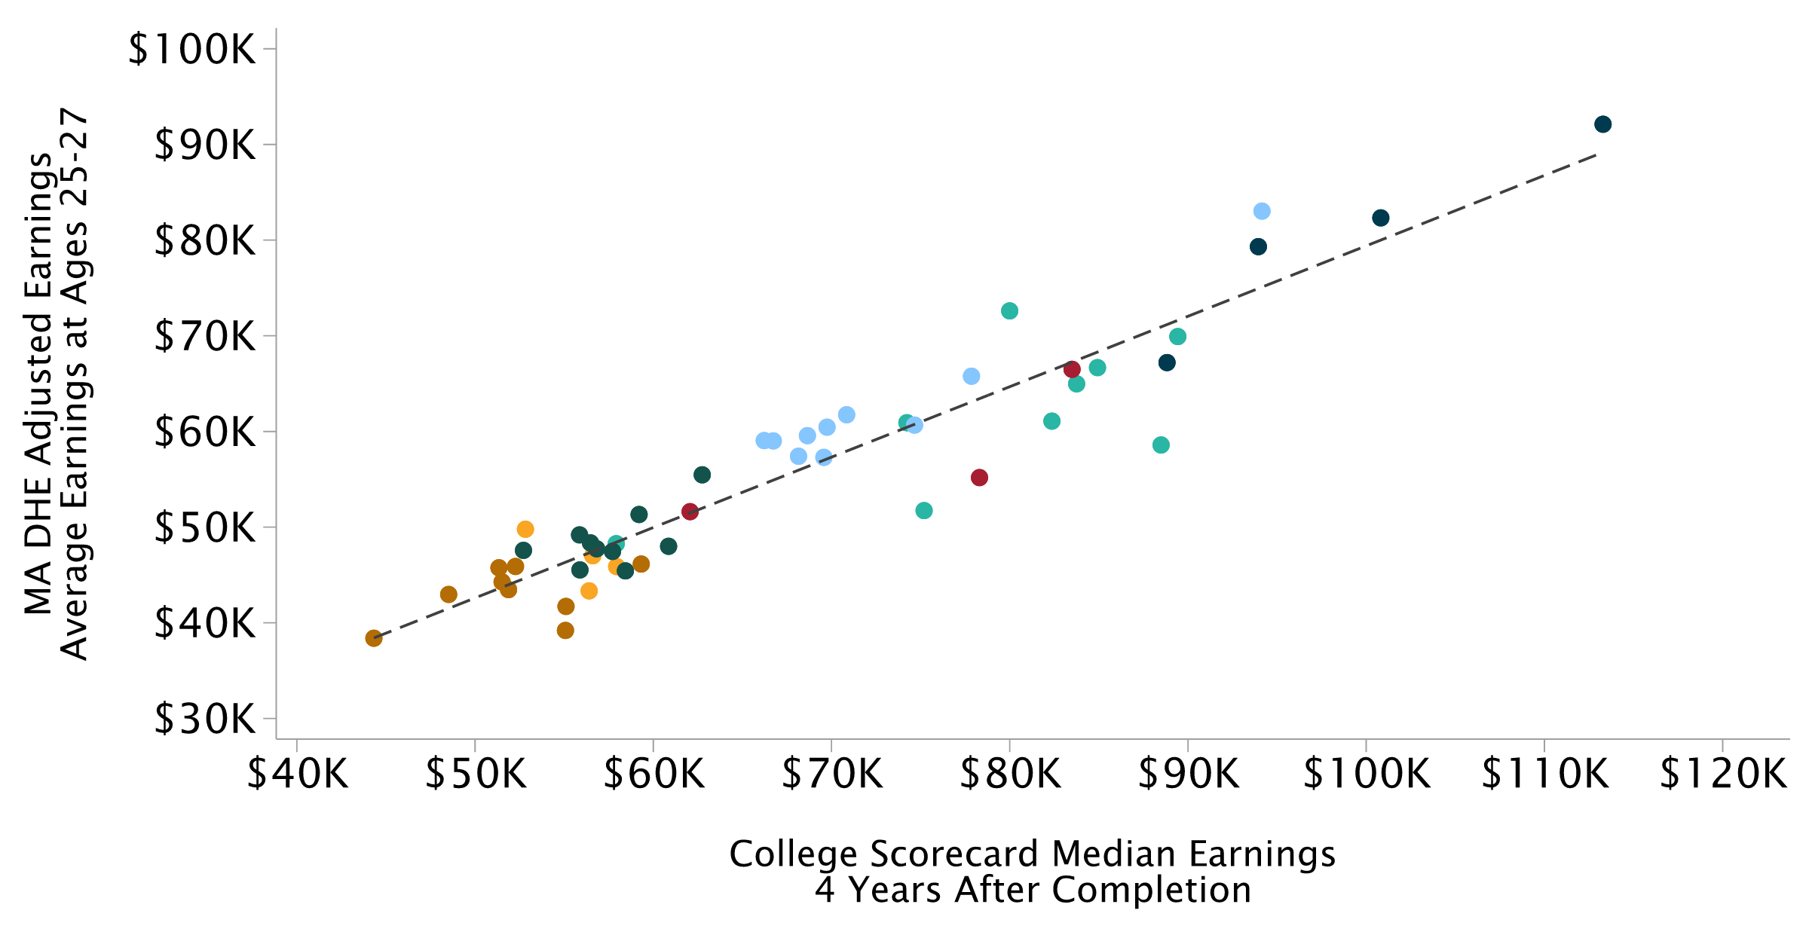
Program-Level VA Relative to Non-Completers vs. Median Earnings
College Scorecard Median Earnings, 4 Years After Completion; Adding Arts & Humanities

Slide 31
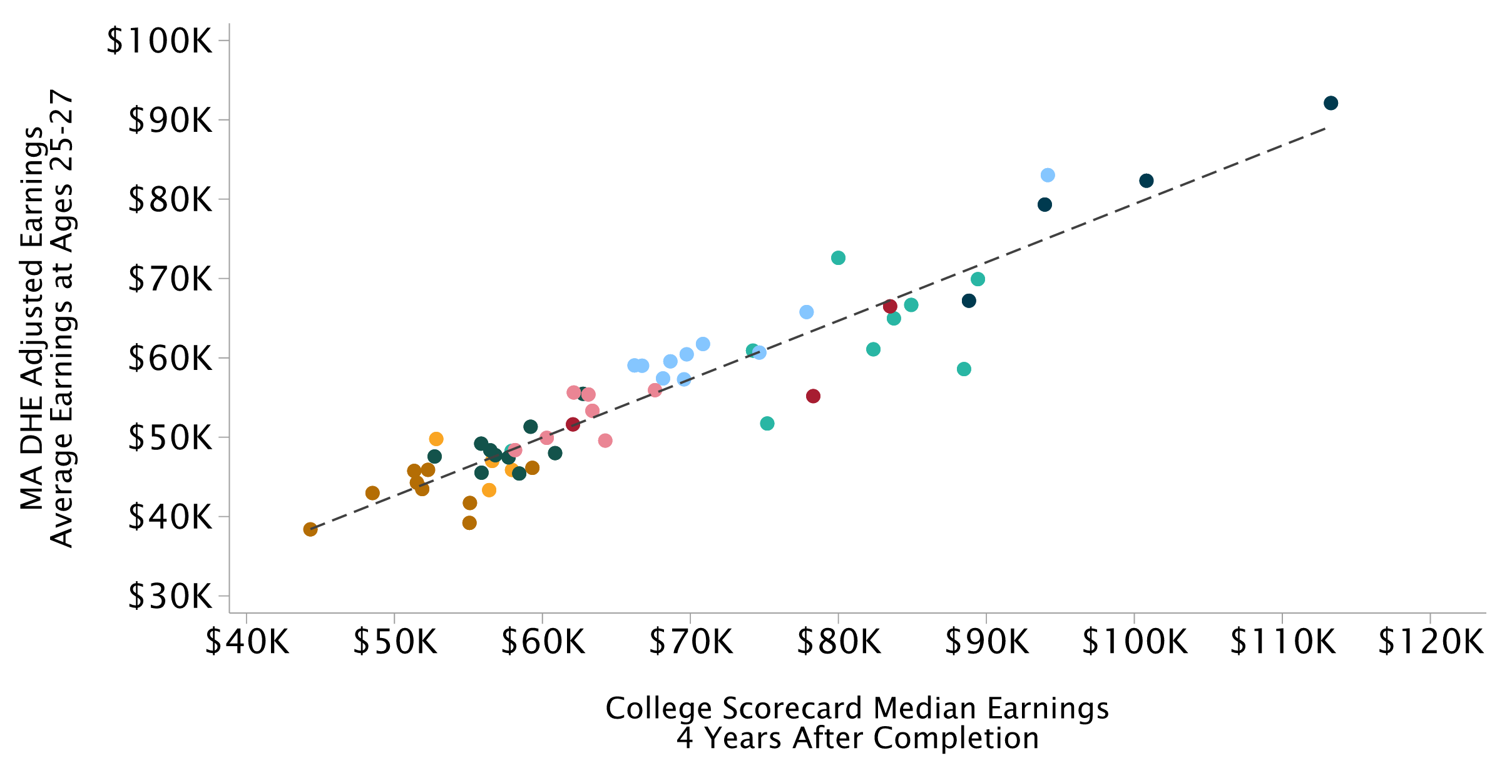
Program-Level VA Relative to Non-Completers vs. Median Earnings
College Scorecard Median Earnings, 4 Years After Completion; Adding Other

Slide 32
Program-Level VA Relative to Non-Completers vs. Median Earnings
College Scorecard Median Earnings, 4 Years After Completion; All Fields

Slide 33
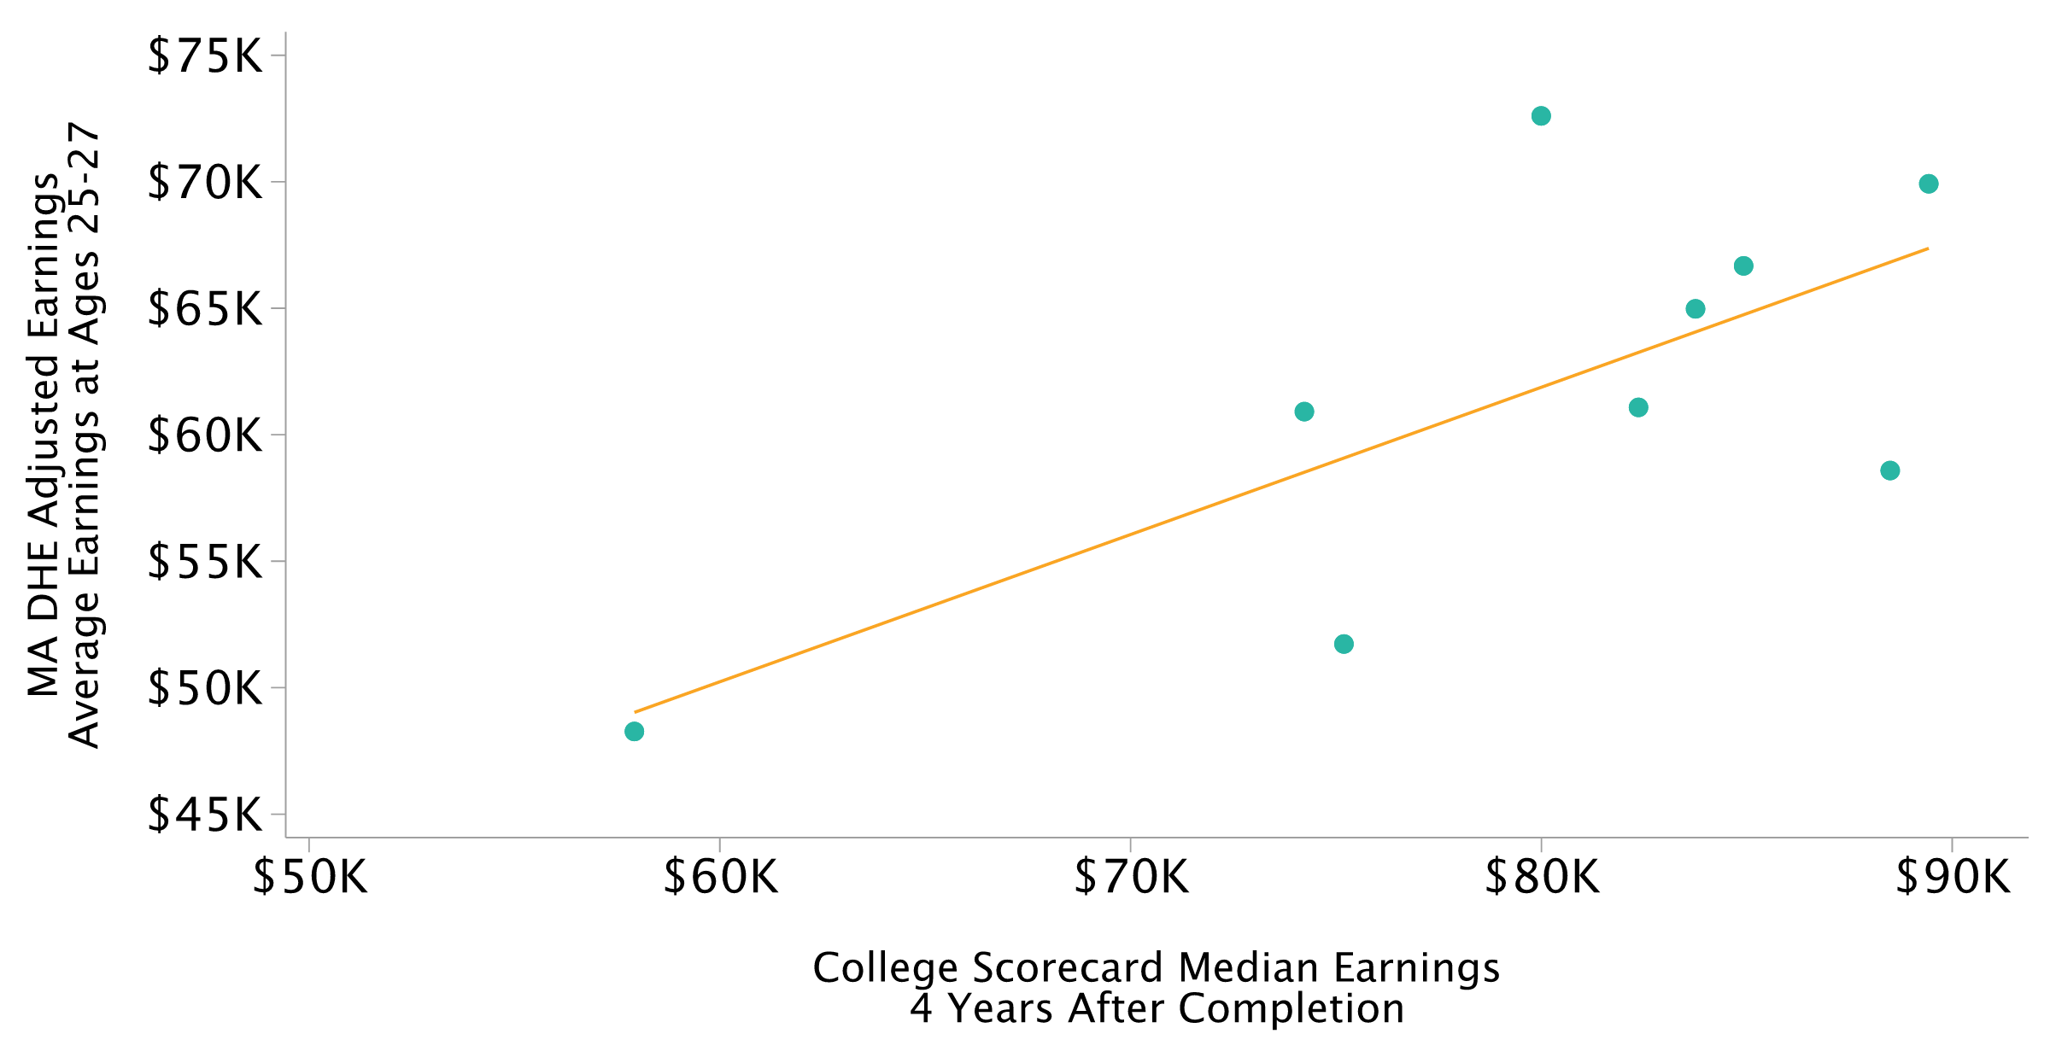
Zooming In on Health Programs
College Scorecard Median Earnings, 4 Years After Completion; Excluding Mass Maritime

Slide 34
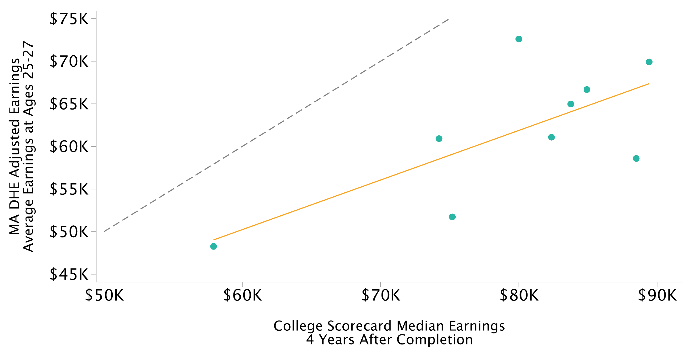
Zooming In on Health Programs
College Scorecard Median Earnings, 4 Years After Completion; Excluding Mass Maritime

Slide 35
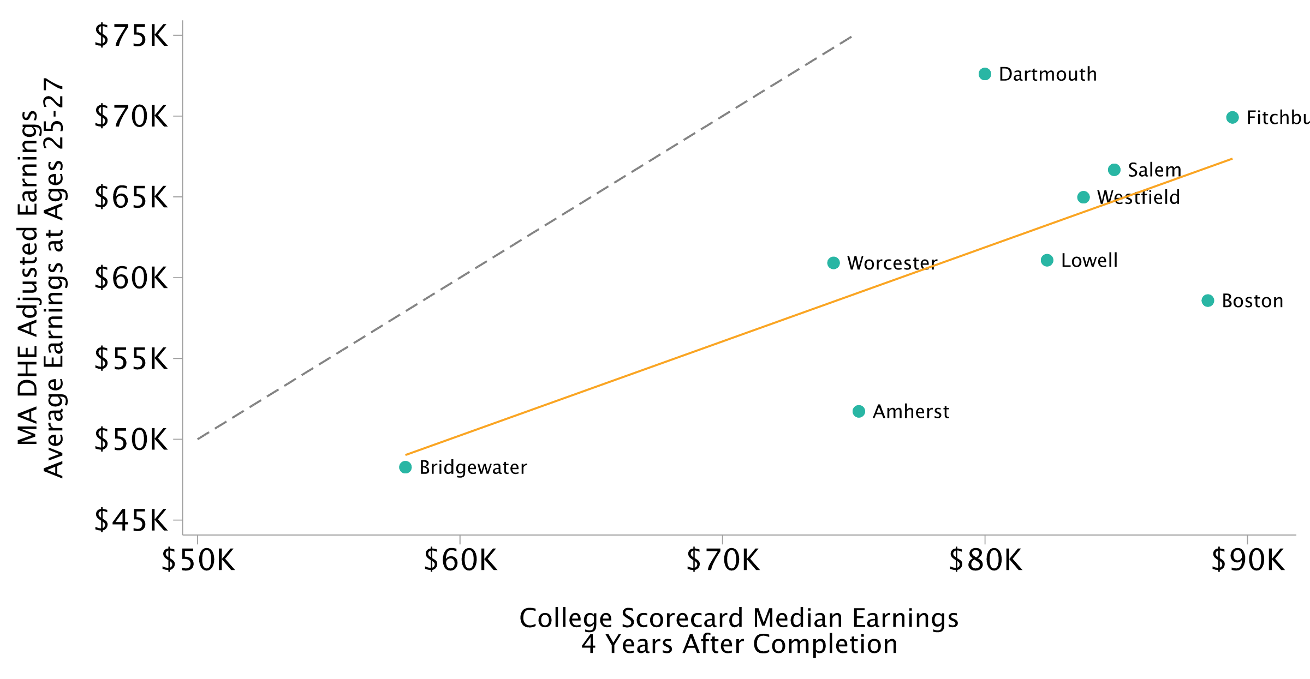
Zooming In on Health Programs
College Scorecard Median Earnings, 4 Years After Completion; Excluding Mass Maritime

Slide 36
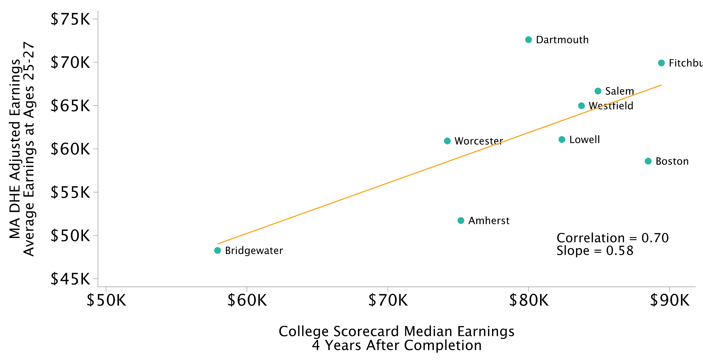
Zooming In on Health Programs
College Scorecard Median Earnings, 4 Years After Completion; Excluding Mass Maritime

Slide 37
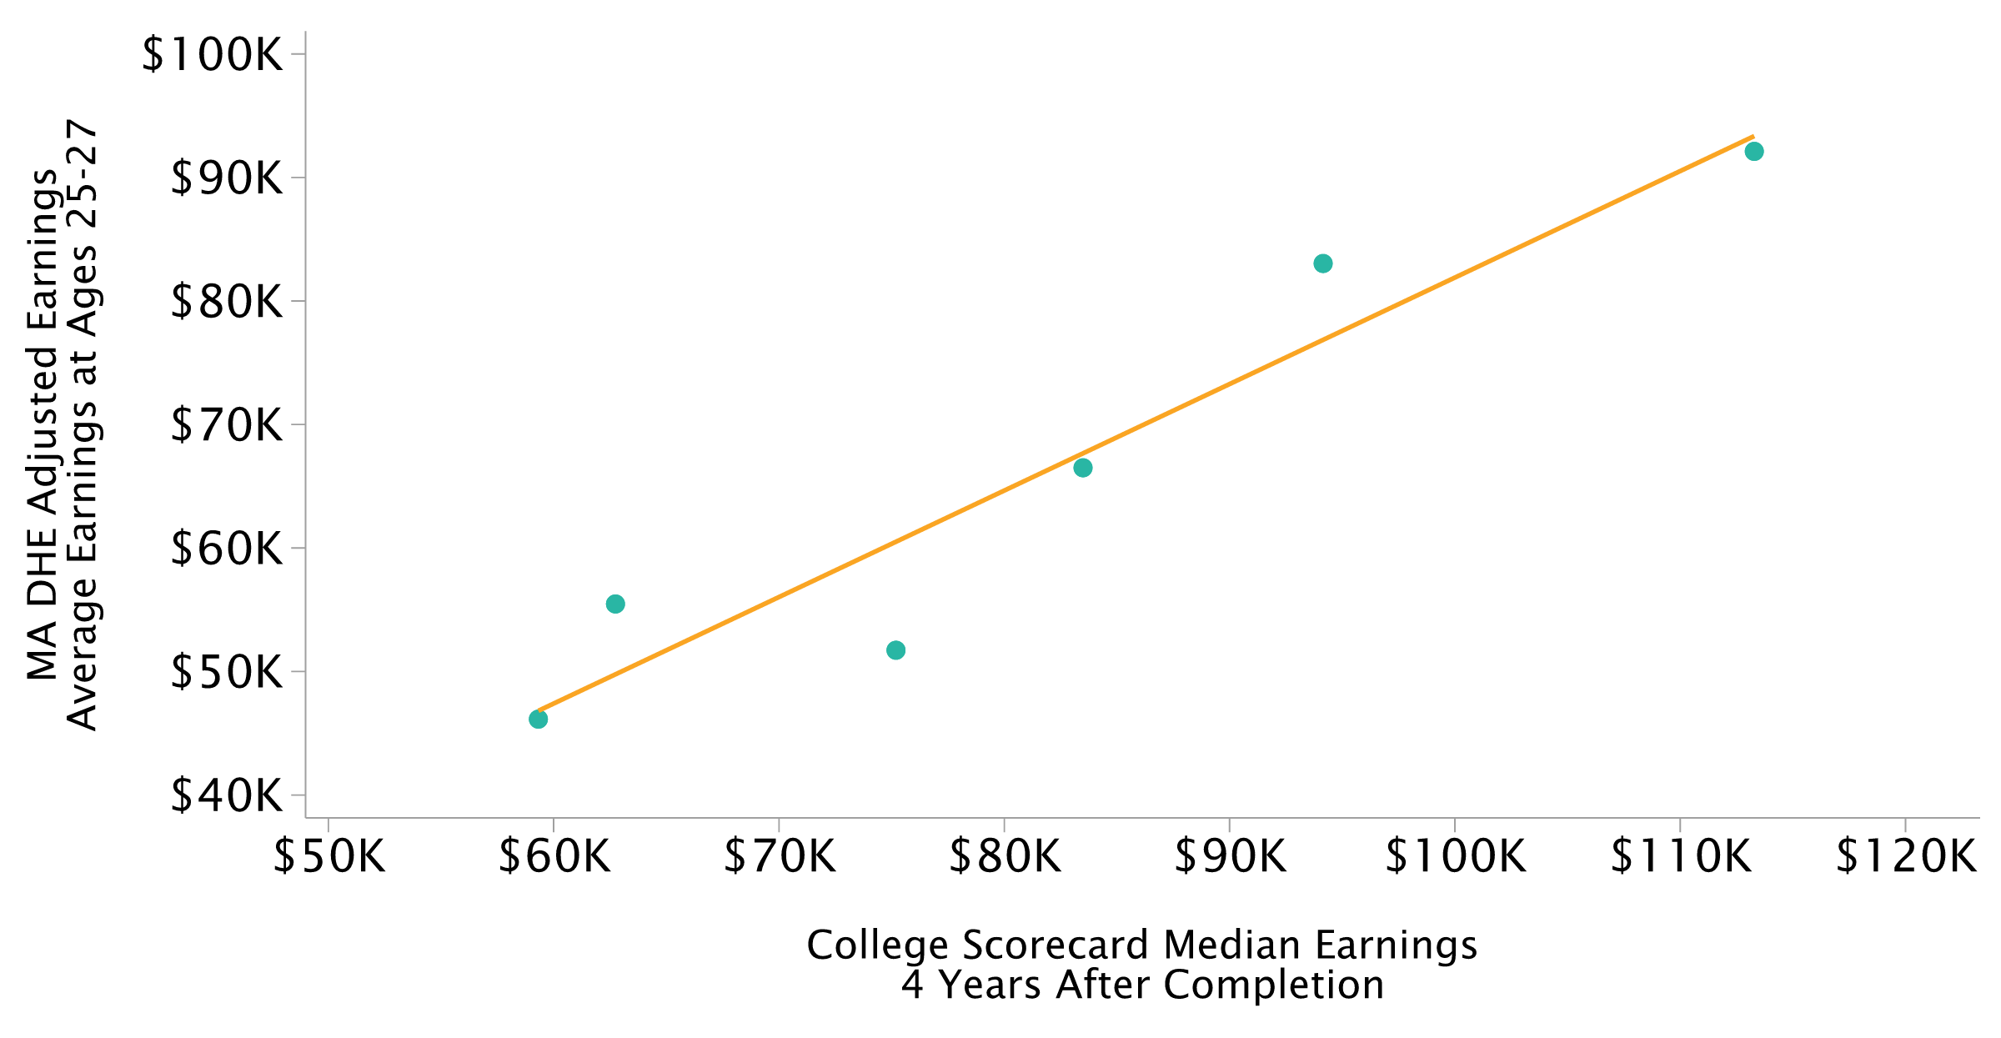
UMass Amherst Program-Level VA
College Scorecard Median Earnings, 4 Years After Completion

Slide 38
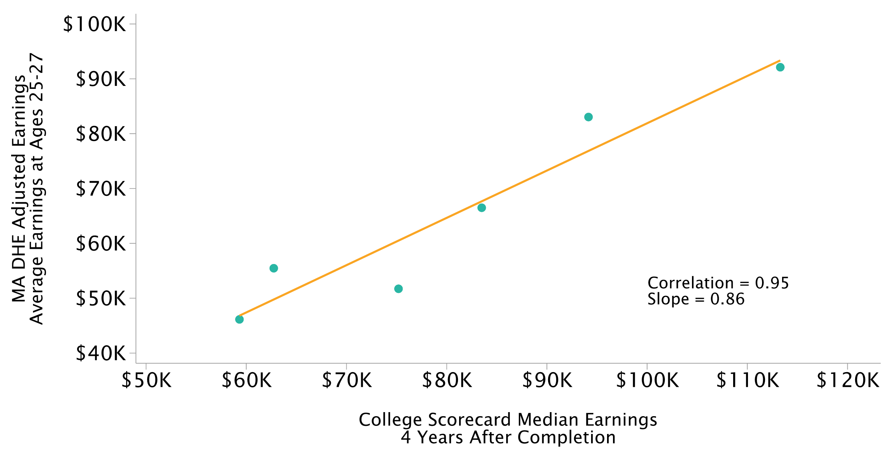
UMass Amherst Program-Level VA
College Scorecard Median Earnings, 4 Years After Completion

Slide 39
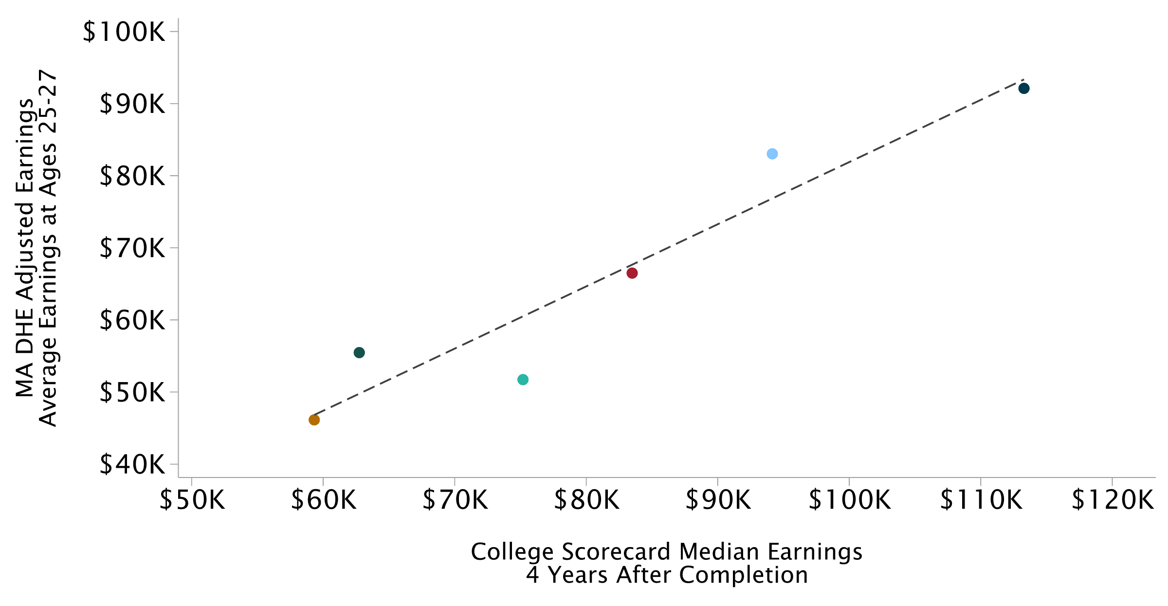
UMass Amherst Program-Level VA
College Scorecard Median Earnings, 4 Years After Completion; Programs Colored by Field

Slide 40
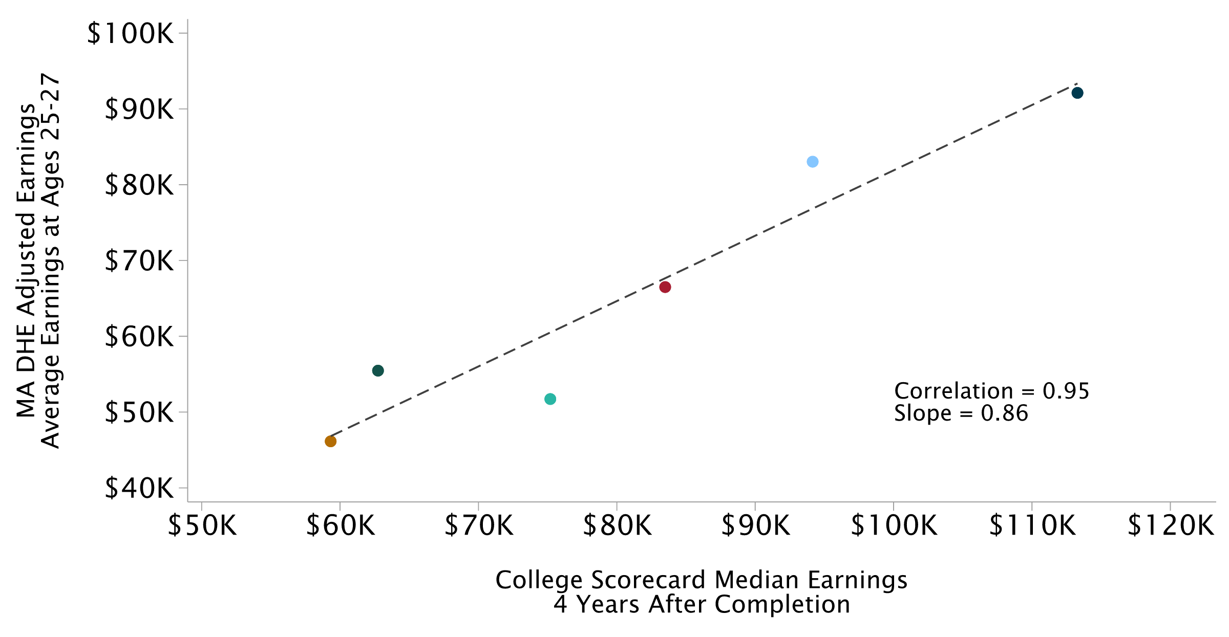
UMass Amherst Program-Level VA
College Scorecard Median Earnings, 4 Years After Completion; Programs Colored by Field

Slide 41
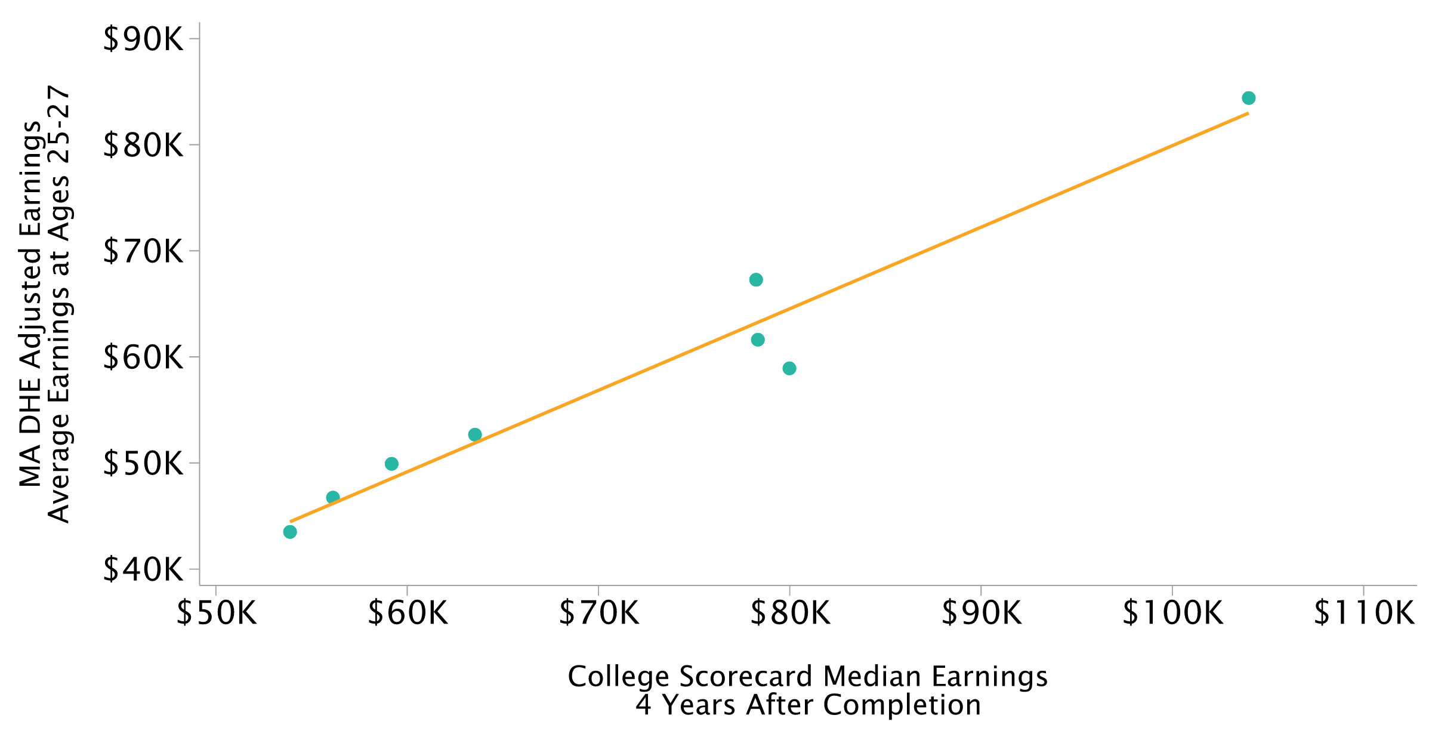
Field-Level VA Relative to Non-Completers vs. Median Earnings
College Scorecard Median Earnings, 4 Years After Completion; One Point per Field Across Institutions

Slide 42
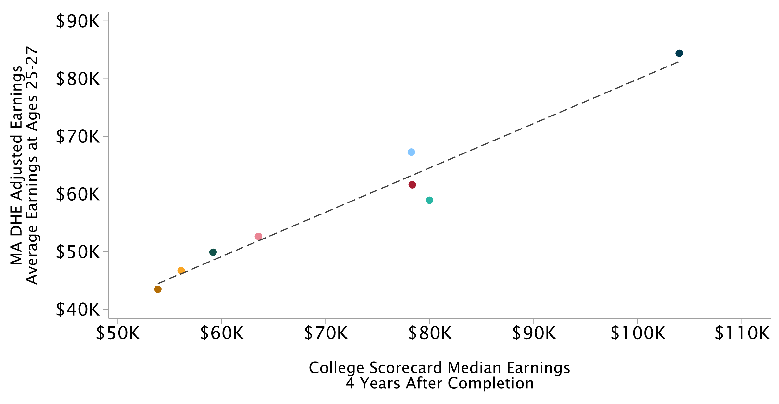
Field-Level VA Relative to Non-Completers vs. Median Earnings
College Scorecard Median Earnings, 4 Years After Completion; One Point per Field Across Institutions

Slide 43
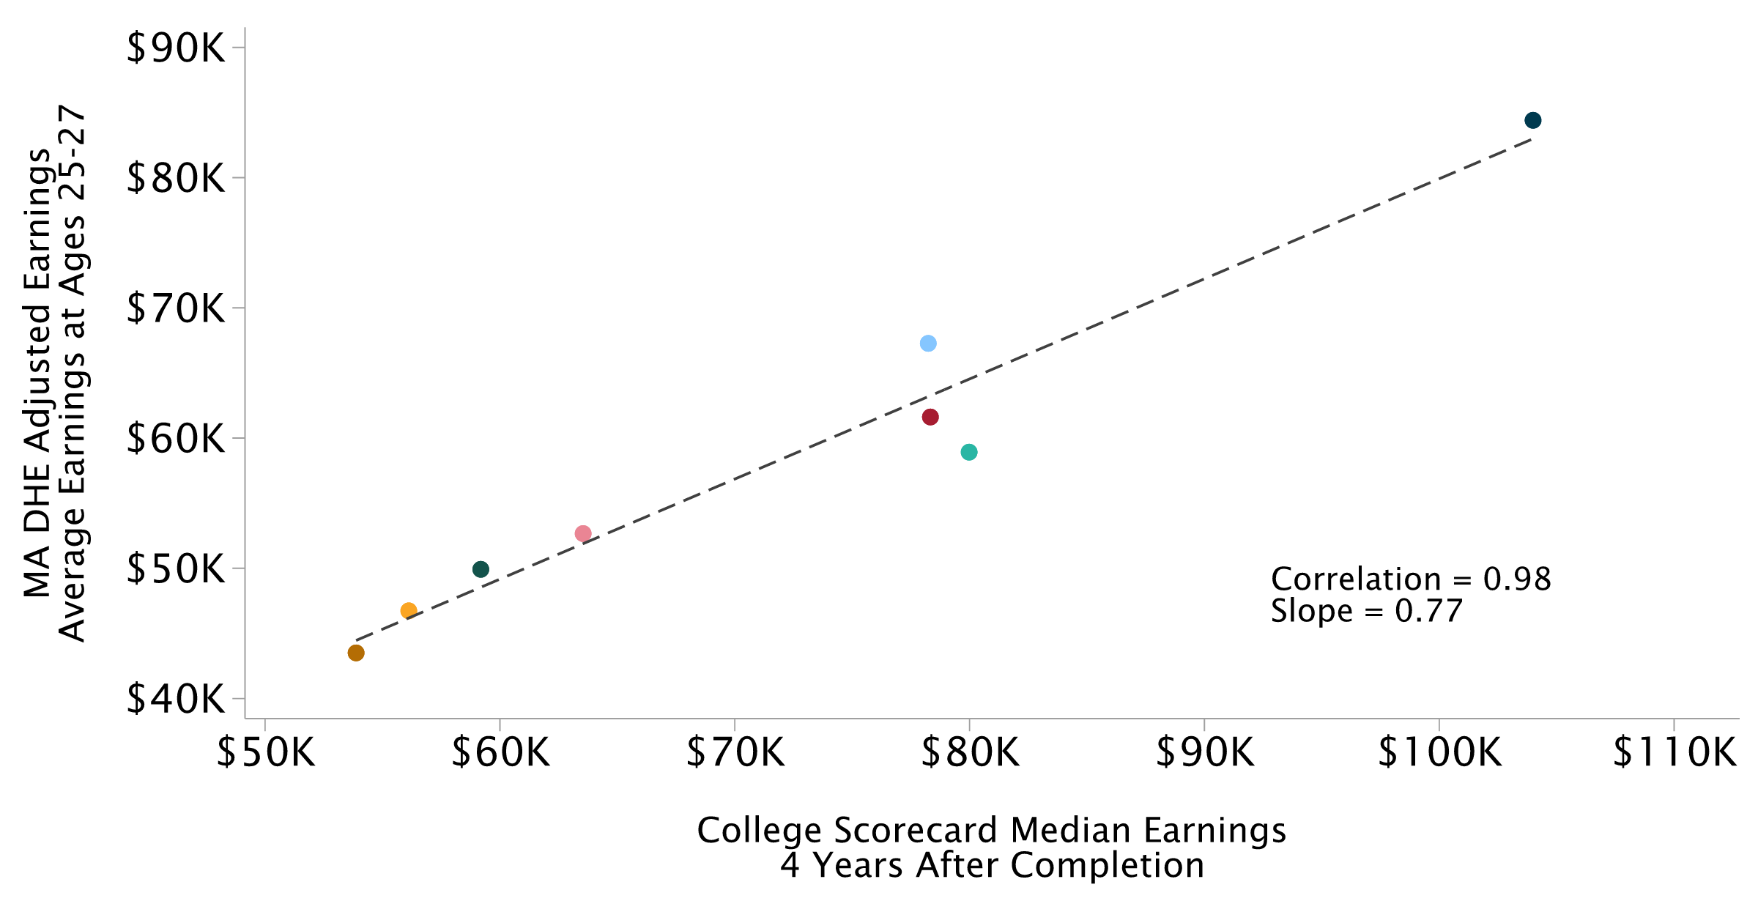
Field-Level VA Relative to Non-Completers vs. Median Earnings
College Scorecard Median Earnings, 4 Years After Completion; One Point per Field Across Institutions

Slide 44

UMass Field-Level VA
College Scorecard Median Earnings, 4 Years After Completion; One Point per Field Across UMass Institutions

Slide 45
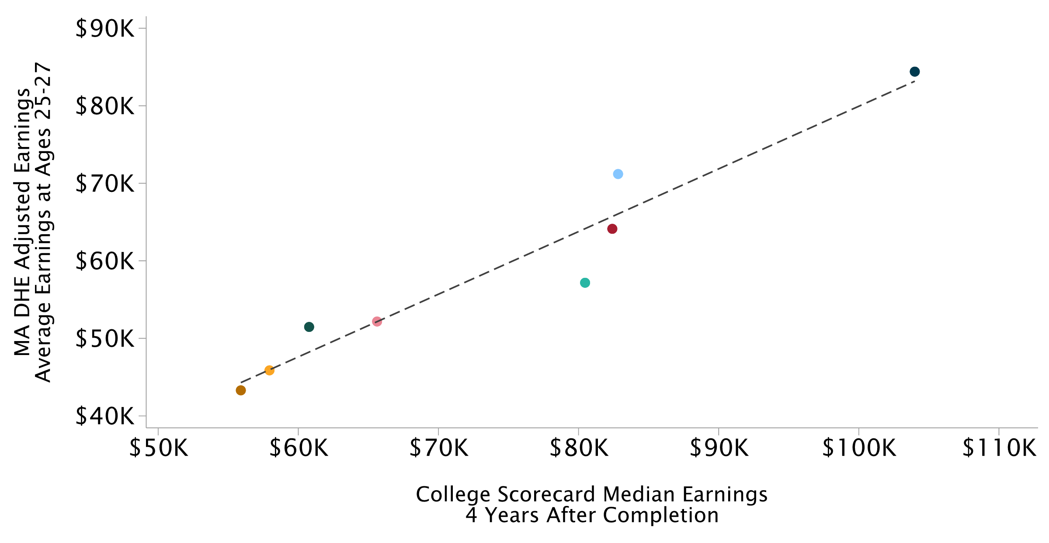
UMass Field-Level VA
College Scorecard Median Earnings, 4 Years After Completion; One Point per Field Across UMass Institutions

Slide 46
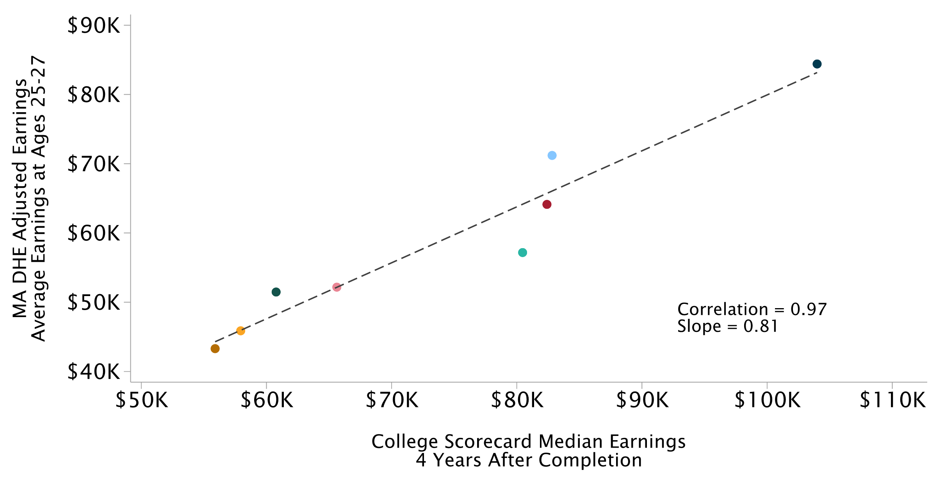
UMass Field-Level VA
College Scorecard Median Earnings, 4 Years After Completion; One Point per Field Across UMass Institutions

Slide 47
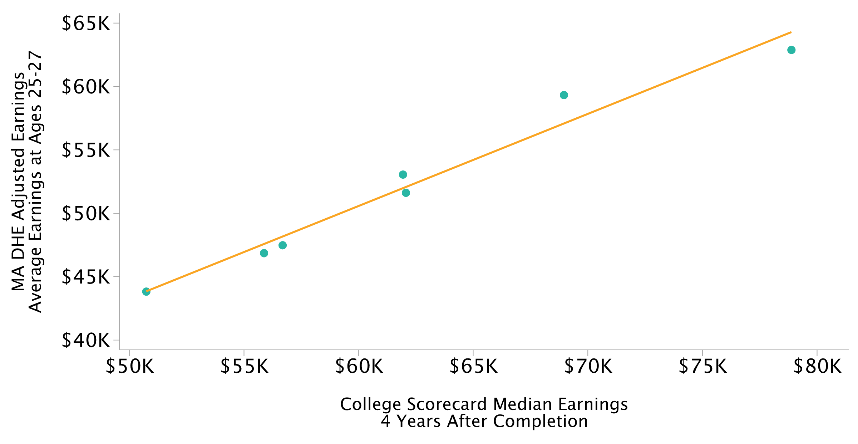
State University Field-Level VA
College Scorecard Median Earnings, 4 Years After Completion; One Point per Field Across State Universities

Slide 48
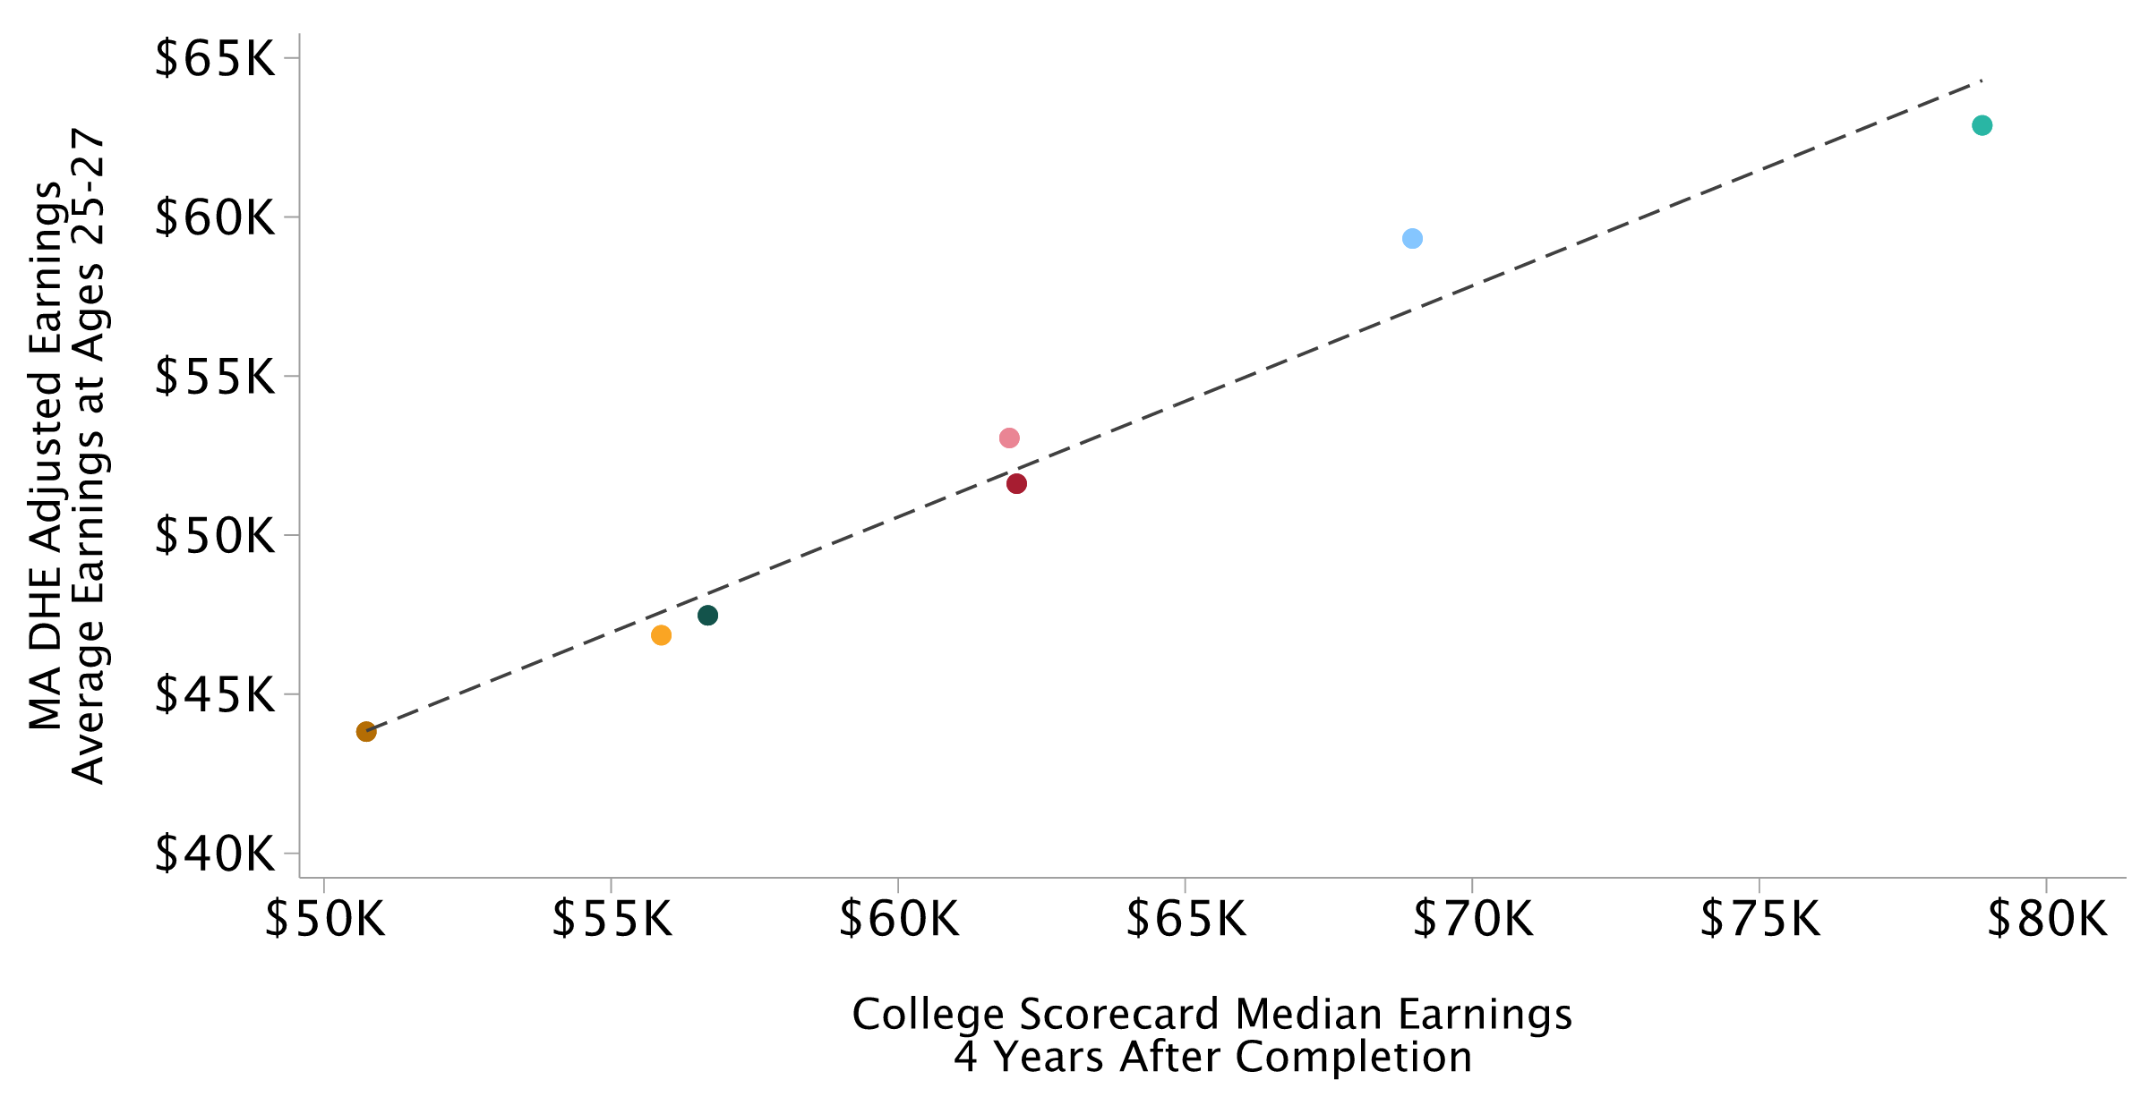
State University Field-Level VA
College Scorecard Median Earnings, 4 Years After Completion; One Point per Field Across State Universities

Slide 49
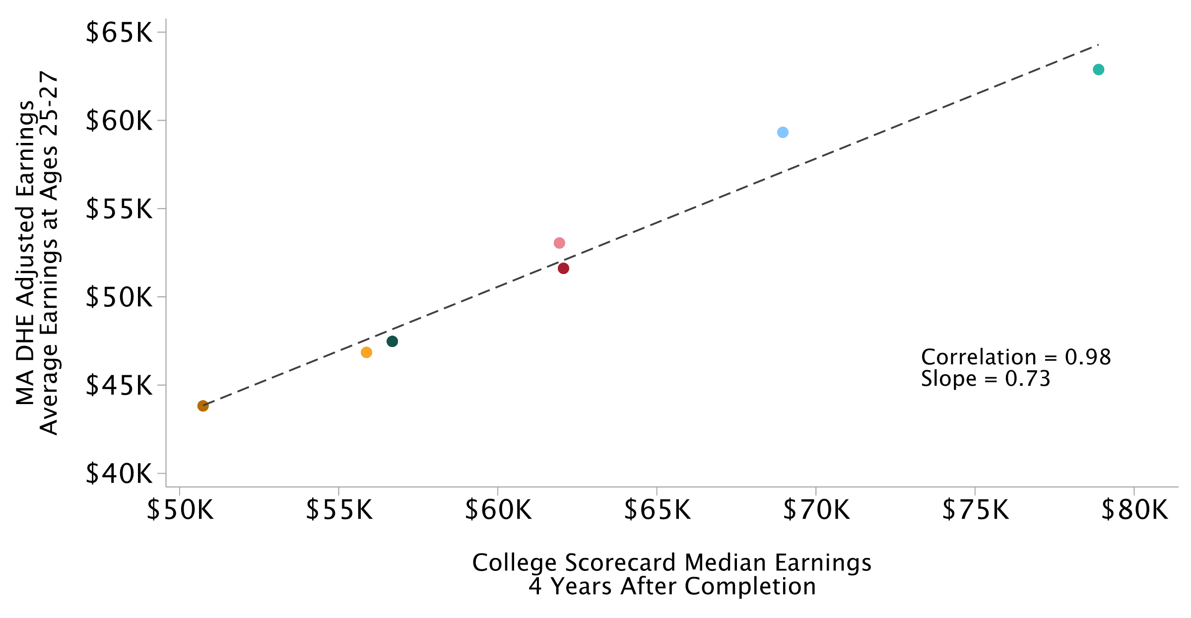
State University Field-Level VA
College Scorecard Median Earnings, 4 Years After Completion; One Point per Field Across State Universities

