Slide 1
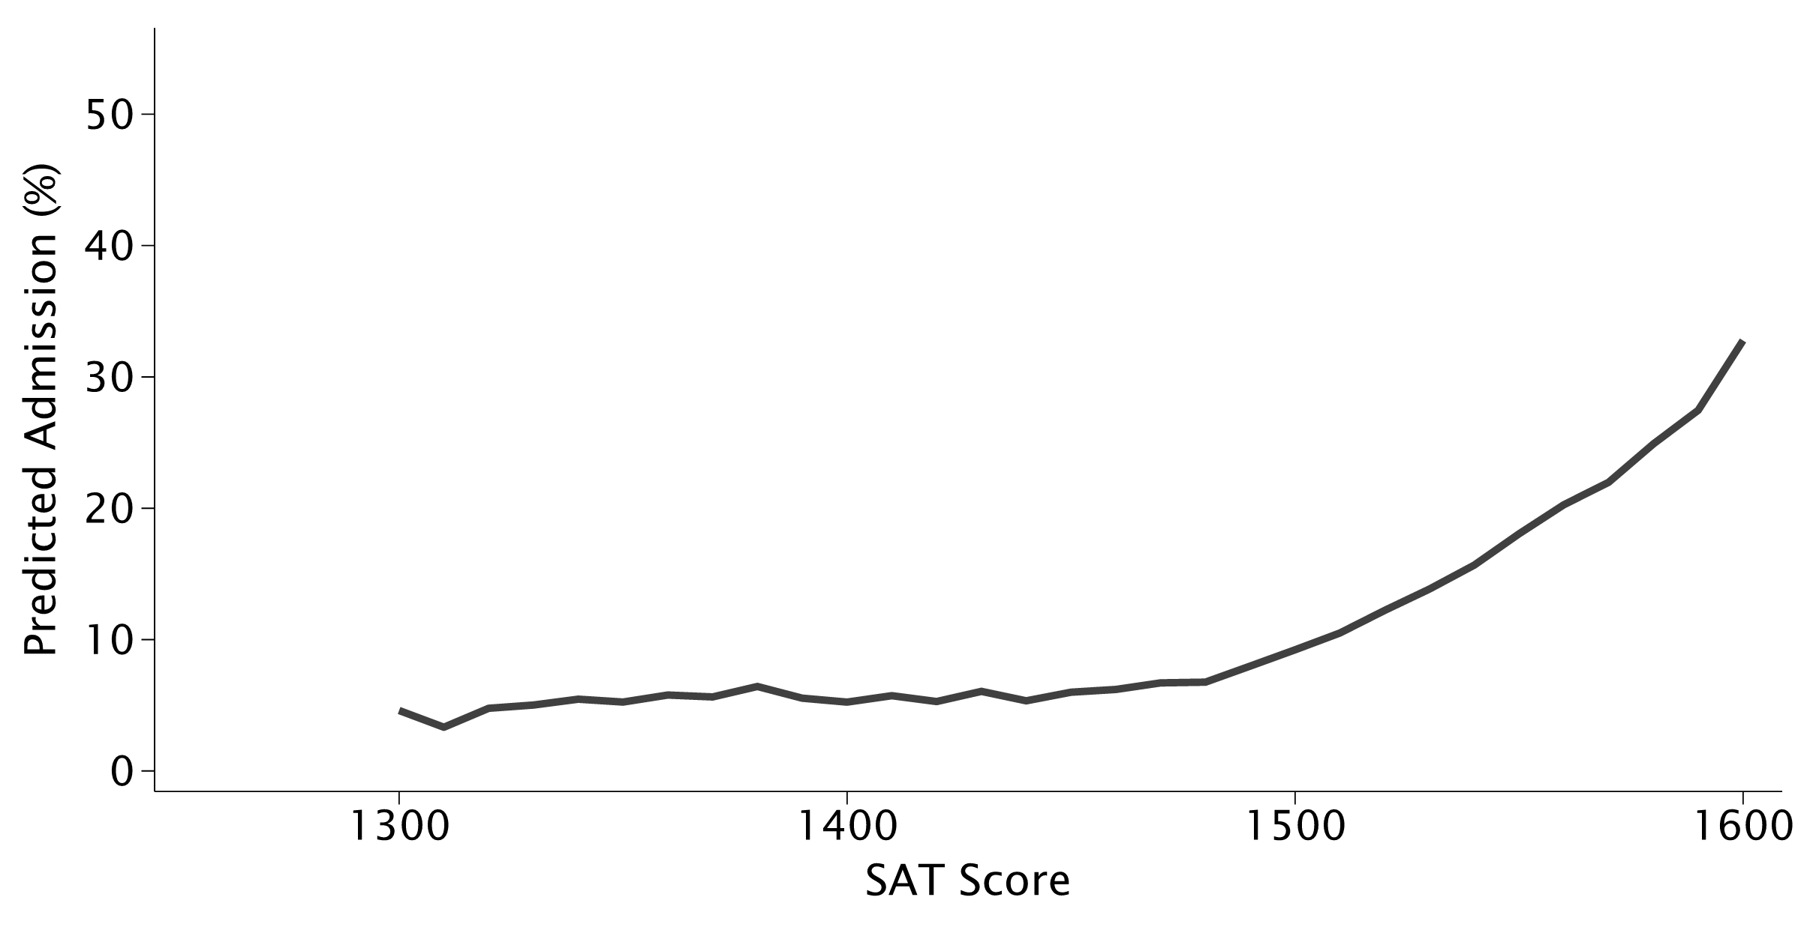
How SAT Scores Affect Admission
Raw Relationship Across All Applicants

Slide 2
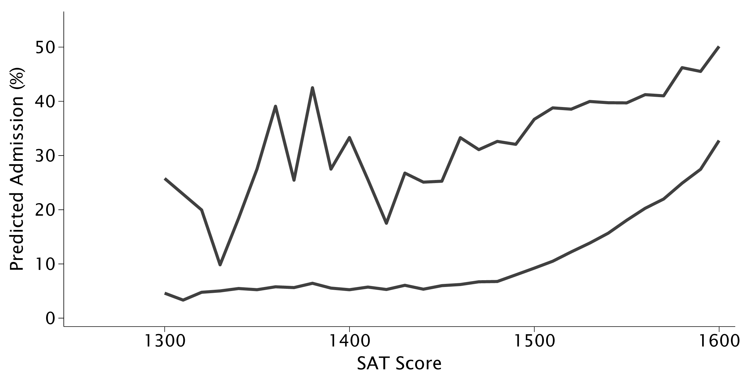
How SAT Scores Affect Admission
Restricting to Second-Round Applicants

Slide 3
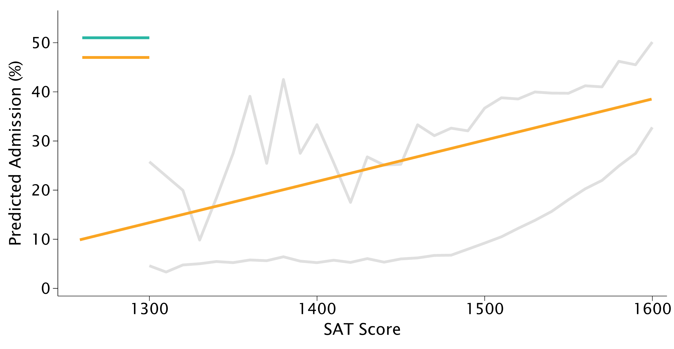
How SAT Scores Affect Admission
Between-Applicant Relationship

Slide 4
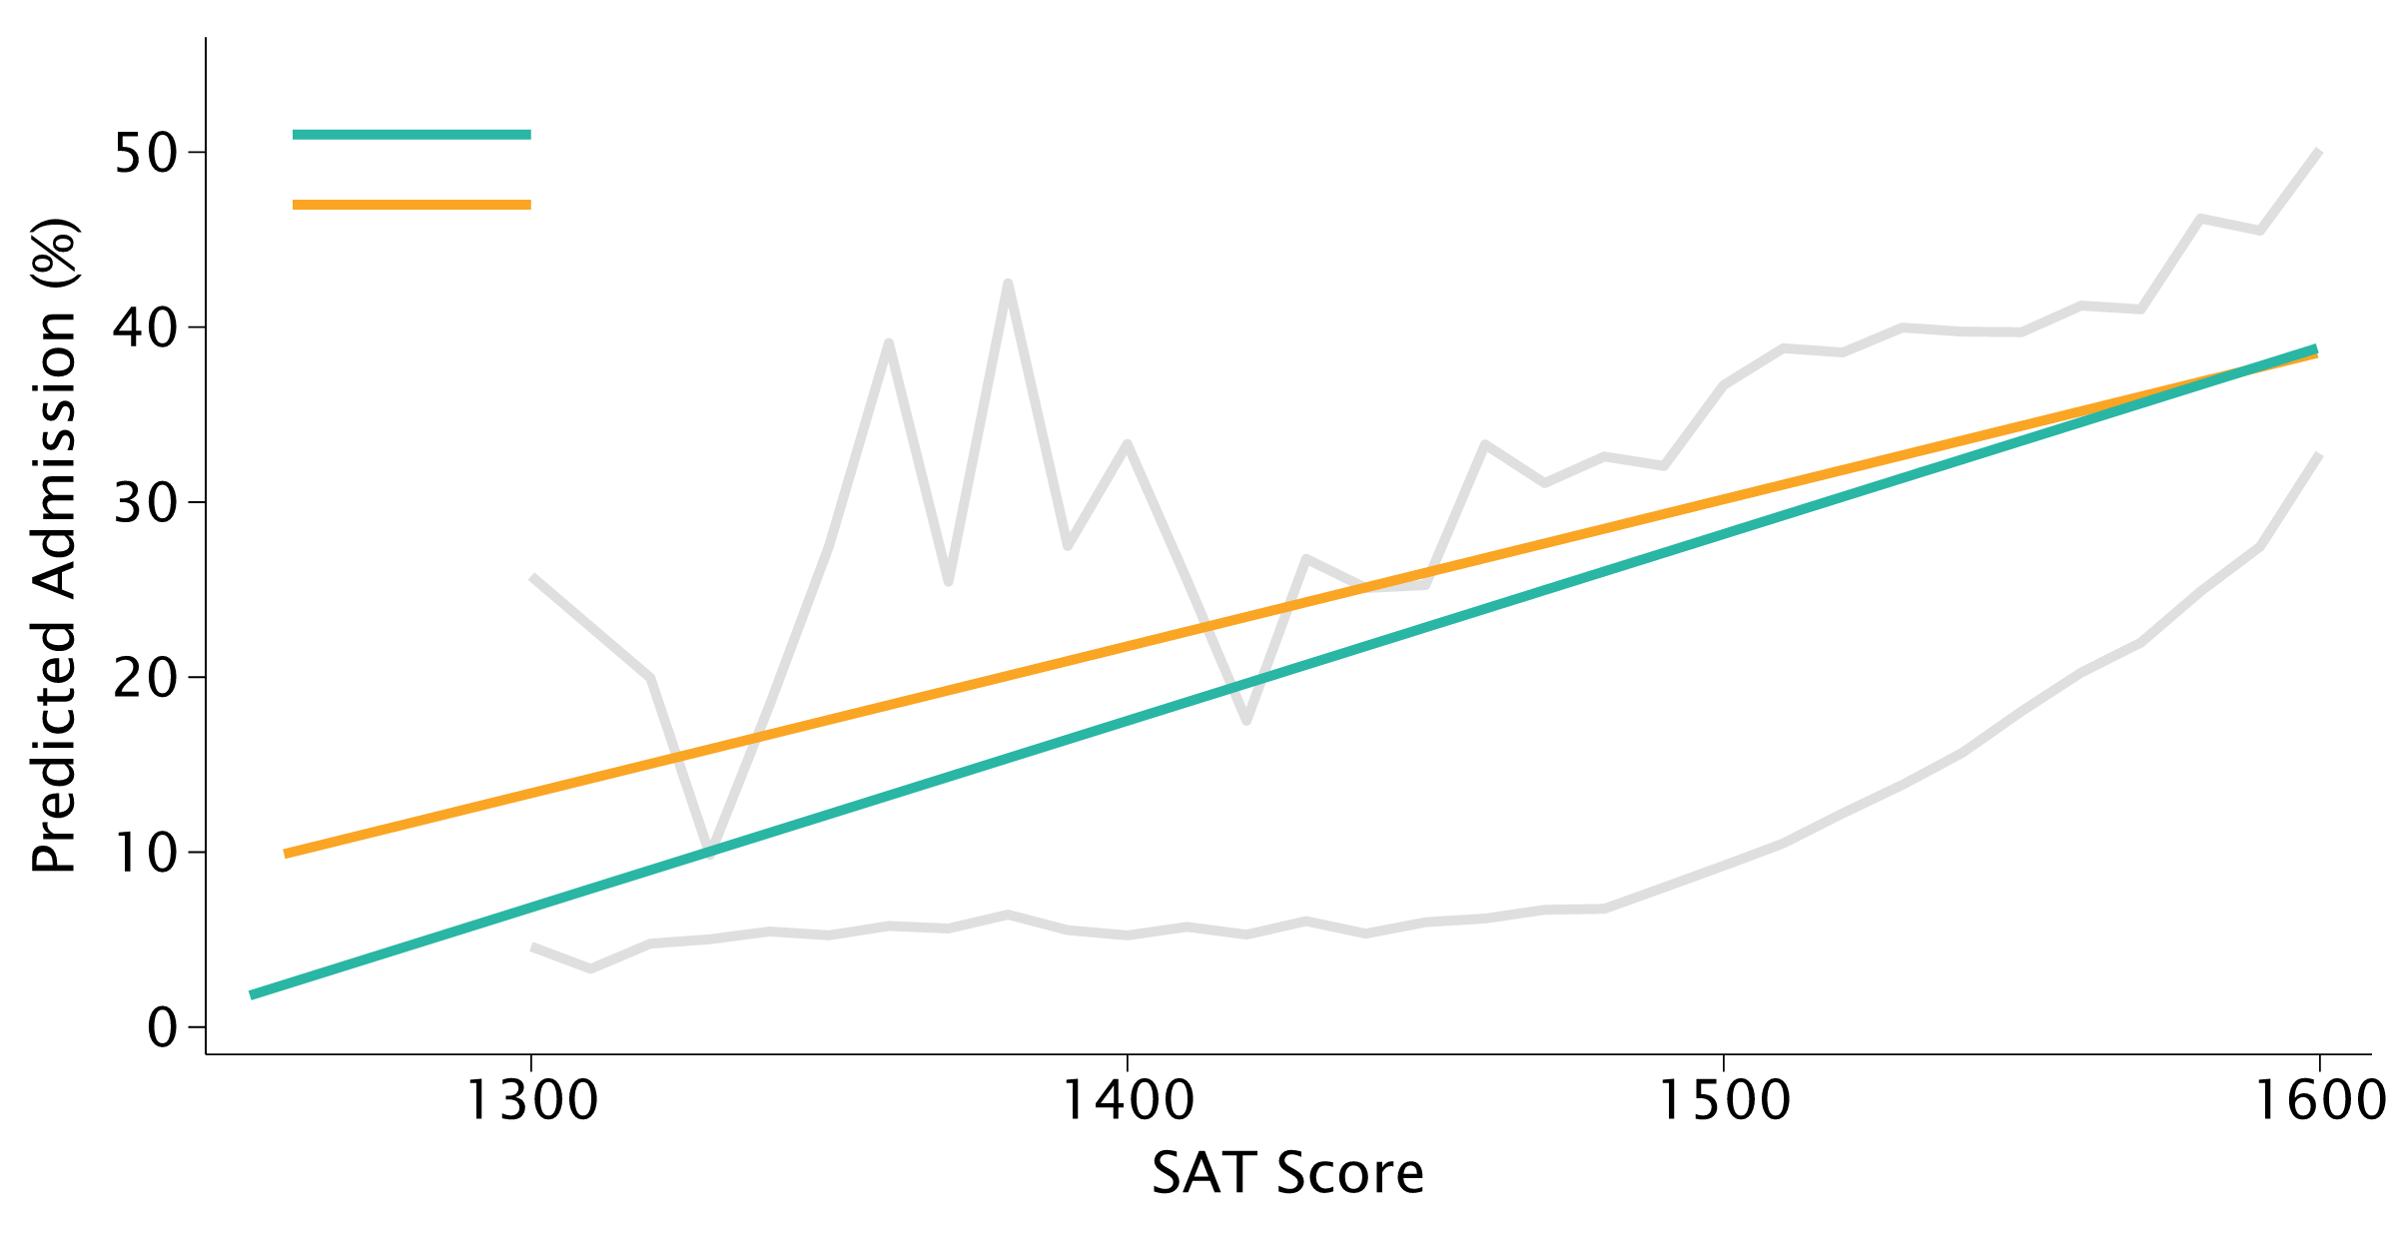
How SAT Scores Affect Admission
Within-Applicant Causal Effect

Slide 5
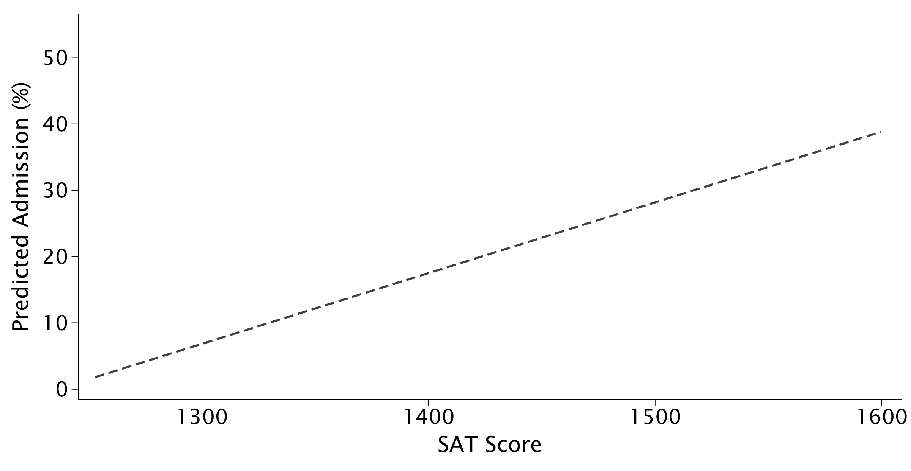
The SAT Effect Is Nonlinear
Average Within-Applicant Effect

Slide 6
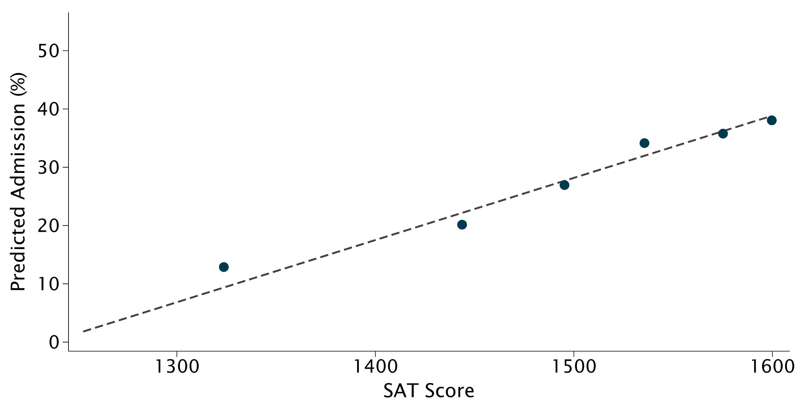
The SAT Effect Is Nonlinear
Flexible Estimates by SAT Sextile

Slide 7
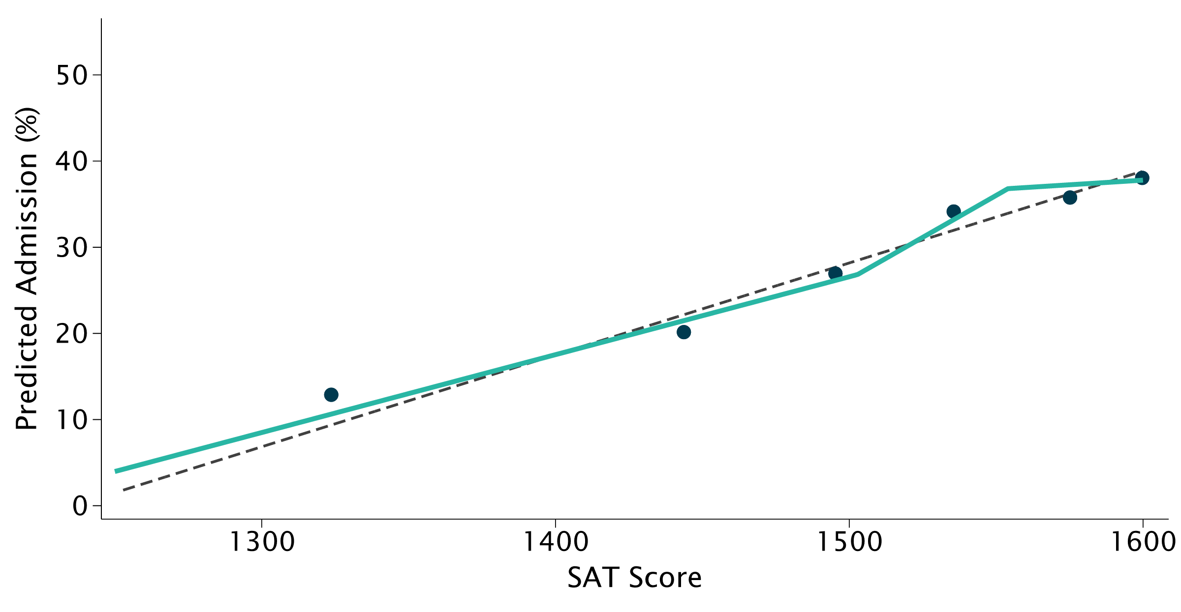
The SAT Effect Is Nonlinear
Separate Slopes by SAT Tercile

Slide 8
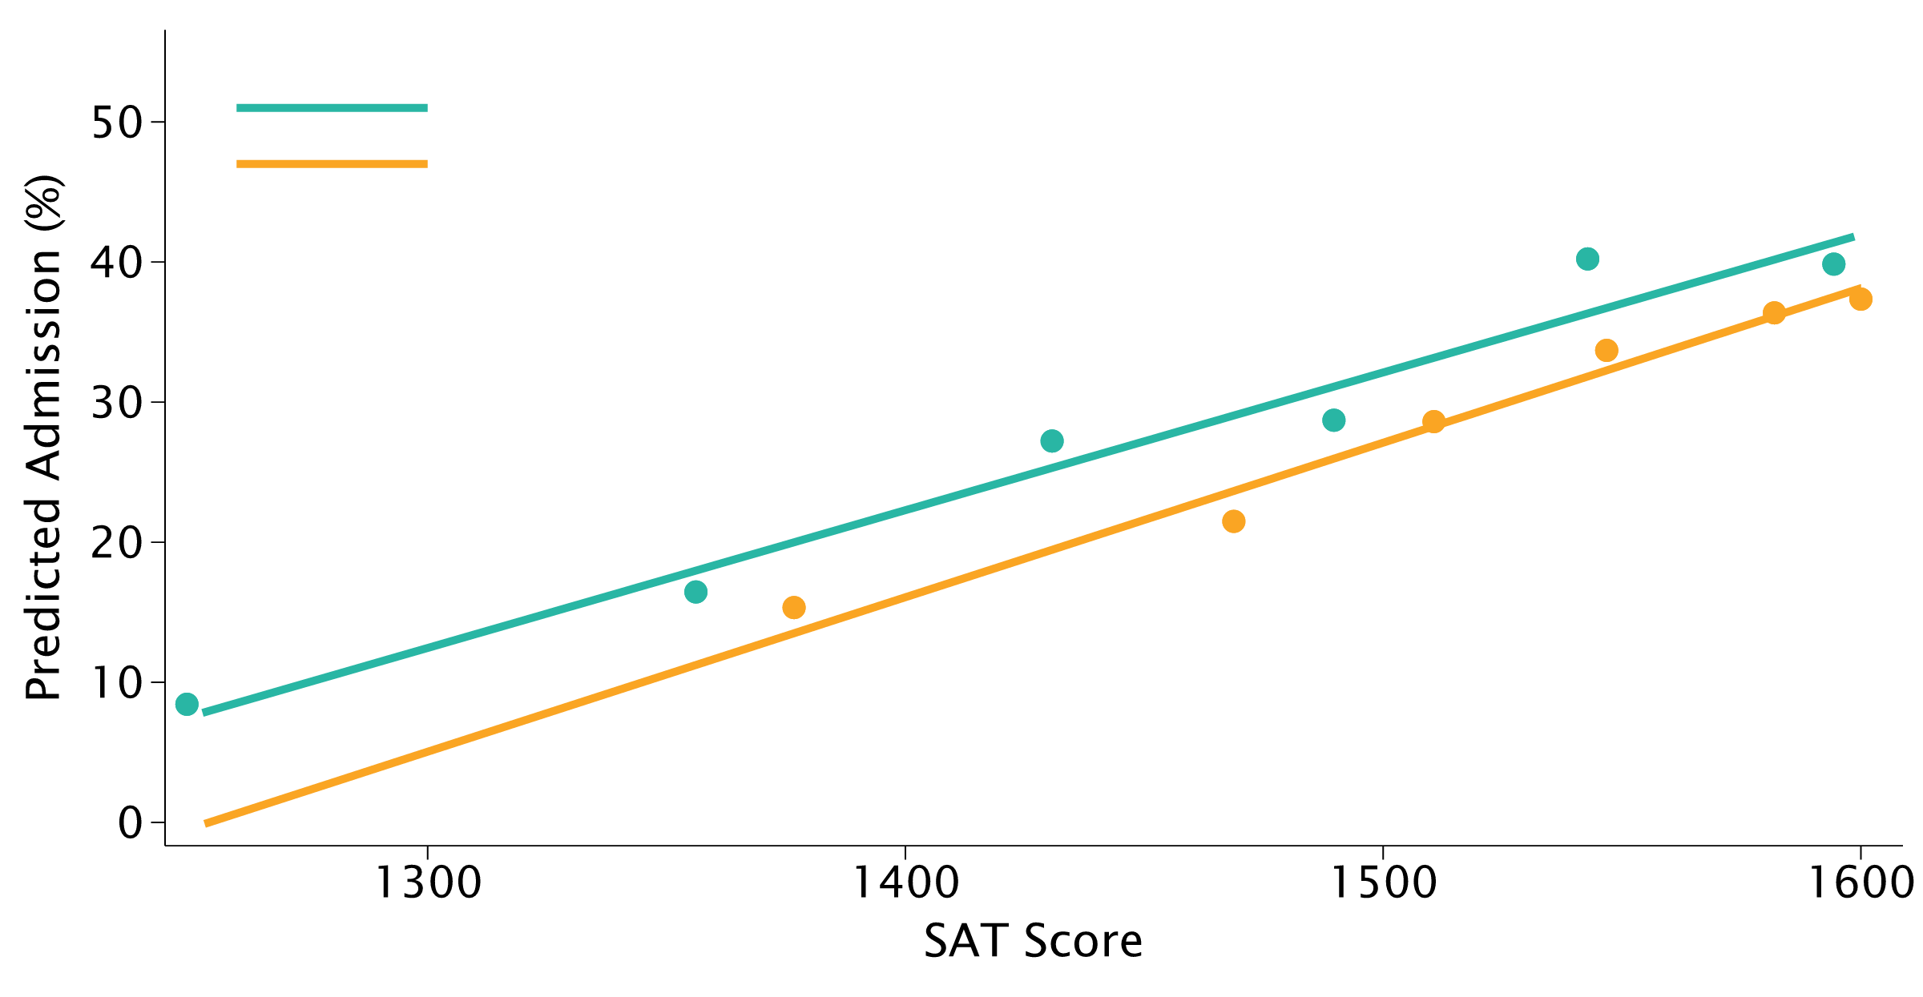
SAT Effects Are Similar by Disadvantage
Within-Applicant Effects for Disadvantaged and Other Applicants

Slide 9
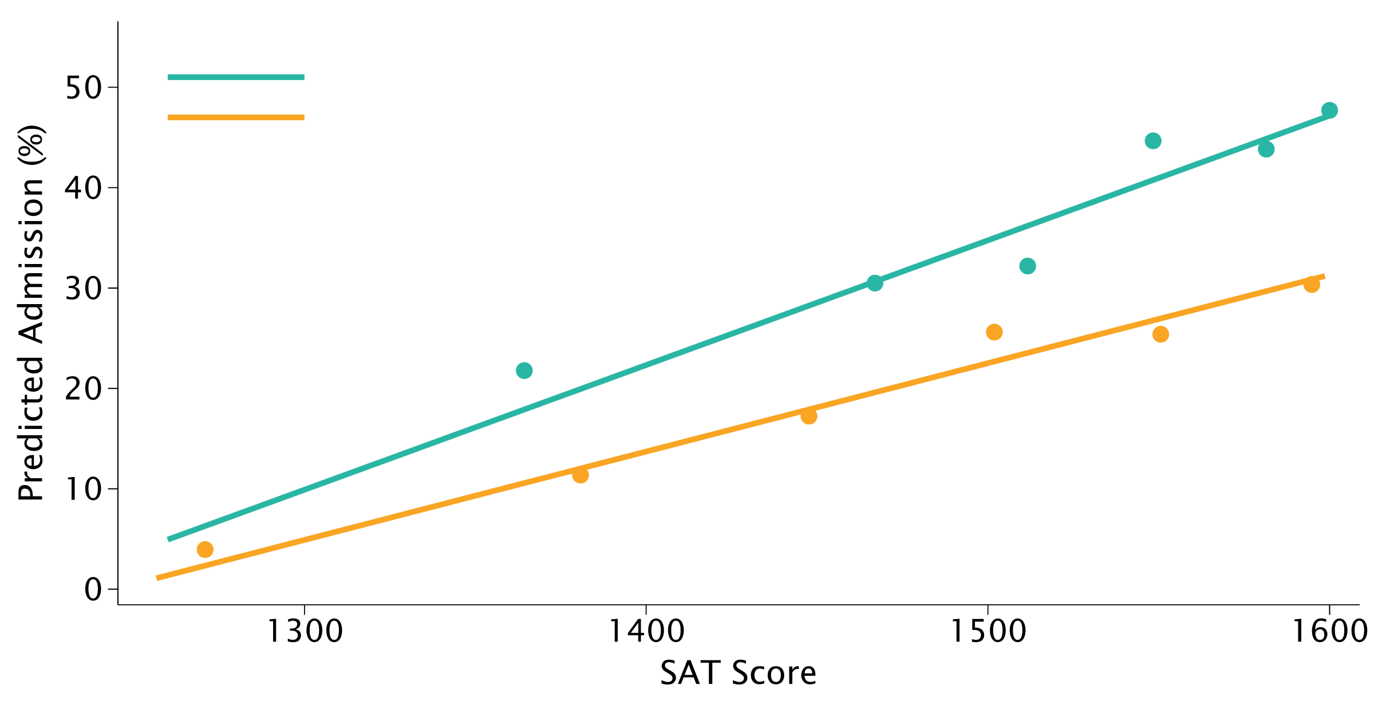
SAT Scores Reinforce Strong Applications
Larger Effects for Applicants with Strong Non-Test Credentials

Slide 10
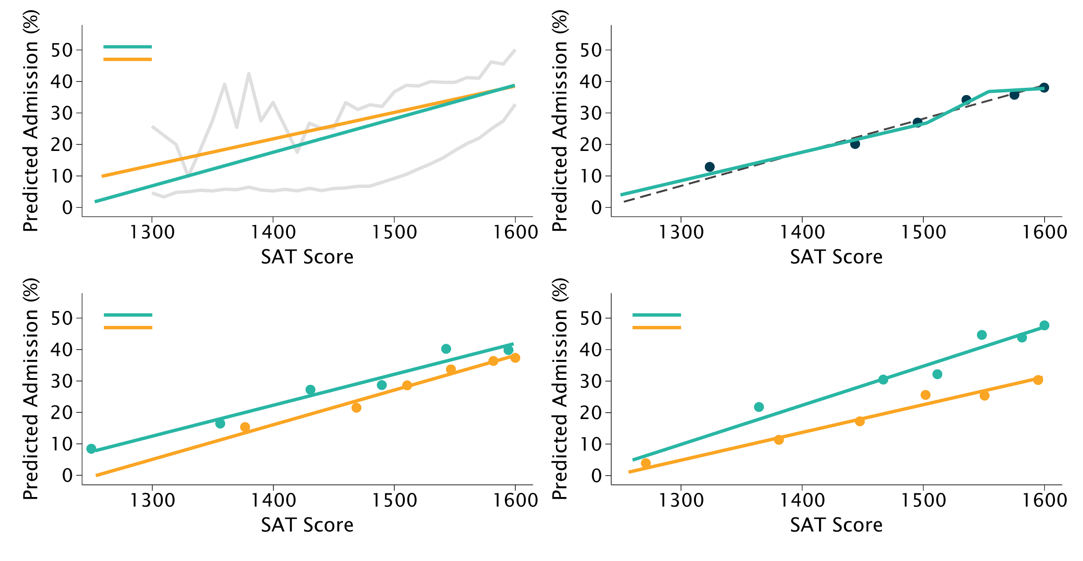
The Causal Effect of SAT Scores
Summary of Figure 1

Slide 11
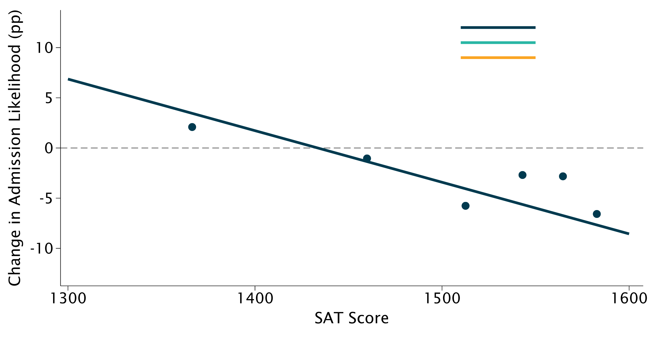
When Does Withholding a Score Help?
Overall Effect of Omitting an SAT Score

Slide 12

When Does Withholding a Score Help?
The Overall SAT Threshold Is About 1433

Slide 13
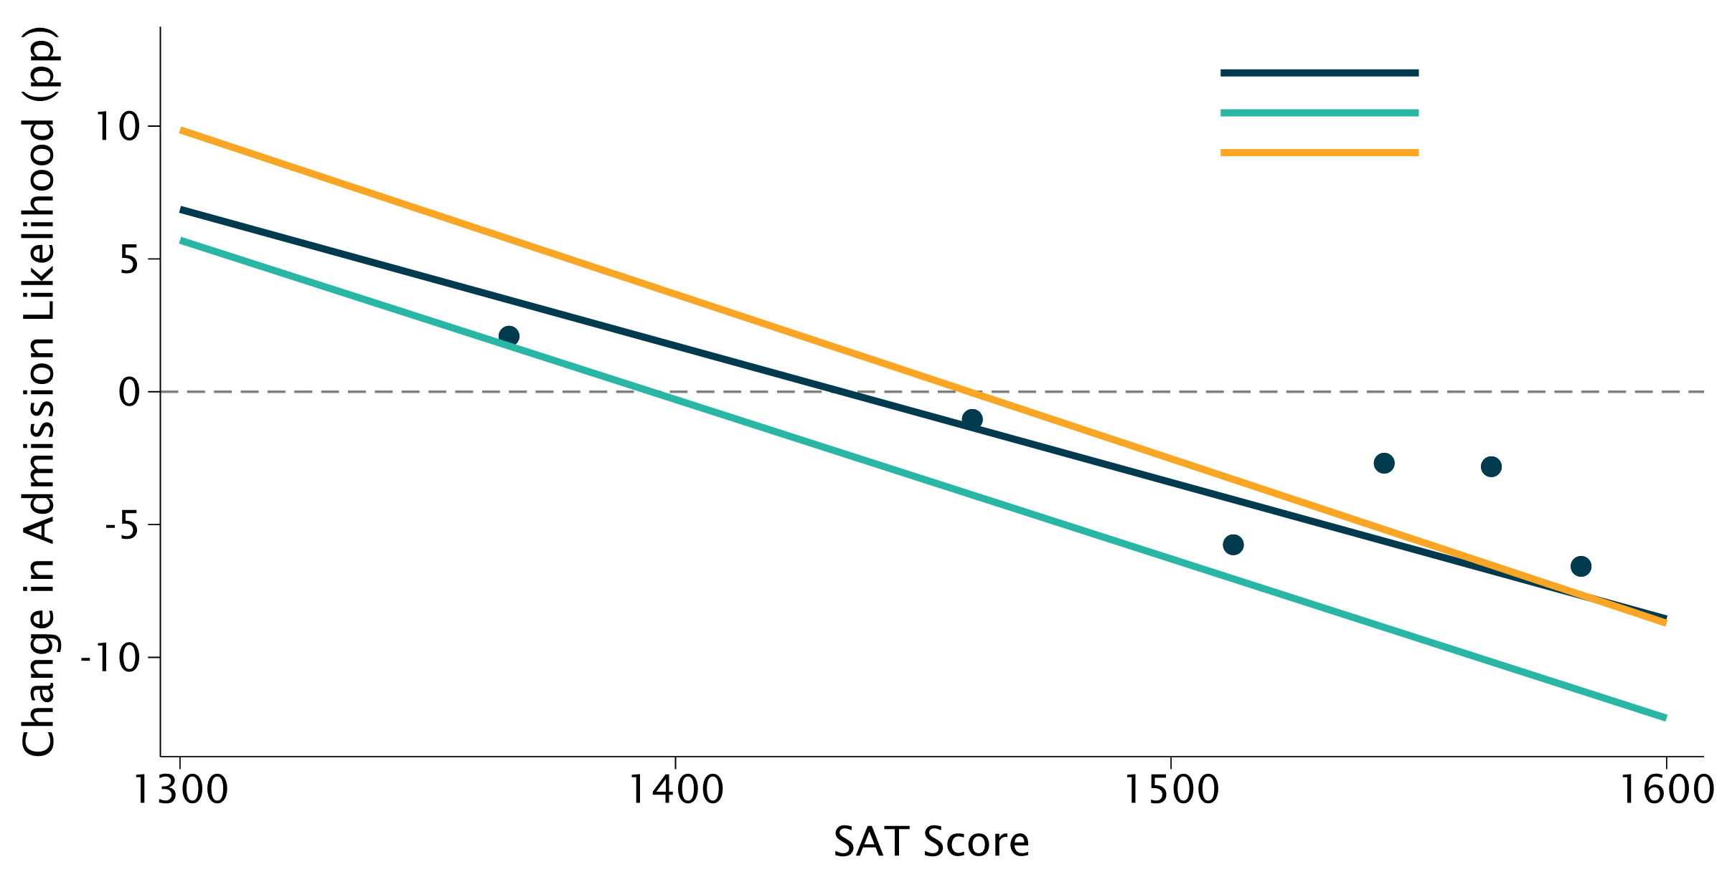
When Does Withholding a Score Help?
Effects by Applicant Disadvantage

Slide 14

When Does Withholding a Score Help?
Group-Specific SAT Thresholds

Slide 15
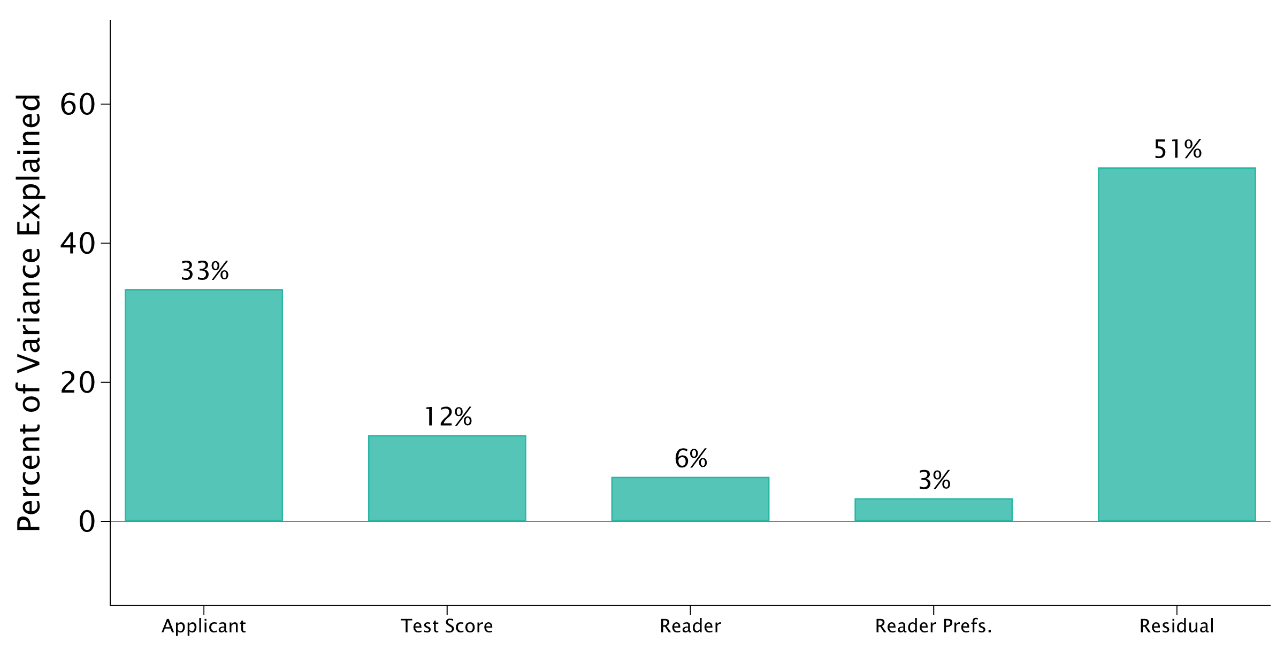
What Drives Predicted Admission?
Variance Decomposition; Covariance Omitted from Display

Slide 16
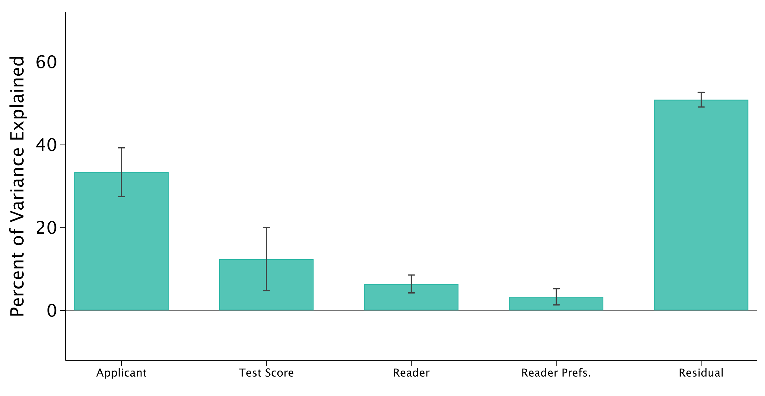
What Drives Predicted Admission?
Adding 95% Confidence Intervals

Slide 17
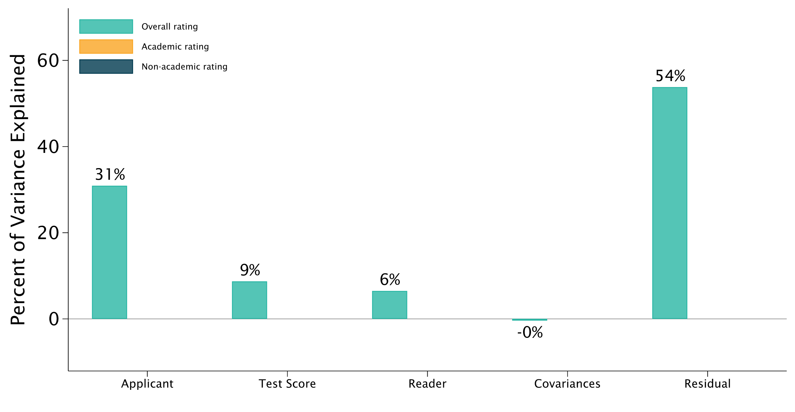
Which Ratings Do SAT Scores Change?
Overall Rating

Slide 18
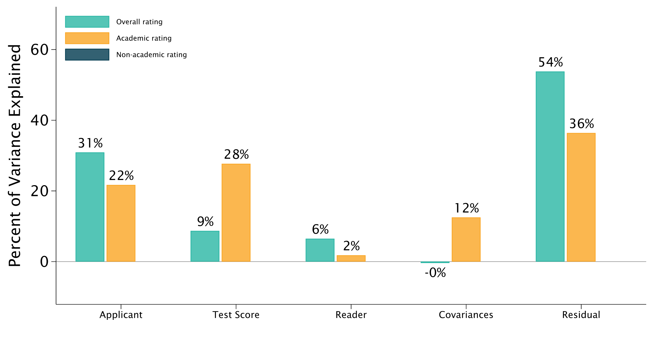
Which Ratings Do SAT Scores Change?
Adding the Academic Rating

Slide 19
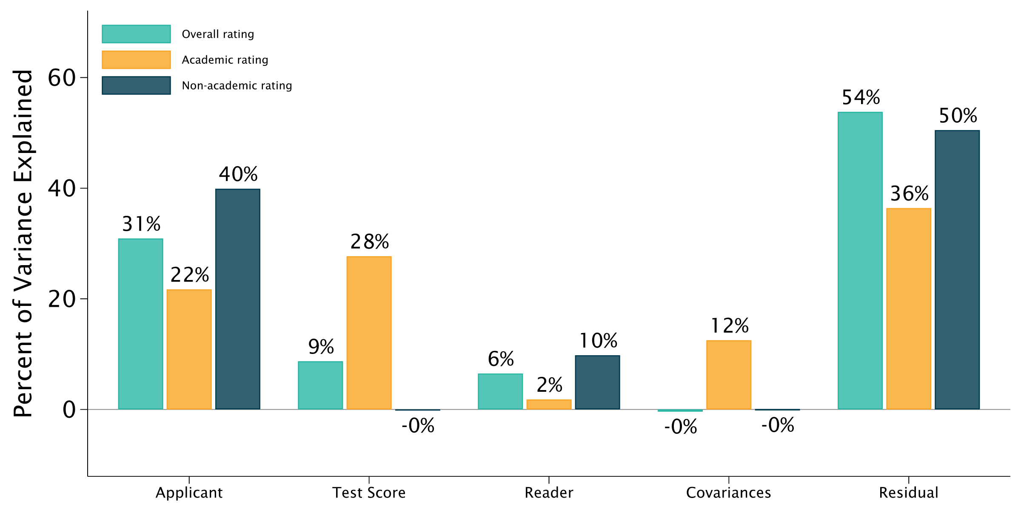
Which Ratings Do SAT Scores Change?
Adding the Non-Academic Rating

Slide 20
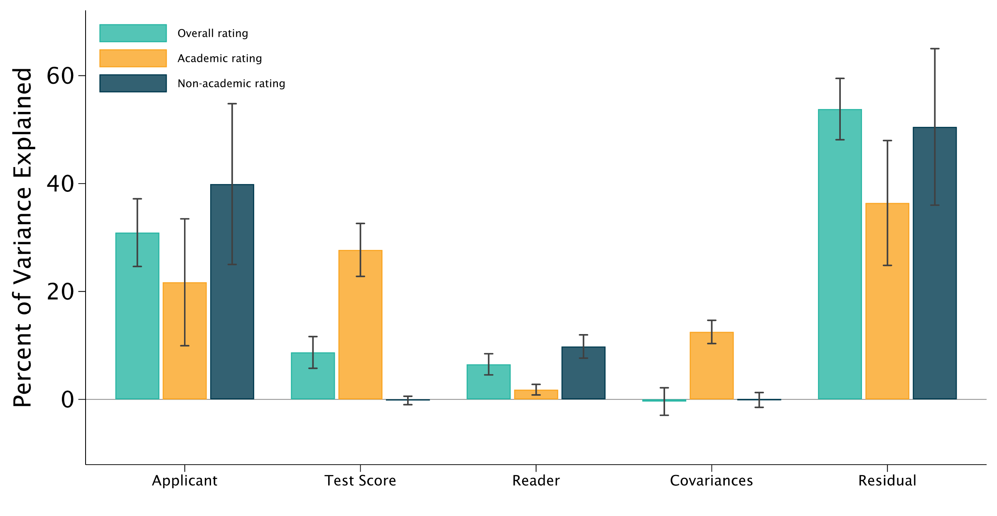
Which Ratings Do SAT Scores Change?
No Non-Academic Halo Effect; 95% Confidence Intervals

Slide 21
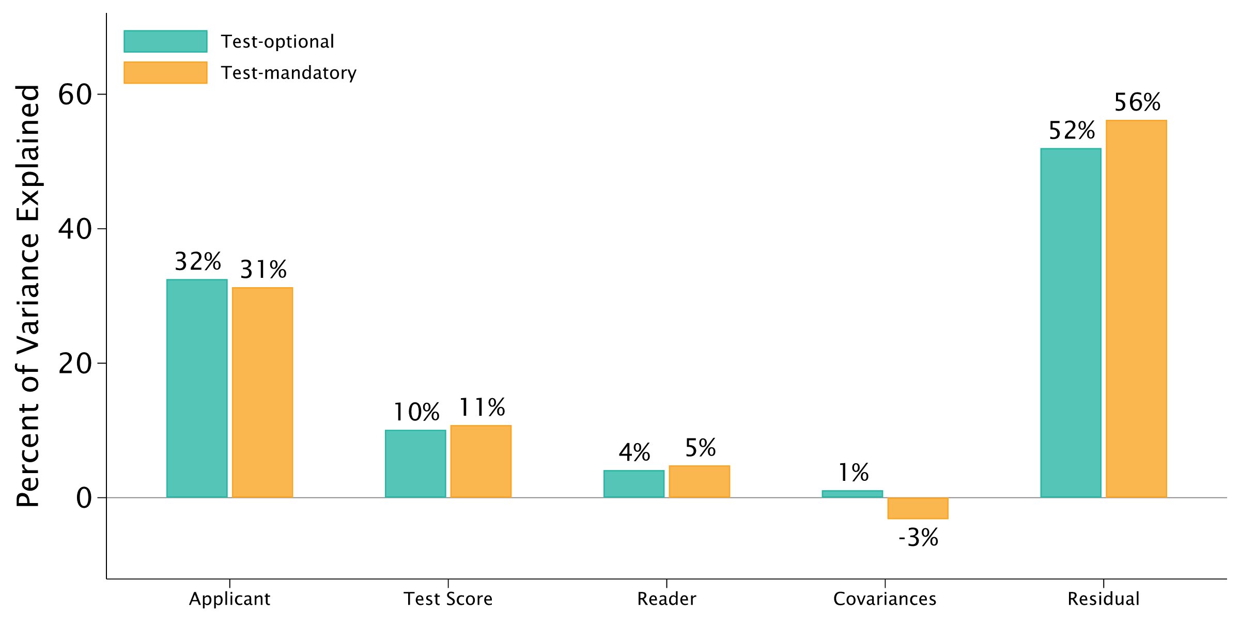
Testing Regime Changes Little
Test-Optional versus Test-Mandatory Evaluation

Slide 22
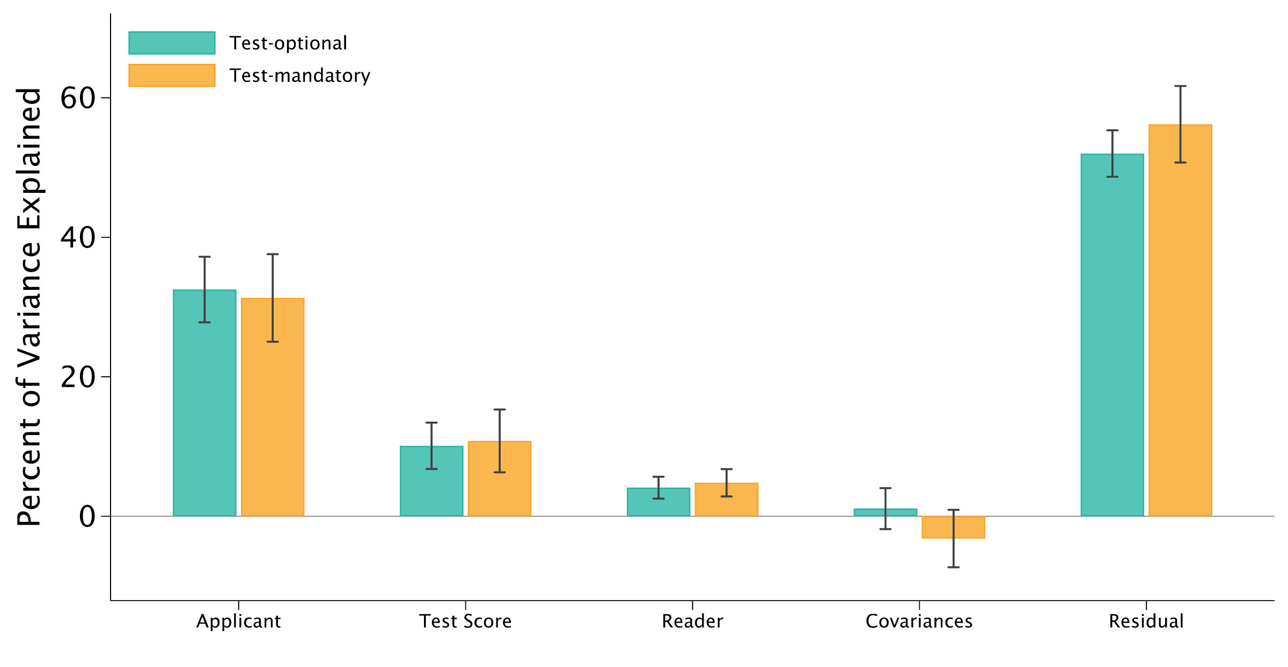
Testing Regime Changes Little
Adding 95% Confidence Intervals

Slide 23
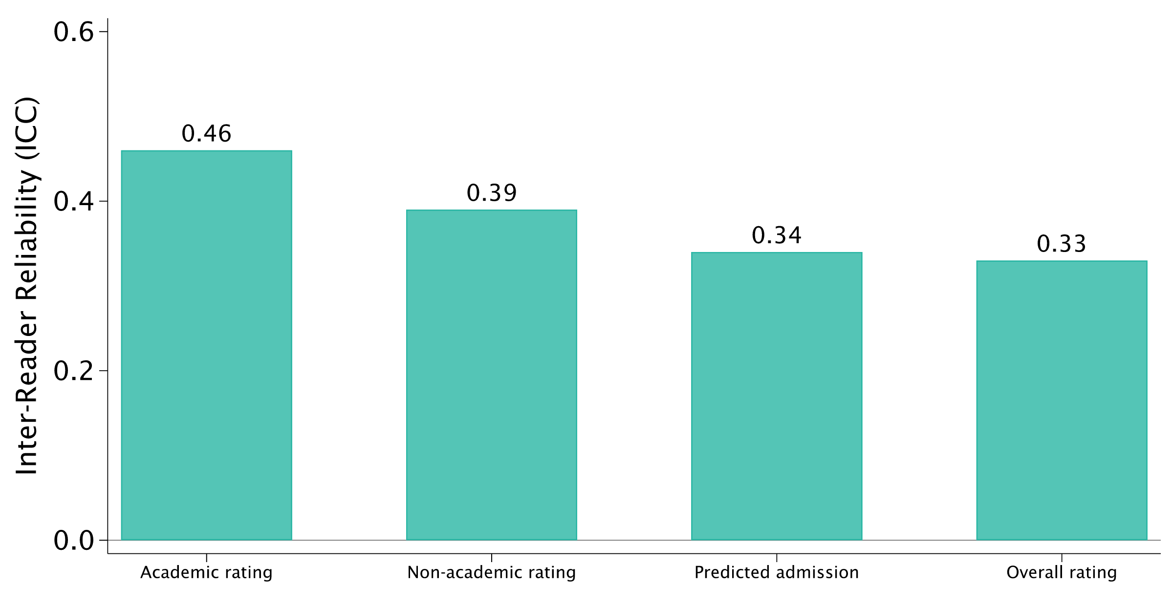
Readers Agree Most on Academics
Inter-Reader Reliability Across Evaluation Measures

Slide 24
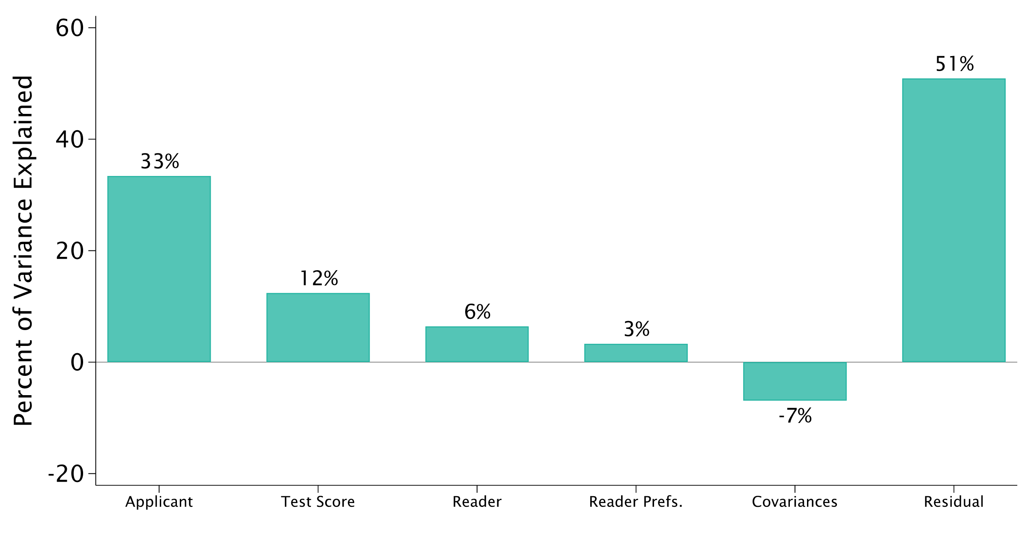
Full Variance Decomposition
Including the Covariance Component

Slide 25
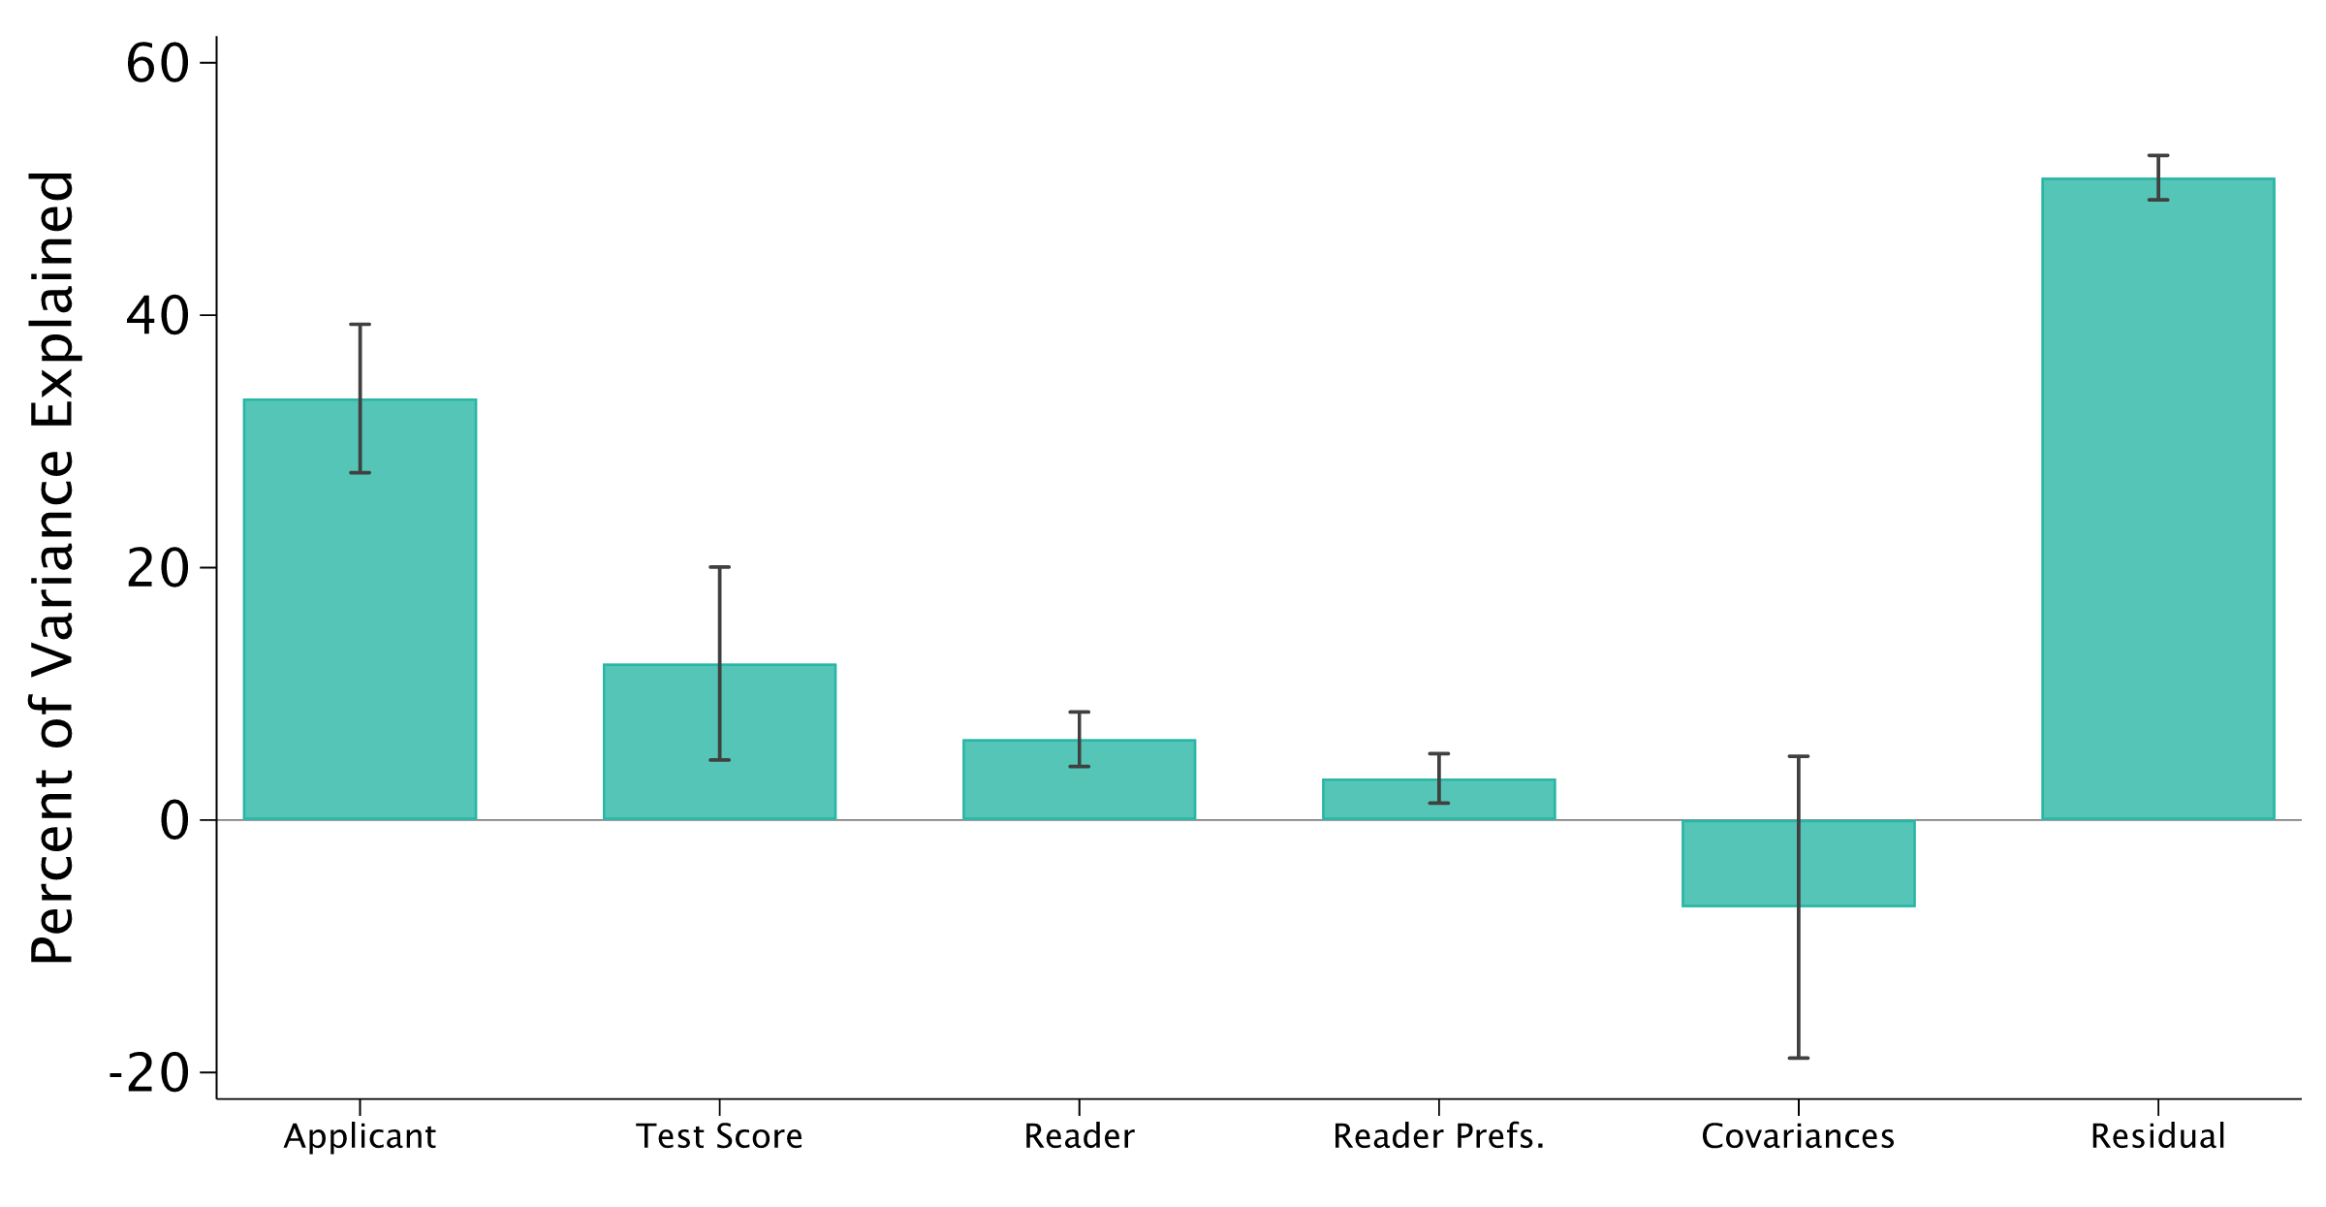
Full Variance Decomposition
Including Covariance and 95% Confidence Intervals

