Slide 1
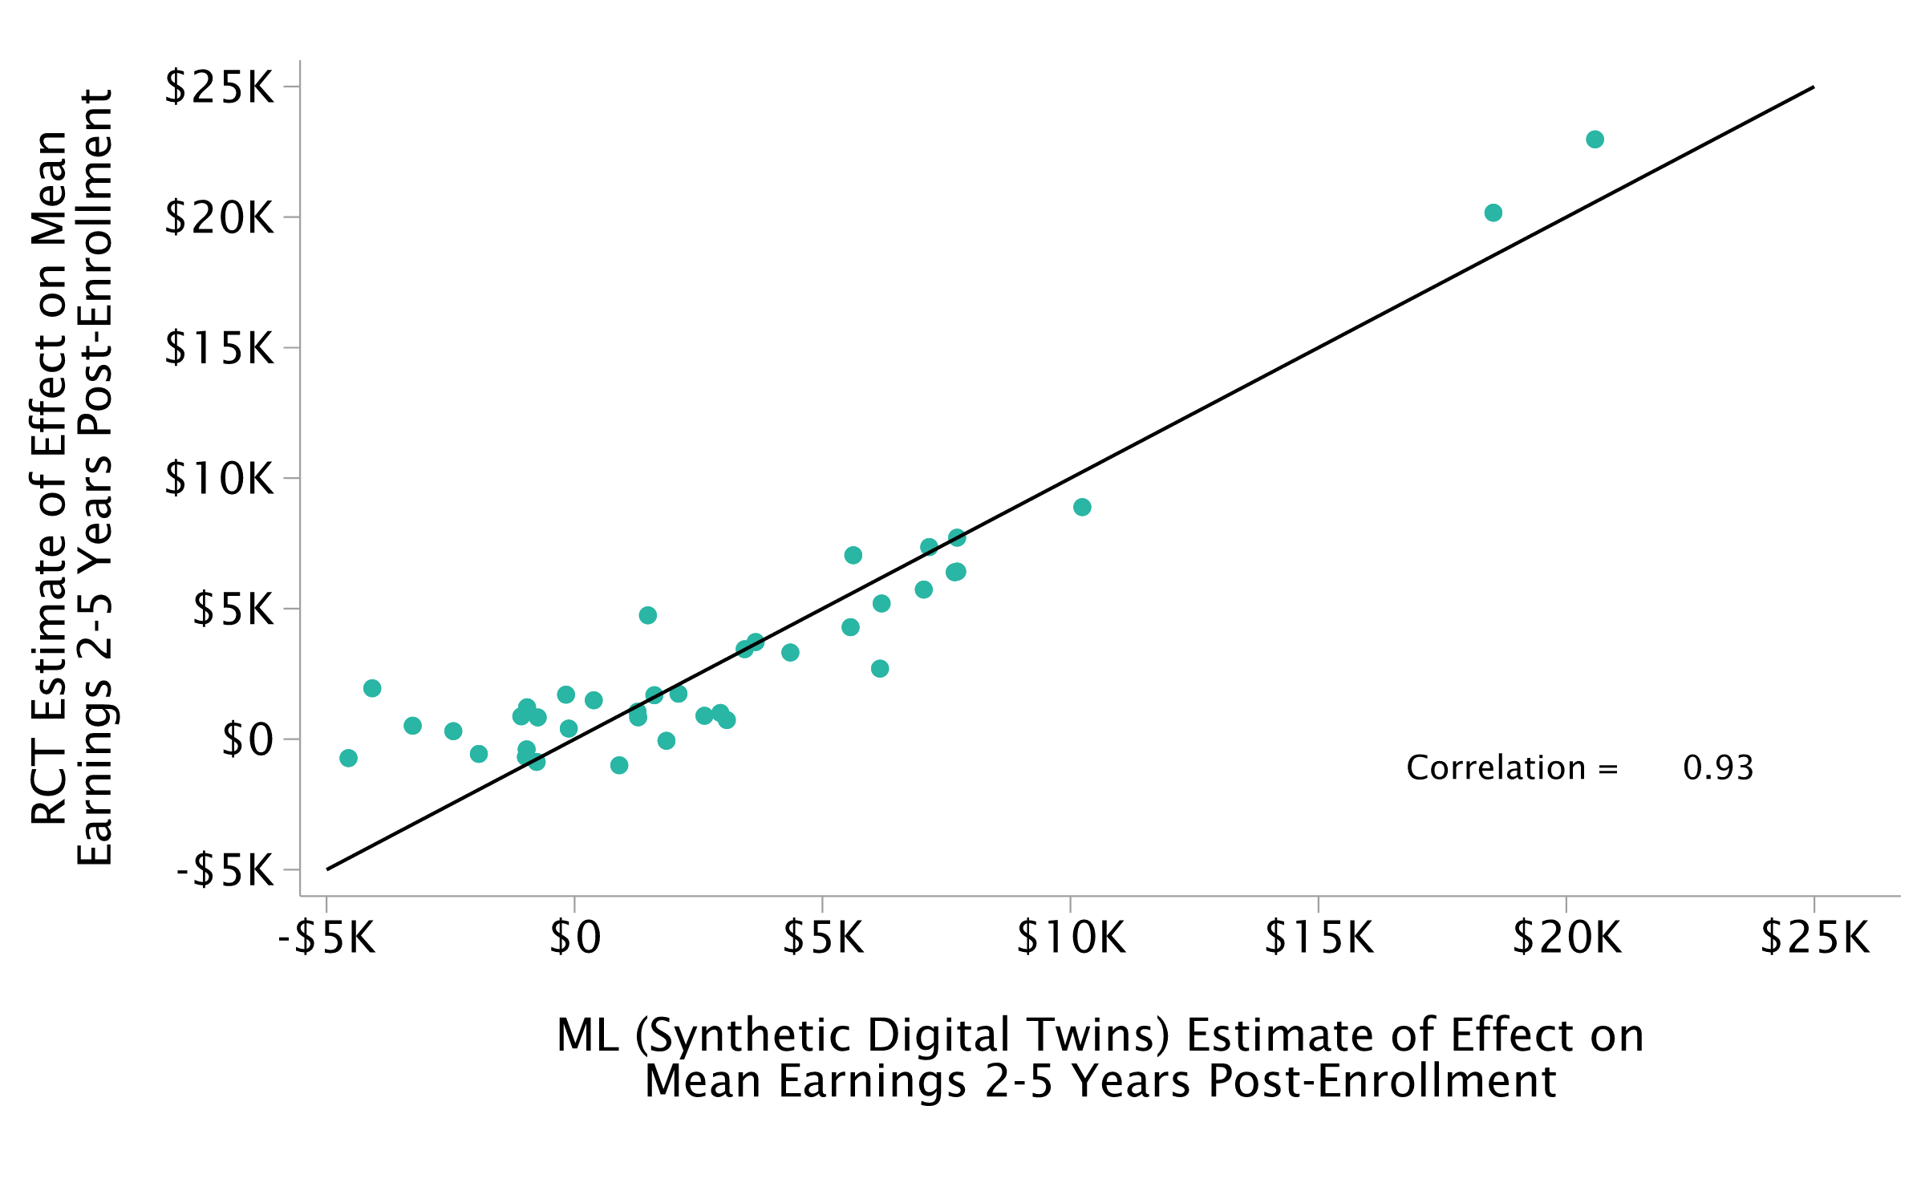
Effects of Workforce Training Programs on Earnings
Observational vs. Randomized Trial Estimates for Programs Implemented in 39 sites

Slide 2
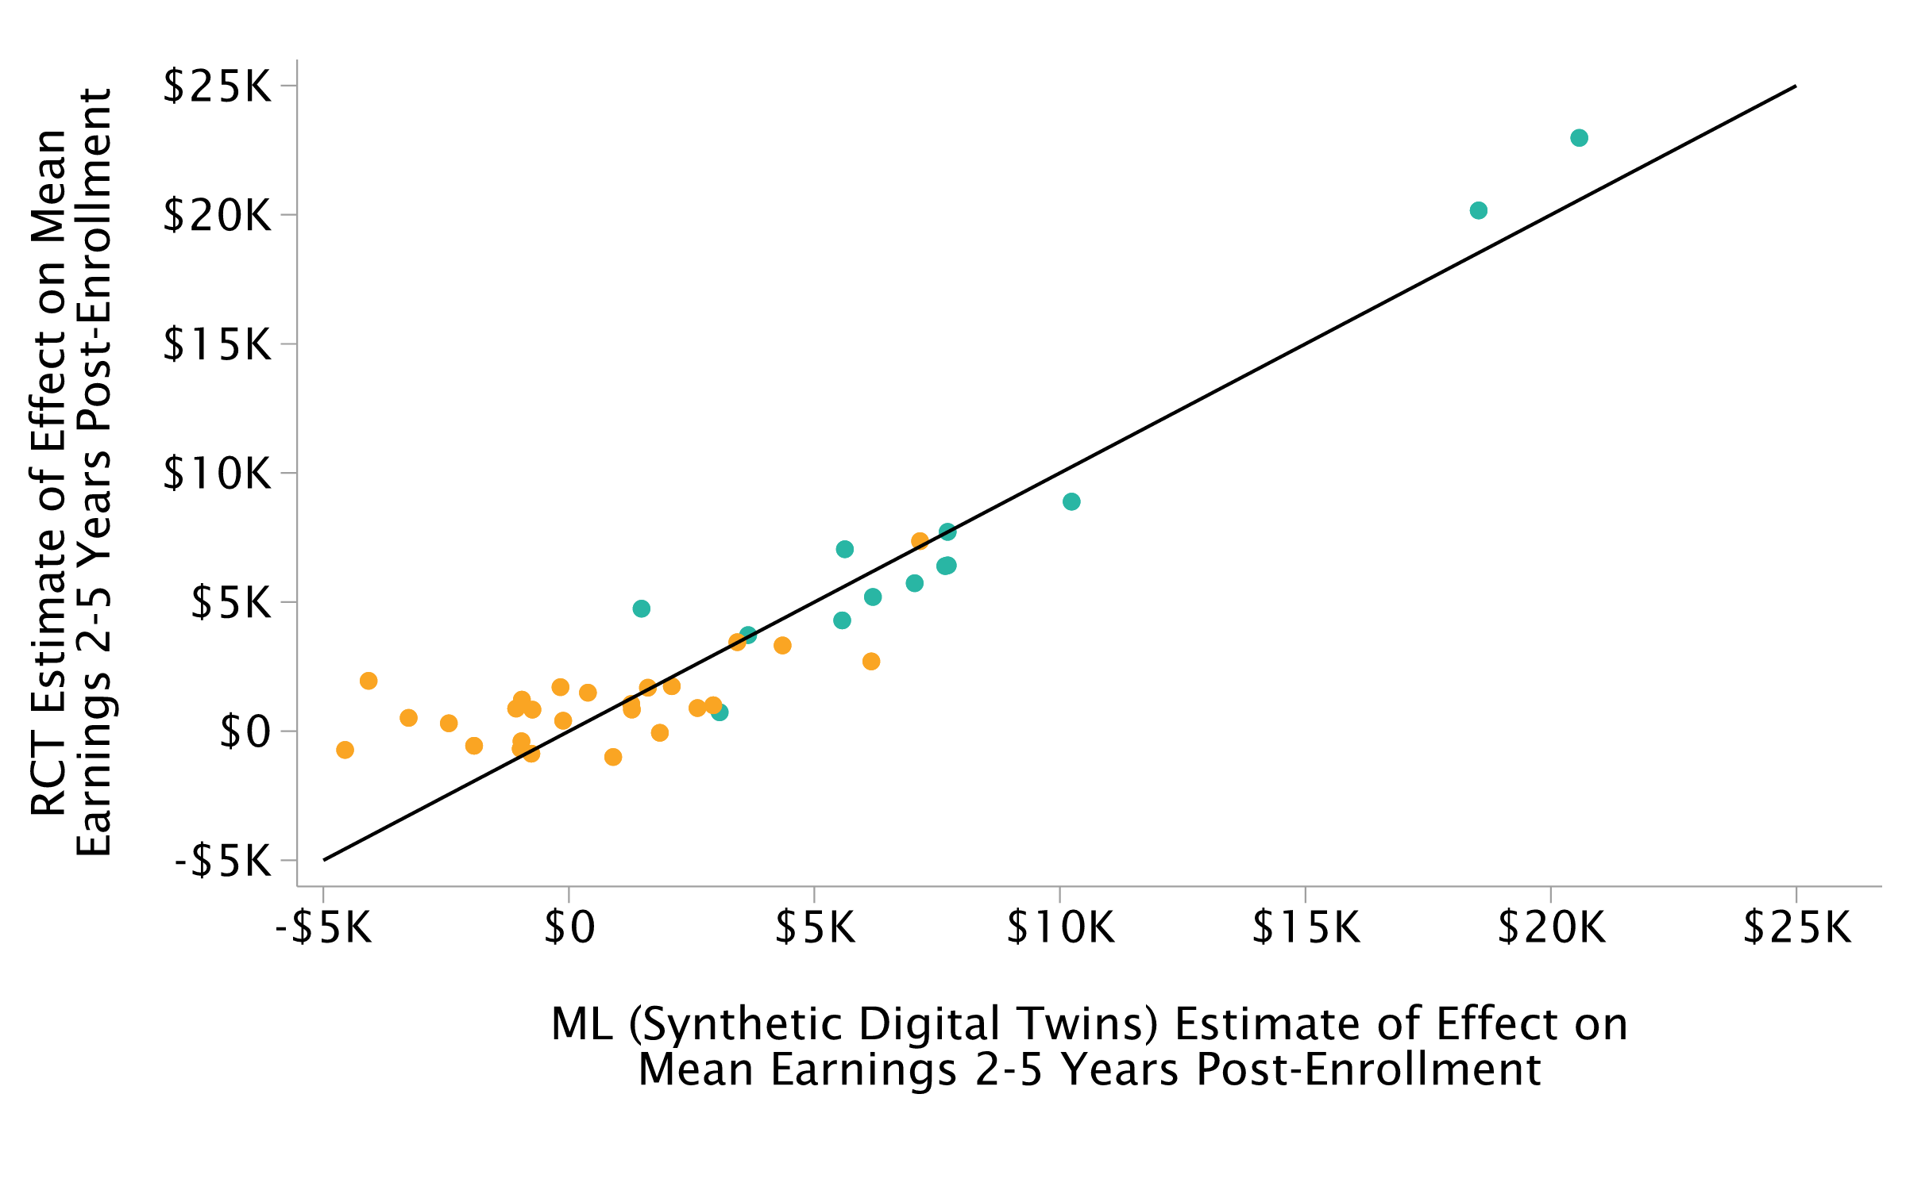
Effects of Workforce Training Programs on Earnings
Observational vs. Randomized Trial Estimates for Programs Implemented in 39 sites

Slide 3
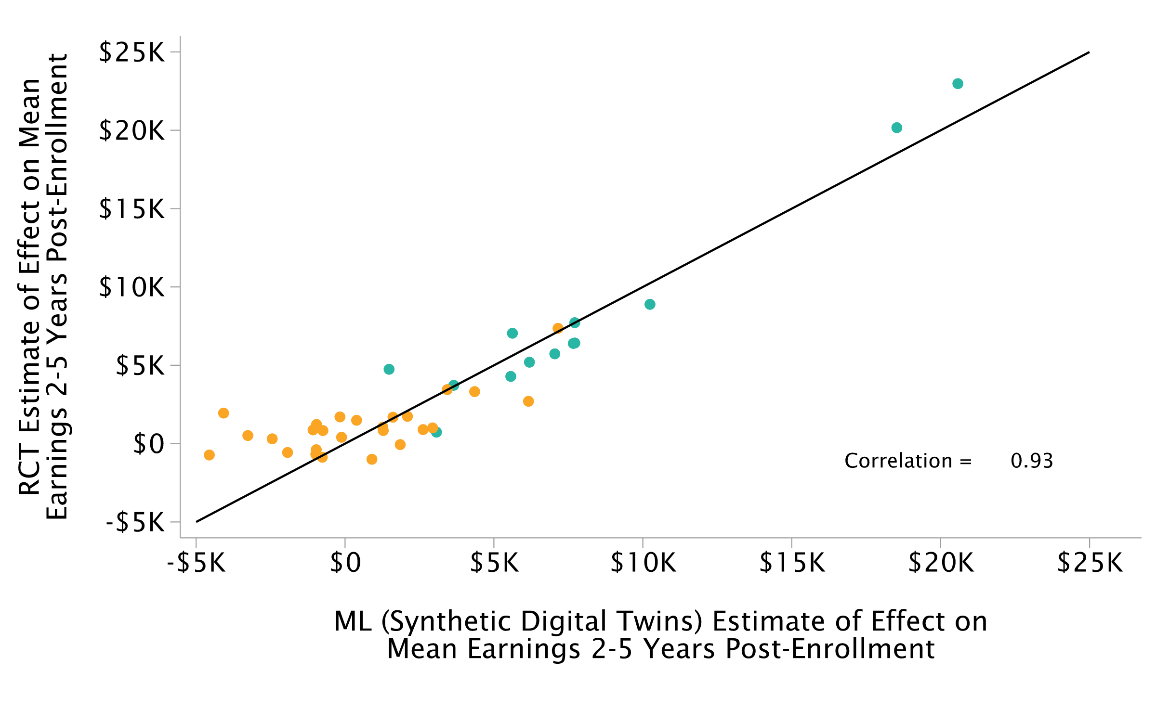
Effects of Workforce Training Programs on Earnings
Observational vs. Randomized Trial Estimates for Programs Implemented in 39 sites

Slide 4
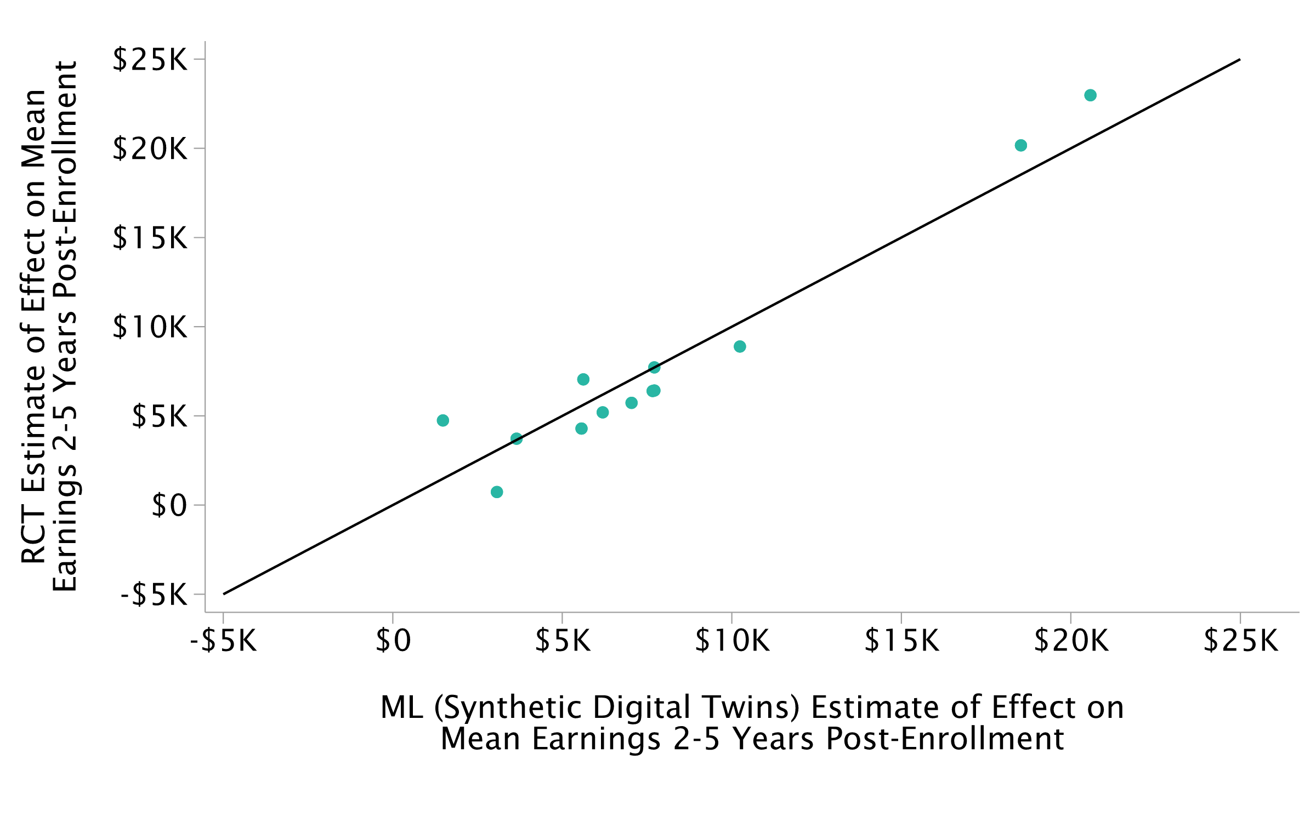
Effects of Workforce Training Programs on Earnings
Observational vs. Randomized Trial Estimates for Programs Implemented in 39 sites

Slide 5
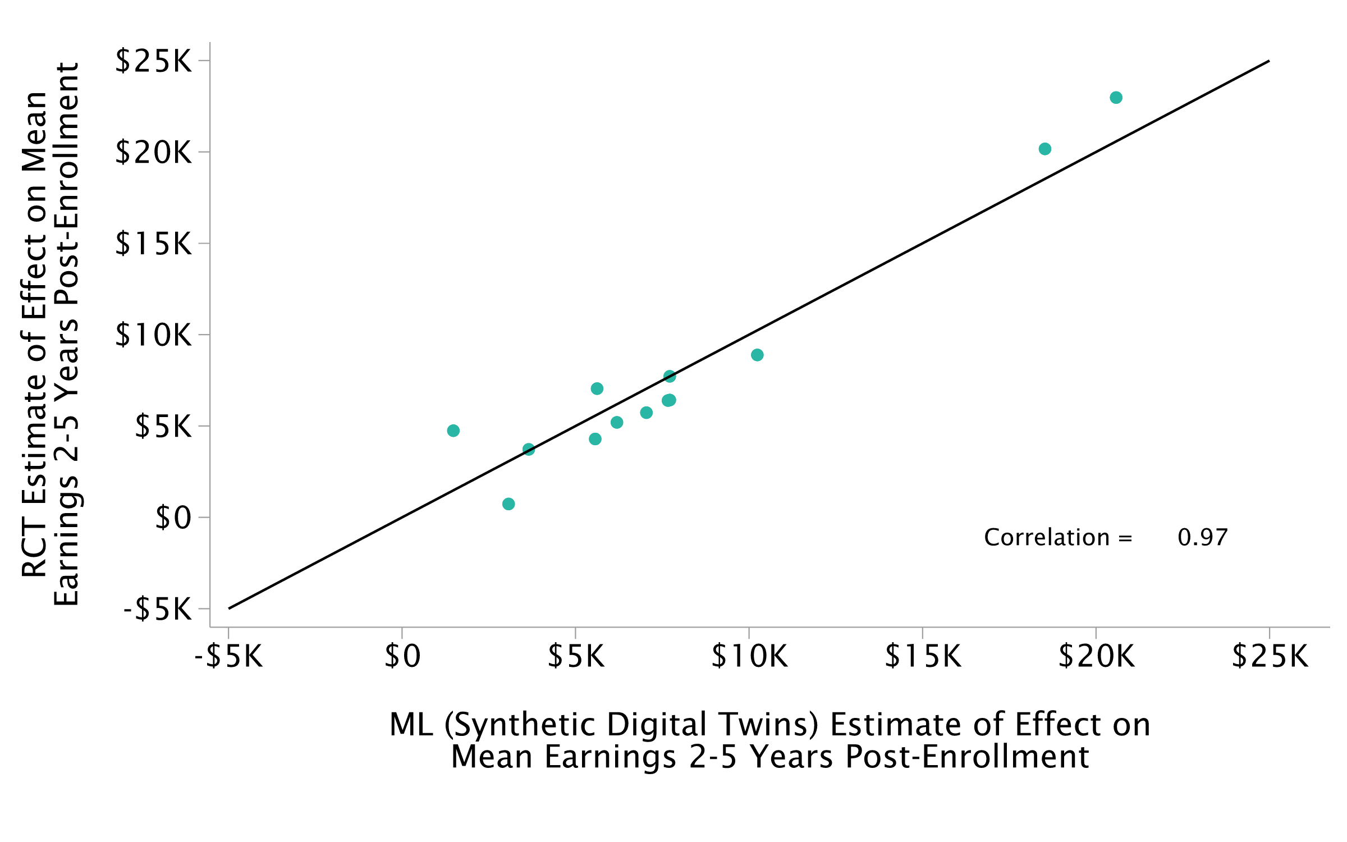
Effects of Workforce Training Programs on Earnings
Observational vs. Randomized Trial Estimates for Programs Implemented in 39 sites

