Slide 1
The Impacts of WGU Programs on Students' Earnings
Preliminary Estimates Using Matched Comparison Groups
February 2026
PRELIMINARY DATA -- DO NOT CITE

Slide 2
Data Sources
• Data: WGU enrollment records linked to Census+tax data covering full U.S. population (including tax filers and non-filers)
  – 99% of WGU enrollees successfully linked
  – Includes WGU graduates, withdrawers, and certificates
• Analysis sample: 262,000 WGU enrollees from 2013-18
  – Earnings observed from 2008-2023 in tax records
• Primary outcome: earnings reported on W-2 forms, measured in real 2021 dollars
  – Includes those not working as 0s
  – Excludes self-employment income (can be incorporated later)

Slide 3
Identifying Matched Controls
• For each WGU enrollee, identify matched controls based on:
  – Pre-enrollment earnings trajectory: W-2 earnings in the three years prior to enrollment
  – Age, sex, and county of residence in year of enrollment
• Then compare average earnings of WGU enrollees to those of matched controls pre vs. post enrollment
  – Average WGU enrollee has 350 matched controls
  – 11% of matched control group enrolls in other non-WGU degree programs at the same time

Slide 4
WGU Program Categories
Programs Grouped into Eight Degree-Sectors
Degree Level | Program | Example Program | Number of Students | Graduation Rate
Bachelor | Education | BA, Interdisciplinary Studies (K-8) | 31,000 | 53%
Bachelor | Health | BS, Nursing | 54,000 | 75%
Bachelor | Business | BS, Business Management | 65,000 | 46%
Bachelor | Technology | BS, Information Technology | 29,000 | 46%
Master | Education | MS, Curriculum and Instruction | 22,000 | 81%
Master | Health | MS, Nursing Education (BSN-MSN) | 25,000 | 67%
Master | Business | MBA | 32,000 | 67%
Master | Technology | MS, Cybersecurity and Information Assurance | 5,000 | 59%
Programs aggregated from individual WGU degree programs into 8 groups by degree level and field of study.

Slide 5
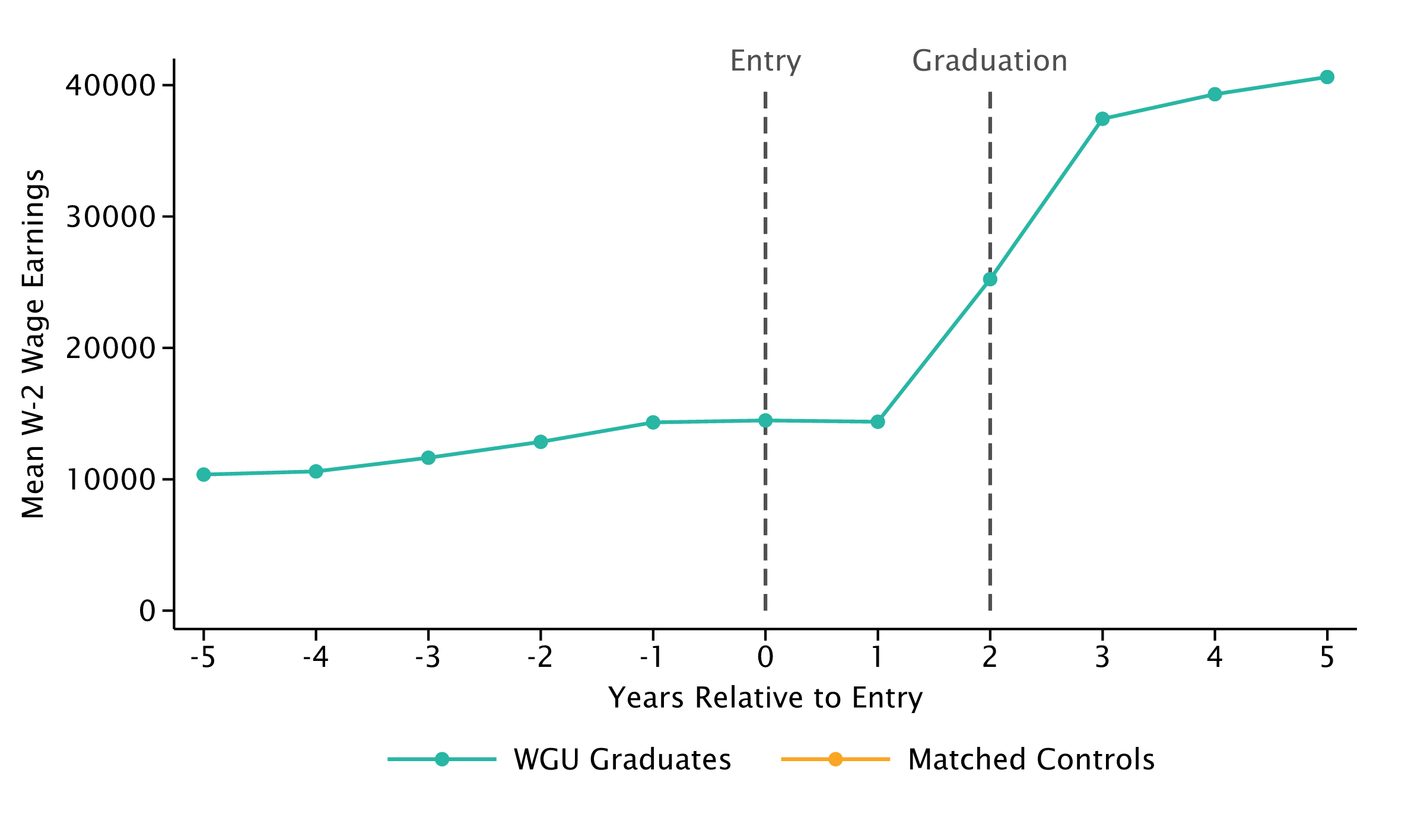
Impact of Bachelor of Education on Earnings
WGU Enrollees who Graduate 2 Years After Entry vs. Matched Controls

Slide 6
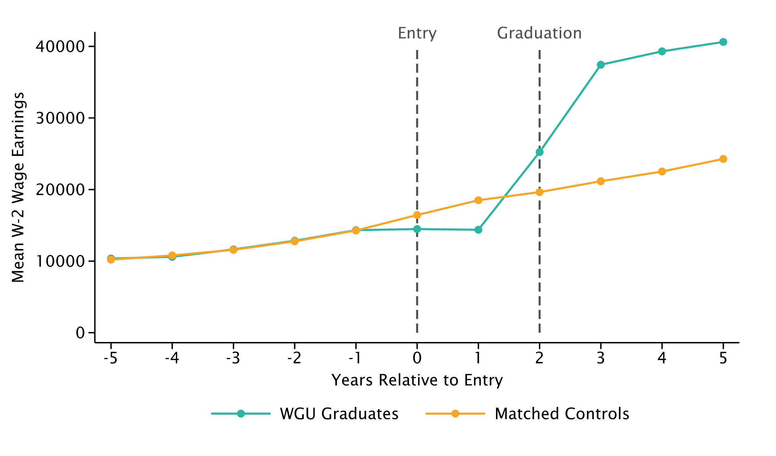
Impact of Bachelor of Education on Earnings
WGU Enrollees who Graduate 2 Years After Entry vs. Matched Controls

Slide 7
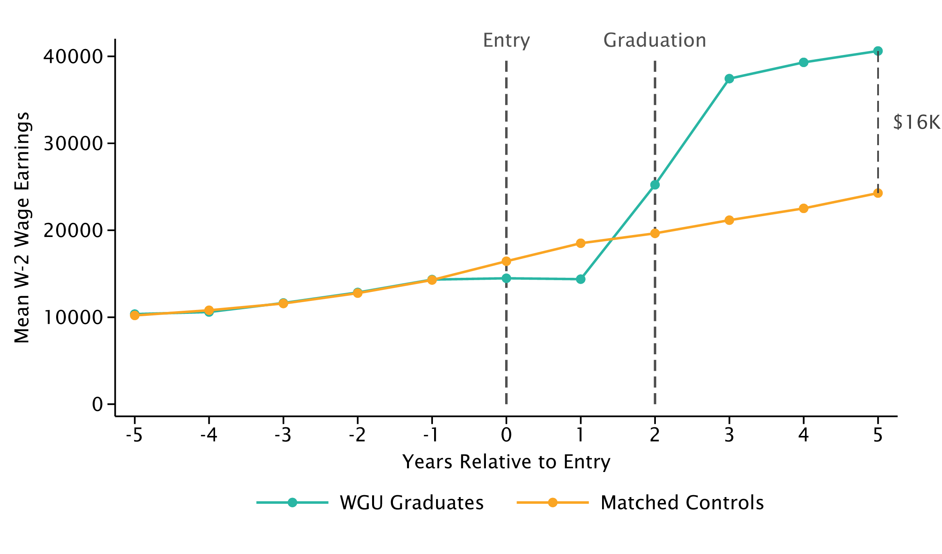
Impact of Bachelor of Education on Earnings
WGU Enrollees who Graduate 2 Years After Entry vs. Matched Controls

Slide 8
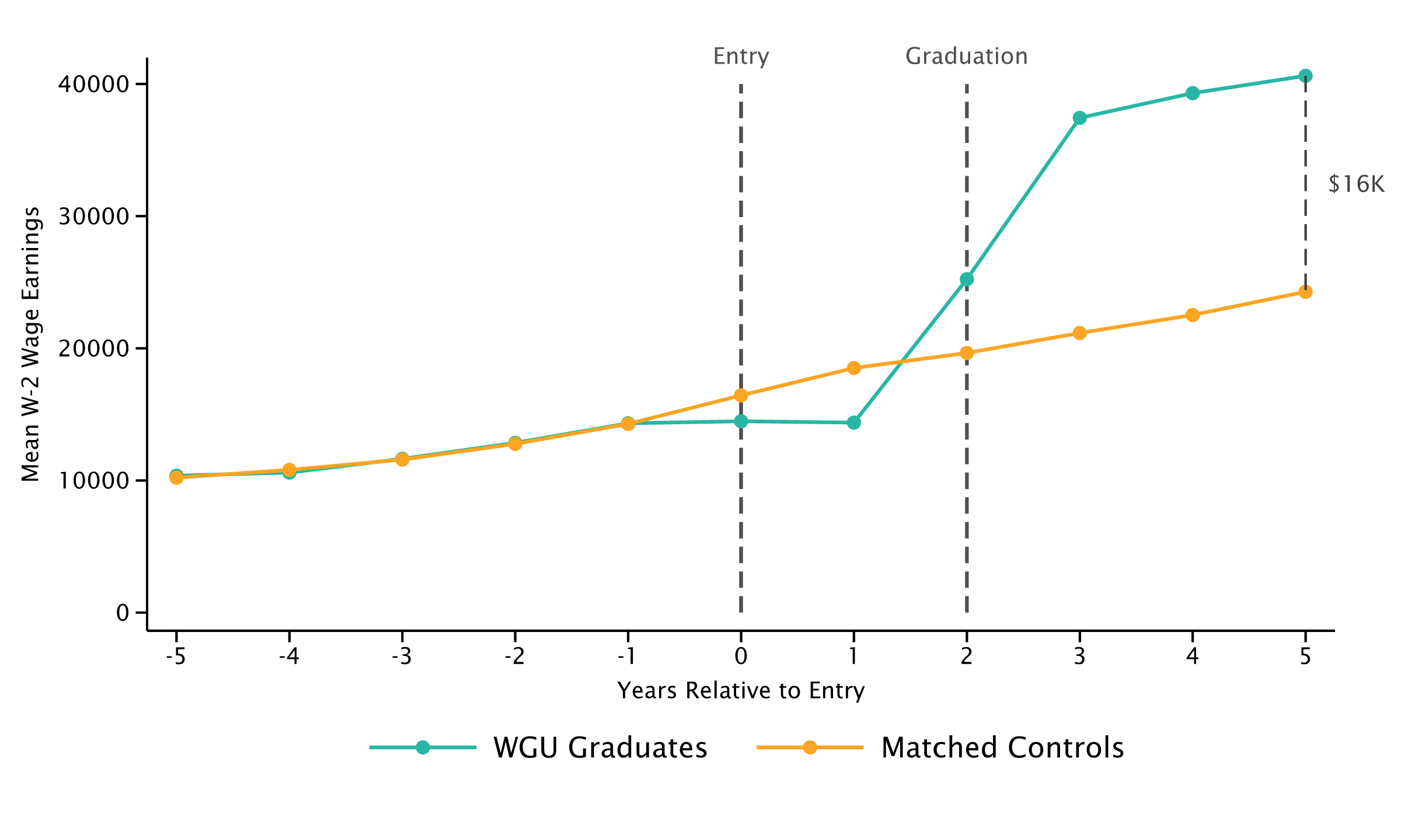
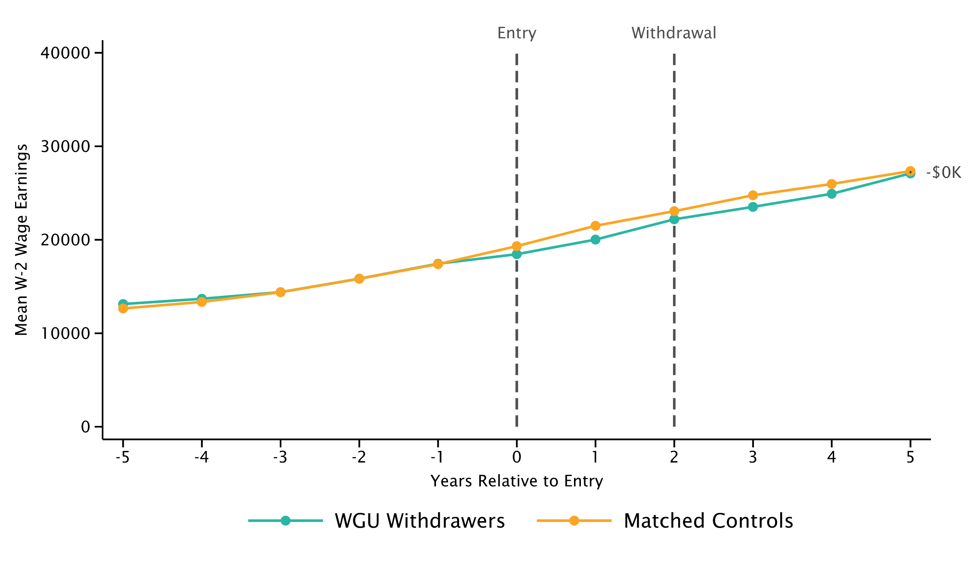
Impact of Bachelor of Education on Earnings
WGU Enrollees who Graduates or Withdraw 2 Years After Entry
Graduates
Withdrawers

Slide 9
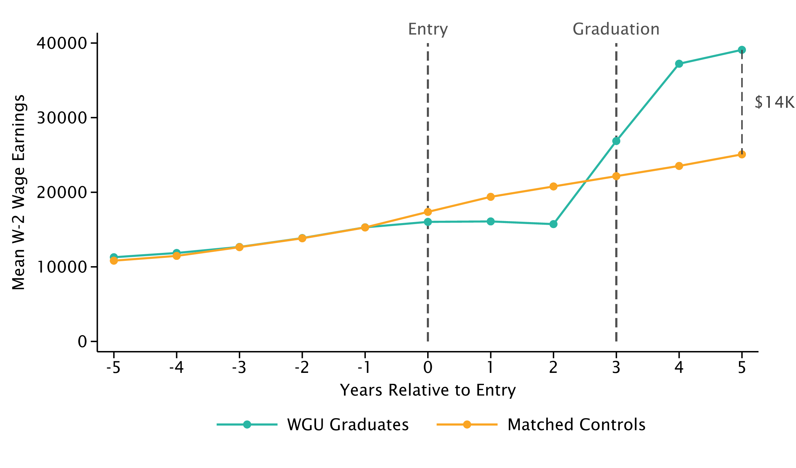
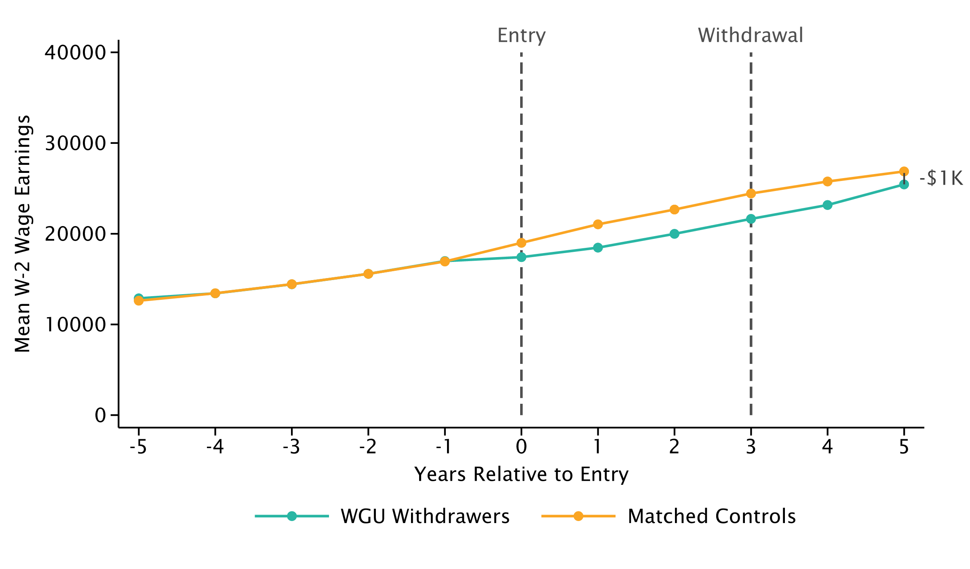
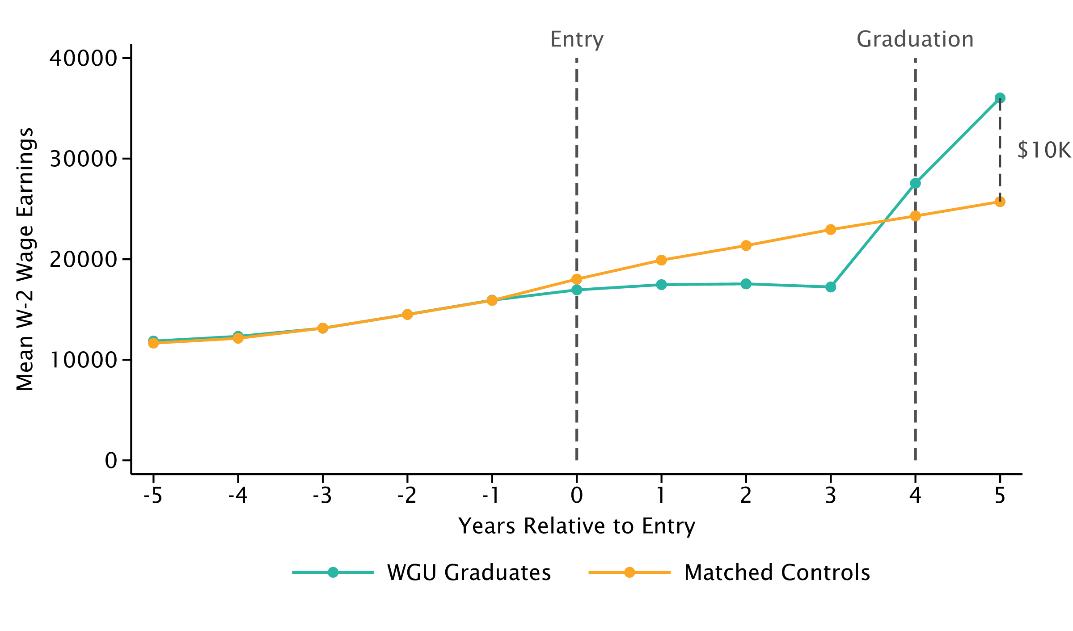
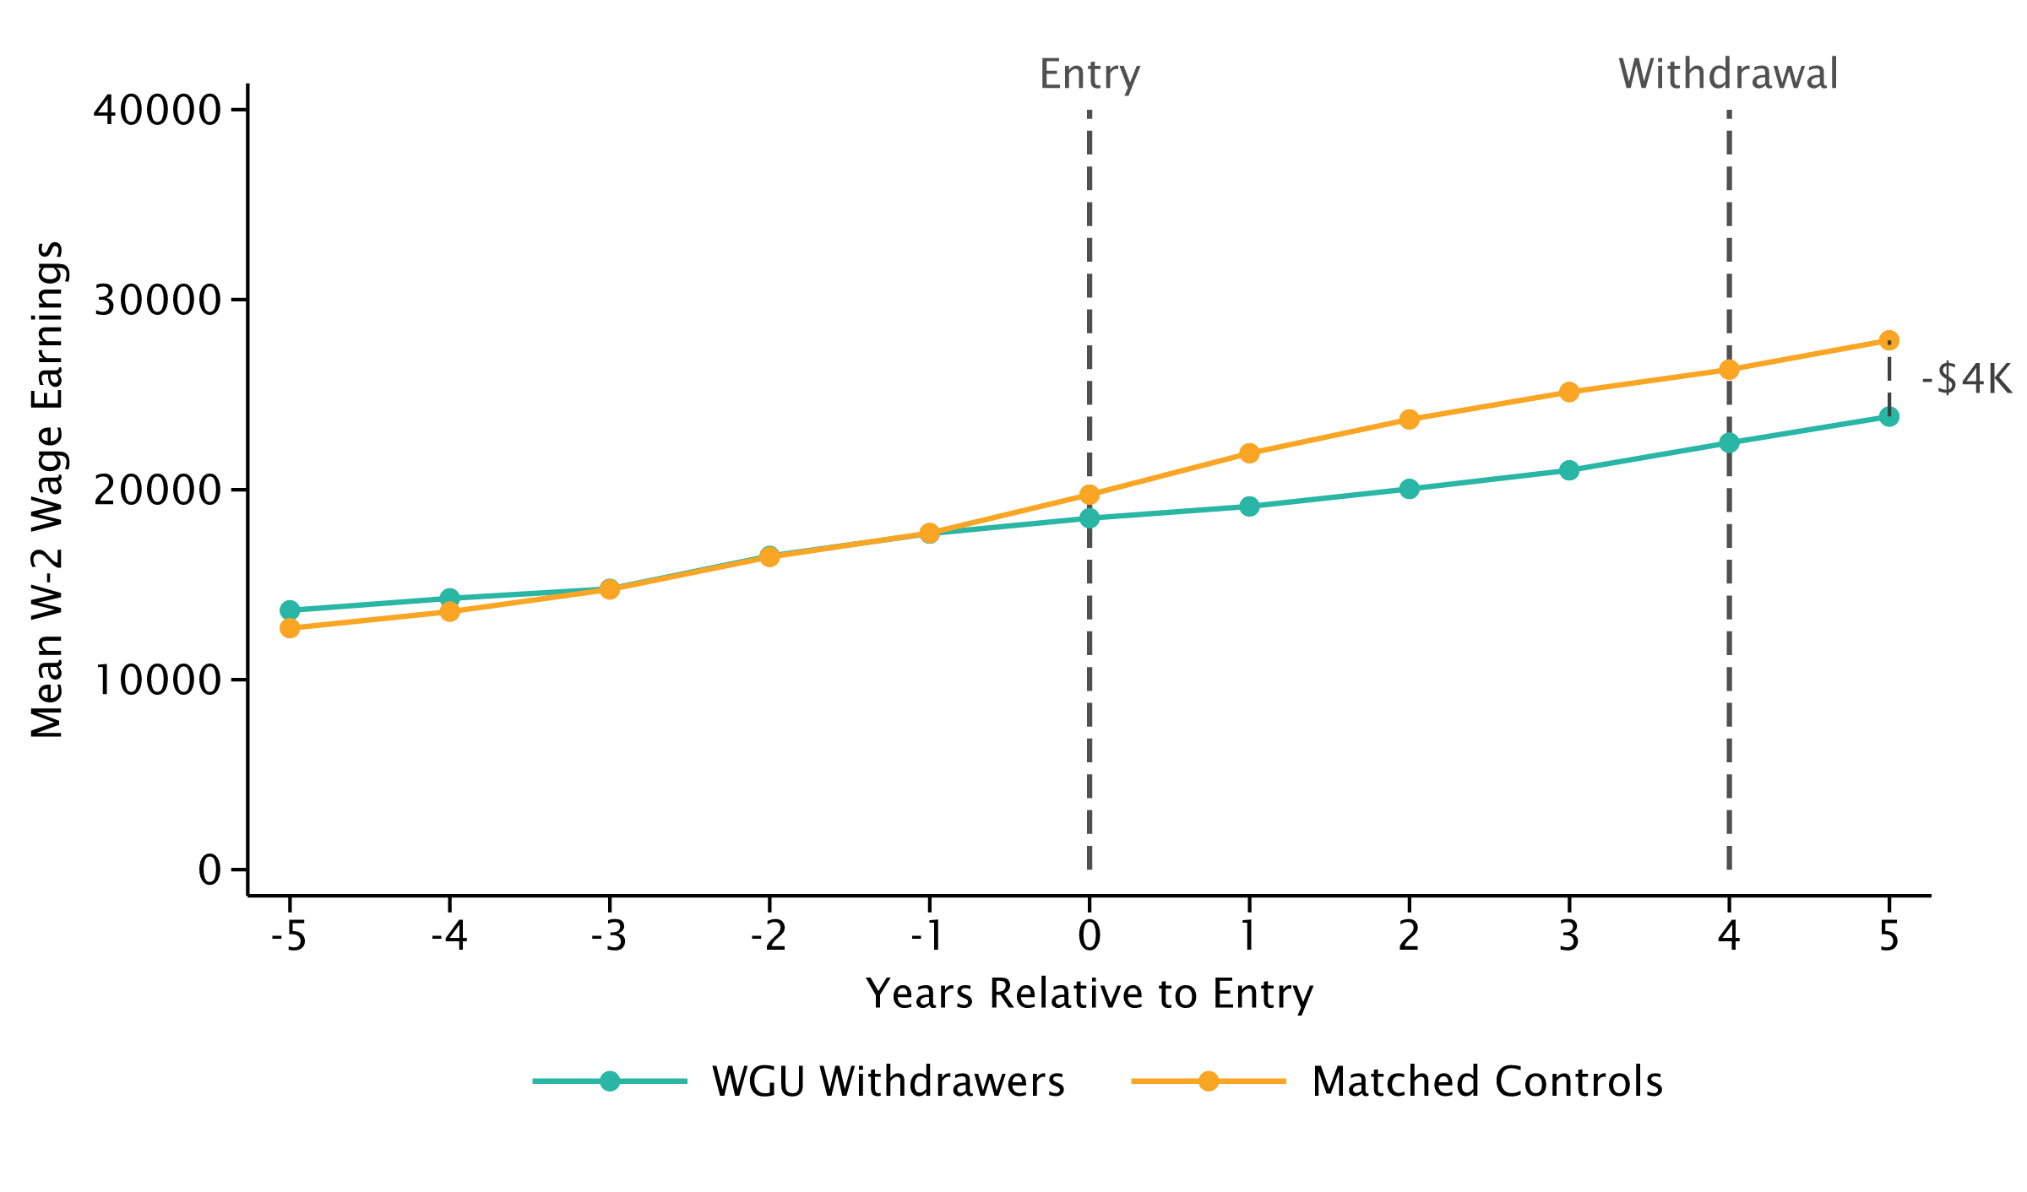
Impact of Bachelor of Education on Earnings
WGU Enrollees who Graduates or Withdraw 3 or 4 Years After Entry
Graduates
Withdrawers

Slide 10
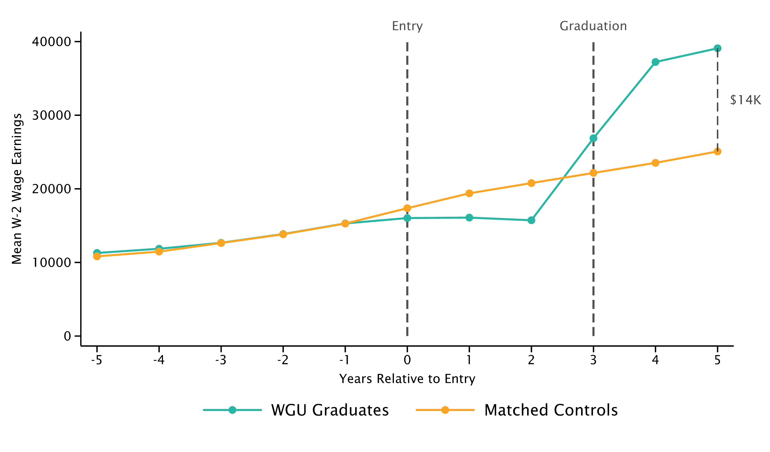
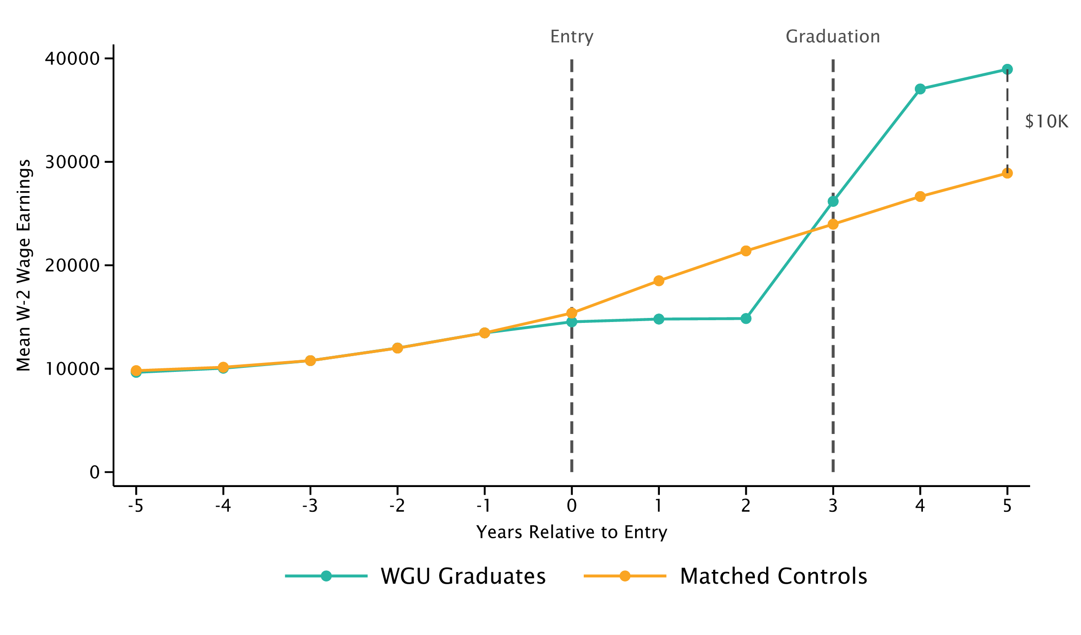
Impact of Bachelor of Education on Earnings
Baseline Model vs. Comparison to People who Enroll in Other Higher Education Institutions
Comparison to All Matched Individuals
Comparison to Other Higher Education Enrollees

Slide 11
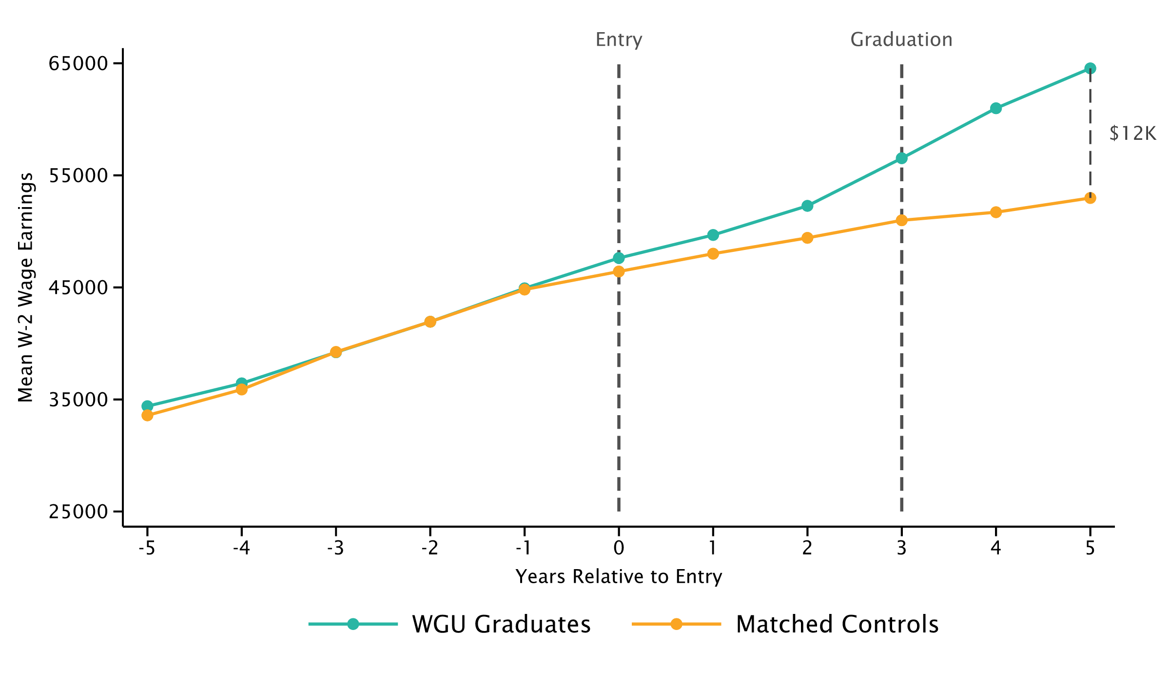
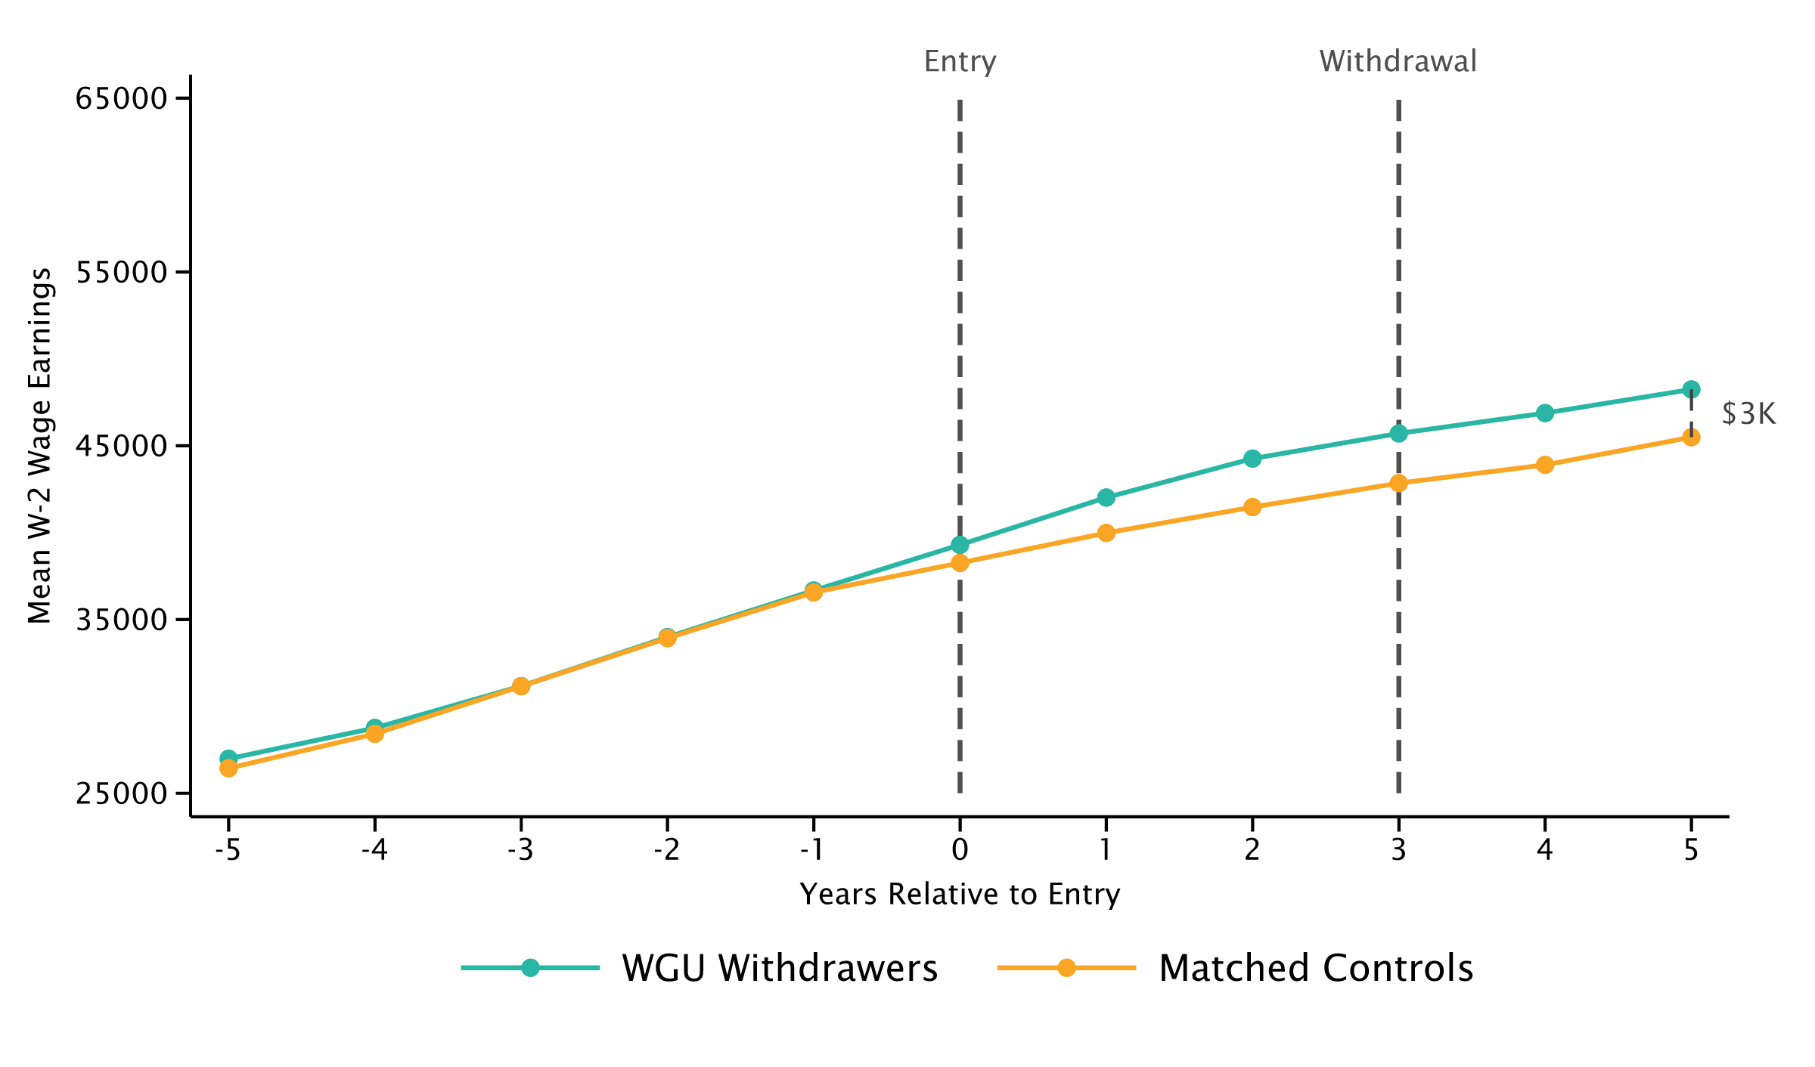
Impact of Bachelor of Business on Earnings
WGU Enrollees who Graduate or Withdraw 3 Years After Entry
Graduates
Withdrawers

Slide 12
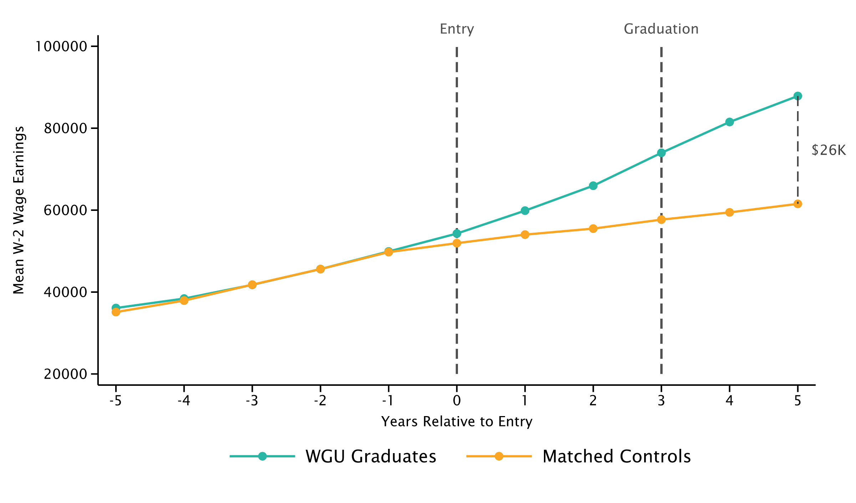
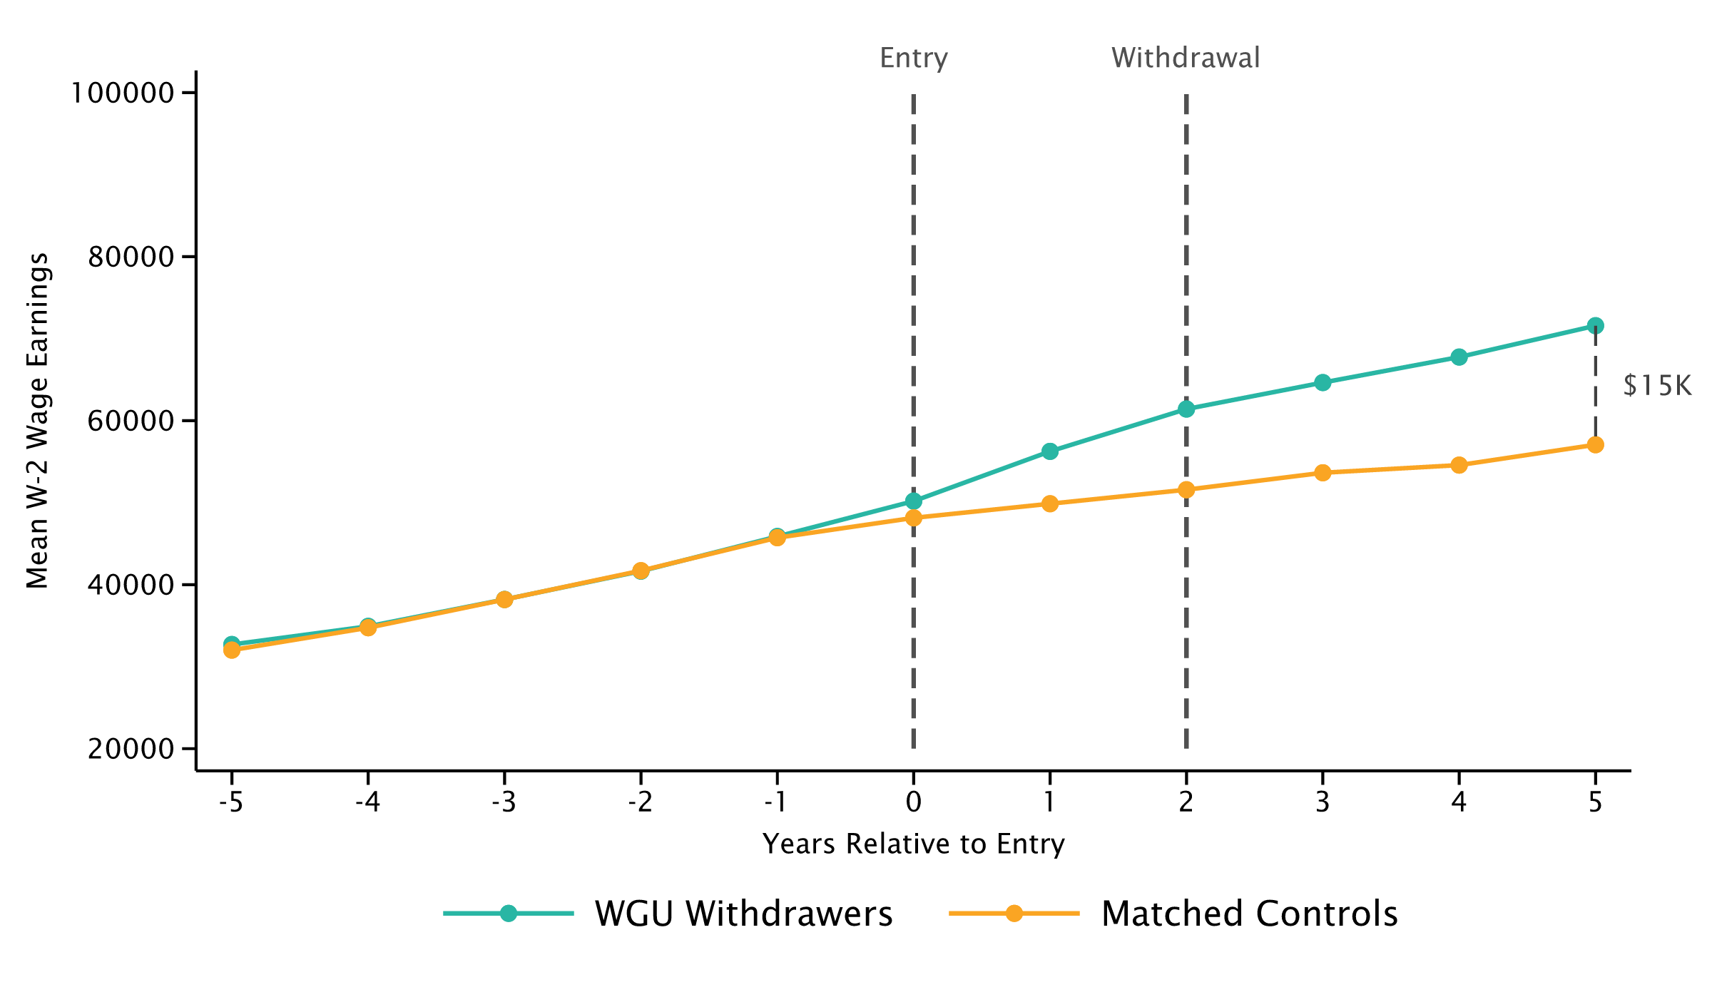
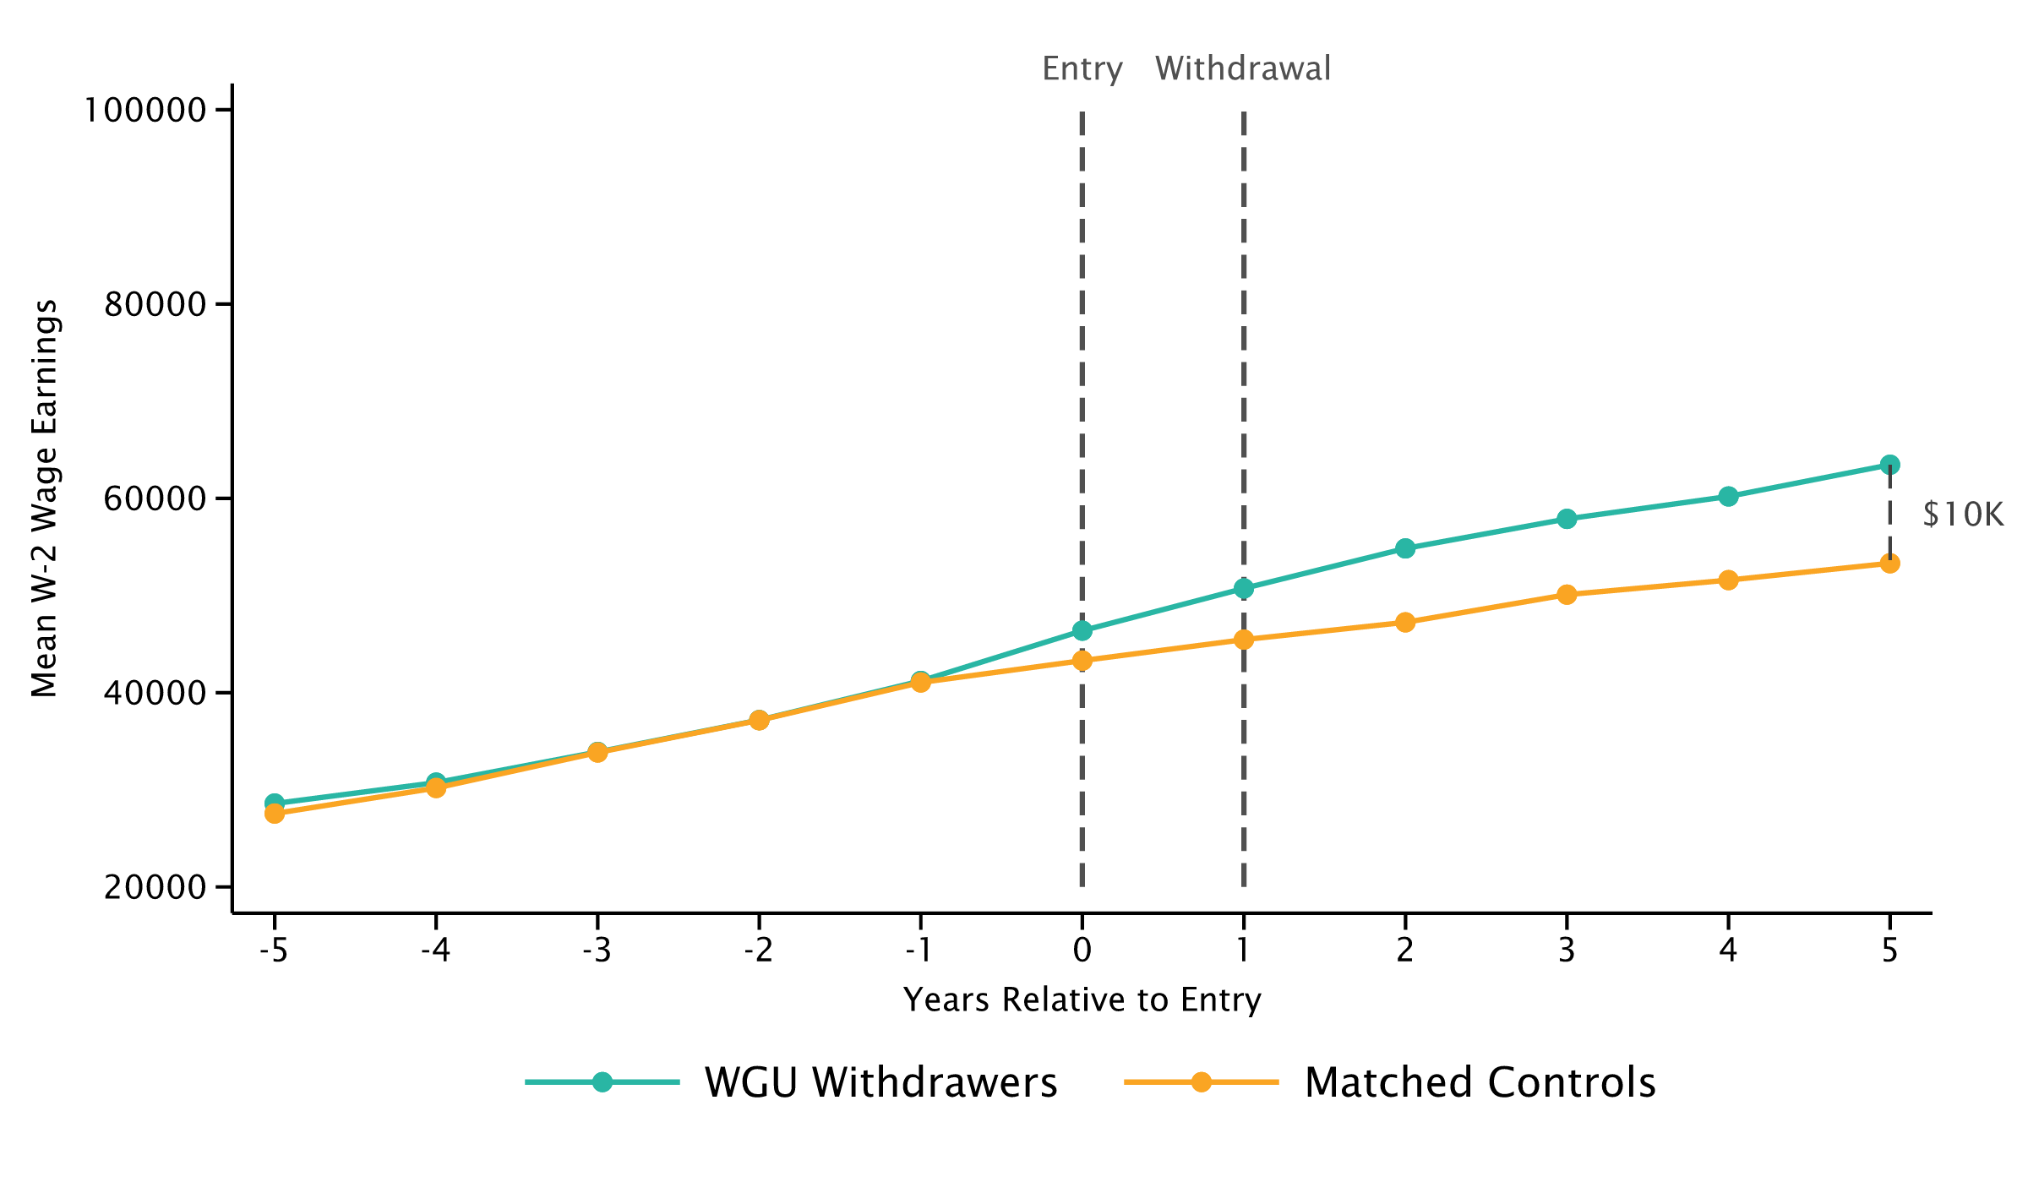
Impact of Bachelor of Technology on Earnings
WGU Enrollees who Graduate 3 Years After Entry, Withdraw w/Certificate, or Withdraw w/o Certificate
Graduates
Withdrawers w/ Certificate
Withdrawers w/o Certificate

Slide 13
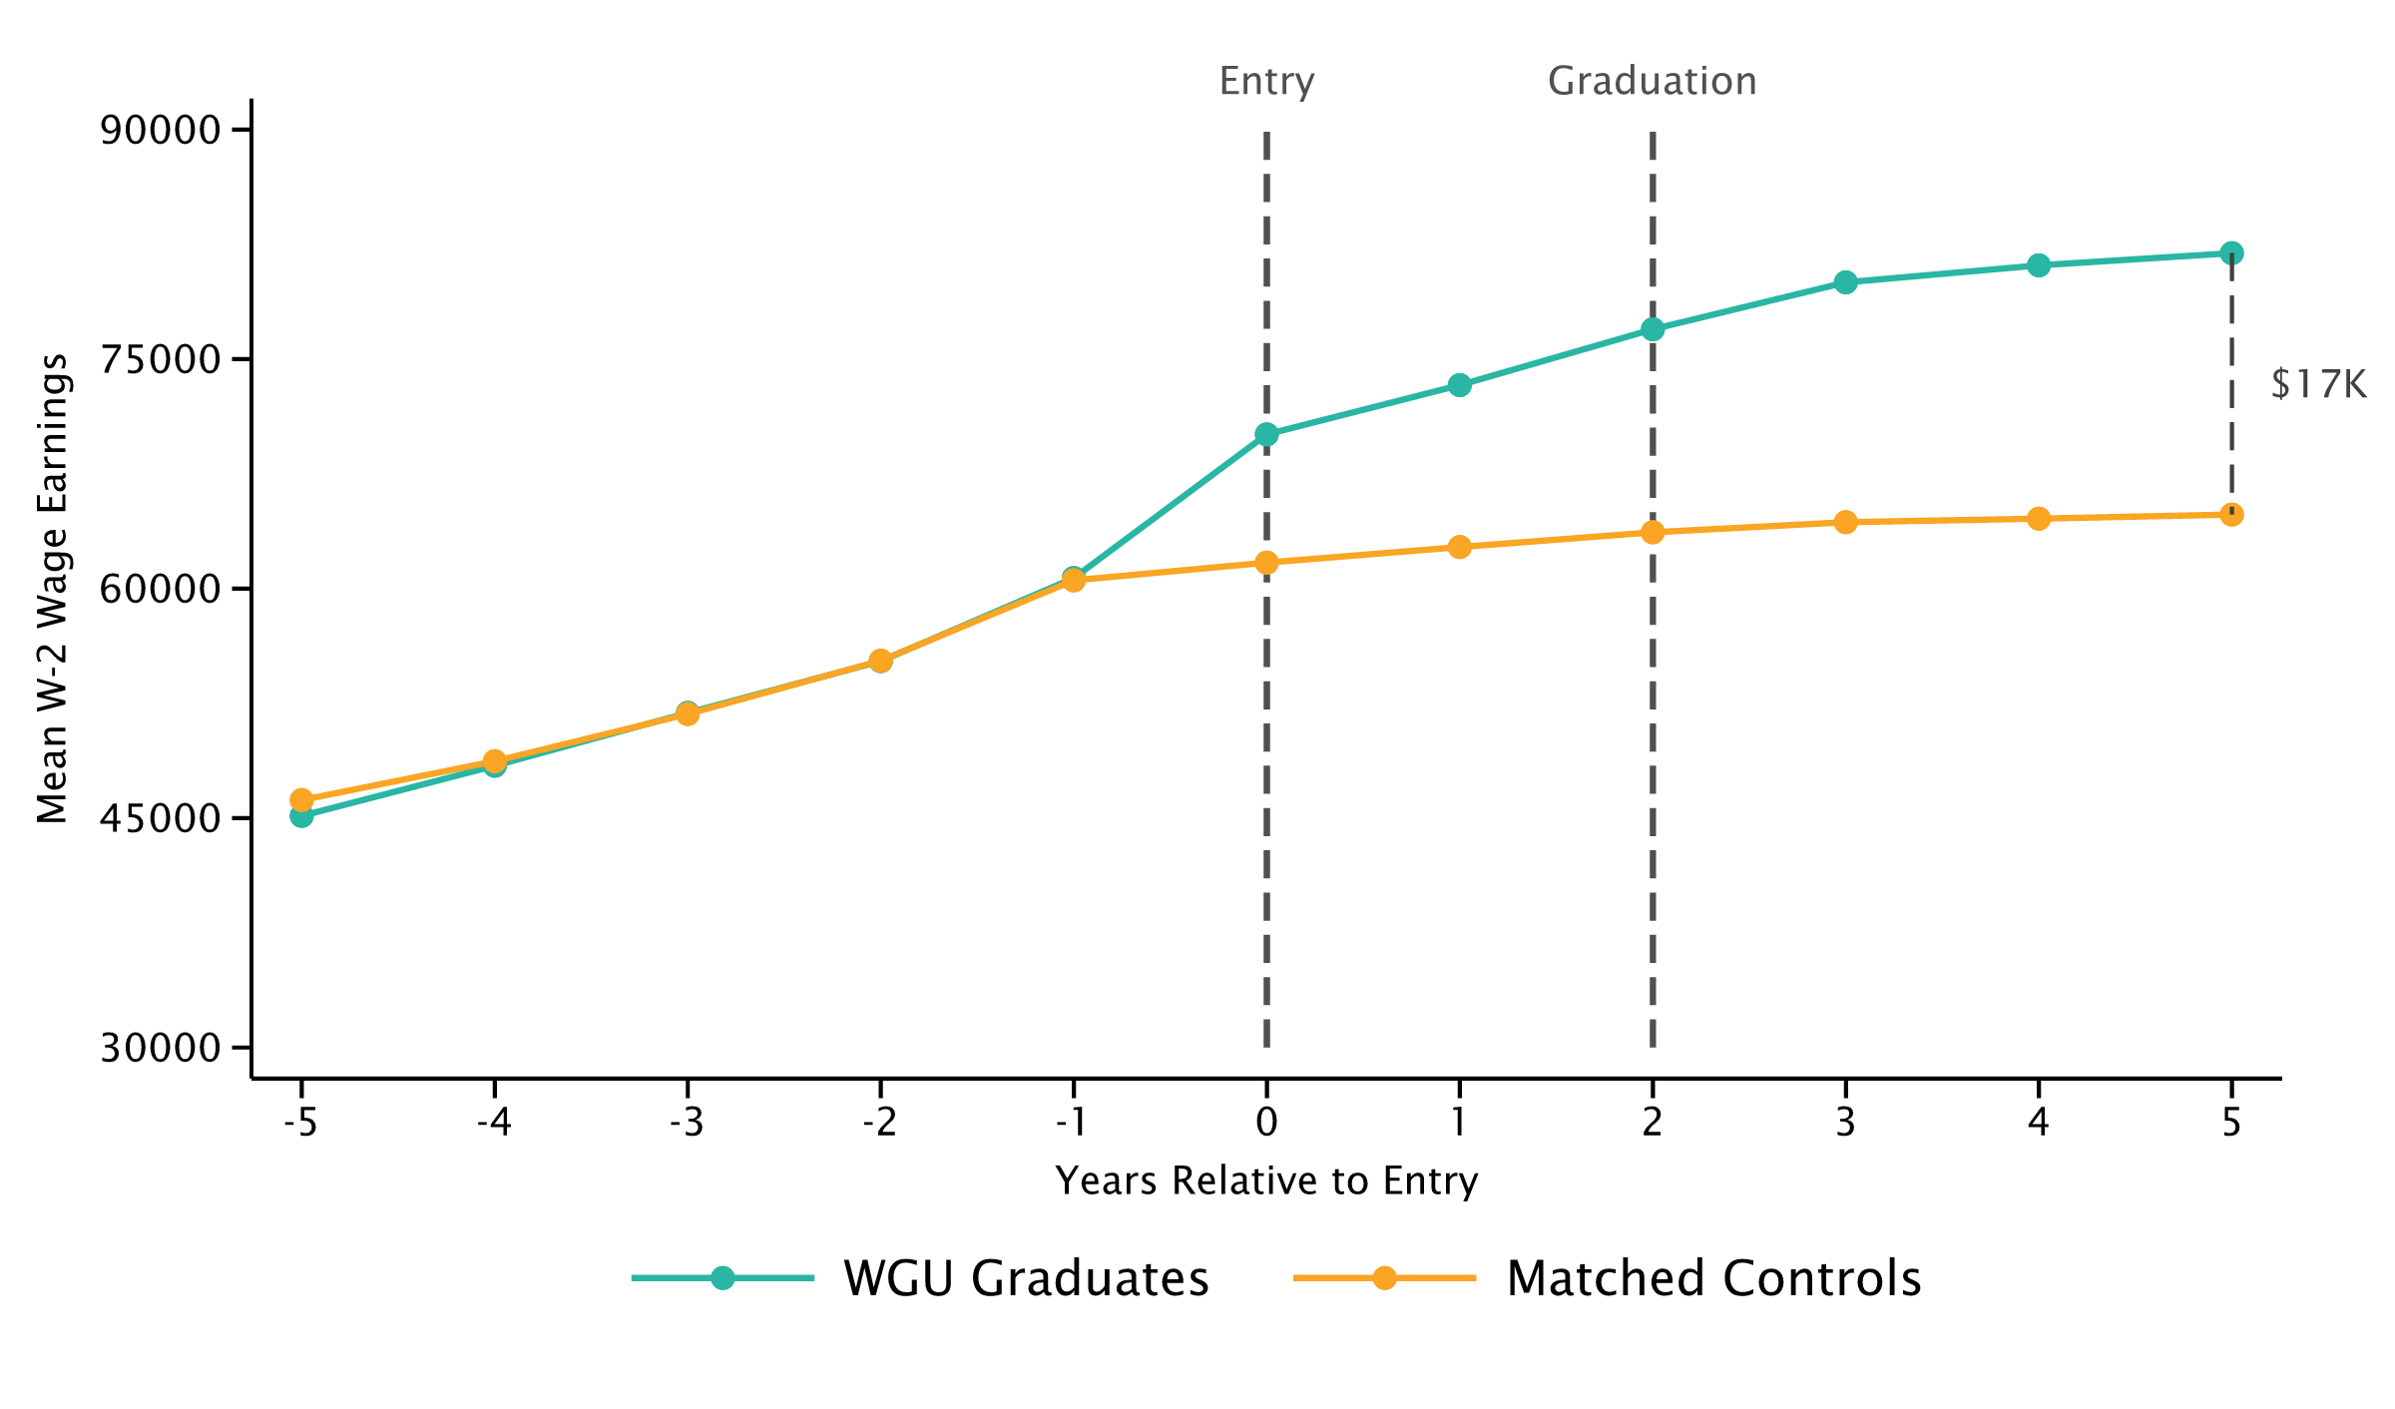
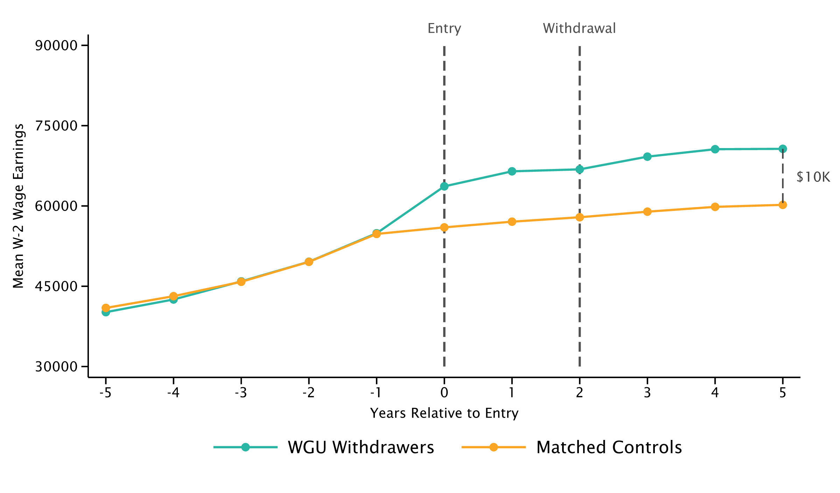
Impact of Bachelor of Health on Earnings
WGU Enrollees who Graduate or Withdraw 2 Years After Entry
Graduates
Withdrawers

Slide 14
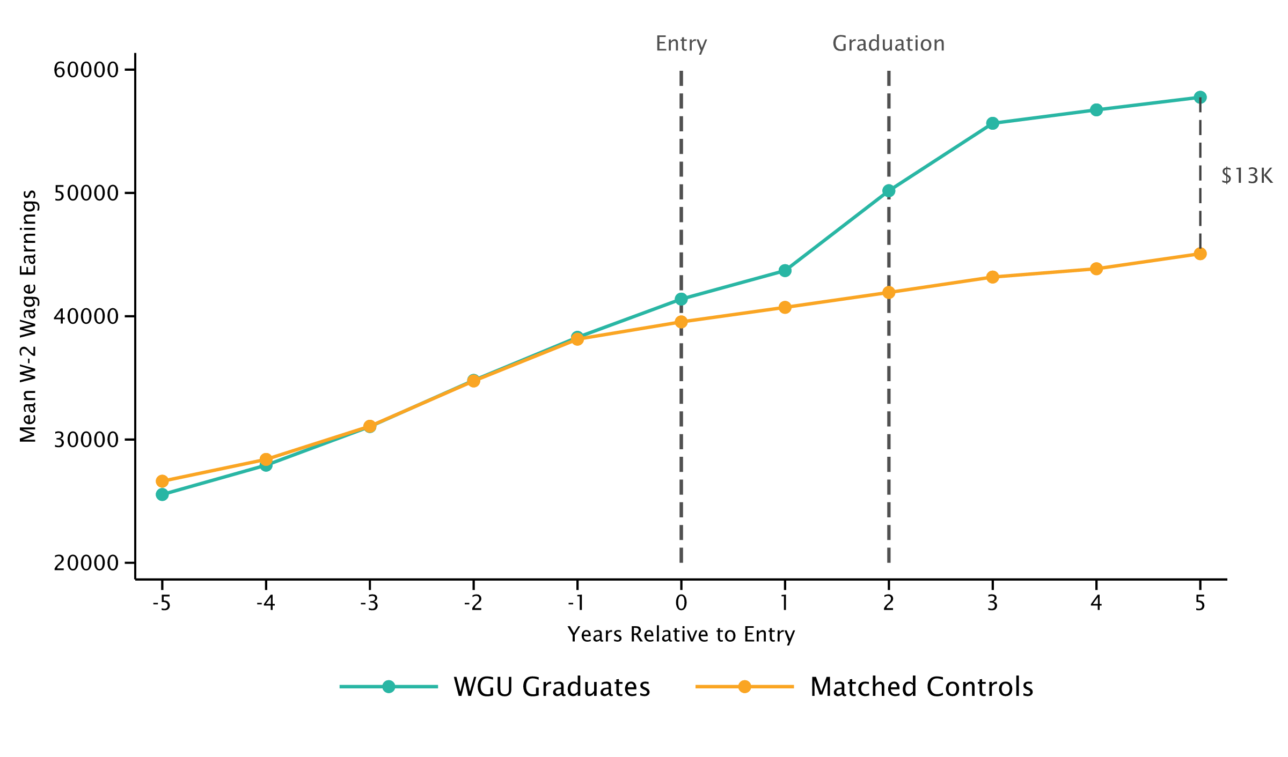
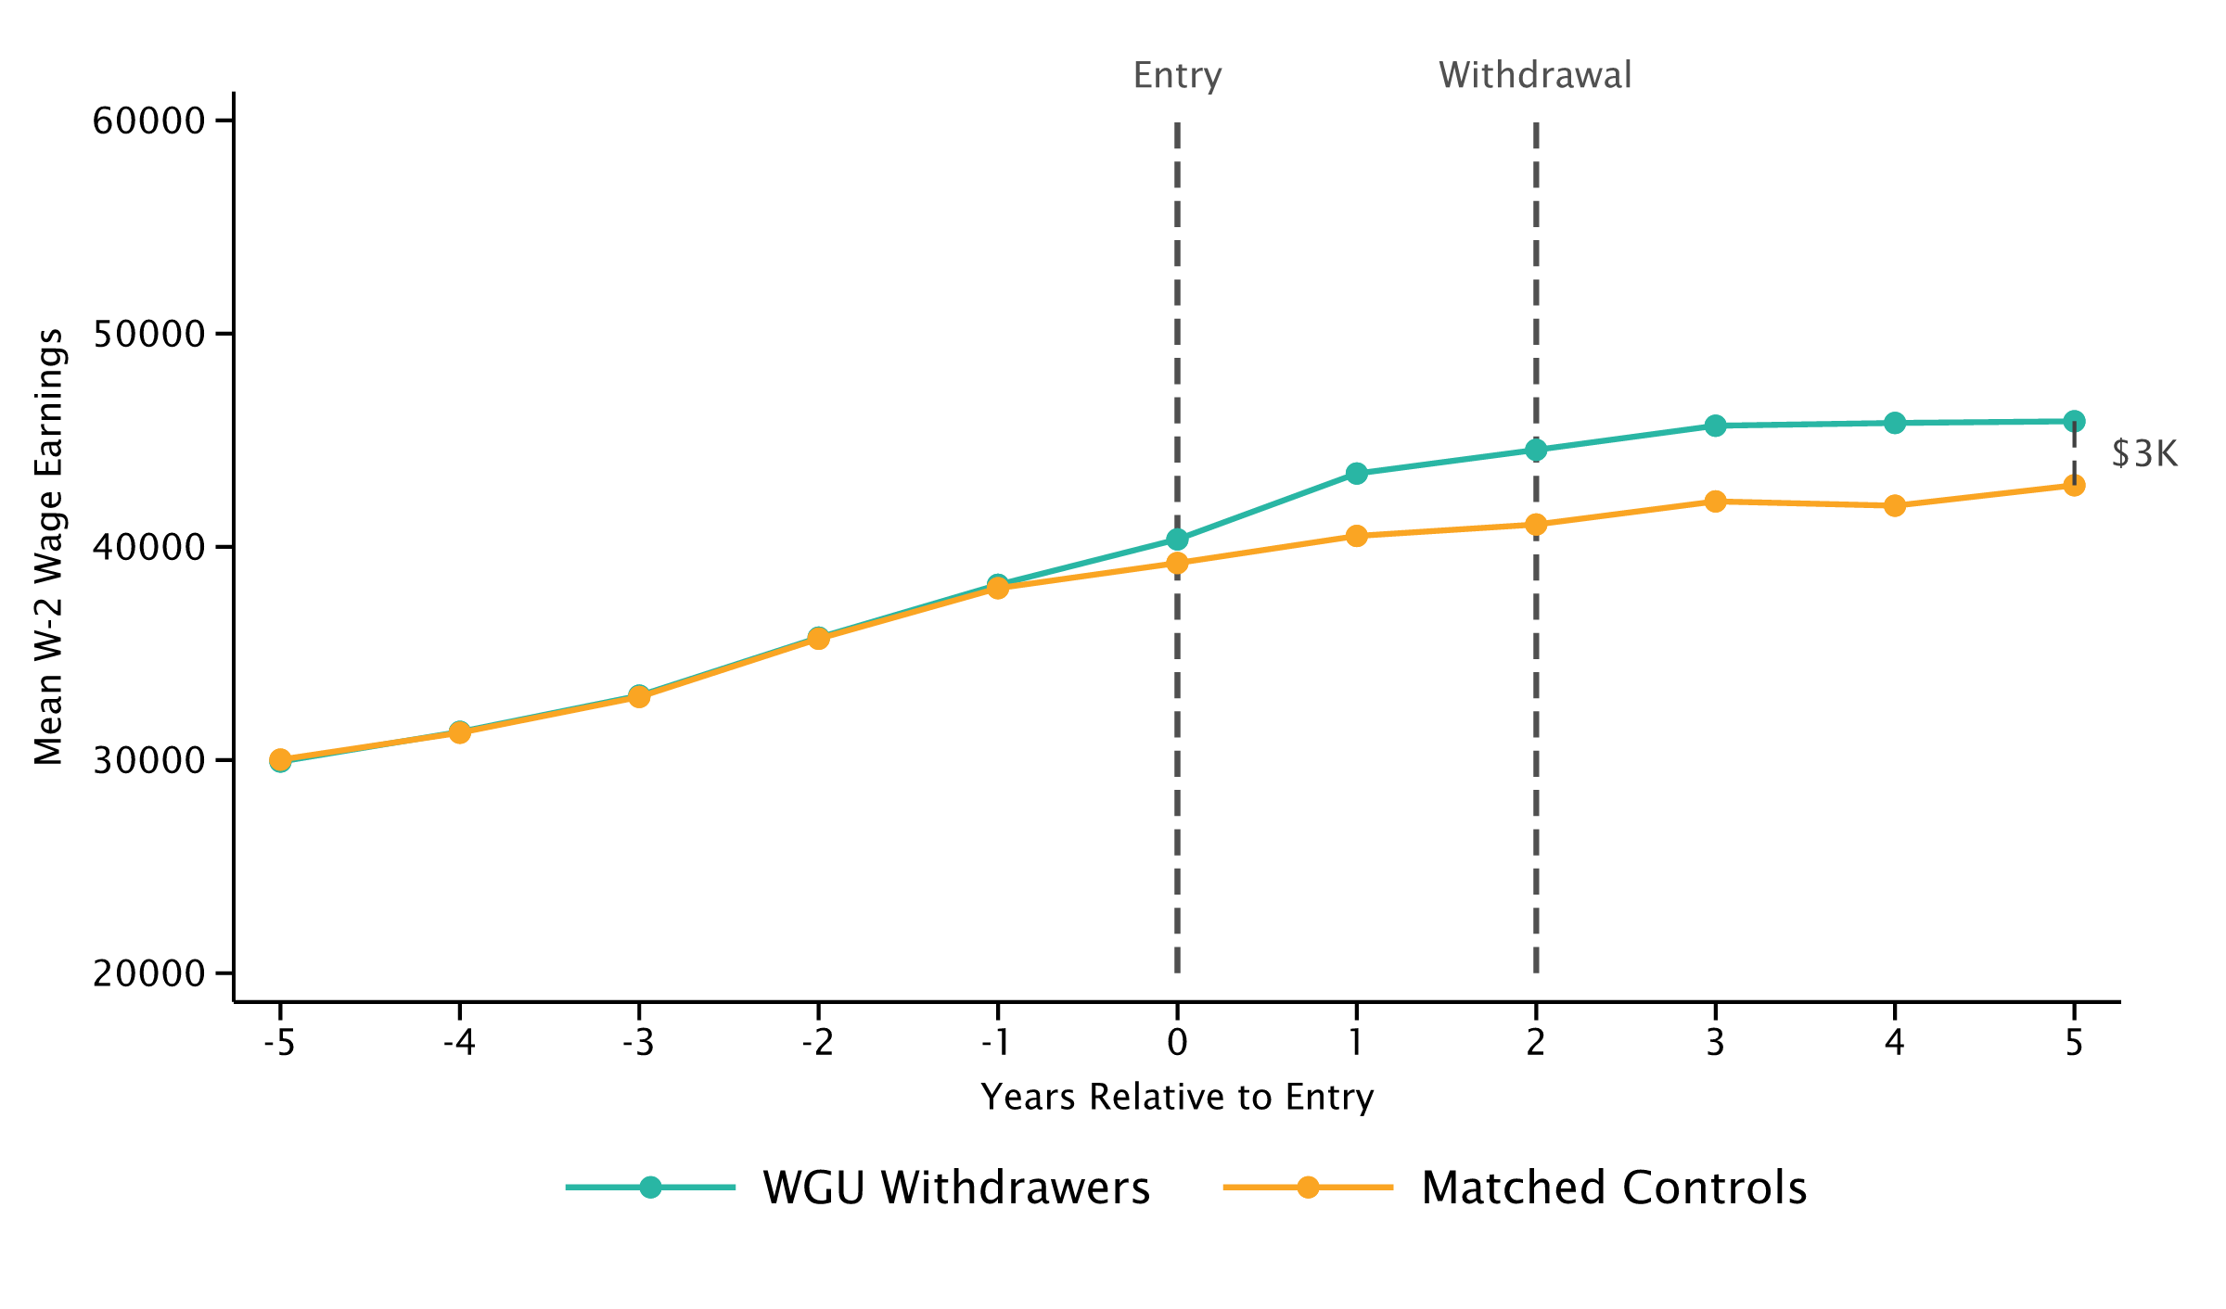
Impact of Master of Education on Earnings
WGU Enrollees who Graduate or Withdraw 2 Years After Entry
Graduates
Withdrawers

Slide 15
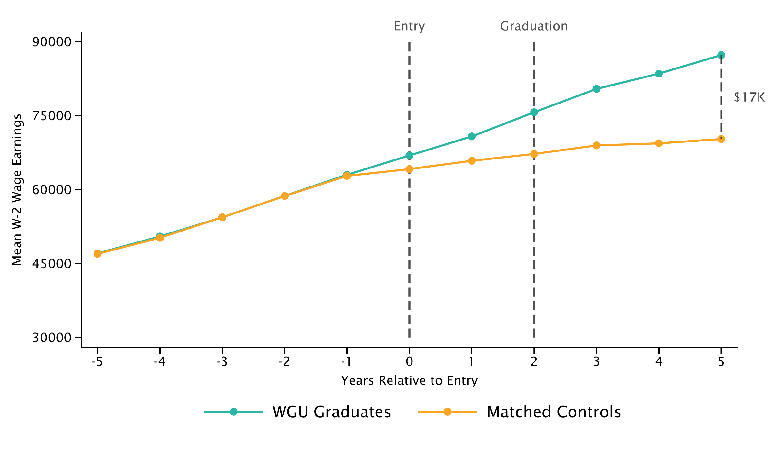
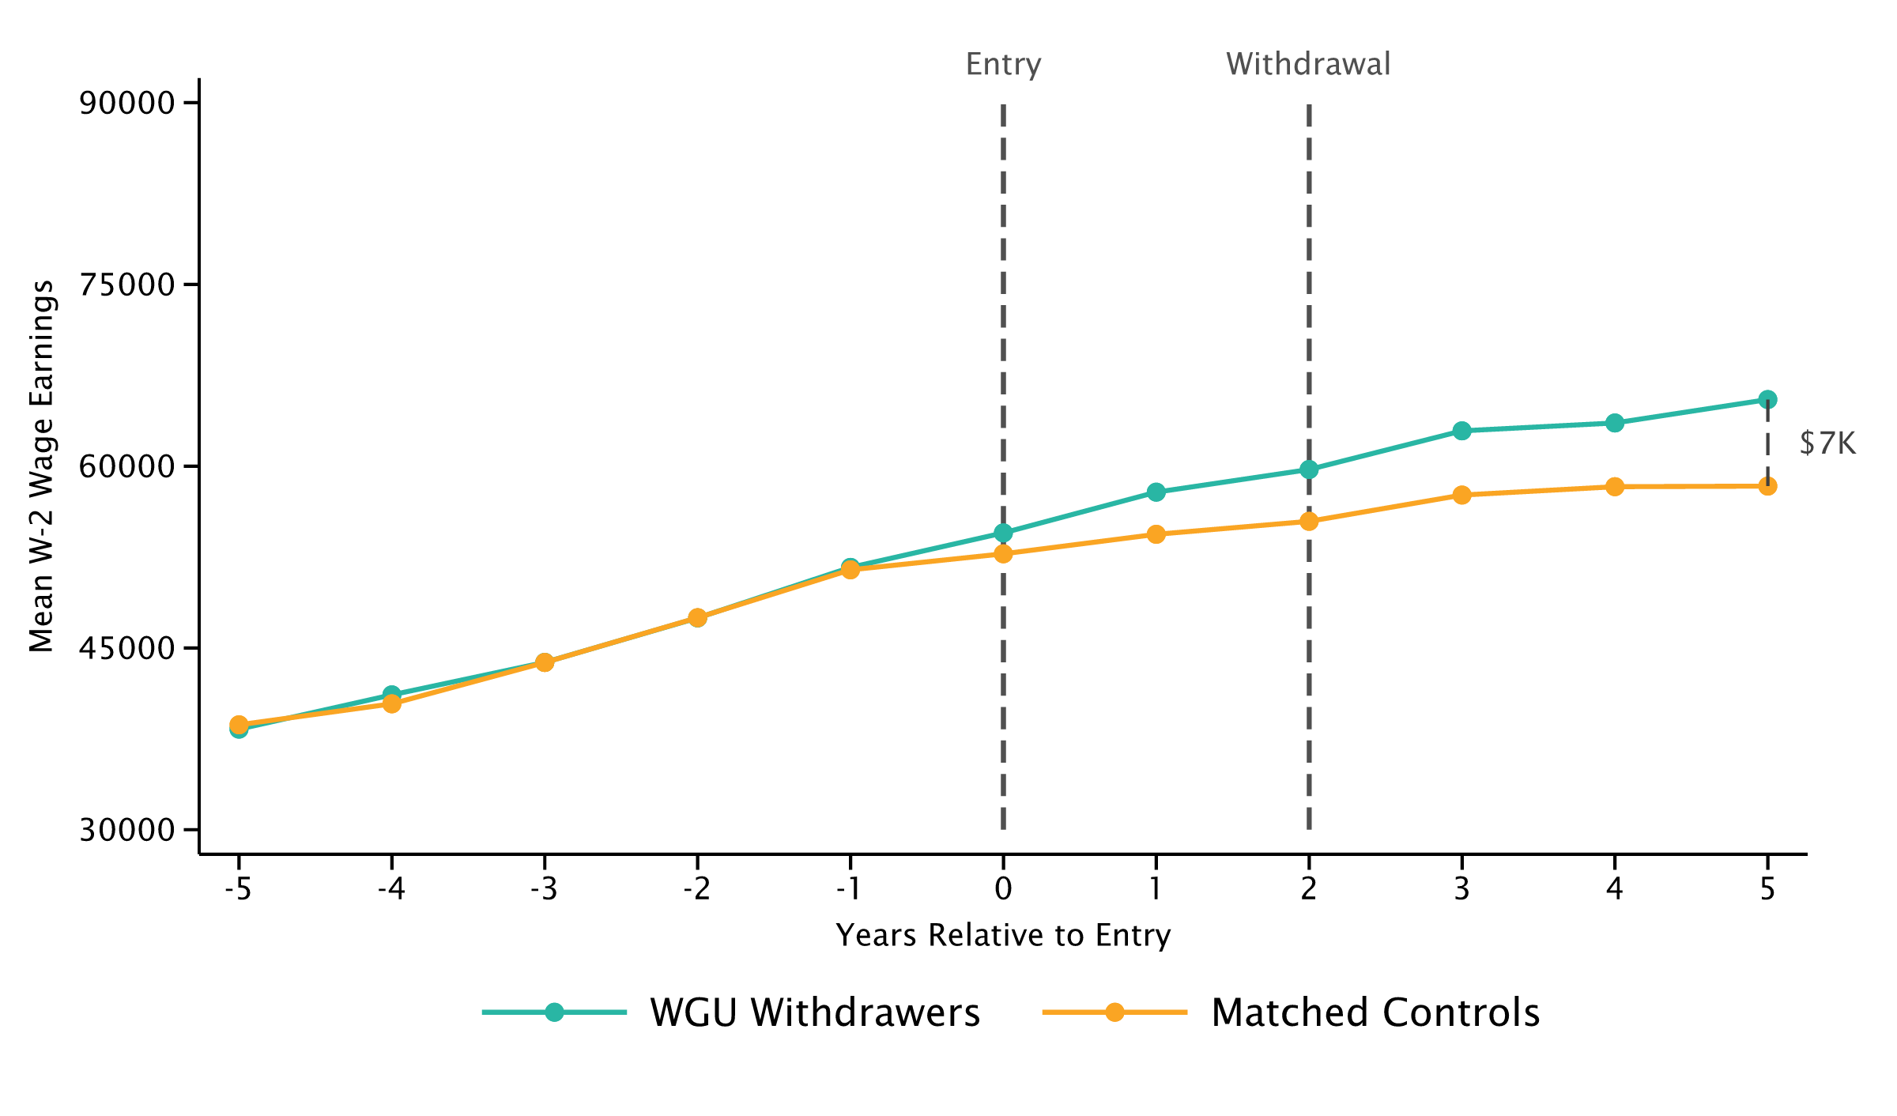
Impact of Master of Business on Earnings
WGU Enrollees who Graduate or Withdraw 2 Years After Entry
Graduates
Withdrawers

Slide 16
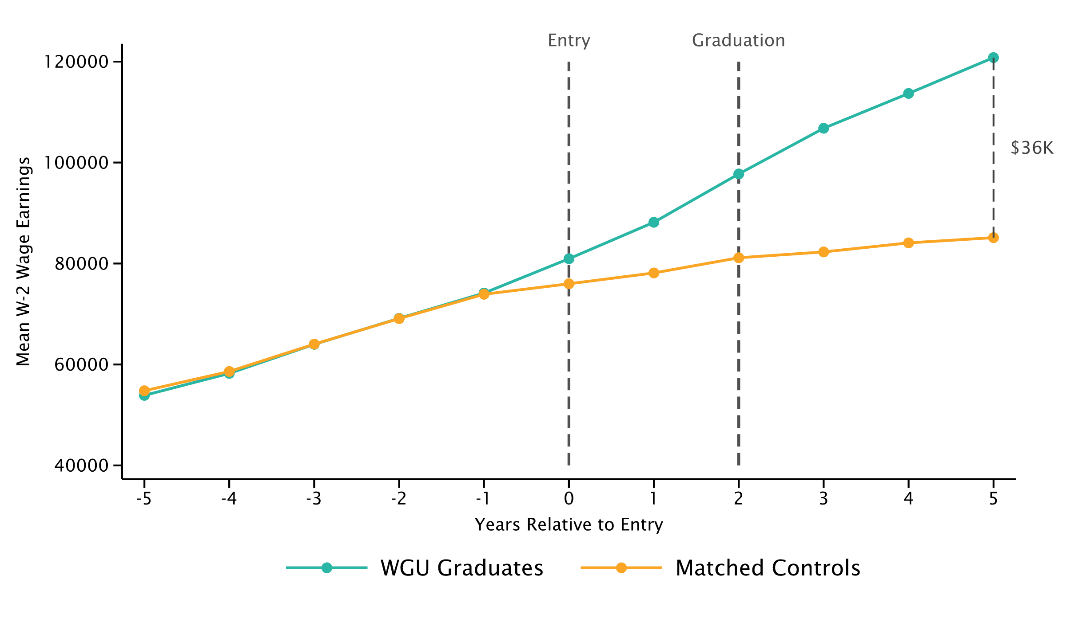
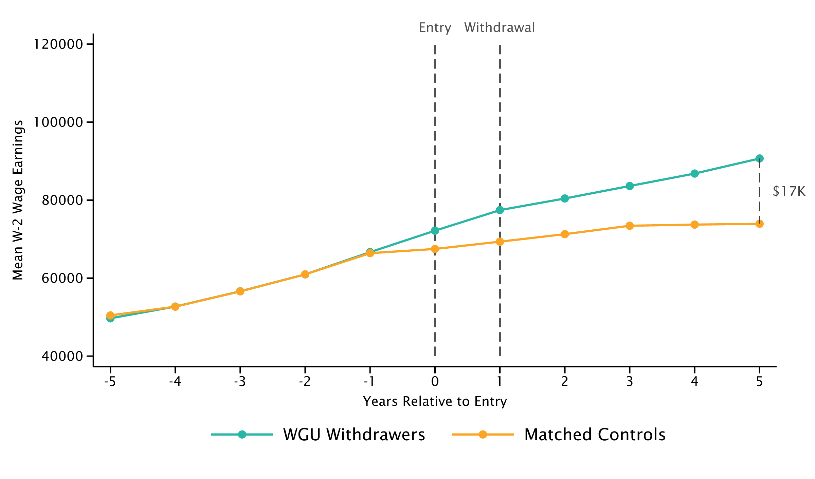
Impact of Master of Technology on Earnings
WGU Enrollees who Graduate 2 Years After Entry or Withdraw
Graduates
Withdrawers

Slide 17
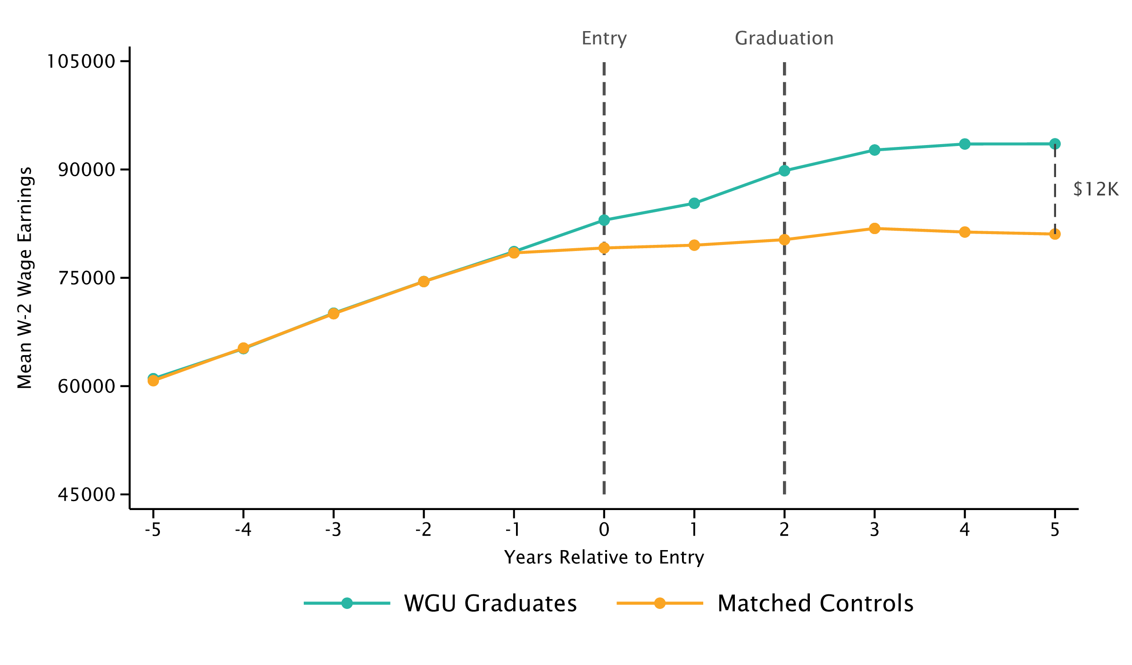
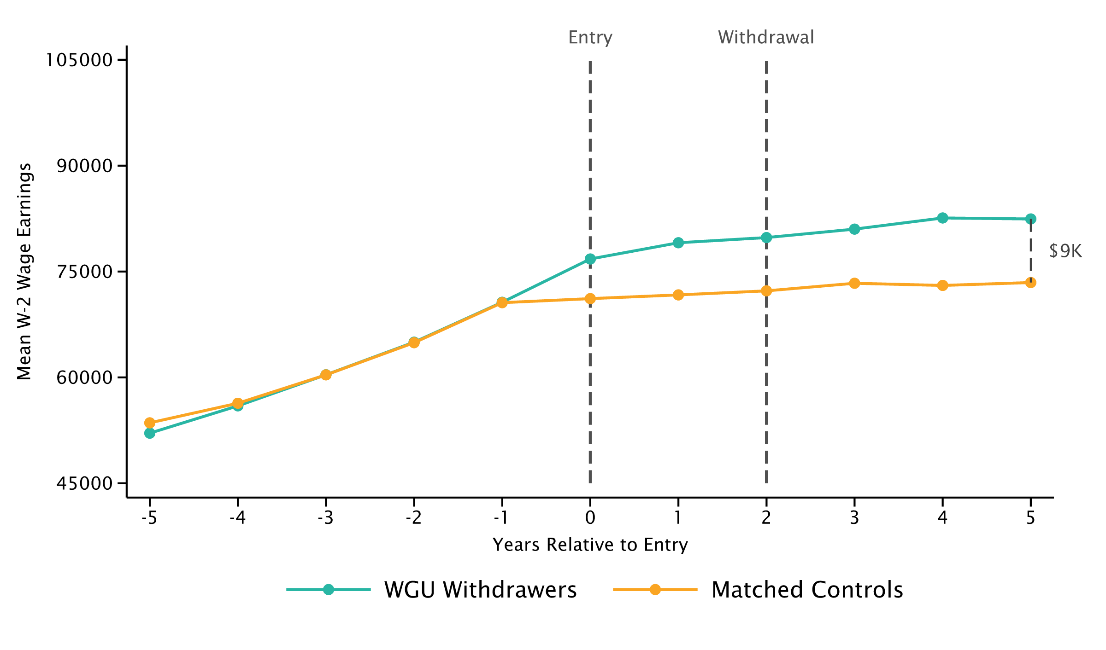
Impact of Master of Health on Earnings
WGU Enrollees who Graduate or Withdraw 2 Years After Entry
Graduates
Withdrawers

Slide 18
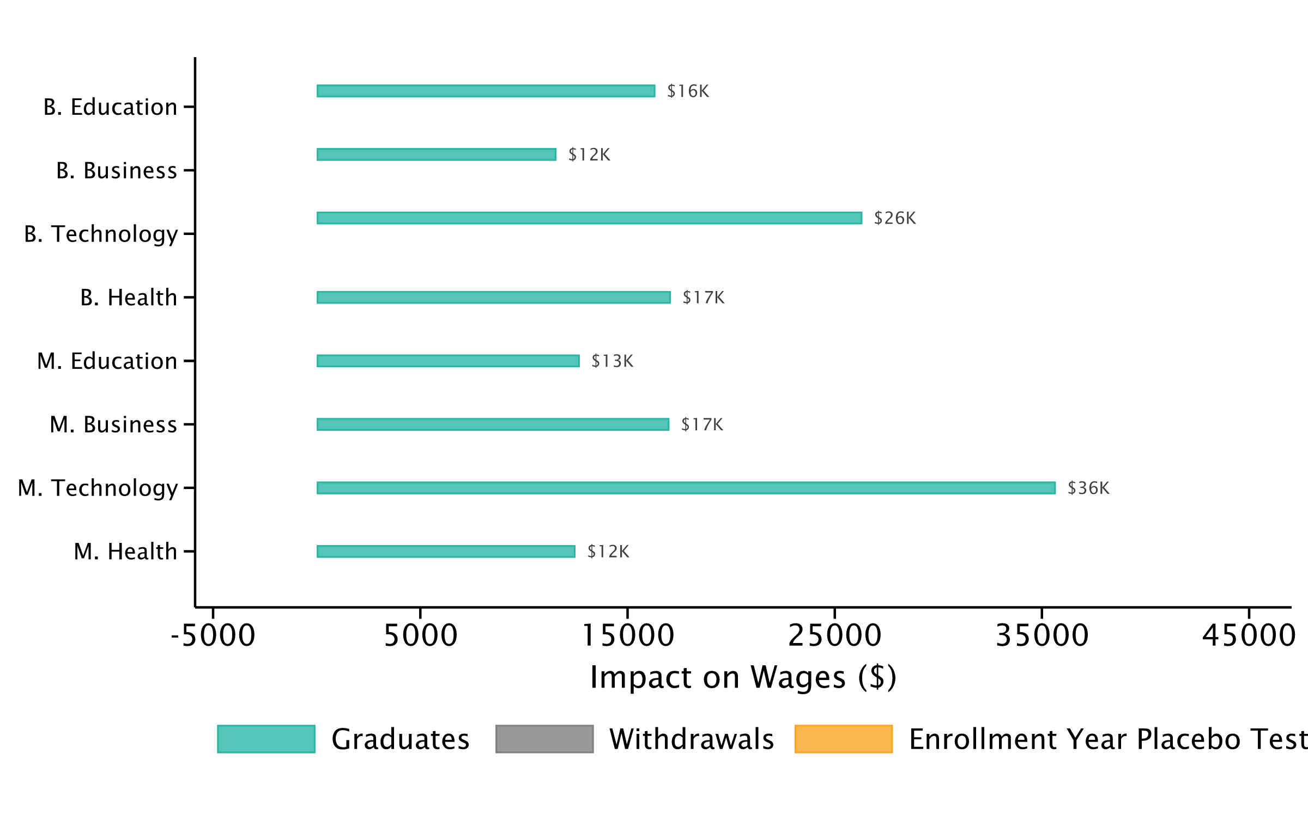
Impact of WGU Programs on Earnings
Treatment Effects on W-2 Wages 5 Years After Enrollment

Slide 19
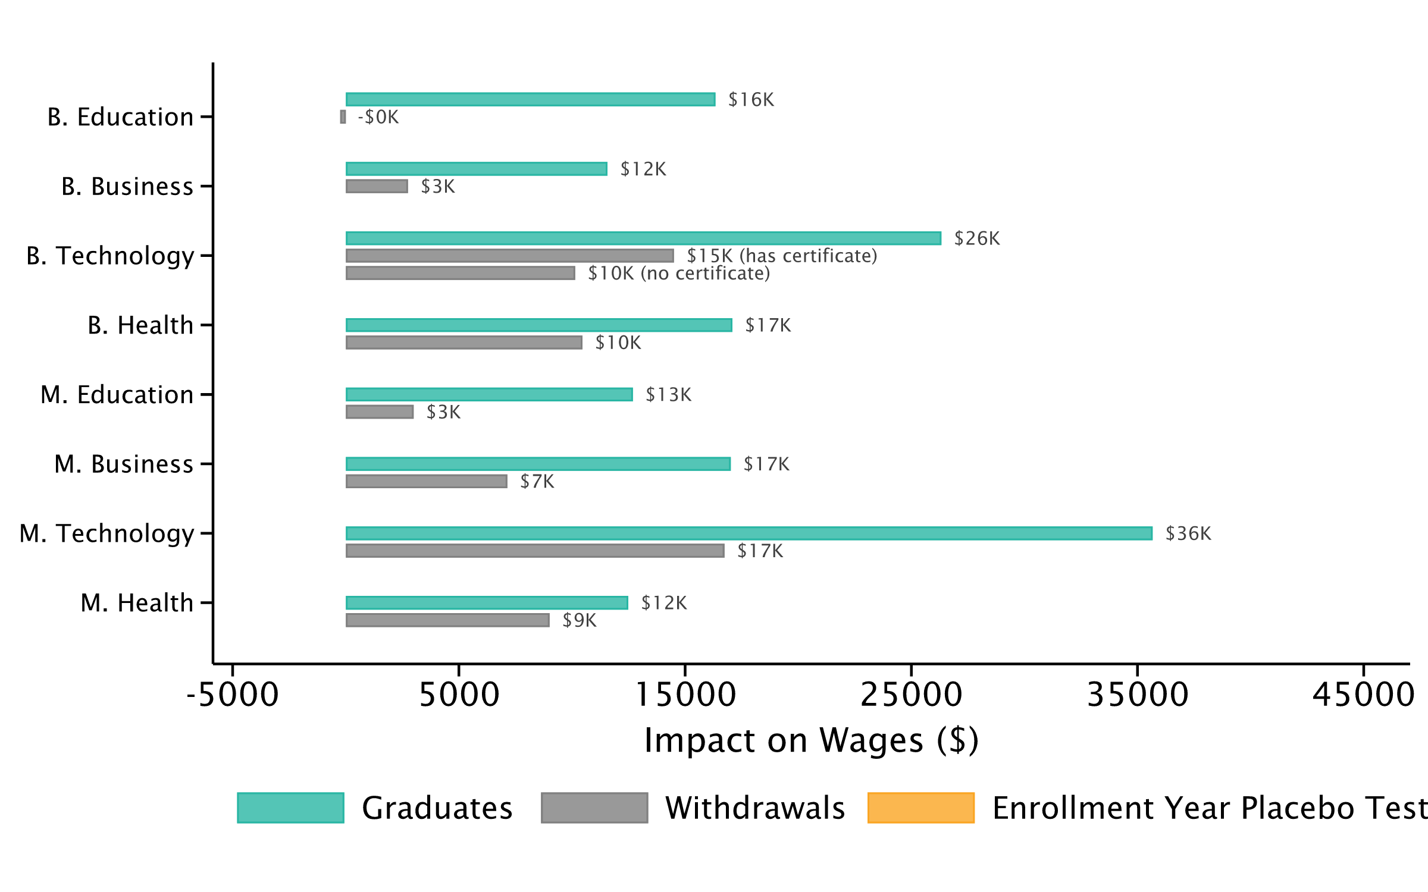
Impact of WGU Programs on Earnings
Treatment Effects on W-2 Wages 5 Years After Enrollment

Slide 20
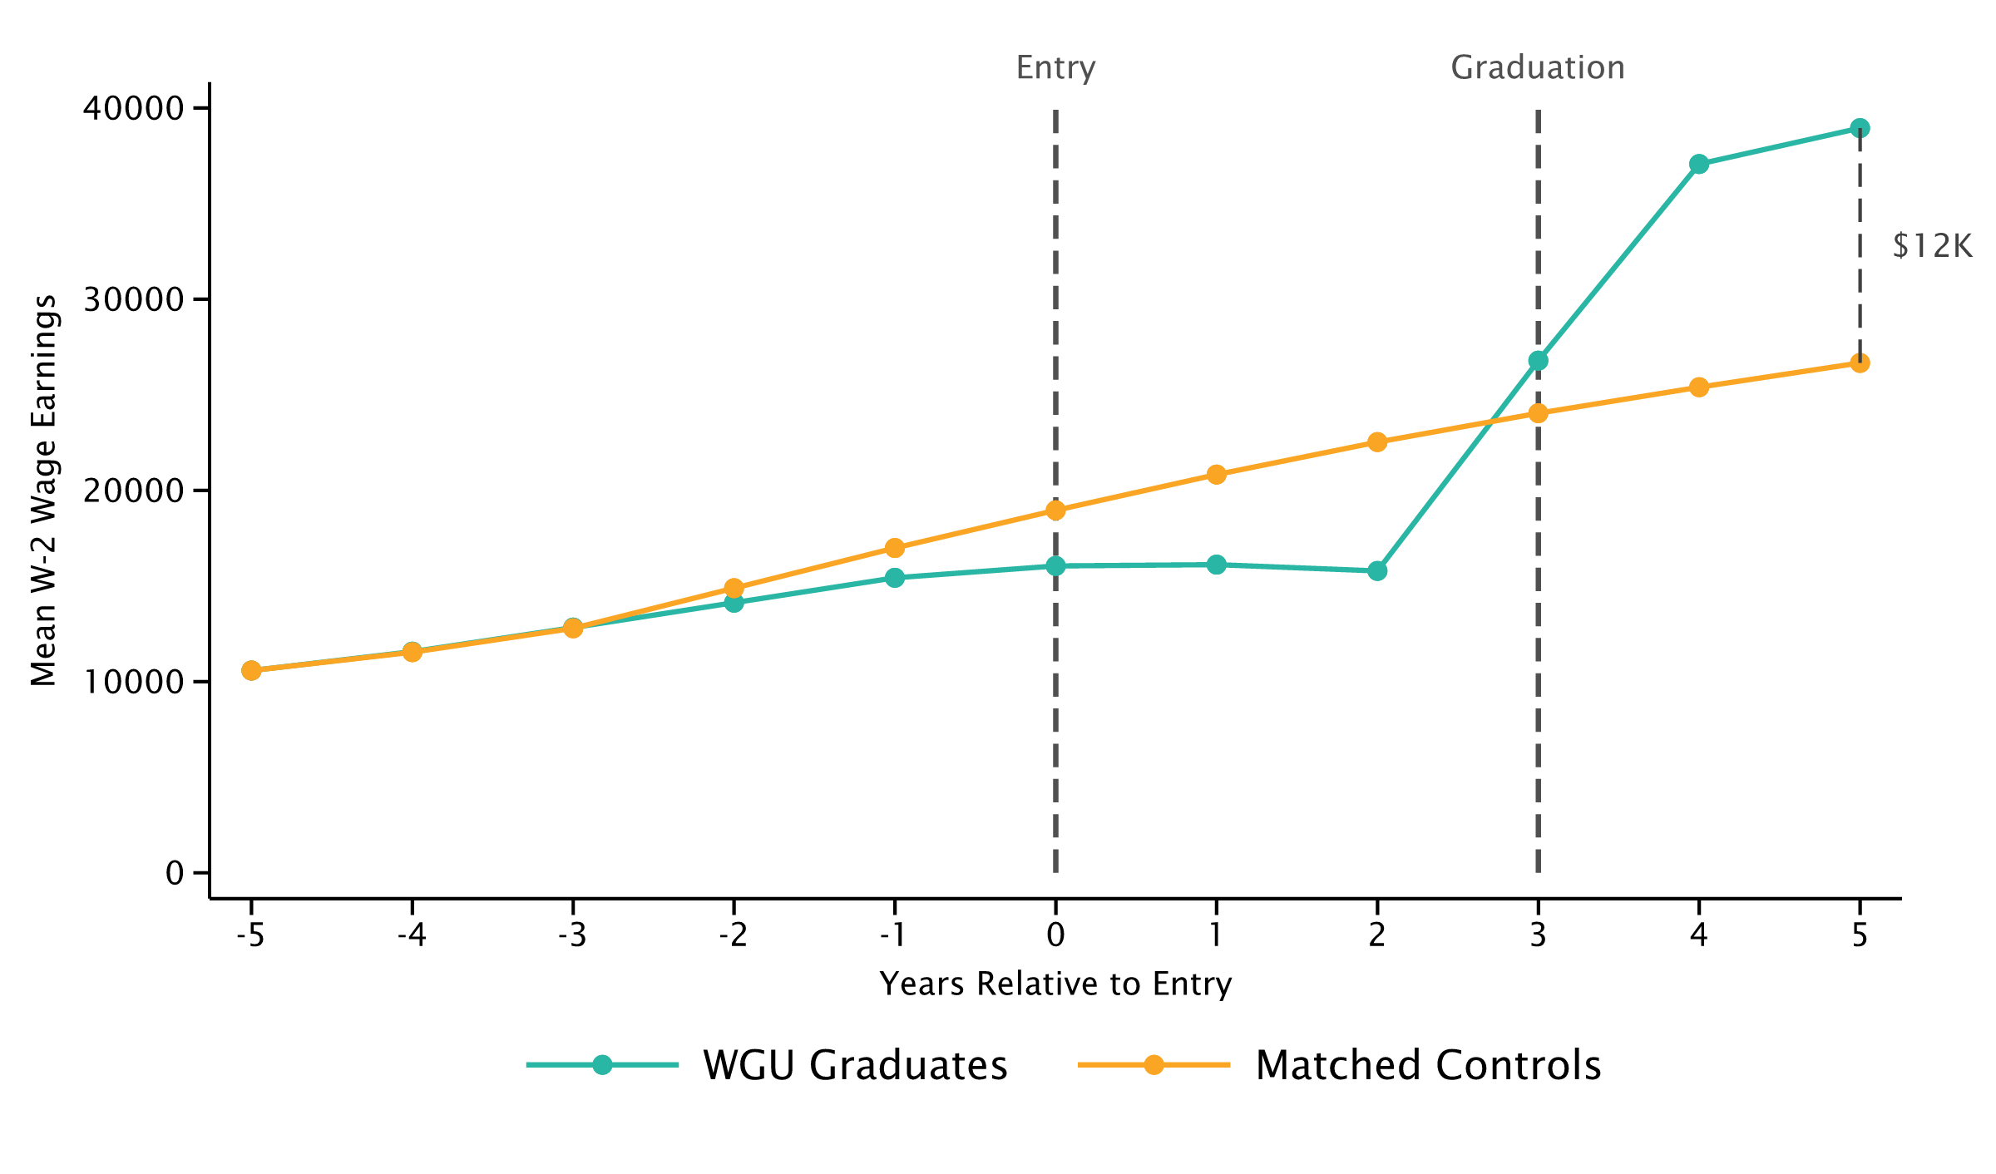
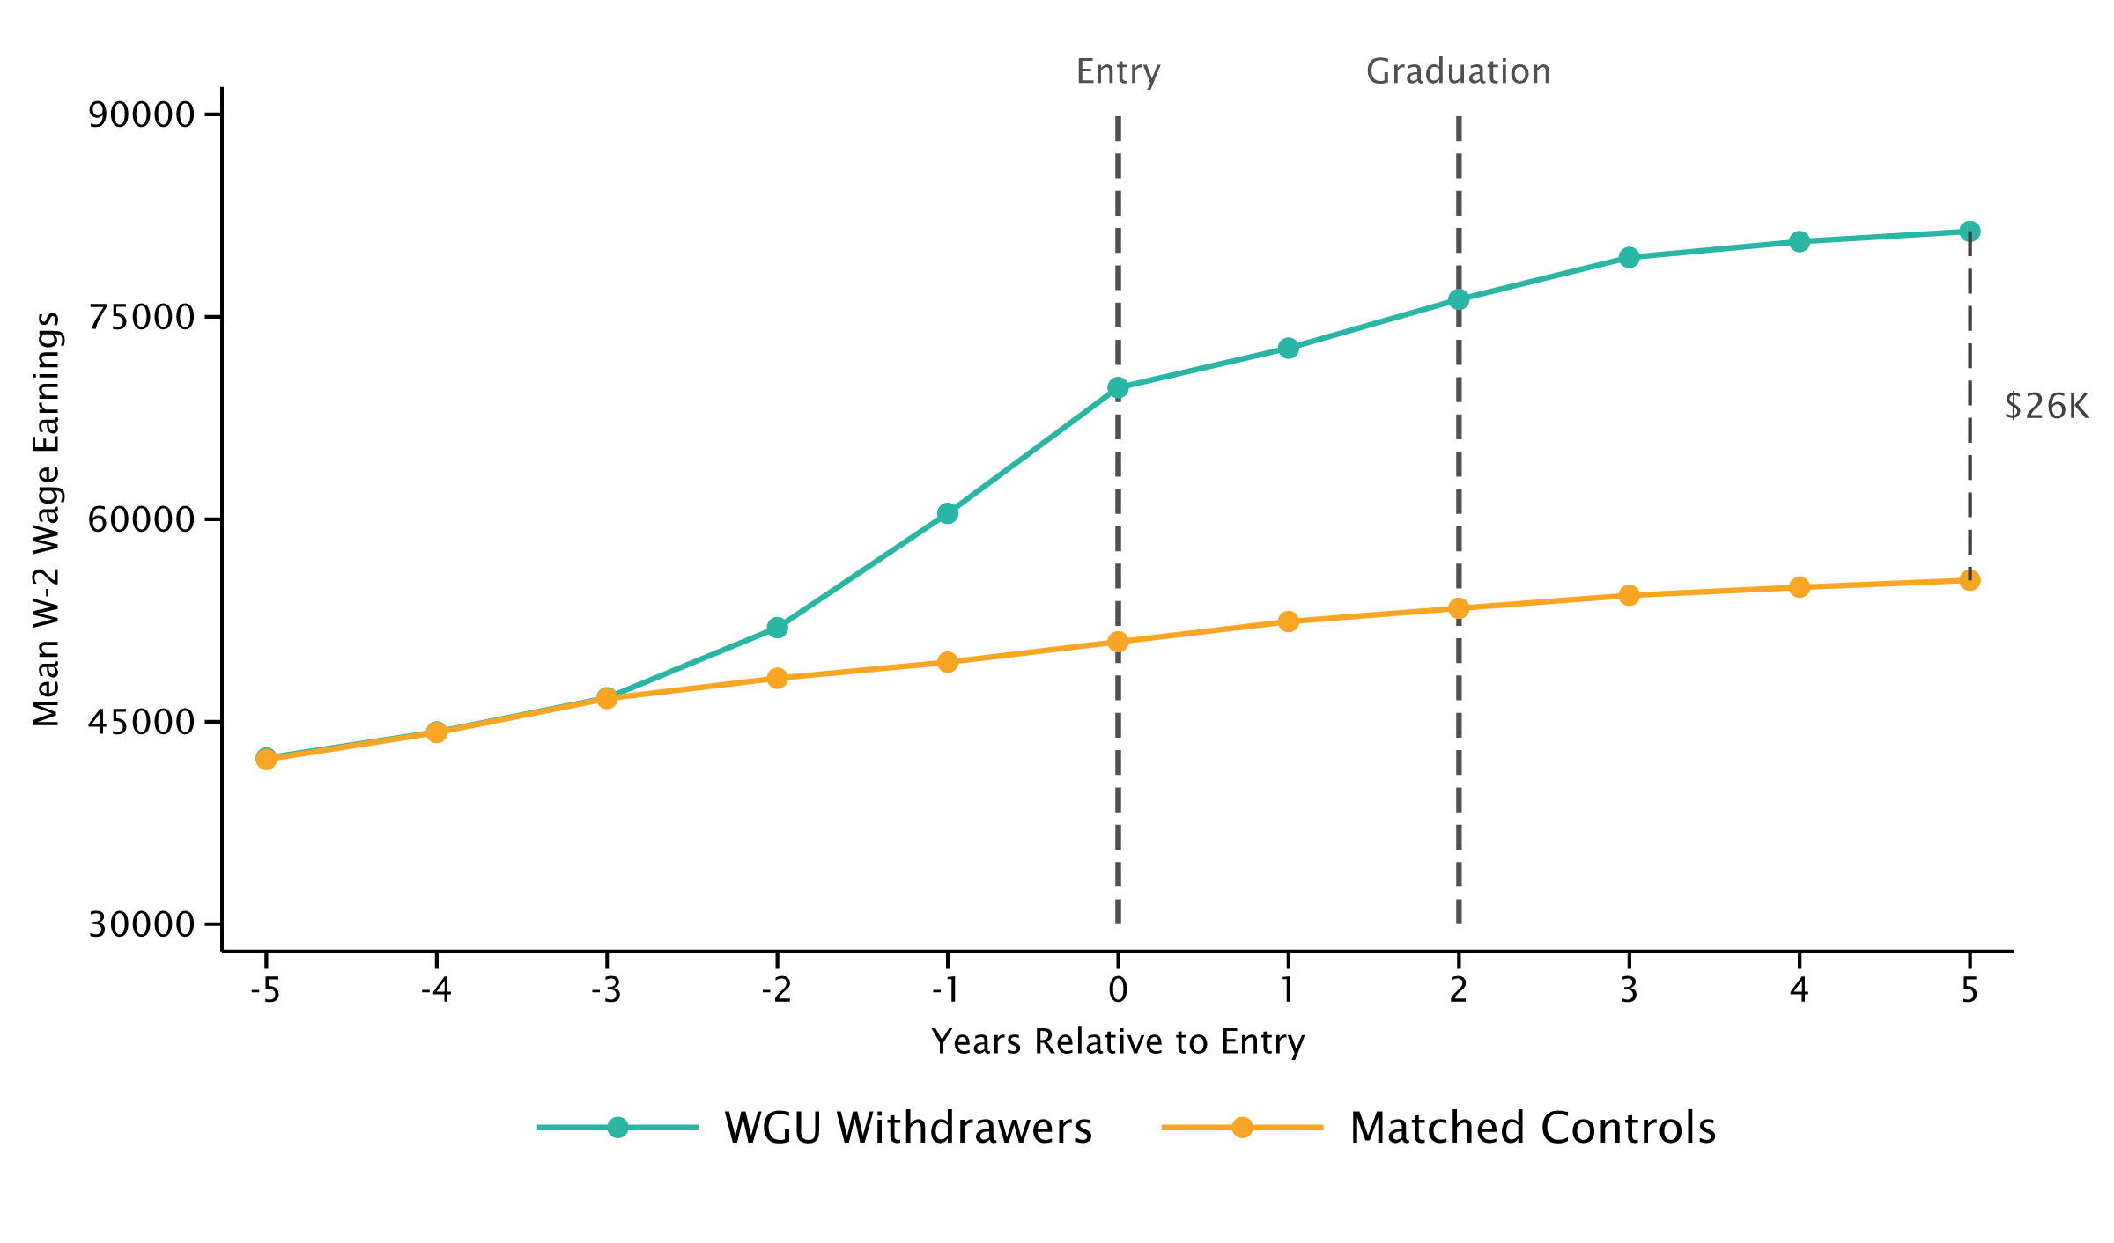
Placebo Test: Matching on Wages 3-5 Years Prior to Enrollment
Bachelor of Education & Bachelor of Health vs. Matched Controls
Bachelor of Education
Bachelor of Health

Slide 21
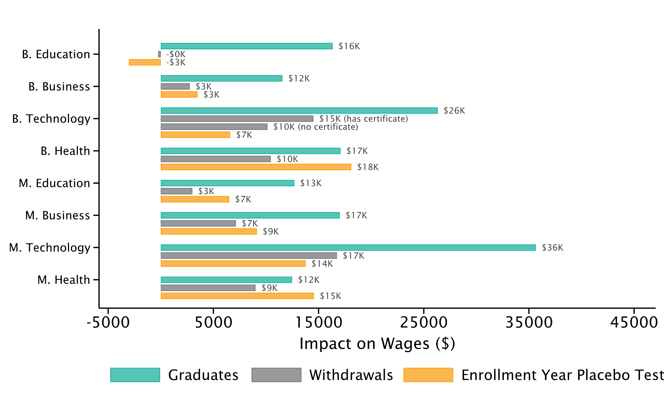
Impact of WGU Programs on Earnings
Treatment Effects on W-2 Wages 5 Years After Enrollment

Slide 22
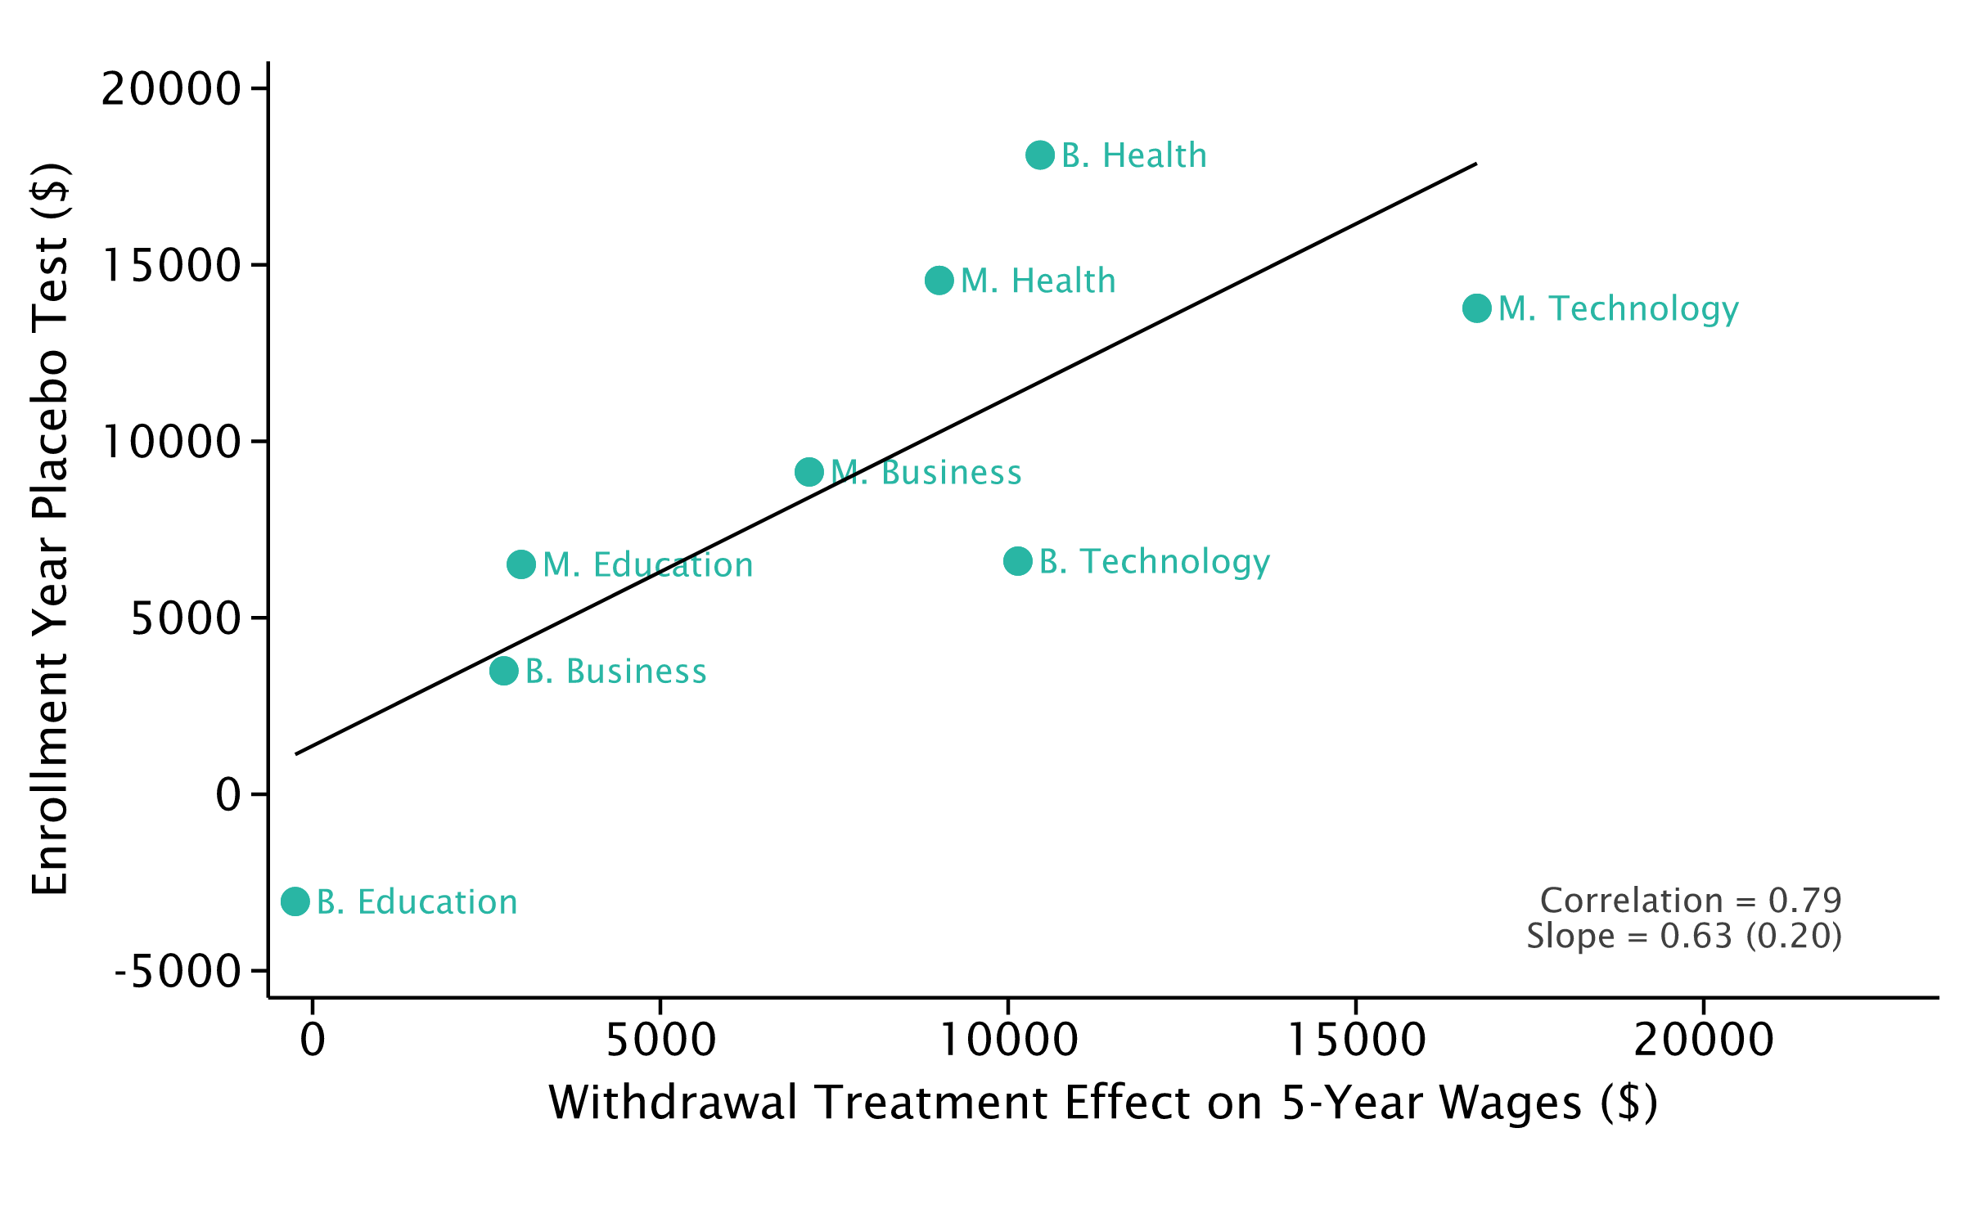
Withdrawal Effects vs. Placebo Tests
Treatment Effects on 5-Year Wages by Program

Slide 23
Next Steps and Discussion
1. Find matched control vector that eliminates selection problem in certain programs (e.g., healthcare)
2. Validate alternative estimators against quasi-experimental designs where variation in WGU enrollment is not driven by individual selection
  – Rollout of WGU programs in certain states/firms
  – Eligibility cutoffs, targeting, or ads to certain subgroups/areas

