Slide 1
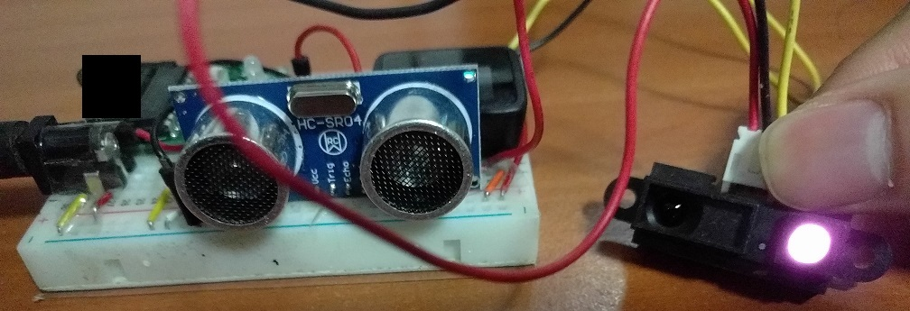
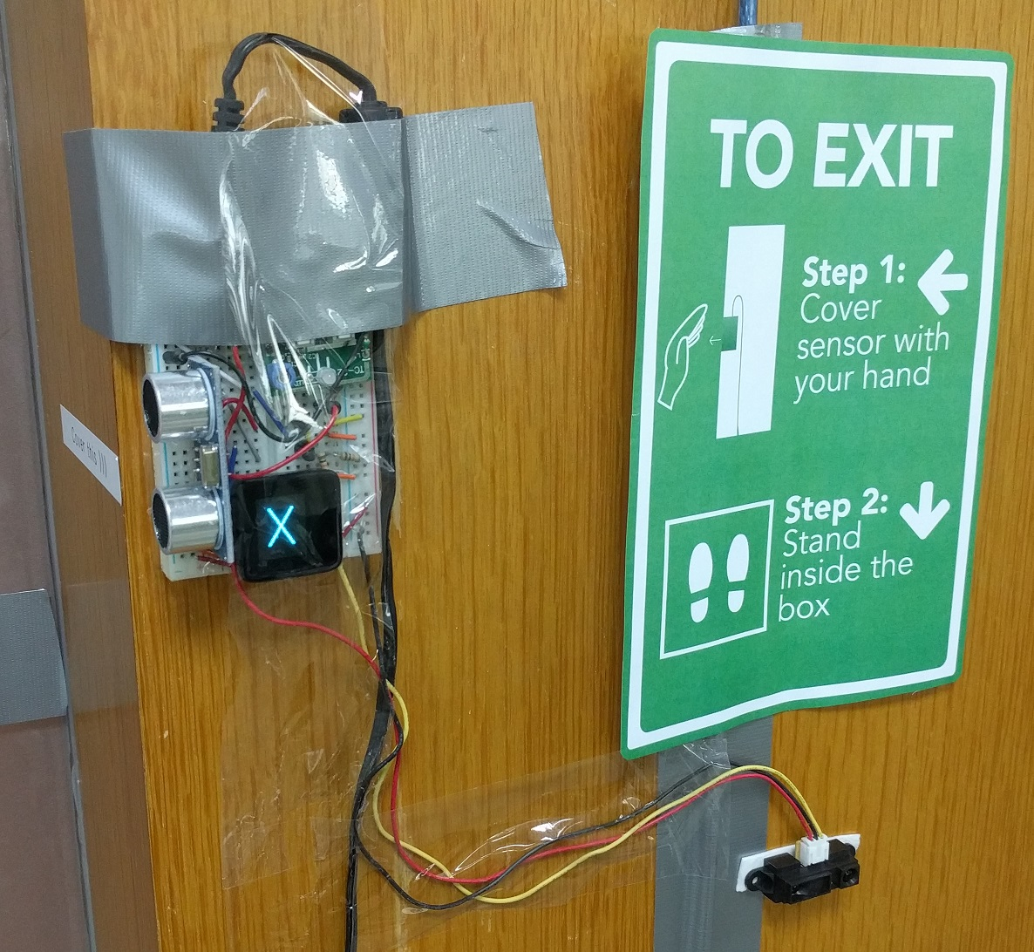
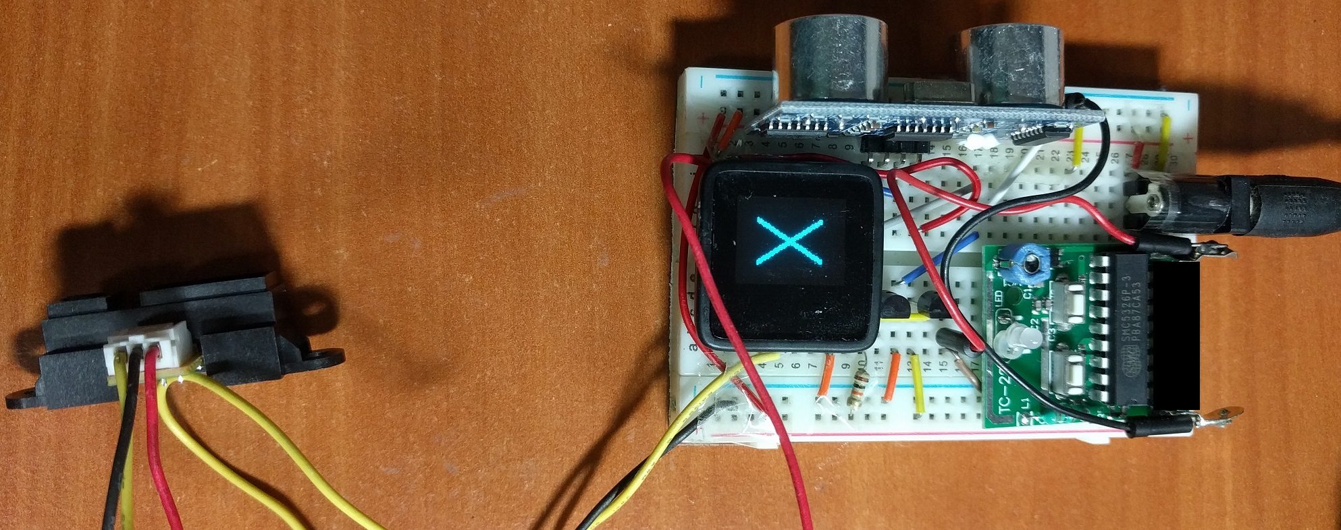
SP Office Gadget: Auto Door Unlocker
Hackware v3.0 (3 May 2017)
SP Digital Tech Talk (29 Dec 2016)
By: Yeo Kheng Meng (yeokm1@gmail.com)
https://github.com/yeokm1/sp-auto-door-unlocker

Slide 2

Demo Video
https://www.youtube.com/watch?v=IeWPlm1Xaz0

Slide 3
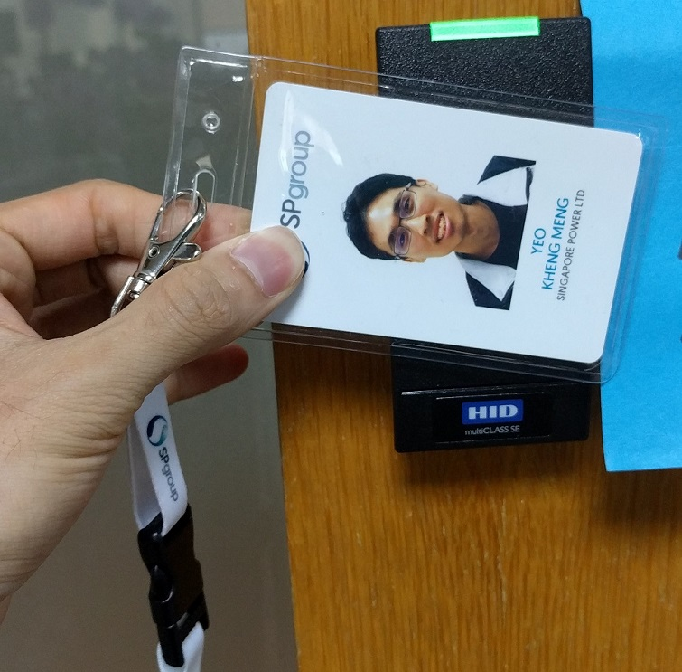
Problem?
Tap staff pass on exit
Trouble for visitors
Hassle of taking out pass
Solution:
Exit without tapping pass

Slide 4
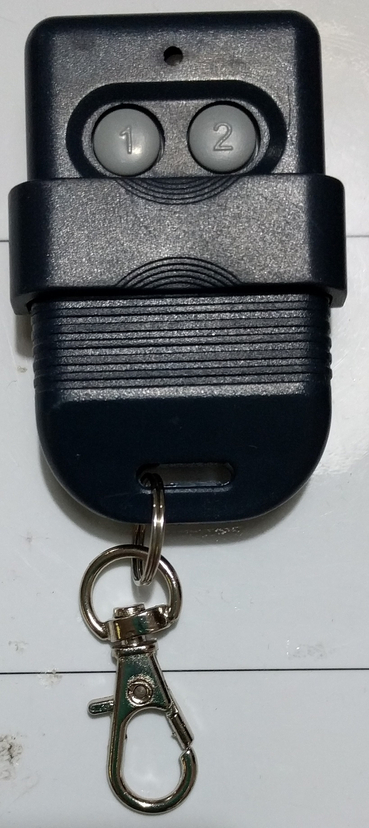
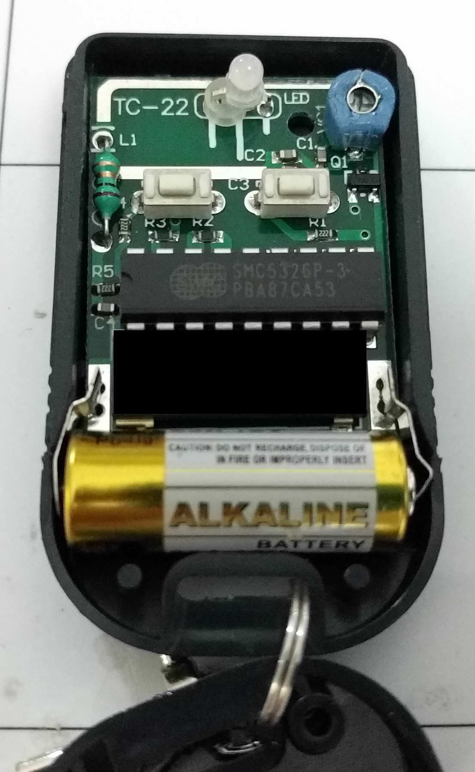
Wireless remote unlocker
12V battery source
2 buttons
DIP code-select switch
Voltage-controlled oscillator (VCO)
Frequency determined by voltage
330Mhz SMC5326P-3
Some China chip
Unknown function
Cannot locate data sheet

Slide 5
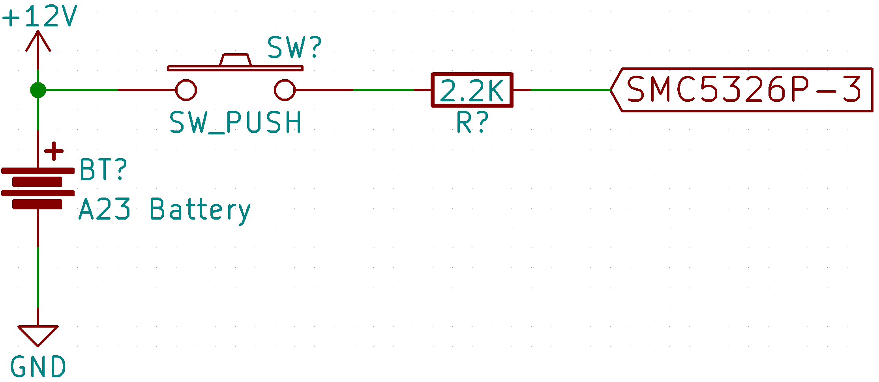
How the button triggers the signal?

Slide 6
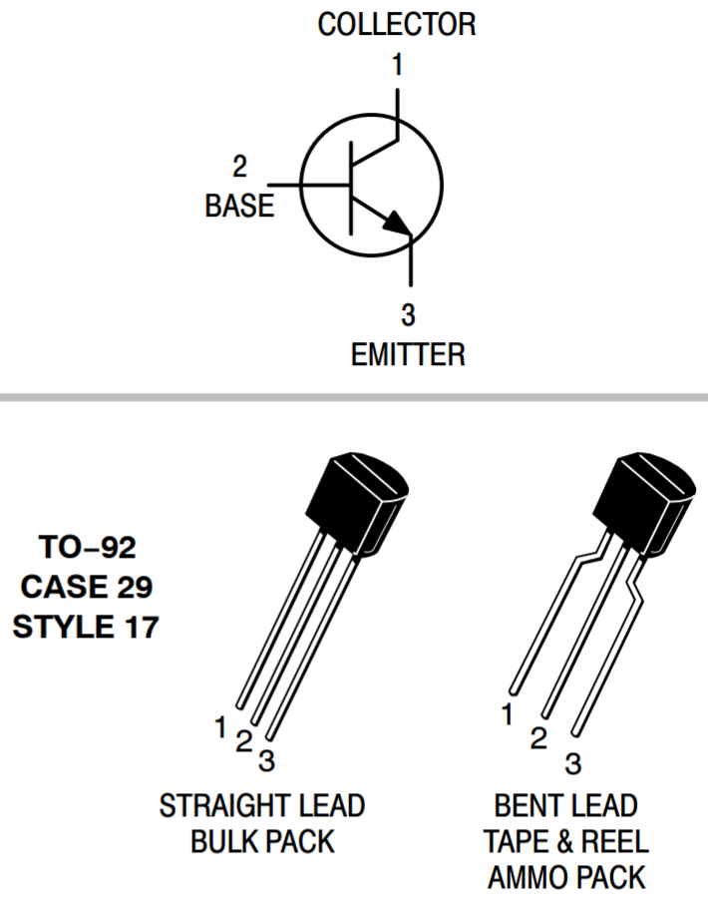
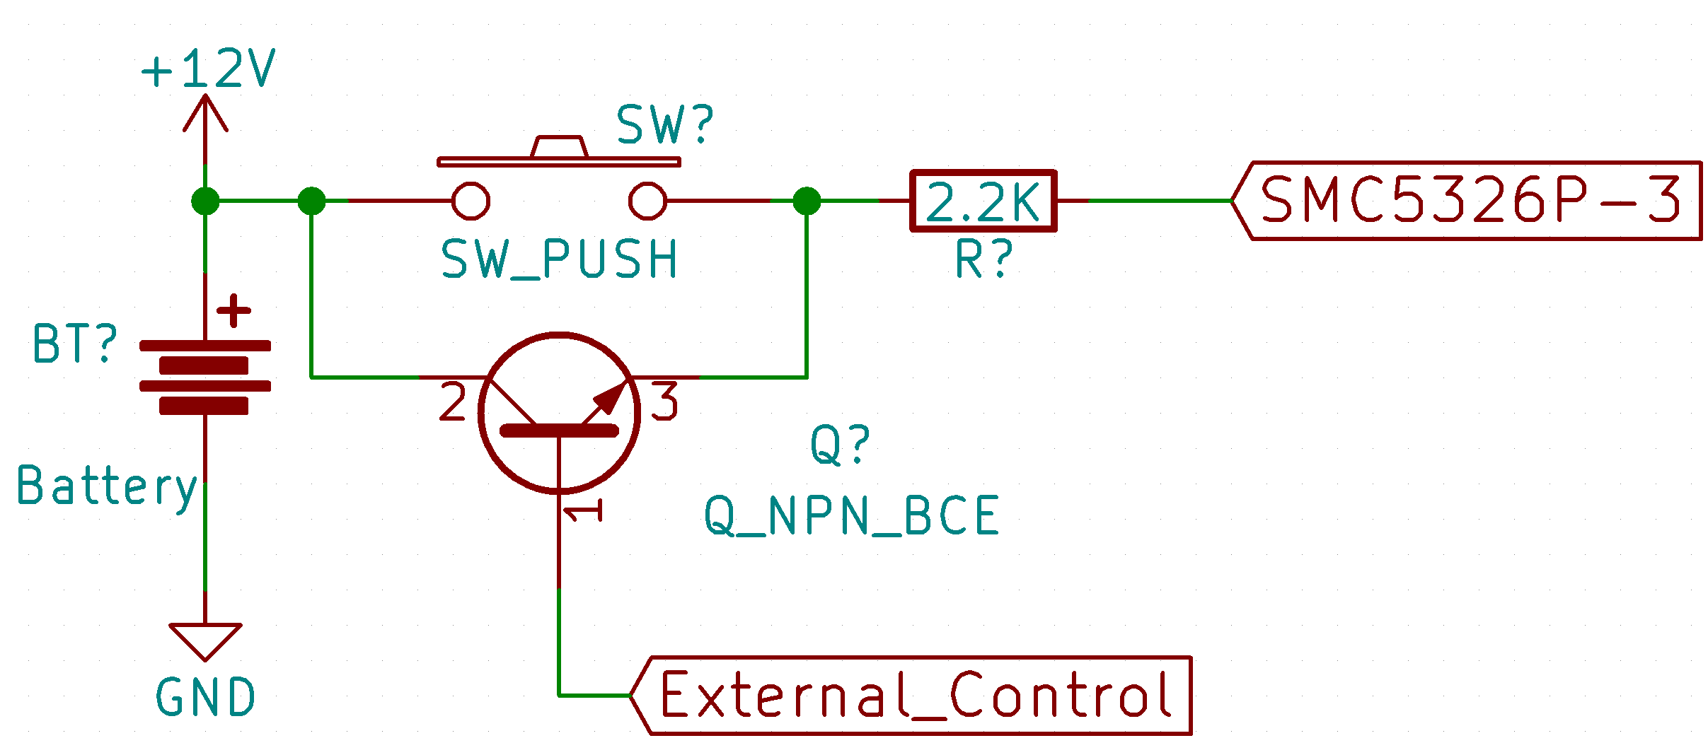
An electronic switch: Transistor
Control current flow with another current flow

Slide 7
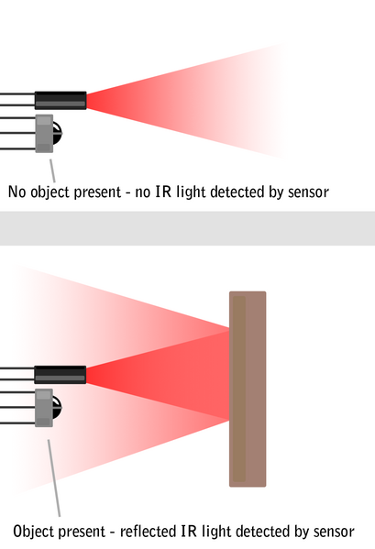

The trigger: Active IR + Ultrasonic Sensor
Ultrasonic HC-SR04 v2
3.3V logic compatible
Physical Domain
Infrared (IR) Distance Sensor GP2Y0A21YKR
Effective range: 10 to 80cm
Active IR
Electromagnetic domain
=> Multi-modal integration / Sensor Fusion to avoid errors
Source: http://education.rec.ri.cmu.edu/content/electronics/boe/ir_sensor/1.html

Slide 8
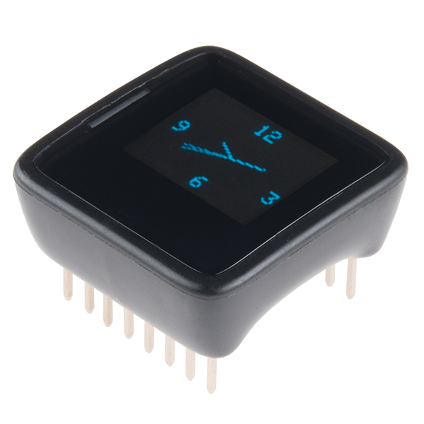
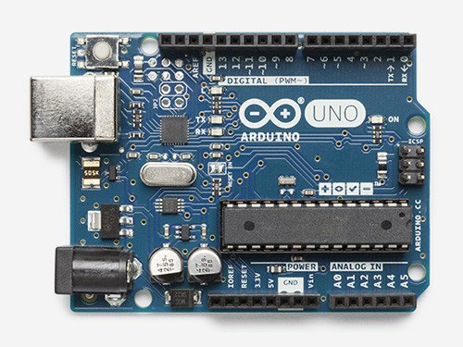
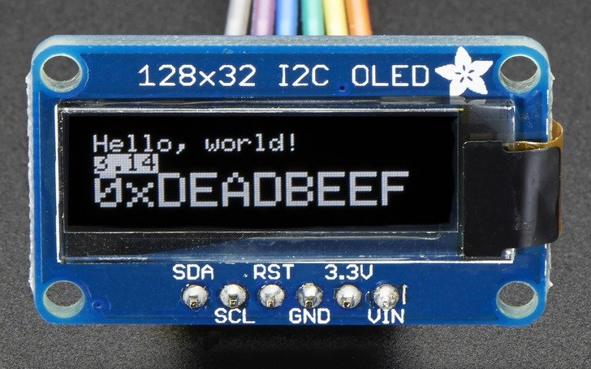
The brain: Microview
=
+
Microview = Arduino + 64x48 OLED screen
Runs on ATmega328P chip as with Arduino Uno
Source: http://makezine.com/2014/03/25/interview-with-marcus-schappi/

Slide 9
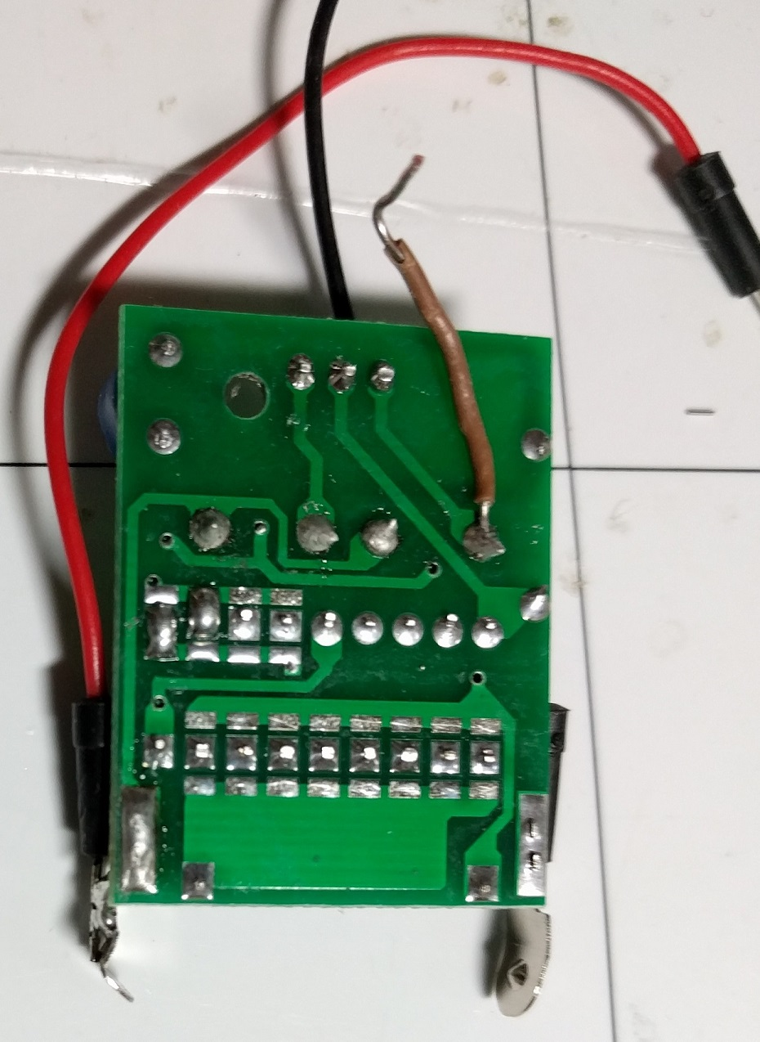
Wireless Remote Modification
Extend button circuit (brown)
External 12V power (red and black)

Slide 10
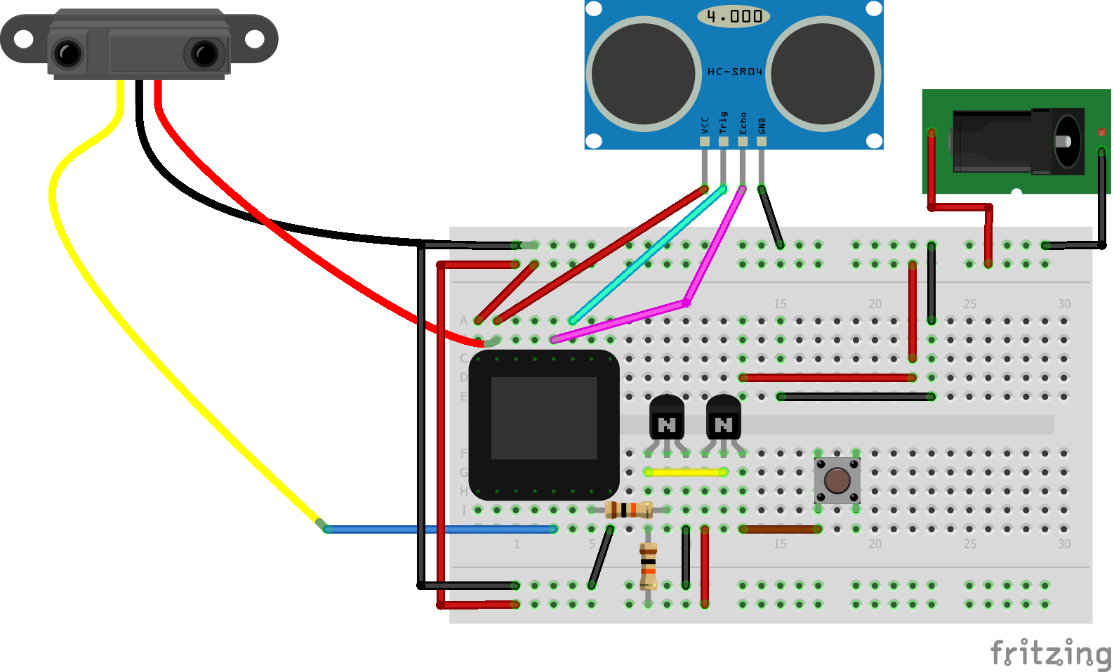
Assembly
Additional Components
Breadboard
12V DC Power Adapter

Slide 11
Final Product

Slide 12
Questions?
By: Yeo Kheng Meng (yeokm1@gmail.com)
https://github.com/yeokm1/sp-auto-door-unlocker

Slide 13
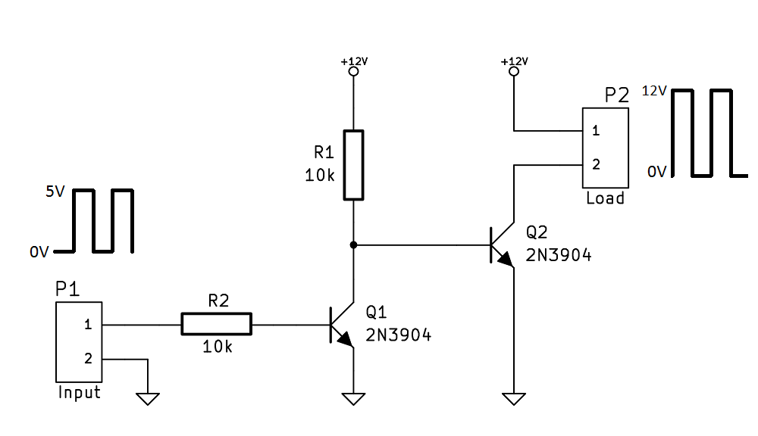
Control 12V signal with 5V
Microview 3.3V Logic Level
Remote is 12V Logic Levels
-> Active-Low Dual NPN transistor
Source: https://electronics.stackexchange.com/a/70246

