Slide 1
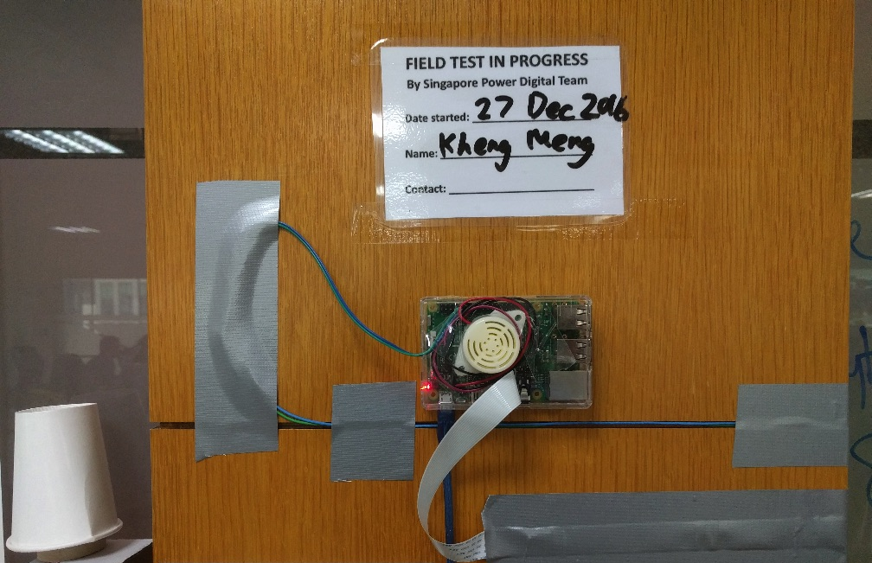
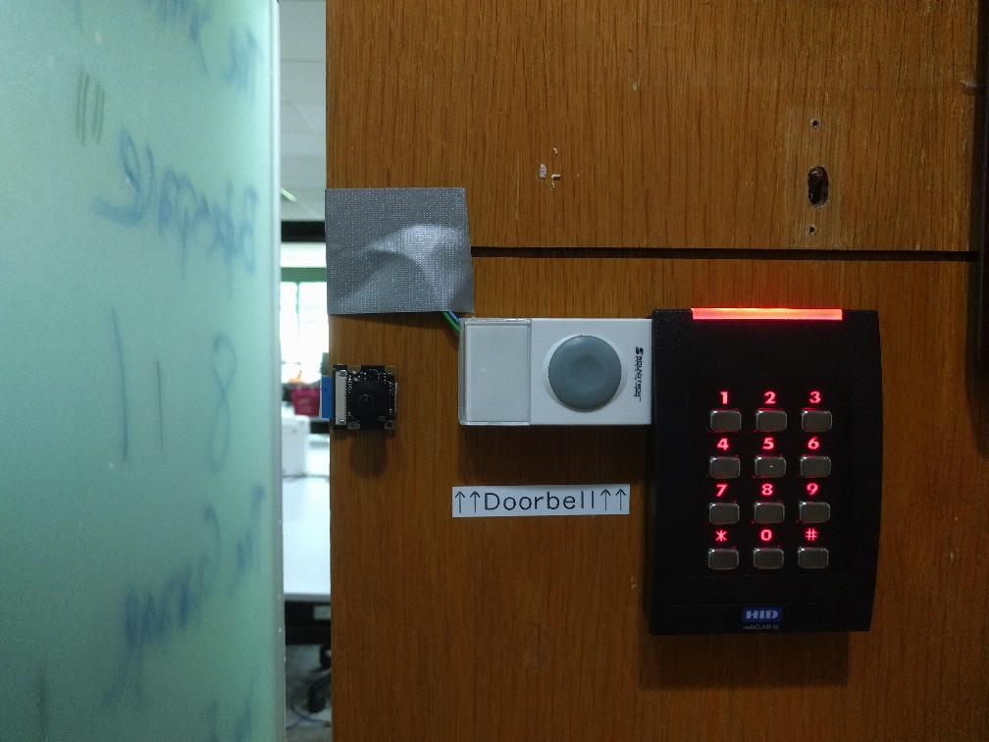
SP Office Gadget: IoT Doorbell
Hackware v3.0 (3 May 2017)
SP Digital Tech Talk (29 Dec 2016)
By: Yeo Kheng Meng (yeokm1@gmail.com)
https://github.com/yeokm1/sp-iot-doorbell

Slide 2
Problem?
My office needs a doorbell
Solution: An overengineered IoT doorbell

Slide 3
Solution Outline
Rings when button is pressed
Informs Slack channel via Wifi connection
Takes photo and uploads to Slack
File system resilience against improper shutdown

Slide 4
Demo video
https://www.youtube.com/watch?v=MGRNmj3iRuI

Slide 5
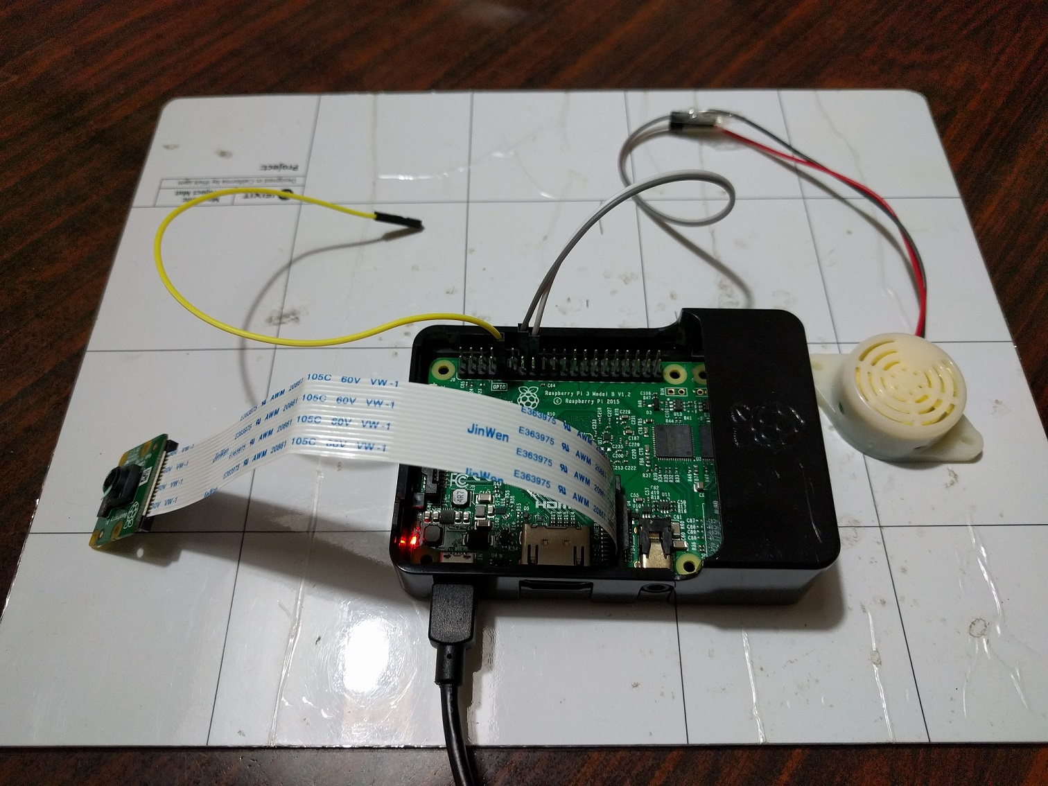
MVP Dev Set
Raspberry Pi 3
8MP RPi camera v2
Sony IMX219
Connected via Camera Serial Interface connector
3V-20V DC Continuous Buzzer
Wire simulated as a button

Slide 6
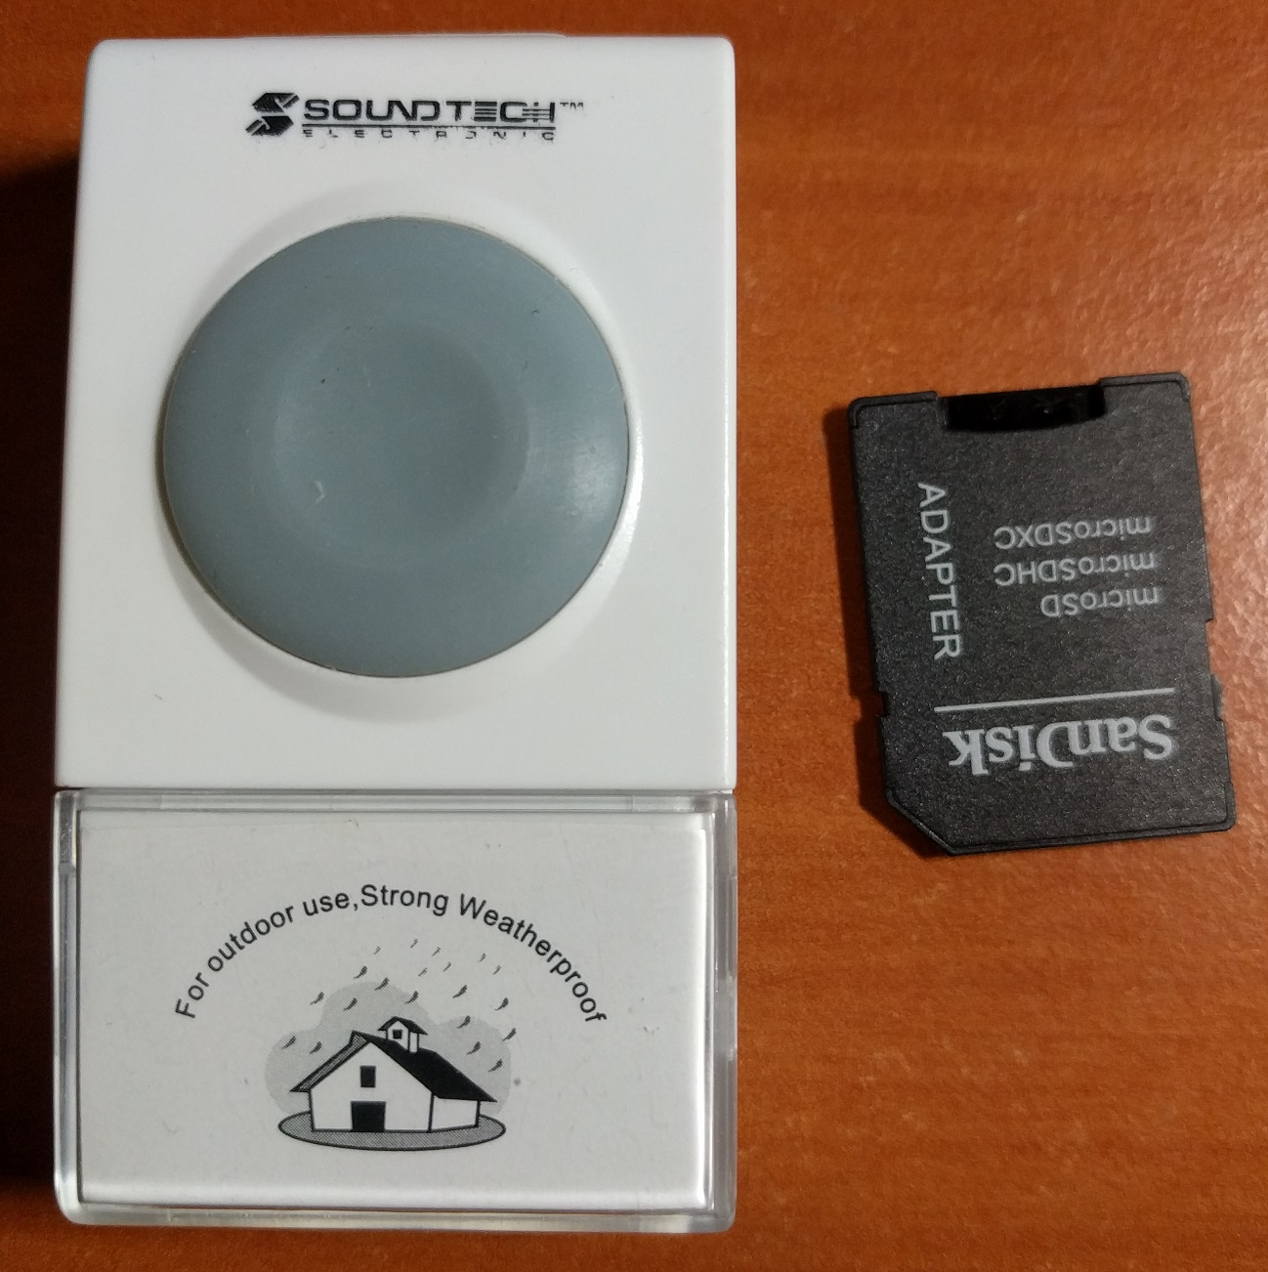
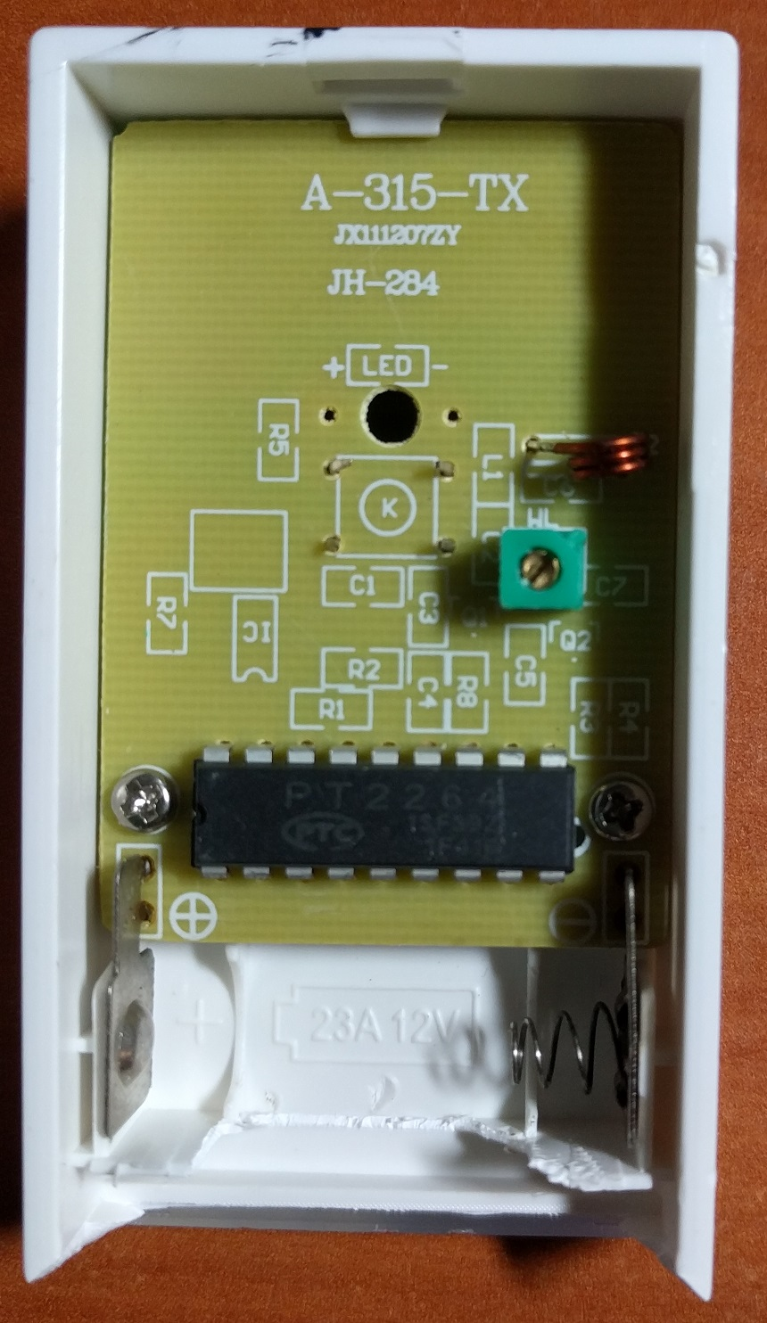
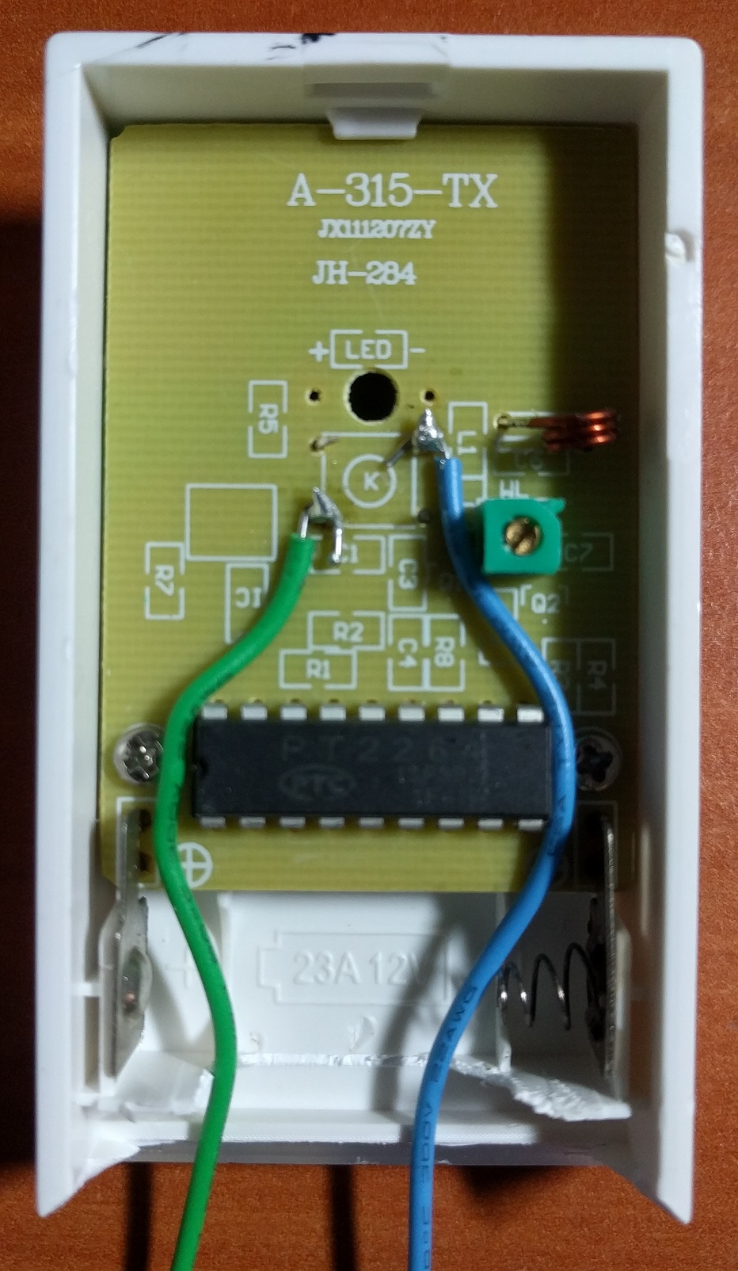
The button

Slide 7
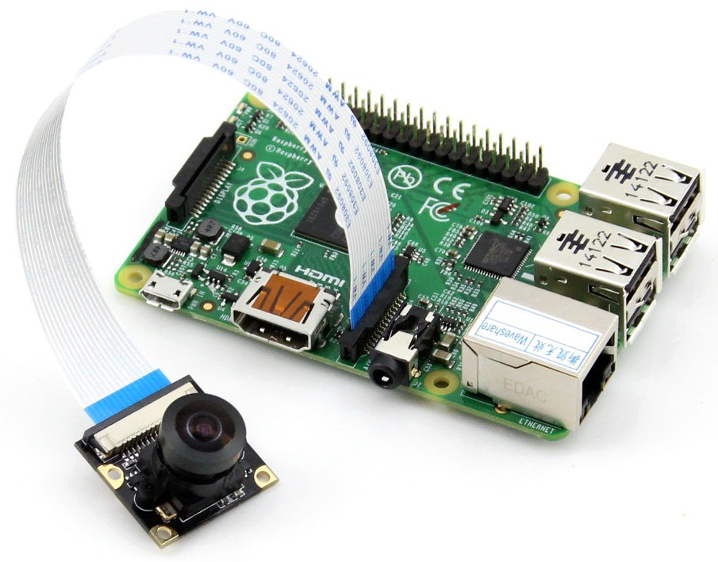
Camera
5MP 160° Horizontal Wide Angle (Fisheye lens)
Usual 72°
70cm flex cable
Usual 10cm
https://www.seeedstudio.com/Raspberry-Pi-Wide-Angle-Camera-Module-p-2774.html

Slide 8
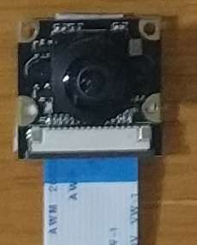
Raspistill’s camera settings
/opt/vc/bin/raspistill -ISO 800 -ss 40000 -q 30 -rot 270 -t 1 -w 640 -h 480 -o /tmp/iot-doorbell-visitor.jpg
30% JPEG quality
270° rotation
1 millisecond picture-taking delay
Default 5 seconds
0 value does not work
640x480 resolution
-> ~100KB file size
ISO 800
40ms shutter speed

Slide 9
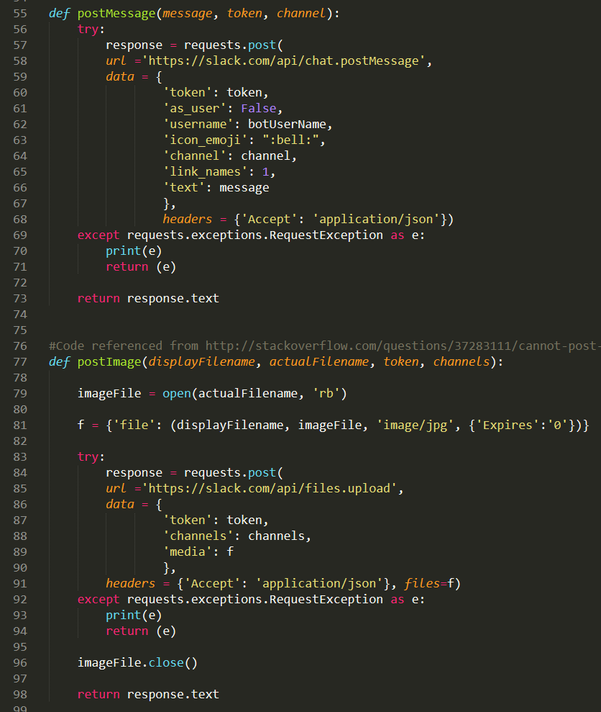
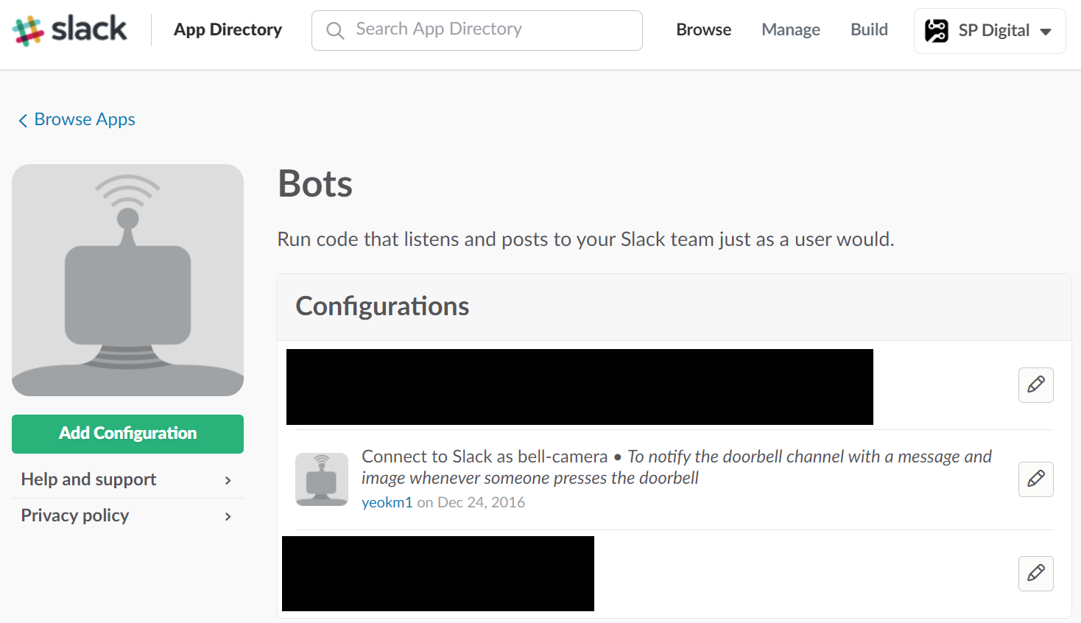
Slack integration
Create Slack bot and get token
https://sp-digital.slack.com/apps/A0F7YS25R-bots
Post Message API: https://api.slack.com/methods/chat.postMessage
File Upload API: https://api.slack.com/methods/files.upload
Slack Python SDK Bug: Only allows file upload from user, not bot
https://github.com/slackapi/python-slackclient/issues/102

Slide 10

Operating System
Arch Linux ARM
My FAVOURITE for personal Raspberry Pi projects
https://archlinuxarm.org/platforms/armv8/broadcom/raspberry-pi-3
Minimal packages OOTB
OOTB: Package Manager (pacman), networking, shell, text editor, SSH
No Git, wget, GUI, Python, GCC
Cutting edge kernel and package releases
Node.js
Python3 as default python

Slide 11
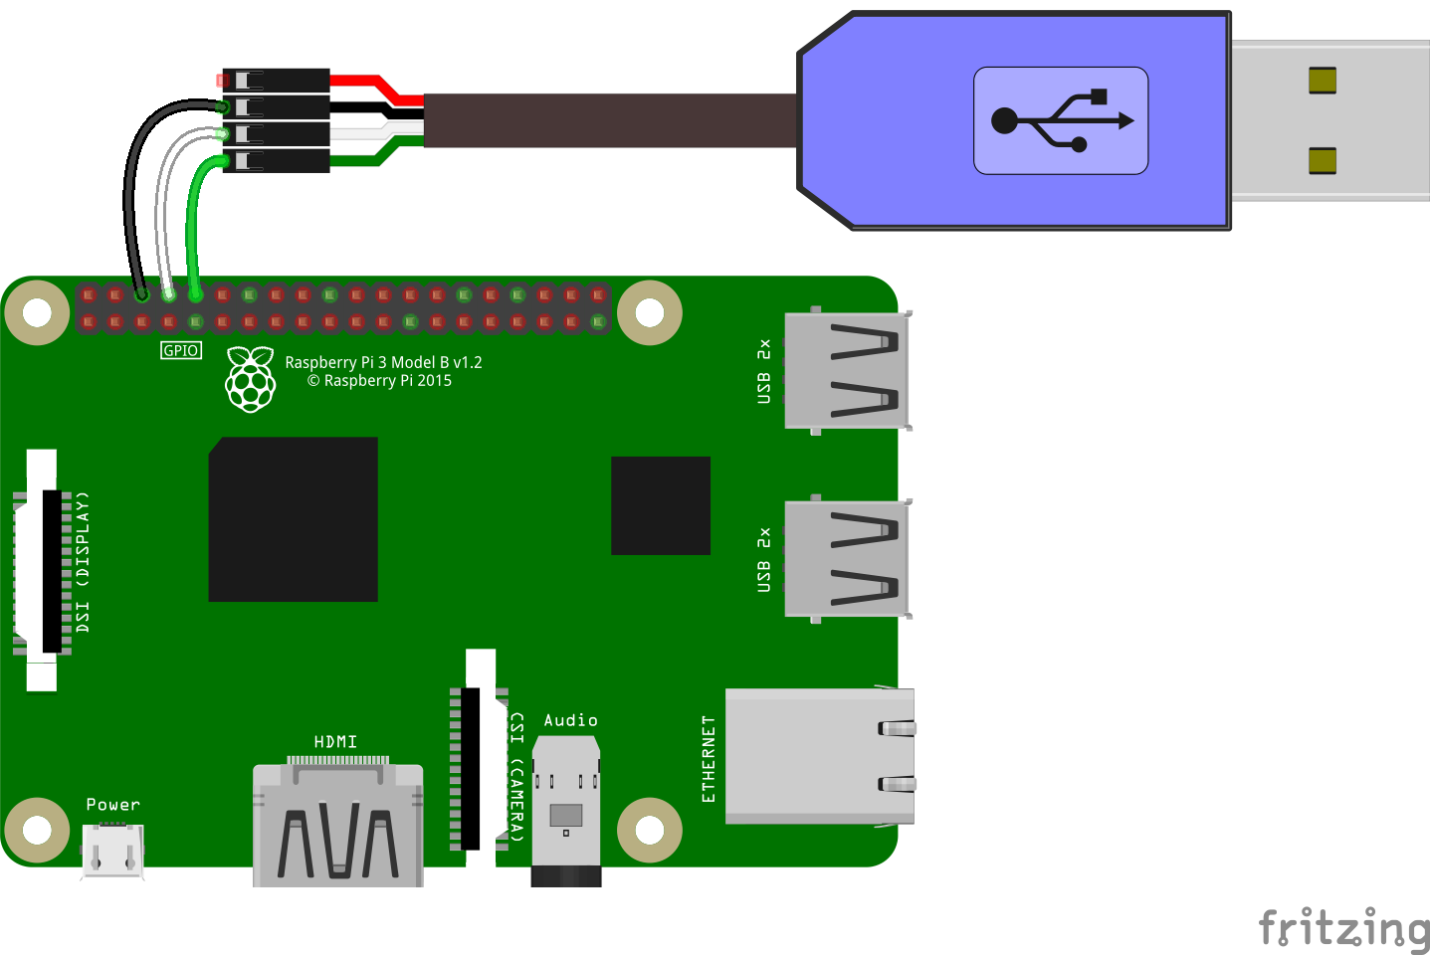
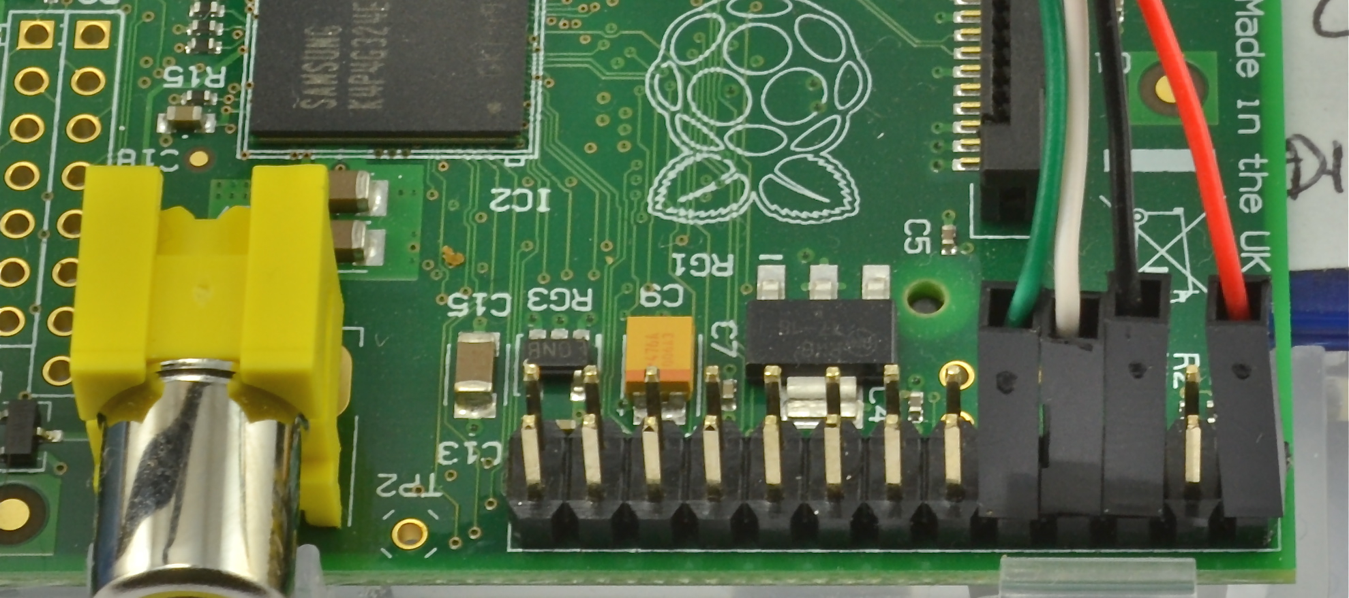
Console access via USB-UART
Access console without SSH
SSH disabled for security
Add to /boot/config.txt
enable_uart=1
Refer to:
https://engineers.sg/video/raspberry-pi-3-uart-bluetooth-issues--609
Hackware (30 March 2016)

Slide 12
Read-only file system for embedded systems
Prevent file-system corruption during improper shutdown
Increase SD card/flash lifespan

Slide 13
Read-only file system options
----------------/etc/fstab------------------------
/dev/mmcblk0p1 /boot vfat defaults,ro,errors=remount-ro 0 0
tmpfs /var/tmp tmpfs nodev,nosuid 0 0
tmpfs /var/log tmpfs nodev,nosuid 0 0
------------------------------------------------------
tmpfs: RAM drive used for temp and log directories
----------------/boot/cmdline.txt------------------------
Set “ro” option for root directory
----------------------------------------------------------------
----------------/etc/systemd/journald.conf-----------
Storage=none
----------------------------------------------------------------
https://gist.github.com/yeokm1/8b0ffc03e622ce011010

Slide 14
Questions
By: Yeo Kheng Meng (yeokm1@gmail.com)
https://github.com/yeokm1/sp-iot-doorbell

