Slide 1
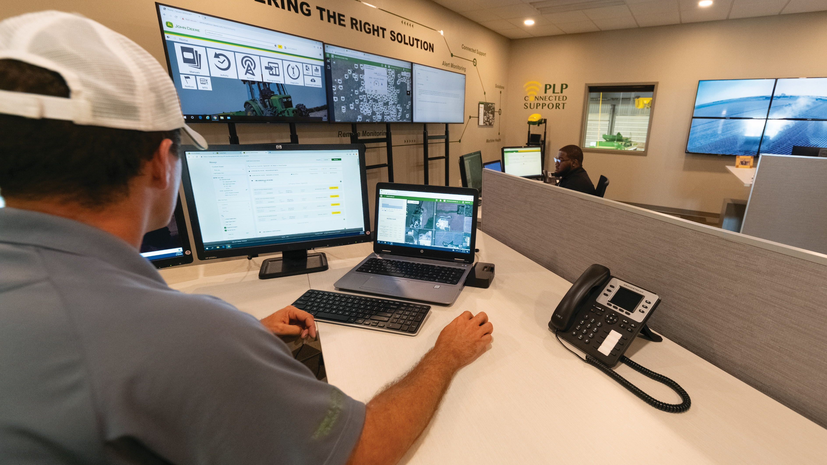

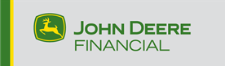
ABTools
Before and After Analysis
January – August 2021

Slide 2

Agenda
Key Takeaways
Methodology
Objectives
Timeline
Study Design
Questionnaires
Participant Demographics
Results
System Usability Scale (SUS)
Satisfaction
Ease of Use
Learnability
System Performance
Human Error Support
Productivity (Convenience)
Improvement Opportunities

Slide 3
Key Takeaways
System Performance System Speed, Latency, Availability, Stable Response, Consistent Connection
62.5 %
Previous ABTools
97.5 %
Current ABTools
Intuitive
8
Usability
Performance
Help
4
Easy
3
Ease of Use
Learnability
Good
3
Clear
2

Slide 4
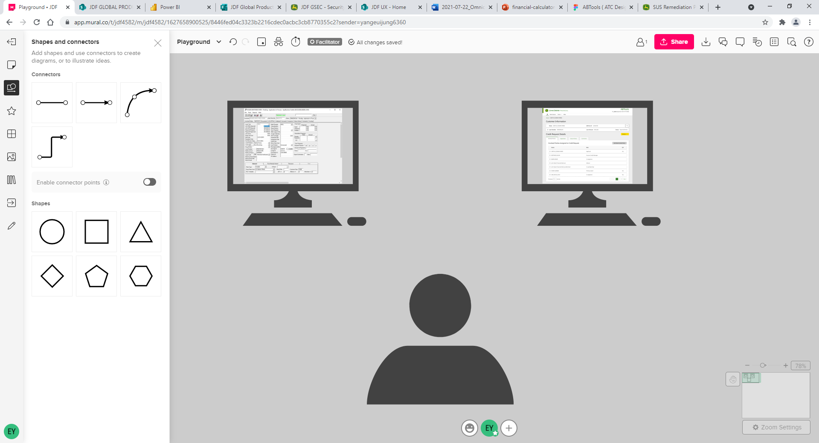
Study Objectives
To measure the level of improvement on
  Satisfaction
  Ease of Use
  Learnability
  System Performance
  Human Error Support
  Productivity (Convenience)
between previous and current ABTools

Slide 5
Study Timeline
Familiarity
Factor
January 2021
Initial Evaluation
of previous ABTools
May-June 2021
Participants started
to use ABTools
August 2021
User Evaluation
of current ABTools

Slide 6
Study Design
Within-Subject Design
  All participants were exposed to the different levels of the independent variable, which are previous and current ABTools.
Longitudinal Research
  A longitudinal study is a research conducted over
  an extended period of time.
  In business, it is mostly used in product launches, customer satisfaction, market trends, brand awareness, employee engagement, etc.
Previous
Current

Slide 7
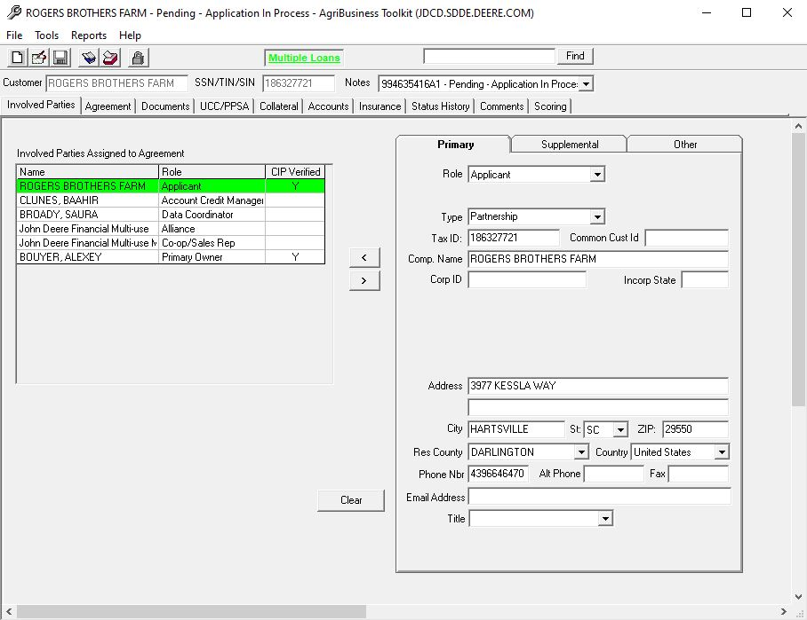
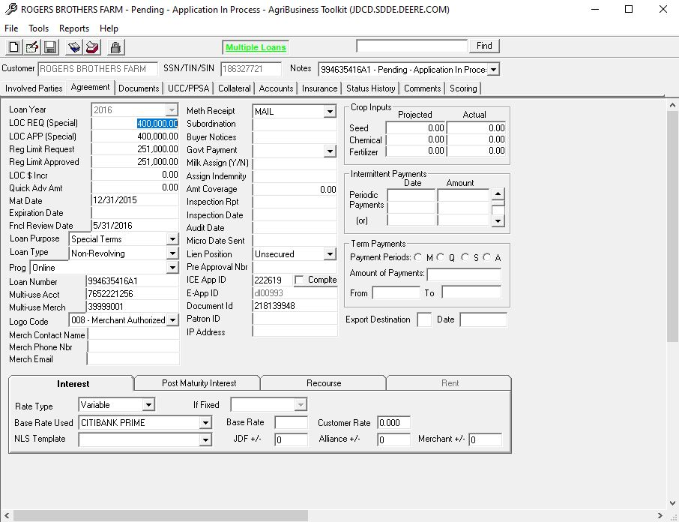
Previous ABTools

Slide 8
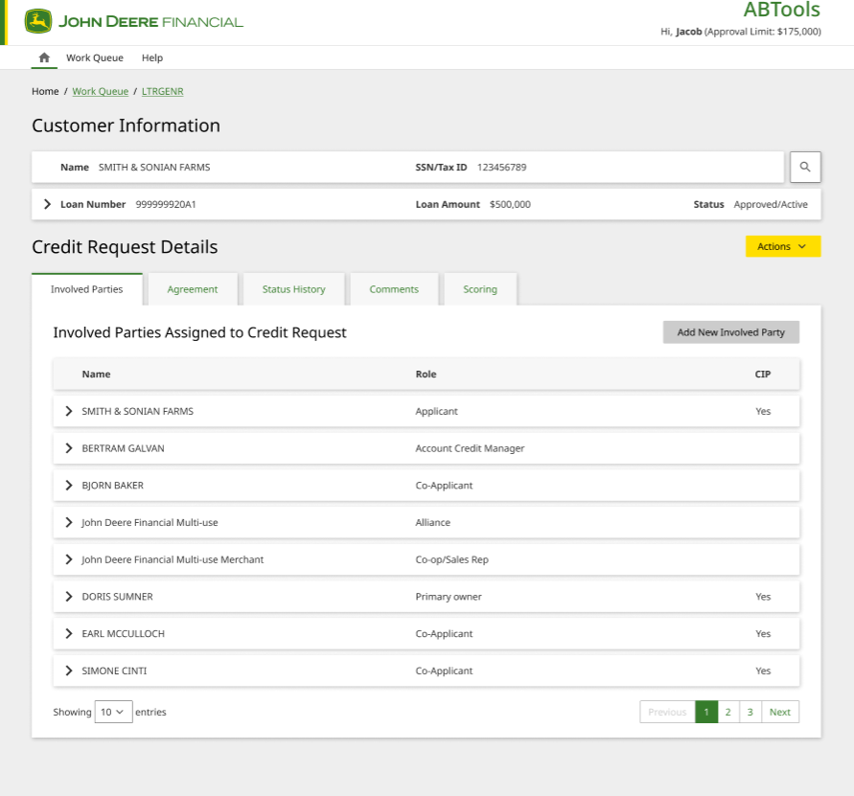
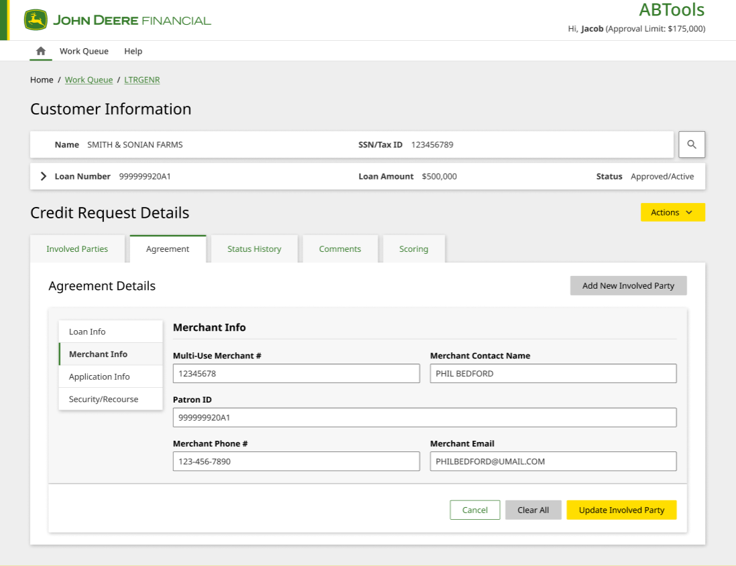
Current ABTools

Slide 9
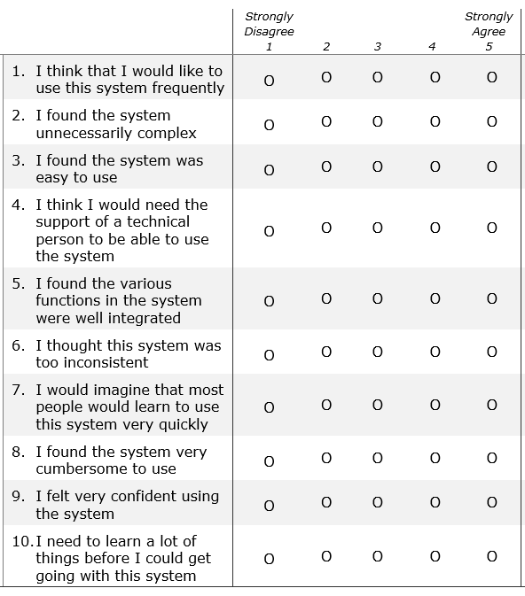
Research Questionnaires
Introduction
User demographics
How long they've been using it (years & hours/day)
Usability with previous and current ABTools
Satisfaction
Ease of use
Learnability
Performance
Human error support (mitigation)
Helpful for productivity (convenience)
Improvement Opportunities
System Usability Scale (SUS)*
Lewis, J. R., & Sauro, J. (2009, July). The factor structure of the system usability scale. In International conference on human centered design (pp. 94-103). Springer, Berlin, Heidelberg.

Slide 10
Participant Demographics
Role
Senior Credit Analyst
Credit Analyst (part of credit admin team)
3.5 years
Using daily, approximately 4-6 hours per day
Been using ABTools since Madison started to use it, a lot of years
Using daily, in ABTools all day, it is part of her job everyday
Years with ABTools
Major systems
ABTools, ACAPS
ABTools, MARS, CreditPath
Application decision that same day
Taking 10-20 calls a day
Answering inbound phone calls from dealers and customers
Placing calls outbound calls to dealers and customers
Provide follow up account information
Review applications
Go into analyst review
Make a decision in a same day
A lot of times as quick as 15 min review
Spreading financials
Reporting working with excels
Sending of annual reviews of financials
Admin work: different from normal credit analysts
Small ticket & large ticket analysts
  Small: do entire process
  Large: two separate processes – do first half
Tasks

Slide 11
Participant Demographics
Role
Credit Processing Specialist
Manager Retail Credit Delivery Admin
Been using ABTools 15+ years
Using daily, approximately 2-3 hours per day
Been using ABTools 20+ years
Using daily, approximately 2-4 hours per day
Years with ABTools
Major systems
ABTools, ACAPS
ABTools
Creating letter for turndown cases
Counteroffer, then go to SharePoint
Using ABTools for entry, and calling to bank if we receive rating from bank
Bank rating, we don't use it for whole lot
Import to ABtools, enter information Merchant Toolkit
Special term -> ABTools, regular->ACAPS
Bank rating come over to our side, produce in Word document, Sent out to the bank
Once bank returns to FileNet, import to comments into ABtools that was received
Going back to the analyst either specific analyst or review queue
Looking at deals and set up worklist
Making employees work with priority order
Training order, training existing process
Managing perpetual management process
Tasks

Slide 12
System Usability Scale (SUS)
100
90
Acceptable
85.6
80
70
68 Industry Average
Average Global IT SUS: 63
Target SUS Score for FY21: 67
Industry Average*: 68
(Industry standard, with references in
over 1300 articles and publications)
60
63 Global IT Average
Marginal
60.0
50
40
30
Not acceptable
20
10
0
Previous
ABTools
Current
ABTools
* https://www.usability.gov/how-to-and-tools/methods/system-usability-scale.html

Slide 13
User Satisfaction
Before
After
71.2%
75.0%
There is a lot of different field you have to click,
you need to jump around
Exporting issues, I have to workaround
It is not great, but it is what we have
It does the job it needs to do but it could be better,
more efficient
Some parts that irritating, kicking you out,
you have to hit okay billion times
Working fairly efficiently for the work that I am doing
Mostly like it but there are a few things could be improved
Still small enhancement pretty sure they are working on, but small stuff could be better user experience
I don't feel the notes, they are not convenient

Slide 14
Ease of Use
Before
After
75.0%
88.7%
Not intuitive, what tabs always to click on to find information
There are lots of information that you don't ever use
Intimidating and overwhelming
It would be a lot more difficult when you start to use it
Learning by doing
More intuitive. It is web based, fewer fields overall and fields actually pertain for underwriting, more useful fields
They got away from a lot of information we never looked at, it is cleaned up, it is easier to find quickly the information that you look for
Once you know where things are it is fairly easy
Training - as long as people know the previous ABTools it is very intuitive, and you know how to click & where to click

Slide 15
Learnability
Before
After
80.0%
92.5%
Job shadowing way – side chair, somebody observing, having a trainer observing and offering help as needed
Started out just using certain tabs only,
next position, I learned couple other tabs
There are 10 tabs in front of me,
which one I need to look at?
Take some time to learn at the beginning
It mirrors a lot the old system as far as the layout of different tabs, how information is layout, this helps speed up learning and
less training needed
same labels and layouts, clicking around when you need
For someone who are from previous ABTools to current ABTools no training needed
Major difference where to find the employee work queue vs. an application work queue, and searching for pending due,
an active deal

Slide 16
System Performance
Before
After
62.5%
97.5%
It times out it is like after an hour if you are not doing any activity
There are pop ups (2-3) lengthy - I don't know what they say - basically some sort of error messages cryptic, system just self close - and need to re-log in
Z scaler - ABtools does not work with Z scaler,
still working with VPN
Sometimes it has issues to give someone access to ABtools
They can't access the system when we submit to system
because it has multiple layers to provide access
You don't understand why it does that way
It will spin and it will close out
I haven't had any issues with latency or any performance issue
Consistent speed
Always been available when I need it
There are a few buttons that don't work yet, and they didn't indicate it wasn't working, if it works that could be 100
You don't get kicked out of it,
you don't have to change password
It hasn't been down, and it is quicker than old ABTools

Slide 17
Human Error Support
Before
After
56.6%
75.0%
Time-out error message does not provide any value –
don’t help any
Half of the application work
some sort of error messages come up
Majority of them aren't helpful
Some messages - can't read, cannot understand
Haven't gotten a whole lot of them – which is a good thing
Error messages simple
but it didn't give me any additional actions
They are more clear than previous ABTools
Haven’t seen any error messages
It could be better with action suggestions

Slide 18
Productivity (Convenience)
Before
After
71.2%
82.5%
Total autopilot mode
I've used so long,
but there is a lot of back-and-forth other tabs
Could be better, it is working what we need,
but it could be easier for navigating work done
There are a lot of information I do not even know
even though work here 15 years
The flow works well
It is still a separate internet tab that we have to go into
Productivity is same from the previous one
ABTools have a different Icon for the browser
With the few improvement it will help a lot

Slide 19
Improvement Opportunities
Notes Feature
  All participants mentioned Notes feature could be better with usability improvement
Usability Issues & Efficiency
  Some user interface issues mentioned
  Usability could be related to the task efficiency
Notes
(16)
Usability
(6)
Others
(3)
Efficiency
(5)
New Feature
(5)

Slide 20
“
Notes
”
  We copy their comment and it format it in this specific way, you can see the comments well because it was as formatted, but new ABTools shows us just a whole paragraph and it is irritating
  Notes: (1) make the comments box bigger (2) or click it so I can see the whole notes (3) if I can click view all notes, I can see it, but the shape is all gone, it ruins layout
  It would be nice if we could update another person’s comment. Say typing error on
  a ph or fx#. would be nice to be able to update that without having to contact them
  Viewing comments on the application, it is not user friendly, it is hard to read,
  it is just on one sentence; it is hard to quickly decide what to review
  I would really like to see the comments box bigger,
  the previous ABTools was better with the comments and notes
  View all comments: too much at once, I like the compact view,
  but such a small box to read
  The comments are all together, I typed in very well layout with spaces,
  but it shows us as a big chunk it is hard to read
  Be able to view and navigate the comments more efficiently
  It doesn't make sense when it is squeezed together
  Too small to see
Notes
(16)
Usability
(6)
Others
(3)
Efficiency
(5)
New Feature
(5)

Slide 21
Usability
“
”
  Browser zoom and out it is not easy to highlight
  Especially in Notes – when you zoom in and out it doesn't change anything, it does not make the font size bigger
  Other UI are changing but the font size isn't
  Assign Credit Request – comment type should be default general
  Be able to get to my worklist a little quicker –
  now you have to navigate and find your name in the work queue
  When you click note overlay, you have to click "x" rather than
  click elsewhere
Notes
(16)
Usability
(6)
Others
(3)
Efficiency
(5)
New Feature
(5)

Slide 22
“
Efficiency
”
  Every time I search my name – it is not detecting me, and I wish it shows me only for me on the top
  Click a button and sort only for you
  Status history, view log, I would like to see record assigned to, what makes it come down to status history vs. view log, I cannot move the overlay modal to other place and check the information both modal and background screen
  Work queue has like 136 items in it, 'credit request' and 'worklist' when you were out from the app, it is not showing the status so need to go back to the list to find what was I working on
  If I am looking at something in wait for bank –
  previous system I could route to the bottom of the list,
  and it route to the bottom, now I have to route
  somewhere else and route back to, like a detour
Notes
(16)
Usability
(6)
Others
(3)
Efficiency
(5)
New Feature
(5)

Slide 23
New Features
“
”
  One thing could be nice, I wish have a refresh button or
  refresh info like every 5 minutes, because new deals,
  I go to home and come back here. Work Queue – Worklist
  It would be nice is ‘Pin it’ the name that you can pin it as top
  Export Excel format of both work queue and credit requests, probably items in the list
  “How many do I need to call" there is no good way,
  something that I would like to know
  The link from ABTools to FileNet
Notes
(16)
Usability
(6)
Others
(3)
Efficiency
(5)
New Feature
(5)

Slide 24
Not working as expected
“
”
  The button “created new credit request” doesn't work
  Employee search – the individuals on the top,
  other employees who have 0 work items on the list and so do I,
  I cannot find my name while I can see other employees’ names.
  I use “employees” tab , it should you give you your name
  with “0” items but it is not showing me at all
  When you hover over the load number
  it gives you 'don't touch it' icon but still I can copy it,
  I still need to copy the loan number,
  no need for scary icons
Notes
(16)
Usability
(6)
Others
(3)
Efficiency
(5)
New Feature
(5)

Slide 25



Future Suggestions
Feedback Loop Establishment
Analytics Observation
Proactive Improvement

