Slide 1
2019 Capstone Design
Ad blog block
Presenter:
Seung Yun Yeom
Notes:
http://minheeblog.tistory.com/category/PPT

Slide 2
2019 Capstone Design
01
Content
Current progress
Problem solving
Schedule
Notes:
http://minheeblog.tistory.com/category/PPT

Slide 3
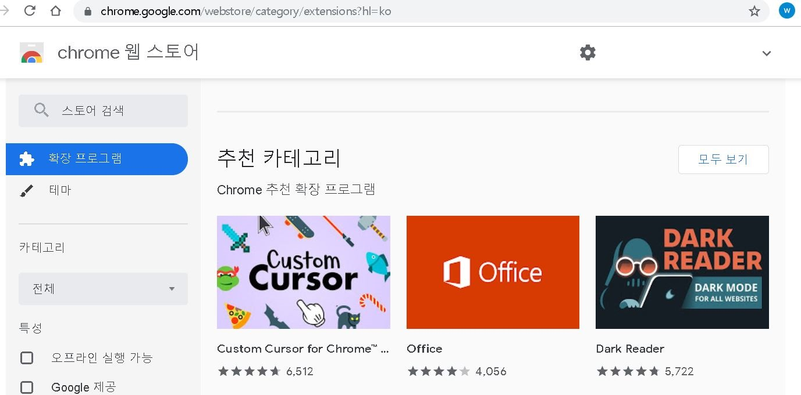
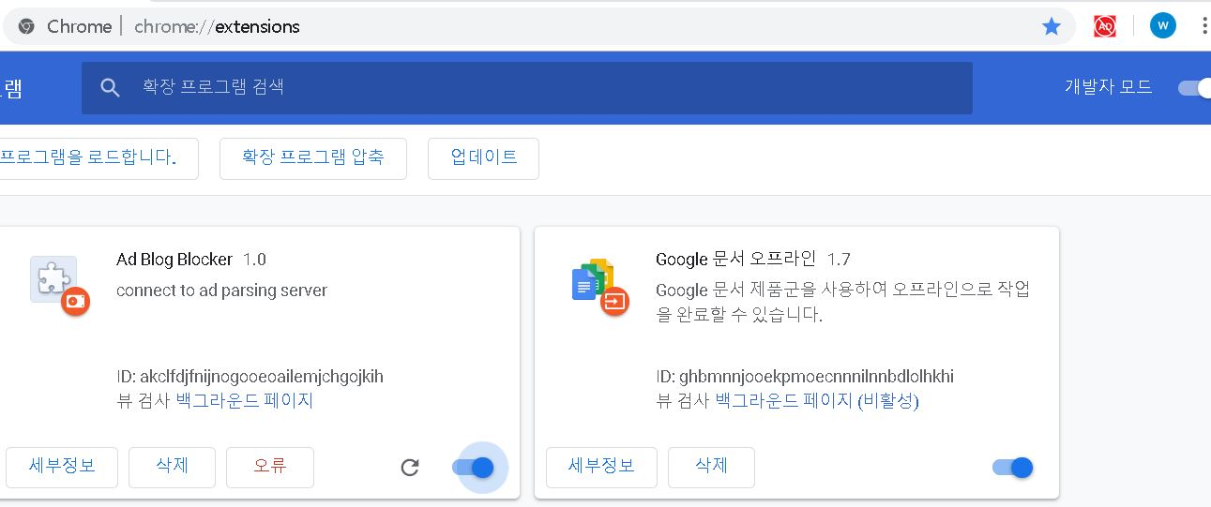
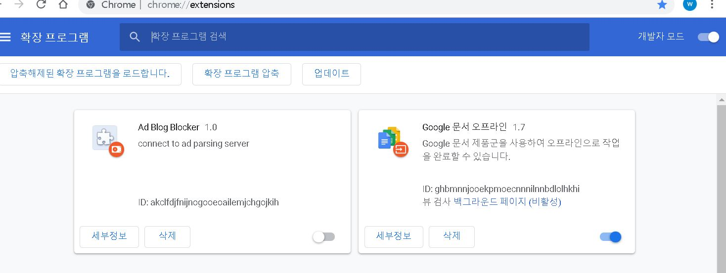
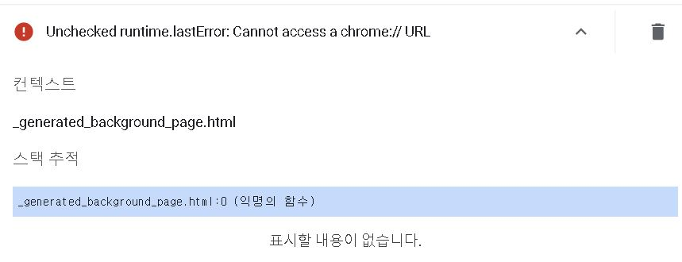
2019 Capstone Design
01
1. Current Progress
Notes:
http://minheeblog.tistory.com/category/PPT

Slide 4
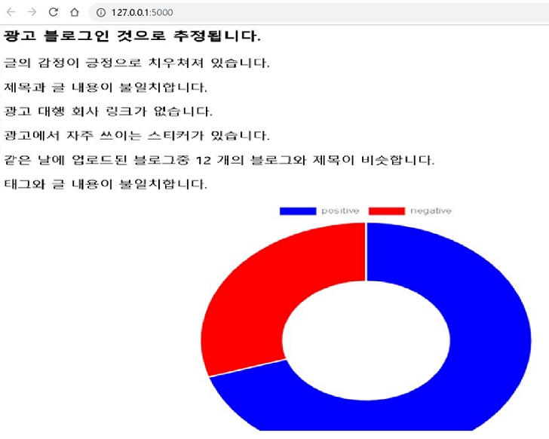
2019 Capstone Design
01
1. Current Progress
Notes:
http://minheeblog.tistory.com/category/PPT

Slide 5
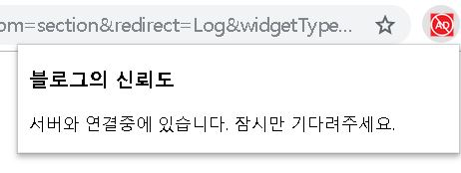
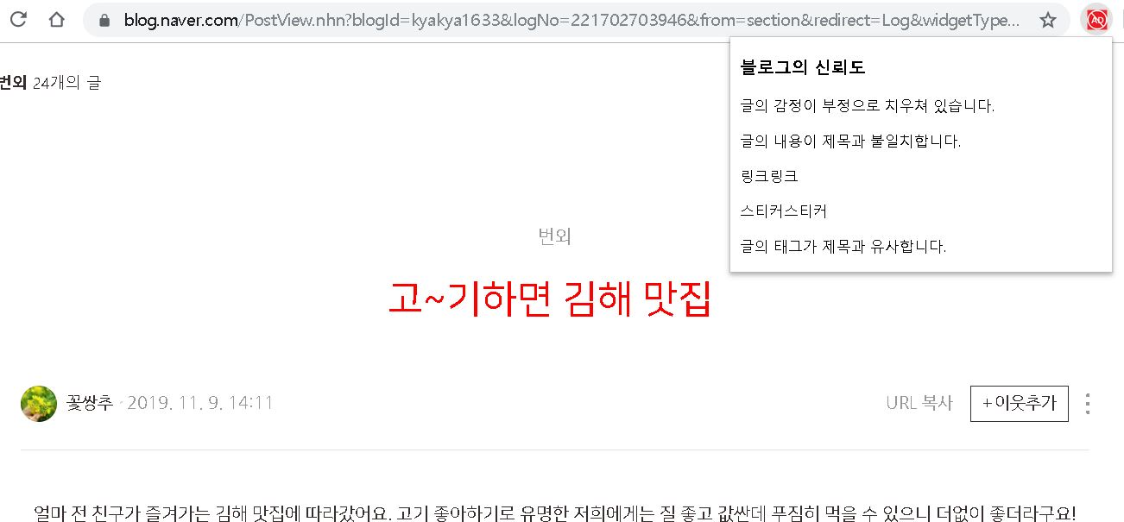
2019 Capstone Design
01
1. Current Progress
Notes:
http://minheeblog.tistory.com/category/PPT

Slide 6
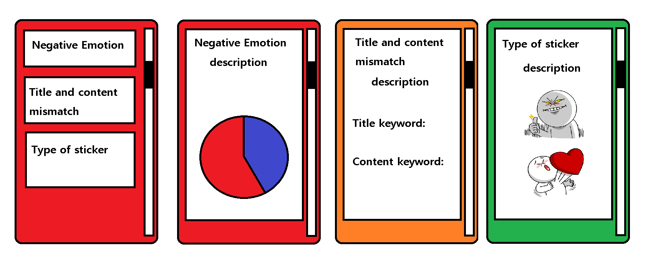
2019 Capstone Design
01
1. Current Progress
Notes:
http://minheeblog.tistory.com/category/PPT

Slide 7

2019 Capstone Design
01
1. Current Progress
Client
1. check URL
(Naver blog or not)
Server
Parsing blog content by accessing the received URL.
Compute 6 features using TF-IDF, emotion dictionary, etc.
Send 6 features data in JSON format.
current page URL
[blog.naver.com/blogid=21312]
Notes:
http://minheeblog.tistory.com/category/PPT

Slide 8
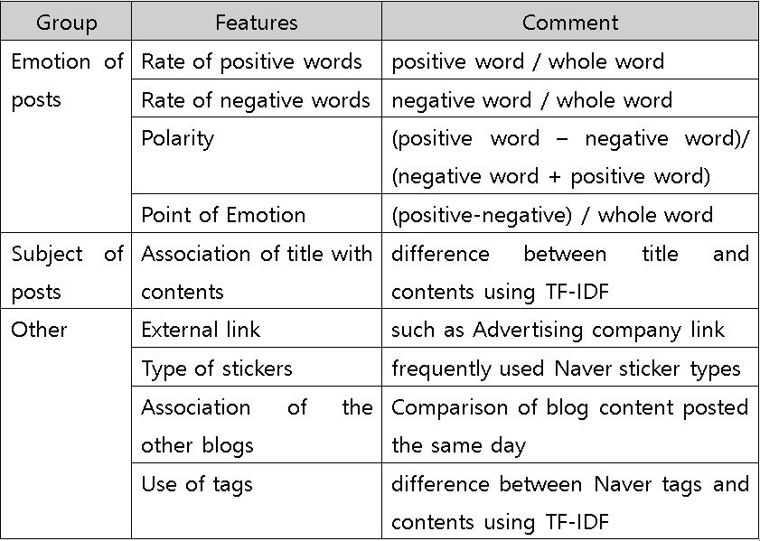
2019 Capstone Design
01
1. Current Progress
Notes:
http://minheeblog.tistory.com/category/PPT

Slide 9
2019 Capstone Design
01
1. Current Progress
Client
1. check URL
(Naver blog or not)
5. Display data received from server to client
Server
Parsing blog content by accessing the received URL.
Compute 6 features using TF-IDF, emotion dictionary, etc.
Send 6 features data in JSON format.
current page URL
[blog.naver.com/blogid=21312]
JSON format
Notes:
http://minheeblog.tistory.com/category/PPT

Slide 10
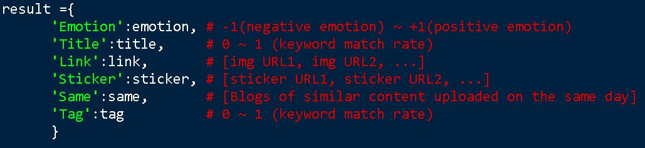
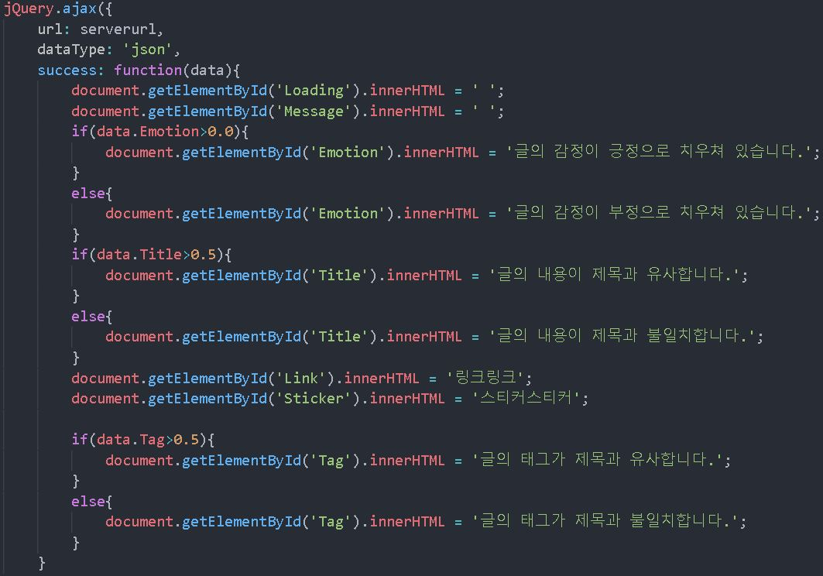
2019 Capstone Design
01
1. Current Progress
Notes:
http://minheeblog.tistory.com/category/PPT

Slide 11
2019 Capstone Design
02
2. Problem solving
Same-Origin Policy
chrome://[Extensions ID]/data.json
chrome://[Extensions ID]
jQuery.ajax{}
https://[Ad_decision_server]/data.json
Notes:
http://minheeblog.tistory.com/category/PPT

Slide 12
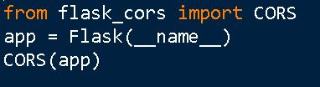
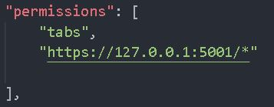
2019 Capstone Design
02
2. Problem solving
Solution
Using CORS(cross-origin resource sharing)
Add Access-Control-Allow-Origin in header
Add server access policy in chrome extension manifest.json file
Notes:
http://minheeblog.tistory.com/category/PPT

Slide 13
2019 Capstone Design
02
2. Problem solving
1. positive/negative dictionary
Problem: too many words still need to check because words typed by man’s hands
Example: konlpy: “기쁘”, dictionary: ”기쁘다
What if dictionary: “기쁜” -> “기쁘” can’t be recognized as a substring of “기쁜”
Solution: check few words which are used more frequently.
We can’t cover all the words perfectly.
Notes:
http://minheeblog.tistory.com/category/PPT

Slide 14
2019 Capstone Design
02
2. Problem solving
2. Title, Tag and blog content similarity check
Problem: The better way is using ‘word2vec’ method which show similarity between words. Because of colloquialism and typos, the results are not as good as expected.
Solution: Check the number of noun in title and tag
-> and then check how many times appears in the contents
Notes:
http://minheeblog.tistory.com/category/PPT

Slide 15
2019 Capstone Design
02
2. Problem solving
3. Sticker check
Problem: only some specific users use stickers.
Solution: With crawled data from the strongly reinforced web crawler. So that we can classify which stickers are used for advertising frequently.
Notes:
http://minheeblog.tistory.com/category/PPT

Slide 16
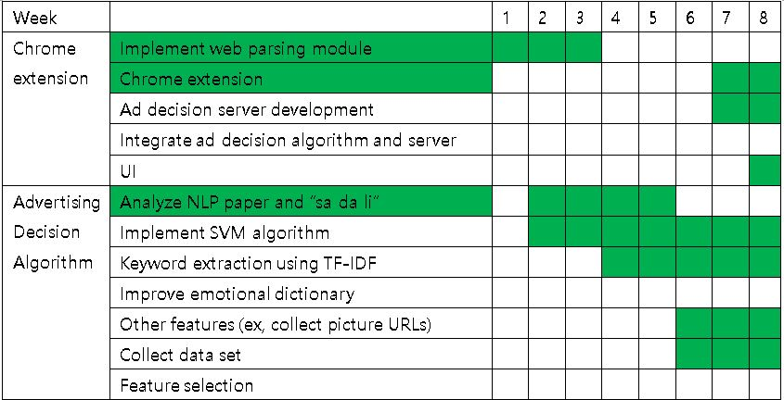
2019 Capstone Design
03
Schedule
Notes:
http://minheeblog.tistory.com/category/PPT

Slide 17
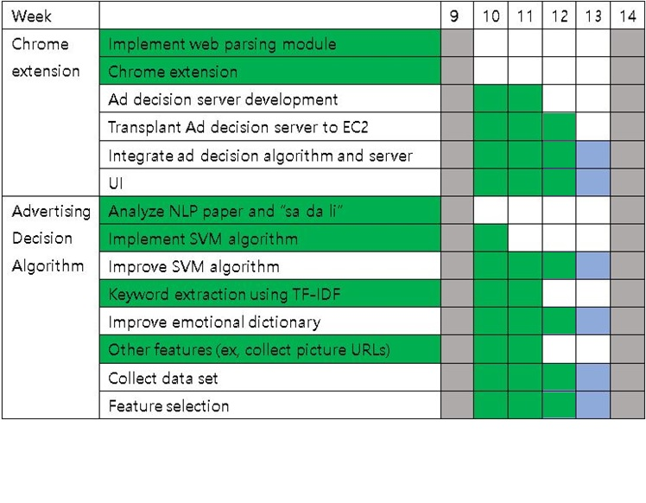
2019 Capstone Design
03
Schedule
Notes:
http://minheeblog.tistory.com/category/PPT

Slide 18
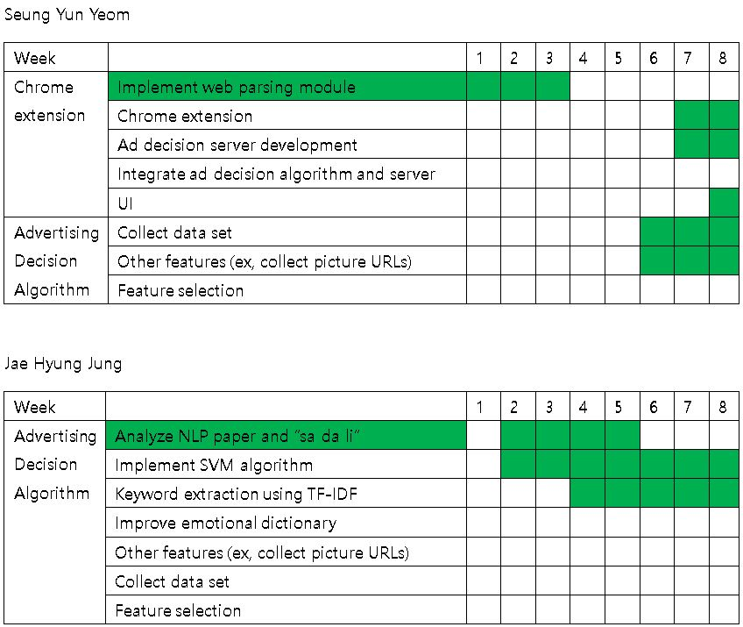
2019 Capstone Design
03
Schedule
Notes:
http://minheeblog.tistory.com/category/PPT

Slide 19
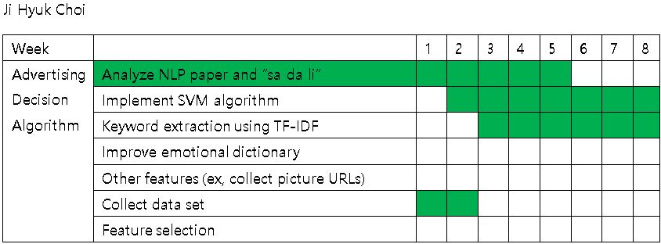
2019 Capstone Design
03
Schedule
Notes:
http://minheeblog.tistory.com/category/PPT

Slide 20
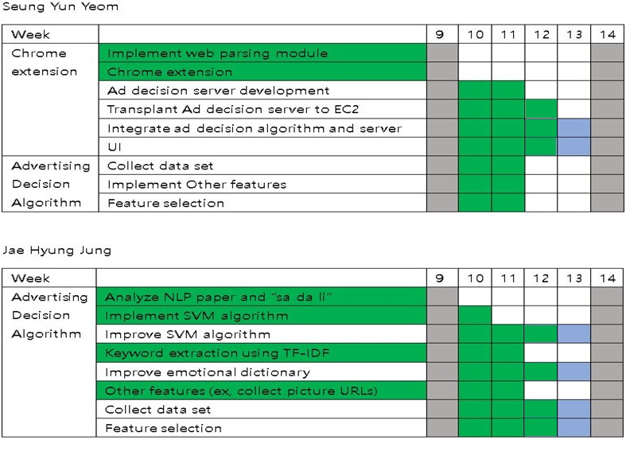
2019 Capstone Design
03
Schedule
Notes:
http://minheeblog.tistory.com/category/PPT

Slide 21
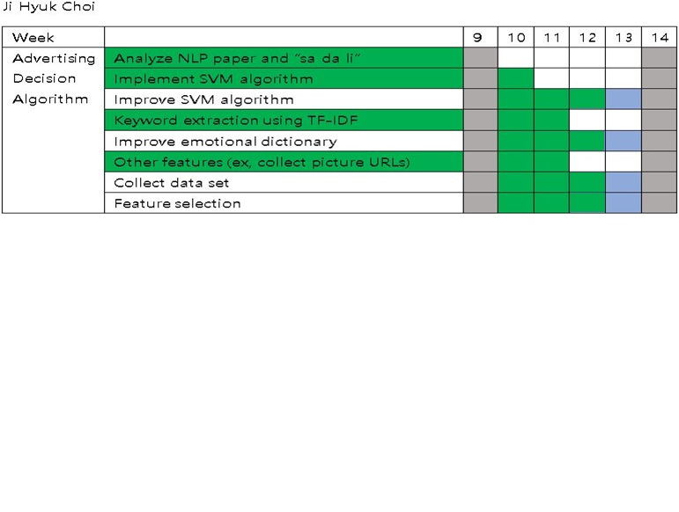
2019 Capstone Design
03
Schedule
Notes:
http://minheeblog.tistory.com/category/PPT

Slide 22
2019 Capstone Design
THANK
YOU
Notes:
http://minheeblog.tistory.com/category/PPT

