Slide 1
2019 Capstone Design
Ad blog block
Notes:
http://minheeblog.tistory.com/category/PPT

Slide 2
2019 Capstone Design
01
Content
Progress
Demo
Schedule
Notes:
http://minheeblog.tistory.com/category/PPT

Slide 3





2019 Capstone Design
01
Chrome extension program
Client
Server
Advertising Decision Algorithm
v
Preprocessing
Notes:
http://minheeblog.tistory.com/category/PPT

Slide 4
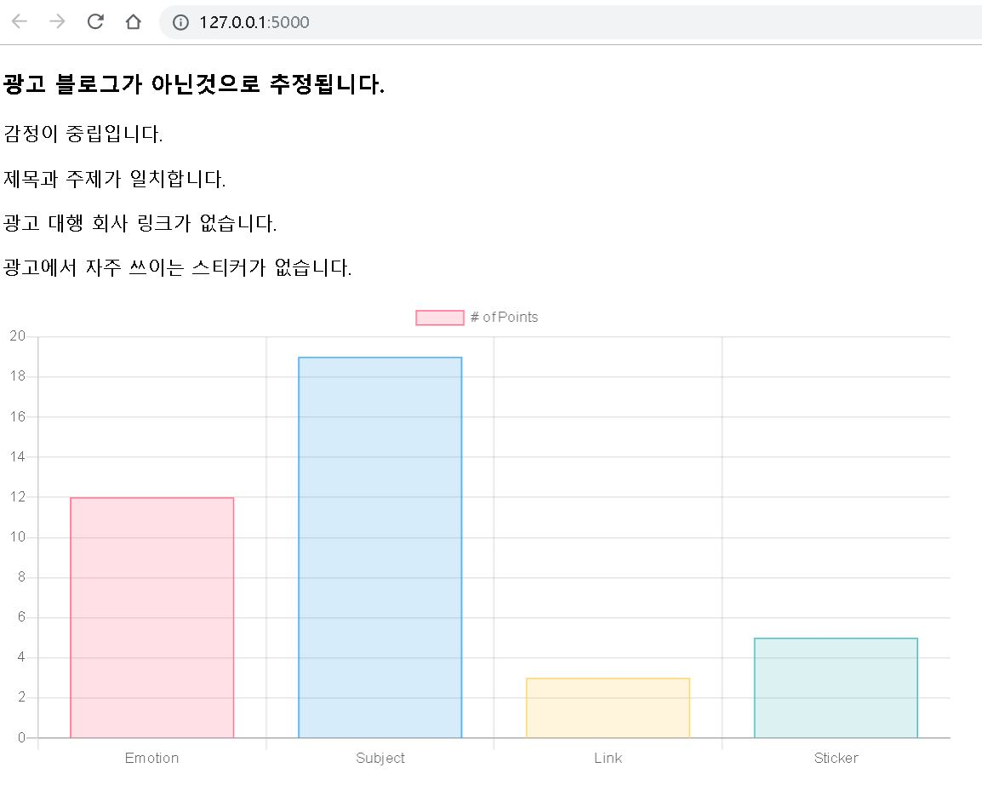
2019 Capstone Design
01
Notes:
http://minheeblog.tistory.com/category/PPT

Slide 5

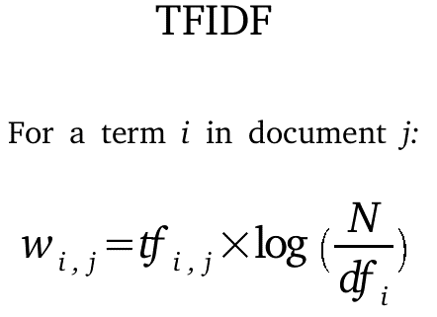
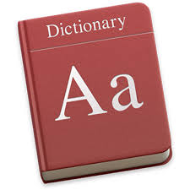
2019 Capstone Design
01
Algorithms which have been implemented
Notes:
http://minheeblog.tistory.com/category/PPT

Slide 6



2019 Capstone Design
01
Programs implemented last week
1. Checking 11 marketing companies
Notes:
http://minheeblog.tistory.com/category/PPT

Slide 7
2019 Capstone Design
01
How?
Marketing Companies Use Same Images
example
https://postfiles.pstatic.net/MjAxNjExMTBfMTcx/MDAxNDc4NzU2MzE1ODA3.B4yixBb15Xxn3Z5lZ8ME_hoOsvUcJxL5sXd_mEO7_-sg.gD9xA3Sr0A7-BLdTivmOKrAZqRCFslCuQm5CA8JJPogg.JPEG.sweety0533/2016-11-10_14%3B36%3B40.JPEG?type=w80_blur
https://www.revu.net/campaign/img.php?p=aa98d7f7c51a8b79c3de8fa24b7a5b10ed01952e79bac82cd6434e8c3f3f81d6&v=4
https://postfiles.pstatic.net/MjAxOTAxMThfMjIg/MDAxNTQ3ODEyODM1Mjky.WbvXpqbIoKF7tmN3rK6dZ7RBXPo3rCx7XhKbS6lNyPgg.iMXNVbHklSj24rH6OZfs7uyd74suKmoh0SCWINuf25Mg.PNG.sweety0533/2001
https://www.revu.net/campaign/img.php?p=53230ab115d75eb7127fb958780dc9a52932616a1e9fdef9dd2f9f5425b81396&v=4
https://www.revu.net/campaign/img.php?p=7267a1ce434b9a70ae865a99919ad50f59bc77d03a0df88a55b040be58287288&v=4
https://postfiles.pstatic.net/MjAxOTA5MTNfMjYz/MDAxNTY4MzQzMDUyMjk3.vn1ACvZbA2dSS-gDhis4I60Ou7dwmY1dN_HVIAnYHkcg.J6TMdQcJsCciZj5yUvj6dbVOIZPOiMXmZE_XMqpI5MAg.JPEG.luna0723/쉬즈.jpg?type=w80_blur
http://dinnerqueen.net/reviews/image/30293_footer.jpg
Notes:
http://minheeblog.tistory.com/category/PPT

Slide 8
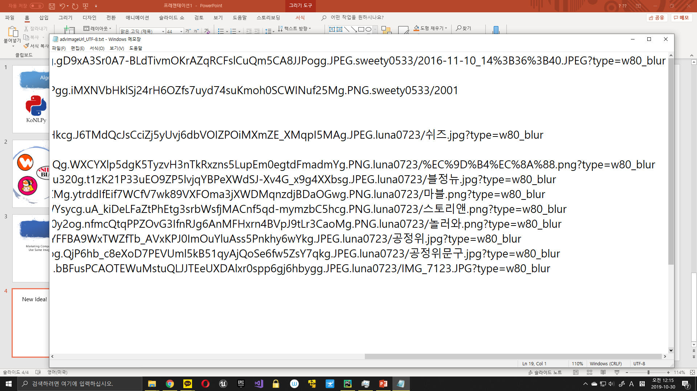
2019 Capstone Design
01
New Idea!
Only Company Images have ‘Korean’ word in URL
Notes:
http://minheeblog.tistory.com/category/PPT

Slide 9
2019 Capstone Design
01
Programs implemented last week 2
Adv Pointing Program Structure
Notes:
http://minheeblog.tistory.com/category/PPT

Slide 10

2019 Capstone Design
01
Problem of last week 1
TF-IDF -> Too Much Time Needed
Notes:
http://minheeblog.tistory.com/category/PPT

Slide 11
2019 Capstone Design
01
Problem of last week 2
Dictionary Reinforcement -> Too Much Time needed
Notes:
http://minheeblog.tistory.com/category/PPT

Slide 12


2019 Capstone Design
01
Data preprocessing
Solution
TFIDF -> fully use API
Dictionary -> weekly Reinforcement
Notes:
http://minheeblog.tistory.com/category/PPT

Slide 13
2019 Capstone Design
01
Experiment
Method | SVM(w/o kernel) | SVM(w/ kernel) | DT | RF | ADA | MLP
Pros | Good result | Anything | Good result | Not so bad result | Good result | Good result
Cons | Not perfect result | Everything | ? | ? | Little slow | VERY SLOW
Quality of result: MLP≥ADA≥DT>SVM(no kernel)>RF>SVM(kernel)
Time: DT>RF≥SVM>ADA>>>>MLP
Notes:
http://minheeblog.tistory.com/category/PPT

Slide 14
2019 Capstone Design
01
Experiment
Conclusion
SVM may be not the best
ADA Boosting may be the best
DT & RF are good but something wrong…
MLP is toooooooo slow (almost 100 times of ADA)
SVM is good compromise
Notes:
http://minheeblog.tistory.com/category/PPT

Slide 15
2019 Capstone Design
01
The Things to Implement
Categorizing
Adjusting TFIDF code by API
Reinforcing Adv_Pointing_Method
Crawling data more
Reinforcing Dictionary weekly
Notes:
http://minheeblog.tistory.com/category/PPT

Slide 16
2019 Capstone Design
02
Demo
Notes:
http://minheeblog.tistory.com/category/PPT

Slide 17
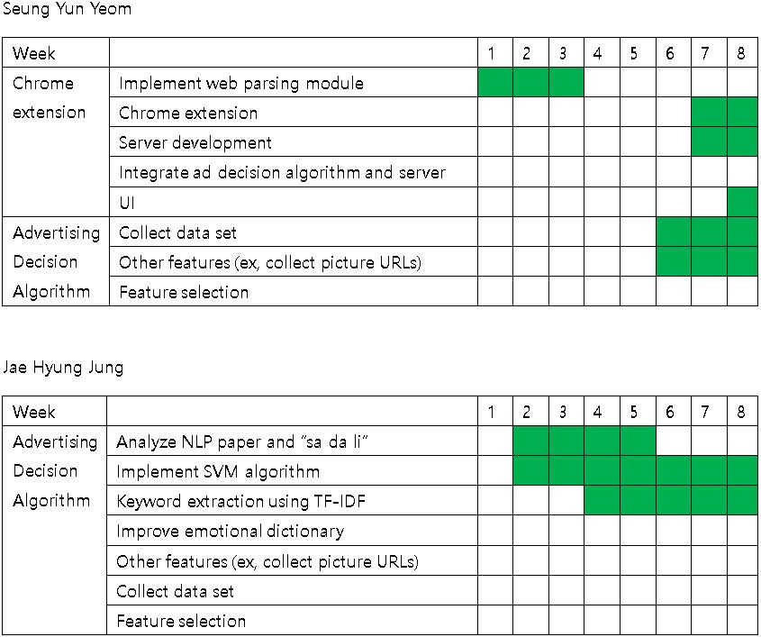
2019 Capstone Design
03
Schedule
Notes:
http://minheeblog.tistory.com/category/PPT

Slide 18
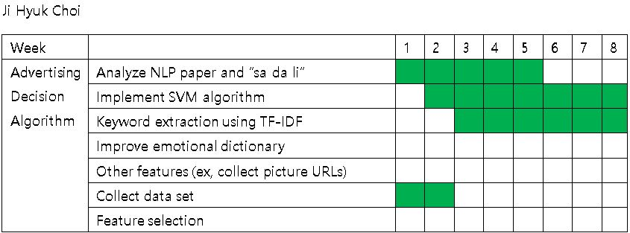
2019 Capstone Design
03
Schedule
Notes:
http://minheeblog.tistory.com/category/PPT

Slide 19
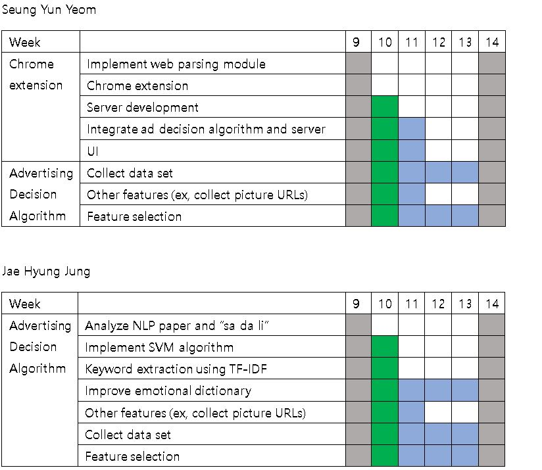
2019 Capstone Design
03
Schedule
Notes:
http://minheeblog.tistory.com/category/PPT

Slide 20
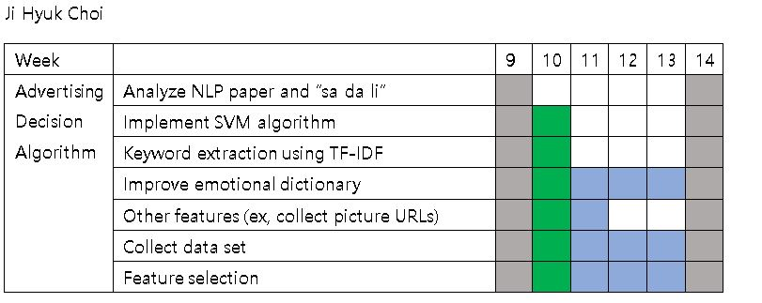
2019 Capstone Design
03
Schedule
Notes:
http://minheeblog.tistory.com/category/PPT

Slide 21
2019 Capstone Design
THANK
YOU
Notes:
http://minheeblog.tistory.com/category/PPT

