Slide 1


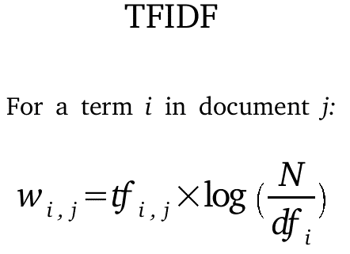

Algorithms which have been implemented

Slide 2




Programs implemented last week
1. Checking 11 marketing companies

Slide 3
How?
example
Marketing Companies Use Same Images
https://postfiles.pstatic.net/MjAxNjExMTBfMTcx/MDAxNDc4NzU2MzE1ODA3.B4yixBb15Xxn3Z5lZ8ME_hoOsvUcJxL5sXd_mEO7_-sg.gD9xA3Sr0A7-BLdTivmOKrAZqRCFslCuQm5CA8JJPogg.JPEG.sweety0533/2016-11-10_14%3B36%3B40.JPEG?type=w80_blur
https://www.revu.net/campaign/img.php?p=aa98d7f7c51a8b79c3de8fa24b7a5b10ed01952e79bac82cd6434e8c3f3f81d6&v=4
https://postfiles.pstatic.net/MjAxOTAxMThfMjIg/MDAxNTQ3ODEyODM1Mjky.WbvXpqbIoKF7tmN3rK6dZ7RBXPo3rCx7XhKbS6lNyPgg.iMXNVbHklSj24rH6OZfs7uyd74suKmoh0SCWINuf25Mg.PNG.sweety0533/2001
https://www.revu.net/campaign/img.php?p=53230ab115d75eb7127fb958780dc9a52932616a1e9fdef9dd2f9f5425b81396&v=4
https://www.revu.net/campaign/img.php?p=7267a1ce434b9a70ae865a99919ad50f59bc77d03a0df88a55b040be58287288&v=4
https://postfiles.pstatic.net/MjAxOTA5MTNfMjYz/MDAxNTY4MzQzMDUyMjk3.vn1ACvZbA2dSS-gDhis4I60Ou7dwmY1dN_HVIAnYHkcg.J6TMdQcJsCciZj5yUvj6dbVOIZPOiMXmZE_XMqpI5MAg.JPEG.luna0723/쉬즈.jpg?type=w80_blur
http://dinnerqueen.net/reviews/image/30293_footer.jpg

Slide 4
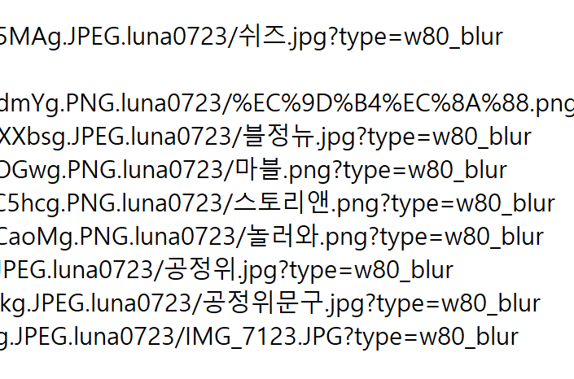
New Idea!
Only Company Images have ‘Korean’ word in URL

Slide 5
Programs implemented last week 2
Adv Pointing Program Structure

Slide 6

Problem of last week 1
TF-IDF -> Too Much Time Needed

Slide 7
Problem of last week 2
Dictionary Reinforcement -> Too Much Time needed

Slide 8



Solution
TFIDF -> fully use API
Dictionary -> weekly Reinforcement

Slide 9
The Things to Implement
Categorizing
Adjusting TFIDF code by API
Reinforcing Adv_Pointing_Method
Crawling data more
Reinforcing Dictionary weekly

