Slide 1
2019 Capstone Design
Ad blog block
Notes:
http://minheeblog.tistory.com/category/PPT

Slide 2
2019 Capstone Design
01
Content
Chrome extension
Data preprocessing
Advertising Decision Algorithm Features
Schedule
Notes:
http://minheeblog.tistory.com/category/PPT

Slide 3





2019 Capstone Design
01
Chrome extension program
Client
Server
Advertising Decision Algorithm
v
Preprocessing
Notes:
http://minheeblog.tistory.com/category/PPT

Slide 4
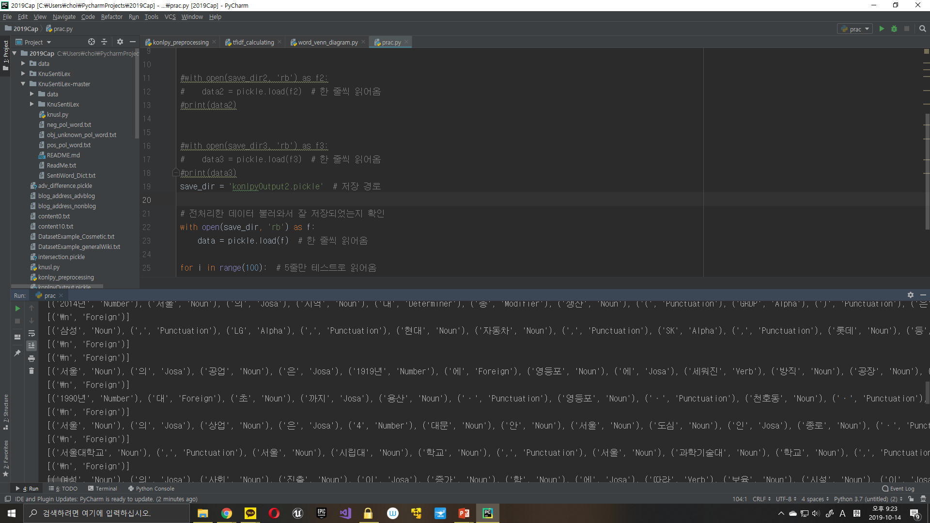
2019 Capstone Design
02
Data preprocessing
Complete stemming with konlpy
Notes:
http://minheeblog.tistory.com/category/PPT

Slide 5
2019 Capstone Design
02
Data preprocessing
Stemming result
Notes:
http://minheeblog.tistory.com/category/PPT

Slide 6
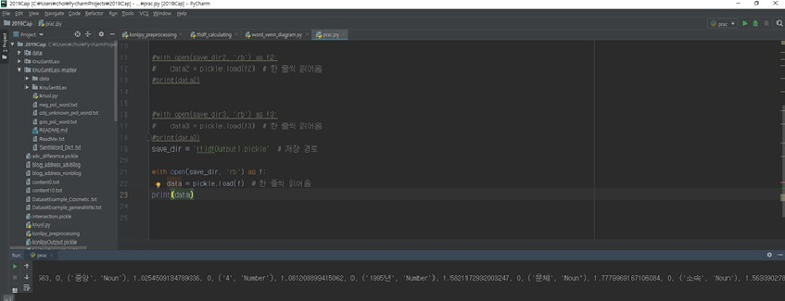
2019 Capstone Design
03
Advertising Decision Algorithm Features
Advertising Decision Algorithm Features (TF-IDF)
Notes:
http://minheeblog.tistory.com/category/PPT

Slide 7

2019 Capstone Design
03
Advertising Decision Algorithm Features
Advertising Decision Algorithm Features (TF-IDF)
Example
- | Samsung | Seoul | city | factory | school
document1 | 0 | 0 | 0 | 1 | 0
document2 | 0 | 0 | 0 | 1 | 1
document3 | 0 | 1 | 1 | 0 | 2
document4 | 1 | 0 | 0 | 0 | 0
n: number of document
f(t): number of times written in all documents
Notes:
http://minheeblog.tistory.com/category/PPT

Slide 8
2019 Capstone Design
03
Advertising Decision Algorithm Features
Advertising Decision Algorithm Features (TF-IDF)
- | Samsung | Seoul | city | factory | school
document1 | 0 | 0 | 0 | 0.287 | 0
document2 | 0 | 0 | 0 | 0.287 | 0.287
document3 | 0 | 0.693 | 0.693 | 0 | 0.575
document4 | 0.693 | 0 | 0 | 0 | 0
Words that frequently appear in the entire document are less important.
Words that appear only in certain documents are considered to be of high importance.
Notes:
http://minheeblog.tistory.com/category/PPT

Slide 9
2019 Capstone Design
03
Advertising Decision Algorithm Features
TF-IDF of our program
There are some unavoidable words when crawling blogs such as “로그인”.
Luckily, this kind of words get a low score for TF-IDF.
2. But If input data is large, the TF-IDF will be slow.
3. The words in the emotional dictionary to distinguish positive and negative are incompatible with the output from konlpy.
Notes:
http://minheeblog.tistory.com/category/PPT

Slide 10
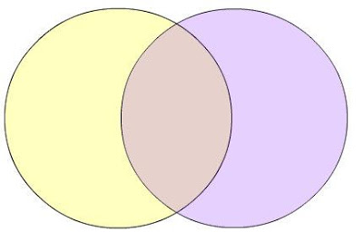
2019 Capstone Design
03
Advertising Decision Algorithm Features
Non Advertising
words
Advertising
words
Notes:
http://minheeblog.tistory.com/category/PPT

Slide 11
2019 Capstone Design
03
Advertising Decision Algorithm Features
Why we use SVM
SVM
Well functions with few learning data
K-means
Requires huge dataset
Doesn’t work well for outlier
Notes:
http://minheeblog.tistory.com/category/PPT

Slide 12
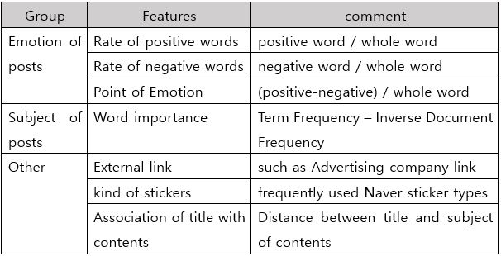
2019 Capstone Design
03
Advertising Decision Algorithm Features
Notes:
http://minheeblog.tistory.com/category/PPT

Slide 13
2019 Capstone Design
03
Advertising Decision Algorithm Features
Differentiator from “Sadari”
ABB
Sadari
svm
K means
Missmatch in machine learning
Machine learning with proper features
Notes:
http://minheeblog.tistory.com/category/PPT

Slide 14
2019 Capstone Design
03
Advertising Decision Algorithm Features
Why not we use other methods?
Deep Learning
Naïve Bayesian
Similar reason with k-Mean
ADAboost
Sensitive to noise
Too heavy
Notes:
http://minheeblog.tistory.com/category/PPT

Slide 15
2019 Capstone Design
03
Advertising Decision Algorithm Features
Features for SVM
(Rogati, Yang, 2002)
$$χ^{2}$$
𝜒^2
TF-IDF
Positive/negative per total
Notes:
http://minheeblog.tistory.com/category/PPT

Slide 16
2019 Capstone Design
03
Advertising Decision Algorithm Features
Implementation SVM
Library
We will use scikit-learn
Kernel
No, linear is enough
(may be)
(python free software machine learning library)
Notes:
http://minheeblog.tistory.com/category/PPT

Slide 17
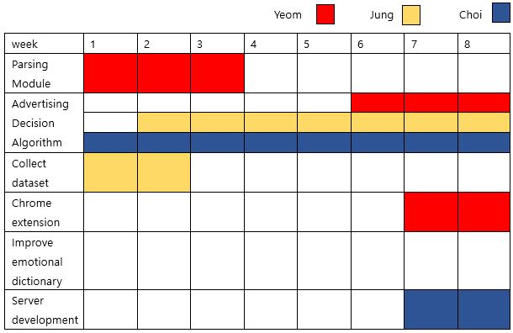
2019 Capstone Design
04
Schedule
Notes:
http://minheeblog.tistory.com/category/PPT

Slide 18
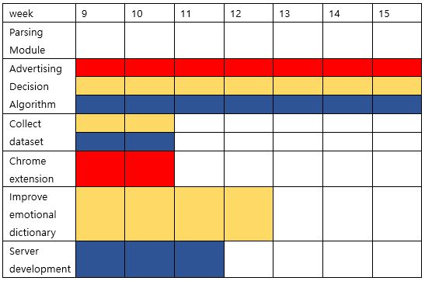
2019 Capstone Design
04
Schedule
Notes:
http://minheeblog.tistory.com/category/PPT

Slide 19
휴먼 ICT 소프트웨어공학
THANK
YOU
Notes:
http://minheeblog.tistory.com/category/PPT

