Slide 1
2019 Capstone Design
Ad blog block
Notes:
http://minheeblog.tistory.com/category/PPT

Slide 2
Content
2019 Capstone Design
02
Chrome extension program
1) Use case
Notes:
http://minheeblog.tistory.com/category/PPT

Slide 3
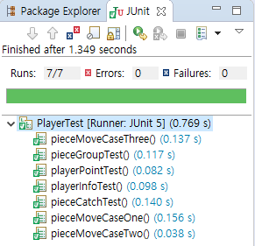
Test
휴먼 ICT 소프트웨어공학
05
Test
Junit
< Test Result >
Notes:
http://minheeblog.tistory.com/category/PPT

Slide 4
휴먼 ICT 소프트웨어공학
THANK
YOU
Notes:
http://minheeblog.tistory.com/category/PPT

