Slide 1
2019 Capstone Design
Ad blog block
Presenter:
Seung Yun Yeom
Notes:
http://minheeblog.tistory.com/category/PPT

Slide 2
2019 Capstone Design
01
Content
Feedback
Problem solving
Current progress
Schedule
Notes:
http://minheeblog.tistory.com/category/PPT

Slide 3
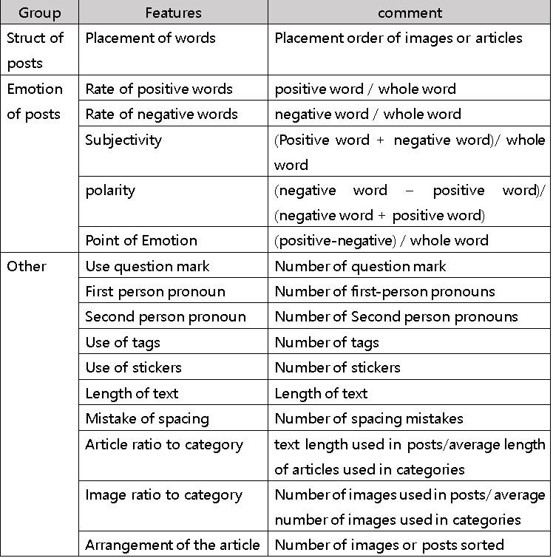
2019 Capstone Design
01
1. Feedback – Machine Learning Features(“Sa da li”)
Notes:
http://minheeblog.tistory.com/category/PPT

Slide 4
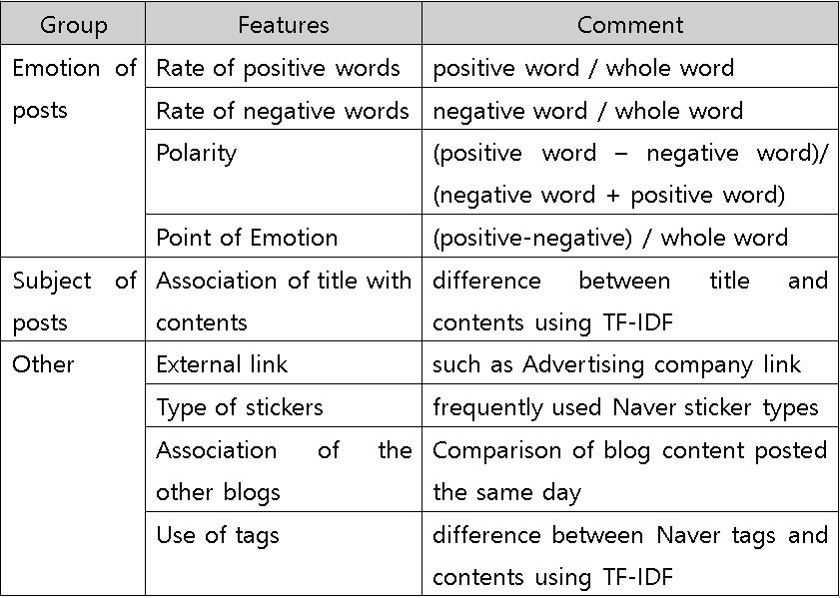
2019 Capstone Design
01
1. Feedback – Machine Learning Features(Ad blog block)
Notes:
Lu, Y., Zhang, L., Xiao, Y., & Li, Y. (2013, May). Simultaneously detecting fake reviews and review spammers using factor graph model. In Proceedings of the 5th annual ACM web science conference (pp. 225-233). ACM.

Slide 5
2019 Capstone Design
01
1. Feedback – Collecting Data
Advertising Blog Data: From the specific blogs which indicate on category or images that they are advertising
Non-Advertising Blog Data: From the website ‘The Blogs Of This Month’ suggested from Naver
Notes:
http://minheeblog.tistory.com/category/PPT

Slide 6
2019 Capstone Design
01
1. Feedback – Collecting Data
Collect blog URLs indiscriminately when searching Naver keywords (tastes, travel, etc.)
After the collection, go in and see the following lists.
1. “~blog”, “~experience group”, “~Written by supporters” letters
2. Reviewing the same location on another blog at the same day when the article was uploaded
3. Daily outings, new reviews, Daily travelers in personal blog
4. overused Naver stickers.
5. When we read it, it's like advertising blog
It's classified into three categories: advertising, non-advertising, and mid-terms
Notes:
(사람이 읽었을 때 사람이 느낀 주제와 알고리즘이 뽑은 대표단어 비교)
(랜덤 블로그글 하나 주고 사람이 센 긍부정 단어 수와 감정어사전이 뽑은 긍부정 단어수 체크)

Slide 7
2019 Capstone Design
02
2. Problem solving
1. collecting blog data requires a lot of time
1’s solution: Parsing module automation
2. The words don’t follow grammar (positive/negative words dictionary)
2’s solution: We can’t cover all the unformal words -> by sorting with appearing frequency, only many used words will be covered
Notes:
http://minheeblog.tistory.com/category/PPT

Slide 8
2019 Capstone Design
03
3. Current Progress
In advertising blogs,
Emotions are positively biased.
In advertising blogs,
there is high proportion of stories that are not related to the title.
Advertising company linked Naver sticker pattern
check blog uploaded same day
relation between tag and content
Notes:
http://minheeblog.tistory.com/category/PPT

Slide 9
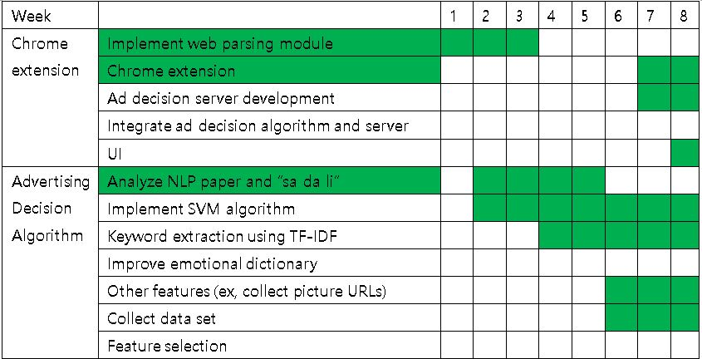
2019 Capstone Design
04
Schedule
Notes:
http://minheeblog.tistory.com/category/PPT

Slide 10
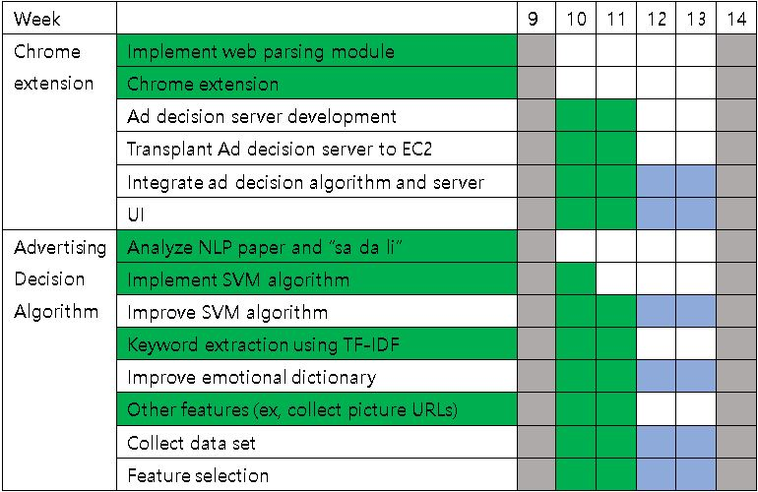
2019 Capstone Design
04
Schedule
Notes:
http://minheeblog.tistory.com/category/PPT

Slide 11
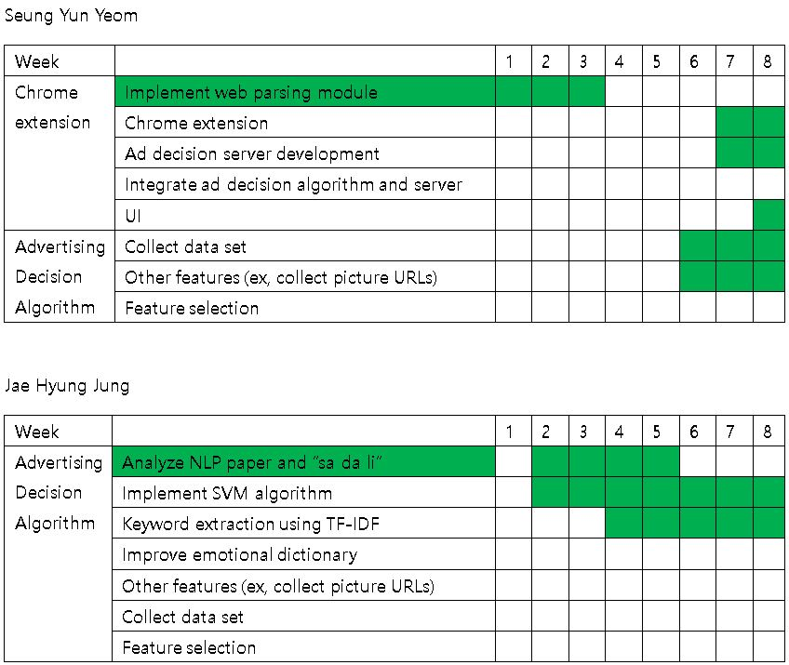
2019 Capstone Design
04
Schedule
Notes:
http://minheeblog.tistory.com/category/PPT

Slide 12
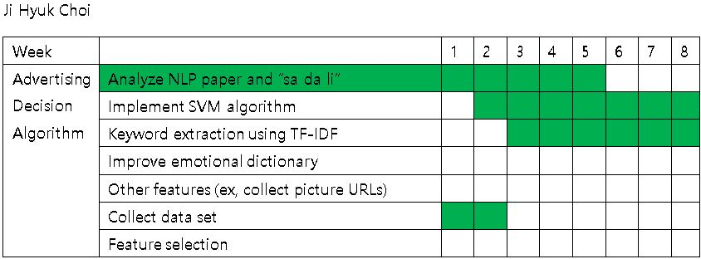
2019 Capstone Design
04
Schedule
Notes:
http://minheeblog.tistory.com/category/PPT

Slide 13
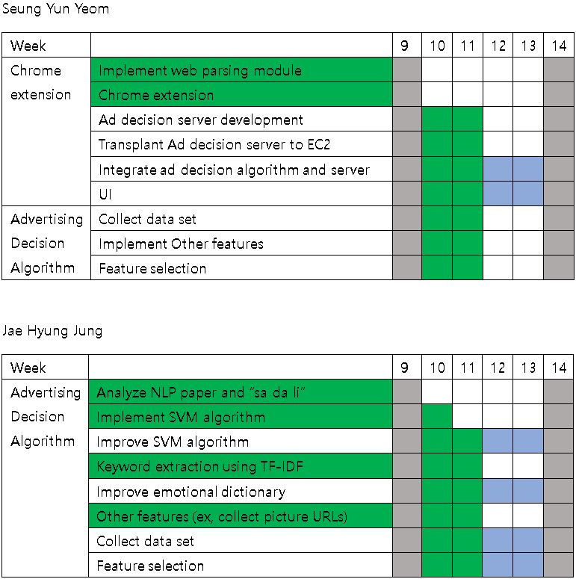
2019 Capstone Design
04
Schedule
Notes:
http://minheeblog.tistory.com/category/PPT

Slide 14
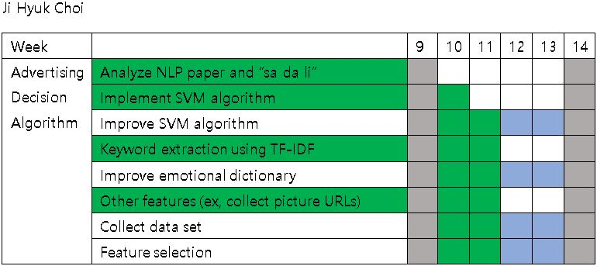
2019 Capstone Design
04
Schedule
Notes:
http://minheeblog.tistory.com/category/PPT

Slide 15
2019 Capstone Design
THANK
YOU
Notes:
http://minheeblog.tistory.com/category/PPT

Slide 16
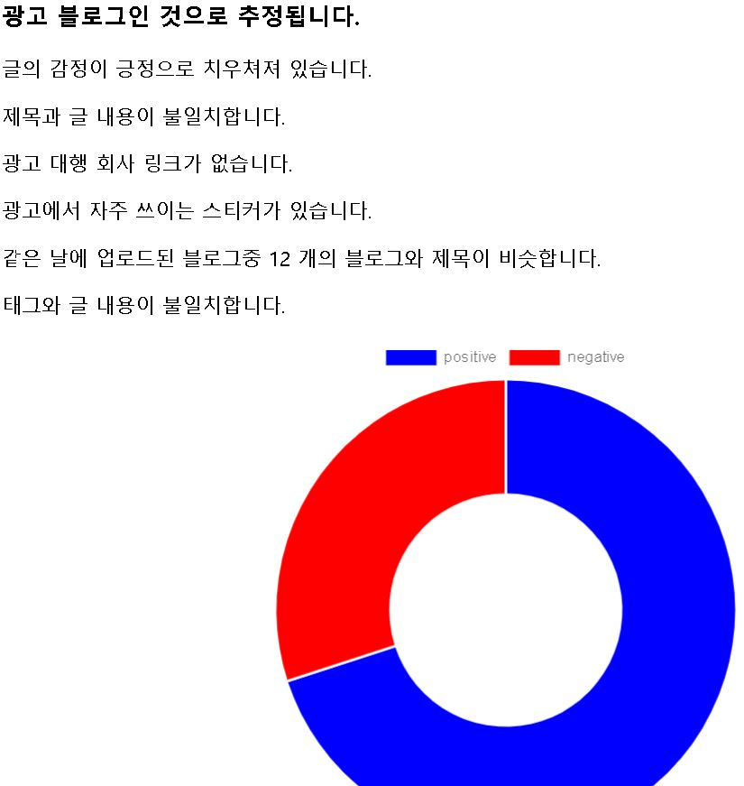
2019 Capstone Design
03
UI
Notes:
http://minheeblog.tistory.com/category/PPT

