Slide 1
Canvas

Slide 2
Sync & Async
Task
Task A
Task B
Task C
Sync
Task A
Async
Task B
Task C
Time

Slide 3
<Public>
DLL
DLL
<Internal>
<Internal>
<Protected>
<Protected>
<Protected>
<Protected>
Class Animal
Class Plant
Class Animal
Class Plant
<Private>
<Private>
<Private>
<Private>
Class A Member A
Class A Member A
Class A Member A
Class A Member A
Class A Member B
Class A Member B
Class A Member B
Class A Member B
Class A Member C
Class A Member C
Class A Member C
Class A Member C
Class Alpaca : Animal
Class Tree : Plant
Class Alpaca : Animal
Class Tree : Plant
<Private>
<Private>
<Private>
<Private>
Class Alpaca Member A
Class Tree Member A
Class Alpaca Member A
Class Tree Member A
Class Alpaca Member B
Class Tree Member B
Class Alpaca Member B
Class Tree Member B

Slide 4
WPF Data Binding
Binding
Binding Target(UI Element = View)
Binding Source(Property = View Model)
Dependency Object
Object
Dependency Property(Control)
Data Context
Property
One Way
Two Way
One Way To Source
Notify Class : INotifyPropertyChanged

Slide 5
Namespace
대리자, 델리게이트(Delegate)
Class
Class Scope
필드(Field), 멤버(Member) 변수, 전역(Global) 변수
Method
Method Scope
Method 지역(Local) 변수
For
For Scope
For 지역(Local) 변수
ETC
ETC Scope

Slide 6
Into(Query Result Before)
Query Result Before
Result
Result

Slide 7
LINQ JOIN
SQL JOIN
Title | Content | Writer
제목 A | 내용 A
제목 B | 내용 B
제목 C | 내용 C | 윤진아
제목 D | 내용 D | 박선아
제목 F | 내용 F | 박선아
제목 E | 내용 E | 윤진아
Title | Content | Writer
제목 A | 내용 A | NULL
제목 B | 내용 B | NULL
제목 C | 내용 C | 윤진아
제목 D | 내용 D | 박선아
제목 F | 내용 F | 박선아
제목 E | 내용 E | 윤진아

Slide 8
PUSH
5
4
4
3
3
3
2
2
2
2
1
1
1
1
1
POP
5
4
4
3
3
3
2
2
2
2
1
1
1
1
0

Slide 9
Queue
1
2
3
4
5
Enqueue
Dequeue

Slide 10
메모리(Memory)
낮은 주소
실행 프로그램 코드
코드(Code Area)
전역 변수
데이터(Data Area)
정적 변수
할당 방향
사용자 정의
힙(Heap Area)
GC 작동 영역(GC Action Area)
가변 크기 (Variable Size)
지역 변수
할당 방향
스택(Stack Area)
높은 주소
매개 변수

Slide 11
캡슐화(Encapsulation)
인터페이스(Interface)
클래스(Class)
클래스(Class)
클래스(Class)
클래스(Class)

Slide 12
추상화(Abstraction)
컴퓨터(Computer)
노트북(Notebook)
스마트폰(Smart Phone)

Slide 13
스택(Stack) : 값 형식(Value Types)
힙(Heap) : 참조 형식(Reference Types)
Garbage Collector
[object]
&1000
300
스택(Stack) : 값 형식(Value Types)

Slide 14
스택(Stack) : 값 형식(Value Types)
스택(Stack) : 값 형식(Value Types)
Int C = 300
Int B = 200
Int A = 100
Int A = 100
스택(Stack) : 값 형식(Value Types)
스택(Stack) : 값 형식(Value Types)
Int B = 200
Int A = 100

Slide 15
Stack
Heap
ArrayList
&1001
[0]
&1001
int
1024
&1002
[1]
&1002
string
“Text”
[2]
&1003
&1003
[3]
&1004
double
10.24
&1004
float
1.024

Slide 16
int iNum = 1024
object oNum = iNum
object oNum = iNum
int rNum = (int)oNum
Stack
Heap
Stack
Heap
oNum
iNum &1001
rNum
iNum &1001
object
&1001
int
1024
int
1024
int
1024
iNum
oNum
int
1024
object
&1001
iNum
int
1024

Slide 17
REDUX FLOW
Action Creators
dispatch(action{type:ANY_ACTION_TYPE, ETC-Field…})
Store
(ANY_ACTION_TYPE)
Reducer(state = Initial State, action)
Current State
State
New State
State
Ayn Event
View
React Components

Slide 18
REACT FLOW
index.js
App.js
setState : UI Rendering
Value
useState(State, setState)
<Header Title={Title}/>
<Body Title={Content}/>
<Footer Title={CopyLight}/>
Function Header(Props)
Function Body(Props)
Function Footer(Props)
<Navbar Item={Item}/>
<TodoList Work={Work}/>
<Help Code={Code}/>
Function Navbar(Props)
Function TodoList(Props)
Function Help(Props)

Slide 19
index.js
App.js
Header.js
Body.js
Footer.js
Navbar.js
TodoList.js
Copylight.js

Slide 20
Views XAML(Window, User Control)
View Models Binding, ICommands, DataTemplates
Model Entities
Database DBMS

Slide 21
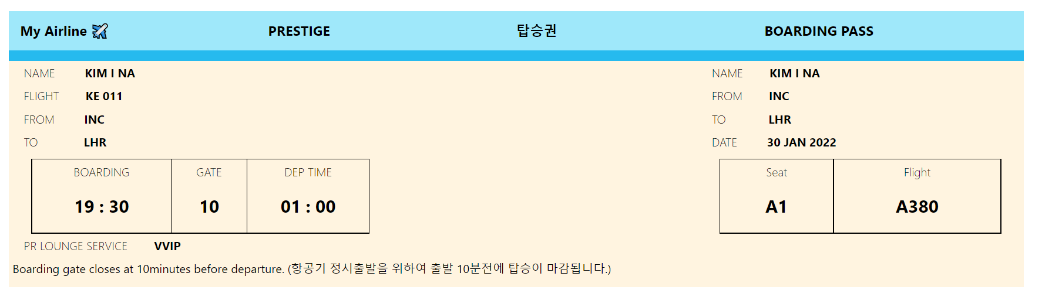

My Airline ✈️
PRESTIGE
탑승권
BOARDING PASS
Boarding gate closes at 10minutes before departure. (항공기 정시출발을 위하여 출발 10분전에 탑승이 마감됩니다.)

Slide 22
index.js
Redux
App.js
Reducer(state, action)
State
New State
Header.js
Body.js
Footer.js
Navbar.js
TodoList.js
Copylight.js

Slide 23
URI(Uniform resource Identifier)
URL(Uniform Resource Locator)
https://대한민국/서울특별시/중구/세종대로/110/시장실=서울특별시장

Slide 24
REDUX FLOW
Network
Request
Response
Action Creators
dispatch(action{type:ANY_ACTION_TYPE, ETC-Field…})
Store
(ANY_ACTION_TYPE)
Reducer(state = Initial State, action)
Current State
State
New State
State
Ayn Event
View
React Components

Slide 25
REDUX FLOW
Network
Request
Response
Action Creators
dispatch
Store
Middleware
(ANY_ACTION_TYPE)
Reducer(state = Initial State, action)
Current State
State
New State
State
Ayn Event
View
React Components

Slide 26
Middleware A
Middleware B
Middleware C
Request
Logic
next();
Logic
next();
Logic
Logic
Logic
Response

Slide 27
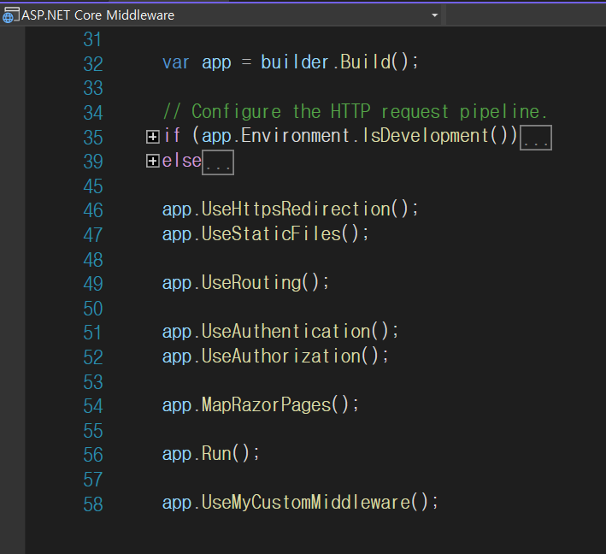
Request
Response
정방향
역방향

Slide 28
ASP.NET Core Identity
Identity Policy
Policy(Role 1, Role 2, …Role N)
정책(Policy)
Policy(Claim 1, Claim 2, … Claim N)
Identity Claim
Identity Role
권한(Role) – Ex. 개발팀 팀원
Identity Claim By Role
권한 별 역할 (Claim) – Ex. Back-End 개발자

Slide 29
DOM
Event
Event
Event
Event
Event
Event
…
…
…

Slide 30
Real DOM
In-Memory
Virtual DOM
State
Patch

Slide 31
Class
Class
Class
Table
Entity Framework
Table
Table

