Slide 1
Slalom
20221124

Slide 2
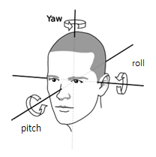
Data
Sampling Rate - 75 Hz
Parameter(Slalom 보행 데이터) – Angle(x,y,z), FSR, IMU(x,y,z각속도)
HS_parameter(Heel strike index) – Angle(x,y,z), FSR, IMU(x,y,z각속도)
Y-z plane: sagittal plane
X-y plane: transverse plane
X-z plane: frontal plane
z
X
y

Slide 3
Data 정리
Window size : 400ms
sub3
Train dataset
각 trial마다 testset을 제외하고 나머지 데이터를 모두 사용하여 testset 생성
Test dataset
모든 trial로 testset 생성
[Gap(1m/1.5m/2m)+constrain(1m/1.5m/2m)]+normal 중 하나를 선택하여 testset 생성

Slide 4
CNN
2Layer
CNN
Optimizer : Adam
Learning rate : 0.003
Weight_Decay : 0.00001
Batch size : 512
Epoch : 300
Convolution(1,32)_filtersize(1x3)
BatchNorm
Convolution(32,32)_filtersize(1x3)
BatchNorm
MaxPool
FC layer

Slide 5
Except gap 1m/constraint 1m
constraint
 | 1m | 1.5m | 2m
1m | G1C1 | G1C1.5 | G1C2
1.5m | G1.5C1 | G1.5C1.5 | G1.5C2
2m | G2C1 | G2C1.5 | G2C2
gap
+
normal
6개 Slalom+normal
Except gap 1.5m/constraint 1m
constraint
 | 1m | 1.5m | 2m
1m | G1C1 | G1C1.5 | G1C2
1.5m | G1.5C1 | G1.5C1.5 | G1.5C2
2m | G2C1 | G2C1.5 | G2C2
gap
+
normal
. . .
Except normal
constraint
 | 1m | 1.5m | 2m
1m | G1C1 | G1C1.5 | G1C2
1.5m | G1.5C1 | G1.5C1.5 | G1.5C2
2m | G2C1 | G2C1.5 | G2C2
gap
+
normal

Slide 6
결과
 | nRMSE 평균
Exg1c1 | 0.0405
Exg1c15 | 0.0331
Exg1c20 | 0.0289
Exg15c1 | 0.0456
Exg15c15 | 0.034
Exg15c20 | 0.0283
Exg20c1 | 0.0368
Exg20c15 | 0.0339
Exg20c20 | 0.0322
Ex normal | 0.0355

Slide 7
6개 Slalom+normal
Except gap 2m+normal
constraint
 | 1m | 1.5m | 2m
1m | G1C1 | G1C1.5 | G1C2
1.5m | G1.5C1 | G1.5C1.5 | G1.5C2
2m | G2C1 | G2C1.5 | G2C2
gap
+
normal
Except constraint 2m+normal
constraint
 | 1m | 1.5m | 2m
1m | G1C1 | G1C1.5 | G1C2
1.5m | G1.5C1 | G1.5C1.5 | G1.5C2
2m | G2C1 | G2C1.5 | G2C2
gap
+
normal

Slide 8
3개 Slalom+normal
C1+normal
constraint
 | 1m | 1.5m | 2m
1m | G1C1 | G1C1.5 | G1C2
1.5m | G1.5C1 | G1.5C1.5 | G1.5C2
2m | G2C1 | G2C1.5 | G2C2
gap
+
normal
C1.5+normal
constraint
 | 1m | 1.5m | 2m
1m | G1C1 | G1C1.5 | G1C2
1.5m | G1.5C1 | G1.5C1.5 | G1.5C2
2m | G2C1 | G2C1.5 | G2C2
gap
+
normal
G1c1g1.5c1.5g2c2+normal
constraint
 | 1m | 1.5m | 2m
1m | G1C1 | G1C1.5 | G1C2
1.5m | G1.5C1 | G1.5C1.5 | G1.5C2
2m | G2C1 | G2C1.5 | G2C2
gap
+
normal

Slide 9
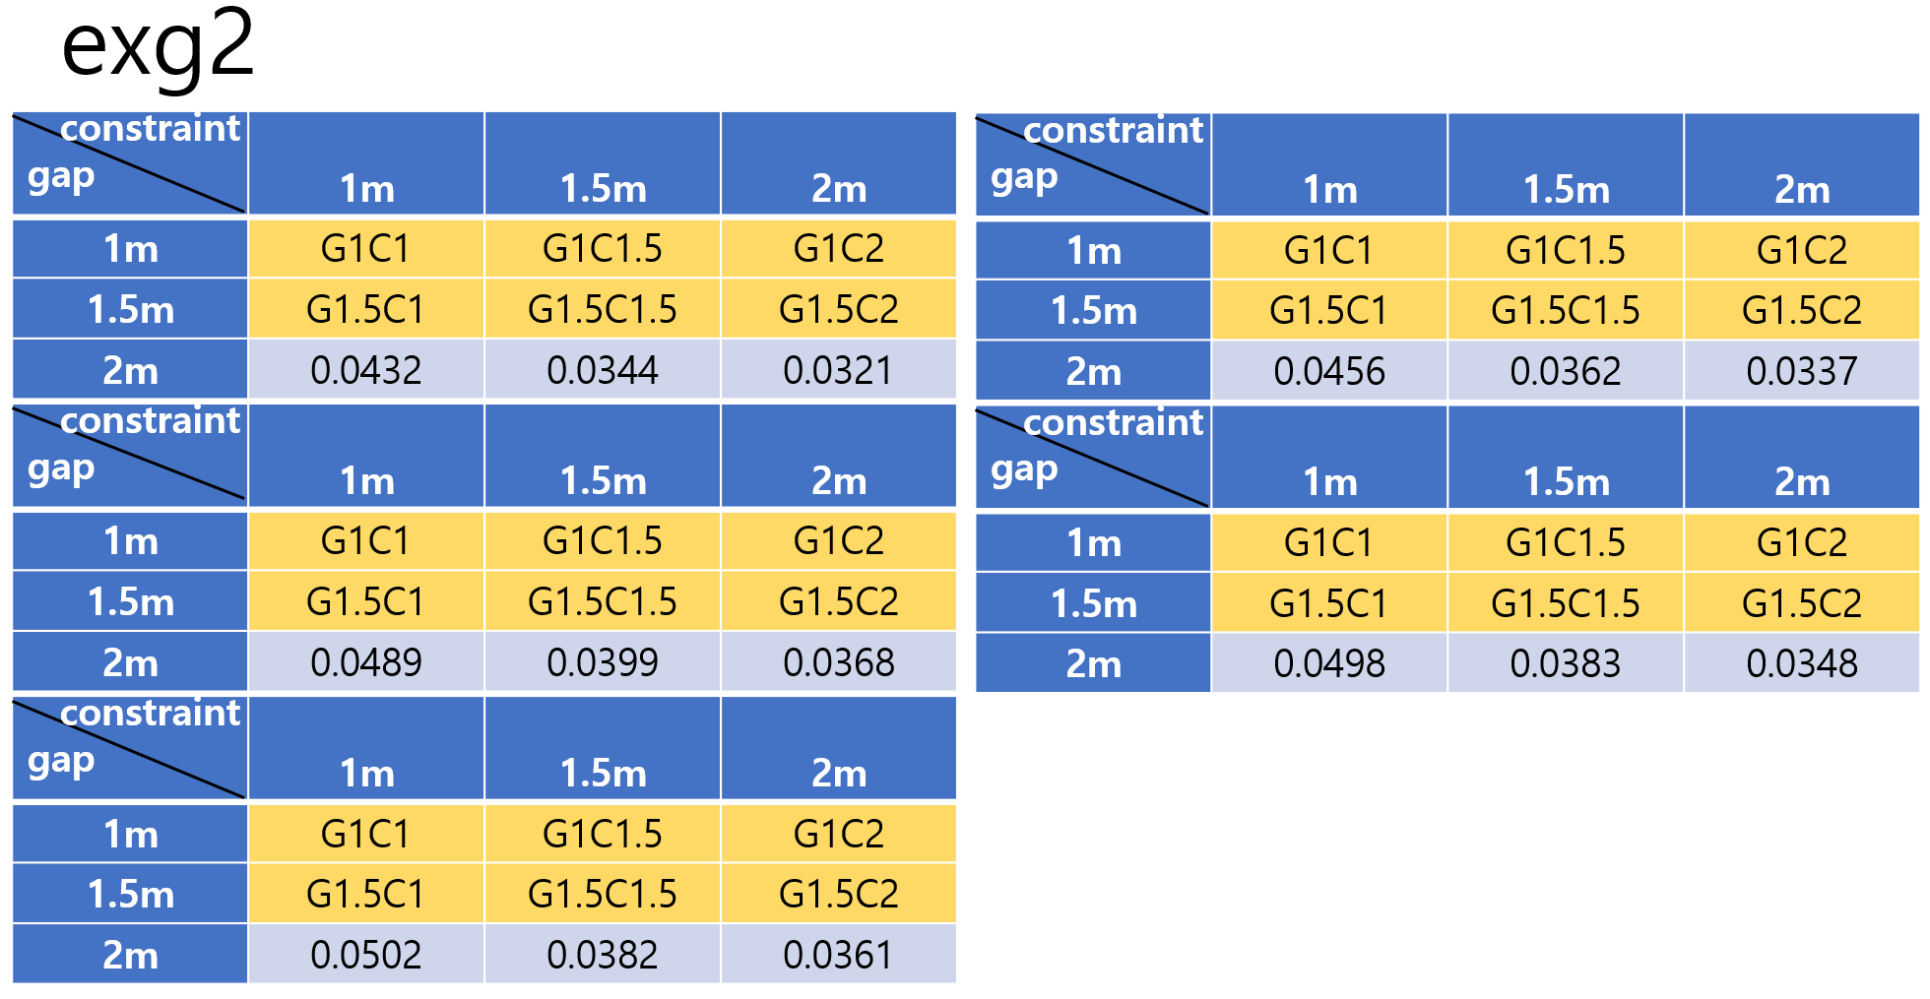
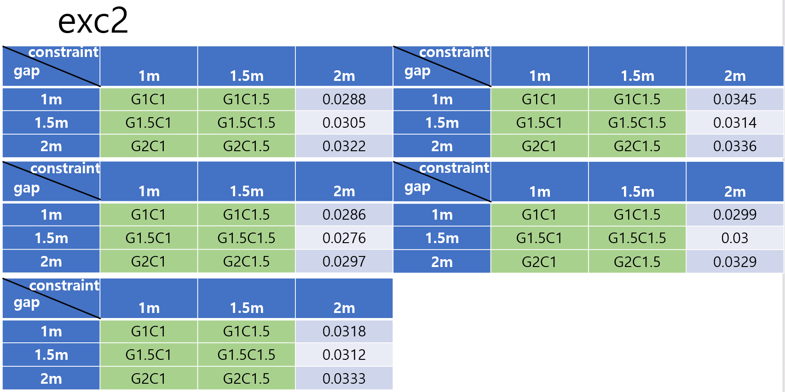
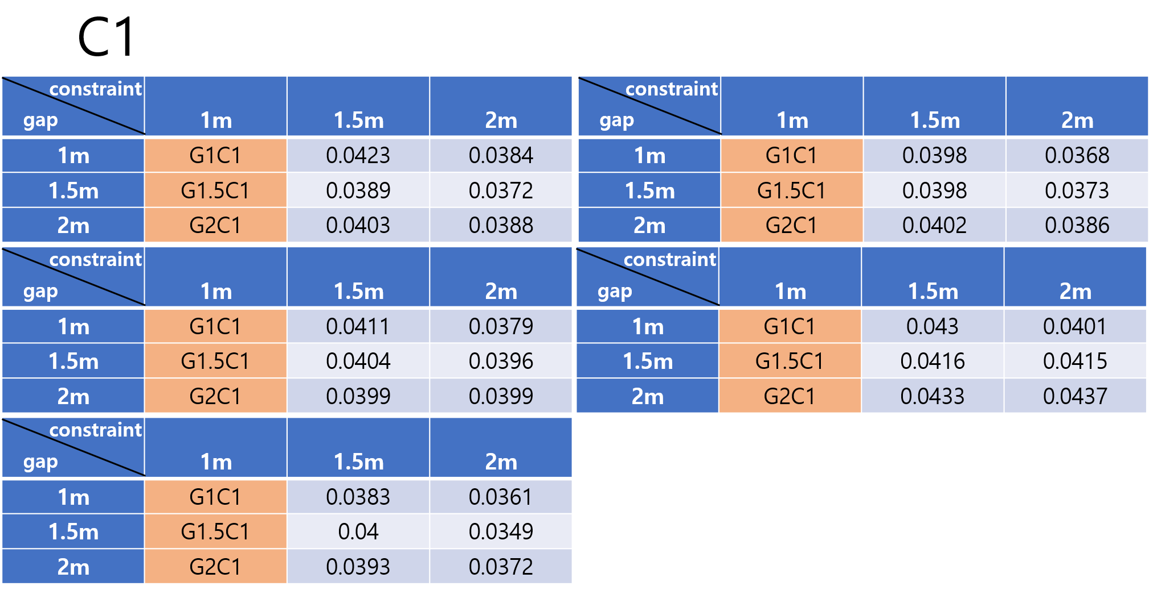
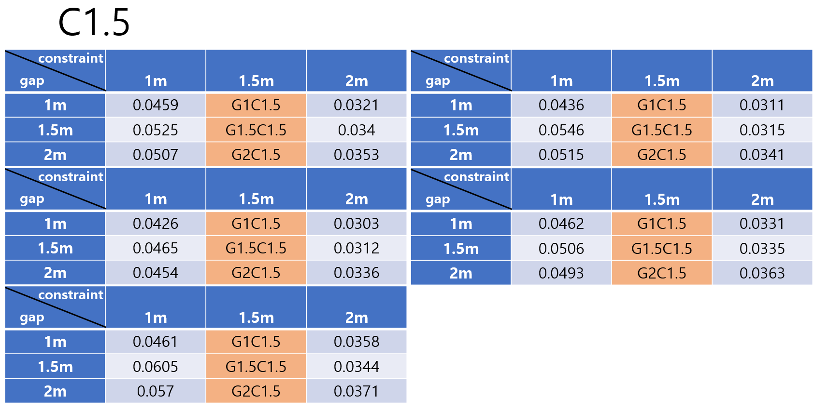
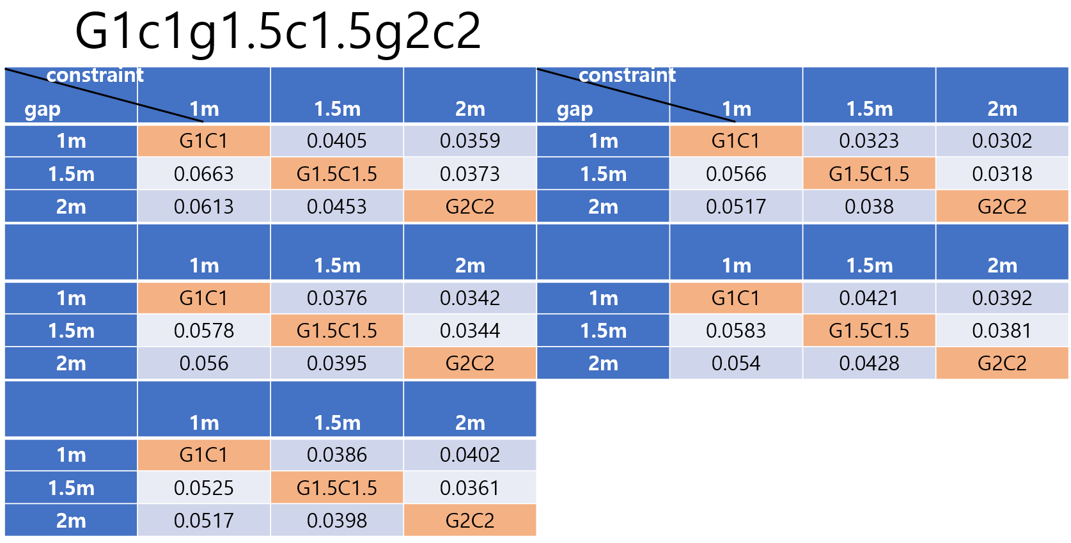

Slide 10
결과
8개 Slalom+normal
6개 Slalom+normal
3개 Slalom+normal
 | nRMSE 평균
Exg1c1 | 0.0405
Exg1c15 | 0.0331
Exg1c20 | 0.0289
Exg15c1 | 0.0456
Exg15c15 | 0.034
Exg15c20 | 0.0283
Exg20c1 | 0.0368
Exg20c15 | 0.0339
Exg20c20 | 0.0322
Ex normal | 0.0355
 | nRMSE 평균
Exg2 | 0.0398
Exc2 | 0.0311
 | nRMSE 평균
C1 | 0.0395
C15 | 0.0416
G1c1g2c2g3c3+normal | 0.044

