Slide 1


$l$-th conv-layer
$(l+1)$-th conv-layer
Conv2d

Slide 2
$l$-th conv-layer
$(l+1)$-th conv-layer
Conv2d
…
…

Slide 3
$l$-th conv-layer
$(l+1)$-th conv-layer
Conv2d
…
…

Slide 4
Hidden layers
Input
Output
…
…
…
…
…

Slide 5
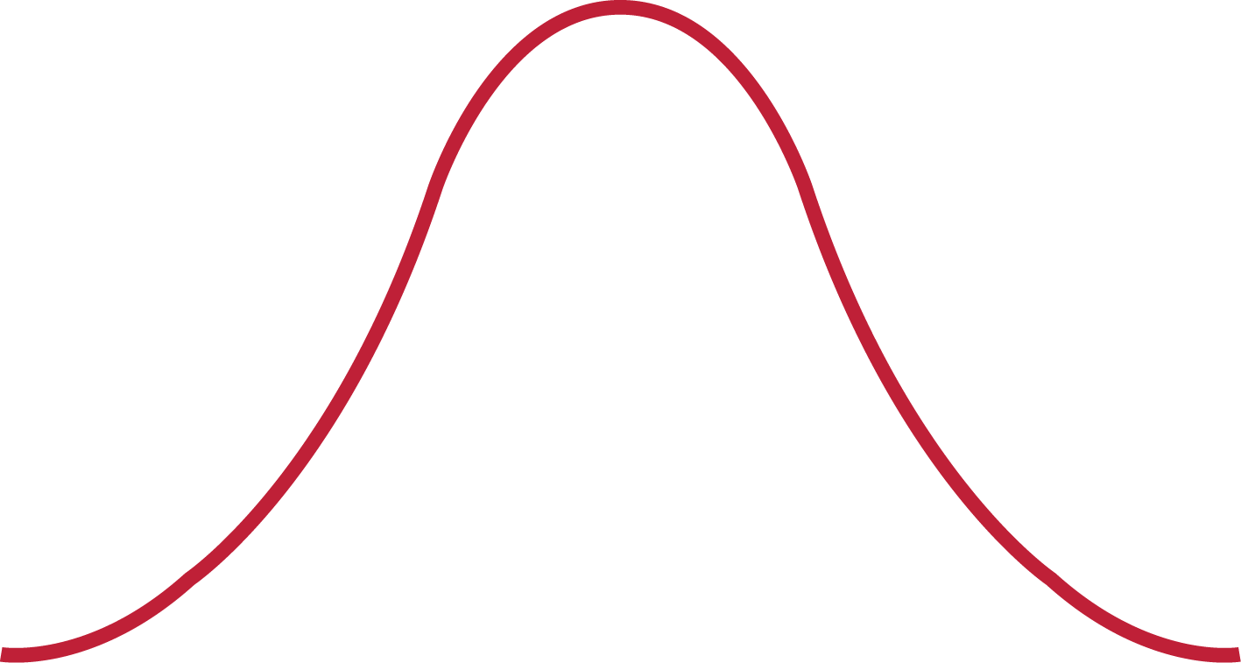
Hidden layers
Input
Output
…
…
…
…
…

Slide 6
Hidden layers
Hidden layers
Input
Output
Input
Output
…
…
…
…
…
…
…
…
…
…
Nodes sparse
Training
Pruning

Slide 7
Hidden layers
Input
Output
…
…
…
…
…

Slide 8
Hidden layers
Input
Output
…
…
…
…
…

Slide 9
Hidden layers
Input
Output
…
…
…
…
…

Slide 10


$l$-th layer
$(l+1)$-th layer
…
…

Slide 11


$l$-th layer
$(l+1)$-th layer
…
…

Slide 12





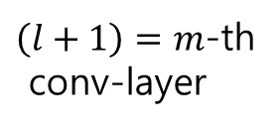










$\left(l+1\right)=m$-th
conv-layer
$l$-th conv-layer
$$C_{m1}$$
$$C_{m2}$$
Output
Input
$$C_{l1}$$
$$C_{m3}$$
…
$$C_{l2}$$
$$C_{m4}$$
…
$$I_{1}$$
$$C_{l3}$$
$$C_{m5}$$
$$I_{2}$$
…
$$C_{m6}$$
…
$$I_{3}$$
$$C_{lp_{l}}$$
…
$$C_{mp_{m}}$$

Slide 13






$\left(l+1\right)=m$-th
conv-layer
$l$-th conv-layer
$$C_{m1}$$
$$C_{m2}$$
Output
Input
$$C_{l1}$$
$$C_{m3}$$
…
$$C_{l2}$$
$$C_{m4}$$
…
$$I_{1}$$
$$C_{l3}$$
$$C_{m5}$$
$$I_{2}$$
…
$$C_{m6}$$
…
$$I_{3}$$
$$C_{lp_{l}}$$
…
$$C_{mp_{m}}$$

Slide 14


$\left(l+1\right)=m$-th
conv-layer
$l$-th conv-layer
$$C_{m1}$$
$$C_{m2}$$
Output
Input
$$C_{l1}$$
$$C_{m3}$$
…
$$C_{m4}$$
…
$$I_{1}$$
$$C_{m5}$$
$$I_{2}$$
…
$$C_{m6}$$
…
$$I_{3}$$
$$C_{lp_{l}}$$
…
$$C_{mp_{m}}$$

Slide 15
$\left(l+1\right)=m$-th
conv-layer
$l$-th conv-layer
$$C_{m1}$$
$$C_{m2}$$
Output
Input
$$C_{l1}$$
$$C_{m3}$$
…
$$C_{l2}$$
$$C_{m4}$$
…
$$I_{1}$$
$$C_{l3}$$
$$C_{m5}$$
$$I_{2}$$
…
$$C_{m6}$$
…
$$I_{3}$$
$$C_{lp_{l}}$$
…
$$C_{mp_{m}}$$

Slide 16
1.2 | 0.1 | -0.5
3.6 | -2.1 | -0.2
0.3 | 0.8 | -1.6
1.2 | 0 | -0.5
3.6 | -2.1 | 0
0 | 0.8 | -1.6

Slide 17








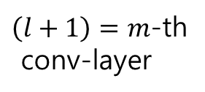



$\left(l+1\right)=m$-th
conv-layer
$l$-th conv-layer
$$C_{m1}$$
$$C_{m2}$$
$$C_{l1}$$
$$C_{m3}$$
$$C_{l2}$$
$$C_{m4}$$
$$C_{l3}$$
$$C_{m5}$$
…
$$C_{m6}$$
$$C_{lp_{l}}$$
…
$$C_{mp_{m}}$$

Slide 18



$\left(l+1\right)=m$-th
conv-layer
$l$-th conv-layer
$$C_{m1}$$
$$C_{m2}$$
$$C_{l1}$$
$$C_{m3}$$
$$C_{2}$$
$$C_{m4}$$
$$C_{l3}$$
$$C_{m5}$$
…
$$C_{m6}$$
$$C_{lp_{l}}$$
…
$$C_{mp_{m}}$$

Slide 19
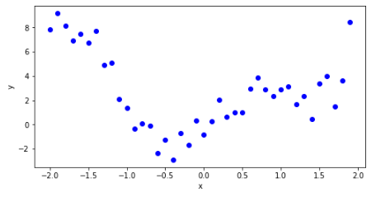
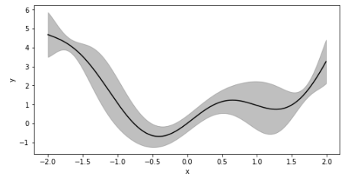
…
…
…
Original data
Teacher model
…
Student model
Preditive distribution

Slide 20
…
…
…
Teacher model
Preditive distribution
…
Student model (BNN)
Generated samples

Slide 21
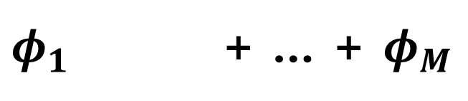
…
…
…
Teacher model
Preditive distribution
$φ_{1}$ + … + $φ_{M}$
Student model (Mixutre of MBNN)
Generated samples

