Slide 1
Lab 3. Dynamic Memory Manager Module System Programming
Juyoung Park
SNU TNET Lab.

Slide 2
What Have You Learned
#include <stdlib.h> void *malloc(size_t size); void free(void *ptr);
0
Heap
p1
char *p1 = malloc(3);
char *p2 = malloc(1);
char *p3 = malloc(4);
free(p2);
char *p4 = malloc(6);
free(p3);
char *p5 = malloc(2);
free(p1);
free(p4);
free(p5);
p2
}
p3
p4
Heap
Stack
0xffffffff
2

Slide 3
What Have You Learned
Stack
Shared libraries
Run-time heap managed by libc
Read/write data
Read-only code and data
User application
User space
malloc(), calloc(), realloc(), free(), sbrk()
C standard library
end of heap
managed by kernel
at request of libc
Kernel
System call interface
brk/mmap
Kernel space

Slide 4
What Have You Learned
K&R Heap Manager
Free list
In
use
In
use
8
In
use
50
20

Slide 5
Dynamic Memory Manager Module
Build a library that implements malloc() and free()
Without using GNU malloc(), free(), calloc(), or realloc()
The code for your reference(heapmgrgnu.c, heapmgrkr.c) and baseline code (heapmgrbase.c) will be given
Guidance on the assignment can also be found on README.md

Slide 6
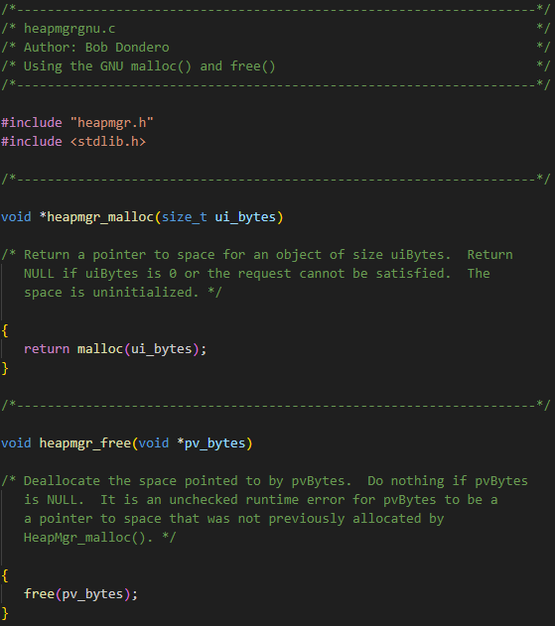
Given Code - heapmgrgnu.c
Implementation that simply calls the GNU malloc() and free()

Slide 7
Given Code - heapmgrkr.c
Kernighan and Ritchie (K&R) implementation
With small modification for the sake of simplicity
void *heapmgr_malloc(size_t nbytes)
void heapmgr_free(void *ap)
Header *morecore(unsigned int nu)
A circular, singly-linked list

Slide 8
Given Code - heapmgrbase.c
Implements baseline code
You can start the task with this code
void *heapmgr_malloc(size_t size)
void heapmgr_free(void *m)
int check_heap_validity(void)
Validity check for entire data structures for chunks
Other functions for implementation
A non-circular, singly-linked list

Slide 9
Chunk Structure
/* chunkbase.h */
typedef struct Chunk *Chunk_T;
/* chunkbase.c */
struct Chunk {
/* Pointer to the next chunk in the free chunk list */
Chunk_T next;
/* Capacity of a chunk (chunk units) */
int units;
/* CHUNK_FREE or CHUNK_IN_USE */
int status;
};

Slide 10
Chunk and Block
Chunk: base unit for allocate memory
Block: set of contiguous chunks that store same data
Free blocks are connected in a linked list
which is called a free list

Slide 11
Given Code - heapmgrbase.c
int check_heap_validity(void)
Checks the validity of chunk data structures (chunk: a base unit for allocation)
Returns 1 on success or 0 (zero) on failure
assert(condition);
If “condition” evaluates to false, the program will print an error message and terminate
heapmgrbase.c calls assert(check_heap_validity())
At leading and trailing edges of heapmgr_malloc() and heapmgr_free()
Checks the integrity of the heap
If this assert() fails, it implies that something’s wrong

Slide 12
Your to-do: Make free() faster
Base requirement for assignment 3 (write code in heapmgr1.c)
Implement a doubly-linked free list with the chunk data structure
Each chunk now contains a header and a footer (as described in lectures)
Chunk is a base unit (e.g., allocate memory in multiples of this unit)
heapmgr1.c (with footer) should make free() faster
Without needing to find/maintain the “previous” node for inserting a freed memory into the free list (K&R)
h
e
a
d
f
o
o
t
Notes:
Linear search ( O(N) ) / O(1)

Slide 13
Navigating Previous/Next Contiguous Block
Start with the user’s data portion of the block
Go backwards to the head of the block
Easy, since you know the size of the header
Go backwards to the footer of the previous block
Easy, since you know the size of the footer
Go backwards to the header of the previous block
Easy, since you know the size from the footer

Slide 14
Navigating Previous/Next Free Block
Start with the user’s data portion of the block
Go backwards to the head of the block
Easy, since you know the size of the header
Go forwards to the footer of the block
Easy, since you know the block size from the header
Go backwards to the previous free block
Easy, since you have the previous free pointer

Slide 15
Strategy for Writing heapmgr1.c
You can start with heapmgrbase.c and enhance it
Or you can ignore heapmgrbase.c and do your own way
You can implement either circular or non-circular list

Slide 16
Extra-credit: Make malloc() faster
heapmgr1.c shows poor worst-case behavior, so try to enhance it
Finding the free block will traverse the list in heapmgr1.c
Use multiple doubly-linked lists, alias bins (as described in lectures)

Slide 17
Strategy for Binning
How to set the range of sizes covered by bin?
Fixed: 1-10, 11-20, 21-30, …
Exponential: 1-2, 3-4, 5-8, 9-16, …
How to handle the newly allocated large memory?
Split into small chunks in advance
Allocate in large bin and wait for split in malloc()
How do you coalesce when free() from binning?
Check after coalesce and move to proper bin
Move to final bin first and coalesce

Slide 18
chunk.c and chunk.h
heapmgrbase.c uses chunkbase.c and chunkbase.h to use ‘struct Chunk’ and functions
If you use heapmgrbase.c as skeleton code, you can use chunkbase.c and chunkbase.h for chunk.c and chunk.h
If you do not use heapmgrbase.c, you have two choices:
1. Define useful structures and functions in chunk.c and chunk.h and use them
2. Just leave chunk.c and chunk.h as is and not use them

Slide 19
Useful Functions in chunkbase.c & chunkbase.h
chunk_get_status(Chunk_T c)
Returns a chunk's status
chunk_set_status(Chunk_T c, int status)
Set the status of the chunk
chunk_get_units(Chunk_T c)
Returns the size of a chunk
chunk_set_units(Chunk_T c, int units)
Sets the current size in 'units' of 'c'

Slide 20
Useful Functions in chunkbase.c & chunkbase.h
chunk_get_next_free_chunk(Chunk_T c)
Returns the next free chunk in free chunk list
chunk_set_next_free_chunk(Chunk_T c, Chunk_T next)
Sets the next free chunk of 'c' to 'next'
chunk_get_next_adjacent(Chunk_T c, void *start, void *end)
Returns the next adjacent chunk to 'c' in memory space
chunk_is_valid(Chunk_T c, void *start, void *end);
Checks the validity of a chunk

Slide 21
Memory Utilization
Implement the strategies for good memory utilization
All techniques learned in class
Check blocks in free list before allocate new memory
Divide the free block if free block is bigger then requested
Check lower/upper neighbor and coalesce
If you ignore memory utilization, you won't get points no matter how fast your implementation is

Slide 22
How to Test Your Code
To test your heapmgr implementations:
$ gcc800 -std=gnu99 testheapmgr.c heapmgr1.c chunk.c -o testheapmgr1
$ gcc800 -std=gnu99 testheapmgr.c heapmgr2.c chunk.c -o testheapmgr2
To collect timing statistics:
$ gcc800 -O3 -D NDEBUG -std=gnu99 testheapmgr.c heapmgrgnu.c -o testheapmgrgnu
$ gcc800 -O3 -D NDEBUG -std=gnu99 testheapmgr.c heapmgrkr.c -o testheapmgrkr
$ gcc800 -O3 -D NDEBUG -std=gnu99 testheapmgr.c heapmgrbase.c chunkbase.c -o testheapmgrbase
$ gcc800 -O3 -D NDEBUG -std=gnu99 testheapmgr.c heapmgr1.c chunk.c -o testheapmgr1
$ gcc800 -O3 -D NDEBUG -std=gnu99 testheapmgr.c heapmgr2.c chunk.c -o testheapmgr2
Don't forget -std=gnu99 ; otherwise you'll get error while compiling

Slide 23
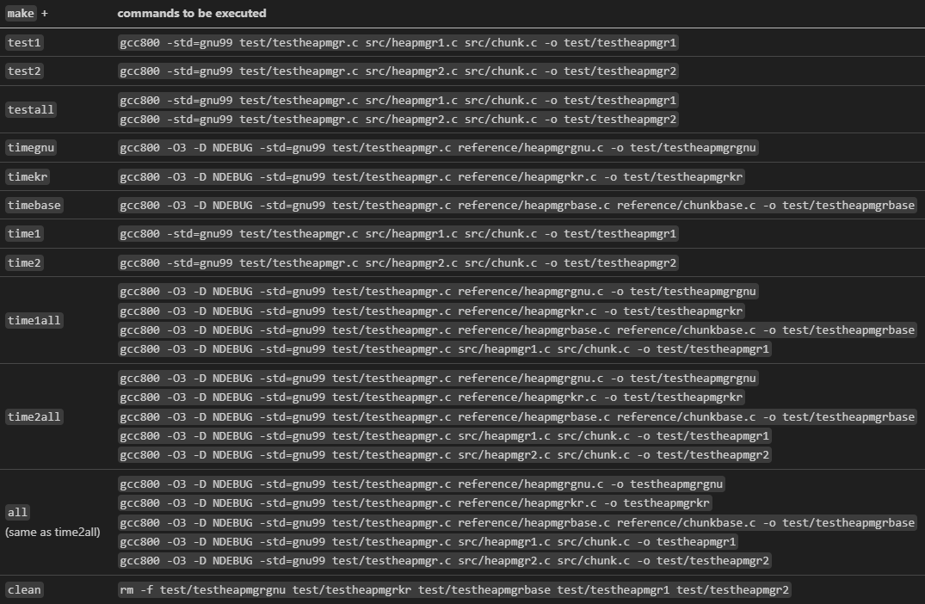
How to Test Your Code
You can also use Makefile to build executable files

Slide 24
How to Test Your Code
If you want to use Makefile, move the codes you implemented (chunk.c, chunk.h, heapmgr1.c, hepmgr2.c) in src folder
You don’t need to move the existing codes
Executable files will be created in the test folder
assignment3
|- reference
| |- chunkbase.c / chunkbase.h
| |- heapmgr.h
| |- heapmgrgnu.c / heapmgrkr.c
| `- heapmgrbase.c
|- src
| |- chunk.c / chunk.h
| `- heapmgr1.c / heapmgr2.c
|- test
| |- heapmgr.h
| `- testheapmgr.c
`-Makefile

Slide 25
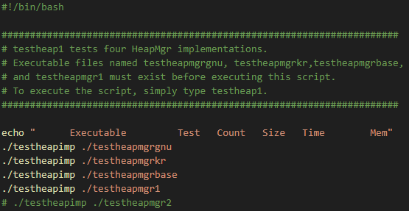
How to Test Your Code
Bash shell scripts (testheap1 & testheap2) will be provided
testheap1 runs testheapmgr.c to test four cases (heapmgrgnu.c, heapmgrkr.c, heapmgrbase.c, heapmgr1.c) and reports timing and memory usage statistics

Slide 26
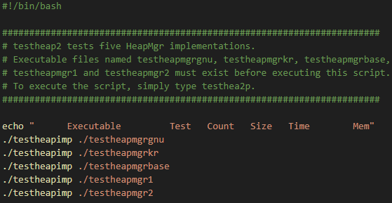
How to Test Your Code
testheap2 runs testheapmgr.c to test five cases (heapmgrgnu.c, heapmgrkr.c, heapmgrbase.c, heapmgr1.c, and heapmgr2.c) and reports timing and memory usage statistics

Slide 27
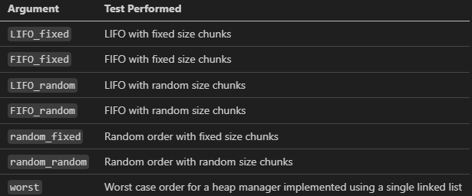
How to Test Your Code

Slide 28
How to Test Your Code
$ ./testheap1 ( or ./testheap2)
Provides timing and memory usage statistics for all codes
$ ./testheapmgr1 LIFO_fixed 100 1000
Perform a LIFO_fixed test with testheapmgr1
Run heapmgr_malloc() and heapmgr_free() 100 times
The (maximum) size of each memory chunk is 1000 bytes
testheap1 and testheap2 is in test folder

Slide 29
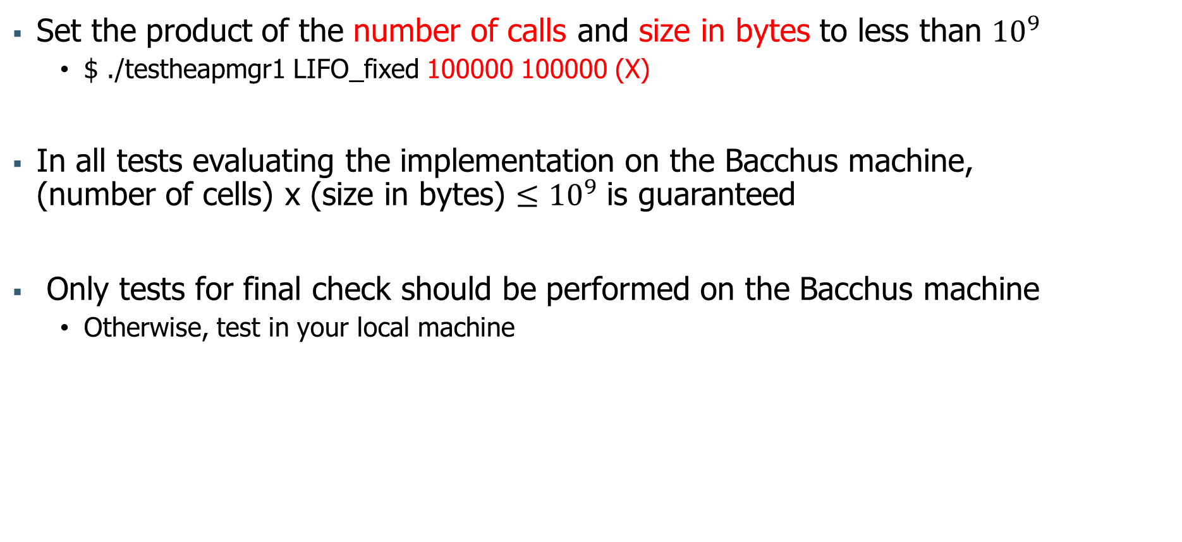
How to Test Your Code
Set the product of the number of calls and size in bytes to less than ${10}^{9}$
$ ./testheapmgr1 LIFO_fixed 100000 100000 (X)
In all tests evaluating the implementation on the Bacchus machine, (number of cells) x (size in bytes) $≤{10}^{9}$ is guaranteed
Only tests for final check should be performed on the Bacchus machine
Otherwise, test in your local machine

Slide 30
Content of readme file
Your name and student ID
Result of ./testheap1 or ./testheap2 (paste the output of the testheap1 or testheap2 script)
(Optionally) An indication of how much time you spent doing the assignment
(Optionally) Your assessment of the assignment
(Optionally) Any information that will help us to grade your work in the most favorable light

Slide 31
How to Submit?
Make a directory
$ mkdir 202400000_assign3
Move your code and readme file there
$ mv heapmgr1.c (heapmgr2.c) chunk.c chunk.h readme 202400000_assign3
Make a gzipped tar file for submission
$ tar zcf 202400000_assign3.tar.gz 202400000_assign3
You must submit chunk.c and chunk.h even if you did not use them in your implementation
In this case, submit chunk.c and chunk.h given in the assignment without modification

Slide 32
How to Submit?
Structure of directory:
YourID_assign3 (don’t use dash)
|-heapmgr1.c
|-heapmgr2.c (optional)
|-chunk.c
|-chunk.h
`-readme (don’t use extension such as .txt, .md, …)
Example:
202400000_assign3
|-heapmgr1.c
|-chunk.c
|-chunk.h
`-readme
Please set files and directory’s names to match the examples above
Don’t use any extension for readme file
Don’t use dash for submit file
Structure files and directories as shown above, then proceed with compression
Deadline: ~11.1(Fri) 21:00
0 points if deadline is missed

Slide 33
Grading - heapmgr1.c
Submit format (12 / 100)
readme, files with proper names
Evaluation from the user’ viewpoint: function correctness (78 / 100)
heapmgr_malloc(), heapmgr_free() are well-designed (include validity check)
time consumption: faster than heapmgrkr.c, heapmgrbase.c (except worst)
Evaluation from the programmer’s viewpoint (10 / 100)
Clarity (names, comments, line lengths, indentation, etc.)
Parameter validation using assert()

Slide 34
Grading - heapmgr2.c (Extra Credit)
Evaluation from the user’ viewpoint: function correctness (+30%)
heapmgr_malloc(), heapmgr_free() are well-designed (using bins) (include validity check)
time consumption: faster than heapmgrkr.c, heapmgrbase.c and heapmgr1.c
Extra credit
Up to 30% of the scores you earn for implementing heapmgr1.c
You will not get the 30% extra credit just by submitting heapmgr2
If you do not get a perfect score on heapmgr2, extra credit you receive will be reduced

