Slide 1
Lab 2. Input and Output System Programming Assignment
Seongjong Bae
SNU TNET Lab.

Slide 2
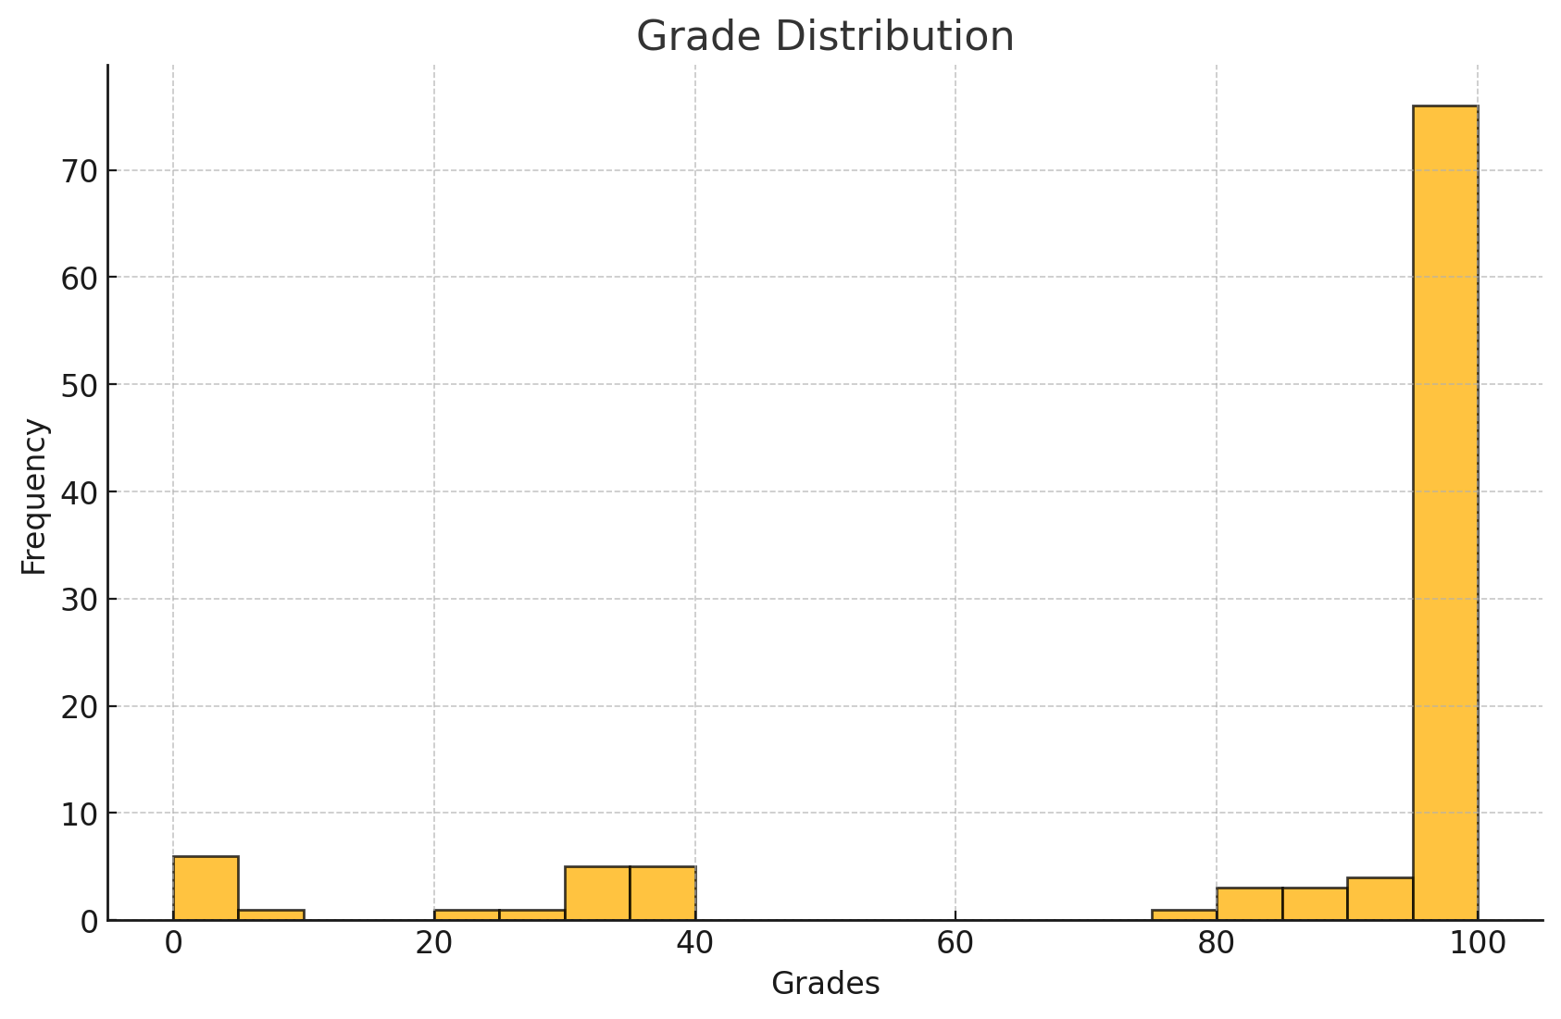
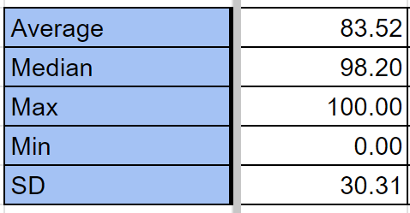
Lab 1 Grade Distribution
Note: Points may be deducted or given 0 points at lab 2
Compile issue (-6 points) : Source file must be compilable with Bacchus' gcc800
If it does not compilable with gcc, you will get no point.
Submission format (-5 points) : extension of ‘readme’, zipped file name as 202400000_assign2 (use the example folder name) or ‘Users’
Late submission: given 0 points

Slide 3
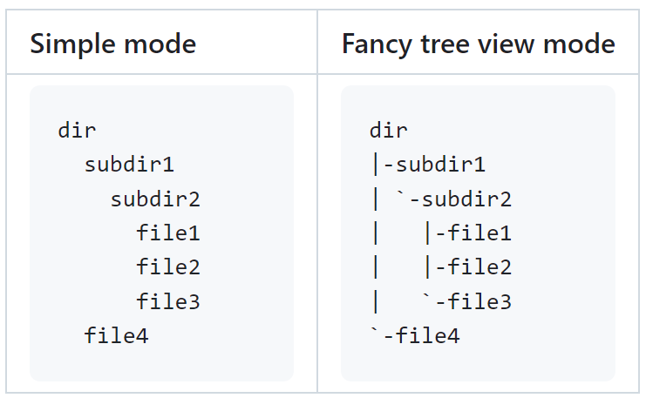
Dirtree Overview
Result of dirtree
What is “dirtree”?
Dirtree recursively traverses a directory tree and prints out a sorted list of all files
Dirtree can also print a fancy directory tree and show details

Slide 4
Dirtree Specification – Operation
Dirtree traverses each directory in the list directories recursively
Prints all of directory entries in alphabetical order
Directories are listed before files
The special entries '.' and '..' are ignored
About summary mode: A summary is printed after each dirtree’s target directory
If several directories are traversed, an aggregate total is printed at the end.

Slide 5
Dirtree Specification – Command Line Arguments
Option | Description
-h | Help screen
-t | Turn on fancy tree view
-v | Turn on detailed mode
-s | Turn on summary mode
Usage: $ ./dirtree [Options] [Directories]
`-t`, `-v`, `-s` options may be used together or not used at all
8 possible combinations

Slide 6

Dirtree Specification – Fancy Tree View Mode (1/5)
Simple mode command: ./dirtree
Fancy tree view mode command: ./dirtree -t

Slide 7
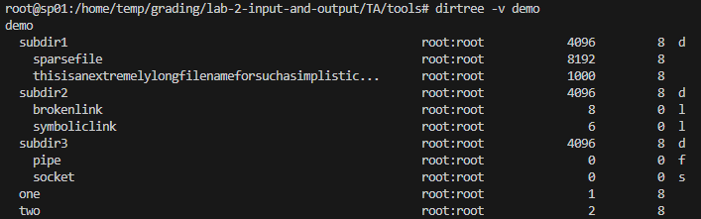
Dirtree Specification – Detailed Mode (2/5)
Blocks & Type
Target directory name
User:Group
Size
It shows detail information of file and directories

Slide 8
Dirtree Specification – Detailed Mode (3/5)
Additional details for each entry | Description
User and group | Each file in Unix belongs to a user and a group. Detailed mode prints the names of the user and the group separated by a colon (:)
Size | The size of the file in bytes
Disk blocks | The number of blocks this file occupies on the disk
File type | Indicates the type of file by a single character
File Type | Character
File | (empty)
Directory | d
Link | l
Character device | c
Block device | b
Fifo | f
Socket | s

Slide 9
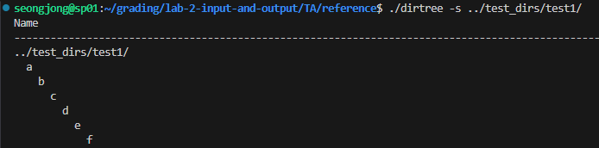
Dirtree Specification – Summary Mode (4/5)
header
…
Footer (& one-liner containing statistics)
Summary mode: dirtree prints a header and footer around each target directory and a one-liner containing statistics about the directory

Slide 10
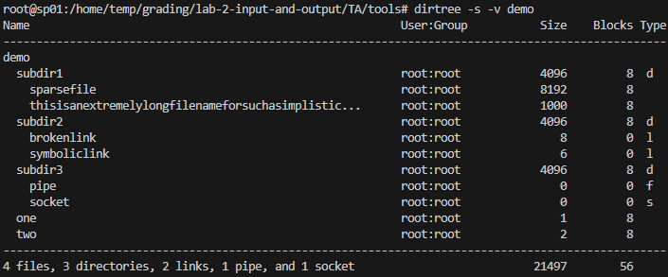
Dirtree Specification – Detailed Mode + Summary Mode (5/5)
Header w/ detailed information
…
Footer w/ detailed information
Detailed mode: detailed information
Summary mode: column title & total statistics
Detailed mode + summary mode: detailed information, total statistics, column title, additional summary information by detailed mode
Red boxes: effect of summary mode, blue boxes: effect of detailed mode

Slide 11
Dirtree Specification – Output Formatting (1/3)
User and group
File size
Disk blocks
Type
$ dirtree -v -s demo2
Name User:Group Size Blocks Type
----------------------------------------------------------------------------------------------------
demo2
subdir1 devel:devel 4096 8 d
subdir2 devel:devel 4096 8 d
fifo devel:devel 0 0 f
link devel:devel 11 0 l
socket devel:devel 0 0 s
unreasonablyextremelylongfilenamethatdoesntfi... devel:devel 0 0
file4 devel:devel 0 0
----------------------------------------------------------------------------------------------------
2 files, 2 directories, 1 link, 1 pipe, and 1 socket 8203 16
Path and name
Summary line
Total size
Total blocks
Output element | Path and name | User name | Group name | File size | Disk blocks | Type | Summary line | Total size | Total blocks
Width | 54 | 8 | 8 | 10 | 8 | 1 | 68 | 14 | 9
Alignment | left | right | left | right | right |  | left | right | right
Action on overflow | cut and end with three dots (Considerations when the ‘-v’ option is present) | ignore | ignore | ignore | ignore |  | cut and end with three dots (Considerations when the ‘-v’ && ‘s’ options are present) | ignore | ignore
Total line length: 100
Handle the overflow at ‘path and name’(with -v option) & ‘summary line’(with -v –s options)

Slide 12
Dirtree Specification – Output Formatting (2/3)
1 2 3 4 5 6 7 8 9 10
1........0.........0.........0.........0.........0.........0.........0.........0.........0.........0
Name User:Group Size Blocks Type
----------------------------------------------------------------------------------------------------
<path and name > < user>:<group > < size> <blocks> t
<path and name > < user>:<group > < size> <blocks> t
...
----------------------------------------------------------------------------------------------------
<summary > < total size> <totblks>
There is a space here, please note.
Please make sure this format is correct
Whitespace differences are acceptable
Newline character differences result in point deduction
Text mismatches result in point deduction
(using the diff command is recommended)
<, > symbols are also included in the character count
Your program should not print that symbol

Slide 13
Dirtree Specification – Output Formatting (3/3)
0 files, 2 directories, 1 link, 1 pipe, and 1 socket
1 file, 1 directory, 2 links, 0 pipes, and 5 sockets
Zero or >=2 elements are output in plural form
Exactly one element the singular form is used

Slide 14
Dirtree Specification – Error Handling (1/2)
$ dirtree -v /etc/cups
/etc/cups
...
ppd root:lp 4096 8 d
.keep_net-print_cups-0 root:root 0 0
ssl root:lp 4096 8 d
ERROR: Permission denied
client.conf root:root 31 8
...
Permission errors should be handled by any option
The ‘$ dirtree /home/seongjong’ command should also result in a permission error

Slide 15
Dirtree Specification – Error Handling (2/2)
$ dirtree -v /proc/self/fd
/proc/self/fd
0 devel:devel 64 0 l
1 devel:devel 64 0 l
2 devel:devel 64 0 l
3 No such file or directory
‘No such file or directory’ errors should be handled by detailed mode
File size, disk blocks, type are not printed
In this case, the output may be different from the result of the example executable file (such as different # of file descriptors). But that's okay
Any errors other than these two (permission error, no such file or directory error) are not considered

Slide 16
Handout Overview
File or Directory | Description
README.md | For information
Makefile | Makefile driver program
src/dirtree.c | Skeleton for dirtree.c. Implement your solution by editing this file.
doc/ | Doxygen instructions, configuration file, and auto-generated documentation
reference/ | Reference implementation
tools/ | Tools to generate directory trees for testing
Makefile
$ make: automates the process of compiling and building programs
$ make clean: is used to remove compiled files and other generated files
tools/: The tools directory contains tools to generate test directory trees to test your solution
doc/: Doxygen is a documentation generation tool that automatically creates software documentation from annotated source code
Not included in the grading. Please look for students who are interested only

Slide 17
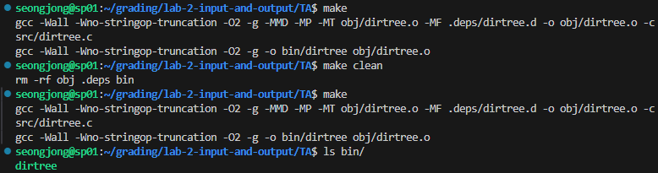
How to use ‘Makefile’
File | Path
dirtree.c | ~/assign2/src/
dirtree (executable file) | ~/assign2/bin/
Basic directory structure
(Assume that the ‘Makefile’ is located in ~/assignment2)
Example of use
You should keep the directory structure as specified in the Makefile
Basically, use the structure you downloaded the files for lab 2
You don’t need to modify the content of Makefile
Just remember that:
$ make: compiles dirtree.c file
$ make clean: removes the results of the compilation (Necessary when performing a new compilation)

Slide 18
About ‘tools/’
File | Description
gentree.sh | Driver script to generate a test directory tree
mksock | Helper program to generate a Unix socket
*.tree | Script files describing the directory tree layout
Example of use: $ ./gentree.sh demo.tree
You can create multiple test cases by modifying only the *.tree files
gentree.sh creates a test case directory based on input files (*.tree files)
mksock is used in gentree.sh and cannot be modified
Read the *.tree file contents. You can easily create test cases

Slide 19
Hints (Useful C Library Calls)
Topic | C library call | Description
String operations | strcmp() | compare two strings
 | strncpy() | copy up to n characters of one string into another
 | strdup() | create a copy of a string. Use free() to free it after use
 | asprintf() | asprintf() is extremely helpful to print into a string and allocate memory for it at the same time. We will show some examples during the lab session.
Directory management | opendir() | open a directory to enumerate its entries
 | closedir() | close an open directory
 | readdir() | read next entry from directory
File meta data | stat() | retrieve meta data of a file, follow links
 | lstat() | retrieve meta data of a file, do not follow links
User/group information | getpwuid() | retrieve user information (including their name) for a given user ID
 | getgrgid() | retrieve group information (including its name) for a given group ID
Sorting | qsort() | quick-sort an array

Slide 20
Submit Format
Structure of directory:
YourID_assign2 (don’t use dash)
|-dirtree.c (source file)
`-readme (don’t use extension such as .txt, .md, …)
Example:
202400000_assign2
|-dirtree.c (source file)
`-readme
Please set files and directory’s names to match the examples above
Don’t use any extension for readme file
Don’t use dash for submit file
Please place all source code in a single file
Structure files and directories as shown above, then proceed with compression
Deadline: ~10.11 21:00
0 points if deadline is missed

Slide 21
Grading
Test cases | Assigned points
dirtree ./target_directory | 9
dirtree –s ./target_directory | 4
dirtree –v ./target_directory | 4
dirtree –t ./target_directory | 4
dirtree -s -v ./target_directory | 3
dirtree -s -t ./target_directory | 3
dirtree -v -t ./target_directory | 3
dirtree -s -v -t ./target_directory | 4
dirtree <options> <multiple directories> (same as single directory case) | 34
Error and overflow handling | 16
README.md (information of your dirtree) | 10
Whether compilation is possible with Makefile | 6
Functionality of each option: 68 points
1 option not implemented: -28 points
2 options not implemented: -40 points
3 options not implemented: -66 points
Tips for testing: use ‘diff’ command
If the submission format is violated: -5 points
If the source file cannot be compiled
w/ gcc800 in Makefile: -6 points
w/ gcc in Makefile: You will get no point

