Slide 1
Longest Common Subsequence

Slide 2
Longest Common Subsequence
Input
X = ⟨x₁, x₂, …, x_{m}⟩ Y = ⟨y₁, y₂, …, y_{n}⟩
X = ⟨A, B, C, B, D, A, B⟩ X = ⟨A, B, C, B, D, A, B⟩
Y = ⟨B, D, C, A, B, A⟩ Y = ⟨B, D, C, A, B, A⟩
LCS
__________, __________, __________
length = ___

Slide 3
Simple LCS
Brute-Force Solution
Input X = ⟨x₁, x₂, …, x_{m}⟩ Y = ⟨y₁, y₂, …, y_{n}⟩
X → 2^{m}
Θ(n)
Running time: Θ(n2^{m})

Slide 4
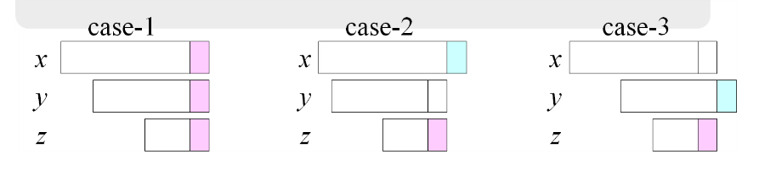
The characteristics of the LCS

Slide 5
The characteristics of the LCS
Case 1: x_{i} = y_{j}
e.g.: X_{i} = ⟨A, B, D, E⟩
Y_{j} = ⟨Z, B, E⟩
Case 2: x_{i} ≠ y_{j}
e.g.: X_{i} = ⟨A, B, D, G⟩
Y_{j} = ⟨Z, B, D⟩
Must solve two problems
find a LCS of X_{i-1} and Y_{j}: X_{i-1} = ⟨A, B, D⟩ and Y_{j} = ⟨Z, B, D⟩
find a LCS of X_{i} and Y_{j-1}: X_{i} = ⟨A, B, D, G⟩ and Y_{j} = ⟨Z, B⟩
단, c[i, j]는 X_{i} = ⟨x₁, x₂, …, x_{i}⟩ and Y_{j} = ⟨y₁, y₂, …, y_{j}⟩ 의 LCS 길이
c[i, j] =
c[i - 1, j - 1] + 1
c[i, j] =
max { c[i - 1, j], c[i, j-1] }

Slide 6
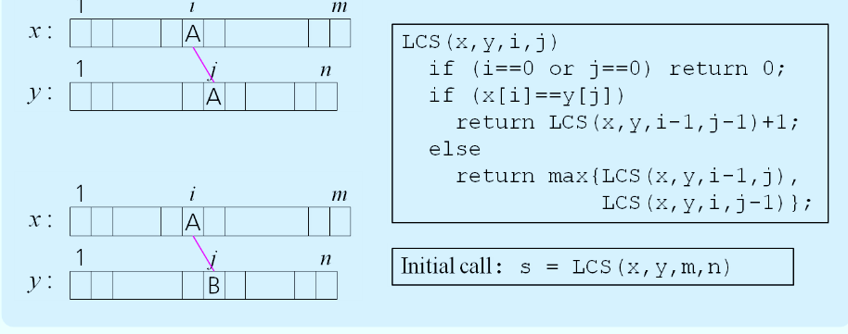
A recursive solution
0 if i = 0 or j = 0
c[i, j] = c[i-1, j-1] + 1 if x_{i} = y_{j}
max(c[i, j-1], c[i-1, j]) if x_{i} ≠ y_{j}

Slide 7



Additional Information
0 if i,j = 0
c[i, j] = c[i-1, j-1] + 1 if x_{i} = y_{j}
max(c[i, j-1], c[i-1, j]) if x_{i} ≠ y_{j}
b[i, j]:
If x_{i} = y_{j}
b[i, j] = “ ”
Else, if c[i - 1, j] ≥ c[i, j-1]
b[i, j] = “ ↑ ”
else
b[i, j] = “ ← ”
b & c:
0
1
2
3
n
y_{j:}
A
C
D
F
0
x_{i}
0 | 0 | 0 | 0 | 0 | 0
0
0
0
0
0
1
A
2
B
c[i-1,j]
i
3
C
c[i,j-1]
m
D
j

Slide 8



Example
0 if i = 0 or j = 0
c[i, j] = c[i-1, j-1] + 1 if x_{i} = y_{j}
max(c[i, j-1], c[i-1, j]) if x_{i} ≠ y_{j}
X = ⟨A, B, C, B, D, A⟩
Y = ⟨B, D, C, A, B, A⟩
If x_{i} = y_{j}
b[i, j] = “ ”
Else if
c[i - 1, j] ≥ c[i, j-1]
b[i, j] = “ ↑ ”
else
b[i, j] = “ ← ”
0
1
2
3
4
5
6
y_{j}
B
D
C
A
B
A
0
x_{i}
0
0
0
0
0
0
0
1
A
0
↑
0
↑
0
↑
0
1
1
←1
2
B
0
1
↑
1
2
←1
←1
←2
3
C
0
↑
1
↑
1
2
↑
2
↑
2
←2
4
B
0
1
↑
1
↑
2
↑
2
3
←3
5
D
0
↑
1
2
↑
2
↑
2
↑
3
↑
3
6
A
0
↑
1
↑
2
↑
2
3
↑
3
4
7
B
0
1
↑
2
↑
2
↑
3
4
↑
4

Slide 9
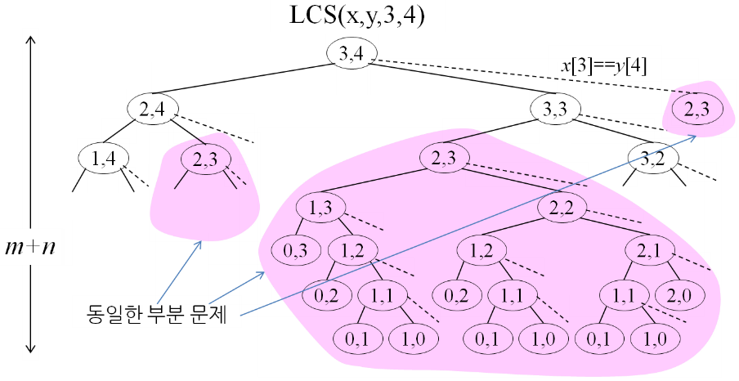
Recursion Tree
The same sub Problem

Slide 10
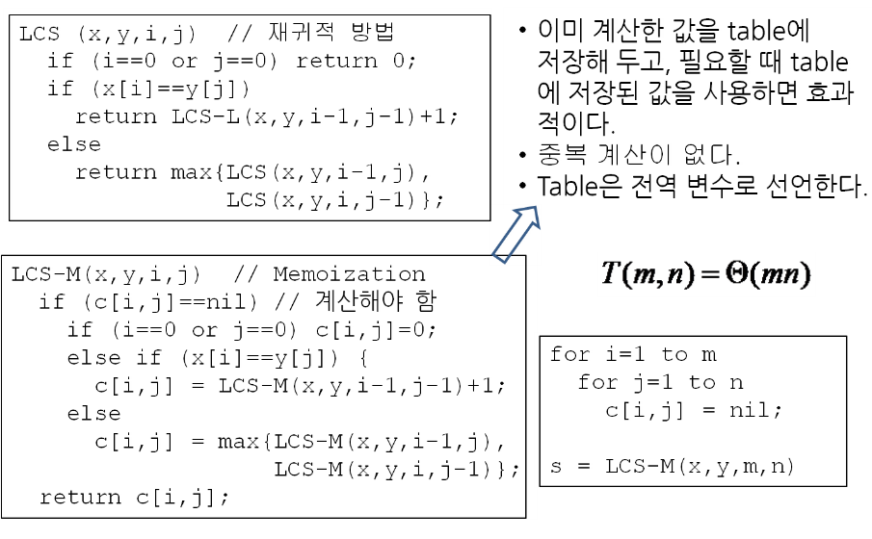
Memoization Algorithm

Slide 11
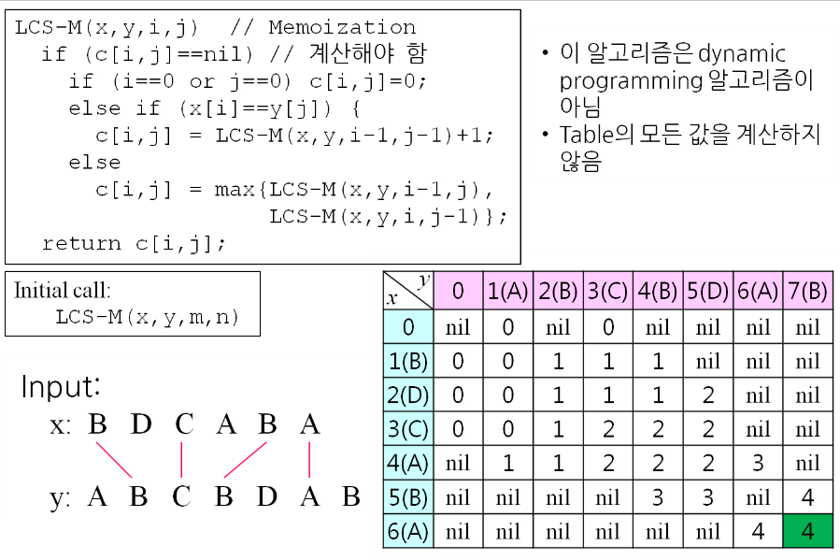
The Length of LCS
y x |  | 0 | 1 | 2 | 3 | 4 | 5 | 6 | 7
 |  | 0 | A | B | C | B | D | A | B
0 | 0 | nil | 0 | nil | 0 | nil | nil | nil | nil
1 | B | 0 | 0 | 1 | 1 | 1 | nil | nil | nil
2 | D | 0 | 0 | 1 | 1 | 1 | 2 | nil | nil
3 | C | 0 | 0 | 1 | 2 | 2 | 2 | nil | nil
4 | A | nil | 1 | 1 | 2 | 2 | 2 | 3 | nil
5 | B | nil | nil | nil | nil | 3 | 3 | nil | 4
6 | A | nil | nil | nil | nil | nil | nil | 4 | 4

Slide 12
LCS Dynamic Programming
0 if i = 0 or j = 0
c[i, j] = c[i-1, j-1] + 1 if x_{i} = y_{j}
max(c[i, j-1], c[i-1, j]) if x_{i} ≠ y_{j}
0
1
2
n
y_{j:}
y₁
y₂
y_{n}
0
x_{i}
0 | 0 | 0 | 0 | 0 | 0
0
0
0
0
0
1
x₁
first
2
x₂
second
i
m
x_{m}
j

Slide 13
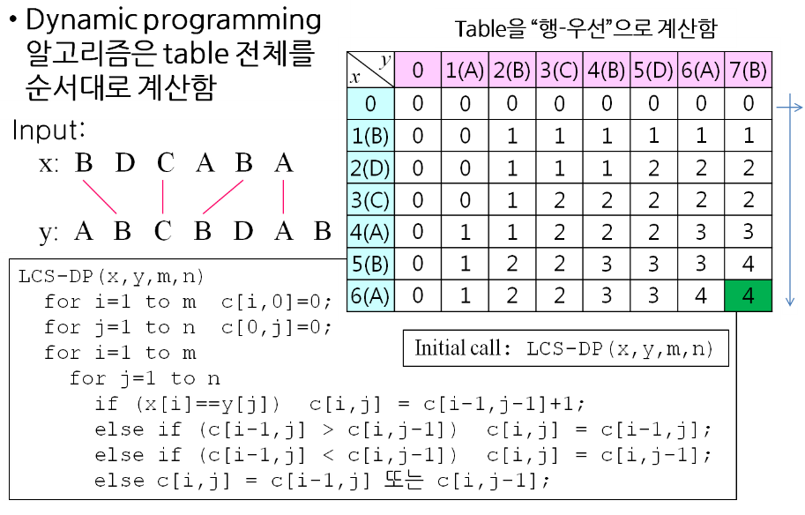
LCS Dynamic Programming
y x |  | 0 | 1 | 2 | 3 | 4 | 5 | 6 | 7
 |  | 0 | A | B | C | B | D | A | B
0 | 0 | 0 | 0 | 0 | 0 | 0 | 0 | 0 | 0
1 | B | 0 | 0 | 1 | 1 | 1 | 1 | 1 | 1
2 | D | 0 | 0 | 1 | 1 | 1 | 2 | 2 | 2
3 | C | 0 | 0 | 1 | 2 | 2 | 2 | 2 | 2
4 | A | 0 | 1 | 1 | 2 | 2 | 2 | 3 | 3
5 | B | 0 | 1 | 2 | 2 | 3 | 3 | 3 | 4
6 | A | 0 | 1 | 2 | 2 | 3 | 3 | 4 | 4

Slide 14
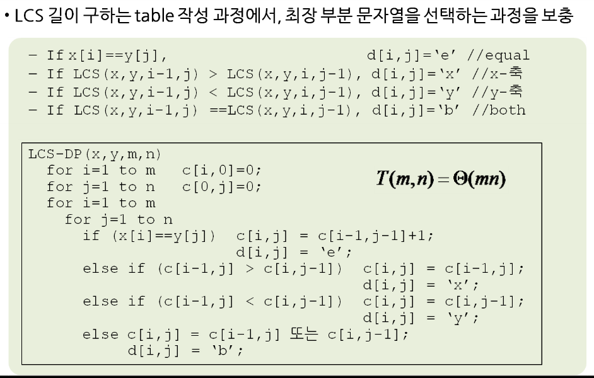
LCS

Slide 15
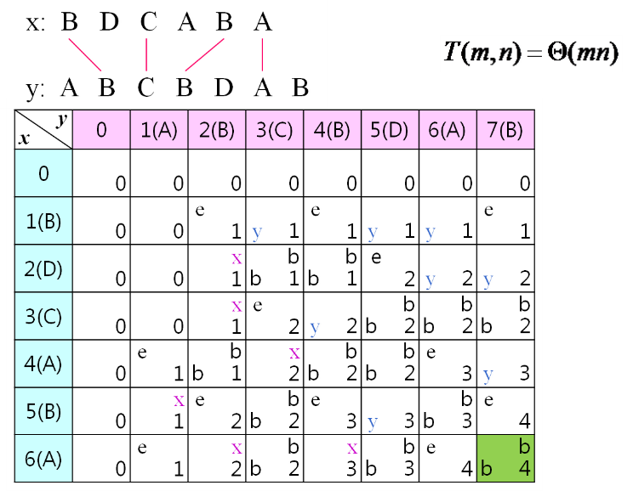
LCS Table
y x |  | 0 |  | 1 |  | 2 |  | 3 |  | 4 |  | 5 |  | 6 |  | 7
 |  | 0 |  | A |  | B |  | C |  | B |  | D |  | A |  | B
0 | 0
 |  |  | 0 |  | 0 |  | 0 |  | 0 |  | 0 |  | 0 |  | 0 |  | 0
1 | B |  |  |  |  | e |  |  |  | e |  |  |  |  |  | e
 |  |  | 0 |  | 0 |  | 1 | y | 1 |  | 1 | y | 1 | y | 1 |  | 1
2 | D |  |  |  |  |  | x |  | b |  | b | e
 |  |  | 0 |  | 0 |  | 1 | b | 1 | b | 1 |  | 2 | y | 2 | y | 2
3 | C |  |  |  |  |  | x | e |  |  |  |  | b |  | b |  | b
 |  |  | 0 |  | 0 |  | 1 |  | 2 | y | 2 | b | 2 | b | 2 | b | 2
4 | A |  |  | e |  |  | b |  | x |  | b |  | b | e
 |  |  | 0 |  | 1 | b | 1 |  | 2 | b | 2 | b | 2 |  | 3 | y | 3
5 | B |  |  |  | x | e |  |  | b | e |  |  |  |  | b | e
 |  |  | 0 |  | 1 |  | 2 | b | 2 |  | 3 | y | 3 | b | 3 |  | 4
6 | A |  |  | e |  |  | x |  | b |  | x |  | b | e |  |  | b
 |  |  | 0 |  | 1 |  | 2 | b | 2 |  | 3 | b | 3 |  | 4 | b | 4

Slide 16
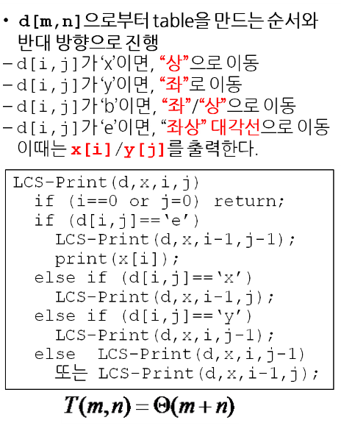
LCS print out
y x |  | 0 |  | 1 |  | 2 |  | 3 |  | 4 |  | 5 |  | 6 |  | 7
 |  | 0 |  | A |  | B |  | C |  | B |  | D |  | A |  | B
0 | 0
 |  |  | 0 |  | 0 |  | 0 |  | 0 |  | 0 |  | 0 |  | 0 |  | 0
1 | B |  |  |  |  | e |  |  |  | e |  |  |  |  |  | e
 |  |  | 0 |  | 0 |  | 1 | y | 1 |  | 1 | y | 1 | y | 1 |  | 1
2 | D |  |  |  |  |  | x |  | b |  | b | e
 |  |  | 0 |  | 0 |  | 1 | b | 1 | b | 1 |  | 2 | y | 2 | y | 2
3 | C |  |  |  |  |  | x | e |  |  |  |  | b |  | b |  | b
 |  |  | 0 |  | 0 |  | 1 |  | 2 | y | 2 | b | 2 | b | 2 | b | 2
4 | A |  |  | e |  |  | b |  | x |  | b |  | b | e
 |  |  | 0 |  | 1 | b | 1 |  | 2 | b | 2 | b | 2 |  | 3 | y | 3
5 | B |  |  |  | x | e |  |  | b | e |  |  |  |  | b | e
 |  |  | 0 |  | 1 |  | 2 | b | 2 |  | 3 | y | 3 | b | 3 |  | 4
6 | A |  |  | e |  |  | x |  | b |  | x |  | b | e |  |  | b
 |  |  | 0 |  | 1 |  | 2 | b | 2 |  | 3 | b | 3 |  | 4 | b | 4

