Slide 1
FMIKit-Simulink-2.9_fork
박연수 연구원
IPG Automotive Korea, 09/05/2023

Slide 2
Overview
Original repository: https://github.com/CATIA-Systems/FMIKit-Simulink
Fork added functionalities
Target non-native architectures
Configure specific C compilers
Dependencies
CMake
Simulink Coder and its dependencies
C Compiler/Make of your choice

Slide 3
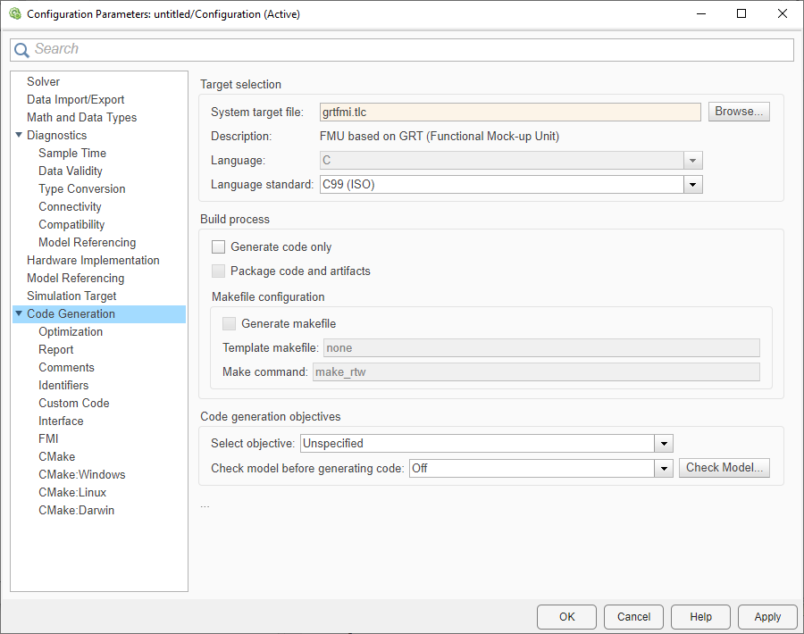
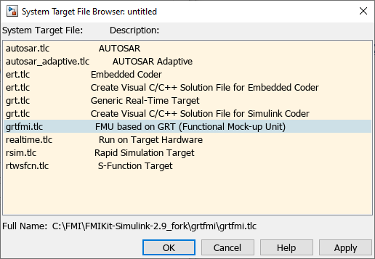
Basic Setup
addpath(“<FMIKit Directory>\grtfmi”) (e.g., C:\FMI\FMIKit-Simulink-2.9_fork\grtfmi)
Code Generation→Target selection→System target file→grtfmi.tlc

Slide 4
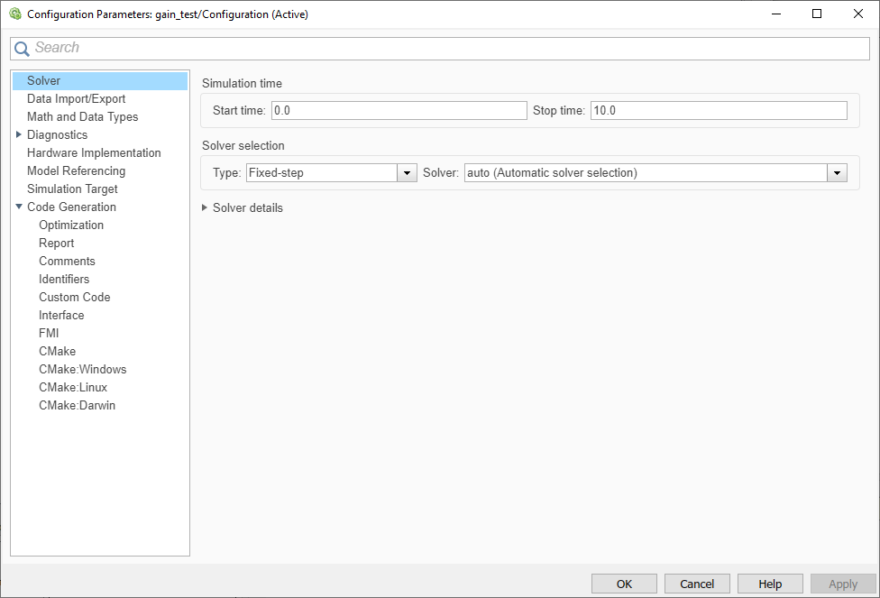
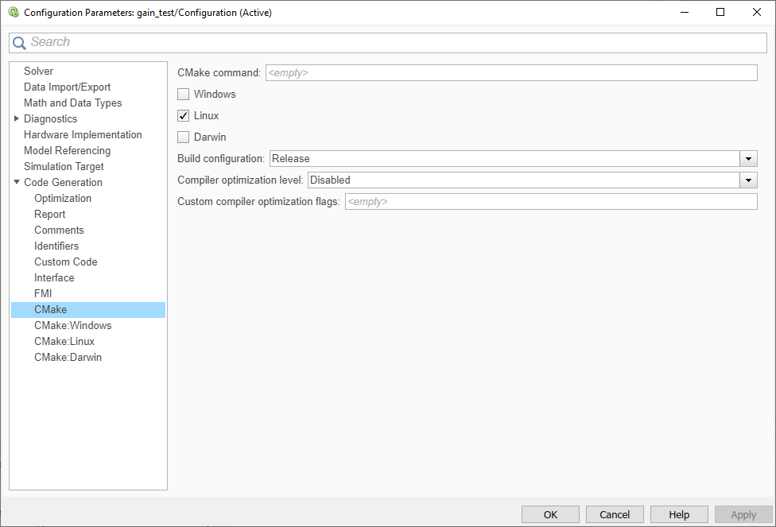
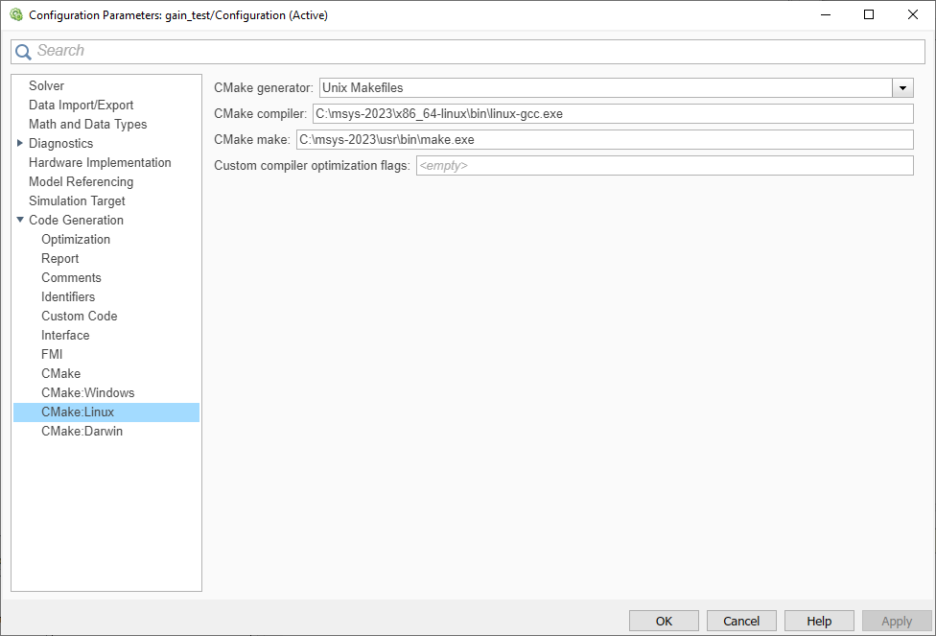
Basic Setup
Solver→Solver selection→Type→Fixed-step
Code Generation→CMake→Checkbox Target Architecture
Code Generation→CMake Linux→CMake compiler (e.g., C:\msys-2023\x86_64-linux\bin\linux-gcc.exe)
Code Generation→CMake Linux→CMake make (e.g., C:\msys-2023\usr\bin\make.exe)

Slide 5
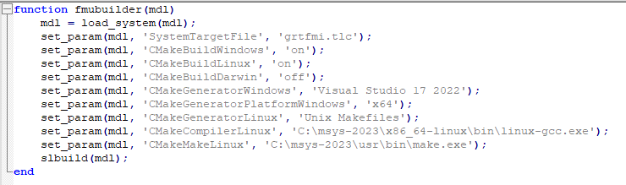
Too Complicated?
Just run fmubuilder.m script!
(addpath is still a must)
Dependancies
FMIKit-Simulink and its dependancies
Visual Studio 17 2022
MSYS-2023(Provided from CarMaker 12) installed on C:\msys-2023

