Slide 1
JW pharma [OJP-4301]
Indication screening Result
ONCOCROSS
AI 연구소
2022-07-11

Slide 2
RAPTOR AI Process
Data Analysis Workflow
Cell – Tissue Similarity Analysis
Drug : OJP-4301
RAPTOR AI Score Distribution
Cell line Integration method: v.ud.15
METHOD (1) Anti-common test
METHOD (2) Anti-projection test
METHOD (3) Anti-Similarity test
OJP4301 indication screening Result

Slide 3
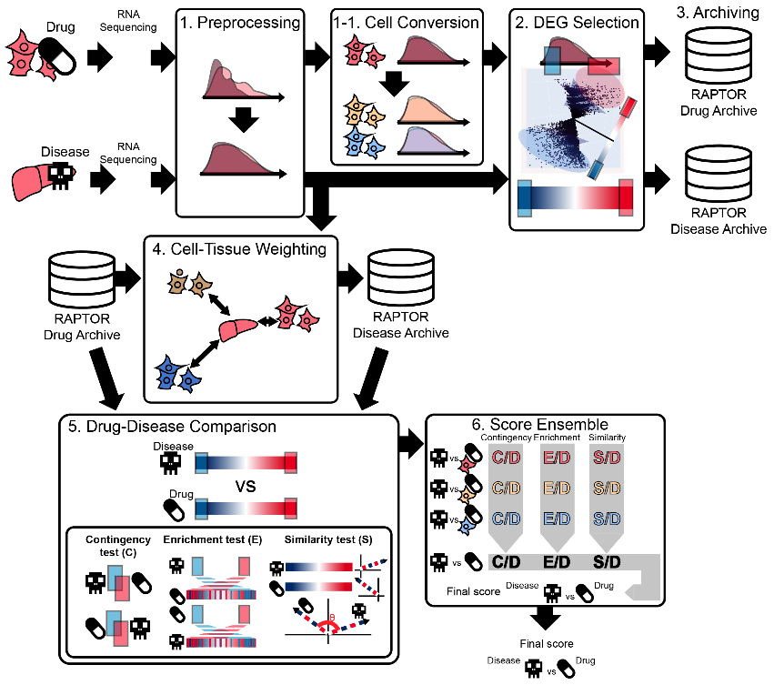
RAPTOR AI Process

Slide 4
RAPTOR AI Data analysis workflow
Gene Expression Analysis
Raw Data (Fastq)
RAPTOR AI Ver 3.b.2
Process | Tools(version)
Trimming | Trimmomatic-0.39-1
Alignment | STAR-2.7.8a(GRCh38.105) RSEM-1.3.3
Cell-Tissue Similarity | UMAP-15D
Trimming
Alignment
Quantification(TPM)
Pre-processing
DEG Analysis
ReDRUG
Indication drug screening

Slide 5
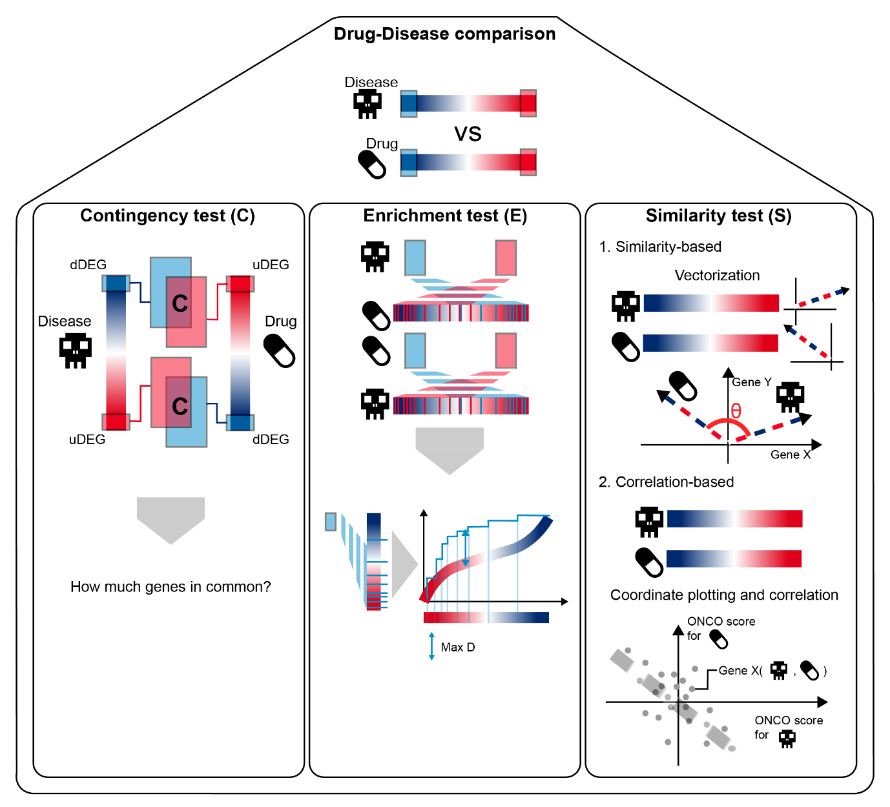
RAPTOR AI Drug-Disease comparison

Slide 6
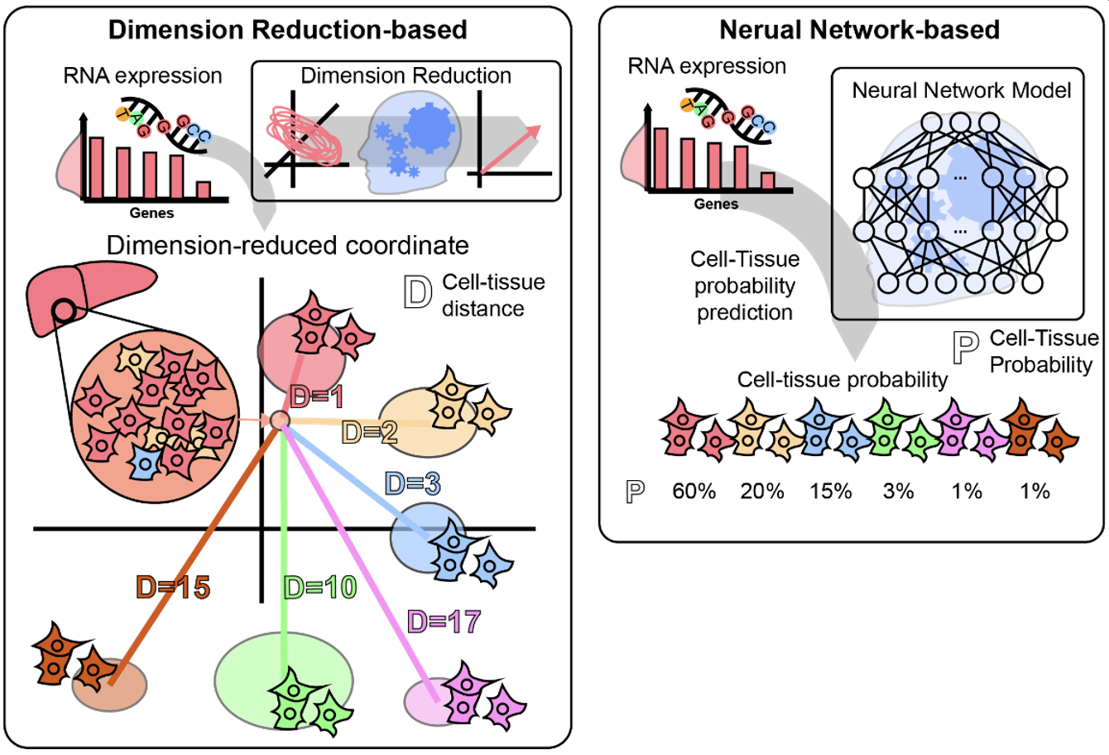
RAPTOR AI Cell - Tissue Similarity Analysis
Cell line Integration method: v.ud.15

Slide 7
OJP-4301
Indication screening result

Slide 8
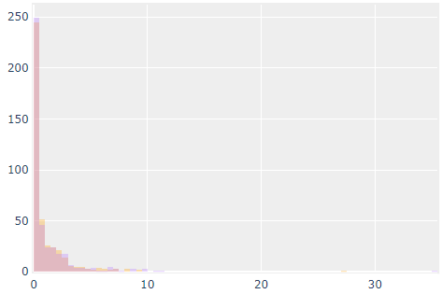
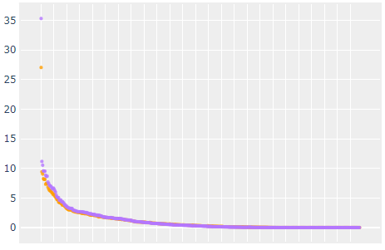

RAPTOR AI Score Distribution
Cell line Integration method: v.ud.15
Result - METHOD (1) SCORE DISTRIBUTION Anti-common test
Frequency distribution for Anti-common test
of drug-disease pair
Top 1000 Drug-Disease pairs
with Anti-common test score
No significant
Significant

Slide 9
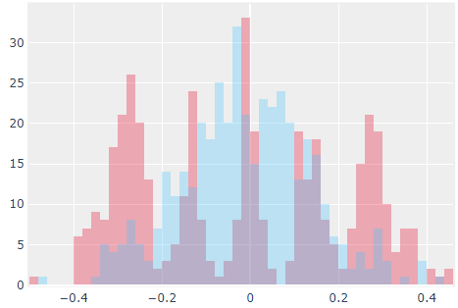
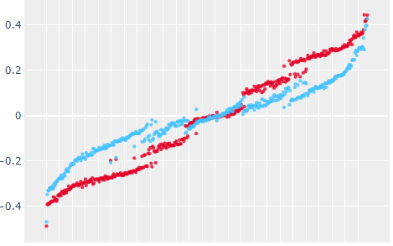

RAPTOR AI Score Distribution
Cell line Integration method: v.ud.15
Result - METHOD (2) SCORE DISTRIBUTION Anti-projection test
Frequency distribution for Anti-projection test of drug-disease pair
Top 1000 Drug-Disease pairs
with Anti-projection test score
significant
No Significant

Slide 10
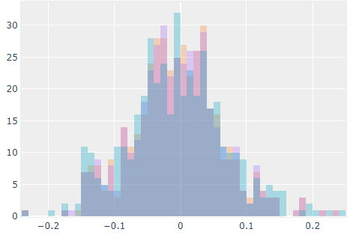
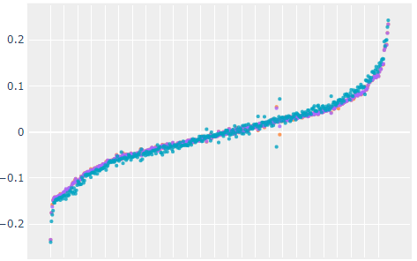

RAPTOR AI Score Distribution
Cell line Integration method: v.ud.15
Result - METHOD (3) SCORE DISTRIBUTION Anti-Similarity test
Frequency distribution for Anti-Similarity test
of drug-disease pair
Top 1000 Drug-Disease pairs
with Anti-Similarity test score
significant
No Significant

Slide 11
OJP-4301 (URAT1 inhibitor)
Indication screening (Top 20)
Cell line Integration method: v.ud.15.ranked
Rank Mean (total : 421) | Disease name | TISSUE | Cohort number | description
1 | Dravet syndrome | blood | DravetSyndrome_v1 | An early infantile epileptic encephalopathy that has_material_basis_in heterozygous mutation in the SCN1A gene on chromosome 2q24.
2 | Aging | brain_cerebellar_hemisphere | GTEx_2030s_vs_6070s | Aging, Biological aging, Scenescence (MeSH Unique ID D000375, Tree Number(s) G07.345.124)
3 | isolated elevated serum creatine phosphokinase levels | myotube | GSE44874 | An inherited metabolic disorder characterized by elevated serum creatine kinase levels in the absence of muscle weakness or other symptoms that has_material_basis_in in some cases in heterozygous mutation in CAV3 on chromosome 3p25.3.
4 | asthma | airway_epithelium | GSE67472 | A bronchial disease that is characterized by chronic inflammation and narrowing of the airways, which is caused by a combination of environmental and genetic factors. The disease has_symptom recurring periods of wheezing (a whistling sound while breathing), has_symptom chest tightness, has_symptom shortness of breath, has_symptom mucus production and has_symptom coughing. The symptoms appear due to a variety of triggers such as allergens, irritants, respiratory infections, weather changes, exercise, stress, reflux disease, medications, foods and emotional anxiety.
5 | membranous glomerulonephritis | kidney_tubulointerstitium | GSE108113 | deposition of immune complexes on the glomerular basement membrane (GBM) with GBM thickening. Cause is usually unknown, although secondary causes include drugs, infections, autoimmune disorders, and cancer.
6 | membranous glomerulonephritis | kidney_glomeruli | GSE108113 | deposition of immune complexes on the glomerular basement membrane (GBM) with GBM thickening. Cause is usually unknown, although secondary causes include drugs, infections, autoimmune disorders, and cancer.
7 | lipoid nephrosis | kidney_tubulointerstitium | GSE108113 | minimal change nephropathy
8 | vasculitis | kidney_tubulointerstitium | GSE108113 | A vascular disease that is characterized by inflammation of the blood vessels.
9 | vasculitis | kidney_glomeruli | GSE108113 | A vascular disease that is characterized by inflammation of the blood vessels.
10 | focal segmental glomerulosclerosis | kidney_glomeruli | GSE108113 | a histopathologic finding of scarring (sclerosis) of glomeruli and damage to renal podocytes.
11 | focal segmental glomerulosclerosis | kidney_tubulointerstitium | GSE108113 | a histopathologic finding of scarring (sclerosis) of glomeruli and damage to renal podocytes.
12 | focal segmental glomerulosclerosis | kidney_glomeruli | GSE104066 | a histopathologic finding of scarring (sclerosis) of glomeruli and damage to renal podocytes.
13 | lipoid nephrosis | kidney_glomeruli | GSE108113 | minimal change nephropathy
14 | retinal detachment | retina | GSE28133 | a disorder of the eye in which the retina peels away from its underlying layer of support tissue.
15 | cryptorchidism | testicular | GSE25518 | the absence of one or both testes from the scrotum.
16 | atopic dermatitis | skin_non_lesion | GSE32924 | An allergic contact dermatitis that is a chronically relapsing inflammatory allergic response located_in the skin that causes itching and flaking.
17 | coronary artery disease | peripheral_blood | GSE71226 | An artery disease that is characterized by plaque building up along the inner walls of the arteries of the heart resulting in a narrowing of the arteries and a reduced blood supply to the cardiac muscles.
18 | cryptorchidism | testicular | GSE16191 | the absence of one or both testes from the scrotum.
19 | type 2 diabetes mellitus | arterial | GSE13760 | A diabetes mellitus that involves high blood glucose resulting from cells fail to use insulin properly.
20 | uremia | whole_blood | GSE37171 | the term for high levels of urea in the blood. Urea is one of the primary components of urine.

Slide 12
Thank you

