Slide 1
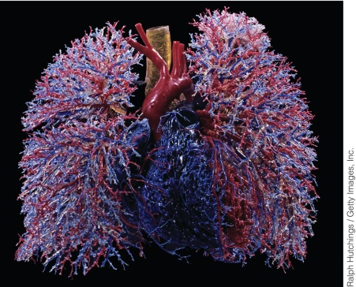
CHAPTER 9
Mitochondrion and Aerobic Respiration

Slide 2
9.0 | Why We Need to Breathe
To satisfy cellular oxygen demand, our blood runs red with hemoglobin.
Much of human anatomy and physiology is devoted to ensuring an adequate oxygen supply.
Oxygen is used to power cellular metabolism by providing energy through the biochemical pathway of respiration, much of which takes place within mitochondria.

Slide 3
9.1 | Mitochondrial Structure and Function
The early Earth was populated by anaerobes, which captured and utilized energy by oxygen-independent metabolism like glycolysis and fermentation.
Oxygen accumulated in the primitive atmosphere after cyanobacteria appeared, which carried out a new type of photosynthetic process in which water molecules were split apart and molecular oxygen was released.
Aerobes evolved to use oxygen to extract more energy from organic molecules, and they eventually gave rise to all of the oxygen-dependent prokaryotes and eukaryotes living today.
In eukaryotes, the utilization of oxygen as a means of energy extraction takes place in a specialized organelle, the mitochondrion.

Slide 4
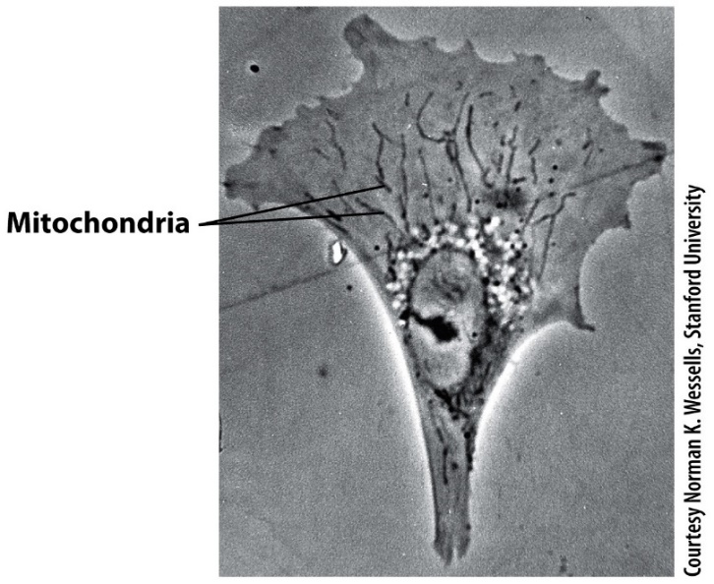
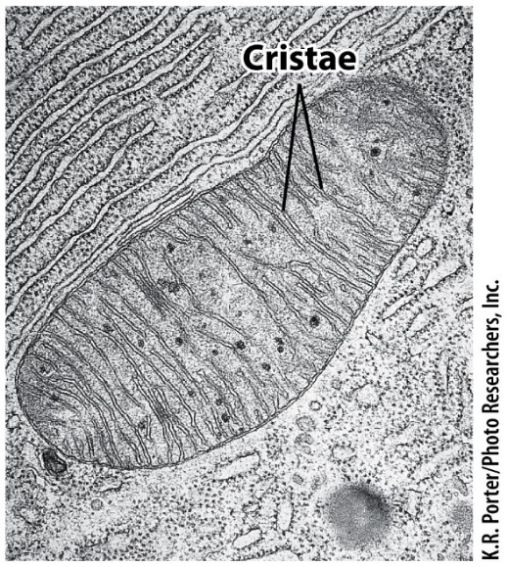
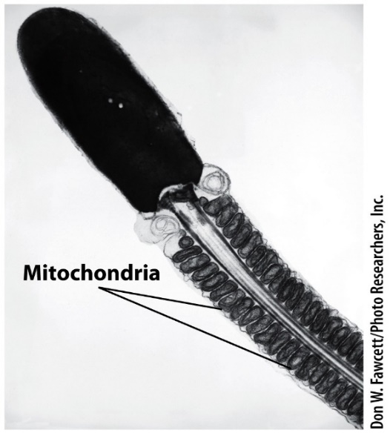
9.1 | Mitochondrial Structure and Function
Elongated mitochondria of fibroblast
Transmission electron micrograph
Mitochondria in the sperm mid-piece
Depending on the cell type, mitochondria can have a very different overall structure.
Typical mitochondria are bean-shaped organelles but may be round or threadlike.
Size and number of mitochondria reflect the energy requirements of the cell.
Notes:
Figure 9.1a-c
Mitochondria. (A) A living fibroblast viewed with a phase-contrast microscope. Mitochondria are seen as elongated, dark bodies. (B) Transmission electron micrograph of a thin section through a mitochondrion revealing the internal structure of the organelle, particularly the membranous cristae of the inner membrane. (C) Localization of mitochondria in the sperm mid-piece surrounding the proximal portion of the flagellum.

Slide 5
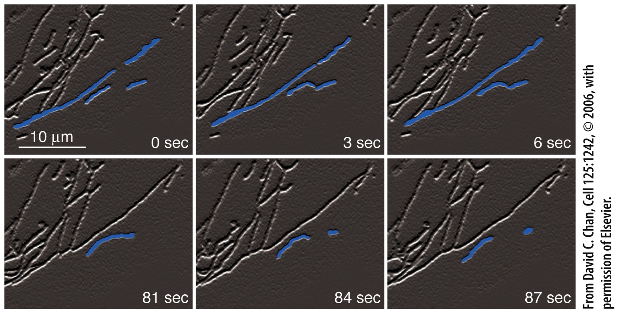
9.1 | Mitochondrial Structure and Function
Dynamic nature of mitochondria revealed in mouse fibroblasts with a fluorescent tagged mitochondrial protein.
Mitochondria can fuse with one another, or split in two.
The balance between fusion and fission is likely a major determinant of mitochondrial number, length, and degree of interconnection.
Notes:
Figure 9.2a-c
Mitochondrial fusion and fission. (A) The dynamic nature of these organelles is captured in the frames of this movie, which shows a portion of a mouse fibroblast whose mitochondria have been labeled with a fluorescent protein. In the first three frames, two pairs of mitochondria (which have been artificially colored) contact end-to-end and immediately fuse. In the last three frames, the lower fusion product undergoes fission, and the daughter mitochondria move apart. (B) Three-dimensional model of contacts between the ER (green) and mitochondria (purple) in a yeast cell based on EM tomography. ER tubules are seen to encircle portions of the yeast mitochondrial network, marking sites of future fission. Similar events occur in mammalian cells. (C) In the model depicted here, contact with ER tubules initiates the process of mitochondrial constriction (step 1). Fission is subsequently accomplished by proteins (e.g. Drp1 in mammals) that assemble into helices around the outer surface of the mitochondria (step 2). Drp1 is a member of the dynamin family of GTP-binding proteins that are involved in severing membrane structures. GTP binding and hydrolysis causes a conformational change in the Drp1 helices that fully constrict the mitochondrion, splitting it into two smaller organelles (step 3).
Mitochondria 끼리 fusion 되기도 하고 fission 되기도 함 (세포 상태에 따라)
한 세포 내의 mitochondria 개수는 늘 일정한 것이 아니라 세포의 상태에 따라 변함 (+ 제 기능을 못하는 mitochondria 를 정상인 것과 구분하는 기작이 있음 → 분해해버림)

Slide 6
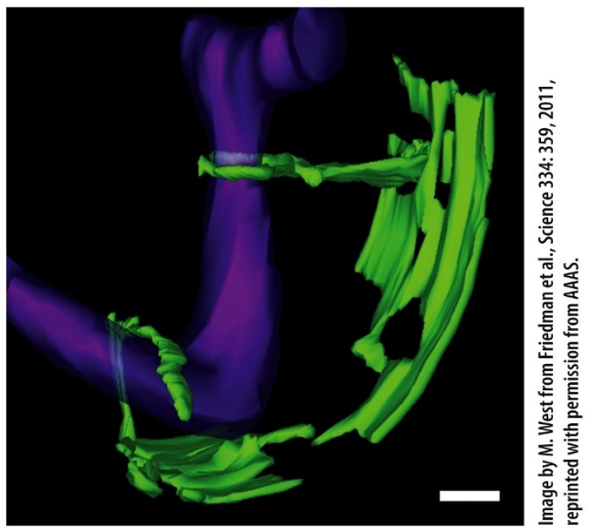
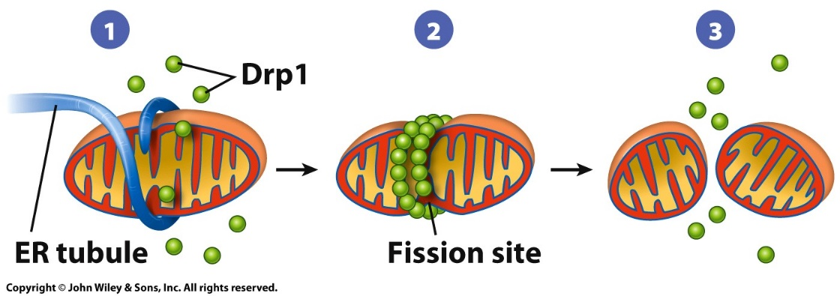
9.1 | Mitochondrial Structure and Function
3D model of contacts between ER and mitochondria
Model for mitochondrial fission: ER tubules and Drp1 mediate mitochondrial constriction.
Mitochondrial fission is apparently induced by contact with thin tubules from the ER, which can encircle the mitochondrion like a noose.
These ER tubules appear to initiate constriction, which is then completed through the action of soluble proteins that are recruited to the outer surface of the mitochondrion from the cytosol.
Notes:
Figure 9.2a-c
Mitochondrial fusion and fission. (A) The dynamic nature of these organelles is captured in the frames of this movie, which shows a portion of a mouse fibroblast whose mitochondria have been labeled with a fluorescent protein. In the first three frames, two pairs of mitochondria (which have been artificially colored) contact end-to-end and immediately fuse. In the last three frames, the lower fusion product undergoes fission, and the daughter mitochondria move apart. (B) Three-dimensional model of contacts between the ER (green) and mitochondria (purple) in a yeast cell based on EM tomography. ER tubules are seen to encircle portions of the yeast mitochondrial network, marking sites of future fission. Similar events occur in mammalian cells. (C) In the model depicted here, contact with ER tubules initiates the process of mitochondrial constriction (step 1). Fission is subsequently accomplished by proteins (e.g. Drp1 in mammals) that assemble into helices around the outer surface of the mitochondria (step 2). Drp1 is a member of the dynamin family of GTP-binding proteins that are involved in severing membrane structures. GTP binding and hydrolysis causes a conformational change in the Drp1 helices that fully constrict the mitochondrion, splitting it into two smaller organelles (step 3).
Mitochondria 나눠지는 현상 (fission)
by Drp1 (GTP-binding proteins ) 이 활성 되면 mitochondrial fission 촉진됨 → ER 에서 유래한 tubule 이 mitochondria 휘감음 → GTP 가수분해되면서 energy 얻어 fission 됨

Slide 7

9.1 | Mitochondrial Structure and Function
Mitochondria occupy 15 to 20 percent of the volume of an average mammalian liver cell and contain more than a thousand different proteins.
To generate ATP, mitochondria are often associated with fatty acid-containing oil droplets from which they derive raw materials to be oxidized.
While energy metabolism has been the focus of interest in the study of mitochondria, these organelles are also involved in other activities.
Mitochondria are the sites of synthesis of numerous substances, including certain amino acids and the heme groups.
Mitochondria also play a vital role in the uptake and release of calcium ions, which are essential triggers for cellular activities
Cell death, which plays an enormous role in the life of all multicellular animals, is also regulated by events that occur within mitochondria.
Notes:
Calcium storage 역할도 하고 있다.
아주 중요한 역할 : 세포사멸과 연관된 반응들이 일어나는 장소 중 하나

Slide 8
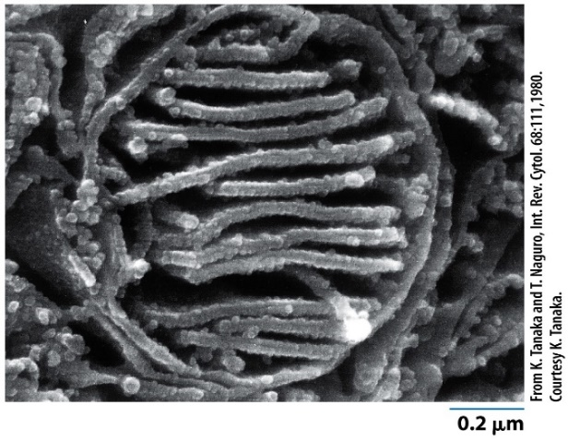
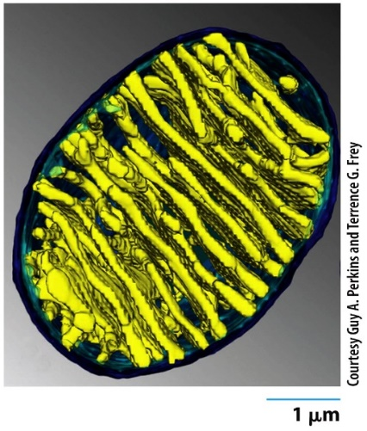
9.1 | Mitochondrial Structure and Function
Mitochondrial Membranes
The outer boundary of a mitochondrion contains two membranes: the outer mitochondrial membrane and the inner mitochondrial membrane.
The outer mitochondrial membrane serves as its outer boundary and the inner mitochondrial membrane is divided into two major domains that carry out distinct functions.
The inner boundary membrane domain is rich in the proteins responsible for the import of mitochondrial proteins.
The other domain lies in the interior of the organelle as a series of invaginated membranous sheets, called cristae.
Scanning electron micrograph of a macerated mitochondrion
3D reconstruction of a mitochondrion based on a micrographs taken with a high-voltage electron microscope
Notes:
Figure 9.3a-c
The structure of a mitochondrion. (A) Scanning electron micrograph of a macerated mitochondrion, showing the internal matrix enclosed by folds of the inner membrane. (B) Three-dimensional reconstruction of a mitochondrion based on a series of micrographs taken with a high-voltage electron microscope of a single thick section of brown fat tissue that had been tilted at various angles. High-voltage instruments accelerate electrons at velocities that allow them to penetrate thicker tissue sections (up to 1.5 um). This technique suggests that the cristae are present as flattened sheets (lamellae) that communicate with the intermembrane space by way of narrow tubular openings, rather than “wide open” channels as is typically depicted. In this reconstruction, the inner mitochondrial membrane is shown in blue at the peripheral regions and in yellow when it penetrates into the matrix to form the cristae. (C) Schematic diagrams showing the three-dimensional internal structure (top) and a thin section (bottom) of a mitochondrion from bovine heart tissue.

Slide 9
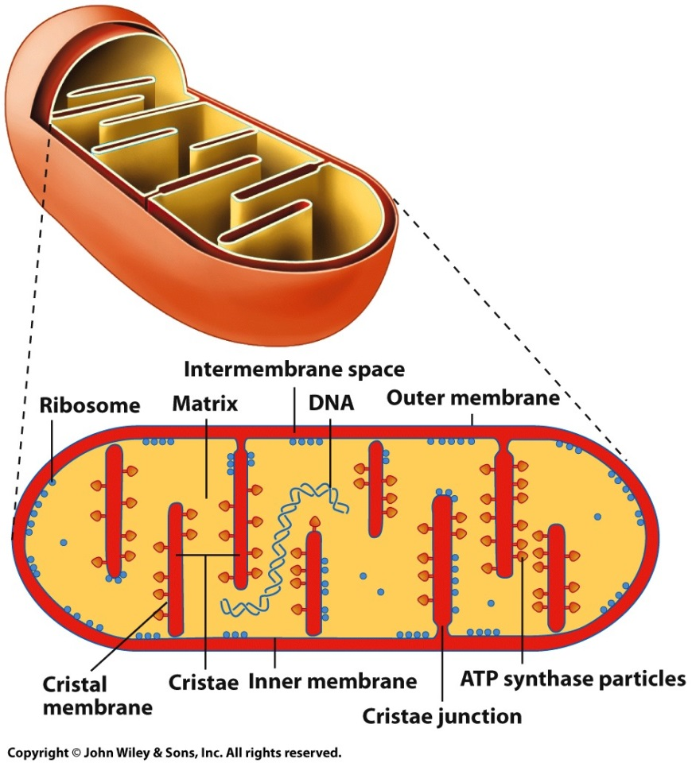
9.1 | Mitochondrial Structure and Function
Mitochondrial Membranes
The cristae houses the machinery needed for aerobic respiration and ATP formation.
The inner boundary membrane and internal cristal membranes are joined to one another by narrow tubular connections, or cristae junctions.
The membranes of the mitochondrion divide the organelle into two aqueous compartments, one within the interior of the mitochondrion, called the matrix, and a second between the outer and inner membrane, called the intermembrane space.
Schematic diagrams showing the 3D internal structure and a thin section of a mitochondrion from bovine heart tissue
Notes:
Figure 9.3a-c
The structure of a mitochondrion. (A) Scanning electron micrograph of a macerated mitochondrion, showing the internal matrix enclosed by folds of the inner membrane. (B) Three-dimensional reconstruction of a mitochondrion based on a series of micrographs taken with a high-voltage electron microscope of a single thick section of brown fat tissue that had been tilted at various angles. High-voltage instruments accelerate electrons at velocities that allow them to penetrate thicker tissue sections (up to 1.5 um). This technique suggests that the cristae are present as flattened sheets (lamellae) that communicate with the intermembrane space by way of narrow tubular openings, rather than “wide open” channels as is typically depicted. In this reconstruction, the inner mitochondrial membrane is shown in blue at the peripheral regions and in yellow when it penetrates into the matrix to form the cristae. (C) Schematic diagrams showing the three-dimensional internal structure (top) and a thin section (bottom) of a mitochondrion from bovine heart tissue.
Membrane 이 2개가 있음 → outer membrane + inner membrane
막 사이 공간 = intermembrane space
기질 = matrix
Cristae = Inner membrane 에서 움푹 들어간 부분 (그 부분 inner membrane = cristae inner membrane)
Cytochrome C 는 intermembrane space 에 위치함
: 세포 사멸 연구하던 연구자가 세포의 사멸을 촉진시켜주는 신호가 오게 되면, 상황에 따라서 cytochrome C 가 cytoplasm (세포질임 / 미토콘드리아 기질이 아님) 쪽으로 이동할 수 있다는 것을 발견함
➔ 어떤 protein 과 interaction 하고 apoptosome 이라는 단백질 복합체 형성한다 → 이 단백질 복합체는 다른 세포자살에 관여하는 물질들을 활성화 시켜주는 cascade를 발생시킴

Slide 10
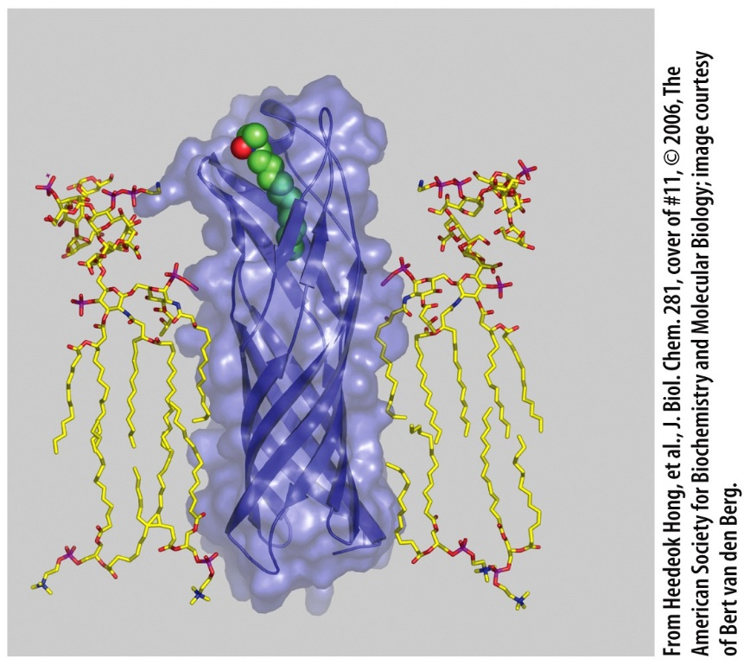
9.1 | Mitochondrial Structure and Function
Mitochondrial Membranes
The outer membrane is about 50%; the inner membrane is more than 75% protein.
The inner membrane contains cardiolipin but not cholesterol, both are true of bacterial membranes.
The outer membrane contains a large pore-forming protein called porin.
The inner membrane is impermeable to even small molecules, virtually all molecules and ions require special membrane transporters to gain entrance to the matrix.
Porin motif: a β-sheet barrel that forms an opening for passage of moderate-sized molecules
Notes:
Figure 9.4
Porins. Gram-negative bacteria have a lipid-containing outer membrane outside of their plasma membrane as part of their cell wall. This outer membrane contains proteins, called porins, that consist of a barrel of beta sheet and form an opening through which moderate-sized molecules can penetrate. This image shows the protein OmpW embedded in the outer membrane of E. coli. The porin contains a small hydrophobic compound within its central channel. A variety of porins having different sized channels and selectivities are also found in the outer mitochondrial membrane in eukaryotic cells.

Slide 11
9.1 | Mitochondrial Structure and Function
Mitochondrial Matrix
The mitochondrial matrix contains ribosomes and several molecules of circular DNA to manufacture their own RNAs and proteins.
The DNA encodes a small number of mitochondrial polypeptides (13 in humans) that are tightly integrated into the inner mitochondrial membrane along with polypeptides encoded by genes residing within the nucleus.
Mitochondrial DNA (mtDNA) is a relic thought to be the legacy from a single aerobic bacterium that took up residence in the cytoplasm of a primitive cell that ultimately became an ancestor of all eukaryotic cells.
For a number of reasons, mtDNA is well suited for use in the study of human migration and evolution.
Notes:
자체 ribosome 과 DNA RNA 를 가지고 있음
Bacteria 에 있는 ribosome 과 size 비슷 (50s <-> 진핵생물은 60s)
항생제 : bacteria 의 translation 하는 기작을 방해함 (60s ribosome 은 건들지 않고 50s 단백질 합성만 억제함. → 우리 몸엔 독성 x )
문제는 mitochondria 의 ribosome 의 translation 도 억제할 수 있음 (부작용)
수정을 통해 형성된 접합자의 mitochondria 는 난자에서 유래한 것임 → 우리 몸에 있는 모든 mitochondria 는 어머니로부터 유래된 것임.
→ 진화적인 경로를 추적하는데 사용

Slide 12
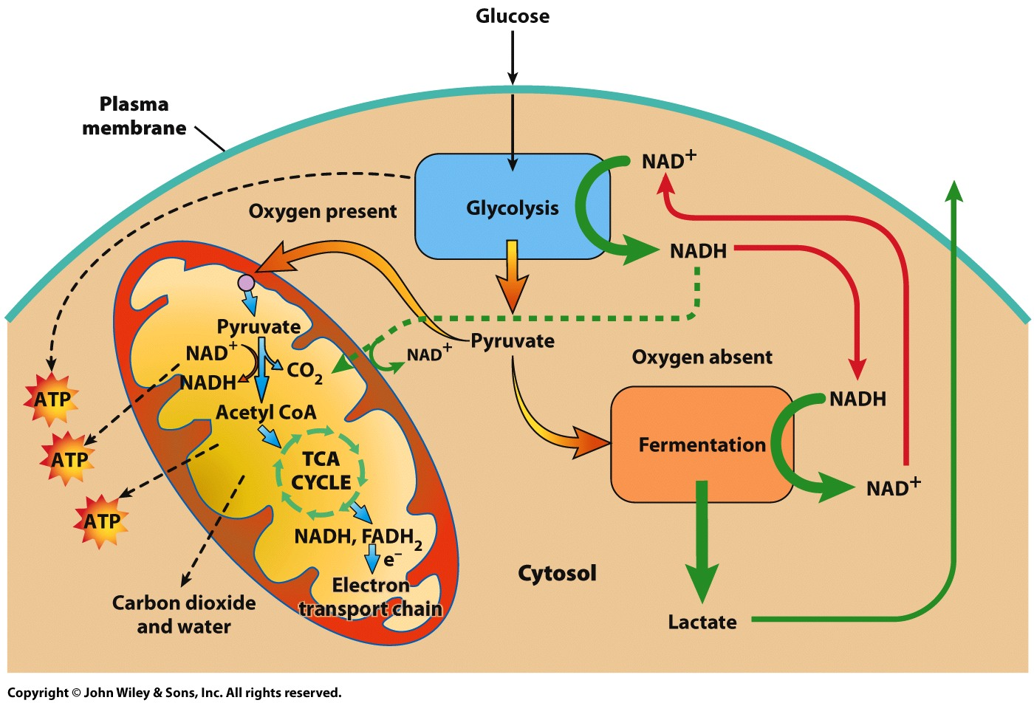
9.1 | Mitochondrial Structure and Function
Mitochondrial Matrix
Coupling cytosolic glycolysis and pyruvate production to the mitochondrial TCA cycle and ATP formation
Notes:
Figure 9.5
An overview of carbohydrate metabolism in eukaryotic cells. The reactions of glycolysis generate pyruvate and NADH in the cytosol. In the absence of O₂, the pyruvate is reduced by NADH to lactate (or another product of fermentation, such as ethanol in yeast). The NAD+ formed in the reaction is reutilized in the continuation of glycolysis. In the presence of O₂, the pyruvate moves into the matrix (facilitated by a membrane transporter), where it is decarboxylated and linked to coenzyme A (CoA), a reaction that generates NADH. The NADH produced during glycolysis donates its high-energy electrons to a compound that crosses the inner mitochondrial membrane. The acetyl CoA passes through the TCA cycle, which generates NADH and FADH₂. The electrons in these various NADH and FADH₂ molecules are passed along the electron-transport chain, which is made up of carriers that are embedded in the inner mitochondrial membrane, to molecular oxygen (O₂). The energy released during electron transport is used in the formation of ATP. If all of the energy from electron transport were to be utilized in ATP formation, approximately 36 ATPs could be generated from a single molecule of glucose.

Slide 13
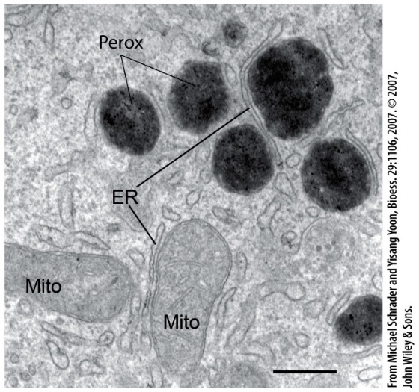
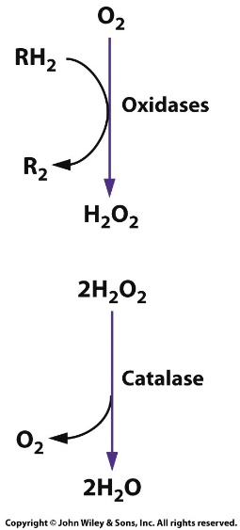
9.9 | Peroxisomes
Peroxisomes are membrane-bound vesicles that contain oxidative enzymes.
They oxidize very-long-chain fatty acids, and synthesize plasmalogens (a class of phospholipids).
They form by splitting from pre-existing organelles, import preformed proteins, and engage in oxidative metabolism.
Hydrogen peroxide (H₂O₂), a reactive and toxic compound, is formed in peroxisomes and is broken down by the enzyme catalase.
Electron micrograph of a rat liver cell section stained for catalase
Peroxisomes contain enzymes to carry out the two-step reduction of molecular oxygen to water
Notes:
Figure 9.31a, b
The structure and function of peroxisomes. (A) Electron micrograph of a section of a rat liver cell, which had been stained for catalase, an enzyme localized in peroxisomes. Note the close association between the darkly stained peroxisomes and mitochondria. An electron micrograph of a peroxisome within a plant cell is shown in Figure 6.23. Bar equals 250 nm. (B) Peroxisomes contain enzymes that carry out the two-step reduction of molecular oxygen to water. In the first step, an oxidase removes electrons from a variety of substrates (RH₂), such as uric acid or amino acids. In the second step, the enzyme catalase converts the hydrogen peroxide formed in the first step to water.
Peroxisome : 에서 일어나는 대표적인 반응은 hydrogen peroxide 을 H2O 로 전환시켜주는 반응임.
Free radical 을 제거하는 기능
Reactive Oxygen Species (ROS) : oxygen free radical 은 전자전달계 반응에서 어쩔 수 없이 형성됨 (반응성 높아 독성 반응 촉진될 수 있음) → 이를 제거해주는 기능을 하는게 peroxisome

Slide 14
Copyright 2017 John Wiley & Sons, Inc.
All rights reserved. Reproduction or translation of this work beyond that permitted in section 117 of the 1976 United States Copyright Act without express permission of the copyright owner is unlawful. Request for further information should be addressed to the Permissions Department, John Wiley & Sons, Inc. The purchaser may make back-up copies for his/her own use only and not for distribution or resale. The Publisher assumes no responsibility for errors, omissions, or damages caused by the use of these programs or from the use of the information herein.

