Slide 1

CHAPTER 3
Bioenergetics, Enzymes, and Metabolism
Notes:
Painting by Giuseppe Arcimboldo: Rudolf II of Habsburg as Vertumnus.

Slide 2
3.5 | Enzymes as Biological Catalysts
Enzymes are catalysts that speed up chemical reactions.
Enzymes are the mediators of metabolism, responsible for virtually every reaction that occurs in a cell. Without enzymes, metabolic reactions would proceed so slowly as to be imperceptible.
Enzymes are protein catalysts, while ribozymes are RNA catalysts.
Enzymes may be conjugated with non-protein components.
Cofactors are inorganic enzyme conjugates (iron atom of a heme group).
Coenzymes are organic enzyme conjugates (vitamins).

Slide 3
3.5 | Enzymes as Biological Catalysts
The Properties of Enzymes
Are present in cells in small amounts.
Are not permanently altered during the course of a reaction.
Cannot affect the thermodynamics of reactions, only the rates.
Are highly specific for their particular reactants called substrates.
Produce only appropriate metabolic products.
Can be regulated to meet the needs of a cell.

Slide 4
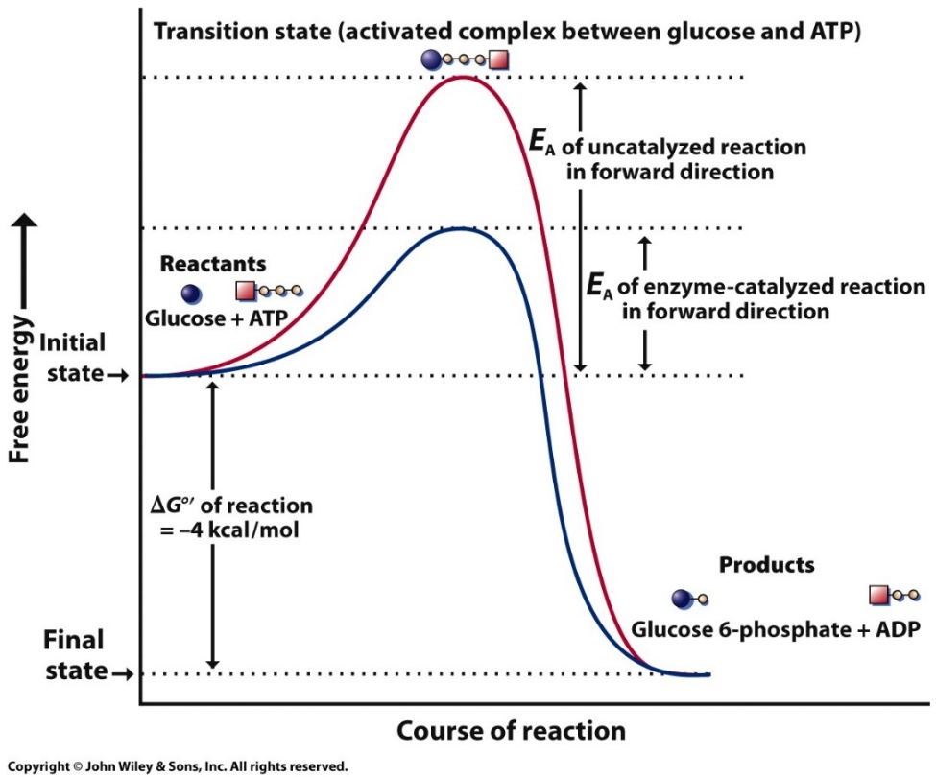
3.5 | Enzymes as Biological Catalysts
Overcoming the Activation Energy Barrier
A small energy input, the activation energy (E_{A}) is required for any chemical transformation.
The E_{A} barrier slows the progress of thermodynamically unstable reactants.
Reactant molecules that reach the peak of the EA barrier are in the transition state.
Without an enzyme, only a few substrate molecules reach the transition state.
Activation energy and enzymatic reactions.
Notes:
Figure 3.8
Activation energy and enzymatic reactions. Even though the formation of glucose 6-phosphate is a thermodynamically favored reaction (G =- 4 kcal/mol), the reactants must possess sufficient energy to achieve an activated state in which the atomic rearrangements necessary for the reaction can occur. The amount of energy required is called the activation energy (E_{A}) and is represented by the height of the curve. The activation energy is not a fixed value, but varies with the particular reaction pathway. E_{A} is greatly reduced when the reactants combine with an enzyme catalyst. (This diagram depicts a simple, one-step reaction mechanism. Many enzymatic reactions take place in two or more steps leading to the formation of intermediates (as in Figure 3.12). Each step in the reaction has a distinct E_{A} and a separate transition state.)

Slide 5
3.5 | Enzymes as Biological Catalysts
The Active Site
An enzyme interacts with its substrate to form an enzyme-substrate (ES) complex.
The substrate binds to a portion of the enzyme called the active site.
The active site and the substrate have complementary shapes that allow substrate specificity.
Formation of an enzyme–substrate complex:
pyruvate kinase, PEP, and ATP
Notes:
Figure 3.10
Formation of an enzyme–substrate complex. Schematic drawing of the reaction catalyzed by pyruvate kinase (see Figure 3.24) in which the two substrates, phosphoenolpyruvate (PEP) and ADP, bind to the enzyme to form an enzyme–substrate (ES) complex, which leads to the formation of the products, pyruvate and ATP.

Slide 6
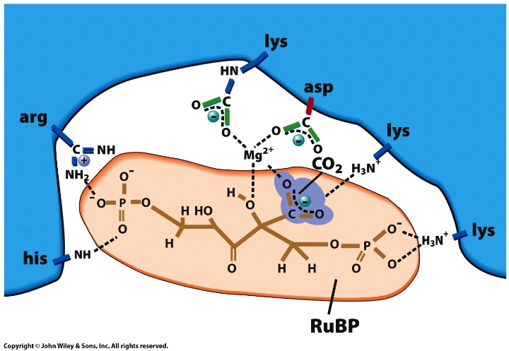
3.5 | Enzymes as Biological Catalysts
The Active Site
The binding of substrate to enzyme is accomplished by noncovalent interactions (e.g. ionic bonds, hydrogen bonds, hydrophobic interactions)
The active site also contains a particular array of amino acid side chains that influence the substrate and lower the activation energy of the reaction.
The importance of individual side chains of the active site can be evaluated by site-directed mutagenesis to change the amino acids at the active site.
Ribulose bisphosphate carboxylase active site interactions
Notes:
Figure 3.11a, b
The active site of an enzyme. (a) Diagrammatic representation of the active site of the enzyme ribulose bisphosphate carboxylase oxygenase showing the various sites of interaction between the bound substrates (RuBP and CO2) and certain amino acid side chains of the enzyme. In addition to determining the substrate‐binding properties of the active site, these noncovalent interactions alter the properties of the substrate in ways that accelerate its conversion to products. (b) An electron density map of the active site of a blood clotting enzyme called Factor Xa with a chemical inhibitor that mimics the substrate, prothrombin, shown superimposed (red). The gray surface provides an indication of the outer reaches of the electron orbitals of the atoms that make up the side chains of the enzyme, thus portraying a visual representation of the space occupied by the atoms of the active site. It can be clearly seen that the substrate binds in a deep cleft in the protein, typical of active sites. The active site serine, Ser195, is shown in blue. Protein regions important for determining which molecules can bind as substrates, known as S1 and S2, are made up of multiple side chains and are indicated in yellow and green.
SOURCE: (a) D. A. Harris, Bioenergetics at a Glance, P. 88, Blackwell, 1995; (b) From Yeh CH, Fredenburgh JC, Weitz JI. 2012. Oral direct factor Xa inhibitors. Circulation Research 111, 1069–1078.

Slide 7
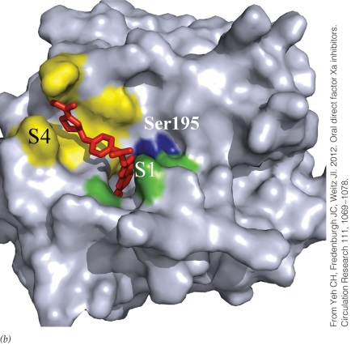
3.5 | Enzymes as Biological Catalysts
The Active Site
The active site is typically buried in a cleft that leads from the aqueous surroundings into a hydrophobic environment.
The reactivity of the active-site side chains may be much greater here compared to the cell’s aqueous solvent.
The amino acids of the active site are usually distant along the polypeptide chain, but close in the tertiary structure.
The structure of the active site accounts for the catalytic activity and specificity of the enzyme.
Electron density map of the active site of a blood clotting enzyme Factor Xa
Notes:
Figure 3.11a, b
The active site of an enzyme. (a) Diagrammatic representation of the active site of the enzyme ribulose bisphosphate carboxylase oxygenase showing the various sites of interaction between the bound substrates (RuBP and CO2) and certain amino acid side chains of the enzyme. In addition to determining the substrate‐binding properties of the active site, these noncovalent interactions alter the properties of the substrate in ways that accelerate its conversion to products. (b) An electron density map of the active site of a blood clotting enzyme called Factor Xa with a chemical inhibitor that mimics the substrate, prothrombin, shown superimposed (red). The gray surface provides an indication of the outer reaches of the electron orbitals of the atoms that make up the side chains of the enzyme, thus portraying a visual representation of the space occupied by the atoms of the active site. It can be clearly seen that the substrate binds in a deep cleft in the protein, typical of active sites. The active site serine, Ser195, is shown in blue. Protein regions important for determining which molecules can bind as substrates, known as S1 and S2, are made up of multiple side chains and are indicated in yellow and green.
SOURCE: (a) D. A. Harris, Bioenergetics at a Glance, P. 88, Blackwell, 1995; (b) From Yeh CH, Fredenburgh JC, Weitz JI. 2012. Oral direct factor Xa inhibitors. Circulation Research 111, 1069–1078.

Slide 8
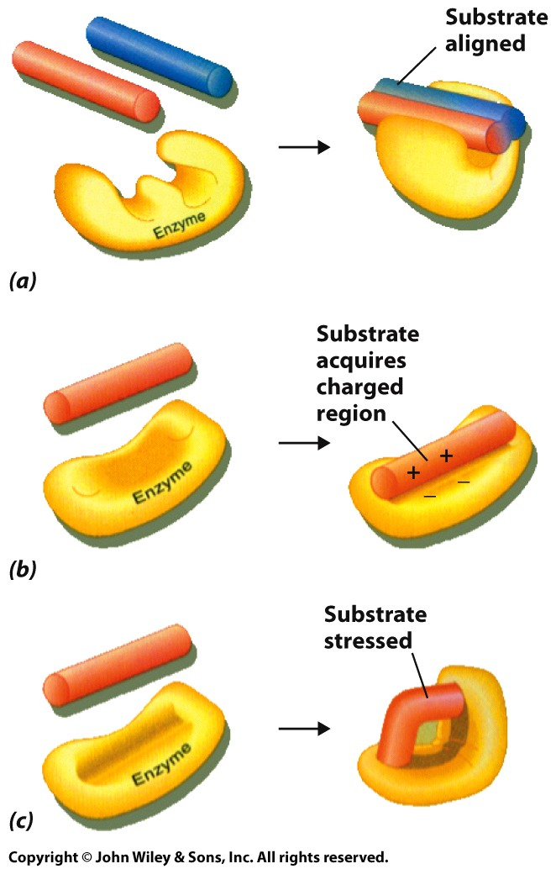
3.6 | Mechanisms of Enzyme Catalysis
Substrate Orientation
During the formation of the enzyme-substrate complex, the physical and chemical properties of the substrate can be altered in different ways.
Substrate Orientation: Multiple substrates brought together in correct orientation to catalyze reaction.
Changing Substrate Reactivity: Substrate influenced by amino acid side chains at active site that alters its chemical properties (e.g., charge).
Inducing Strain in the Substrate: Enzyme changes conformation of substrate to bring closer to conformation of transition state.
Enzyme mechanisms to accelerate reactions
Notes:
Figure 3.12a-c
Three mechanisms by which enzymes accelerate reactions: (A) maintaining precise substrate orientation, (B) changing substrate reactivity by altering its electrostatic configuration, (C) exerting physical stress on bonds in the substrate to be broken.

Slide 9
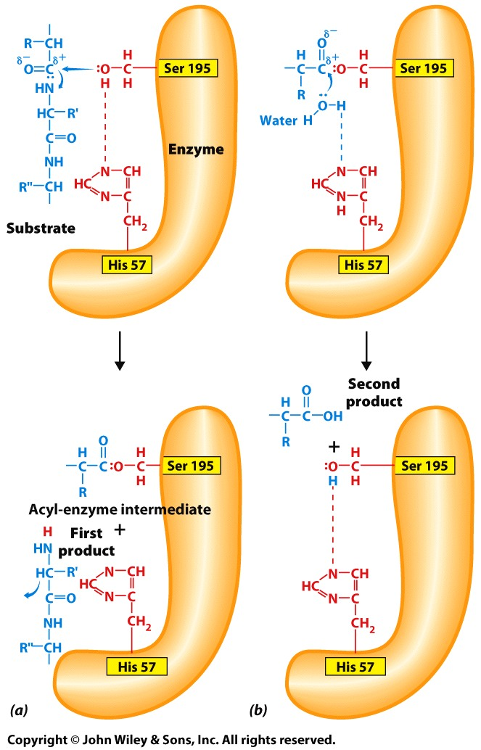
3.6 | Mechanisms of Enzyme Catalysis
Changing Substrate Reactivity
Changes in the reactivity of the substrate temporarily stabilize the transition state.
Acidic or basic R groups on the enzyme may change the charge of the substrate.
Charged R groups may attract the substrate.
Cofactors of the enzyme increase the reactivity of the substrate by removing or donating electrons.
Diagrammatic representation of the catalytic mechanism of chymotrypsin.
Notes:
Figure 3.13a, b
Diagrammatic representation of the catalytic mechanism of chymotrypsin. The reaction is divided into two steps. (A) The electronegative oxygen atom of a serine residue (Ser 195) in the enzyme, which carries a partial negative charge, carries out a nucleophilic attack on the carbonyl carbon atom of the substrate, which carries a partial positive charge, splitting the peptide bond. The polypeptide substrate is shown in blue. The serine is made more reactive by a closely applied histidine residue (His 57) that draws the proton from the serine and subsequently donates the proton to the nitrogen atom of the cleaved peptide bond. Histidine is able to do this because its side chain is a weak base that is capable of gaining and losing a proton at physiologic pH. (A stronger base, such as lysine, would remain fully protonated at this pH.) Part of the substrate forms a transient covalent bond with the enzyme by means of the serine side chain, while the remainder of the substrate is released. (It can be noted that the serine and histidine residues are situated 138 amino acids away from each other in the primary sequence but are brought together within the enzyme by the folding of the polypeptide. An aspartic acid, residue 102, which is not shown, also plays a role in catalysis by influencing the ionic state of the histidine.) (B) In the second step, the electronegative oxygen atom of a water molecule displaces the covalently linked substrate from the enzyme, regenerating the unbound enzyme molecule. As in the first step, the histidine plays a role in proton transfer; in this step, the proton is removed from water, making it a much stronger nucleophile. The proton is subsequently donated to the serine residue of the enzyme.

Slide 10
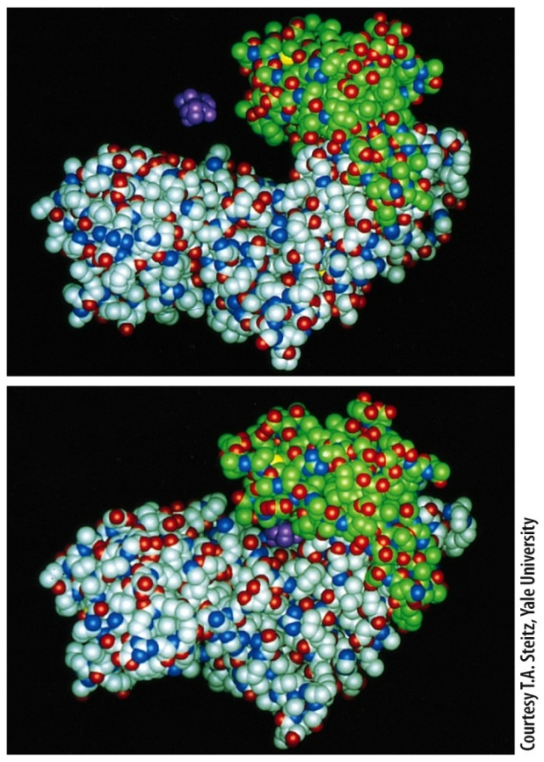
3.6 | Mechanisms of Enzyme Catalysis
Inducing Strain in the Substrate
Although the active site of an enzyme may be complementary to its substrate, a conformation shift of atoms in the enzyme can occur so that the fit is improved (induced fit).
As these conformational changes occur, mechanical work is performed, allowing the enzyme to exert a physical force on certain bonds within a substrate molecule.
This has the effect of destabilizing the substrate, causing it to adopt the transition state in which the strain is relieved.
Conformational change of hexokinase when a glucose molecule binds
Notes:
Figure 3.14a, b
An example of induced fit. When a glucose molecule binds to the enzyme hexokinase, the protein undergoes a conformational change that encloses the substrate within the active site pocket and aligns the reactive groups of the enzyme and substrate.

Slide 11
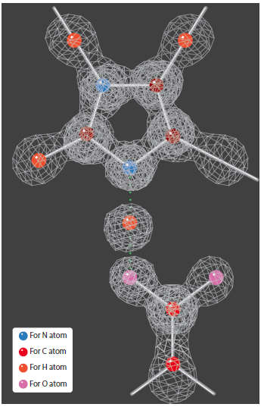
3.6 | Mechanisms of Enzyme Catalysis
Inducing Strain in the Substrate
Various changes in atomic and electronic structure occur in both the enzyme and substrate during a reaction.
The use of X-ray crystallography gives a more static snapshot of 3D structure.
Using time-resolved crystallography, researchers can determine the 3D structure of an enzyme at successive stages during a reaction.
Electron density map of a single hydrogen bond
Notes:
Figure 3.15
Electron density map of a single hydrogen bond (green dotted line). This map shows a very small part of the proteolytic enzyme subtilisin at atomic (0.78 Å) resolution. The hydrogen atom (yellow) is seen to be shared between a nitrogen atom on the ring of a histidine residue and an oxygen atom of an aspartic acid residue.

Slide 12
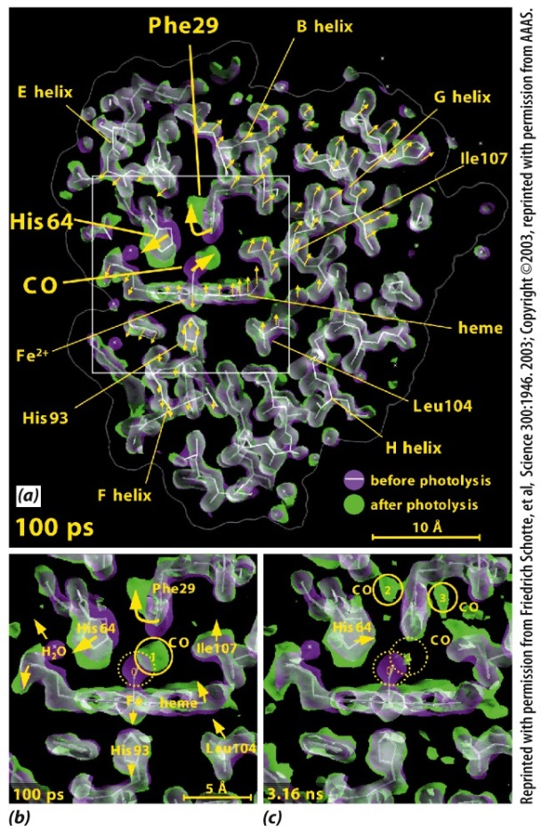
3.6 | Mechanisms of Enzyme Catalysis
Inducing Strain in the Substrate
Individual “snapshots” are put together in sequence to produce a “movie” showing the various catalytic intermediates that appear and disappear in the reaction.
Proteins, even in the absence of substrates, are capable of many of the same movements detected during the protein’s catalytic cycle.
Rather than inducing a specific conformational change, the substrate might simply be “waiting” for
a protein to assume a conformation to which it can bind effectively.
Myoglobin: structure by time resolved X-ray crystallography.
Notes:
Figure 3.16a-c
Myoglobin: the movie. In this example of timeresolved X-ray crystallography, the structure of myoglobin (Mb) was determined with a molecule of CO bound to the heme group and at various times after the CO molecule was released. (CO binds to the same site on Mb as O2 but is better suited for these types of studies.) Release of CO was induced simultaneously throughout the crystal by exposure to a flash of laser light (photolysis). Each of the structures was determined following a single, intense X-ray pulse from a synchrotron. The myoglobin molecule being studied had a single amino acid substitution that made it a better subject for analysis. (A) A 6.5 Å-thick slice through a Mb molecule showing the changes that occur by 100 picoseconds (1 ps one-trillionth of a second) following the release of CO from its binding site. The structure of Mb prior to the laser flash is shown in magenta, and the structure of the protein 100 ps after the laser flash is shown in green. Those parts of the molecule that did not change in structure over this time period appear white. Three large-scale displacements near the CO-binding site can be seen (indicated by the yellow arrows). (B) An enlarged view of the boxed region in part a. The released CO (solid circle) is situated about 2 Å from its original binding site (dashed circle). Movement of CO is accommodated by the rotation of Phe29, which pushes His64 outward, which in turn dislodges a bound water molecule. (C) By 3.16 nanoseconds after the laser flash, the CO molecule has migrated to either of the two positions shown (labeled 2 and 3), Phe29 and His64 have relaxed toward their initial states, and the heme group has undergone considerable displacement as indicated by the increased amount of green shading in the region of the heme.

Slide 13
3.11 | Metabolic Regulation
Altering Enzyme Activity by Covalent Modification
Cellular activity is regulated as needed.
Regulation may involve controlling key enzymes of metabolic pathways.
Enzymes are controlled by alteration in active sites.
Covalent modification of enzymes regulated by phosphorylation such as protein kinases.
Two different types of protein kinases: One type adds phosphate groups to specific tyrosine residues in a substrate protein; the other type adds phosphates to specific serine or threonine residues in the substrate.
The importance of protein kinases is reflected in the fact that approximately 2 percent of all the genes of a yeast cell encode members of this class of enzymes.
Notes:
*kinase : protein을 phosphorylation 하는 enzyme
기질 단백질에 있는 특정 tyrosine(aa 중 하나) residue에 phosphate group 추가
기질 단백질에 있는 특정 serine || threonine residue에 phosphate group 추가
Histone 단백질 : basic protein (평소 pH7에서 + charge 를 갖는 protein)
DNA: 평소 pH7 환경에서 – charge를 갖는 molecule
But 둘이 떨어져야 하는 경우가 있어야함 -> 그래야 적절한 enzyme 이 DNA와 Interaction 가능
https://en.wikipedia.org/wiki/Histone_acetylation_and_deacetylation
★★★★★histone acetylation and deacetylation★★★★★
---How?---
Histone ( 라이신, 아르지닌이 가진 R기의 positive charge 때문에 histone이 +charge를 가지고 있었지 이게 없어져야 함.)
…Acetylation이 중요한 역할을 한다 (Lysine에 acetyl group이 붙으면 neutralization 된다.)
Acetic acid 의 carboxylic group 과 lysine의 amine group이 탈수 축합반응 -> amide 가 형성되면서 histone 단백질의 lysine의 amine group에 있던 nh3+ +charge가 없어지지.
By Histone acetylase (HAT)
반대 반응
Histone deacetylation
By Histone deacetylase (HDAC)
-----

Slide 14
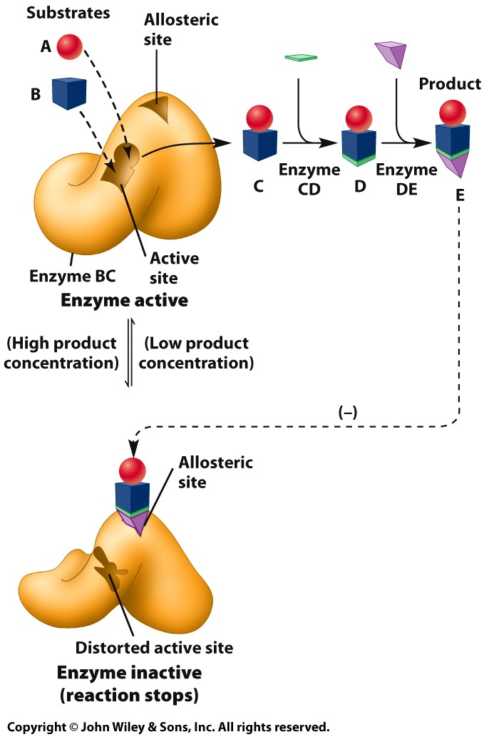
3.11 | Metabolic Regulation
Altering Enzyme Activity by Allosteric Modulation
Allosteric modulation is a mechanism whereby the activity of an enzyme is either inhibited or stimulated by a compound that binds to a site, called the allosteric site, that is spatially distinct from the enzyme’s active site.
Very small changes in the structure of the enzyme induced by the allosteric modulator can cause marked changes in enzyme activity.
Feedback inhibition
Notes:
Figure 3.30
Feedback inhibition. The flow of metabolites through a metabolic pathway stops when the first enzyme of the pathway (enzyme BC) is inhibited by the end product of that pathway (compound E), which binds to an allosteric site on the enzyme. Feedback inhibition prevents a cell from wasting resources by continuing to produce compounds that are no longer required.
★★★★★ubiquitination★★★★★
Ubiquitin: 다른 단백질에 결합해 단백질의 분해를 촉진하는 단백질 (76개 아미노산으로 이뤄진 작은 단백질)
아미노산 1개 분자량을 대충 110 ~ 120Da정도로 많이 본다 (76*120)
이 Ubiquitin 단백질은 다른 protein과 interaction 하는데 비공유결합을 하는게 아니라 어떤 특정 site에 가서 공유결합을 한다. (* allosteric site: 다른 자리 <-> active site: 활성 자리)
3단계에 걸쳐 일어 남. ( https://www.creative-proteomics.com/services/ubiquitination.htm )
E1 E2 E3 protein이 순차적으로 관여. (이미 결합된 ubiquitin에 다른 ubiquitin이 또 가서 공유결합을 하더라.. 그래서 그걸 저렇게 순차적으로 이름 붙임)
Energy 사용.

Slide 15
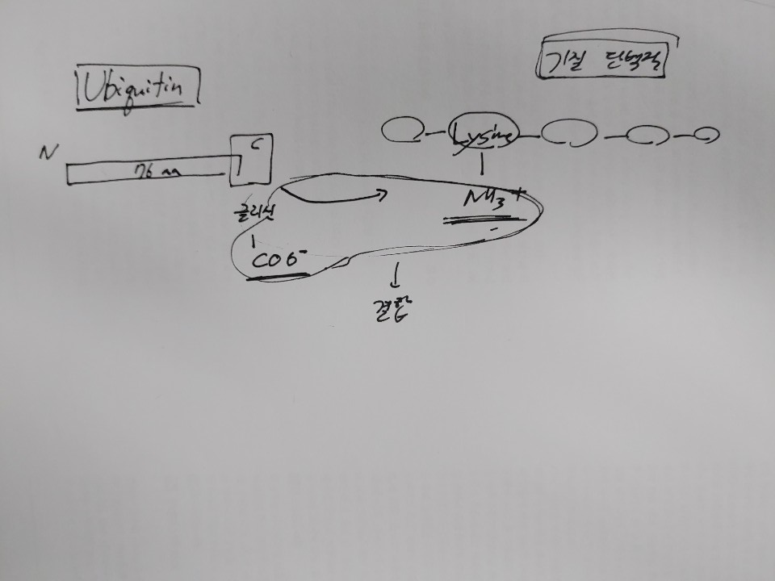
Notes:
Glycine
2번 ubiquitin
1번 ubiquitin (E1) 중간에 있는 특정 lysine의 amine group과
2번 ubiquitin (E2) C terminal의 carboxylic group과 결합
-> 이런 식으로 여러 개의 ubiquitination 이 일어나면
Polyubiquitination 이라고 한다 (di- tri- tetra-…)
K-48 ubiquitination : k (20개의 aa의 약자를 알파벳 대문자로 표현할 때 lysine은 k라고 표시) -> ubiquitin 의 48번째 아미노산 = Lysine.
K-63 ubiquitination : 마찬가지로 ubiquitin 의 63번째 아미노산이 Lysine이고 이 ubiquitin 이 ubiquitination 일으키면 이걸..
Linear ubiquitination : 말 뜻 그대로 ubiquitin 이 쭉 연결되어 있는데 linear하게 연결되어 있는 경우. (E1의 “N-terminal” 과 E2의 C-terminal 이 공유결합.. E3 E2도 마찬가지)
= peptide 결합을 한 모양을 이룬다..
* 다른건 E1의 N-terminal 이 아닌 중간에 있는 lysin과 E2의 C-terminal과 결합하는 거짆아 ( k-48은 48th Lysine / k-63은 63rd Lysine ) => not linear
-> 어떤 protein 이 polyubiquitination 이 일어났는데 이게 k-48 ubiquitination이면 단백질 분해 반응을 일으킴 (with proteasome)
-> k-63 ubiquitination 이면 세포내 (signaling) 신호 전달에 관여함. (target protein의 activity를 조절함. )
-> Linear ubiquitination 이면.. Linear ubiquitin chains are crucial modulators of innate and adaptive immune responses, and act by regulating inflammatory and cell death signalling.
=>이렇게 4개의 ubiquitin이 결합한 polyubiquitin 이 기질에 붙을 때만 기질의 protein 의존적 분해가 일어난다.

Slide 16
3.11 | Metabolic Regulation
Altering Enzyme Activity by Allosteric Modulation
Cells do not waste energy and materials making compounds that are not utilized.
Cells shut down anabolic assembly via a type of allosteric modulation called feedback inhibition.
The enzyme catalyzing the first step in a metabolic pathway is temporarily inactivated when the concentration of the end product of that pathway reaches a certain level.
Feedback inhibition exerts immediate, sensitive control over a cell’s anabolic activity.
Feedback inhibition
Notes:
Figure 3.30
Feedback inhibition. The flow of metabolites through a metabolic pathway stops when the first enzyme of the pathway (enzyme BC) is inhibited by the end product of that pathway (compound E), which binds to an allosteric site on the enzyme. Feedback inhibition prevents a cell from wasting resources by continuing to produce compounds that are no longer required.

Slide 17
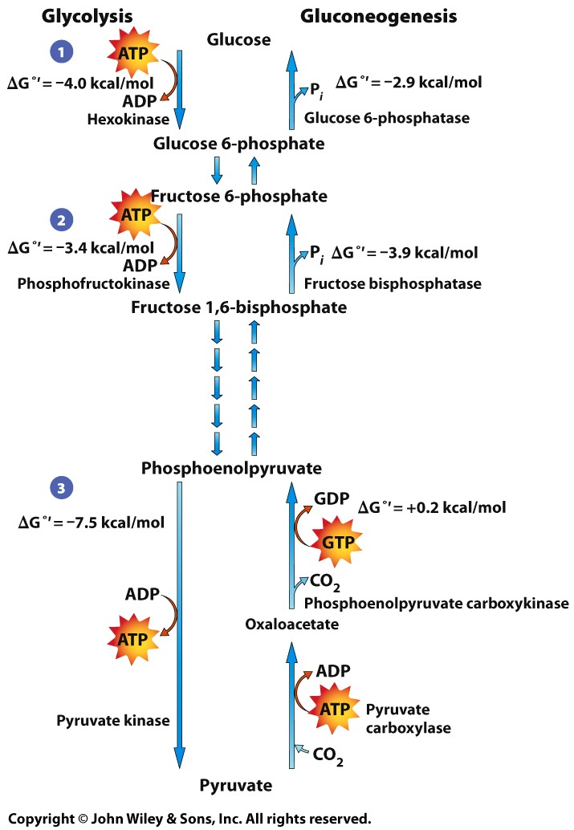
3.12 | Separating Anabolic and Catabolic Pathways
Glycolysis and gluconeogenesis are the catabolic and anabolic pathways of glucose metabolism.
Synthesis of fructose 1,6-bisphosphate is coupled to hydrolysis of ATP.
Breakdown of fructose 1,6-bisphosphate is via hydrolysis by fructose 1,6-bisphosphatase in gluconeogenesis.
Glycolysis versus gluconeogenesis
Notes:
Figure 3.31
Glycolysis versus gluconeogenesis. Whereas most of the reactions are the same in the two pathways, even though they run in opposite directions, the three irreversible reactions of glycolysis (steps 1 to 3 here) are replaced in the gluconeogenic pathway by different, thermodynamically favored reactions.
생체 내 여러 pathway 를 보면 정방향, 역방향이 길이 다르게 진행되는 경우가 많음.
그러면 정방향, 역방향을 더 세밀하게 조절할 수 있다.
Ex. Glucolysis 와 Gluconeogenesis 에서 Phosphoenolpyruvate 와 Pyruvate 가 왔다 갔다 하는 pathway는 서로 다르고 다른 enzyme이 관여함.

Slide 18
3.12 | Separating Anabolic and Catabolic Pathways
Phosphofructokinase is regulated by feedback inhibition with ATP as the allosteric inhibitor.
Fructose 1,6-bisphosphatase is regulated by covalent modification using phosphate binding.
ATP levels are highly regulated.
Glycolysis versus gluconeogenesis
Notes:
Figure 3.31
Glycolysis versus gluconeogenesis. Whereas most of the reactions are the same in the two pathways, even though they run in opposite directions, the three irreversible reactions of glycolysis (steps 1 to 3 here) are replaced in the gluconeogenic pathway by different, thermodynamically favored reactions.

Slide 19
3.12 | Separating Anabolic and Catabolic Pathways
Anabolic pathways do not proceed via the same reactions as the catabolic pathways even though they may have steps in common.
Some catabolic pathways are essentially irreversible due to large ΔGº’ values.
Irreversible steps in catabolic pathways are catalyzed by different enzymes from those in anabolic pathways.
Glycolysis versus gluconeogenesis
Notes:
Figure 3.31
Glycolysis versus gluconeogenesis. Whereas most of the reactions are the same in the two pathways, even though they run in opposite directions, the three irreversible reactions of glycolysis (steps 1 to 3 here) are replaced in the gluconeogenic pathway by different, thermodynamically favored reactions.

