Slide 1
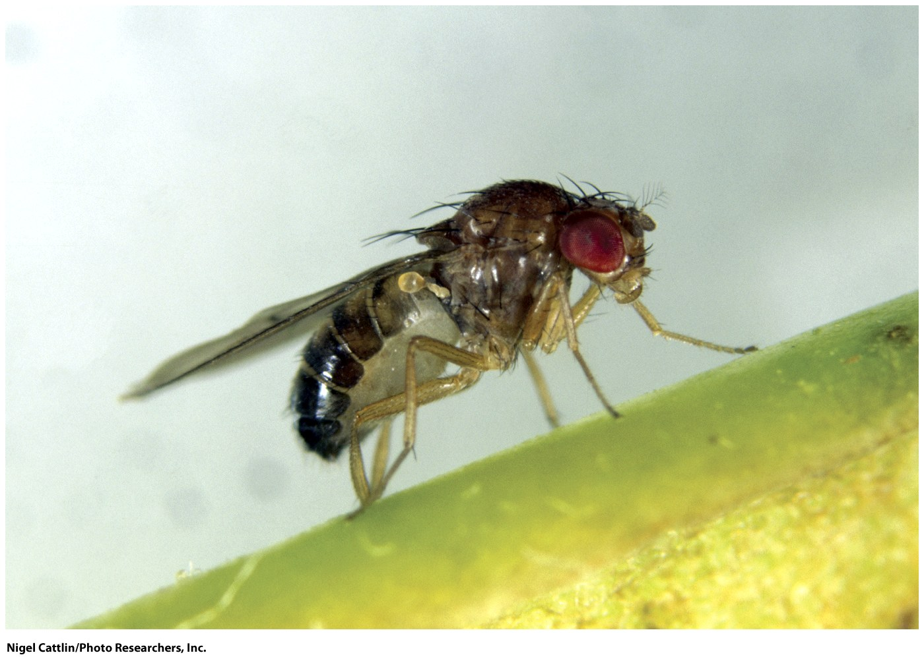
Chapter 5
The Chromosomal Basis of Mendelism
© John Wiley & Sons, Inc.

Slide 2
Chapter Outline
Chromosomes
The Chromosome Theory of Heredity
Sex-Linked Genes in Humans
Sex Chromosomes and Sex Determination
Dosage Compensation of X-Linked Genes
© John Wiley & Sons, Inc.

Slide 3
Chromosomes
Each species has a characteristic set of chromosomes.
© John Wiley & Sons, Inc.

Slide 4
Chromosome Vocabulary
Chromatin
Euchromatin
Heterochromatin
Haploid (n)
Diploid (2n)
Tetraploid (4n)
Octaploid (8n)
© John Wiley & Sons, Inc.

Slide 5
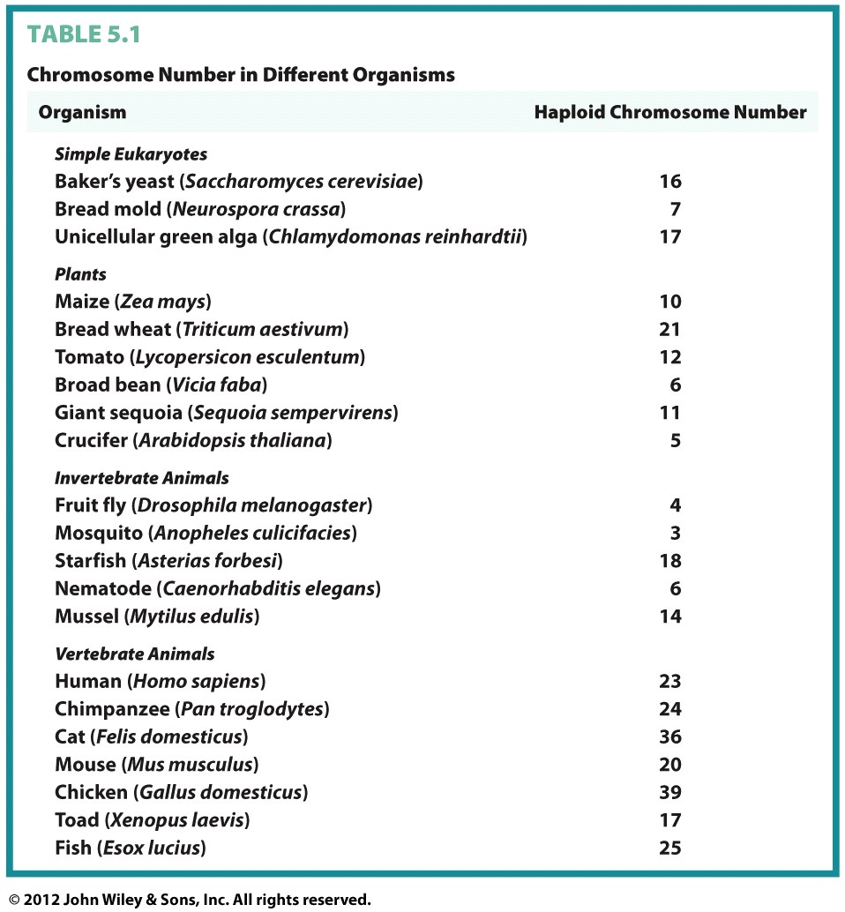
© John Wiley & Sons, Inc.

Slide 6
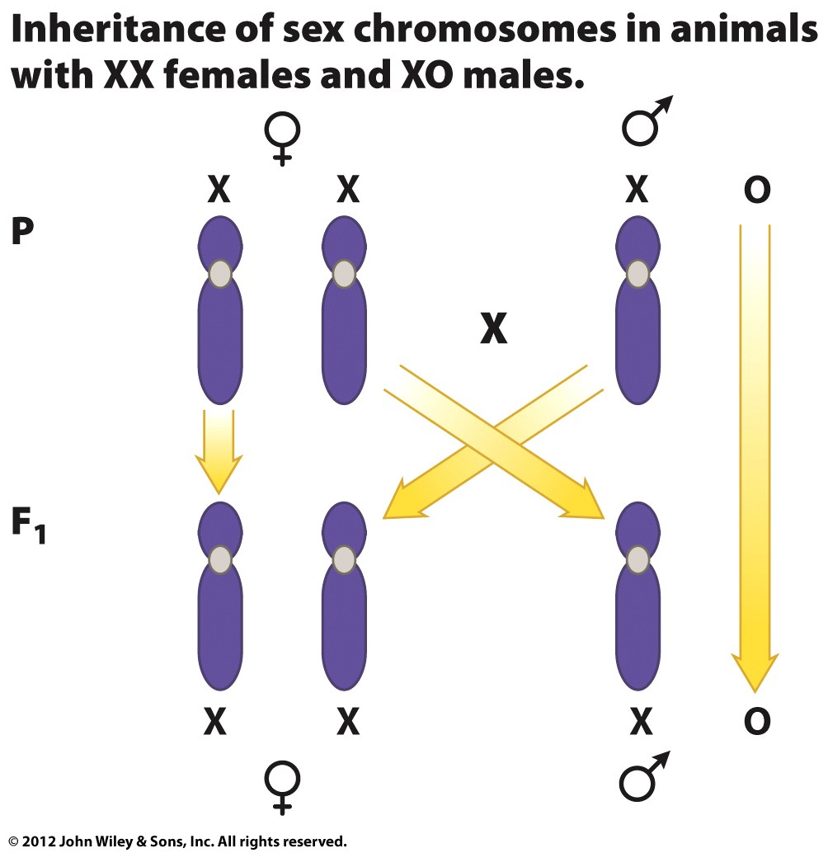
Sex Chromosomes in Grasshoppers
Females are XX
Males are XO
© John Wiley & Sons, Inc.
Notes:
여자 메뚜기는 XX
남자 메뚜기는 XO
로 표기

Slide 7
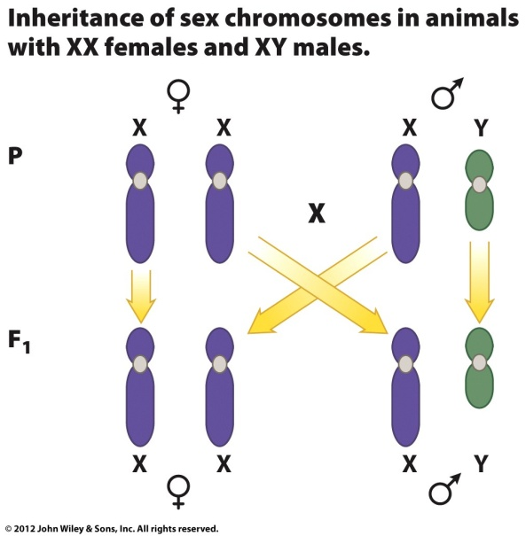
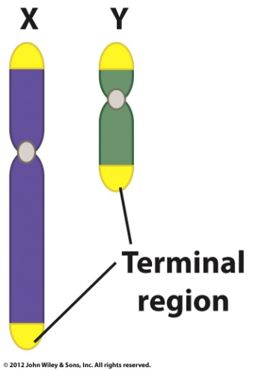
Sex Chromosomes in
Humans
Females are XX
Males are XY
During meiosis in males, the X and Y chromosomes pair
Sex chromosomes
Autosomes
© John Wiley & Sons, Inc.
Notes:
사람의 경우는 XX XY 시스템을 씀

Slide 8

Key Points
Individual chromosomes become visible during cell division; between divisions they form a diffuse network of fibers called chromatin.
Diploid somatic cells have twice as many chromosomes as haploid gametes.
Sex chromosomes are different between the two sexes, whereas autosomes are the same.
© John Wiley & Sons, Inc.
Notes:
멘델의 유전 요소는 거의 chromosome 을 얘기하는 것.

Slide 9
The Chromosome Theory of Heredity
Studies on the inheritance of a sex-linked trait in Drosophila provided the first evidence that the meiotic behavior of chromosomes is the basis for Mendel’s Principles of Segregation and Independent Assortment.
© John Wiley & Sons, Inc.

Slide 10
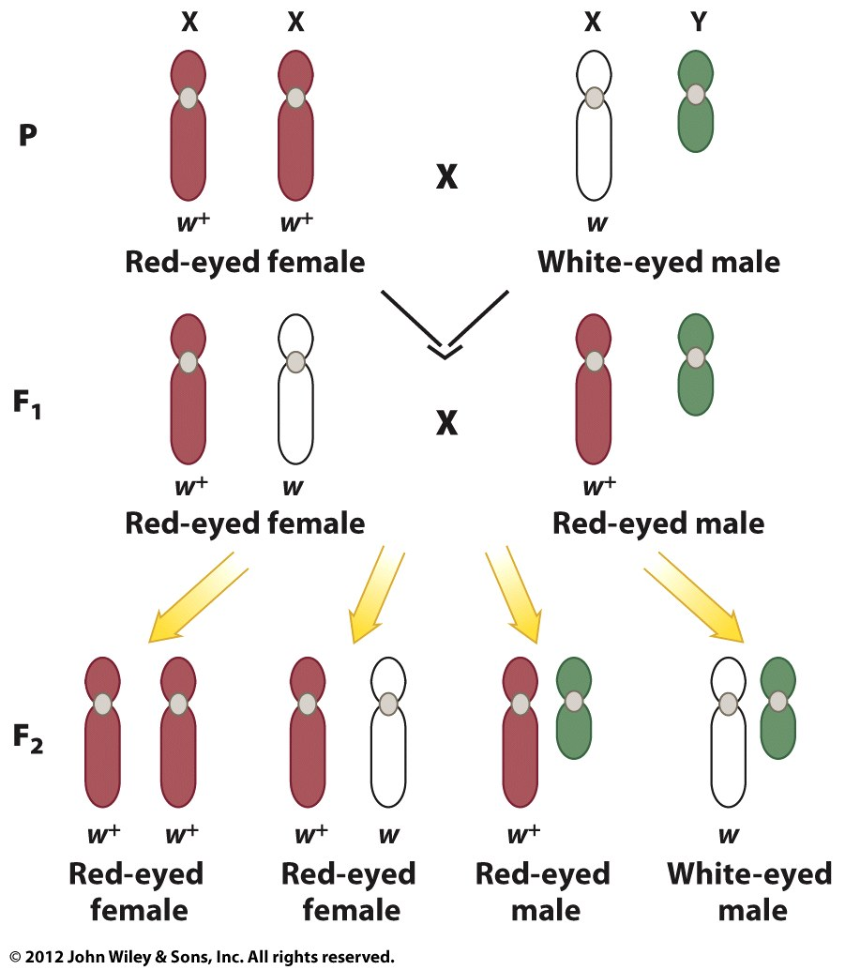
© John Wiley & Sons, Inc.
Notes:
Morgan 의 실험에서
X chromosome 과 눈 색깔 결정하는 유전자가 같이 돌아다닌다는 것을 밝혀냄

Slide 11
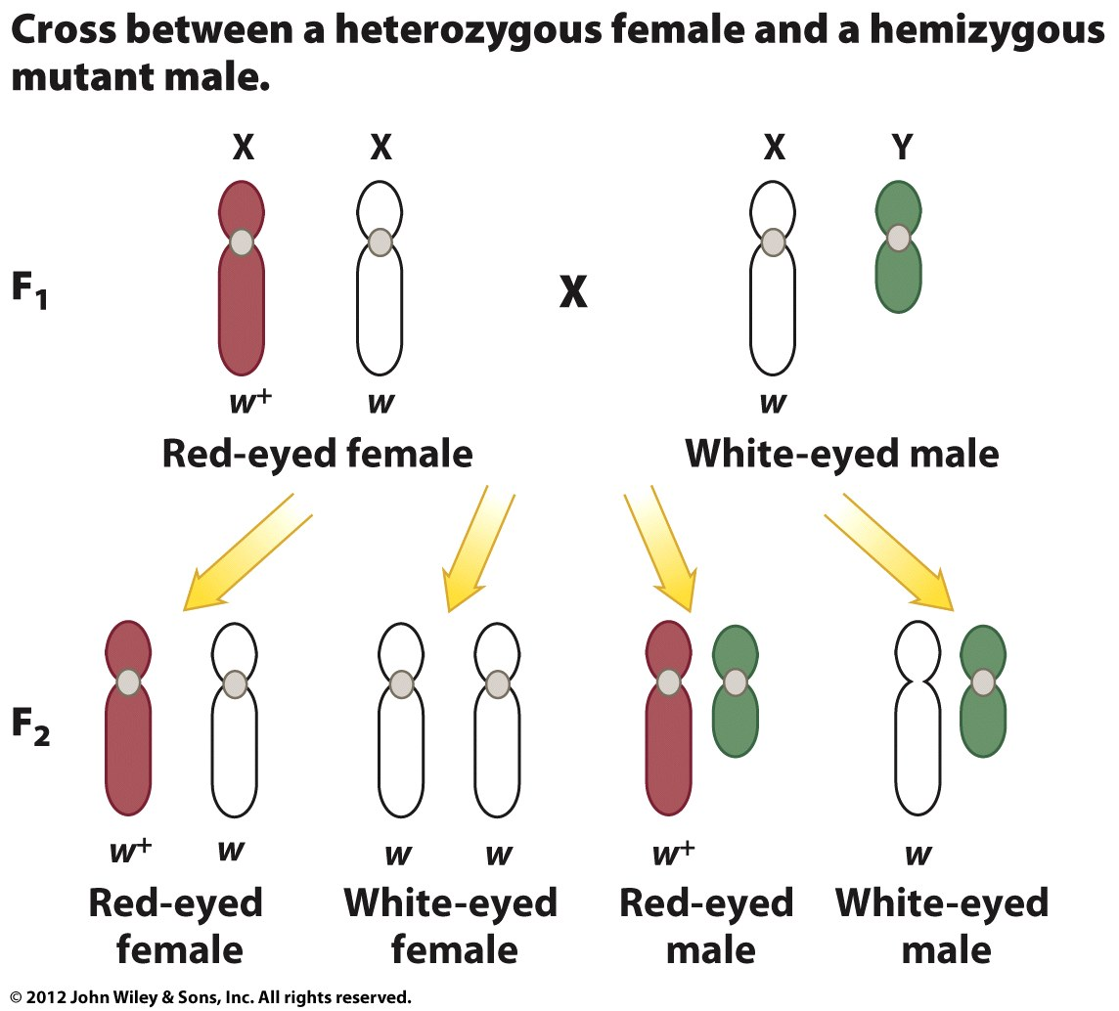
© John Wiley & Sons, Inc.
Notes:
모건 실험의 분리 비는 멘델의 법칙으론 설명이 안됨
그럼 eye color 의 유전 factor 는 어디에?
아마 X chromosome 에 있을 것이다 라고 추측

Slide 12
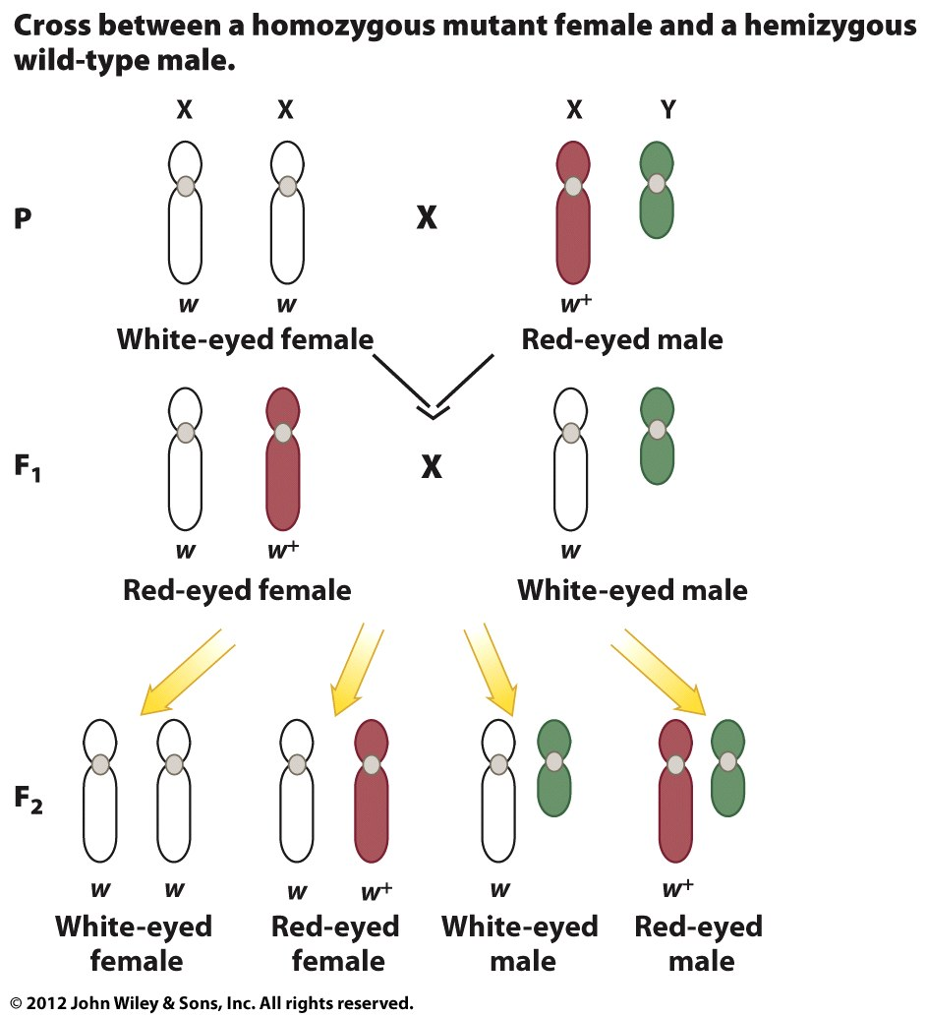
© John Wiley & Sons, Inc.

Slide 13
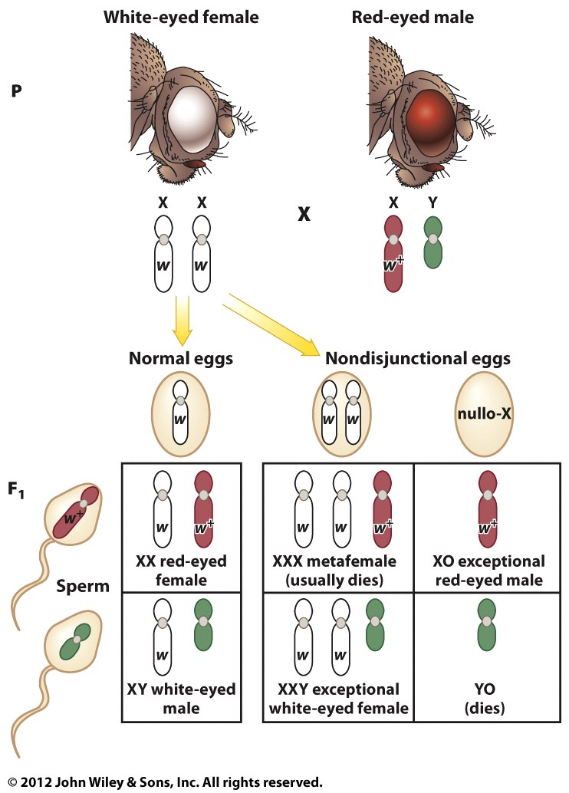
Nondisjunction as Proof of the Chromosome Theory of Heredity
© John Wiley & Sons, Inc.
Notes:
Nondisjunction : 비분리
의 경우 : 보통 죽는다 (XXX)
의 경우 : alive (XO) 수컷 → Red Eye
의 경우 : alive (XXY) 암컷 → White Eye
의 경우 : 죽음 (YO)
사람의 경우 Y 염색체의 유무로 성이 결정되지만
초파리의 경우는 X의 수 : Autosome (상염색체에 有) 의 비율이 성을 결정한다
X : A >= 1 → female
X : A < 0.5 → male

Slide 14
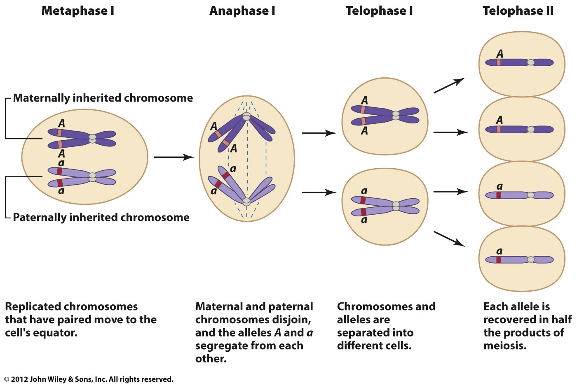
The Principle of Segregation
© John Wiley & Sons, Inc.

Slide 15
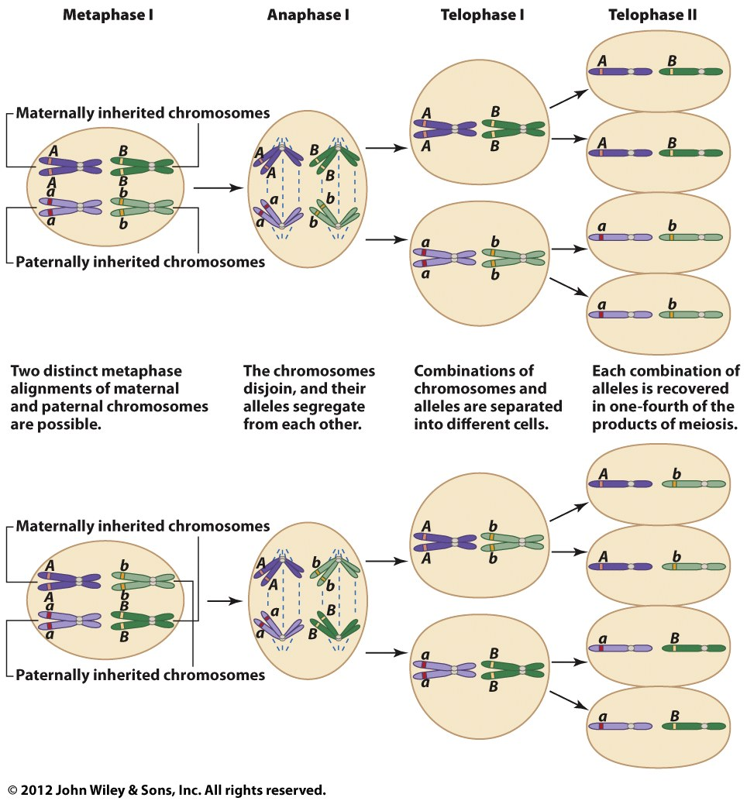
The Principle of Independent Assortment
© John Wiley & Sons, Inc.

Slide 16

Key Points
Genes are located on chromosomes.
The disjunction of chromosomes during meiosis is responsible for the segregation and independent assortment of genes.
Nondisjunction during meiosis leads to abnormal numbers of chromosomes in gametes, and ultimately in zygotes.
© John Wiley & Sons, Inc.

Slide 17
Sex-Linked Genes in
Humans
X- and Y-linked genes have been studied in humans.
© John Wiley & Sons, Inc.

Slide 18
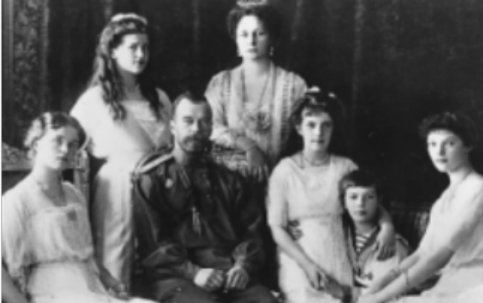
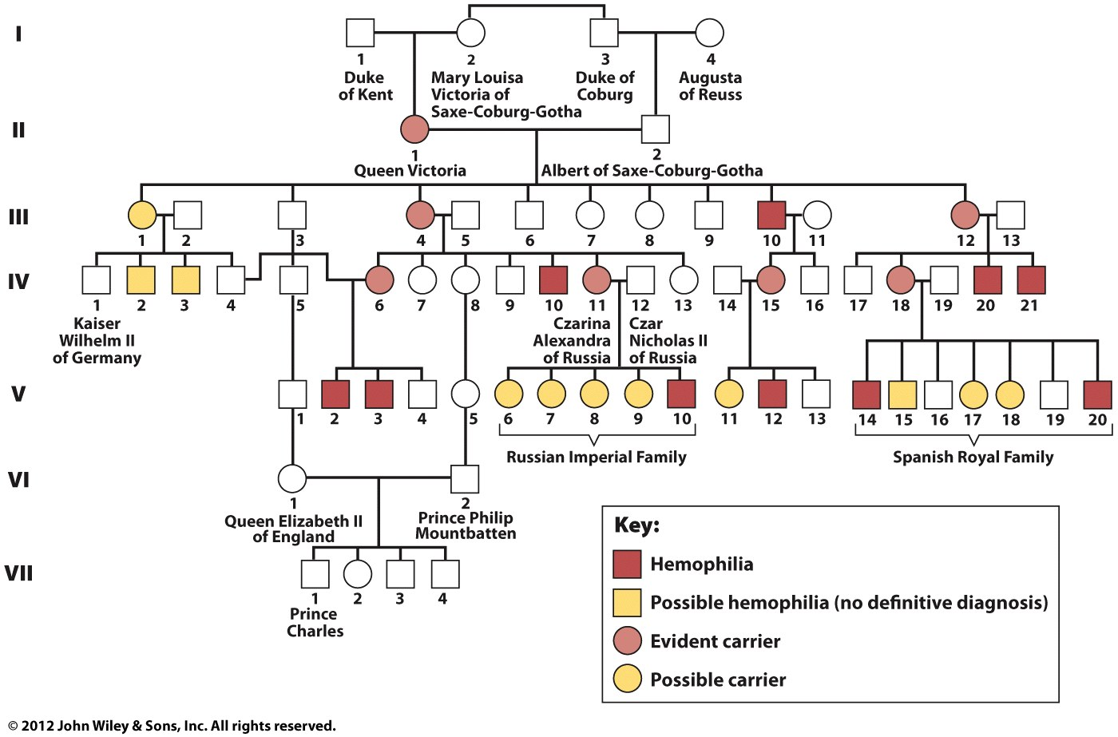
An X-Linked Recessive Disorder: Hemophilia
© John Wiley & Sons, Inc.

Slide 19
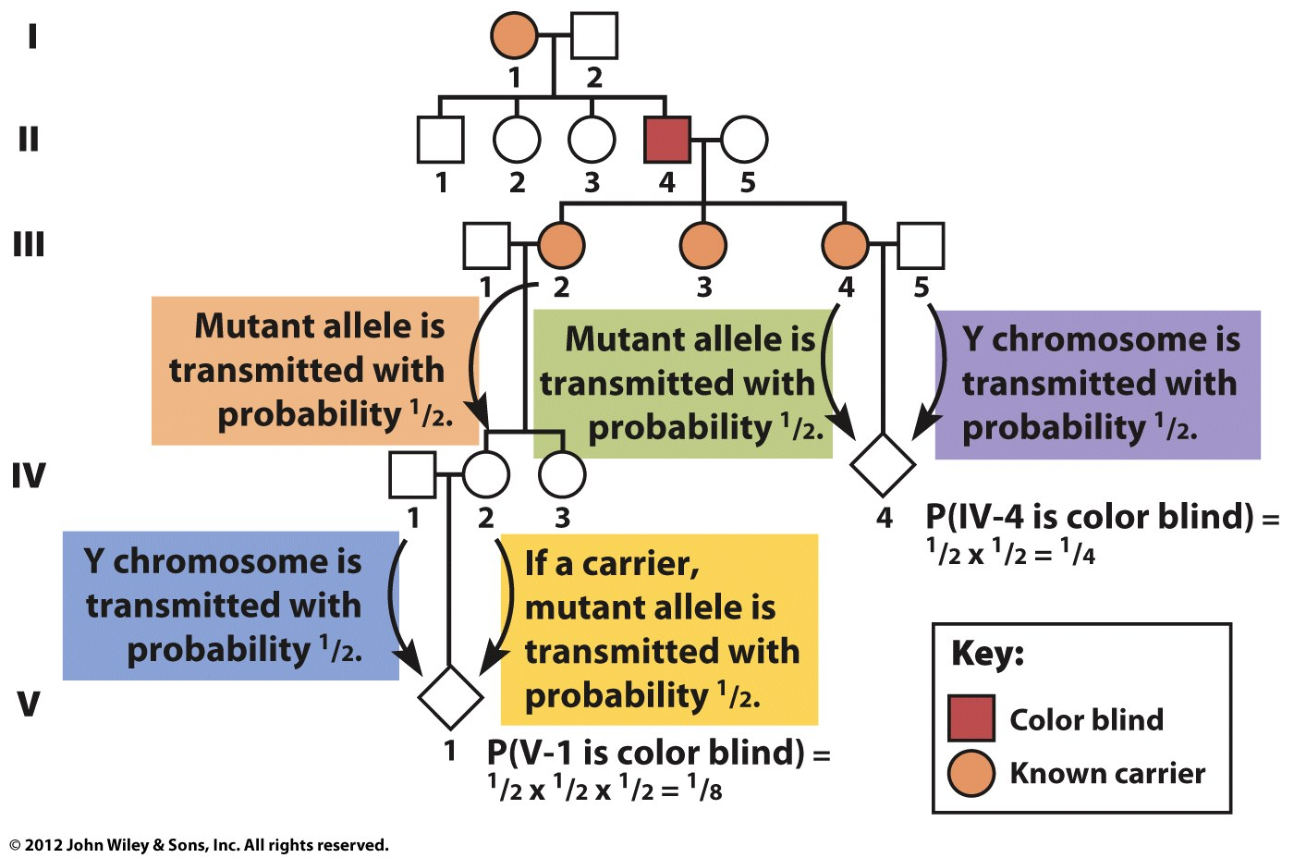
Calculating the Risk of Inheriting an X-Linked Disorder: Colorblindness
© John Wiley & Sons, Inc.

Slide 20
Key Points
Disorders such as hemophilia and color blindness, which are caused by recessive X-linked mutations, are more common in males than in females.
In humans the Y chromosome carries fewer genes than the X chromosome.
In humans pseudoautosomal genes are located on both the X and Y chromosomes.
© John Wiley & Sons, Inc.

Slide 21
Sex Chromosomes and
Sex Determination
In some organisms, chromosomes—in particular, the sex chromosomes—determine male and female phenotypes.
© John Wiley & Sons, Inc.

Slide 22
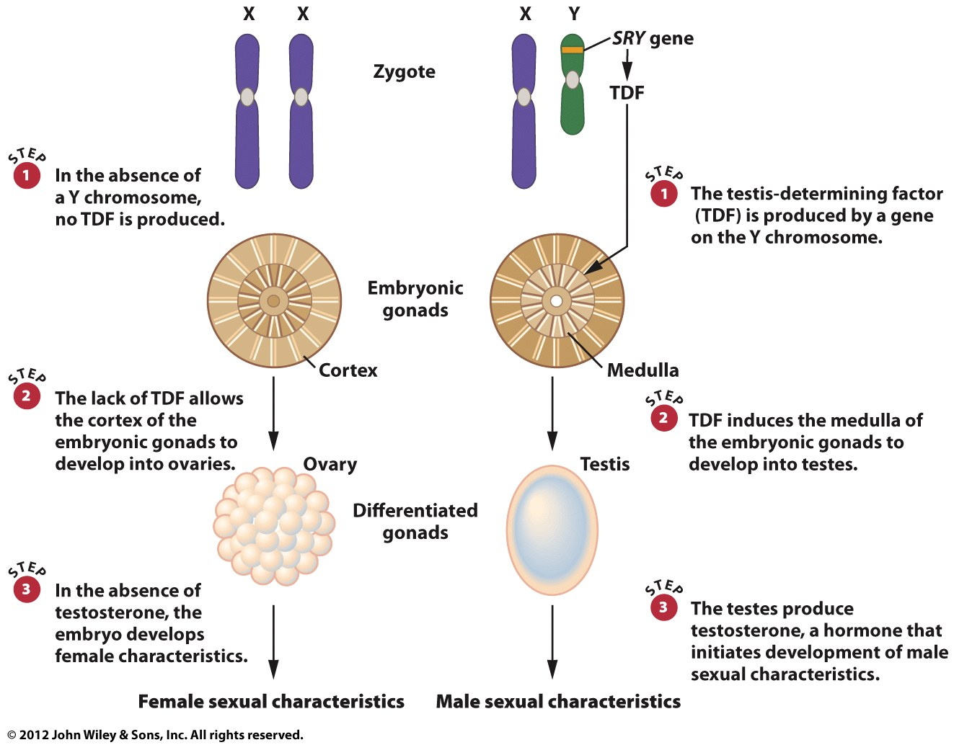
Sex Determination in Human Beings:
The Presence the Y Chromosome
© John Wiley & Sons, Inc.
Notes:
Medulla : 골수
Gonad : 생식선
Teste : 고환

Slide 23
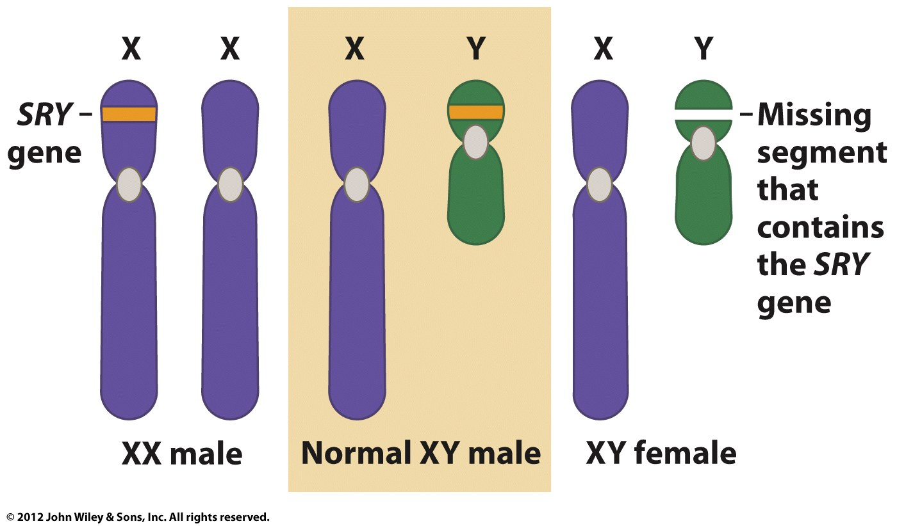
The SRY gene and the
Testis-Determining Factor (TDF)
© John Wiley & Sons, Inc.
Notes:
XX 유전자 중 하나의 염색체에 SRY gene 을 넣어 줌
그랬더니 XY 인 male 이 됨
Y에 존재하는 SRY gene 을 다시 제거했더니 → XY 인 female 이 됨

Slide 24
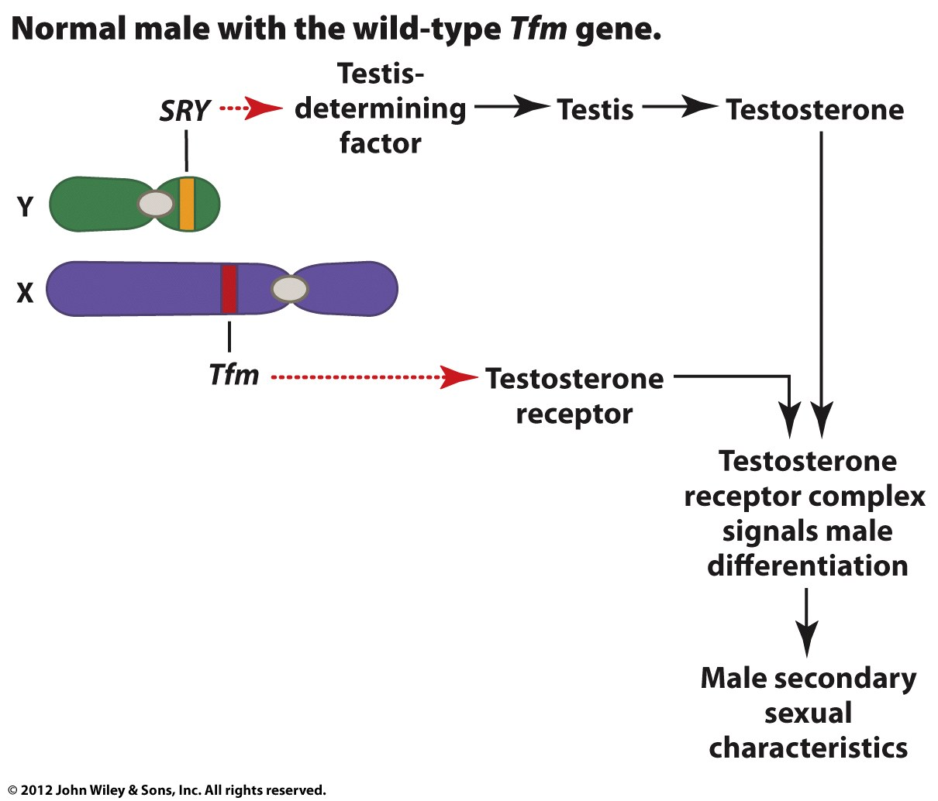
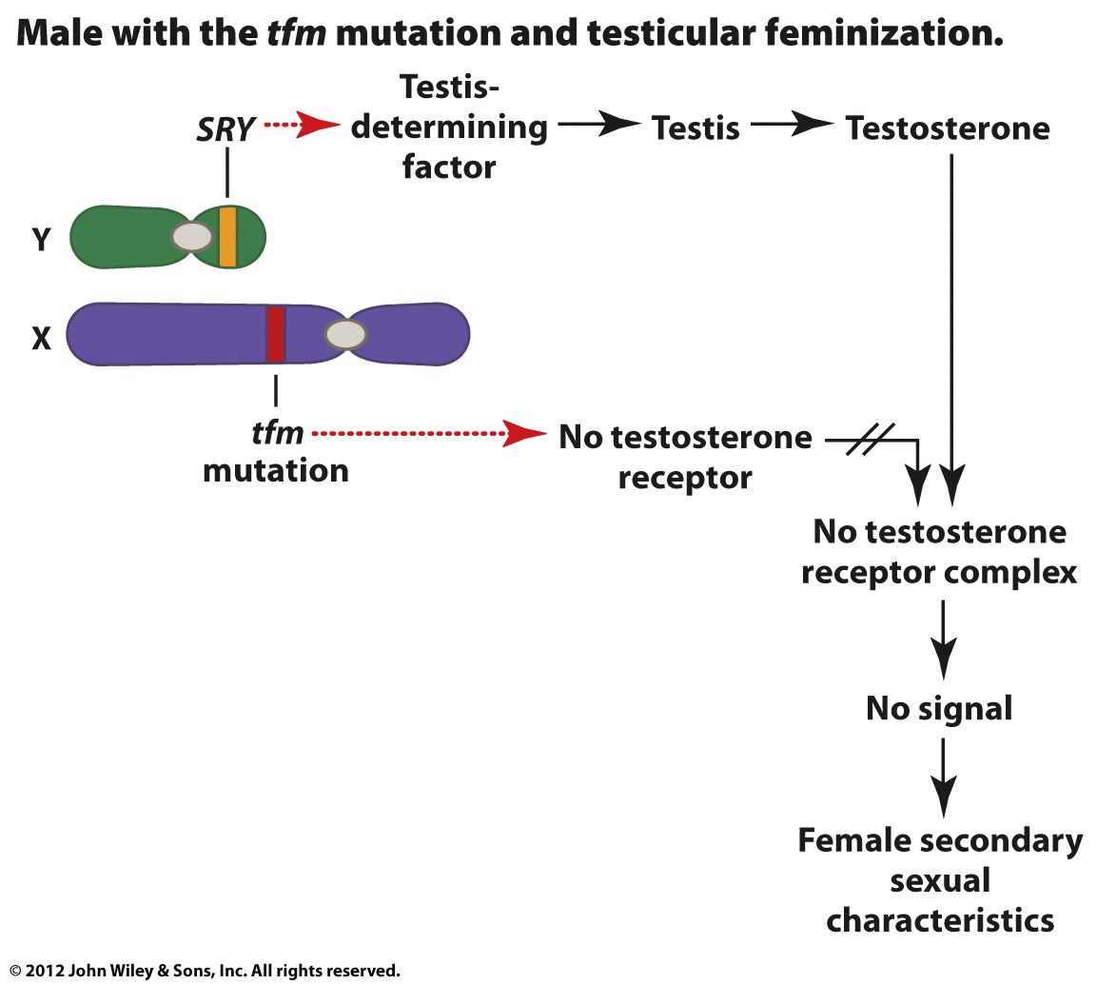
Testicular Feminization
© John Wiley & Sons, Inc.
Notes:
SRY gene 이 있어도 Tfm 의 gene 에 mutation 이 생기면 testosterone receptor 가 형성되지 않아 female 의 특성을 띤다. → 이런걸 Testicular feminization (고환성 여성화)

Slide 25
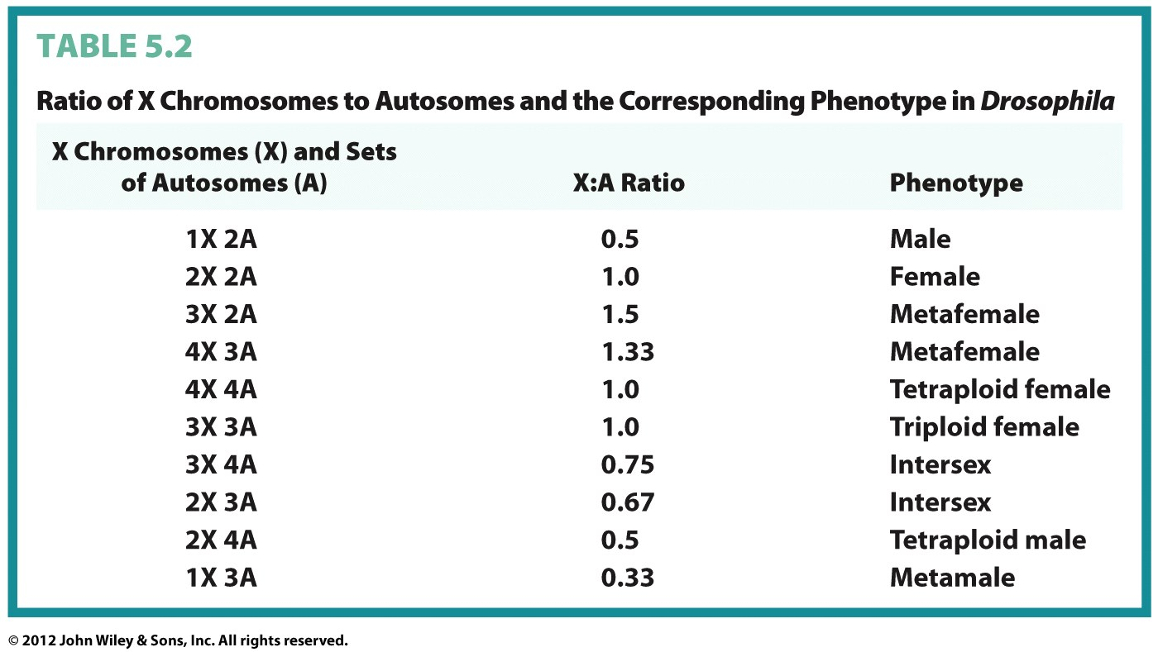

















Sex Determination in Drosophila:
The Ratio of X Chromosomes to Autosomes
© John Wiley & Sons, Inc.
Notes:
X chromosome 과 autosome 의 비율로 성이 결정됨

Slide 26
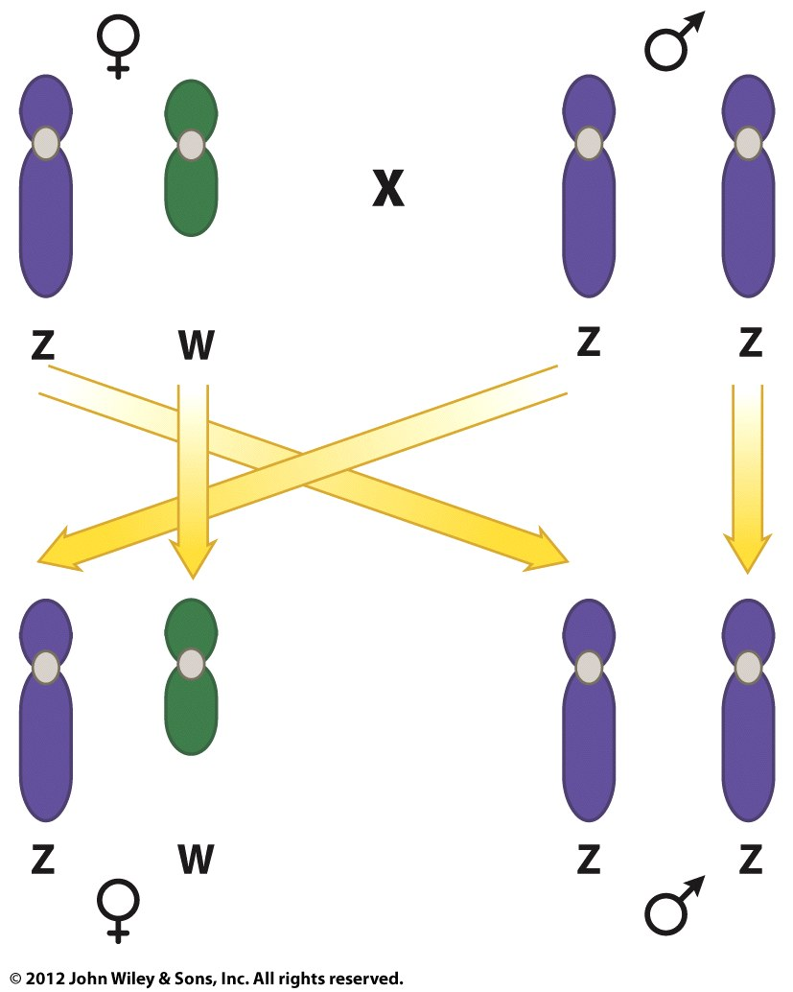
Other Sex Determination Mechanisms:
The ZW System
© John Wiley & Sons, Inc.

Slide 27
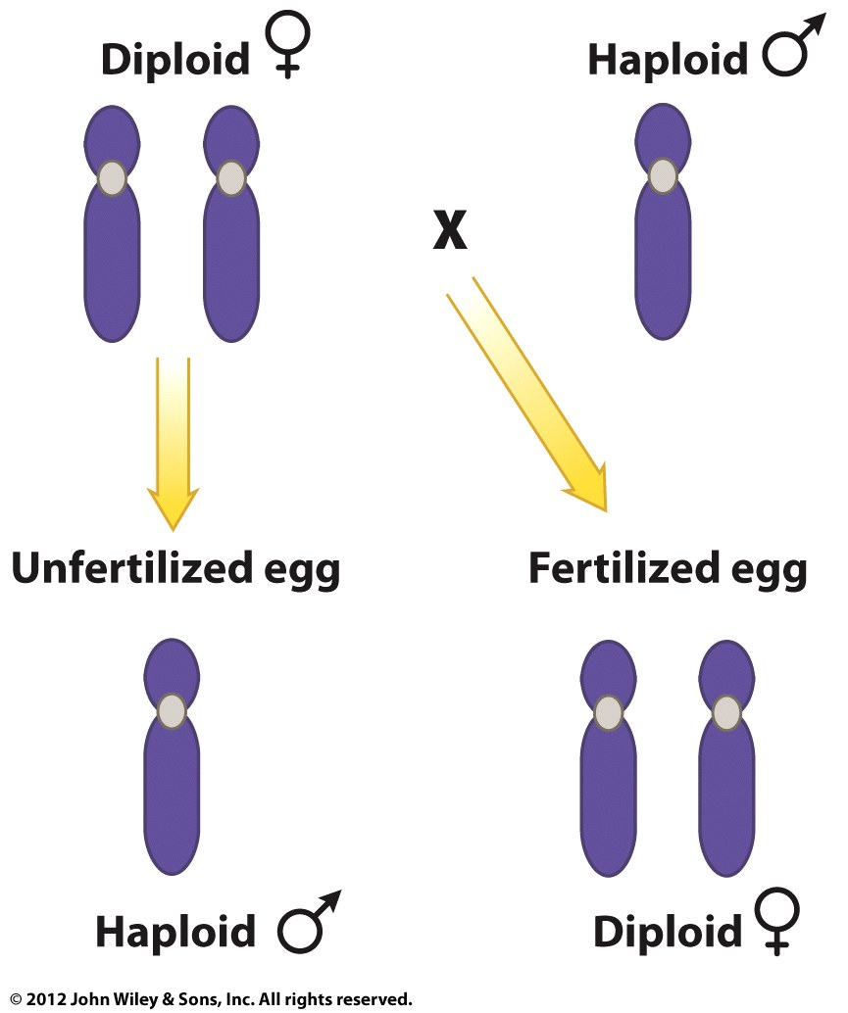
Other Sex Determination Systems:
The Haplo-Diplo System
© John Wiley & Sons, Inc.

Slide 28

Key Points
In humans sex is determined by a dominant effect of the SRY gene on the Y chromosome; the product of this gene, the testis-determining factor (TDF), causes a human embryo to develop as a male.
In Drosophila, sex is determined by the ratio of X chromosomes to sets of autosomes (X:A; for X:A,0.5, the fly develops as a male; for X:A>1.0, it develops as a female, and for 0.5,X:A<1.0, it develops as an intersex.
In honeybees, sex is determined by the number of chromosome sets; haploid embryos develop into males and diploid embryos develop into females.
© John Wiley & Sons, Inc.

Slide 29
Dosage Compensation of X-Linked Genes
Different mechanisms adjust for the unequal dosage of X-linked genes in male and female animals.
© John Wiley & Sons, Inc.

Slide 30
Mechanisms of Dosage Compensation
Hyperactivation of X-linked genes in male Drosophila
Inactivation of X-linked genes in female mammals
© John Wiley & Sons, Inc.
Notes:
Female 의 경우 XX 이므로
X chromosome 이 male 의 2배
포유류의 경우는 XX 중 하나를 inactivation 시켜 남자 X 수와 맞춘다.
= dosage compensation : the process by which organisms equalize the expression of genes between members of different biological sexes.
포유류는 inactivation (여자의 XX 염색체 중 하나를)
초파리는 Hyperactivation (남자의 X 염색체를 과발현시킴 2배)

Slide 31
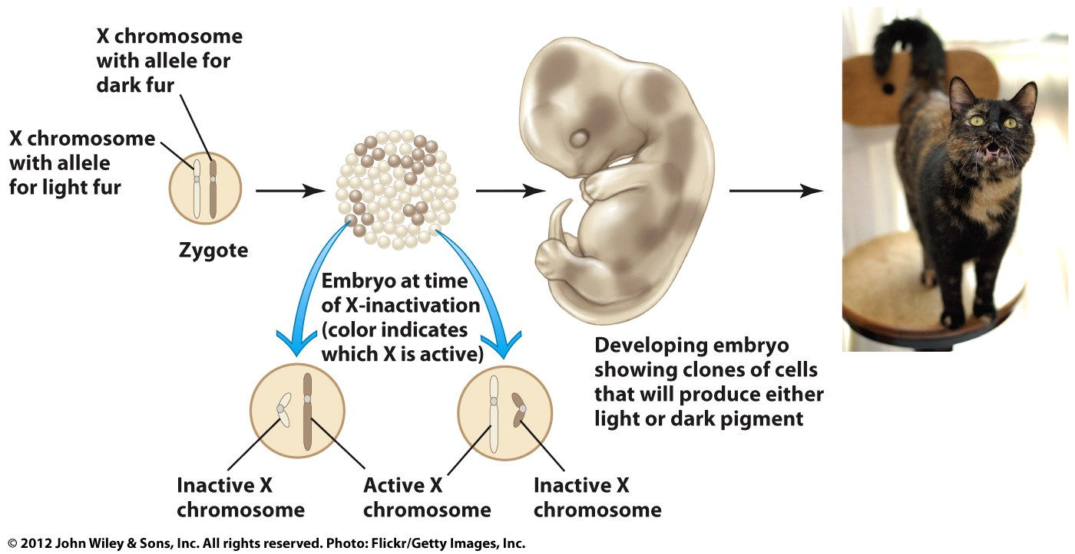
Mosaicism
© John Wiley & Sons, Inc.
Notes:
복제 당한 놈과 복제한 놈의 털 색깔이 다름
Why?
X chromosome 에 의해 결정됨
2개 중 뭐가 inactivation 될지는 몰라
Random 하게 되기 때문에 복제를 해도 다른 색을

Slide 32
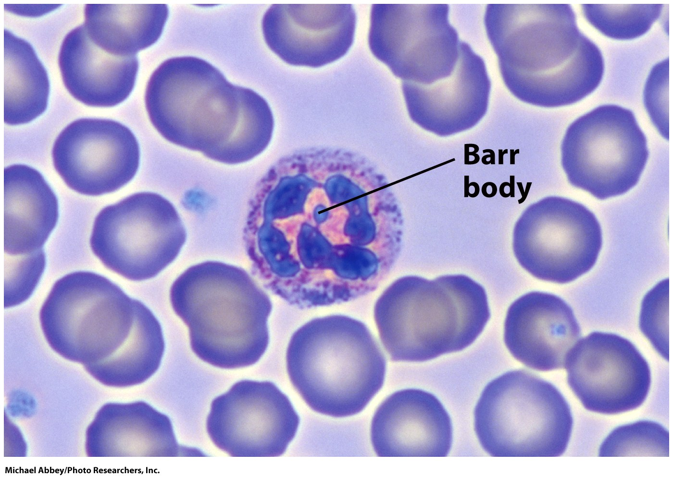
The Barr Body
© John Wiley & Sons, Inc.
Notes:
바소체
: 여성의 체세포에서 발견되는 비활성화된 X염색체이다 (by methylation) → female 만 Random 하게 inactivation 시킴.

Slide 33
Key Points
In Drosophila, dosage compensation for X-linked genes is achieved by hyperactivating the single X chromosome in males.
In mammals, dosage compensation for X-linked genes is achieved by inactivating one of the two X chromosomes in females.
© John Wiley & Sons, Inc.

