Slide 1
대학생을 위한 미팅주선 웹사이트 개발
멀티미디어 공학과 2016112627 김승연

Slide 2
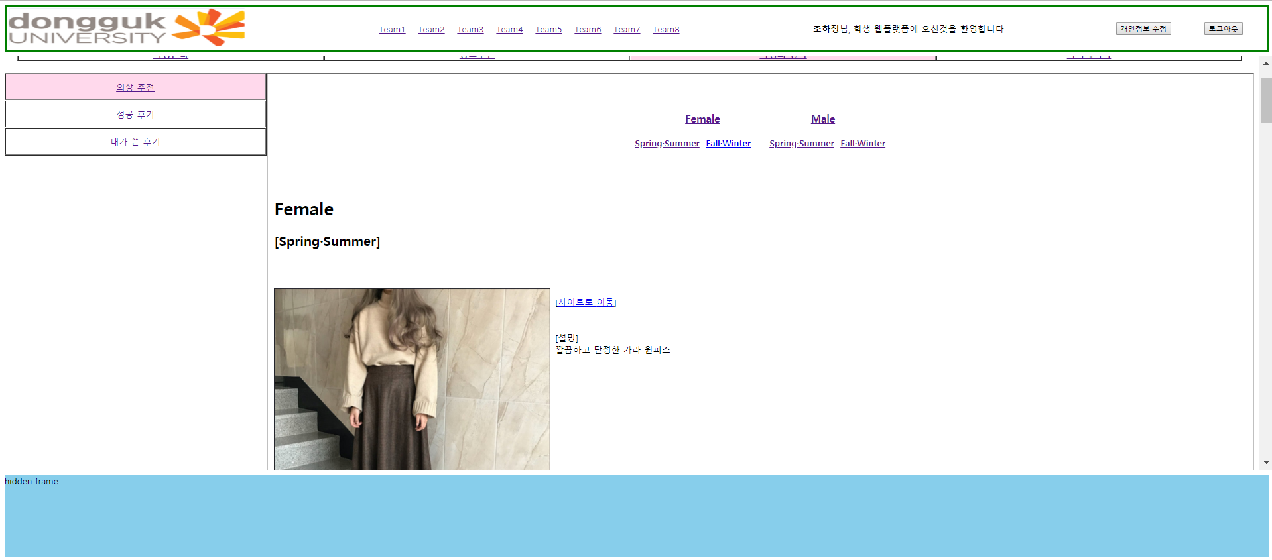
1. /1/ meetingTip - 목록용
Select Clothes.cl_mf, Clothes.cl_png, Clothes.cl_weather, Clothes.cl_address, Clothes.cl_content From Clothes Order by Clothes.cl_mf, Clothes.cl_date
DB에 저장된 계절 순 정렬되며 그 안에서는 등록 날짜 순으로 정렬되어 보여진다.

Slide 3
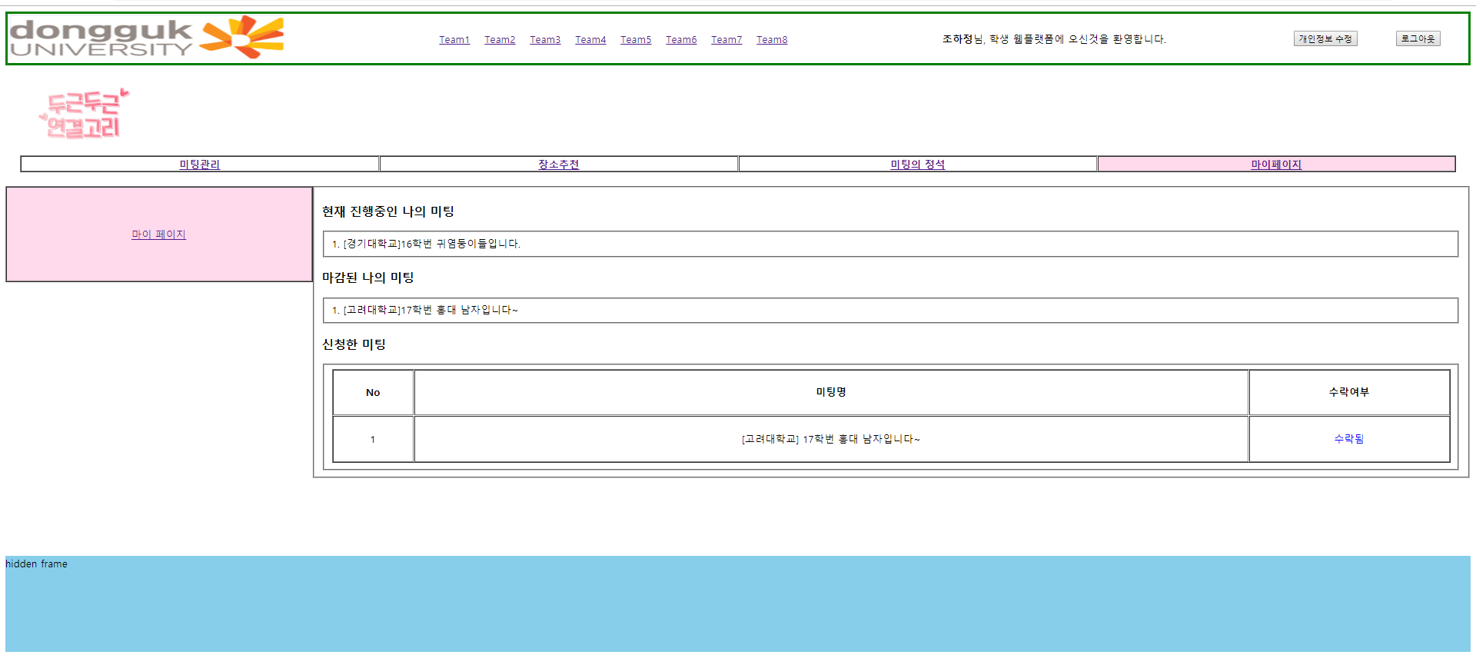
2. /1/ mypage - 목록용
Select School.sh_name, Meeting.me_title From ((Meeting left outer join User on User.us_id=Meeting.us_id) left outer join Acceptance on Acceptance.me_id = Meeting.me_id and Acceptance.ac_yesno='y' ) left outer join School on School.sh_code = Meeting.sh_code Where (User.us_id='
+ id + ' or Acceptance.us_id=' + id
+ ') and Meeting.me_deadline >= cast(curdate()as unsigned) Order by Meeting.me_deadline DESC;
:현재진행중인 나의 미팅
Select School.sh_name, Meeting.me_title From ((Meeting left outer join User on User.us_id=Meeting.us_id) left outer join Acceptance on Acceptance.me_id = Meeting.me_id and Acceptance.ac_yesno='y' ) left outer join School on School.sh_code = Meeting.sh_code Where (User.us_id='
+ id + ' or Acceptance.us_id='" + id
+ ') and Meeting.me_deadline < cast(curdate()as unsigned) Order by Meeting.me_deadline DESC;
:마감된 나의 미팅
:내가 신청한 미팅
select School.sh_name,Meeting.me_title,Acceptance.ac_yesno from ((Meeting left outer join Acceptance on Meeting.me_id=Acceptance.me_id)left outer join School on Meeting.sh_code=School.sh_code)left outer join User on User.us_id=Acceptance.us_id where User.us_id='+ id +';
마이페이지에서는 내가 주최한 것은 물론 내가 신청한 미팅을 날짜순으로 보여주며 또한 내가 신청한 미팅이 수락되었는지도 보여준다.

Slide 4
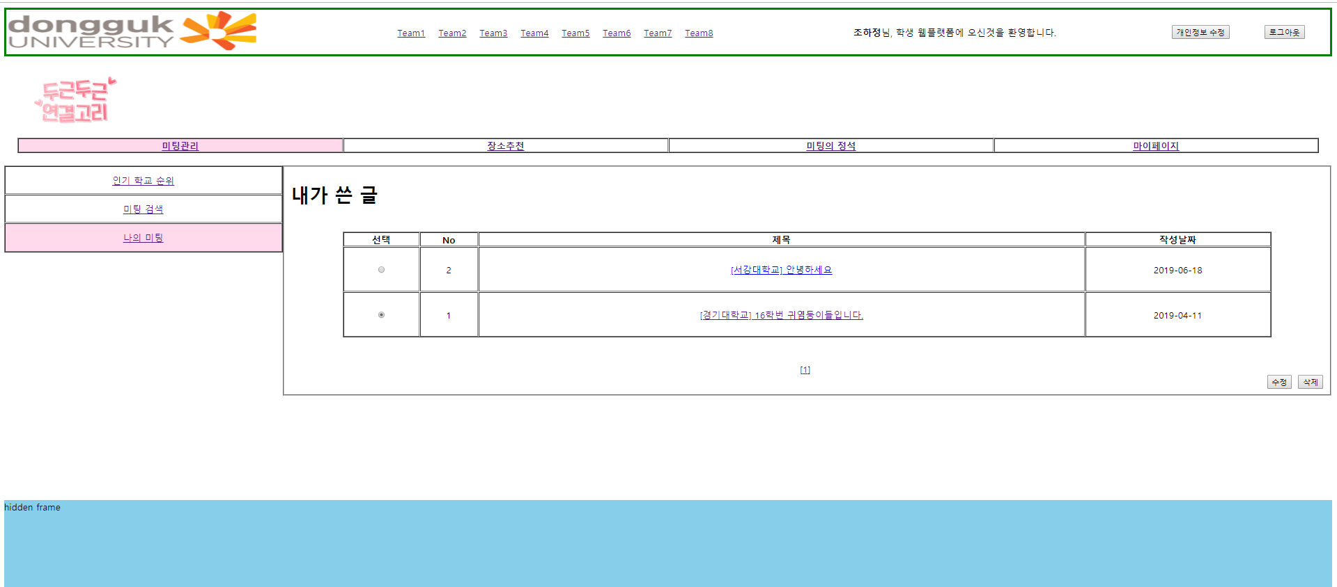
3. /1/ meeting_my - 데이터용
조회, 수정, 삭제 기능구현
:페이징
:내가 작성한 미팅 글을 보여줌
select count(*) cnt from Meeting where us_id='+id+’;
Select me_id, sh_name, me_title, me_write_date from (Select @ROWNUM := @ROWNUM + 1 ROWNUM, A.* from (Select Meeting.me_id, School.sh_name, Meeting.me_title, Meeting.me_write_date From (Meeting left outer join User on Meeting.us_id= User.us_id)left outer join School on School.sh_code=Meeting.sh_code Where User.us_id='+id+' Order by Meeting.me_write_date DESC) A, (select @ROWNUM := 0) R) M where ROWNUM between " + startRecord + " and " + endRecord

Slide 5
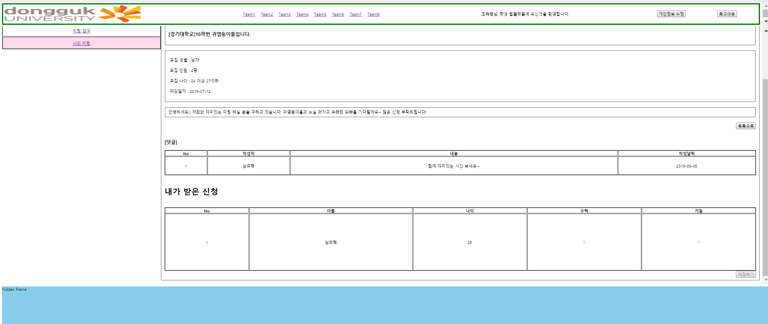
3. /1/ meeting_my - 데이터용
조회 기능구현
:내가 작성한 미팅 글을 보여줌
Select School.sh_name, Meeting.me_title, Meeting.me_content, Meeting.me_available_cnt,Meeting.me_available_mf,Meeting.me_age_from,Meeting.me_age_to,Meeting.me_deadline, User.us_name From (Meeting left outer join School on School.sh_code=Meeting.sh_code) left outer join User on Meeting.us_id=User.us_id Where Meeting.me_id='
+ me_id + '
:작성된 댓글을 보여줌
Select User.us_name, Comment.ct_content, Comment.ct_write_date from (Comment left outer join User on User.us_id=Comment.us_id) left outer join Meeting on Meeting.me_id=Comment.me_id where Meeting.me_id=' + me_id + ' Order by Comment.ct_write_date DESC
Update Acceptance set Acceptance.ac_yesno := '" + arrYN[i]
+ ' where Acceptance.me_id=' + acceptanceMeId + ' and Acceptance.ac_id=' + appId[i]+ '
:신청한 사람들을 수락하고 거절할 수 있으며 이미 한번 저장된 경우
저장하기버튼은 disable된다.
:내가 작성한 미팅 글에 대한 신청을 보여줌
Select User.us_name, User.us_age, Acceptance.ac_id,Acceptance.ac_yesno ,count(Acceptance.ac_id) From User, Acceptance,Meeting Where User.us_id = Acceptance.us_id and Acceptance.me_id=Meeting.me_id and Meeting.me_id='
+ me_id + '

Slide 6
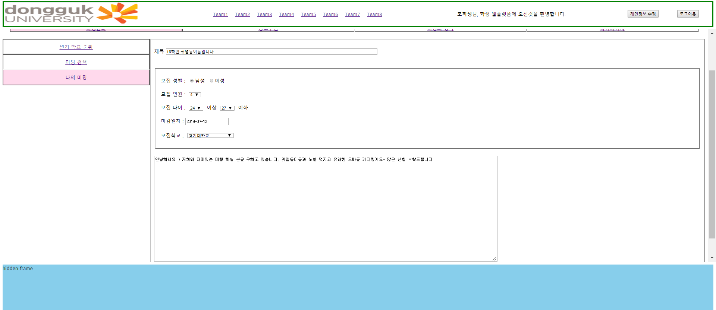
3. /1/ meeting_my - 데이터용
수정폼
:내가 이전에 작성한 글을 보여줌
Select School.sh_name, Meeting.me_title, Meeting.me_available_mf,Meeting.me_available_cnt,Meeting.me_age_from,Meeting.me_age_to,Meeting.me_deadline,Meeting.me_content From Meeting left outer join School on School.sh_code=Meeting.sh_code Where Meeting.me_id=' + mMyID + '
:DB 업데이트
update Meeting set Meeting.sh_code := '"+ mMySchoolCode
+ ', Meeting.me_title := '+ mMyTitle + ', Meeting.me_available_cnt := ' + mMyPeople
+ ', Meeting.me_available_mf := ' + mMyGender + ', Meeting.me_content := ' + mMyContent
+ ', Meeting.me_age_from := ' + mMyAge_from + ', Meeting.me_age_to := ' + mMyAge_to
+ ', Meeting.me_deadline := ' + mMydeadline + ', Meeting.me_write_Date := ' + today
+ ' where Meeting.me_id = ' + mMyID + ' and Meeting.us_id = '+id+'

Slide 7
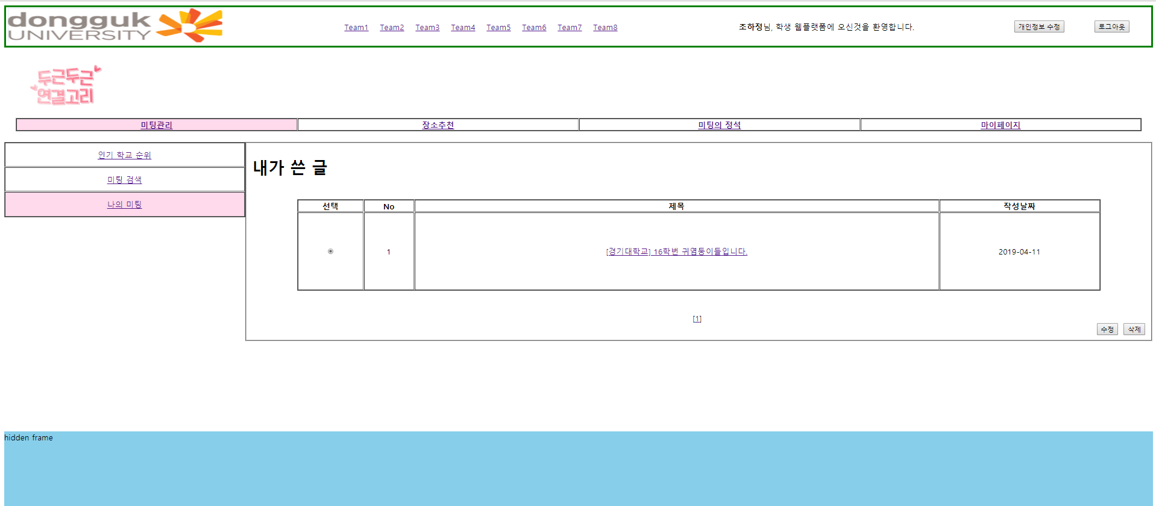
3. /1/ meeting_my - 데이터용
삭제 기능구현
:라디오 버튼으로 선택된 글을 삭제 (연쇄삭제)
Delete from Meeting where Meeting.us_id IN(select User.us_id from User where User.us_id=' + id + ') and Meeting.me_id=' + mMyDelete + ‘;
Delete from Review where Review.us_id IN(select User.us_id from User where User.us_id=' + id + ') and Review.me_id=' + mMyDelete + '
Delete from Acceptance where Acceptance.us_id IN(select User.us_id from User where User.us_id=' + id + ') and Acceptance.me_id=' + mMyDelete + '

Slide 8
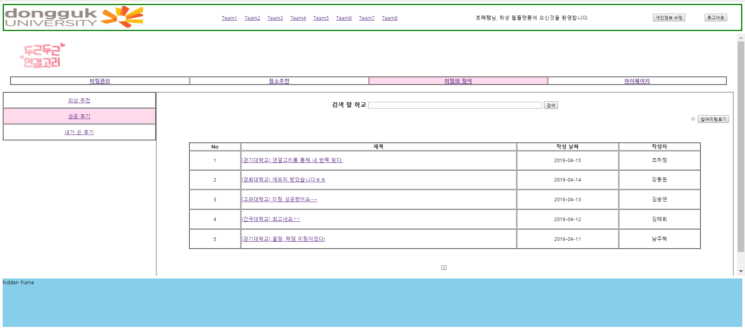
4. /1/ successReview - 데이터용
조회, 입력 기능구현
:페이징
select count(*) cnt from Review

Slide 9
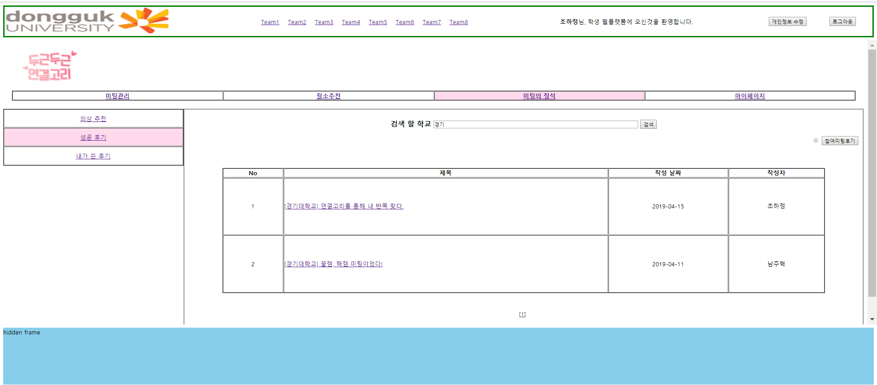
:아무것도 검색하지 않을 시 전체 조회가능
Select rv_id, sh_name, rv_title, rv_write_date, us_name from (Select @ROWNUM := @ROWNUM + 1 ROWNUM, A.* from (Select Review.rv_id, School.sh_name, Review.rv_title, Review.rv_write_date, User.us_name From ((Review left outer join Meeting on Meeting.me_id=Review.me_id) left outer join School on School.sh_code=Meeting.sh_code) left outer join User on User.us_id = Review.us_id Order by Review.rv_write_date DESC) A, (select @ROWNUM := 0) R) M where ROWNUM between " + startRecord + " and " + endRecord;
4. /1/ successReview - 데이터용
Select rv_id, sh_name, rv_title, rv_write_date, us_name from (Select @ROWNUM := @ROWNUM + 1 ROWNUM, A.* from (Select Review.rv_id, School.sh_name, Review.rv_title, Review.rv_write_date, User.us_name From ((Review left outer join Meeting on Meeting.me_id=Review.me_id) left outer join School on School.sh_code=Meeting.sh_code) left outer join User on User.us_id = Review.us_id Where School.sh_name like '%" +schoolName+ "%'Order by Review.rv_write_date DESC) A, (select @ROWNUM := 0) R) M where ROWNUM between " + startRecord + " and " + endRecord;
:검색어를 통해 검색가능

Slide 10
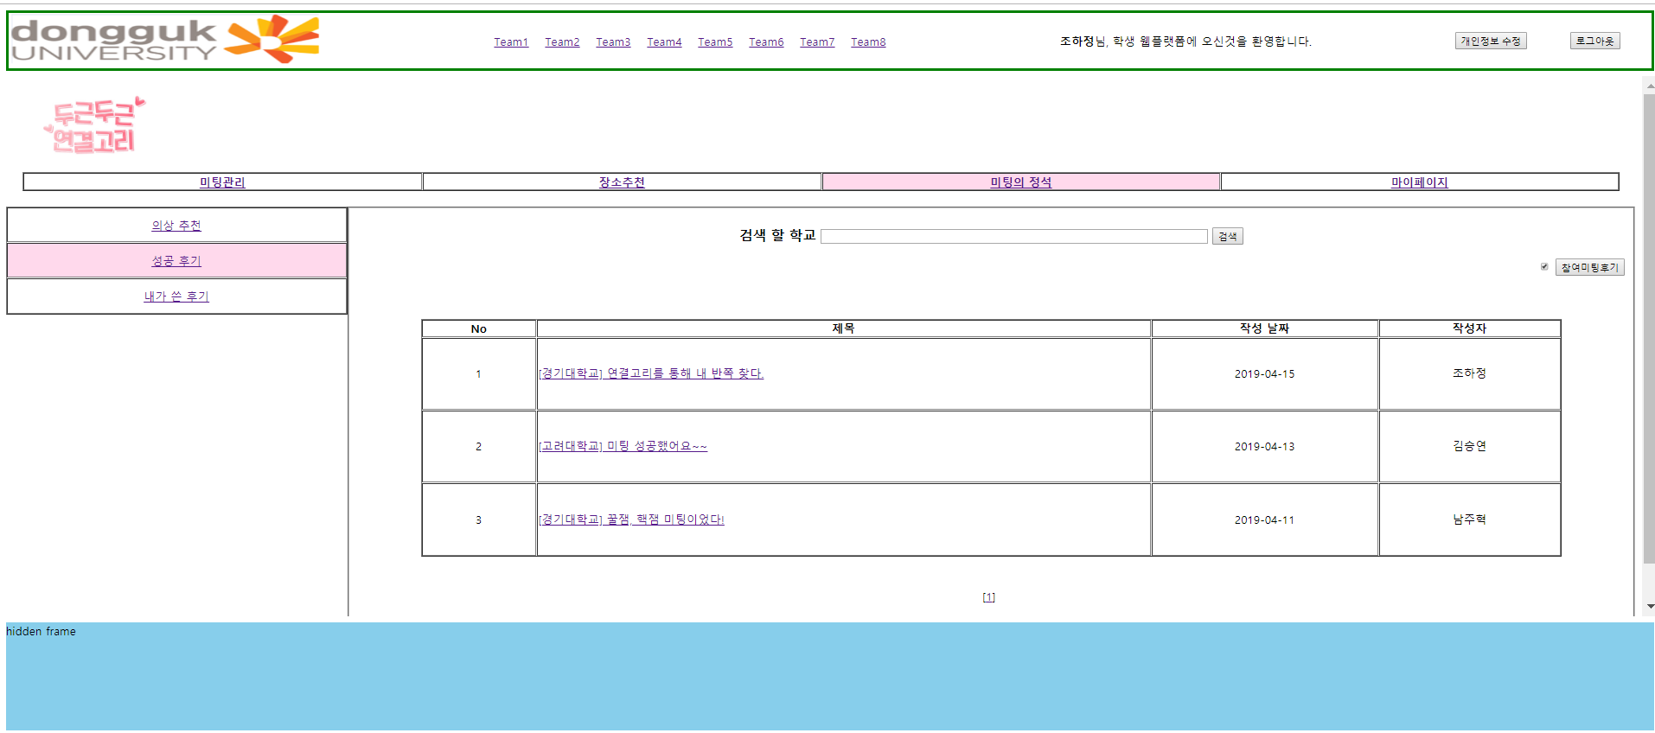
4. /1/ successReview - 데이터용
:참여 미팅 보기 버튼 누를 시 내가 참여하거나 주최한 미팅의 후기를 보여줌
Select distinct rv_id, sh_name, rv_title, rv_write_date, us_name from (Select @ROWNUM := @ROWNUM + 1 ROWNUM, A.* from ( select distinct Review.rv_id,School.sh_name,Review.rv_title,Review.rv_write_date,user1.us_name from ((((Review left outer join Meeting on Meeting.me_id=Review.me_id)left outer join User as user1 on user1.us_id=Review.us_id)left outer join School on School.sh_code=Meeting.sh_code)join User as user2)left outer join Acceptance on Acceptance.me_id=Review.me_id where (Meeting.us_id=user2.us_id or (Acceptance.us_id=user2.us_id and Acceptance.ac_yesno='y')) and user2.us_id='"+id+"'Order by Review.rv_write_date DESC) A, (select @ROWNUM := 0) R) M where ROWNUM between " + startRecord + " and " + endRecord;

Slide 11
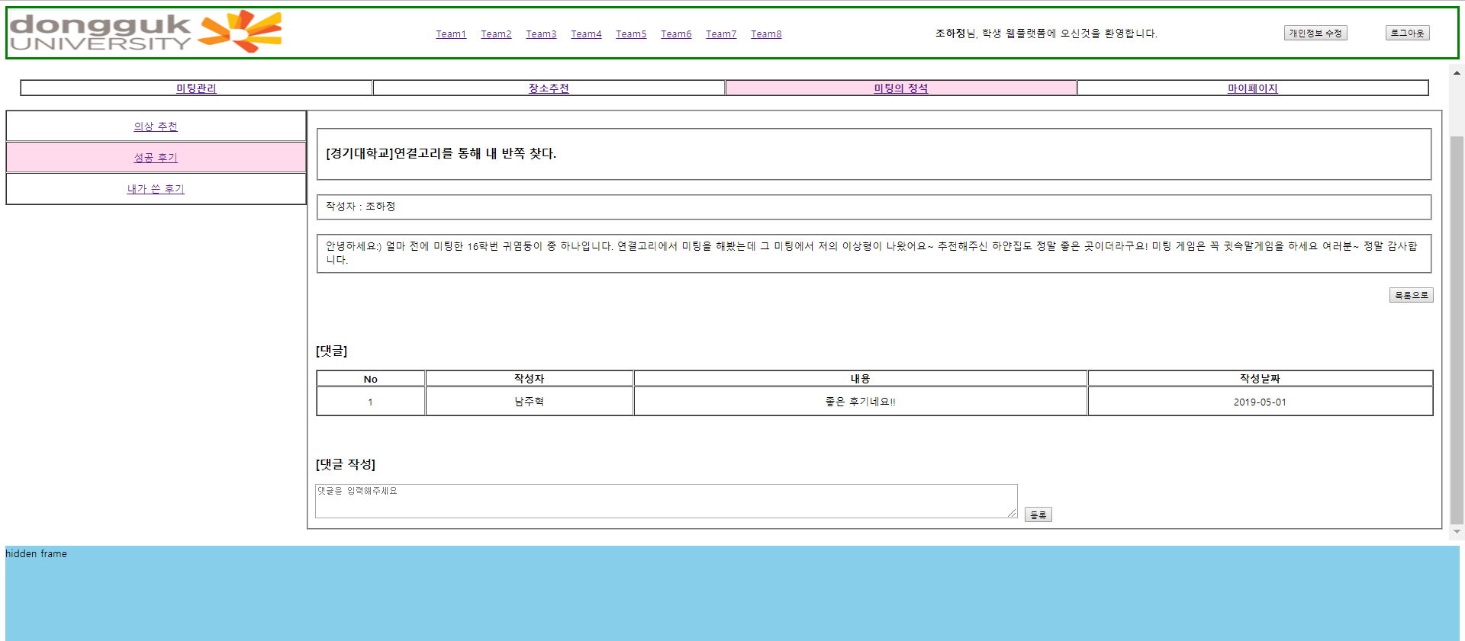
4. /1/ successReview - 데이터용
조회 기능구현
:후기 글
Select School.sh_name,Review.rv_title,Review.rv_content,User.us_name From ((Review left outer join Meeting on Meeting.me_id=Review.me_id) left outer join School on School.sh_code= Meeting.sh_code)left outer join User on Review.us_id=User.us_id Where Review.rv_id='+rv_id+'
:댓글
Select User.us_name, Comment.ct_content, Comment.ct_write_date from (Comment left outer join User on User.us_id=Comment.us_id) left outer join Review on Review.rv_id=Comment.rv_id where Review.rv_id=' + rv_id + ' Order by Comment.ct_write_date DESC";
:댓글삽입
insert into Comment (ct_id, us_id, rv_id, ct_content, ct_write_date) values ('
+ new_ct_id + ', ' + id + ', ' + crCommentID + ', ' + crComment + ', ' + today+');
:자신이 참여하거나 주최한 미팅에만 댓글 달 수 있음
select distinct Review.rv_id as attend from (((Review left outer join Meeting on Meeting.me_id=Review.me_id)left outer join User as user1 on user1.us_id=Review.us_id)join User as user2)left outer join Acceptance on Acceptance.me_id=Review.me_id where (Meeting.us_id=user2.us_id or (Acceptance.us_id=user2.us_id and Acceptance.ac_yesno='y')) and user2.us_id='+id+';

Slide 12
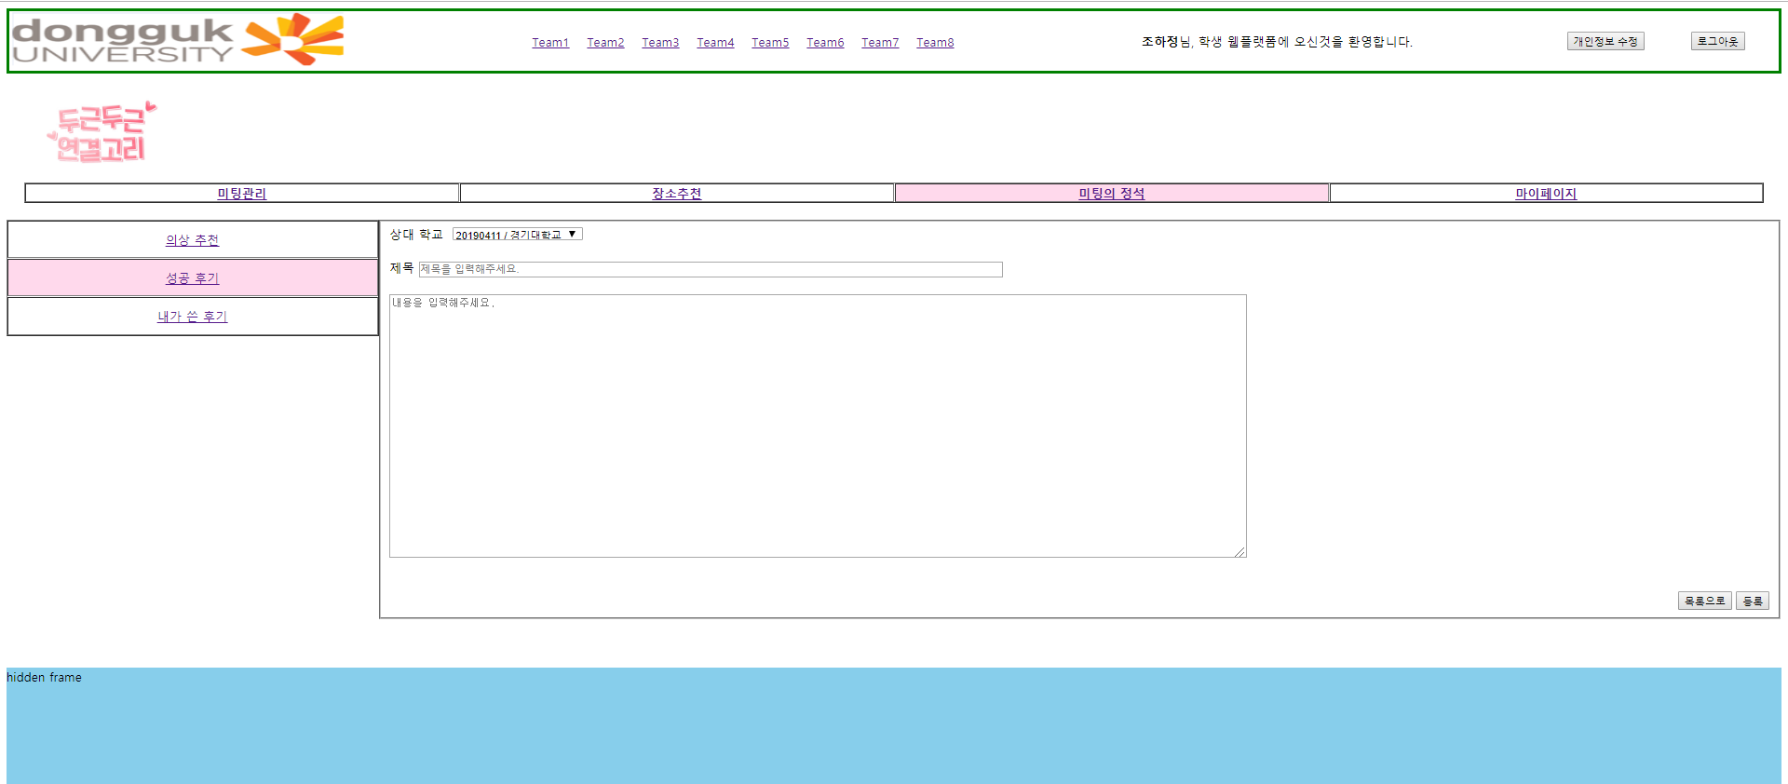
4. /1/ successReview - 데이터용
입력 기능구현
:새로운 글삽입
insert into Review (me_id, rv_id, us_id, rv_title, rv_content, rv_write_date) values (
+ rMeetingID + , ' + new_rv_id + ', ' + id + ', ' + rTitle + ', ' + rContent + ', ' + today + ')

Slide 13
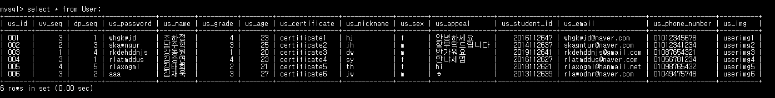
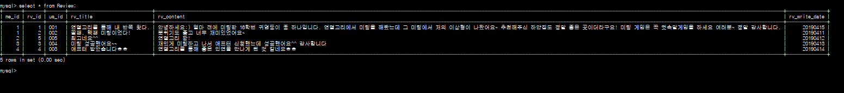
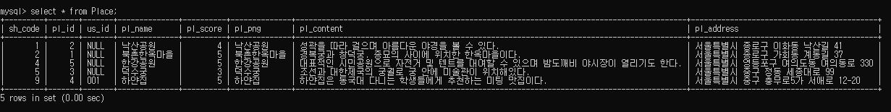
5. DB 구축
User
Review
Place

Slide 14
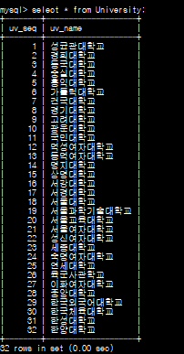
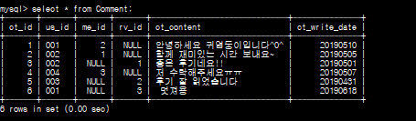
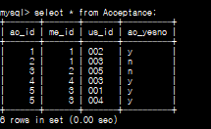
5. DB 구축
Meeting
University
Comment
Acceptance

Slide 15
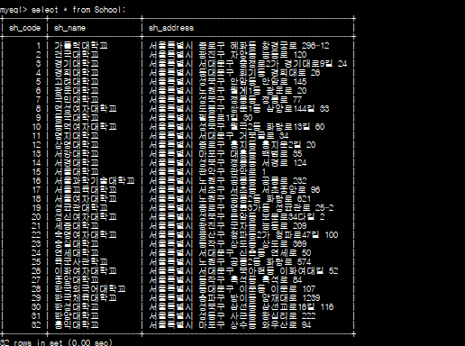
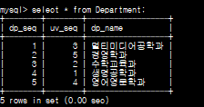
5. DB 구축
Clothes
School
Departmnet

Slide 16
감사합니다

