Slide 1
Gao Ge | Ge Xiao Min | Goh Boon Leng Mark | Hong Ziling | Tommy Lapierre | Yeo Wei Zheng
Blog Page Admin Subjects Subject Add & Cancel & Description Leave View Notification | News Page Enrolled Grades Faculty Leave Approval Faculty Leave Schedule | Frontend Design & Layout Faculty courseList, enrollmentList FacultyRepo EnrollmentRepo Password Hashing (Bcrypt) Input Validations | Home page Blog page Add Faculty User Student Enrolled Course Apply & Update Faculty Leaves Send & Receive Notifications | Home Calendar Home Events Student Login Student page Available Courses Faculty Leaves Admin CGPA | Overall framework Code integration Ajax & REST API Date clash validation
Team 7 SMS Work Allocation

Slide 2





Technologies used

Slide 3
LESSONS LEARNT
How to START?
Be Consistent
No Stone
Left UNTURNED
Be a USER
e.g： Course Vs CourseS
What to USE?
GIT?
Faith in Compiler
It’s ALL
Connected
Gathering
Our Thoughts
TIME
Constrains
Work Distri
Standardize Signatures
Divide & Conquer
BE READY
PROJECT
START
DEC
02
05
06
07
09
10
11
12
13
14
15
16
DESIGN
EXECUTION
INTEGRATION
TEST RUN
Notes:
How to Start: understanding in the requirements, brainstorms on idea/ changes, database structure, ERs
What to Use? : templates, GIT, JAVA techniques
TIME Constraints : can't be too greedy

Slide 4
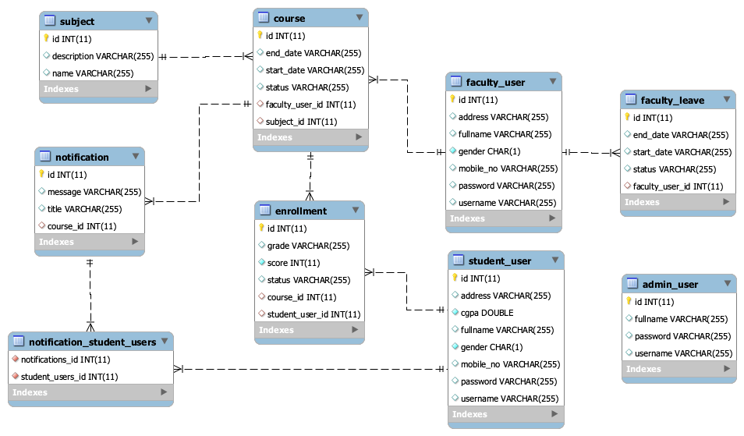
Entity Relationship Diagrams

Slide 5
Layered Architecture
Admin Views
Faculty Views
Student Views
Home Views
Error Page
Index Page
“MVC Layer”
(Business
& Presentation)
AdminController
FacultyController
HomeController
IndexController
StudentController
RESTController
AdminUser
StudentUser
FacultyLeave
FacultyUser
Subject
Course
Enrollment
Notification
DBServiceInterface
Service Layer
DB Service
Persistence
Layer
AdminLeave
Repository
AdminUser
Repository
Course
Repository
Enrollment
Repository
FacultyLeave
Repository
FacultyUser
Repository
Notification
Repository
StudentUser
Repository
Subject
Repository
Database
Layer
admin_user
course
enrollment
faculty_leave
faculty_user
notification
student_user
subject
notification_student_users

