Slide 1
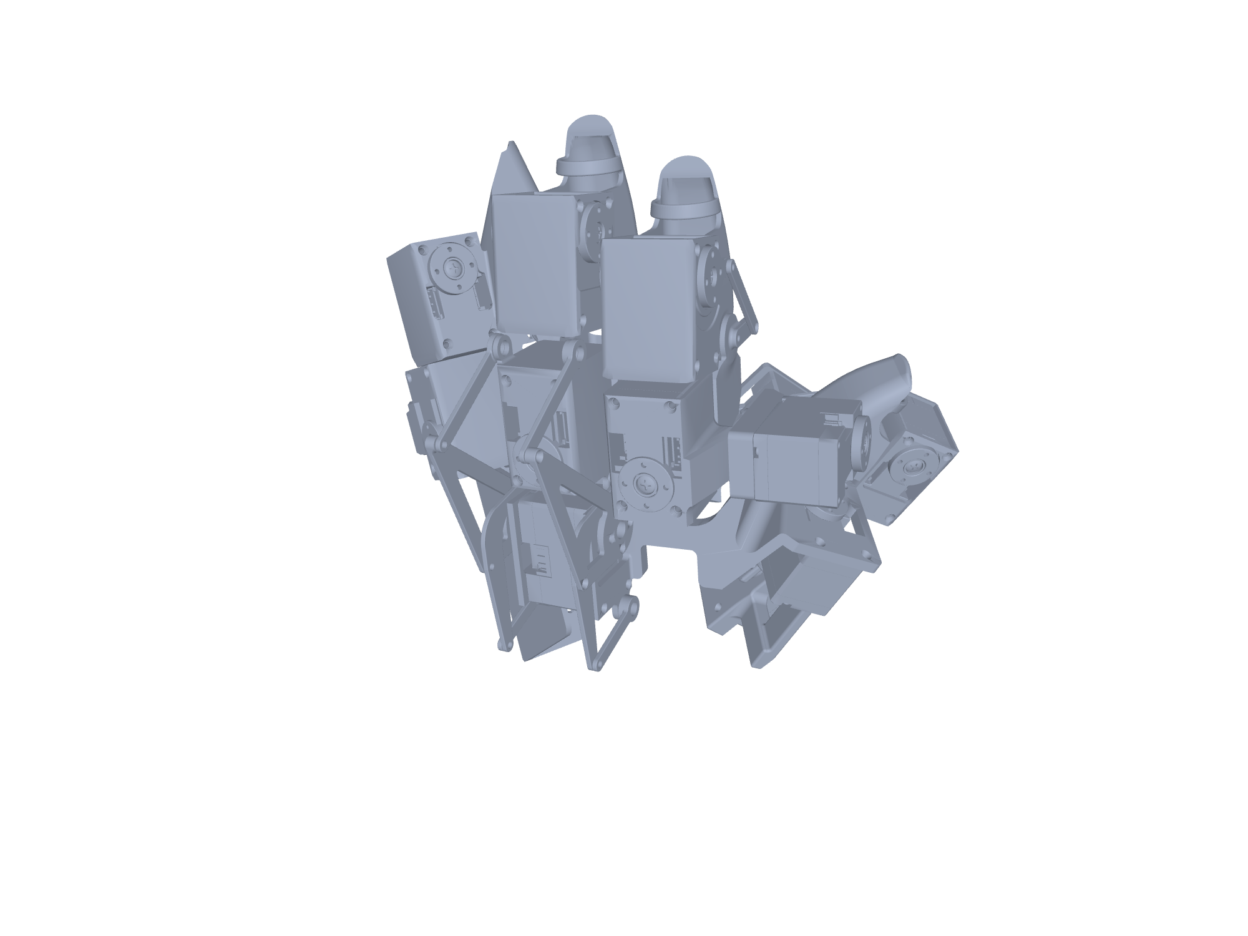
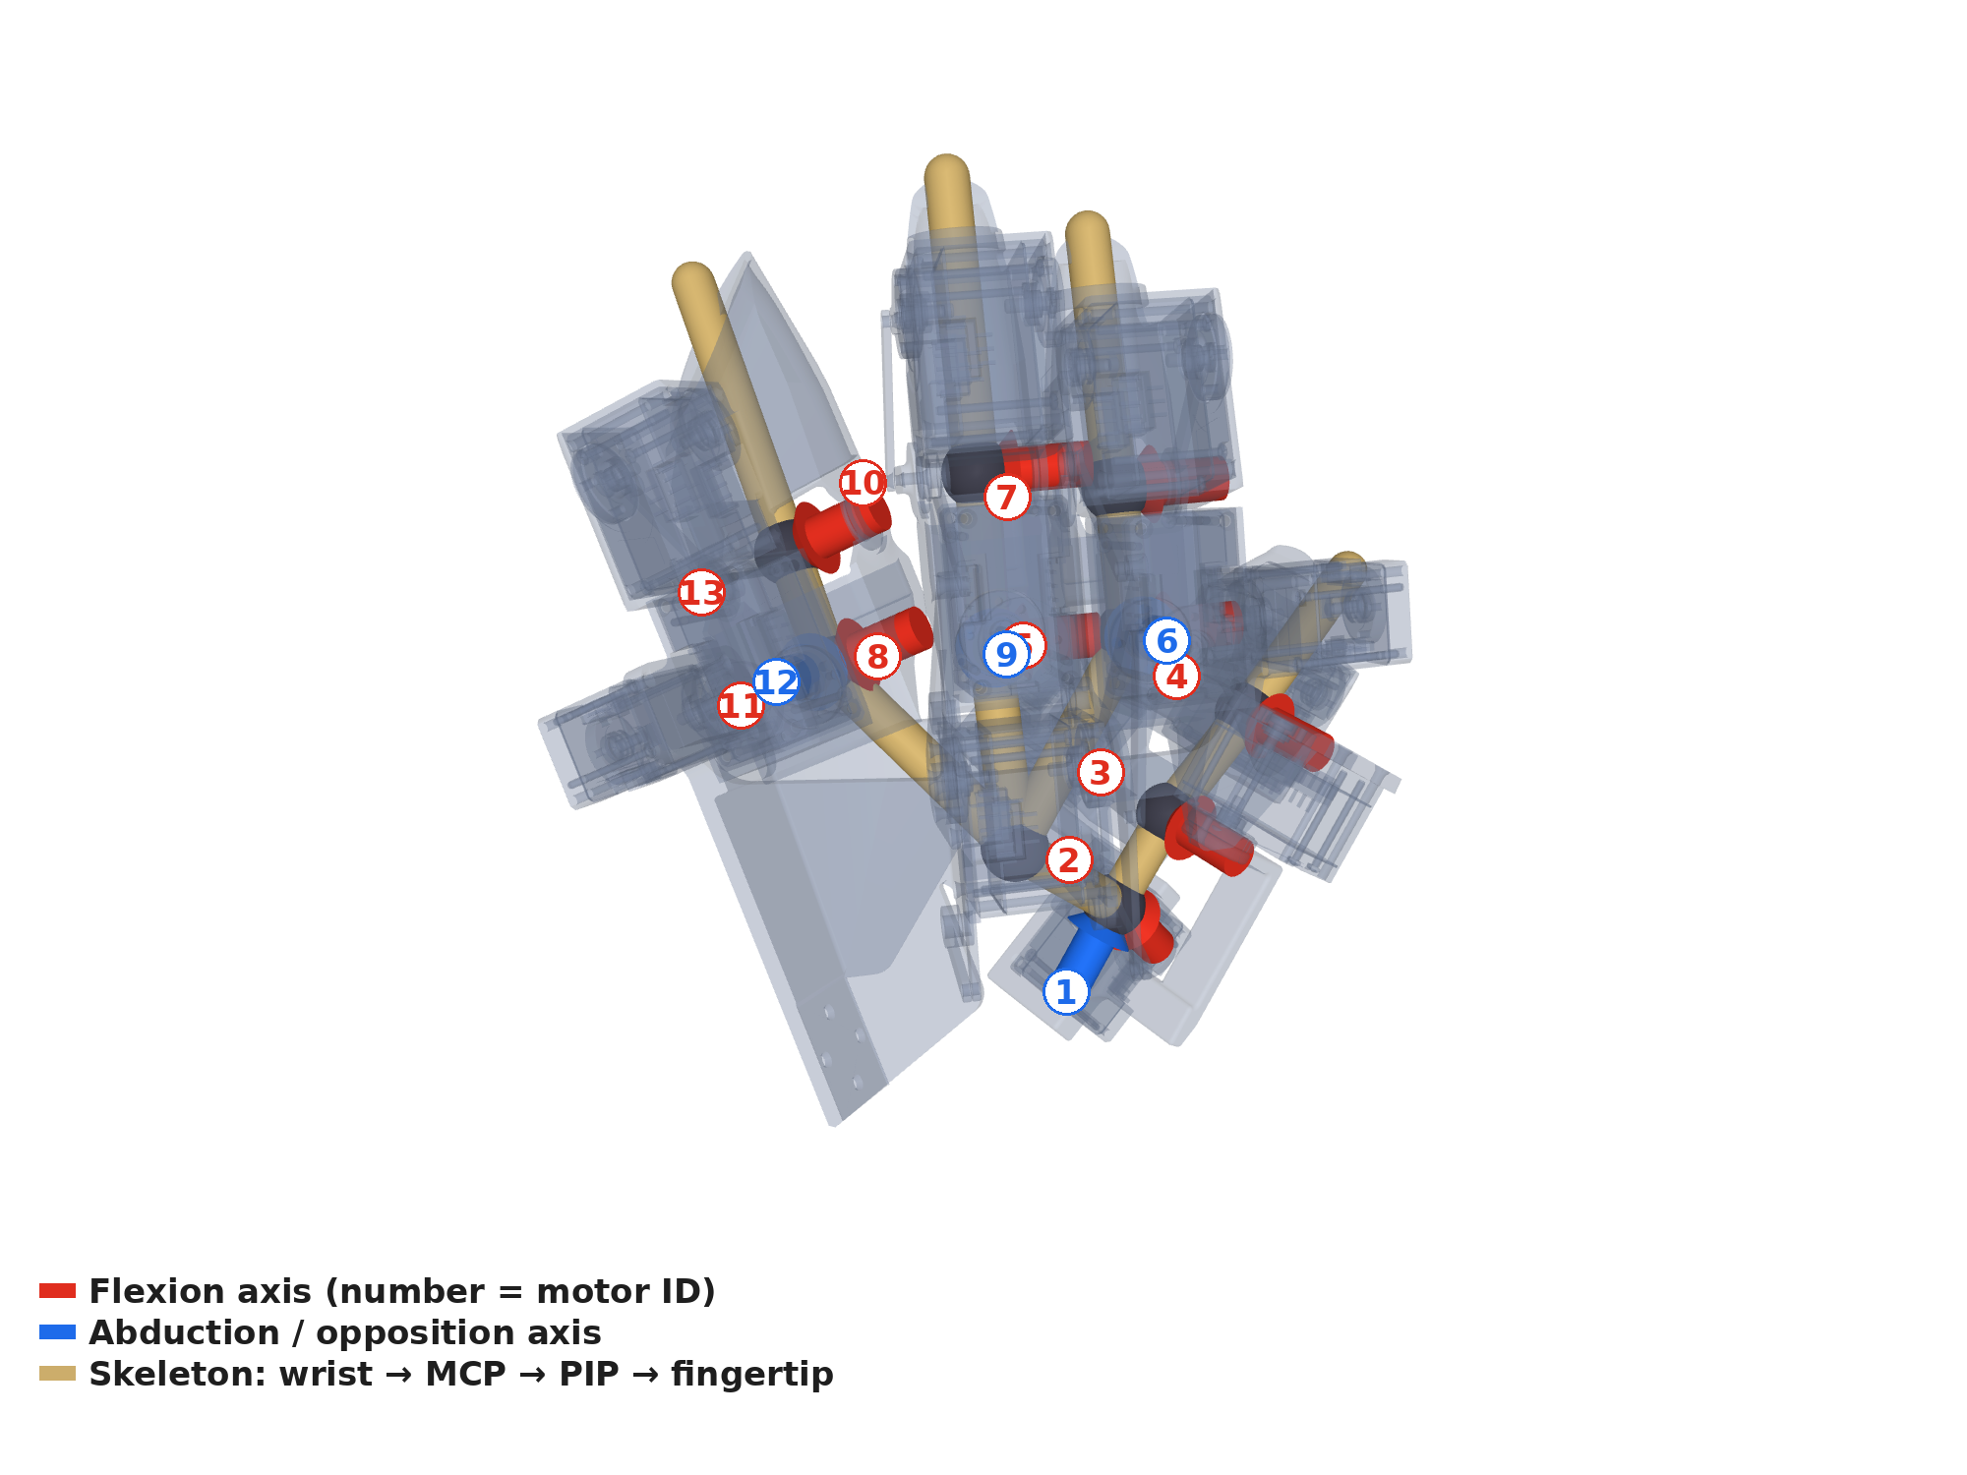
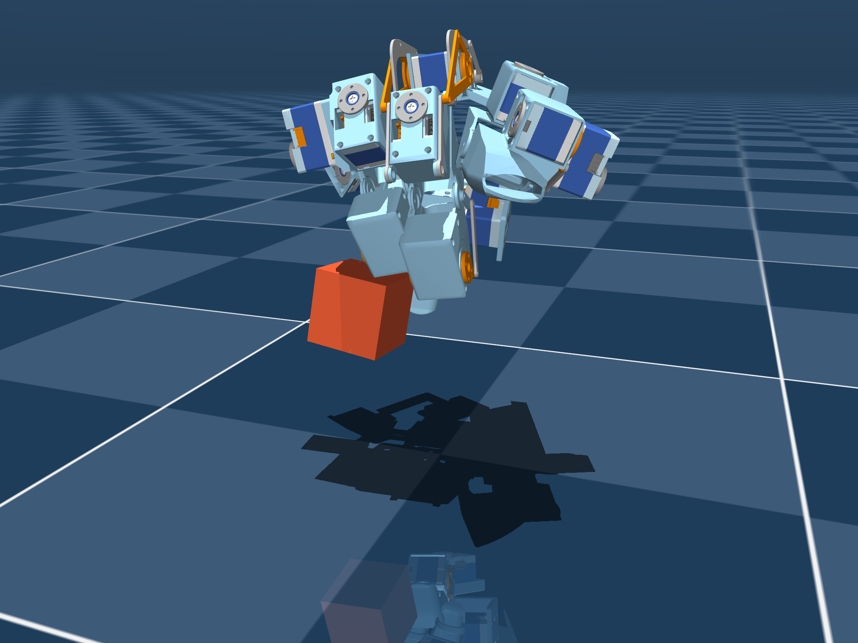
LAB MEETING · 15 OCTOBER 2026
An Isomorphic Force-Feedback Glove–Hand Pair for Dexterous Teleoperation
13 motor joints, joint-to-joint bilateral control, and what it lets us record for policy learning
Pengfei Ye
HKUST / MIT CSAIL · ongoing work with E. Adelson
Notes:
一句话：一只按人手设计的手套，和一只完全相同的机械手，关节一一对应、带力反馈。今天讲三件事：为什么要机器人在环、我们做了什么、记录下来的力和刚度怎么用。

Slide 2
Motivation
Handheld devices record what the human did, not what the robot must do
UMI-style collection has no motor in the loop: gripper width stops at contact, grasp force is never recorded
STATE IS NOT ACTION
FOUR REQUIREMENTS FOR GOOD DEXTEROUS DATA
A policy needs robot actions: force, compliance, actuator dynamics, feasibility
Human-held demos capture the human's closed loop, not the robot's actuators
DITTO: handheld-only data → 0 % at "hold and lift"; +10 teleop episodes → 70 %
ForceMimic: force in the action → +54.5 % relative over vision-only
ACP (UMI's own group): compliance is ignored by position-only visuomotor policies
UMI: kinematic feasibility unknown at collection time, filtered afterwards
UMI
DexUMI
ART-Glove
MILE
DITTO
DITTO-X
Ours
① Dexterous
enough independent DoF
✗
✓
✓
✓
② No embodiment gap
human motion runs 1:1 on the robot
✓
✗
✓
✓
✓
③ Operator feels contact
real or rendered force
✓
✓
✓
✗
✓
✓
✓
0 % → 70 %
+54.5 %
13 × 220 Hz
④ Robot in the loop
takeover, DAgger, actuator dynamics
DITTO: handheld only vs +10 teleop episodes (hold & lift)
ForceMimic: force as action vs vision-only
what our pair logs: q*, q, τ, I, K per joint
✗
✗
✗
✓
✓
✓
The scorecard returns on every paper slide and on our limitations slide
Notes:
全片的论点。无本体采集记录的是人在自己闭环下的运动学轨迹（state）；策略部署需要的是机器人本体的动作（action）：力、柔顺、执行器动力学、可行性，这些只有机器人在环时才会被记录。证据：DITTO 手持数据在"抓住并抬起"阶段 0%，加 10 条遥操作数据升到 70%；ForceMimic 把力加进动作相对提升 54.5%；ACP（UMI 作者同组）指出位置控制策略忽略柔顺。由此引出四条要求，后面每篇论文都用这张卡打分。

Slide 3
Motivation
Forty years of data gloves: from input devices to linkages, motors and tactile skins
Top: teleoperation (robot in the loop). Bottom: demonstration capture (no robot). Colour = what the glove carries
1988–2002
2022–2024
2025
2026
Dexterous HandMaster A. D. Little, 1988
NimbRo Avatar Bonn
DOGlove Tsinghua
DITTO / DITTO-X Columbia · 7 DoF, force feedback
CyberGrasp Virtual Technologies, 1999
iCub3 avatar IIT
HOMIE Shanghai AI Lab
TAG (Feel Robot Feels) tactile arrays
Rutgers Master II Rutgers, 2002
BiDex CMU, 2024
GEX 11-DoF hand + 12-DoF exo
Our glove isomorphic, motors in every joint
MILE SJTU · isomorphic, passive
▲ Teleoperation (robot in the loop)
▼ Demonstration capture (no robot)
1977–1990
2019–2024
2025
2026
Sayre Glove UIC, 1977
STAG MIT, 2019
DexUMI Stanford
ART-Glove CMU · 22 DoF, 2048 taxels
DataGlove VPL, 1987
DexCap Stanford, 2024
ExoStart DeepMind · CMU · MIT
DexEXO UCLA
CyberGlove 1990
DEXOP MIT
SEED-UMI PKU · shared exoskeleton
OSMO Meta FAIR
Motion sensors
Tactile skin
Haptic / force feedback
Exoskeleton matched to a robot hand
Ours
Notes:
两条轨：上面是遥操作（机器人在环），下面是演示采集（没有机器人）。颜色是手套带了什么：只有运动传感、带触觉皮肤、带力/触觉反馈、以及按某只机械手设计的外骨骼。这页只讲一句：两条轨到 2025–2026 年在外骨骼上汇合了，MILE 和 DITTO 已经做了同构的主从对，MILE 没有电机、DITTO 只有两根手指，我们在它们中间：四指、有电机。条目都核实过（arXiv 号在大纲里）。

Slide 4
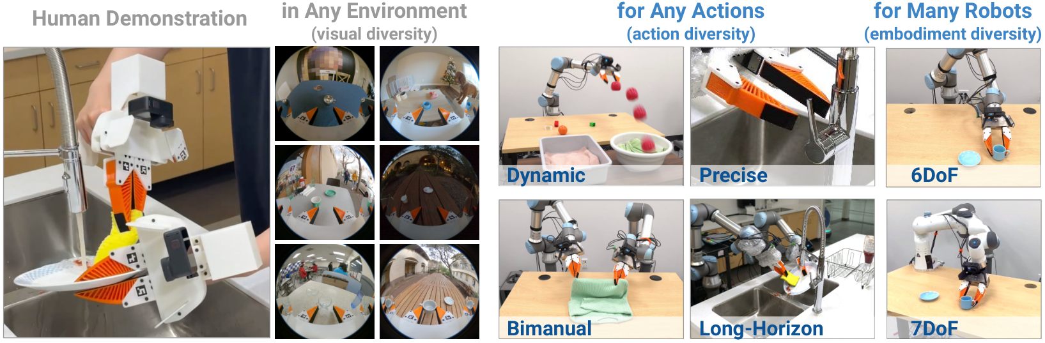
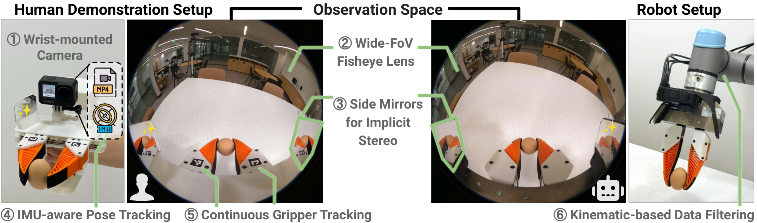
Prior Work · UMI
UMI
①
②
③
④
✗
✓
✓
✗
UMI: make the collection device identical to the robot's end-effector
Same soft gripper on both sides, a wrist camera for observation, and the data deploys across robots
$73 + $298
3×
printed parts + GoPro kit
faster than SpaceMouse teleop
71.7 %
in-the-wild cup task, 30 locations, 1400 demos
Chi et al., "Universal Manipulation Interface," arXiv:2402.10329, Fig. 1
INSIGHT
LIMITATIONS
Identical soft gripper on the handheld device and the robot
Wrist GoPro, 155° fisheye + side mirrors: observation aligned with action
Latency matching + relative-trajectory actions → cross-robot deployment
Parallel gripper only: no dexterity
State only: grasp force never recorded
Kinematic feasibility unknown at collection time
UMI hardware (Fig. 2): soft gripper, fisheye camera, mirrors
Transition: a gripper cannot do dexterous tasks. What if we replace it with a hand?
Notes:
UMI 的贡献是让无本体数据能直接训练出可部署的策略，而不是"开创了无机器人采集"（2020 年就有 Grasping in the Wild）。做法：采集设备和机器人末端长得一样，腕部 155° 鱼眼相机加侧面镜子，延迟匹配加相对轨迹动作，所以数据能跨机器人部署。局限：平行夹爪；只采 state；采集时不知道机器人运动学是否可行，只能事后过滤。过渡：夹爪做不了灵巧操作，换成手会怎样？

Slide 5
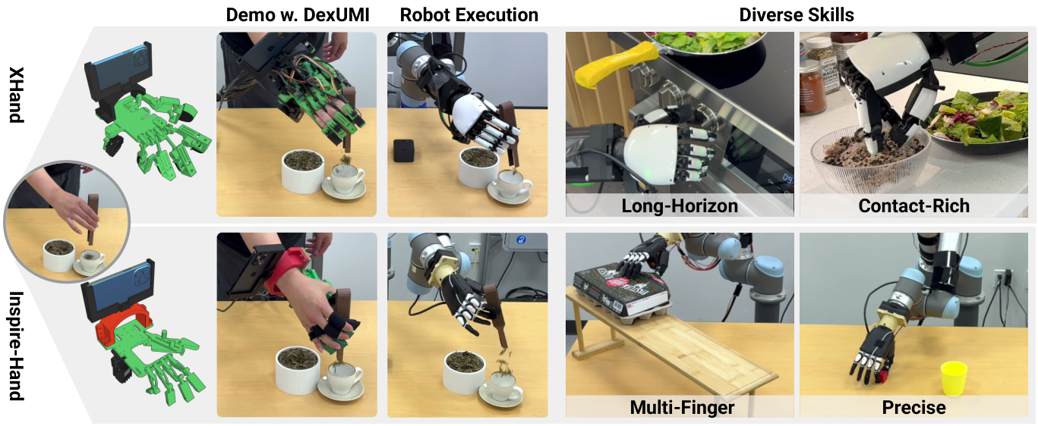
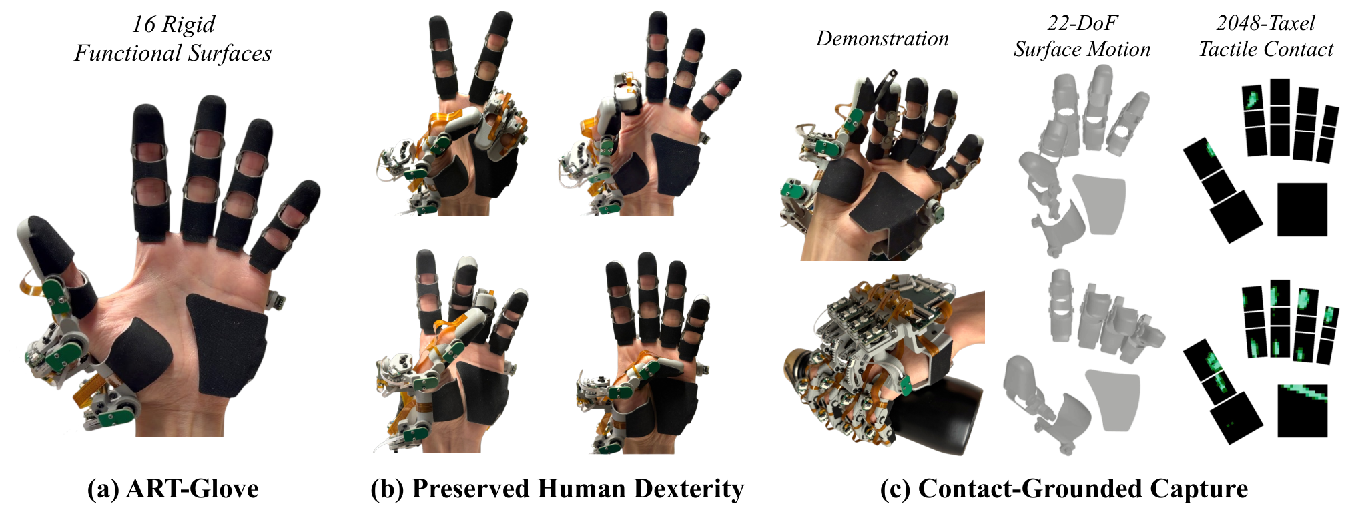
Exoskeletons
DexUMI
①
②
③
✓
④
✗
ART-Glove
①
✓
②
✗
③
✓
④
✗
DexUMI fits the exoskeleton to a robot hand; ART-Glove fits it to the human hand
Neither has the robot in the loop: the human, not the actuator, bears the contact
DEXUMI: ROBOT-FIRST
ART-GLOVE: HUMAN-FIRST
Xu et al., "DexUMI," arXiv:2505.21864, Fig. 1
Lin & Zhao, "ART-Glove," arXiv:2606.16370, Fig. 1
Hardware adaptation: exoskeleton optimized to the robot's fingertip workspace, joint encoders
Software adaptation: segment the human hand (SAM2), inpaint, render the robot hand back
86 % average success on Inspire (6 active) and XHand (12 active)
Authors' limits: per-hand tuning; human force > robot force so tactile drifts; fixed camera
16 rigid plates, 22 encoder-measured joints aligned to anatomical joints, 2048 taxels at 120 Hz
Kapandji 10/10: the hand is almost unconstrained
Measurement only: no robot, no policy; normal force only, one size
Future work in the paper: an actuated hand built on the glove geometry — our direction
Real contact in both, but the human feels the object; the robot never does
Notes:
左：DexUMI 是"机器人优先"，外骨骼按商用手的指尖工作空间优化，用编码器读关节角，再用 SAM2 和 ProPainter 把机器人手贴回图像，平均成功率 86%。但每只手要单独调参，人手力比机器人大所以触觉读数会漂移，渲染仍需真机。右：ART-Glove 是"人手优先"，22 个解剖关节全部编码器测量，2048 触点，但没有机器人、没有策略结果；作者未来工作要做"按手套几何的驱动手"，正是我们的路线。

Slide 6
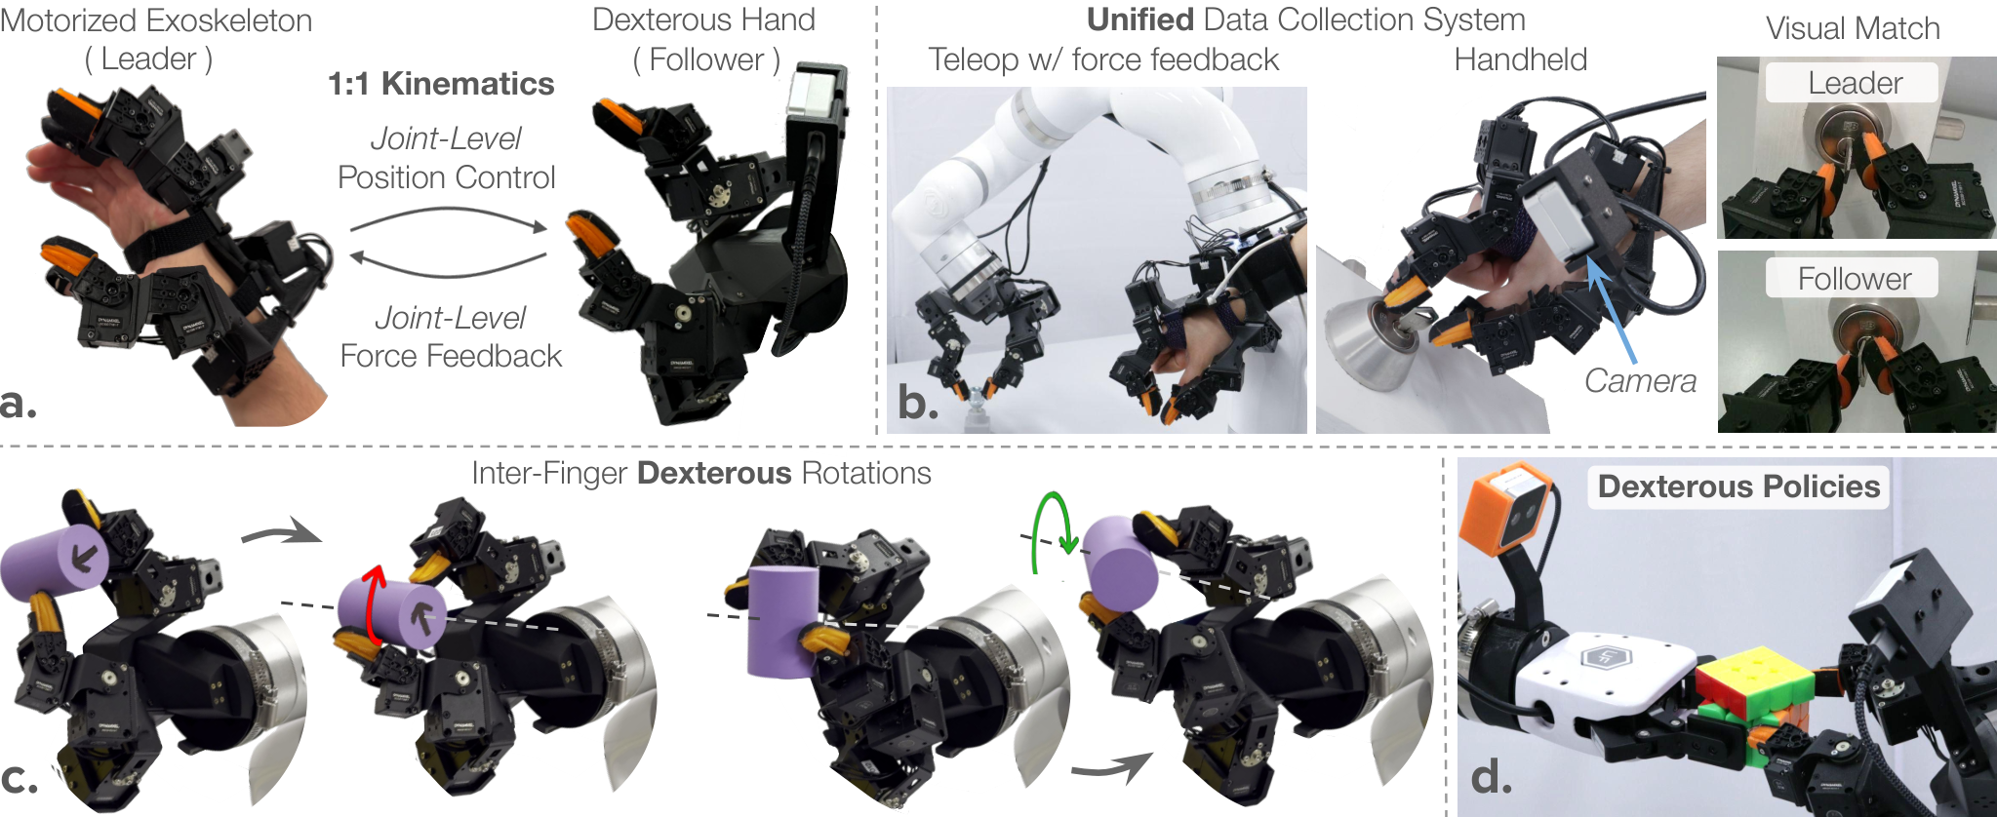
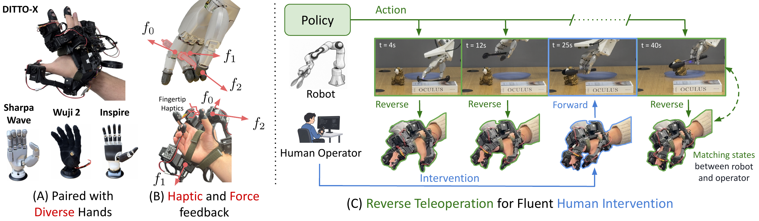
DITTO / DITTO-X
DITTO
①
②
✓
③
✓
④
✓
DITTO-X
①
②
③
✓
④
✓
DITTO closes the loop with an equivalent leader; DITTO-X trades isomorphism for generality
The closest work to ours: joint-level force feedback from follower current, then one exoskeleton for three hands
DITTO (2026-09): 1:1 KINEMATICS, 7 DoF
DITTO-X (2026-10): ONE EXOSKELETON, THREE HANDS
DITTO-X, arXiv:2610.00781, Fig. 1
DITTO, arXiv:2609.19196, Fig. 1
Index and middle 1:1; thumb retargeted in task space, force via Jacobian pseudo-inverse; ring and pinky coupled
Force feedback + fingertip vibration are complementary
Reverse teleoperation: take over a running policy; DAgger improves over two rounds
Leader and follower kinematically equivalent: thumb 4 + index 3, 1:1 motor mapping
Joint-level force feedback from follower current, 200 Hz
With feedback, users apply about half the contact force
0 % → 70 %
6.9 N vs 13.0 N
86.1 % vs 61.1 %
78.3 % vs 27.7 %
handheld-only data vs +10 teleop episodes at hold & lift
contact force with vs without force feedback
size discrimination, both channels vs either alone
takeover success, DITTO-X vs Manus glove
Generality cost isomorphism. We take the other end of that trade-off
Notes:
DITTO：主从运动学等价，拇指 4 加食指 3 共 7 自由度，1:1 电机映射，用从手电流算关节级力反馈，200 Hz；有力反馈时用户接触力约减半（6.9 N 对 13.0 N）；手持数据 0% 对加 10 条遥操作 70%。DITTO-X：为通用性放弃同构，一个外骨骼驱动 Sharpa、Wuji、Inspire；食指中指 1:1，拇指任务空间重定向，力用雅可比伪逆估计；力反馈加振动才有 86.1% 的物体大小辨识率，去掉任一通道 61.1%；反向遥操作接管 78.3% 对 Manus 27.7%。老师读过这篇，我们的差异必须讲成：同构做到 4 指 13 自由度、拇指完整、主从一起设计。

Slide 7
Our Position
Design the glove around the human hand, then derive an identical robot hand
Human-first and fully isomorphic: every one of the 13 joints maps 1:1, so force, takeover and data need no retargeting
 | UMI | DexUMI | ART-Glove | MILE | DITTO | DITTO-X | Ours
Dexterity | parallel gripper | Inspire 6 active / XHand 12 | 22 DoF measured | 4 fingers, 17 DoF | 2 fingers, 7 DoF | 3 fingers (~9 motors) | 4 fingers, 13 DoF
Correspondence to the robot | identical gripper | fingertips only | none (retargeting) | 1:1, exoskeleton first | 1:1 | index, middle 1:1; thumb retargeted | all 13 joints 1:1
What the operator feels | real contact | real contact | real contact | nothing (tactile on screen) | rendered joint force | joint force + fingertip vibration | rendered joint force
Robot in the loop | no | no | no | yes | yes | yes, reverse teleop | yes (sim / glove #2; robot hand next)
Policy results | yes | yes, 86 % avg. | none | yes, 76 % avg. | yes | yes, with DAgger | not yet
GENERALITY ⟷ FIDELITY
WHAT ISOMORPHISM BUYS
generality
fidelity
Force feedback joint-to-joint: no estimation, no retargeting
Reverse teleop is exact: write joint angles, no inverse kinematics
The simulation twin is the robot itself; recorded data needs no retargeting
Closest pair: MILE (SJTU 2025) also builds the hand from a 17-DoF exoskeleton, but the exoskeleton is passive: no force to the operator. Ours puts motors in the glove → bilateral feedback, stiffness as action
DITTO-X
one exoskeleton, many hands
Ours
one pair, all 13 joints 1:1
Same idea as isomorphic leader arms (GELLO, HOMIE), taken to a 13-joint hand. Cost: we must build the hand ourselves
Notes:
对比表后，讲通用性与保真度的取舍轴：DITTO-X 在通用那端，我们在同构那端。同构的四个好处：力反馈关节对关节、不用估计不用重定向；反向遥操作直接写关节角、不用逆运动学；仿真孪生就是机器人本身；采到的数据不需要重定向。代价：机械手要自己造，机器人手运动学被人手约束。类比 GELLO、HOMIE 的同构主臂。最接近的工作是 MILE（上海交大，2025-11）：先按人手设计 17 自由度的外骨骼，再按外骨骼做机械手，关节一一对应、不用重定向，指尖有视触觉，四任务 76% 对手套基线 28%。但 MILE 的外骨骼是纯编码器的、被动的，论文自己写了"不向操作者提供任何主动力或触觉反馈"，并把它列为未来工作。我们的手套里有电机，所以多了双边力反馈，而且刚度可以当动作。

Slide 8
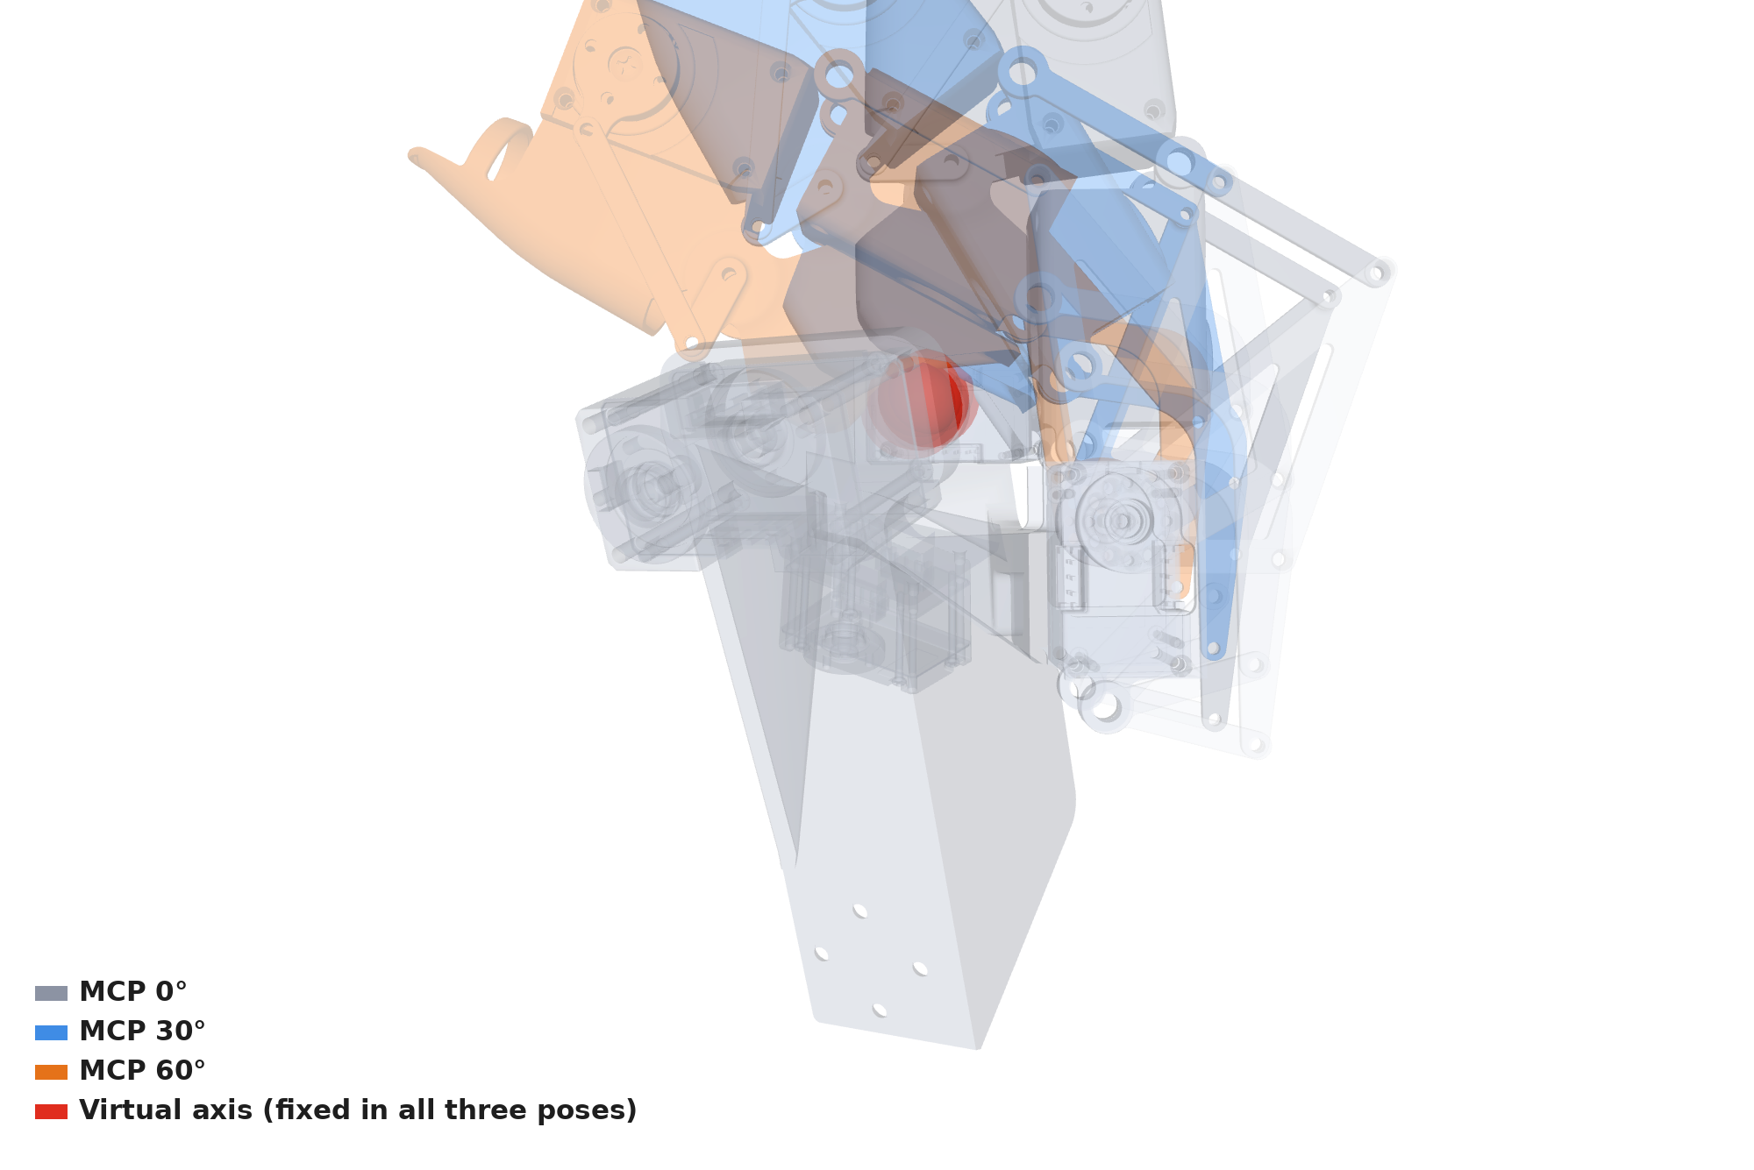
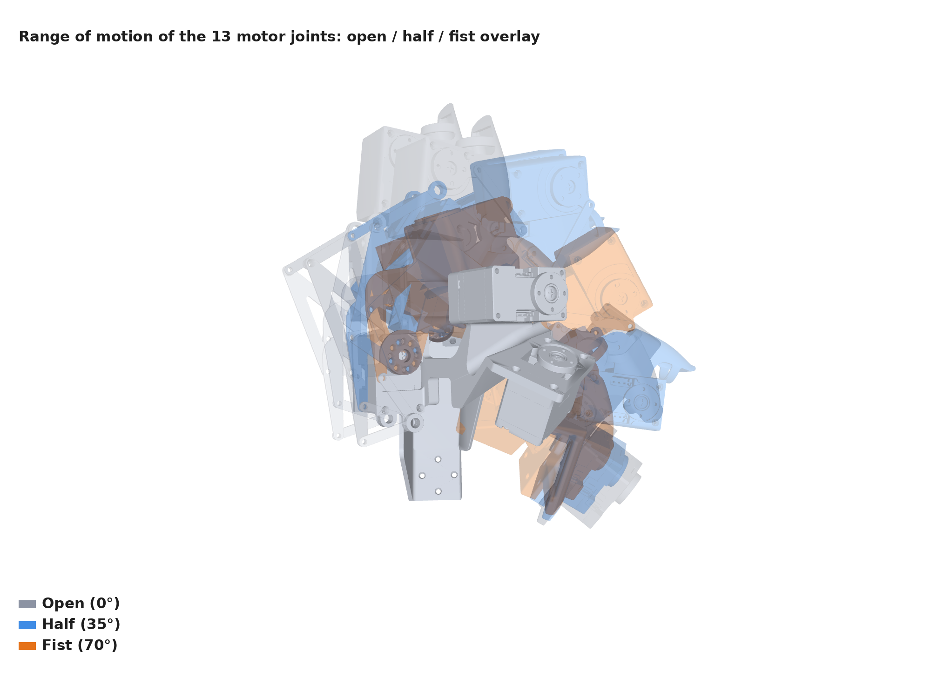
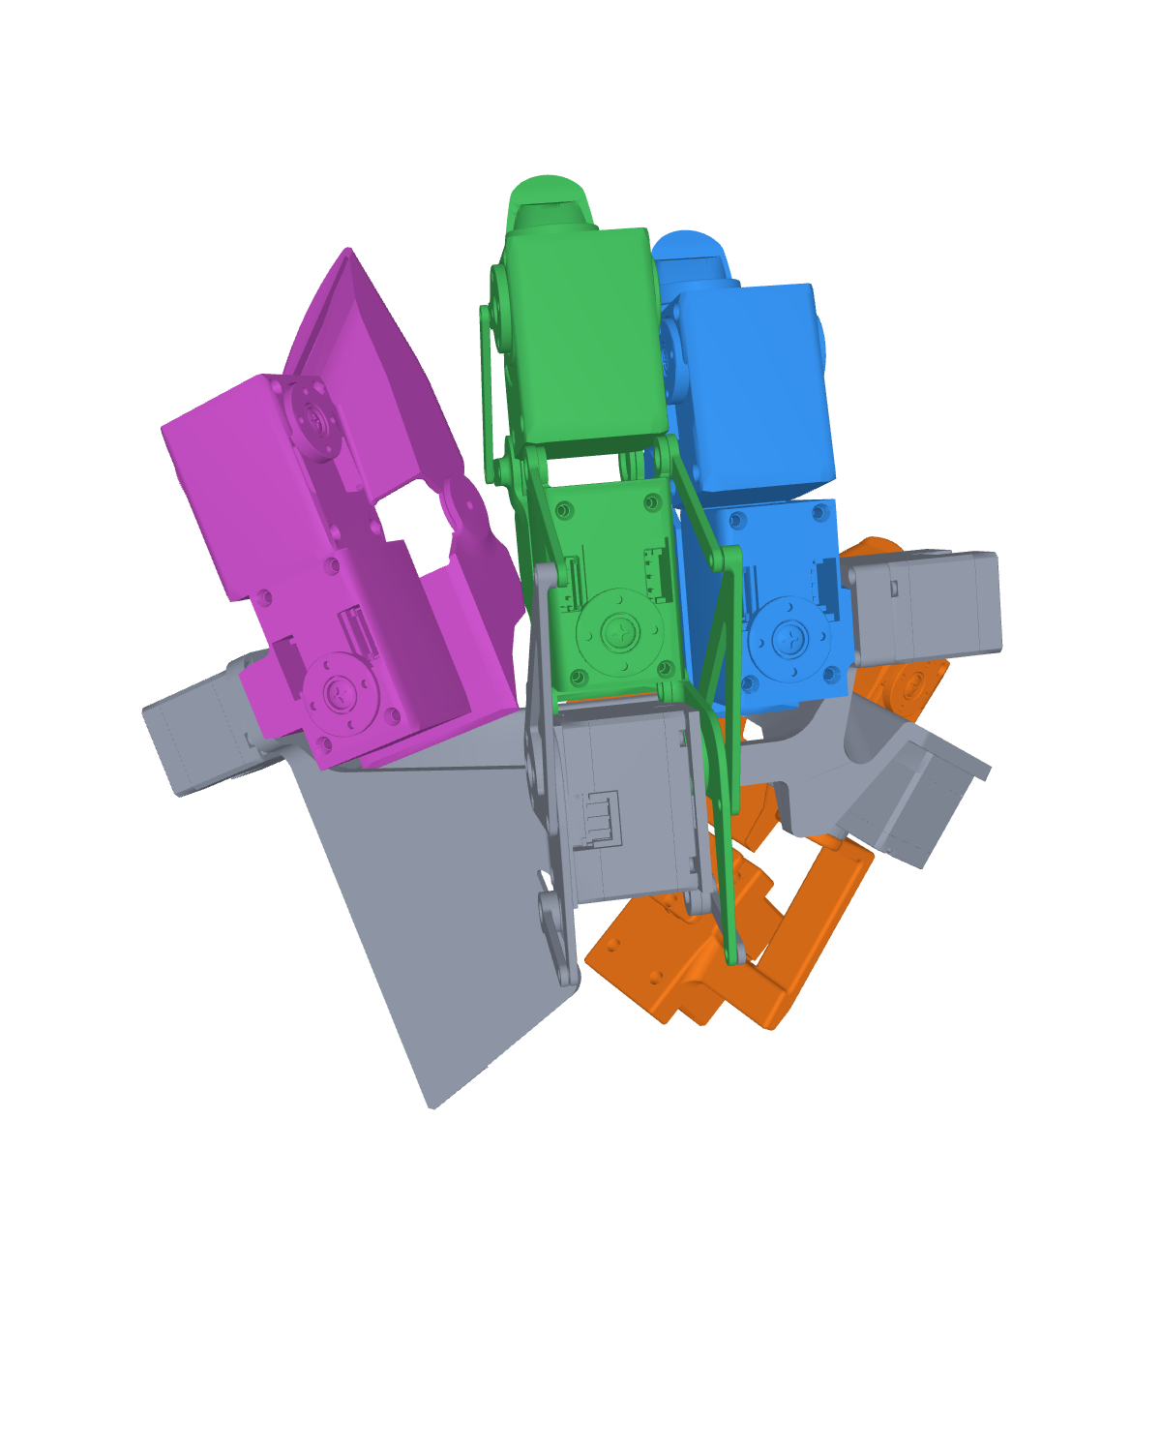
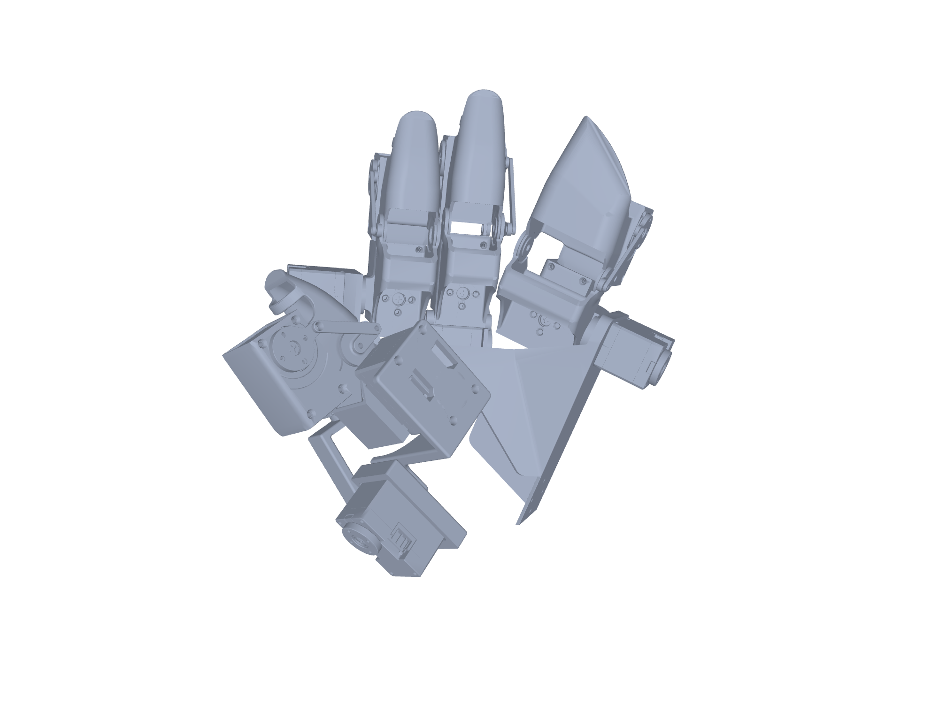
Design
Why a glove is hard to wear: the hand leaves little room where the glove needs it most
Four constraints that shaped the 13-joint layout
Joint axes are hidden
The thumb sweeps wide
No room between fingers
Hands differ in size
The MCP axis lies under the skin, so the motor cannot sit on it. A double parallelogram puts a virtual axis there while the motor stays outside the finger
From open to opposition the thumb needs abduction, flexion and two more joints: four motors on the thumb alone, mounted to clear the palm
Three finger modules sit side by side on the dorsal base; linkages and motors must clear their neighbours through the whole range
DexEXO models hand lengths of 140–217 mm. Our glove is one size today; sizing is on the limitations slide
Our middle-finger MCP, 0° / 30° / 60° overlay
Our CAD, open / half / fist overlay
Our CAD, one colour per finger module
DexEXO, arXiv 2603.17323
Every one of these shows up again on the next slide as a design decision
Notes:
四个约束：关节轴藏在手掌里（MCP 轴在皮肤下面，电机放不到轴上）；拇指扫过的范围很大（从张开到对掌，要 4 个关节）；手指之间没有空间（三个模块并排，连杆和电机不能互相碰）；手的尺寸差别大（DexEXO 按 140–217 mm 的手长设计；我们现在只有一个尺寸，这是局限）。

Slide 9
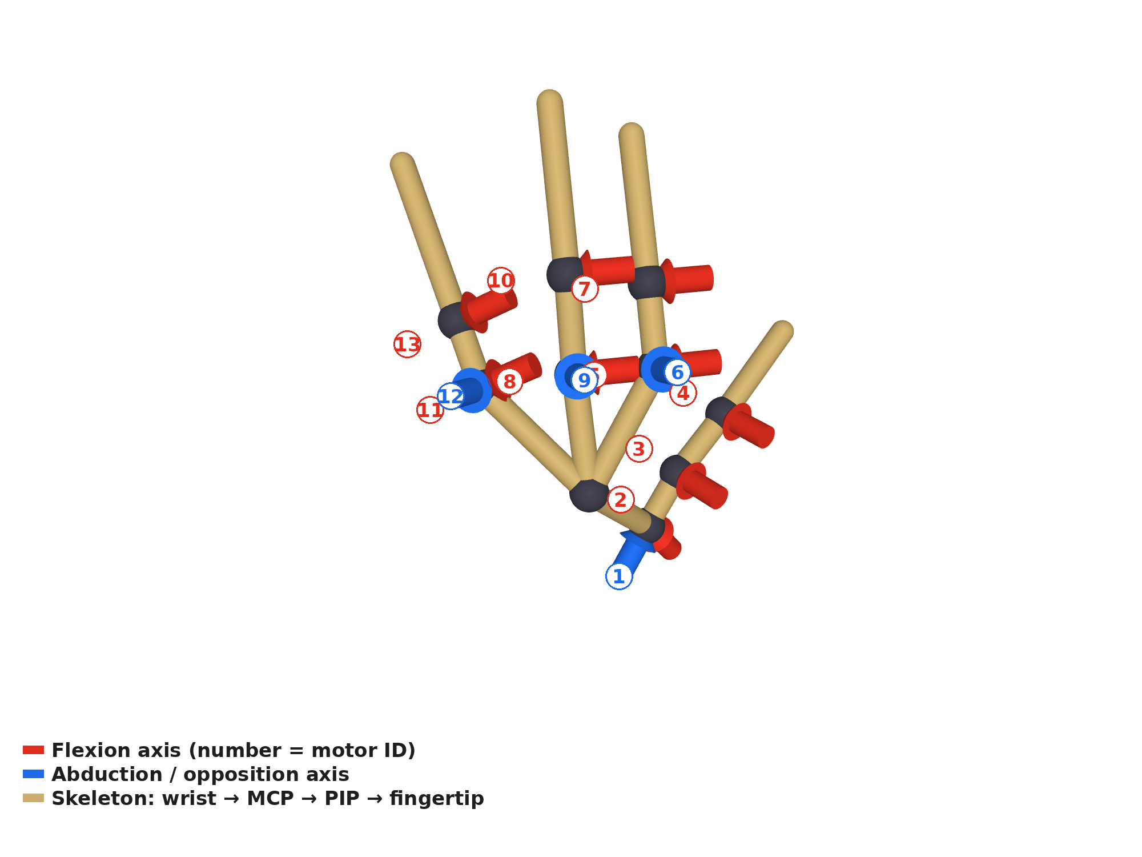
Design
13 joints, four fingers, every axis where the human joint is
Thumb 4 + index / middle / ring 3 each; a double-parallelogram MCP puts the middle-finger axis inside the finger
Thumb ID 1–4 · index 5–7 · middle 8–10 · ring 11–13
Middle-finger MCP: 0° / 30° / 60° overlay, the red virtual axis never moves
ACTUATION AND ELECTRONICS
13 × DYNAMIXEL XL330; distal PIP / IP joints use 77.5:1 (easier to back-drive), others 288:1
OpenRB-150 bridge, 1 Mbps bus, 6 V pack, all 13 motors read and written at ≈ 220 Hz
Onshape → URDF / MuJoCo export is automated, closed chains included
Skeleton of the glove: red = flexion axes, blue = abduction / opposition, numbers = motor IDs
Human-first: the glove is designed on the human hand, the robot hand is derived from it
Notes:
布局：拇指 4（CMC 侧摆、CMC 弯曲、MCP 弯曲、IP），食指、中指、无名指各 3（MCP 弯曲、MCP 侧摆、PIP），没有小指。中指 MCP 用双平行四边形做出虚拟转轴，电机不在转轴上，这是"按人手关节轴设计"的证据。远端 4 个关节用 77.5:1 的 XL330-M077 便于反拖，其余 288:1。OpenRB-150，1 Mbps，6 V，约 220 Hz。

Slide 10
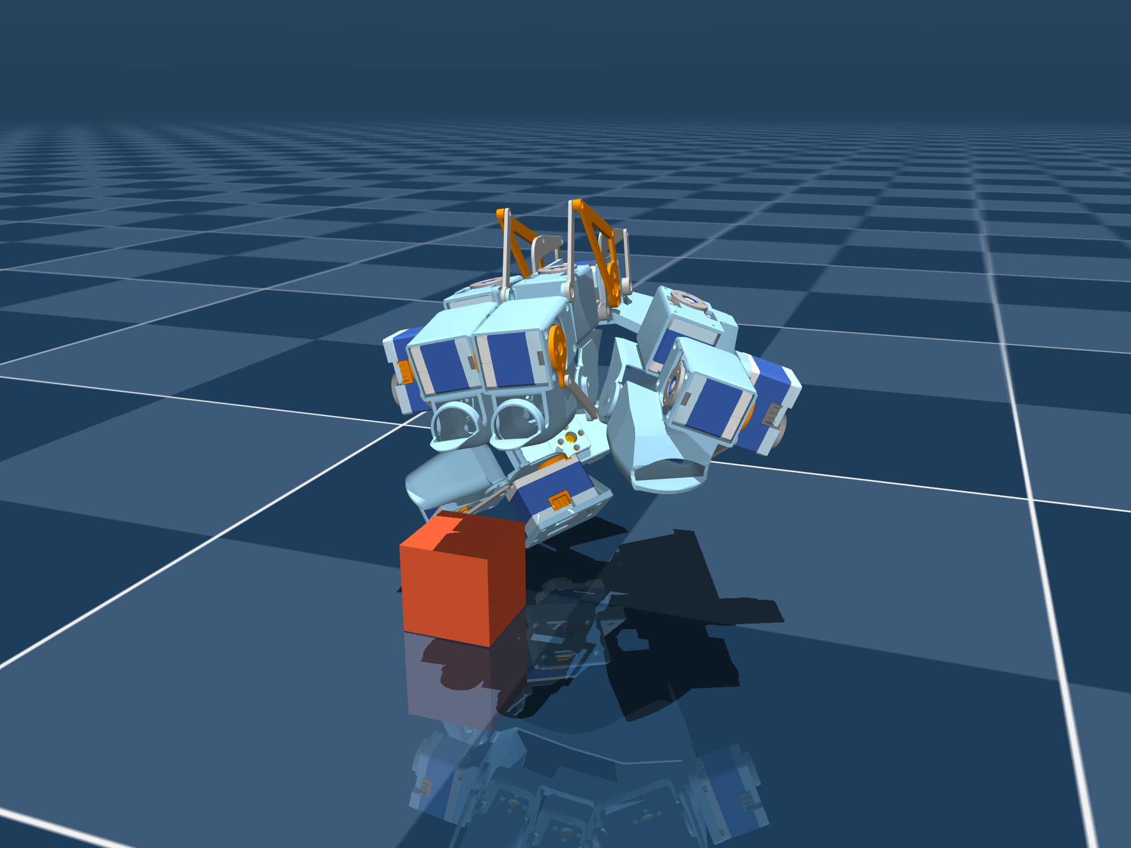
Progress
It works: sim-in-the-loop force feedback and a two-glove bilateral pair
Position goes forward, force comes back, only in contact and only against penetration
Leader glove (worn)
q_L
PC ≈ 220 Hz
q* = q_L
Follower hand
≈ 220 Hz
0.06 N·m
13 × XL330, current mode
renders feedback torque
MuJoCo twin or glove #2
τ = −kp(|e| − db)·sign(e)
position mode + current limit
blocked → error e grows
13 motors read + written (DITTO: 200 Hz)
per-joint limit (DITTO: 0.08)
I_L ← τ
q_F, I_F
MuJoCo twin driven by the glove: open, then grasp and lift the cube 7.8 cm
[VIDEO 1] glove drives the MuJoCo hand; the operator feels the cube
[VIDEO 2] two gloves: follower pinches a cup → leader pushed back
Force only in contact, only outward, with a 13-channel current budget and a 100 ms bus watchdog
Notes:
先放视频再讲参数。链路：Onshape 自动导出 URDF 和 MuJoCo，13 个电机标定完成。控制律：e = q_leader − q_follower，τ = −kp(|e| − 死区)·sign(e)，kp 0.4 N·m/rad，死区 ±2°，单关节上限 0.06 N·m（DITTO 0.08），只在接触时出力、只往外推，13 路电流总和有上限，约 220 Hz（DITTO 200 Hz）。视频 1：手套驱动 MuJoCo 虚拟手抓积木，碰到积木时人捏不下去，虚拟手抓起 7.8 cm。视频 2：两只手套，从手被挡住，主手被往回推。

Slide 11
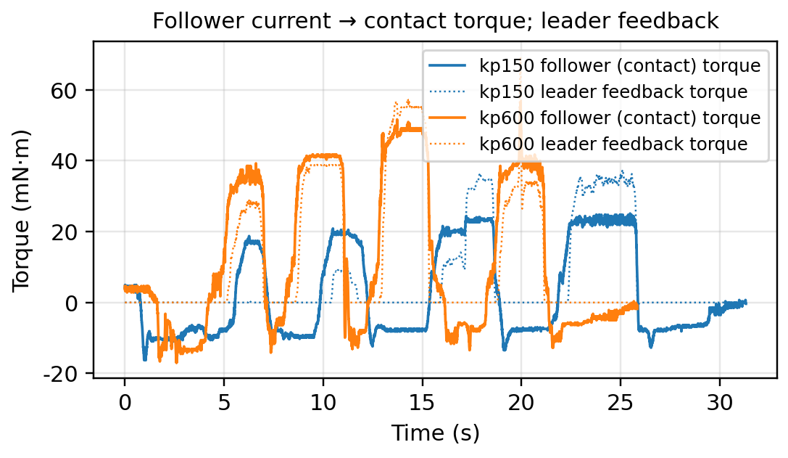
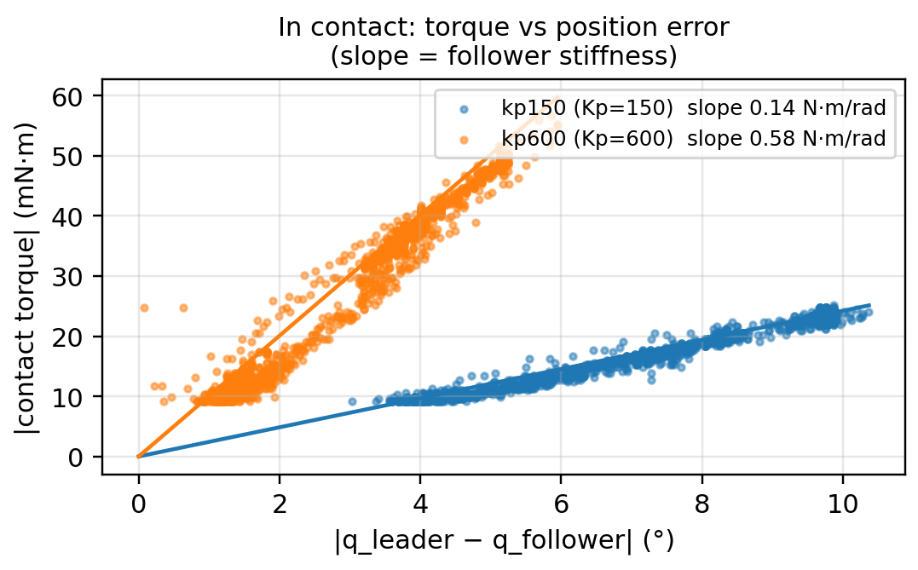
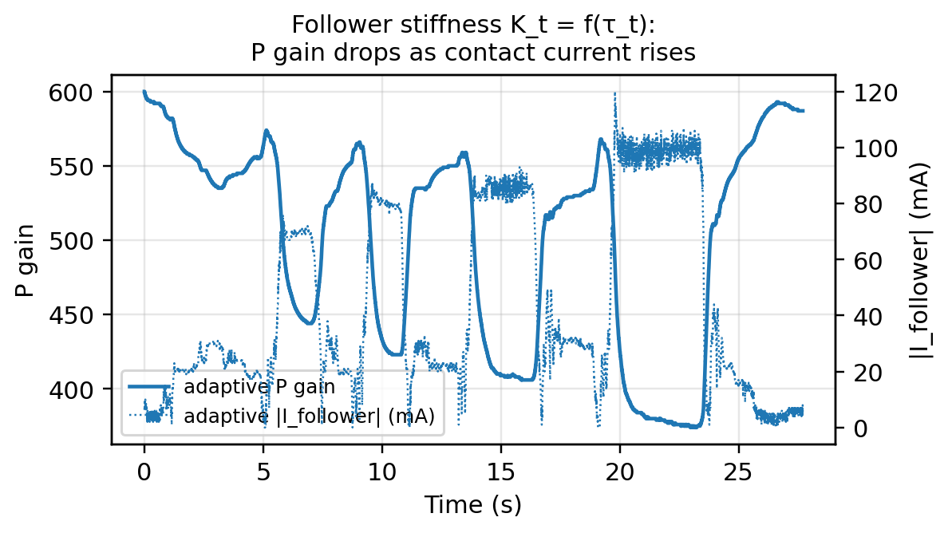
Force & Impedance
Every cycle we log command, result and force; stiffness itself can be an action
Three ways to turn the recorded force into supervision: observation, action, or impedance
Logged, 13 joints × 220 Hz
① Force as observation
③ Impedance as action
Deployment
q* leader angle = command
q follower angle = result
τ follower current × Kt = contact torque
I current rendered to the operator
K_t follower stiffness this cycle
policy input += τ
current is available at deployment · FACTR
action chunk = (q*, K_t)
τ_cmd = K(q* − q) + D(q̇* − q̇)
label K_t = f(τ_t): high force → soft (ACP rule)
XL330 P / D gains writable online
ACP, Comp-ACT, CompVLA
isomorphic robot hand
same controller
no retargeting
② Force as action
action chunk = (q*, τ*)
hybrid position / force control
Goal Current is the action · Bi-ACT
MEASURED ON THE TWO-GLOVE PAIR: INDEX MCP PINCHING A PAPER CUP, Kp 150 vs 600, AND Kp SCHEDULED BY CONTACT CURRENT
Same pinch, same q*: 25 mN·m with Kp 150 vs 57 mN·m with Kp 600 — the robot's force is set by K, so K belongs in the action
Notes:
重点页。记录：q*（主手指令）、q（从手结果）、τ（从手电流 × Kt = 接触力矩）、I（渲染给人的电流）、K_t（从手当周期的刚度）。方法 1 力作观测：策略输入多一项 τ，部署时同一只手的电流同样可得。方法 2 力作动作：策略输出 (q*, τ*)，底层混合位置/力控制，Goal Current 当动作。方法 3 阻抗作动作：策略输出 (q*, K_t)，底层阻抗控制 τ = K(q* − q) + D(q̇* − q̇)；标签 K_t = f(τ_t)：力大就软、空中就硬（ACP 规则）；XL330 的 P、D 增益通电可改写，所以 (q*, Kp, Kd, 电流上限) 可整组作为动作。实测（食指 MCP，捏纸杯）：Kp 150 时刚度 0.14 N·m/rad、最大夹持力矩 25 mN·m；Kp 600 时 0.58 N·m/rad、57 mN·m，斜率比 4.1 对 Kp 比 4.0，K ≈ Kp/1030。自适应那段接触电流升到 100 mA 时 Kp 从 600 降到 380，规则跑通。同一个位置指令下机器人出多大力由 K 决定，所以 K 要进动作。

Slide 12
Outlook
What is missing, and what we do next
The scorecard again, honestly: one half circle, and the plan to fill it
LIMITATIONS
NEXT STEPS
QUESTIONS FOR THE GROUP
No physical robot hand yet: feedback comes from the MuJoCo twin or glove #2
No user study, no policy results
No fingertip vibration (DITTO-X ablation: both channels needed)
No pinky, one glove size
Back-drive friction of 288:1 joints not quantified (DITTO chose 181:1)
Power: 5-cell NiMH drifts 5.0–7.0 V around the 3.7–6.0 V XL330 spec; one 12 V-class motor runs under-volted
1
Build the isomorphic robot hand
Gear ratio: transparency vs torque?
How many thumb DoF are worth it?
Should the pair also drive non-isomorphic hands?
2
Quantify and compensate back-drive friction
3
Validate methods ① → ② → ③ on the real pair
Ours, today
4
User study: force feedback on / off
✓
① Dexterous
✓
② No embodiment gap
✓
③ Operator feels contact
④ Robot in the loop
5
Reverse teleoperation + DAgger
④ becomes ✓ the day the robot hand exists
Ongoing work with E. Adelson · exploring broader collaboration
Notes:
用小卡讲那个半圆：机械手还没造，力反馈来自仿真或第二只手套；没有用户实验和策略结果；没有指尖振动（DITTO-X 消融说两个通道都需要）；没有小指，手套只有一个尺寸；288:1 的反拖阻力要量化（DITTO 特意选 181:1）；6 V 略超 XL330 规格，拇指 MCP 那个 12 V 电机欠压运行。下一步：造机械手 → 量化并补偿反拖 → 方法 1 到 3 逐级验证 → 用户实验 → 反向遥操作和 DAgger。讨论题：减速比怎么选、拇指几个自由度、要不要兼顾非同构的手。

