Slide 1
Basic Image Operations
孙 焱
sun_yan@sjtu.edu.cn

Slide 2
pixel operation
点操作 (Point operation)
代数操作 (Algebraic operation)
几何操作 (Geometric operation)

Slide 3
Point Operation
Point operation:
  Output pixel’s gray level depends only upon the gray level of the corresponding input pixel.
  Contrast enhancement; contrast stretching; gray scale transformation;
  pixel-by-pixel copying operations, except that the gray levels are modified according to the transformation function.
  B(x,y) = f[A(x,y)]

Slide 4
Point Operation
Linear point operations:
D_{B} = f(D_{A}) = aD_{A} + b
  a>1: contrast increased; 0<a<1: contrast reduced
  a=1 & b≠0: shift gray level; a<0: reverse the contrast.
Nonlinear monotonic point operations:
f(x) = x+Cx(D_{m} – x)
D_{m:} maximum gray level;
C: determine the amount of increase (C>0) or decrease (C<0) in the midlevel gray range.

Slide 5
Application
Photometric calibration
Contrast enhancement
thresholding
Contour lines
clipping

Slide 6
Algebraic operation
Algebraic operation:
  Produce an output image which is the pixel-by-pixel sum, difference, product, or quotient of two or more images.
  If one of the input image is a constant, it can be treated as a linear point operation.

Slide 7
Definition
The four algebraic image-processing operations are expressed mathematically as:
C(x,y) = A(x,y) + B(x,y)
C(x,y) = A(x,y) - B(x,y)
C(x,y) = A(x,y) × B(x,y)
C(x,y) = A(x,y) ÷ B(x,y)
Where, A(x,y) and B(x,y) are the input images
C(x,y) is the output image.

Slide 8
Application
Image Addition:
  Averaging for noise reduction
  Double-exposure effect
Image Subtraction:
  Background subtraction
  Motion detection
  Gradient magnitude
Multiplication and division

Slide 9
M=1
Addition:
  averaging for noise reduction
M=2
M=4
M=16
Notes:
Matlab
-toolbox
image processing\feature-based logic

Slide 10
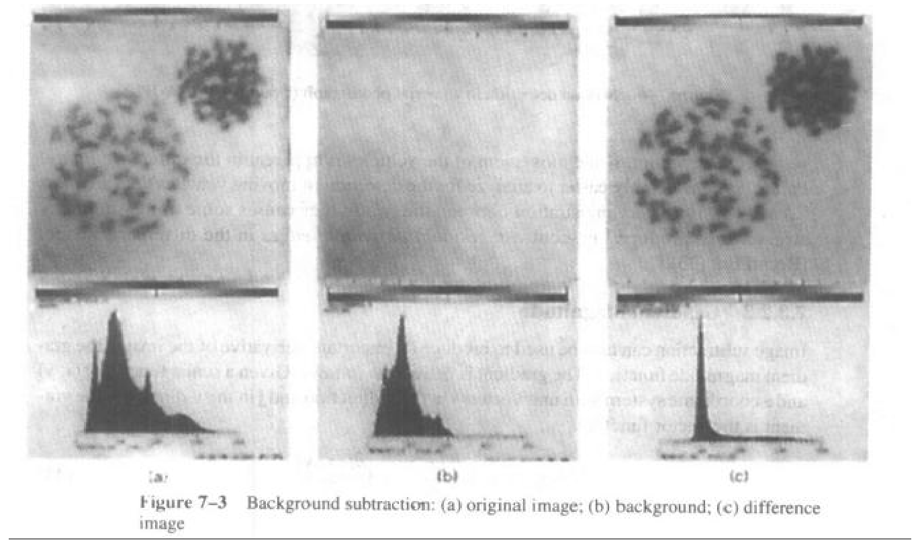
Subtraction
Notes:
Matlab
-toolbox
image processing\correction of nonuniform illumination

Slide 11
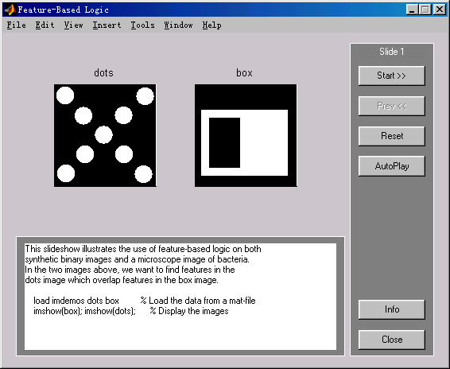
Multiplication
Notes:
Matlab
-toolbox
image processing\feature-based logic

Slide 12
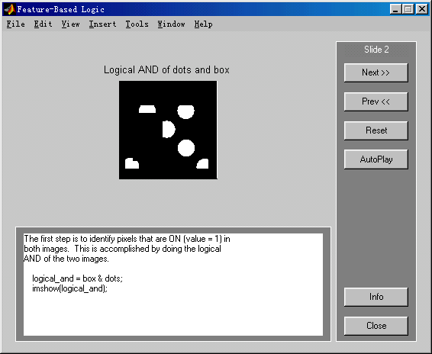
Multiplication
Notes:
Matlab
-toolbox
image processing\feature-based logic

Slide 13
Multiplication:
  masking used to zero out areas that you don’t want to use in calculations
(a)
(b)
x
(a) Magnetic resonance velocity image through the human neck. Multiplying by the mask in (b) isolates pixels corresponding to one of the carotid arteries. Averaging pixel values inside the masked region and multiplying by the area of the mask yields the average blood flow. (Image courtesy of D. A. Steinman, RRI.)
Notes:
A）人颈部核磁图像
乘图b中的掩模

Slide 14
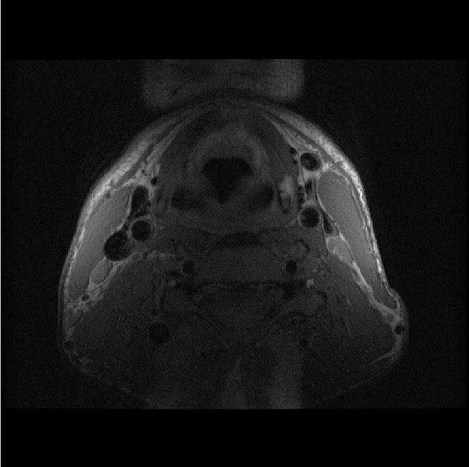
Division:
  image formation is often a multiplicative process:
  need to eliminate I(x, y) for better visualization and processing (e.g., thresholding)
Black blood MR image through neck of a subject. The rolloff in image intensity can be modelled as a multiplicative process. (Image courtesy of D. A. Steinman, RRI.)

Slide 15
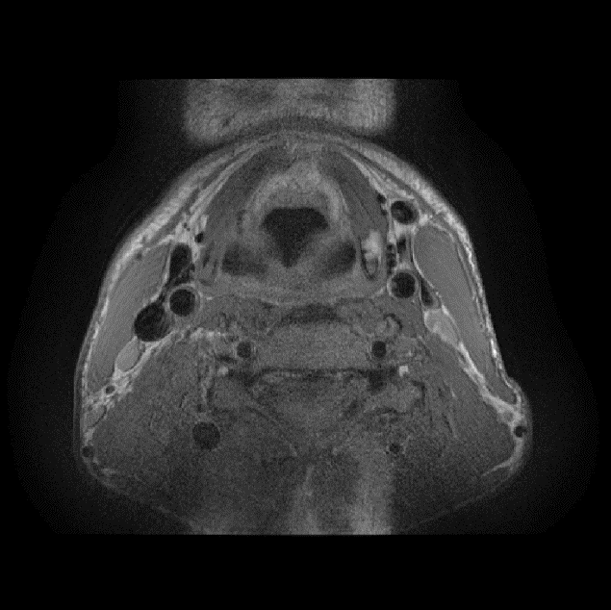
Division (cont’d):
  estimate I(x, y) and divide it out
  many procedures for estimating I(x, y); will cover one later (homomorphic filtering)
(a)
(b)
(a) Black blood MR image through neck of a subject. (b) Image after dividing out estimated rolloff function. (Image courtesy of D. A. Steinman, RRI.)
Notes:
Matlab
-toolbox
image processing\feature-based logic

Slide 16
Geometric Operation
Geometric operation:
  Change the spatial relationships among the objects in an image.
  Moving things around within the image.
  Two algorithms are required:
    Spatial transformation
    Gray level interpolation

Slide 17
Transformation
Simple transform:
  Suppose the coordinate before and after the transform are (x,y) and (x’,y’)
  Translation:
  Rotation:

Slide 18
Transformation
Scale change:
Order of transform
  Translation followed by scale change
  Scale change followed by translation

Slide 19
Typical Transformations
Scale change followed by rotation
Rotation followed by scale change

Slide 20
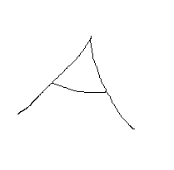
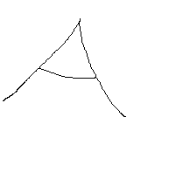
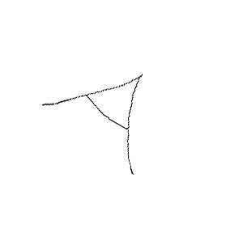
Application
Original
Translation
Rotation (30⁰)
Scale change (60%)

Slide 21
Interpolation Algorithm
Nearest Neighbor Interpolation:
Bilinear Interpolation (square interpolation):
Higher Order Interpolation:
  样条函数 （B-Spline）
  多项式函数 （Polynomials）

Slide 22
PROBLEM
SOLUTION
f(x’, y’)
g(x, y )

Slide 23
Interpolation methods:
Nearest neighbor
Bilinear
Bicubic,...
Nearest Neighbor (Zero order):
Example: From which input pixel (1, 2, 3 or 4) would you get the gray level of the output pixel?
The nearest neighbor algorithm selects the value of the nearest point and does not consider the values of neighboring points at all, yielding a piecewise-constant interpolant.
f(x’, y’)
g(x, y )
1
1
2
3
4

Slide 24
Bilinear (First-Order) Interpolation:
Gray level at non-integer coordinates found by interpolating values of four (4) neighboring pixels using bilinear function.
f(x’, y’)
x
y
g(x, y)

Slide 25
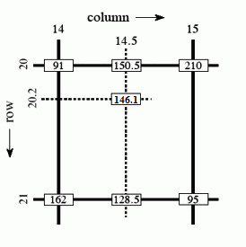

Bilinear Interpolation
With I(14,20), I(15,20), I(14,21) and I(15,21), we want to get interpolated value of I(14.5, 20.2).
We first calculate two interpolated values in X direction, using linear interpolation:
Then calculate interpolated value in Y direction.

Slide 26
Bilinear vs. Nearest Neighbour:
Original
Nearest Neighbor
Bilinear

Slide 27
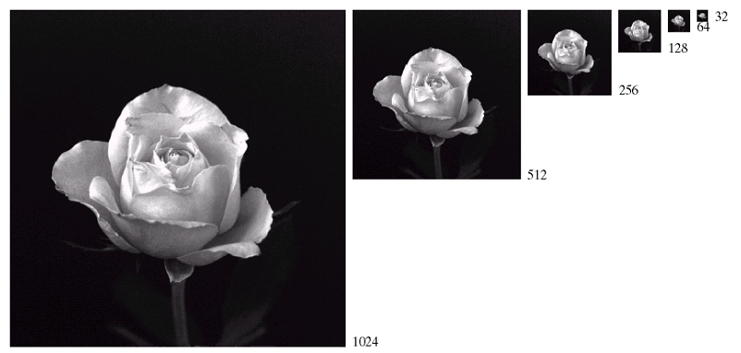

Slide 28
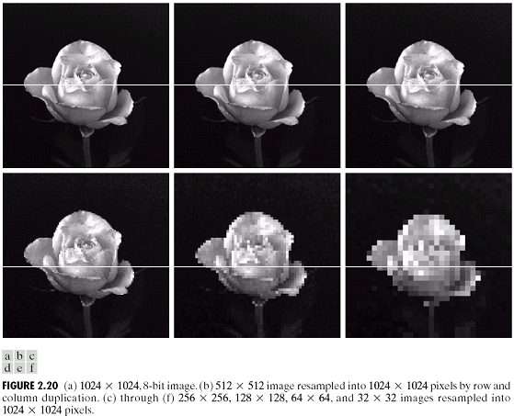
Resample into 1024*1024
Adapted from Gonzales and Woods

Slide 29
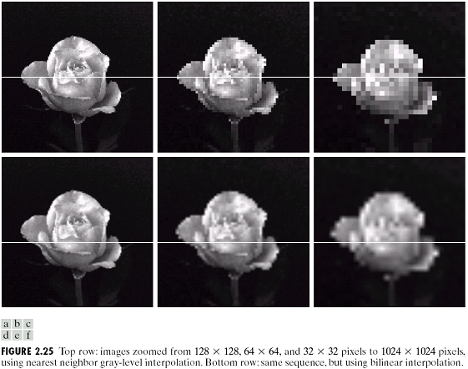
Interpolation
Adapted from Gonzales and Woods
Notes:
上行：最近邻
下： 双线性

Slide 30
Neighborhood Operators

Slide 31
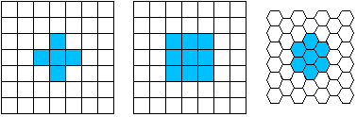
Neighborhood Operators
Pixel Connectivity:
for a pixel P(x,y)
    4-neighbours:
      N₄(P) = {(x+1,y), (x-1,y), (x,y+1),(x,y-1)}
    8-neighbours :
      N₈(P) = N₄(P) ∪{(x+1,y+1), (x+1,y-1),
    (x-1,y+1),(x-1,y-1)}
    4(8)-connected:
      two pixels within N₄(P) or N₈(P)

Slide 32

Connected Component Labeling
Connected components labeling:
    groups the pixels in an image into components based on pixel connectivity
    Labels components with a gray level or a color (color labeling)
Connected component labeling works by scanning an image, pixel-by-pixel (from top to bottom and left to right) in order to identify connected pixel regions
Intensity criterion(IC): the same set of intensity values ( 1 for a binary image; a value range for a gray level image)

Slide 33
Labeling Algorithm
Labeling algoirithm: for a pixel P satisfy IC
  Step 1 (First Scan):
    If all neighbors do not satisfy IC, assign a new label to P
    if only one neighbor satisfy IC, assign its label to P
    if one or more of the neighbors satisfy IC, assign one of the labels to P and make a note of the equivalences.
  Step2 (Resolve equivalence) : The equivalent label pairs are sorted into equivalence classes by a equivalence resolve algorithm ( e.g. Floyd-Warshall algorithm) and a unique label is assigned to each class
  Step3 (Second scan) : Each label is replaced by the label assigned to its equivalence classes

Slide 34
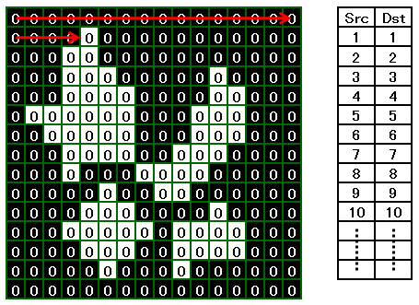
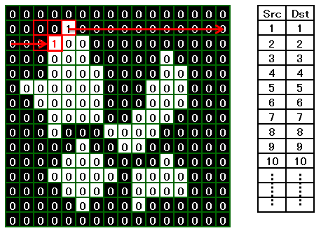

Slide 35
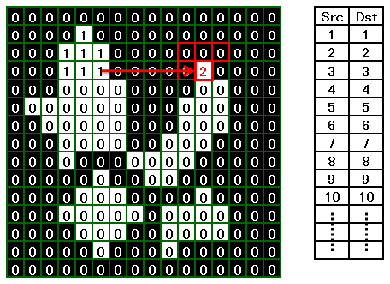
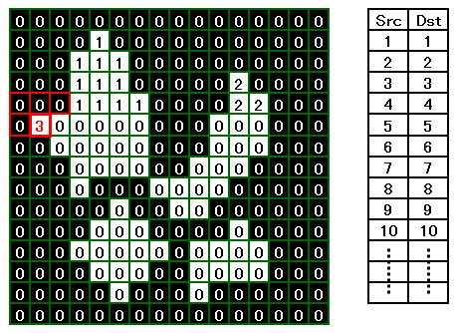

Slide 36
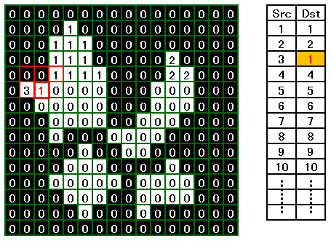
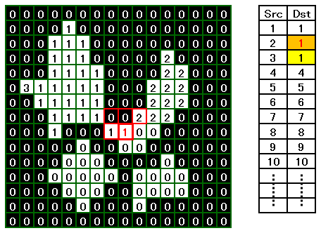

Slide 37
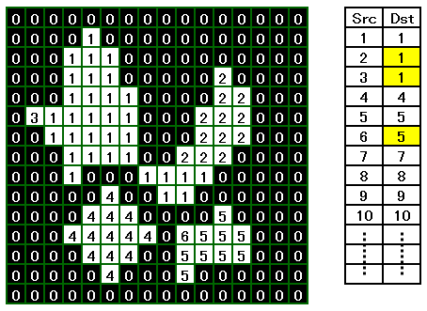
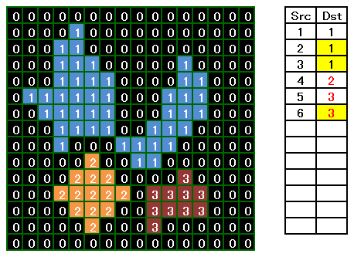

Slide 38
Region Property
Region Properties are important features for the region analysis (or measurement) after the regions have been labeled (segmented)
Region Properties:
    Perimeter and Area
    Center, Radius and Diameter
    Centroid Moments and Orientation
    Extreme Points and Curvature
    Intensity Properties

Slide 39
Region Property
Perimeter and Area:
  Perimeter: The length of the contour of a connected component (region).
    calculated from the chain-code of the contour,or
    estimated by the number of pixels on the contour.
  Area: The number of unit squares contained.
    Pick’s formula: A(P) = n_{I} + n_{B}/2-1
    n_{I} , n_{B} : number of interior points or the points lie on borders, respectively.

Slide 40
Region Property
Center, Radius and Diameter :
  Eccentricity of a point P in F is the maximum of distance d(p,q) for all points q∈F:
  ecc(p) = max d(p,q) | q∈F
  Center: The set of points P of least eccentricity
  Radius: The value of the least eccentricity d(p,p’)
  Diameter: The value of the greatest eccentricity d(p’,q’)
F
P’
q’
P
Notes:
偏心距

Slide 41
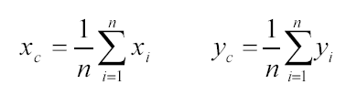

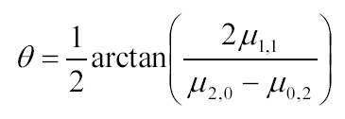
Region Property
Centroid Moments and Orientation:
  Centroid: Given F, a set of n connected pixels (x_{i},y_{i}), we can define a centroid c as:
  Moments: The discrete (k,l)-order central moment is defined as:
  Orientation: Orientation is defined here as an angle θ :

