Slide 1
Instruction Selection

Slide 2
Instruction Selection
Process of finding set of machine instructions
  that implement operations specified in IR tree.
Each machine instruction can be specified as
  an IR tree fragment -> tree pattern (tile)
Goal of instruction selection is
  to cover IR tree with non-overlapping tree pattern
  tiling

Slide 3
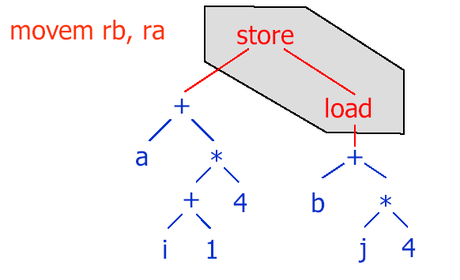
Tile

Slide 4
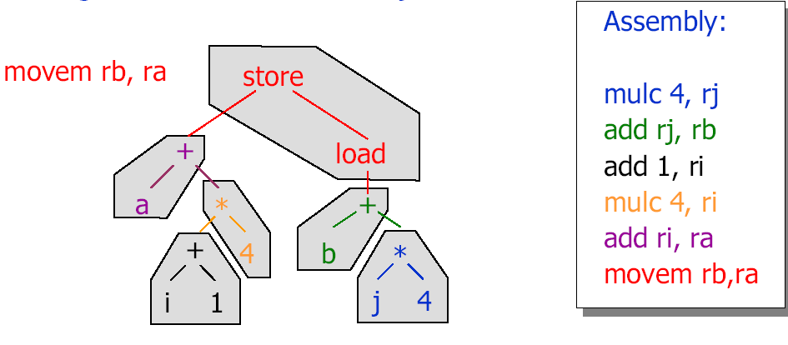
Tiling

Slide 5
The Jouette Architecture
Load/store architecture
Relative large, general purpose register file
  Data or address can reside in registers
  Each instruction can access any register
r₀ always contains zero
Each instruction has latency of one cycle
  Except MOVEM
Execution of only one instruction per cycle

Slide 6
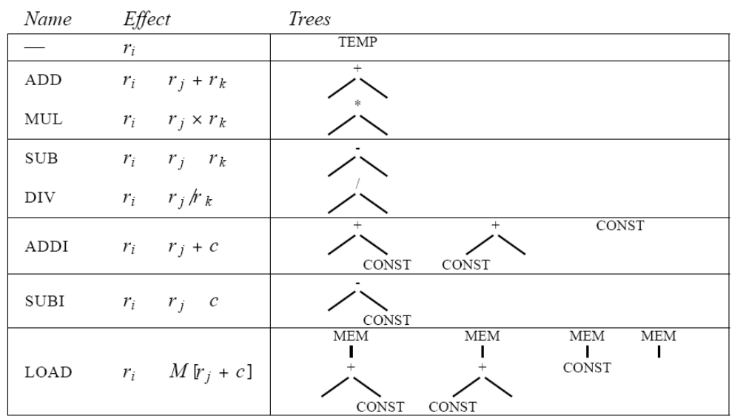
Instruction Tree Patterns
-
-

Slide 7
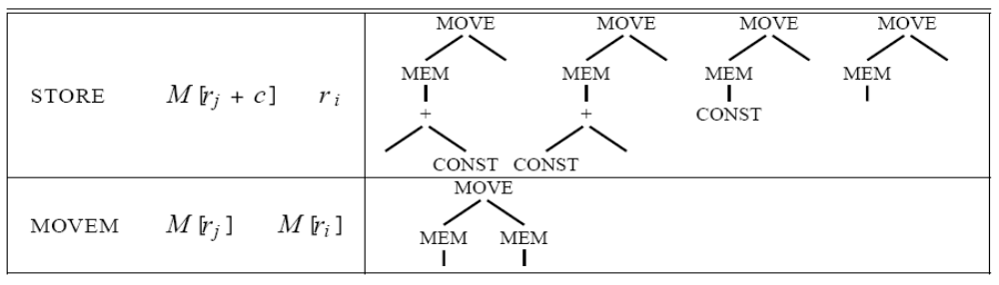
Instruction Tree Patterns

Slide 8
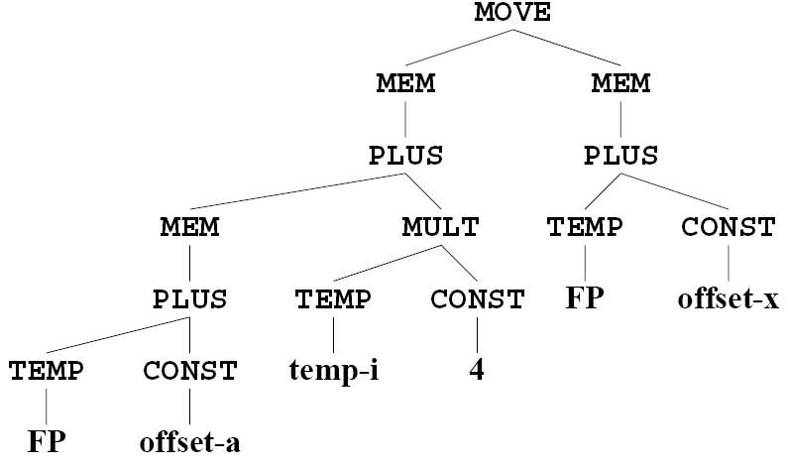
Example
a[i] : = x, assuming i in register, a and x in stack frame

Slide 9
Example
a[i] : = x, assuming i in register, a and x in stack frame

Slide 10
One Tiling Method
LOAD r₁ = M[fp+a]
ADDI r₂ = r₀ + 4
MUL r₂ = r_{i} * r₂
ADD r₁ = r₁ + r₂
LOAD r₂ = M[fp+x]
STORE M[r₁] = r₂

Slide 11
Another Tiling

Slide 12
Another Tiling
LOAD r₁ = M[fp + a]
ADDI r₂ = r₀ + 4
MUL r₂ = r_{i} * r₂
ADD r₁ = r₁ + r₂
ADDI r₂ = fp + x
MOVEM M[r₁] = M[r₂]

Slide 13
Node Selection
There exist many possible tiles
We want to have an instruction sequence of least cost
  Sequence of instructions that take least amount of time to execute.
  For single issue fixed-latency machine: fewest number of instruction

Slide 14
Node Selection (cont.)
Suppose each instruction has fixed cost:
  Optimum tiling:
    tiles sum to lowest possible value
    globally “the best”
  Optimal tiling:
    no two adjacent tiles can be combined into a single tile of lower cost
    locally “the best”

Slide 15
Node Selection (cont.)
Optimal instruction selection
  easier to implement
  is roughly equivalent to Optimum for RISC machines.
Optimal and Optimum are noticeably different for CISC machines.

Slide 16
Optimal Instruction Selection – Maximal Munch
Cover root node of IR tree with largest tile t that fits (most nodes)
  Tiles of equivalent size =>arbitrarily choose one
Repeat for each subtree at leaves of t.
Generate assembly instructions in reverse order
  instruction for tile at root emitted last

Slide 17
Maximal Munch

Slide 18
Maximal Munch

Slide 19
Maximal Munch

Slide 20
Maximal Munch

Slide 21
Maximal Munch

Slide 22
Maximal Munch
LOAD r₁ = M[fp+a]
ADDI r₂ = r₀ + 4
MUL r₂ = r_{i} * r₂
ADD r₁ = r₁ + r₂
ADD r₂ = fp + x
MOVEM M[r₁] = M[r₂]
6 instructions

Slide 23
Maximal Munch
Maximal Munch is quite easy to write in C
Two recursive functions:
  munchStm for statements
  munchExp for expressions
Each clause in these functions matches pattern/tile
Clauses ordered in order of tile preference

Slide 24
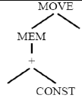
Maximal Munch
static void munchStm(T_stm t) {
switch (s->kind) {
case T_MOVE:
T_exp dst = s->u.MOVE.dst, src = s->u.MOVE.src ;
if (dst->kind = T_MEM) {
if (dst->u.MEM->kind = T_BINOP &&
dst->u.MEM->u.BINOP==T_PLUS &&
dst->u.MEM->u.BINOP.right->kind == T_CONST) {
T_exp e1=dst->u.MEM->u.BINOP.left, e2=src;
/*MOVE(MEM(e1+i), e2) */
muchExp(e1); muchExp(e2); emit(“STORE”);
}

Slide 25
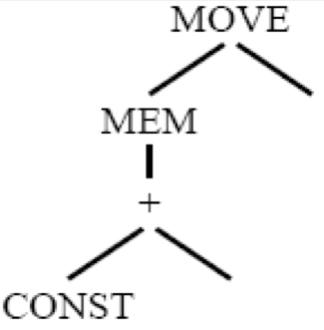
Maximal Munch
…...
case T_MOVE:
T_exp dst = s->u.MOVE.dst, src = s->u.MOVE.src ;
if (dst->kind = T_MEM) {
……
else if (dst->u.MEM->kind = T_BINOP &&
dst->u.MEM->u.BINOP==T_PLUS &&
dst->u.MEM->u.BINOP.left->kind == T_CONST) {
T_exp e1=dst->u.MEM->u.BINOP.right, e2=src;
/*MOVE(MEM(i+e1), e2) */
muchExp(e1); muchExp(e2); emit(“STORE”);
}

Slide 26
Maximal Munch
…...
case T_MOVE:
T_exp dst = s->u.MOVE.dst, src = s->u.MOVE.src ;
if (dst->kind = T_MEM) {
……
else if (src->kind==T_MEM) {
T_exp e1=dst->u.MEM, e2=src->u.MEM;
/*MOVE(MEM(e1), MEM(e2)) */
muchExp(e1); muchExp(e2); emit(“MOVEM”);
}

Slide 27
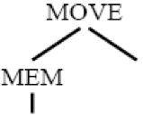
Maximal Munch
…...
case T_MOVE:
T_exp dst = s->u.MOVE.dst, src = s->u.MOVE.src ;
if (dst->kind = T_MEM) {
……
else {
T_exp e1=dst->u.MEM, e2=src;
/*MOVE(MEM(e1), e2) */
muchExp(e1); muchExp(e2); emit(“STORE”);
}
}

Slide 28
Maximal Munch
…...
case T_MOVE:
T_exp dst = s->u.MOVE.dst, src = s->u.MOVE.src ;
if (dst->kind = T_MEM) {
……
}
else if (dst->kind==T_TEMP) {
T_exp e2=src;
/*MOVE(TEMP~i, e2) */
muchExp(e2); emit(“ADD”);
}

Slide 29
Maximal Munch
static Temp_temp munchExp(T_exp t)
MEM(BINOP(+,e1,CONST(i))=>
muchExp(e1); emit(r ← “LOAD”); return r;
MEM(BINOP(+,CONST(i),e1)=>
muchExp(e1);emit(r ← “LOAD”); return r;
MEM(CONST(i)) =>
emit(r ← “LOAD”); return r;
MEM(e1)=>
muncExp(e1); emit(r ← “LOAD”); return r;

Slide 30
Maximal Munch
static Temp_temp munchExp(T_exp t)
BINOP(+,e1,CONST(i))=>
muchExp(e1); emit(r ← “ADDI”); return r;
BINOP(+,CONST(i),e1)=>
muchExp(e1); emit(r ← “ADDI”); return r;
CONST(i)=>
emit(r ← “ADDI”); return r;
BINOP(+, e1, e2)=>
muchExp(e1);muchExp(e2);emit(r ← “ADD”); return r;
TEMP(i)=> return i ;

Slide 31
Optimum Instruction Selection
Find optimum solution for problem
  tiling of IR tree
Based on optimum solutions for each subproblem
  tiling of subtrees

Slide 32
Optimum Instruction Selection (cont.)
Use Dynamic Programming
  to avoid unnecessary re-computation of subtree costs
Cost assigned to every node in IR tree
  Cost of best instruction sequence that can tile subtree rooted at node.

Slide 33
Optimum Instruction Selection (cont.)
Algorithm works bottom-up
  Cost of each subtree s_{j}(c_{j}) has already been computed
  (Maximum Munch is top-down)
For each tile t of cost c that matches at node n, cost of matching t is:
  c+∑c_{i}
Tile is chosen which has minimum cost.

Slide 34
Optimum Instruction Selection - Example
MEM(BINOP(PLUS, CONST(1), CONST(2)))
MEM(PLUS(CONST(1), CONST(2)))
MEM
+
CONST 1
CONST 2

Slide 35
Optimum Instruction Selection - Example
The only tile that matches CONST 1 is an ADDI instruction with cost 1
Similarly, CONST 2
Several tiles match the + node
+
CONST 1
CONST 2
Tile | instruction | Tile Cost | Leaves Cost | Total cost
 | ADD | 1 | 1+1 | 3
 | ADDI | 1 | 1 | 2
 | ADDI | 1 | 1 | 2
+
+
CONST
+
CONST

Slide 36
Optimum Instruction Selection - Example
Several tiles match the MEM node
Tile | instruction | Tile Cost | Leaves Cost | Total cost
 | LOAD | 1 | 2 | 3
 | LOAD | 1 | 1 | 2
 | LOAD | 1 | 1 | 2
MEM
MEM
+
CONST
MEM
+
CONST

Slide 37
Optimum Instruction Selection - Example
The last two matches will be optimum
Once the cost of the root node is found
Instruction emission phase begins
Emission(node n)
  for each leaf l_{i} of the tile selected at node n, perform Emission(l_{i})
  Emit the instruction matched at n
ADDI r₁ = r₀ + 1
LOAD r₁ = M[r₁ +2]

Slide 38
CISC Machines
For CISC Machine, some new problems are issued:
  Few registers
  Classes of registers
    Some operations available only on certain registers
    division instruction in Pentium needs both %rax and %rdx
  Two-address instructions
  Arithmetic operations can address memory
  Several addressing modes
  Variable-length instructions
  Instruction with side effects
    Auto-increment addressing modes (push/pop)

Slide 39
CISC Machines
Classes of registers t1 ← t2/t3
  movq t2, %rax
  cltq
  idivq t3 //%rdx useless
  movq %rax, t1
Two-address instructions t1 ← t2+t3
  movq t2, t1
  addq t3, t1

Slide 40
CISC Machines
Arithmetic operations can address memory
  movq -8(%rbp), %rax addl %rcx, -8(%rbp)
  addl %rcx, %rax
  movl %rax, %rcx
  The left sequence needs one more register %rax
Several addressing modes
  Simple addressing modes may trash more registers
Instruction with side effects
  Auto-increment addressing modes
  Ignore it, try to match in an ad-hoc way, using new algorithms

Slide 41
Instruction Selection for the Tiger Compiler

Slide 42
Abstract Assembly-Language Instructions
/* assem.h */
typedef struct {Temp_labelList labels;} *AS_targets;
AS_targets AS_Targets(Temp_LabelList labels);
typedef struct {
enum {I_OPER, I_LABEL, I_MOVE} kind ;
union { struct {string assem; Temp_tempList dst, src;
AS_targets jumps; } OPER;
struct {string assem; Temp_label label;} LABEL;
struct {string assem; TempList dst, src;} MOVE;
} u;
} *AS_instr;

Slide 43
Abstract Assembly-Language Instructions
An OPER holds an assembly-language instruction assem
  A list of operand registers src
  A list of result registers dst
  Either of these lists may be empty
  Operations always fall through to the next instruction have jump=NULL
  Other operations have a list of “target” labels
    to which they may jump
    it must explicitly include the next instruction if it is possible to fall through to it

Slide 44
Abstract Assembly-Language Instructions
MEM(+(Temp fp, CONST 8)
AS_Oper(“LOAD `d0 <- M[`s0+8]”,
Temp_TempList(Temp_newtemp(),NULL),
Temp_TempList(Temp(F_FP()), NULL),
NULL)
The actual assembly language of Jouette after register allocation
  LOAD r1 <- M[r27+8]
  r27 is the frame pointer fp
  register allocatior assign the new temp to register r1
The assem instruction does not know about register assignment
  Talks about the source and destination
  One source `s0, one destination `d0

Slide 45
Abstract Assembly-Language Instructions
*(+(TEMP t87, CONST3),MEM(TEMP t92))
Could be translated as follows
assem dst src
ADDI `d0 <- `s0+3 t908 t87
LOAD `d0<-M[`s0+0] t909 t92
MUL `d0<- `s0 * `s1 t910 t908, t909
After register allocation, it might look like
ADDI r1 <- r12+3
LOAD r2<-M[r13+0]
MUL r1<- r1 * r2

Slide 46
Abstract Assembly-Language Instructions
Two address instructions
t₁ ← t₁ + t₂
Can be described as
assem dst src
ADD `d0, `s1 t1 t1,t2
Where `s0 is implicitly mentioned in the assem string

Slide 47
Abstract Assembly-Language Instructions
A LABEL is a point in a program to which jumps may go
  An Assem component showing how the label will look in the assembly-language program
  A label component identifying which label-symbol was used
An MOVE is like OPER, but must perform only data transfer
  if dst and src temporaries are assigned to the same register, the MOVE can later be deleted

Slide 48
Abstract Assembly-Language Instructions
AS_instr AS_label(string a, Temp_label label);
AS_instr AS_Move(string a, Temp_tempList d, Temp_tempList s);
void AS_print(FILE *out, AS_instr i, Temp_map m) ;
  Formats an assembly instruction i as a string
  Prints it to the file out
  Temp_map m tells the register assignment of every temp

Slide 49
Abstract Assembly-Language Instructions
/* temp.h */
…
typedef struct Temp_map_ *Temp_map;
Temp_map Temp_empty(void); /* create a new, empty map */
Temp_map Temp_layerMap(Temp_map over, Temp_map under);
void Temp_enter(Temp_map m, Temp_temp t, string s);
string Temp_look(Temp_map m, Temp_temp t);

Slide 50
Abstract Assembly-Language Instructions
A Temp_map is just a table
  whose keys are Temp_temps and
  whose bindings are strings
One mapping can be layered over another
When to use the Temp_map operations
  The register allocation
  Frame module makes it to describe the names of all the preallocated registers
    Such as %rsp for SP, %rax for RV
  For debugging purpose
    Just mapps each temporary to it name

Slide 51
Producing Assembly Instructions
static Temp_temp munchExp(T_exp e) {
Temp_temp r = Temp_newtemp() ;
switch ( e )
case MEM(BINOP(PLUS, e1, CONST(i))) : {
emit(AS_Oper(“LOAD `d0<- M[`s0+” + i + ”]\n” ,
L(r, NULL), L(munchExp(e1), NULL), NULL)) ;
return r ; }
case MEM(BINOP(PLUS, CONST(i), e1)): {
emit(AS_Oper(“LOAD `d0 <- M[`s0+” + i + “]\n”,
L(r, NULL), L(munchExp(e1), NULL), NULL)) ;
return r; }

Slide 52
Producing Assembly Instructions
case MEM(CONST(i)) : {
emit(AS_Oper(“LOAD `d0<- M[r0+” + i + ”]\n” ,
L(r, NULL), NULL, NULL) );
return r ; }
case MEM(e1): {
emit(AS_Oper(“LOAD `d0 <- M[`s0+0]\n”,
L(r, NULL), L(munchExp(e1), NULL), NULL)) ;
return r; }

Slide 53
Producing Assembly Instructions
case BINOP(PLUS, e1, CONST(i)) : {
emit(AS_Oper(“ADDI `d0<- `s0+” + i + ”\n” ,
L(r, NULL), L(munchExp(e1), NULL), NULL)) ;
return r ; }
case BINOP(PLUS, CONST(i), e1): {
emit(AS_Oper(“ADDI `d0 <- `s0+” + i + “\n”,
L(r, NULL), L(munchExp(e1), NULL), NULL)) ;
return r; }

Slide 54
Producing Assembly Instructions
case CONST(i) : {
emit(AS_Oper(“ADDI `d0<- r0+” + i + ”\n” ,
L(r, NULL), NULL, NULL)) ;
return r ; }
case BINOP(PLUS, e1, e2): {
emit(AS_Oper(“ADD `d0 <- `s0+`s1\n”,
L(r, NULL), L(munchExp(e1), L(munch(e2),NULL)),
NULL)) ;
return r; }
case TEMP (t):
return t ;
……

Slide 55
Producing Assembly Instructions
static void munchStm(T_stm s) {
switch ( s )
case MOVE(MEM(BINOP(PLUS, e1, CONST(i))), e2) :
emit(AS_Oper(“STORE M[`s0+” + i + ”]<-`s1\n” ,
NULL, L(munchExp(e1), L(munch(e2), NULL)),
NULL)) ;
case MOVE(MEM(BINOP(PLUS, CONST(i), e1)), e2):
emit(AS_Oper(“STORE M[`s0+” + i + ”]<-`s1\n” ,
NULL, L(munchExp(e1), L(munch(e2), NULL)),
NULL)) ;

Slide 56
Producing Assembly Instructions
case MOVE(MEM(e1), MEM(e2)) :
emit(AS_Oper(“MOVEM M[`s0]<-M[`s1]\n” ,
NULL, L(munchExp(e1), L(munch(e2), NULL)),
NULL)) ;
case MOVE(MEM(CONST(i), e1)):
emit(AS_Oper(“STORE M[r0+” + i + ”]<-`s0\n” ,
NULL, L(munchExp(e1), NULL), NULL)) ;
case MOVE(MEM(e1), e2) :
emit(AS_Oper(“STORE M[`s0]<-`s1\n” ,
NULL, L(munchExp(e1), L(munch(e2), NULL)),
NULL)) ;

Slide 57
Producing Assembly Instructions
case MOVE(TEMP(i), e2) :
emit(AS_Oper(“ADD `d0]<-`s0 + r0\n” , i, munch(e2)));
case LABEL(lab):
emit(AS_Label(Temp_labelstring(lab) + “:\n”, lab));
….

Slide 58
Producing Assembly Instructions
/* assem.h */
……
typedef struct AS_instrList_ *AS_instrList;
struct AS_instrList_ {AS_instr head; AS_instrList tail;};
AS_instrList AS_InstrList(AS_instr head, AS_instrList tail);
AS_instrList AS_splice(AS_instrList a, AS_instrList b);
void AS_printInstrList(FILE *out, AS_instrList iListl,
Temp_map m);
typedef struct {
string prolog; AS_instrList body; string epilog;
} *AS_proc;

Slide 59
Producing Assembly Instructions
/* codegen.c */
……
static AS_instrList iLIst=NULL, last=NULL ;
static void emit(AS_instr inst) {
if (last!=NULL) last = last->tail = AS_InstrList(inst, NULL);
else last = ilist = AS_InstrList(inst, NULL) ;
}
AS_instrList F_codegen(F_frame f, T_stmList stmList) {
AS_instrList list; T_stmList s1;
…… /*miscellaneous initializations as necessary */
for (sl=stmList; sl; sl = sl->tail) munchStm(s1->head);
list=iListl; iList=last=NULL; return list ;
}

Slide 60
Procedure Call
Procedure call EXP(CALL(f,args))
Function call MOVE(TEMP f, CALL(f,args))
case EXP(CALL(e, args)): {
Temp_temp r = munchExp(e) ;
Temp_tempList l = munchArgs(0, args);
emit(AS_Oper(“CALL `s0\n”, calldefs, L(r,l), NULL)); }
munchArgs generates code to move all the arguments to their correct position
  munchArgs(i,args) is for ith argument
  munchArgs(i,args) will recur with i+1 for the next argument

Slide 61
Procedure Call
munchArgs returns a list of all the temporaries that are to be passed to the machine’s call instructions
  They should be listed as “sources” of the instruction
  The liveness analysis can see these sources are used by call instruction
CALL instruction will trash caller saved registers
  Calldefs specifies these registers and as “destinations” of the call

Slide 62
No Frame Pointer
In the translation phase
  tiger uses a virtual frame pointer FP
  each inFrame variable is referred as FP+k
In code generation phase
  Tiger replaces the FP to SP
  each inFrame variable is referred as SP+k+fs
fs is the size of the frame
  Which can be known only after the register alloction

Slide 63
No Frame Pointer
Code gen only generates SP+L14_framesize
  L14 is assumed as the label of current function to be generated
  L14_framesize will included in the frame f
    .set L4_framesize 0x20
    be generated by F_proEntryExit3
If we use the frame pointer, we do not need to the above hacking
Frame pointer must be used when frame size varied

Slide 64
F_procEntryExit2
/* frame.h */
……
AS_InstrList F_procEntryExit2(AS_instrList body) ;
static Temp_TempList returnSink=NULL ;
AS_InstrList F_procEntryExit2(AS_instrList body) {
if (!returnSink) returnSink =
Temp_TempList(Zero, Temp_TempList(RA,
Temp_TempList(SP, calleeSaves)));
return AS_splice(body, AS_InstrList(
AS_Oper(“”, NULL, returnSink, NULL), NULL));
}

Slide 65
Global Optimization

Slide 66
Lecture Outline
Global flow analysis
Liveness analysis

Slide 67
Local Optimization
The simple optimizations in basic blocks
  Constant propagation
  Dead code elimination
X := 3
Y := Z * W
Q := X + Y
X := 3
Y := Z * W
Q := 3 + Y
Y := Z * W
Q := 3 + Y

Slide 68
Global Optimization
These optimizations can be extended to an entire control-flow graph
X := 3
B > 0
Y := Z + W
Y := 0
X := 4

Slide 69
Global Optimization
These optimizations can be extended to an entire control-flow graph
X := 3
B > 0
Y := Z + W
Y := 0
X := 4

Slide 70
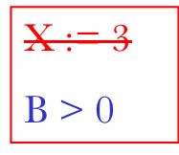
Global Optimization
These optimizations can be extended to an entire control-flow graph
Y := Z + W
Y := 0
X := 4

Slide 71
Correctness
How do we know it is OK to globally dead code elimination?
There are situations where it is incorrect:
X := 3
B > 0
Y := Z + W
A := X
Y := 0
X := 4

Slide 72
Live and Dead
The first value of x is dead (never used)
The second value of x is live (may be used)
Liveness is an important concept
X := 3
X := 4
Y := X

Slide 73
Liveness
A variable x is live at statement s if
  There exists a statement s’ that uses x
  There is a path from s to s’
  That path has no intervening assignment to x

Slide 74
Global Dead Code Elimination
A statement x := … is dead code if x is dead after the assignment
Dead statements can be deleted from the program
But we need liveness information first . . .

Slide 75
Example 1 Revisited
X := 3
B > 0
Y := Z + W
Y := 0
X := 4

Slide 76
Example 2 Revisited
X := 3
B > 0
Y := Z + W
A := X
Y := 0
X := 4

Slide 77
Discussion
The correctness condition is not trivial to check
“All paths” includes paths around loops and through branches of conditionals
Checking the condition requires global analysis
  An analysis of the entire control-flow graph for one function body

Slide 78
Global Analysis
Global optimization tasks share several traits:
  The optimization depends on knowing a property X at a particular point in program execution
  Proving X at any point requires knowledge of the entire function body
  It is OK to be conservative. If the optimization requires X to be true, then want to know either
    X is definitely true
    Don’t know if X is true
  It is always safe to say “don’t know”

Slide 79
Global Analysis (Cont.)
Global dataflow analysis is a standard technique for solving problems with these characteristics
Global Livenesss is one example of an optimization that requires global dataflow analysis
Consider the case of computing liveness for a single variable x at all program points

Slide 80
Liveness Analysis
To make the problem precise, we associate one of the following values with x at every program point
value | interpretation
true | x is live
false | x is not live

Slide 81
Using the Information
Given liveness information, it is easy to perform the dead code elimination
  Simply inspect the x = ? associated with an assignment to x
  If x is false, eliminate that statement
But how do we compute the properties x = ?

Slide 82
The Idea
The analysis of a complicated program can be expressed as a combination of simple rules relating the change in information between adjacent statements

Slide 83
Explanation
The idea is to “push” or “transfer” information from one statement to the next
For each statement s, we compute information about the value of x immediately before and after s
L_{in}(x,s) = value of x before s
L_{out}(x,s) = value of x after s

Slide 84
Transfer Functions
Define a transfer function that transfers information from one statement to another
In the following rules, let statement s have immediate successor statements s₁,…,s_{n}

Slide 85
Liveness Rule 1
p
X = true
X = ?
X = ?
X = true
X = ?
L_{out}(x, p) = ∨ { L_{in}(x, s) | s a successor of p }

Slide 86
Liveness Rule 2
X = true
…:= x + …
X = ?
L_{in}(x, s) = true if s refers to x on the rhs

Slide 87
Liveness Rule 3
X = false
x := e
X = ?
L_{in}(x, x := e) = false if e does not refer to x

Slide 88
Liveness Rule 4
X = a
s
X = a
L_{in}(x, s) = L_{out}(x, s) if s does not refer to x

Slide 89
Algorithm
Let all L_(…) = false initially
Repeat until all statements s satisfy rules 1-4
  Pick s where one of 1-4 does not hold and update using the appropriate rule

Slide 90
Another Example
L(X) = false
X := 3
B > 0
L(X) = false
true
L(X) = false
true
L(X) = false
true
Y := Z + W
Y := 0
L(X) = false
true
L(X) = false
true
L(X) = false
true
A := 2 * X
X := X * X
X := 4
A < B
L(X) = false
true
L(X) = false
Dead code
L(X) = false
true
L(X) = false
true
L(X) = false

Slide 91
Termination
A value can change from false to true, but not the other way around
Each value can change only once, so termination is guaranteed
Once the analysis is computed, it is simple to eliminate dead code

Slide 92
Forward vs. Backward Analysis
Liveness is a backwards analysis:
  information is pushed from outputs back towards inputs
Some other kinds of analysis such as constant propagation is a forwards analysis:
  information is pushed from inputs to outputs

Slide 93
Analysis
There are many other global flow analyses
Most can be classified as either forward or backward
Most also follow the methodology of local rules relating information between adjacent program points

Slide 94
Computing Liveness Set
We just computed the liveness for one variable using L_(x, s)
Now we need to compute the liveness information for each point of a program
We can use the following set for a statement s:
  Use[s] the set of variables that are used by s
  Def[n] the set of variables that are defined in s
  In[s] the set of variables that are live on entry to s
  Out[s] the set of variables that are live on exit to s

Slide 95
Computing Liveness Set
We have the following equations
  in[n] = use[n] ∪ (out[n] – def[n])
  out[n] = ∪_{s ∈succ[n]} in[s]

Slide 96
Example
Compute live variables for each point:
{b,c,f}
{a,c,f}
a := b + c
d := -a
e := d + f
{c,d,f}
{c,d,e,f}
{c,e}
b := d + e
e := e - 1
f := 2 * e
{b,c,e,f}
{c,f}
{c,f}
b := f + c
{b}
{b}

