Slide 1
Garbage Collection

Slide 2
Garbage Collection
Heap allocated records that are not reachable by any chain of pointers from program variables are garbage
Garbage collection
  a runtime system of reclaiming the garbage for reusing the space
  conservative approximation that a dynamic live variable is always reachable guaranteed by compilers (such as the tiger compiler and the java compiler but not the C compiler)

Slide 3
Example
12
●
●
let
type list = {link: list, key: int}
type tree = {key: int, left: tree, right: tree}
function maketree() = ……
function showtree() = ……
in
let var x := list{link=nil, key=7}
var y := list{link=x, key=9}
in x.link := y
end
let var p := maketree()
var r := p.right
var q := r.key
in garbage collection here
showtree(r)
end
end
15
●
●
p
q
r
37
●
7
37
●
●
59
●
●
●
9
20
●
●

Slide 4
Mark and Sweep
Directed graph
  nodes: program variables and heap-allocated records
  edges: pointers
Mark
  Search the graph from the roots (program variables)
  Mark all the nodes searched
Sweep
  Sweep the entire heap
  Reclaim nodes not marked (put them into a freelist)
  Unmark marked nodes
Program resumes execution after GC
  Allocates records from the freelist
  Do GC again when freelist is empty

Slide 5
Mark and Sweep
Mark phase: function DFS(x)
for each root v if x is a pointer and points to the heap y
DFS(v) if record y is not marked
mark y
Sweep phase: for each field f_{i} of record y
p ← first address in heap DFS(y.f_{i})
while p < last address in heap
if record p is marked
unmark p
else let f₁ be the first field in p
p.f₁ ← freelist
freelist ← p
p ← p + (size of record p)

Slide 6
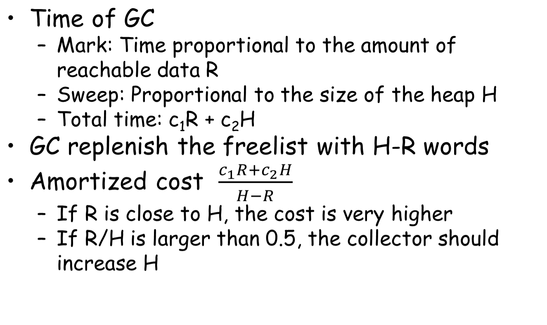
Cost of garbage collecction

Slide 7
Explicit Stack
function DFS(x)
if x is a pointer to record y which is not marked
mark y
t ← 1
stack[t] ← y
while t > 0
y ← stack[t]; t ← t – 1
for each field f_{i} of record y
if y.f_{i} is a pointer to record z which is not marked
mark z
t ← t + 1; stack[t] ← z

Slide 8
Pointer reversal
function DFS(x)
if x is a pointer to record y which is not marked
t ← nil; mark y; done[y] ← 0
while true
i ← done[y]
if i < # of fields in record y
x ← y.f_{i}
if x is a pointer to record z which is not marked
y.f_{i} ← t ; t ← y; y ← z; mark y; done[y] ← 0
else
done[y] ← i + 1
else
z ← y; y ← t
if y = nil then return
i ← done[y]; t ← y.f_{i}; y.f_{i} ← z; done[y] ← i+1

Slide 9
Array of freelist
Just like aggregate lists in malloc

Slide 10
Reference Counts
Reference count
  An extra field in a record to keep how many pointers point to the record
y is a record
  Y is stored into x.f_{i}, reference count of y is increased
  The record z originally stored in x.f_{i} is decreased
  If the reference count of z is 0, z is put into the freelist
  Defer reducing the reference count of z.f_{i} when z is removed from the freelist (allocator)

Slide 11
Two Problems in Reference Counts
Cycles of garbage prevent the reference counts to be zero
Too many emitted codes
z ← x.fi
c ← z.count
c ← c – 1
z.count ← c
if c = 0 call putOnFreelist
x.fi ← p
c ← p.count
c ← c + 1
p.count ← c

Slide 12
Tackle Cycles
Programmer breaks all cycles explicitly when doing with a data structure
  Better than calling free explicitly
Combine reference counting with an occasional mark-sweep collection
Less attractive in practice because of the two problems

Slide 13
Copying Collection
from-space
to-space
from-space
to-space
root
root
next
next
limit
limit

Slide 14
Copying Collection
Split the heap into two parts
  from-space, to-space
Without sweep
  Copy the reachable nodes from from-space to to-space with a compact way
  All the reachable nodes are around the beginning of to-space
  Rest part of the to-space are freed
  When next reaches the limit
    Switch the roles of from-space and to-space

Slide 15
Cheney’s algorithm
function Forward(p) scan ← next ← beginning of to-space
if p is a pointer to from-space then for each root r
if p.f₁ points to to-space then r ← Forward(r)
return p.f₁ while scan < next
else for each field f_{i} at scan
for each field f_{i} of *p scan.f_{i} ← Forward(scan.f_{i})
next. f_{i}← p.f_{i} scan ← scan + size of record at scan
p.f₁ ← next
next ← next +size of record p
return p->f₁
else
return p

Slide 16
Cheney’s algorithm
Pro
  No external stack
  No pointer reverse
Con
  Poor locality
  Irrelevant records are copied together

Slide 17
Semi-depth-first algorithm
function Forward(p)
if p points to from-space then
if p.f₁ points to to-space then
return p.f₁
else
chase(p)
return p.f₁
else
return p

Slide 18
Semi-depth-first algorithm
function Chase(p)
repeat
q ← next
next ← next + size of record p
r ← nil
for each field f_{i} of record p
q.f_{i} ← p.f_{i}
if q.f_{i} points to from-space and q.f_{i}.f₁ does not points to to-space then
r ← q.f_{i}
p.f₁ ← q
p ← r
until p = nil

Slide 19
Generational Collection
Observations
  Newly created objects are likely to die soon
  Object will probably survive for many collections more if it is still reachable after many collections
Collector concentrates on “young data”
The heap is divided into generations G₀, G₁, G_{2,} …
The collector just collects G₀
  Roots are not just program variables
  But also pointers in G₁, G_{2,} … that points to G₀

Slide 20
Generational Collection
It is rare that pointers in G₁, G_{2,} … point to G₀
  An object a is created, its fields are created immediately which point to objects b and c which are already created
  An object a in old generation whose field points to young generation may the field is updated by latter which is a rare case
To avoid all of G₁, G_{2,} … for roots of G₀
  Compilers must let the program remember where there are pointers from old objects to new ones

Slide 21
Ways of Remembering
Remembered List
  After each update store of the form b.f ← a
  Put b into a vector updated objects
Remembered Set
  Like remembered list, but uses a bit within object b to record that b is already in the vector
  To avoid duplicate references to b in the vector

Slide 22
Ways of Remembering
Card Marking
  Divide memory into logical “cards” of size 2^{k} bytes
  A object can
    occupy part of a card or
    start in the middle of one card and continue onto the next
  Whenever address b is updated, the card containing that address is marked
  There is an array of bytes that serves marks
    The byte index can be found by shifting address b right by k bits

Slide 23
Ways of Remembering
Page Marking
  Like card marking, but 2^{k} is the page size
  Update an object in a page makes the page dirty
  User level program can protect each page write-protected after each GC
  When a write protect violation occurs, user lever fault handler can record the dirtiness and unprotects the page

Slide 24
Generational Collection
When garbage collection begins
  the remembered set tells which objects of the old generation can possibly contain pointers in G₀
After several collections of G₀,
  generation G₁ may have accumulated a significant amount of garbage that should be collected
  It is better to collect G₀ and G₁ together
Each old generation should be exponentially bigger than the previous one
An object should be promoted from G_{i} to G_{i+1}
  When it survives two or three collections of G_{i}

Slide 25
State-of-the-art GC (in Java)

Slide 26
Parallel Scavenge
Generation GC
  Stop-Copy-Compact
Different algorithms for old/young
  Minor GC: From-to copy
  Major GC: In-place copy

Slide 27
Heap Layout Overview
Allocation
Young
From
Old
Eden
To

Slide 28
Minor GC
To
Eden

Slide 29
Minor GC
From
Eden
Copy!
To

Slide 30
Minor GC
From
Eden
To

Slide 31
Minor GC
To
Eden
From

Slide 32
Minor GC
To
Eden
From

Slide 33
Minor GC
To
Eden
From

Slide 34
Minor GC
Promote (Age > K)
To
Eden
Copy!
Copy!
From

Slide 35
Minor GC
To
Eden
From

Slide 36
Minor GC
From
Eden
To

Slide 37
Minor GC in parallel
Root assignment to GC threads
Copy race
Work-stealing

Slide 38
MetaData
T1 stack
T2 stack
Dirty card table (512 bytes)
int a
pointer
obj a
obj b
pointer
pointer
int b
int v
double
double
Worker 1
Worker 2

Slide 39
Header
pointer
int
pointer
From
Worker 1
Worker 2
To

Slide 40
Header
pointer
int
pointer
Step 1: Copy
From
Worker 1
Worker 2
To

Slide 41
Header
pointer
int
pointer
Step 2: Push into queues
From
Worker 1
Worker 2
To

Slide 42
Header
pointer
int
pointer
Step 3: Dequeue
From
Worker 1
Worker 2
To

Slide 43
Copy race
Header
pointer
int
pointer
Step 1: Copy
From
Worker 1
Worker 2
To

Slide 44
Copy race
Header
pointer
int
pointer
Step 2: CAS
From
Worker 1
Worker 2
To

Slide 45
Copy race
Newaddr1
pointer
int
pointer
Step 3: Clean-up
From
Worker 1
Worker 2
To

Slide 46
Copy race
Newaddr1
pointer
int
pointer
Step 3: Clean-up
From
Worker 1
Worker 2
To

Slide 47
Copy race
Newaddr1
pointer
int
pointer
Step 3: Clean-up
From
Worker 1
Worker 2
To

Slide 48
Work stealing
Worker 1
Worker 2

Slide 49
Work stealing
Worker 1
Worker 2

Slide 50
Full(Major) GC
Marking
  Mark all live objects
Summary
  Calculate new address for live objects
Compact
  Move objects and update references

Slide 51
Marking
Bitmap
Source
A
B
C

Slide 52
Summary
Bitmap
Source
A
B
C
dest
Destination

Slide 53

Summary & Compact
Bitmap
Source
A
B
C
dest
Destination

Slide 54
Summary & Compact
Bitmap
Source
A
B
C
dest
Destination
A

Slide 55
Summary & Compact
Bitmap
Source
A
B
C
dest
Destination
A
B

Slide 56
Summary & Compact
Bitmap
Source
A
B
C
dest
Destination
A
B
C

Slide 57
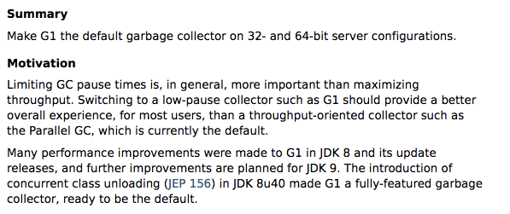
G1GC

Slide 58
G1GC
Also known as Garbage-First Garbage Collection (ISMM’04)
Latency-oriented
  Instead of throughput-oriented (like PS)
Best effort
  A soft UDF deadline for each GC

Slide 59
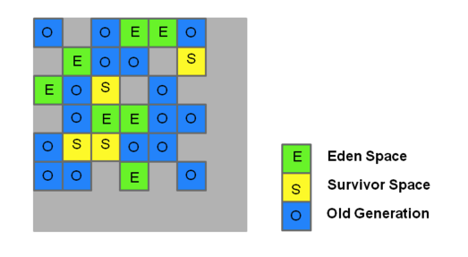
Heap Layout

Slide 60
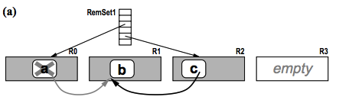
Remember sets
Each ‘region’ has a remember set
Stores the cross-region pointers
  i.e. a possible ‘root’

Slide 61
Steps
Initial marking (STW)
  Mark all the live objects
Concurrent marking
  SATB (snapshot-at-the-beginning)
  Live data counting
Cleanup (evacuation, STW)
  Start from the regions with the most garbage
  Compact

Slide 62
Marking
GC thread
Mutator thread
ROOT

Slide 63
Initial Marking (STW)
GC thread
Mutator thread
ROOT
RUNNING
SUSPEND

Slide 64
Concurrent Marking
GC thread
Mutator thread
ROOT
RUNNING
RUNNING

Slide 65
Concurrent Marking
GC thread
Mutator thread
ROOT
RUNNING
RUNNING
log

Slide 66
Concurrent Marking
GC thread
Mutator thread
ROOT
RUNNING
RUNNING

Slide 67
Concurrent Marking
GC thread
Mutator thread
ROOT
RUNNING
RUNNING

Slide 68
Final Marking (STW)
GC thread
Mutator thread
ROOT
RUNNING
SUSPEND
Live bytes = XX bytes

