Slide 1
State-of-the-art GC (in Java)

Slide 2
Parallel Scavenge
Generation GC
Stop-Copy-Compact
Different algorithms for old/young
Minor GC: From-to copy
Major GC: In-place copy

Slide 3
Heap Layout Overview
Allocation
Young
From
Old
Eden
To

Slide 4
Minor GC
To
Eden

Slide 5
Minor GC
From
Eden
Copy!
To

Slide 6
Minor GC
From
Eden
To

Slide 7
Minor GC
To
Eden
From

Slide 8
Minor GC
To
Eden
From

Slide 9
Minor GC
To
Eden
From

Slide 10
Minor GC
Promote (Age > K)
To
Eden
Copy!
Copy!
From

Slide 11
Minor GC
To
Eden
From

Slide 12
Minor GC
From
Eden
To

Slide 13
Minor GC in parallel
Root assignment to GC threads
Copy race
Work-stealing

Slide 14
MetaData
T1 stack
T2 stack
Dirty card table (512 bytes)
int a
pointer
obj a
obj b
pointer
pointer
int b
int v
double
double
Worker 1
Worker 2

Slide 15
Header
pointer
int
pointer
From
Worker 1
Worker 2
To

Slide 16
Header
pointer
int
pointer
Step 1: Copy
From
Worker 1
Worker 2
To

Slide 17
Header
pointer
int
pointer
Step 2: Push into queues
From
Worker 1
Worker 2
To

Slide 18
Header
pointer
int
pointer
Step 3: Dequeue
From
Worker 1
Worker 2
To

Slide 19
Copy race
Header
pointer
int
pointer
Step 1: Copy
From
Worker 1
Worker 2
To

Slide 20
Copy race
Header
pointer
int
pointer
Step 2: CAS
From
Worker 1
Worker 2
To

Slide 21
Copy race
Newaddr1
pointer
int
pointer
Step 3: Clean-up
From
Worker 1
Worker 2
To

Slide 22
Copy race
Newaddr1
pointer
int
pointer
Step 3: Clean-up
From
Worker 1
Worker 2
To

Slide 23
Copy race
Newaddr1
pointer
int
pointer
Step 3: Clean-up
From
Worker 1
Worker 2
To

Slide 24
Work stealing
Worker 1
Worker 2

Slide 25
Work stealing
Worker 1
Worker 2

Slide 26
Full (Major) GC
Marking
Mark all live objects
Summary
Calculate new address for live objects
Compact
Move objects and update references

Slide 27
Marking
Bitmap
Source
A
B
C

Slide 28
Summary
Bitmap
Source
A
B
C
dest
Destination

Slide 29
Summary & Compact
Bitmap
Source
A
B
C
dest
Destination

Slide 30
Summary & Compact
Bitmap
Source
A
B
C
dest
Destination
A

Slide 31
Summary & Compact
Bitmap
Source
A
B
C
dest
Destination
A
B

Slide 32
Summary & Compact
Bitmap
Source
A
B
C
dest
Destination
A
B
C
In-place compact: what if the destination is also source?

Slide 33
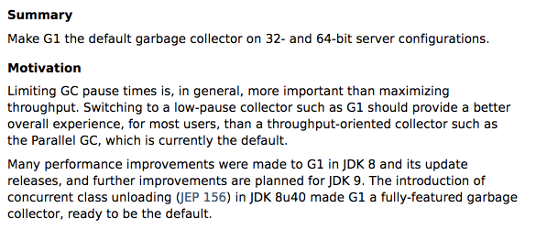
Garbage-First GC (G1GC)

Slide 34
Design Highlight of G1
Controllable GC pauses
Soft limits
Region-based heap layout
Mixed GC
(Partially) concurrent execution
Concurrent marking

Slide 35
Controlling GC Pauses: Soft Limit
G1 allows applications to set a maximum GC pause time
e.g. –XX:MaxGCPauseMillis=50
G1 will adjust the heap layout to meet the limit
The layout must be adjustable and flexible
Two spaces are not enough!

Slide 36
Controlling GC Pauses: Soft Limit
G1 allows applications to set a maximum GC pause time
e.g. –XX:MaxGCPauseMillis=50
G1 will adjust the heap layout to meet the limit
The layout must be adjustable and flexible
Two spaces are not enough!

Slide 37
Region-based Heap Layout
Dividing the whole heap space into many regions
Young-space now can be segregated

Slide 38
Region-based Heap Layout
Dividing the whole heap space into many regions
Young-space now can be segregated
Easy to enlarge/shrink

Slide 39
Region-based Heap Layout
Dividing the whole heap space into many regions
Young-space now can be segregated
Easy to enlarge/shrink
Also designed for mixed GC

Slide 40
Mixed GC: Meeting the Soft Limit
Prior GC (like PSGC) only has two inflexible GC algorithms
Minor GC pause: too short
Major GC pause: too long
Minor GC (10 ms)
Soft Limit (50 ms)
Major GC (200 ms)

Slide 41
Mixed GC: Meeting the Soft Limit
Prior GC (like PSGC) only has two inflexible GC algorithms
Minor GC pause: too short
Major GC pause: too long
Solution: collect young-space and part of old-space
Mixed GC
Minor GC (10 ms)
Soft Limit (50 ms)
Major GC (200 ms)

Slide 42
Mixed GC: Collection Set (CSet)
Mixed GC should construct a CSet to reach a close-to-soft-limit GC pause
Including all young regions

Slide 43
Mixed GC: Collection Set (CSet)
Mixed GC should construct a CSet to reach a close-to-soft-limit GC pause
Including all young regions
Adding old regions and estimating
the GC pause
Until the estimated pause time
reaching the soft limit
10ms to collect
20ms
to collect
15 ms
to collect

Slide 44
Mixed GC: Collection Set (CSet)
Mixed GC should construct a CSet to reach a close-to-soft-limit GC pause
Including all young regions
Adding old regions and estimating
the GC pause
Until the estimated pause time
reaching the soft limit
10ms to collect
20ms
to collect
15 ms
to collect
Problem: which regions to collect?

Slide 45
Concurrent Marking
Before STW collection, mark live objects concurrently
Handling concurrent update
Java threads will write update into logs
Marking threads will consume
the logs periodically

Slide 46
Live Data Profiling
After concurrent marking, count per-region live object size
Choose regions with the least live object for collection
live data: 0%
live data: 2%
live data: 3%

Slide 47
Live Data Profiling
After concurrent marking, count per-region live object size
Choose regions with the least live object for collection
live data: 0%
live data: 2%
live data: 3%
Think about the name: “Garbage First”

Slide 48
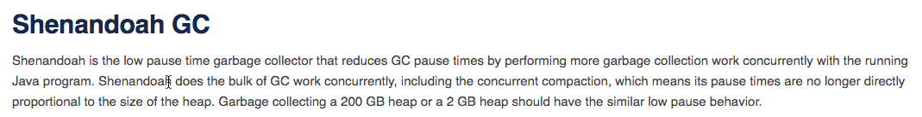
Shenandoah GC
A ultra-low pause time GC regardless of heap size

Slide 49
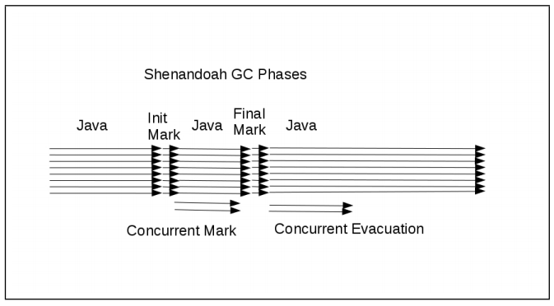
Workflow of Shenandoah
Only init/final mark require pauses

Slide 50
Design Highlight of Shenandoah
Concurrent collection
Indirect references
Lazy reference update
Piggy-backed with concurrent marking

Slide 51
Concurrent Collection
GC threads will generate a new copy of objects
Two copies will co-exist

Slide 52
Concurrent Collection
GC threads will generate a new copy of objects
Two copies will co-exist
Direct update would cause
problems
Updates may not be observed

Slide 53
Concurrent Collection
Solution: Indirect pointer
Always point to the newest version
All read/writes will be forwarded to the newest one

Slide 54
In-Reference Updates
Only part of heap space will be scanned and copied (similar to G1)

Slide 55
In-Reference Updates
Only part of heap space will be scanned and copied (similar to G1)
Only out-references will be updated

Slide 56
In-Reference Updates
Only part of heap space will be scanned and copied (similar to G1)
Only out-references will be updated
in-references may cause dangling pointers

Slide 57
In-Reference Updates
Design 1: Stop-The-World update
Large pause time (violating the goal of Shenandoah)
Design 2: piggy-backed with next marking phase
Concurrent marking will scan the whole heap (similar to G1)

Slide 58
Lazy Reference Updates
Keeping a dummy object after collection
Still using the indirect pointer

Slide 59
Lazy Reference Updates
Keeping a dummy object after collection
Still using the indirect pointer
Correct references during marking

Slide 60
Lazy Reference Updates
Keeping a dummy object after collection
Still using the indirect pointer
Correct references during marking
Now the object can be reclaimed

Slide 61
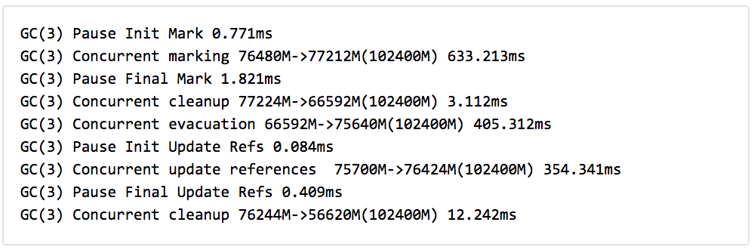
Results of Shenandoah
The pauses are really short!

Slide 62
Results of Shenandoah
But the concurrent execution time is long

Slide 63
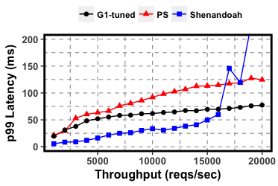
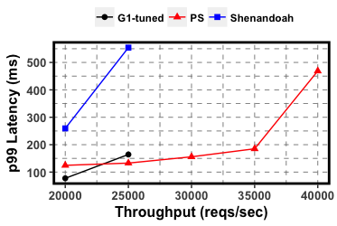
Comparison Among Modern GCs
SpecJBB2015 (online supermarket)
80 cores, 16GB heap
Low Throughput
High Throughput

Slide 64
Summary: Throughput vs. Latency
Better GC Throughput
PS
PSGC: Stop-The-World
Throughput-oriented
Large GC pauses
G1GC: adjustable & partially-concurrent
Concurrent marking
Controllable GC pauses
Shenandoah: mostly-concurrent
Concurrent collection
Ultra-low GC pauses
Hurting application throughput
G1
Shenandoah
Better User Latency

