Slide 1
Introduction to LR Parsing

Slide 2
Bottom-Up Parsing
Bottom-up parsing is more general than top-down parsing
  And just as efficient
  Builds on ideas in top-down parsing
  Preferred method in practice
Also called LR parsing
  L means that tokens are read left to right
  R means that it constructs a rightmost derivation !

Slide 3
An Introductory Example
LR parsers don’t need left-factored grammars and can also handle left-recursive grammars
Consider the following grammar:
    E → E + ( E ) | int
  Why is this not LL(1)?
Consider the string: int + ( int ) + ( int )

Slide 4
The Idea
LR parsing reduces a string to the start symbol by inverting productions:
str ← input string of terminals
repeat
  Identify β in str such that A → β is a production
  (i.e., str = αβγ)
  Replace β by A in str (i.e., str becomes αAγ)
until str = S

Slide 5
A Bottom-up Parse in Detail (1)
int + (int) + (int)
E → E + ( E ) | int
int
+
(
int
)
+
(
int
)

Slide 6
A Bottom-up Parse in Detail (2)
int + (int) + (int)
E + (int) + (int)
E → E + ( E ) | int
E
int
+
(
int
)
+
(
int
)

Slide 7
A Bottom-up Parse in Detail (3)
int + (int) + (int)
E + (int) + (int)
E + (E) + (int)
E → E + ( E ) | int
E
E
int
+
(
int
)
+
(
int
)

Slide 8
A Bottom-up Parse in Detail (4)
int + (int) + (int)
E + (int) + (int)
E + (E) + (int)
E + (int)
E → E + ( E ) | int
E
E
E
int
+
(
int
)
+
(
int
)

Slide 9
A Bottom-up Parse in Detail (5)
int + (int) + (int)
E + (int) + (int)
E + (E) + (int)
E + (int)
E + (E)
E → E + ( E ) | int
E
E
E
E
int
+
(
int
)
+
(
int
)

Slide 10
A Bottom-up Parse in Detail (6)
int + (int) + (int)
E + (int) + (int)
E + (E) + (int)
E + (int)
E + (E)
E
E → E + ( E ) | int
E
E
A rightmost derivation in reverse
E
E
E
int
+
(
int
)
+
(
int
)

Slide 11
Important Fact #1
Important Fact #1 about bottom-up parsing:
An LR parser traces a rightmost derivation in reverse

Slide 12
Where Do Reductions Happen
Important Fact #1 has an interesting consequence:
  Let αβγ be a step of a bottom-up parse
  Assume the next reduction is by A→ β
  Then γ is a string of terminals !
Why? Because αAγ → αβγ is a step in a right-most derivation

Slide 13
Notation
Idea: Split string into two substrings
  Right substring (a string of terminals) is as yet unexamined by parser
  Left substring has terminals and non-terminals
The dividing point is marked by a I
  The I is not part of the string
Initially, all input is unexamined: Ix₁x₂ . . . x_{n}

Slide 14
Shift-Reduce Parsing
Bottom-up parsing uses only two kinds of actions:
Shift
Reduce

Slide 15
Shift
Shift: Move I one place to the right
  Shifts a terminal to the left string
E + (I int )
⇒ E + (int I )

Slide 16
Reduce
Reduce: Apply an inverse production at the right end of the left string
  If E → E + ( E ) is a production, then
E + (E + ( E ) I )
⇒ E +(E I )

Slide 17
Shift-Reduce Example
I int + (int) + (int)$
int
+
(
int
)
+
(
int
)

Slide 18
Shift-Reduce Example
I int + (int) + (int)$ shift
int
+
(
int
)
+
(
int
)

Slide 19
Shift-Reduce Example
I int + (int) + (int)$ shift
int I + (int) + (int)$
int
+
(
int
)
+
(
int
)

Slide 20
Shift-Reduce Example
I int + (int) + (int)$ shift
int I + (int) + (int)$ red. E → int
int
+
(
int
)
+
(
int
)

Slide 21
Shift-Reduce Example
I int + (int) + (int)$ shift
int I + (int) + (int)$ red. E → int
E I + (int) + (int)$
E
int
+
(
int
)
+
(
int
)

Slide 22
Shift-Reduce Example
I int + (int) + (int)$ shift
int I + (int) + (int)$ red. E → int
E I + (int) + (int)$ shift 3 times
E
int
+
(
int
)
+
(
int
)

Slide 23
Shift-Reduce Example
I int + (int) + (int)$ shift
int I + (int) + (int)$ red. E → int
E I + (int) + (int)$ shift 3 times
E + (int I ) + (int)$
E
int
+
(
int
)
+
(
int
)

Slide 24
Shift-Reduce Example
I int + (int) + (int)$ shift
int I + (int) + (int)$ red. E → int
E I + (int) + (int)$ shift 3 times
E + (int I ) + (int)$ red. E → int
E
int
+
(
int
)
+
(
int
)

Slide 25
Shift-Reduce Example
I int + (int) + (int)$ shift
int I + (int) + (int)$ red. E → int
E I + (int) + (int)$ shift 3 times
E + (int I ) + (int)$ red. E → int
E + (E I ) + (int)$
E
E
int
+
(
int
)
+
(
int
)

Slide 26
Shift-Reduce Example
I int + (int) + (int)$ shift
int I + (int) + (int)$ red. E → int
E I + (int) + (int)$ shift 3 times
E + (int I ) + (int)$ red. E → int
E + (E I ) + (int)$ shift
E
E
int
+
(
int
)
+
(
int
)

Slide 27
Shift-Reduce Example
I int + (int) + (int)$ shift
int I + (int) + (int)$ red. E → int
E I + (int) + (int)$ shift 3 times
E + (int I ) + (int)$ red. E → int
E + (E I ) + (int)$ shift
E + (E) I + (int)$
E
E
int
+
(
int
)
+
(
int
)

Slide 28
Shift-Reduce Example
I int + (int) + (int)$ shift
int I + (int) + (int)$ red. E → int
E I + (int) + (int)$ shift 3 times
E + (int I ) + (int)$ red. E → int
E + (E I ) + (int)$ shift
E + (E) I + (int)$ red. E → E + (E)
E
E
int
+
(
int
)
+
(
int
)

Slide 29
Shift-Reduce Example
I int + (int) + (int)$ shift
int I + (int) + (int)$ red. E → int
E I + (int) + (int)$ shift 3 times
E + (int I ) + (int)$ red. E → int
E + (E I ) + (int)$ shift
E + (E) I + (int)$ red. E → E + (E)
E I + (int)$
E
E
E
int
+
(
int
)
+
(
int
)

Slide 30
Shift-Reduce Example
I int + (int) + (int)$ shift
int I + (int) + (int)$ red. E → int
E I + (int) + (int)$ shift 3 times
E + (int I ) + (int)$ red. E → int
E + (E I ) + (int)$ shift
E + (E) I + (int)$ red. E → E + (E)
E I + (int)$ shift 3 times
E
E
E
int
+
(
int
)
+
(
int
)

Slide 31
Shift-Reduce Example
I int + (int) + (int)$ shift
int I + (int) + (int)$ red. E → int
E I + (int) + (int)$ shift 3 times
E + (int I ) + (int)$ red. E → int
E + (E I ) + (int)$ shift
E + (E) I + (int)$ red. E → E + (E)
E I + (int)$ shift 3 times
E + (int I )$
E
E
E
int
+
(
int
)
+
(
int
)

Slide 32
Shift-Reduce Example
I int + (int) + (int)$ shift
int I + (int) + (int)$ red. E → int
E I + (int) + (int)$ shift 3 times
E + (int I ) + (int)$ red. E → int
E + (E I ) + (int)$ shift
E + (E) I + (int)$ red. E → E + (E)
E I + (int)$ shift 3 times
E + (int I )$ red. E → int
E
E
E
int
+
(
int
)
+
(
int
)

Slide 33
Shift-Reduce Example
I int + (int) + (int)$ shift
int I + (int) + (int)$ red. E → int
E I + (int) + (int)$ shift 3 times
E + (int I ) + (int)$ red. E → int
E + (E I ) + (int)$ shift
E + (E) I + (int)$ red. E → E + (E)
E I + (int)$ shift 3 times
E + (int I )$ red. E → int
E + (E I )$
E
E
E
E
int
+
(
int
)
+
(
int
)

Slide 34
Shift-Reduce Example
I int + (int) + (int)$ shift
int I + (int) + (int)$ red. E → int
E I + (int) + (int)$ shift 3 times
E + (int I ) + (int)$ red. E → int
E + (E I ) + (int)$ shift
E + (E) I + (int)$ red. E → E + (E)
E I + (int)$ shift 3 times
E + (int I )$ red. E → int
E + (E I )$ shift
E
E
E
E
int
+
(
int
)
+
(
int
)

Slide 35
Shift-Reduce Example
I int + (int) + (int)$ shift
int I + (int) + (int)$ red. E → int
E I + (int) + (int)$ shift 3 times
E + (int I ) + (int)$ red. E → int
E + (E I ) + (int)$ shift
E + (E) I + (int)$ red. E → E + (E)
E I + (int)$ shift 3 times
E + (int I )$ red. E → int
E + (E I )$ shift
E + (E) I $
E
E
E
E
int
+
(
int
)
+
(
int
)

Slide 36
Shift-Reduce Example
I int + (int) + (int)$ shift
int I + (int) + (int)$ red. E → int
E I + (int) + (int)$ shift 3 times
E + (int I ) + (int)$ red. E → int
E + (E I ) + (int)$ shift
E + (E) I + (int)$ red. E → E + (E)
E I + (int)$ shift 3 times
E + (int I )$ red. E → int
E + (E I )$ shift
E + (E) I $ red. E → E + (E)
E
E
E
E
int
+
(
int
)
+
(
int
)

Slide 37
Shift-Reduce Example
I int + (int) + (int)$ shift
int I + (int) + (int)$ red. E → int
E I + (int) + (int)$ shift 3 times
E + (int I ) + (int)$ red. E → int
E + (E I ) + (int)$ shift
E + (E) I + (int)$ red. E → E + (E)
E I + (int)$ shift 3 times
E + (int I )$ red. E → int
E + (E I )$ shift
E + (E) I $ red. E → E + (E)
E I $
E
E
E
E
E
int
+
(
int
)
+
(
int
)

Slide 38
Shift-Reduce Example
I int + (int) + (int)$ shift
int I + (int) + (int)$ red. E → int
E I + (int) + (int)$ shift 3 times
E + (int I ) + (int)$ red. E → int
E + (E I ) + (int)$ shift
E + (E) I + (int)$ red. E → E + (E)
E I + (int)$ shift 3 times
E + (int I )$ red. E → int
E + (E I )$ shift
E + (E) I $ red. E → E + (E)
E I $ accept
E
E
E
E
E
int
+
(
int
)
+
(
int
)

Slide 39
The Stack
Left string can be implemented by a stack
Shift pushes a terminal on the stack
Reduce pops 0 or more symbols off of the stack (production rhs) and pushes a non-terminal on the stack (production lhs)

Slide 40
Key Issue: When to Shift or Reduce?
Decide based on the left string (the stack)
Idea: use a finite automaton (DFA) to decide when to shift or reduce
  The DFA input is the stack
  The language consists of terminals and non-terminals
We run the DFA on the stack and we examine the resulting state X and the token tok after I
  If X has a transition labeled tok then shift
  If X is labeled with “A → β on tok” then reduce

Slide 41
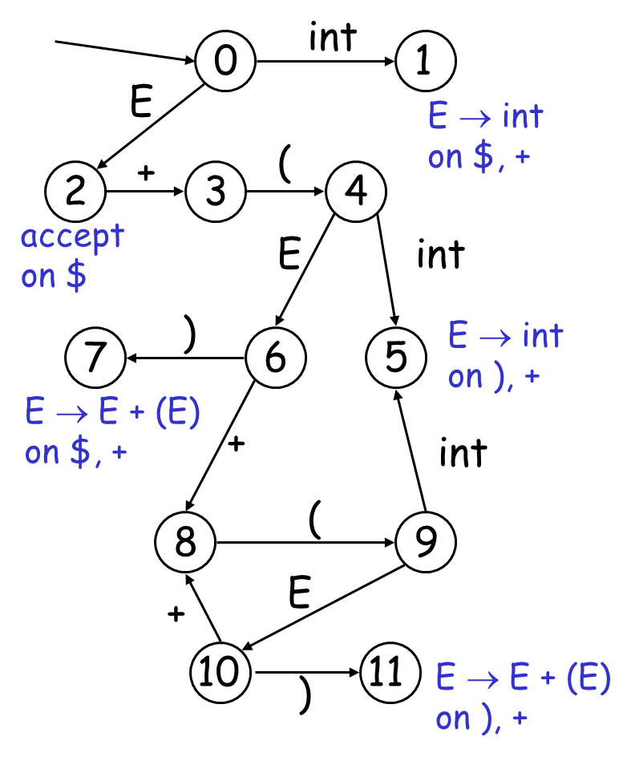
LR(1) Parsing. An Example
I int + (int) + (int)$ shift
int I + (int) + (int)$ E → int
E I + (int) + (int)$ shift
E + I (int) + (int)$ shift
E + (Iint) + (int)$ shift
E + (int I ) + (int)$ E → int
E + (E I ) + (int)$ shift
E + (E) I + (int)$ E → E+(E)
E I + (int)$ shift (x3)
E + (int I )$ E → int
E + (E I )$ shift
E + (E) I $ E → E+(E)
E I $ accept

Slide 42
Representing the DFA
Parsers represent the DFA as a 2D table
  Recall table-driven lexical analysis
Lines correspond to DFA states
Columns correspond to terminals and non-terminals
What should an entry of a table represent for ?

Slide 43
Representing the DFA (transition)
The table for a fragment of our DFA:
(
 | int | + | ( | ) | $ | E
…
3 |  |  | 4
4 | 5 |  |  |  |  | 6
5
6 |  | 8 |  | 7
7
…
3
4
int
E
6
5
E → int
on ), +
+
)
8
7
E → E + (E)
on $, +
Each entry of the table should represent a transition state

Slide 44
Representing the DFA (action)
The table for a fragment of our DFA:
(
 | int | + | ( | ) | $ | E
…
3 |  |  | s
4 | s
5 |  | r_{E→ int} |  | r_{E→ int}
6 |  | s |  | s
7 |  | r_{E→ E+(E)} |  |  | r_{E→ E+(E)}
…
3
4
int
E
6
5
E → int
on ), +
+
)
8
7
E → E + (E)
on $, +
Each entry of the table should represent an action on the token

Slide 45
Representing the DFA. (combine)
The table for a fragment of our DFA:
(
 | int | + | ( | ) | $ | E
…
3 |  |  | s4
4 | s5 |  |  |  |  | 6
5 |  | r_{E→ int} |  | r_{E→ int}
6 |  | s8 |  | s7
7 |  | r_{E→ E+(E)} |  |  | r_{E→ E+(E)}
…
3
4
int
E
6
5
E → int
on ), +
+
)
8
7
E → E + (E)
on $, +

Slide 46
Representing the DFA
Typically columns are split into:
  Those for terminals: action table
  Those for non-terminals: goto table
Goto table
 | int | + | ( | ) | $
…
3 |  |  | s4
4 | s5
5 |  | r_{E→ int} |  | r_{E→ int}
6 |  | s8 |  | s7
7 |  | r_{E→ E+(E)} |  |  | r_{E→ E+(E)}
…
E
6
Action table

Slide 47
Representing the DFA. (normal form)
The table for a fragment of our DFA:
(
 | int | + | ( | ) | $ | E
…
3 |  |  | s4
4 | s5 |  |  |  |  | g6
5 |  | r_{E→ int} |  | r_{E→ int}
6 |  | s8 |  | s7
7 |  | r_{E→ E+(E)} |  |  | r_{E→ E+(E)}
…
3
4
int
E
6
5
E → int
on ), +
+
)
8
7
E → E + (E)
on $, +

Slide 48
The LR Parsing Algorithm
After a shift or reduce action we rerun the DFA on the entire stack
  This is wasteful, since most of the work is repeated
Remember for each stack element on which state it brings the DFA
LR parser maintains a stack
⟨ sym₁, state₁ ⟩ . . . ⟨ sym_{n}, state_{n} ⟩
  state_{k} is the final state of the DFA on sym₁ … sym_{k}

Slide 49
The LR Parsing Algorithm
Let I = w$ be initial input
Let j = 1
Let DFA state 0 be the start state
Let stack = ⟨ dummy, 0 ⟩
repeat
case action[top_state(stack), I[j]] of
shift k: push ⟨ I[j++], k ⟩
reduce X → α:
pop |α| pairs,
push ⟨X, Goto[top_state(stack), X]⟩
accept: halt normally
error: halt and report error

Slide 50
LR Parsing Notes
Can be used to parse more grammars than LL
Most programming languages grammars are LR
Can be described as a simple table
There are tools for building the table
How is the table constructed?

