Slide 1
Register Allocation Implementation in the Tiger Compiler

Slide 2
Graph
Graph abstract data type
G_Graph()
Create an empty directed graph
G_Node(g,x)
Make a new node within graph g
x is any extra information “attached” to the new node
G_addEdge(n,m)
Create a direct edge from n to m
g_succ(n), g_pred(m)
G_adj(m)=g_succ(m)∪g_pred(m)
G_emEdge() deletes an edge

Slide 3
Attach additional information to nodes
Each node represents some thing
An instruction in a program
Dataflow information
A variable in a program
Two ways to map from node to things
Put things in node directly (via a pointer)
n=G_Node(g,x)
G_nodeinfo(n) retrieves x
Using G_table
G_enter(mytable, n, x)
Associates information x to node n in a mapping mytable

Slide 4
Control Flow Graph
G_graph FG_AssemFlowGraph(AS_instrList il)
Info of each G_node is actually a pointer to an AS_instr
jump fields of the instrs are used to in creating control flow edges
Temp_tempList FG_def(G_node n)
def information is obtained from the dst fields of the instruction
Temp_tempList FG_use(G_node n)
use information is obtained from the src fields of the instruction
bool FG_isMove(G_node n)

Slide 5
Liveness Analysis
Takes a flow graph produce liveness information at the exit of each flownode
static void enterLiveMap(G_table t, G_node flownode, Temp_tempList temps)
Remember what is live at the exit of flownode
Using a table to attach information
static Temp_tempList lookupLiveMap(G_table t, G_node flownode)

Slide 6
Register Allocation
Takes a flow graph produce a Live_graph
An interference graph
Using liveness information at the exit of each node
A list of node-pairs representing MOVE instructions
Live_gtemp(n)
Tells what temporary variable is represented by n
Implemented by making info field point to a Temp_temp
If a variable is defined but never used, we still need to generate interference edge from this variable because this instruction needs to be executed

Slide 7
Register Allocation
Two ways to represent edges
Adjacent list
Only for normal temporaries
Because the adjacent list for machine registers may be too large
Machine registers cannot be selected
We only coalesce temporary node to machine registers using George method
Bitmap
Both for temporaries and machine registers
Move-related node
associated with a count number of moves
easy to maintain and test if it is no longer move-related

Slide 8
Register Allocation
All nodes
associated with a count of the number of neighbors currently in the graph
This number is used to determine whether
a node is of significant degree during coalescing
a node can be removed from the graph during simplification

Slide 9
Program Code
procedure Main()
LivenessAnalysis()
Build()
MakeWorklist()
repeat
if simplifyWorklist != {} then Simplify()
else if worklistMoves != {} then Coalesce()
else if freezeWorklist != {} then Freeze()
else if spillWorklist != {} then SelectSpill()
until simplifyWorklist = {} && worklistMove={} &&
freezeWorklis={} && spillWorklist={}
AssignColor()
if spilledNodes != {} then
RewriteProgram(spilledNodes)
Main()

Slide 10
Program Code
procedure Build()
forall b∈blocks in program
let live = liveOut(b)
forall I∈instruction(b) in reverse order
if isMoveInstruction(I) then
live ← live\use(I)
forall n∈def(I)∪use(I)
moveList[n] ← moveList[n]∪{I}
workListMoves ← workListMoves∪{I}
live ← live∪def(I)
forall d∈def(I)
forall l∈live
AddEdge(l, d)
live ← use(I)∪(live\def(I))

Slide 11
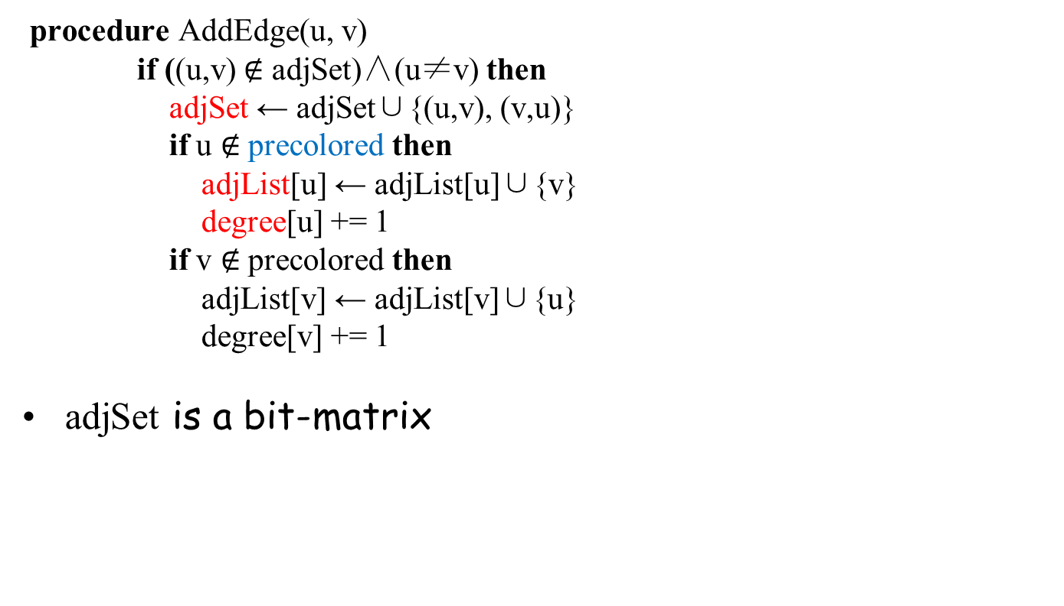
Program Code

Slide 12
Program Code
procedure MakeWorkList()
forall n∈intial
intial ← intial\{n}
if degree[n] ≥ K then
spillWorkList ← spillWorkList∪{n}
else if MoveRelated(n) then
freezeWorkList ← freezeWorkList∪{n}
else
simplifyWorkList ← simplifyWorkList∪{n}

Slide 13
Program Code
function Adjacent(n)
adjList[n] \ (selectStack∪coalescedNodes)
function NodeMoves(n)
moveList[n]∩(activeMoves∪worklistMoves)
function MoveRelated(n)
NodeMoves(n) ≠ {}
procedure Simplify()
let n∈simplifyWorkList
simplifyWorkList ← simplifyWorkList\{n}
push(n, selectStack)
forall m∈Adjacent(n)
DecrementDegree(m)

Slide 14
Program Code
procedure Decrement(m)
let d = degree[m]
degree[m] ← d - 1
if d = K then
EnableMoves(m∪Adjcent(m))
spillWorkList ← spillWorkList \ {m}
if MoveRelated(m) then
freezeWorkList ← freezeWorkList∪{n}
else
simplifyWorkList ← simplifyWorkList∪{n}
procedure EnableMoves(nodes)
forall n∈nodes
forall m∈NodeMoves(n)
if m∈activeMoves then
activeMoves ← activeMoves \ {m}
workListMoves ← workListMoves∪{m}

Slide 15
Program Code
procedure Coalesce()
let m(_{=copy(x,y)})∈workListMoves
x ← GetAlias(x)
y ← GetAlias(y)
if y∈ precolored then
let (u,v) = (y, x)
else
let (u,v) = (x, y)
workListMoves ← workListMoves\{m}
if ( u = v ) then
coalescedMoves ← coalescedMoves∪{m}
AddWorkList(u)
else if v∈ precolored∨(u,v)∈adjSet then
constrainedMoves ← contrainedMoves∪{m}
AddWorkList(u)
AddWorkList(v)

Slide 16
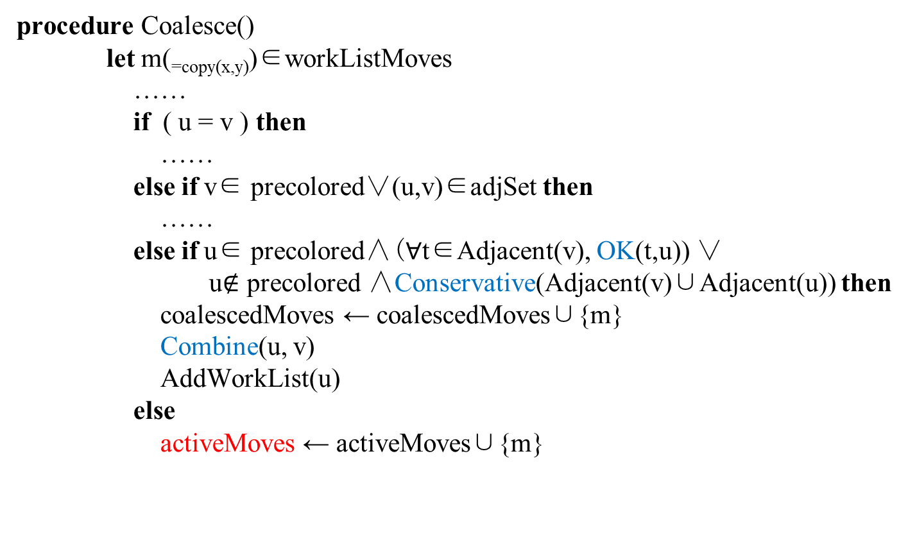
Program Code

Slide 17
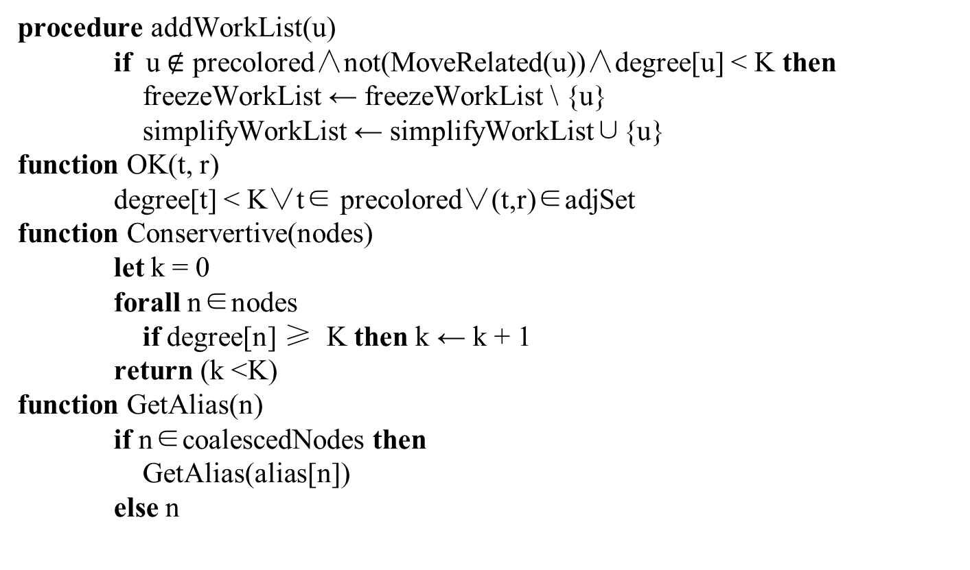
Program Code

Slide 18
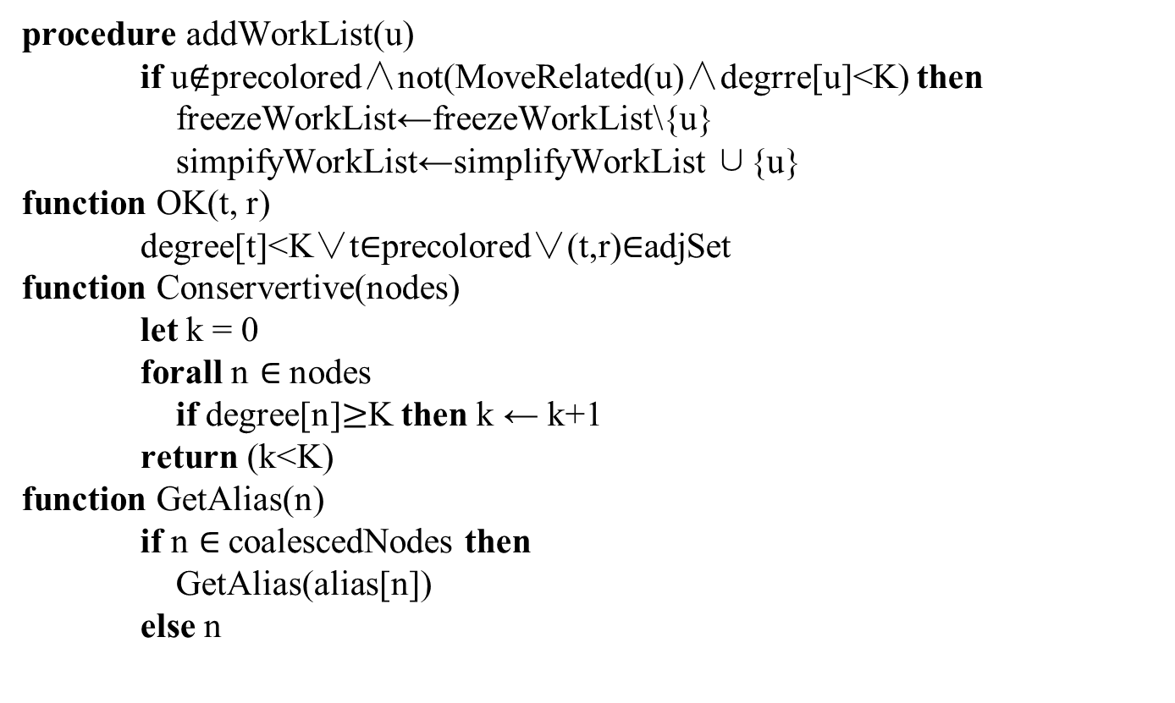
Program Code

Slide 19
Program Code
procedure Combine(u,v)
if v∈freezeWorkList then
freezeWorkList ← freezeWorkList \ {v}
else
spillWorkList ← spillWorkList \ {v}
coalescedNodes ← coalescedNodes ∪{v}
alias[v] ← u
moveList[u] ← moveList[u] ∪moveList[v]
EnableMoves(v)
forall t ∈Adjacent(v)
addEdge(t, u)
DecrementDegree(t)
if degree[u]≥K∧ u ∈freezeWorkList then
freezeWorkList ← freezeWorkList \ {u}
spillWorkList ← spillWorkList ∪ {u}

Slide 20
Program Code
procedure Freeze()
let u∈freezeWorkList
freezeWorkList ← freezeWorkList \ {u}
simplifyWorkList ← simplifyWorkList ∪{u}
FreezeMoves(u)
procedure FreezeMoves(u)
forall m(_{=copy(x,y)})∈NodeMoves(u)
if GetAlias(y)=GetAlias(u) then
v ← GetAlias(x)
else
v ← GetAlias(y)
activeMoves ← activeMoves \ {m}
frozenMoves ← frozenMoves ∪ {m}
if NodeMoves(v) = {}∧ degree[v] < K then
freezeWorkList ← freezeWorkList \ {v}
simplifyWorkList ← simplifyWorkList ∪ {v}

Slide 21
Program Code
procedure SelectSpill()
let m ∈ spillWorkList
/* Should use heuristic algorithms */
/* Now just randomly pick one */
spillWorkList ← spillWorkList \ {m}
simplifyWorkList ← simplifyWorkList ∪ {m}
FreezeMoves(m)

Slide 22
Program Code
procedure AssignColor()
while SelectStack not empty
let n = pop(SelectStack)
okColors ← [0, … , K-1]
forall w∈adjList[n]
if GetAlias[w]∈(ColoreNodes∪precolored) then
okColors ← okColors \ {color[GetAlias(w)]}
if okColor = {} then
spillWorkList ← spillWorkList ∪{n}
else
coloredNodes ← coloredNodes ∪ {n}
let c ∈ okColor
color[n] ← c

Slide 23
Program Code
procedure RewriteProgram()
Allocate memory locations for each v ∈ spilledNodes
Create a new temporary v_{i} for each definition and each use
In the program (instructions), insert a store after each
definition of a v_{i} , a fetch before each use of a v_{i}
Put All the v_{i} into a set newTemps
spilledNode ← {}
initial ← coloredNodes∪coalescedNodes∪newTemp
coloredNodes ← {}
coalescedNodes ←{}

Slide 24
Putting It All Together

Slide 25
As simple as possible, but not simpler
Nested functions
Escape analysis
Structured l-value
No record or array variables
Only pointers to heap
Register allocation
Back end much bigger
We can put all the temporaries to the stack without register allocation
Need load and store instruction
Optimized in basic block
Using labeling algorithm to assign registers for trees

Slide 26
As simple as possible, but not simpler
Tree intermediate representation
Cannot describe procedure entry and exit
Not completely machine independent
No enough information to simulate the execution of an entire program
View shift is partly done implicitly by procedure prologues and epilogues
Useful as a low-level IR
Useful for instruction selection and intraprocedural optimization
High-level IR would be more tied to a family of source languages
Preserve more of the source program semantics

Slide 27
Data structures for frame
registers
A list of all the register names on the machine
Can be used as “color” for register allocation
tempMap
For each machine register, a particulare Temp_temp is maintained by the Frame module to serve as the “precolored temporary” that stands for the register, appears
in the Assem CALL instructions
Procedure entry/exit sequences generated by procEntryExit1
tempMap tells the “color” of each these precolored temps

Slide 28
procEntryExit1
newFrame
creates a sequence of T_MOVE as it creates all the formal parameter “accesses”
puts this into the frame data structure
Concatenates the sequence in the frame data structure onto the procedure body
On entry move all the callee-save registers to their new temporary locations
On exit move back the called save register from their new temporary locations
These moves will be eliminated by register coalescing

Slide 29
procEntryExit3
Creates the procedure prologue and epilogue assembly language
Calculates the size of the outgoing parameter space in the frame
Maximum number of outgoing parameters of any CALL instructions in the procedure body
In Assem trees it is not obvious
procEntryExit2 should scan the body and record this information
Or the maximum legal value is used
Generates the assembly language for procedure entry, stack-pointer adjustment, and procedure exit

Slide 30
string
A string literal in Tiger is translated into a F_stringFrag fragment
It will be translated into machine-dependent assembly language that reserves and initializes a block of memory
F_string function returns a string containing the assembly-language instructions required to define and initialize a string literal
Be careful \0 in tiger

Slide 31
Register Allocation for Trees
procedure SimpleAlloc(t)
for each nontrivial tile u that is a child of t
SimpleAlloc(u)
for each nontrivial tile u that is a child of t
n ← n – 1
n ← n + 1
assign r_{n} to hold the value at the root of t
Assume we have enough number of registers
Still we want to minimize the number of registers to be used
The above code is only sub-optimal
n is a global initialize as 0

Slide 32
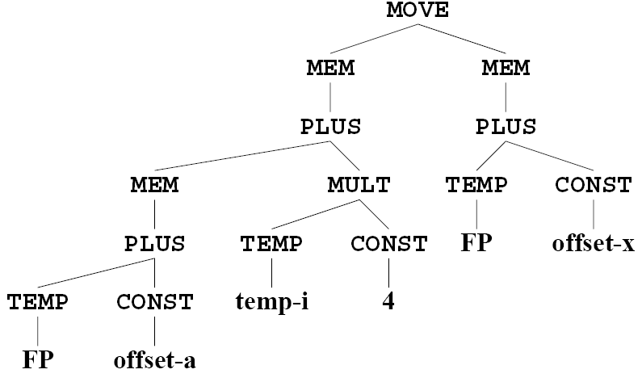
Example
r₁
r₂
r₁
r₂
r₂
r₁

Slide 33
Example
+
r₁
MEM(NAME a)
*
r₂
r₁
MEM(NAME b)
MEM(NAME c)
r₂
r₃

Slide 34
Sethi-Ullman Labeling Algorithm
procedure Label(t)
for each tile u that is a child of t
Label(u)
if t is trivial then need[t] ← 0
else if t has two children, u_{left} and u_{right} then
if need[u_{left}] = need[u_{right}] then
need[t] ← 1+ need[u_{left}]
else need[t] ← max(1, need[u_{left}], need[u_{right}])
else if t has one child, u then
need[t] ← max(1, need[u])
else if t has no children then
need[t] ← 1

Slide 35
Sethi-Ullman Labeling Algorithm
+
2
1
MEM(NAME a)
*
2
1
1
MEM(NAME b)
MEM(NAME c)

Slide 36
Sethi-Ullman Labeling Algorithm
Maximal Munch should identify the tiles simultaneously with the labeling algorithm
Next pass emits Assem instruction for the tiles
In descendent order of need
Will minimize the number of simultaneously live temporaries and reduce the number of spills

