Slide 1

Computer Vision Lecture 1: Course Introduction
School of Software, SJTU
Lectured by: Yan Sun（孙焱）
Email: sun_yan@sjtu.edu.cn
1105#, School of Software, Shanghai Jiao Tong University

Slide 2
Course Overview
Introduction
Image processing
Morphological Operations
Histogram
Image enhancement
Thresholding
Color image
Filtering
Frequency Domain Filtering

Slide 3
Course Overview
Feature detection
Segmentation
Thresholding; Clustering; Classification
3D vision
3D vision; Tracking; Kalman filter; Snake
Pattern recognition & Machine learning

Slide 4
Outline
“Image” and “Vision”
Why it is important
How the course works

Slide 5
What is Image Processing and Analysis
“The study of methods and techniques whereby artificial vision systems can be constructed and usefully employed…” (Davies)
“Computing properties of the 3D world from one or more digital images” (Trucco)
“Make useful decisions about real physical objects and scenes based on sensed images” (Shapiro)

Slide 6
What is Vision
“What does it mean, to see? The plain man's answer (and Aristotle's, too) would be, to know what is where by looking. -- David Marr, Vision (1982)
(In other words, vision is the process of discovering from images what is present in the world, and where it is.”)

Slide 7
What is Computer Vision
Automatic understanding of images and video
Computing properties of the 3D world from visual data (measurement)
Algorithms and representations to allow a machine to recognize objects, people, scenes, and activities (perception and interpretation)

Slide 8
Why Study Computer Vision
As image sources multiply, so we do applications
Relieve of human of boring, repeating tasks
Enhance human abilities: human-computer interaction, visualization
Perception for robotics / autonomous agents
Organize and give access to visual content

Slide 9
Goal of Vision Research
Give machines the ability to understand scenes
Aid understanding and modeling of human vision
Automate visual operations

Slide 10

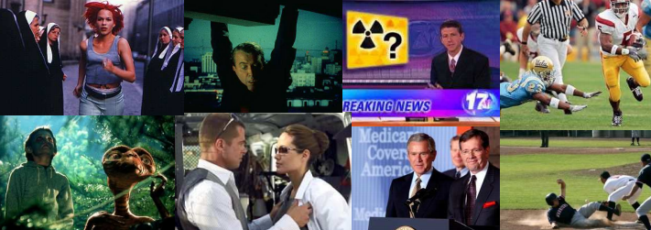
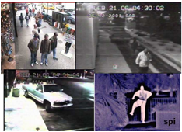
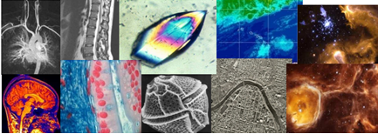
Applications
Personal Photo Albums
Movie, News, Sports
Surveillance and Security
Medicine and Science

Slide 11
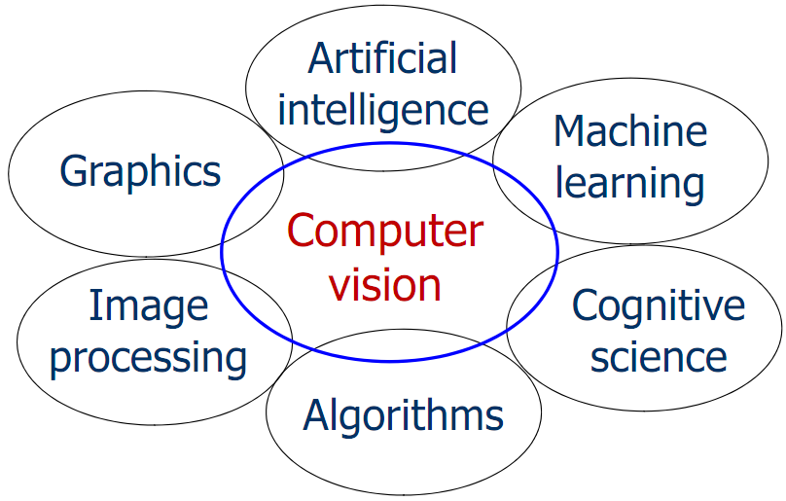
Related Disciplines

Slide 12
Applications
Medical Image Analysis
Security
Biometrics
Surveillance
Tracking
Target Recognition
Remote Sensing
Robotics
Industrial Inspection, Quality Control
Document Analysis
Multimedia
Human-Computer Interfaces

Slide 13
So much so that….
The goals of image processing and computer vision (what + where) are in terms of what humans care about.
So, we use computer to assist human to identify and locate stuff in images.

Slide 14
Critical Issues
What information should be extracted?
How can it be extracted?
How should it be represented?
How can it be used to aid analysis and understanding?

Slide 15

What is Computer Vision
Describing an image over telephone
“There’s a sort of rough collie puppy and a plastic Pepsi bottle on a marble table. It looks like the photo was taken with a flash. The background is somewhat like bamboo. Liquid in the Pepsi bottle is neither full nor empty. The place should be outdoor and it seems it was in the evening or night.”

Slide 16
What is Computer Vision
Describing an image over telephone
“There’s a rough collie puppy and a plastic Pepsi bottle standing on a marble table. It looks like the photo was taken with a flash. The background is somewhat like bamboo. Liquid in the Pepsi bottle is neither full nor empty. The place should be outdoor and it seems it was in the evening or night.”
Object Detection
Pose Estimation
Lighting Estimation
Texture Estimation
Segmentation and Estimating Material Properties

Slide 17
What is Image Processing and Analysis
The intelligent, concise summary of the contents of images.
What are contents?
Notes:
聪明、简洁

Slide 18
Image “contents”
Higher level, More semantic
Elegant? Grim? Funny? Cute?
What are those people doing?
How sick or healthy is this person?
Are there regions that are all the same color or texture?
What objects are in it?
How blurry it is?
Are there edges in it?

Slide 19
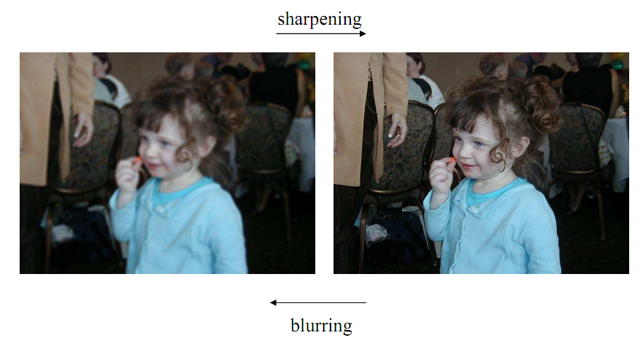
Low-Level Operations

Slide 20
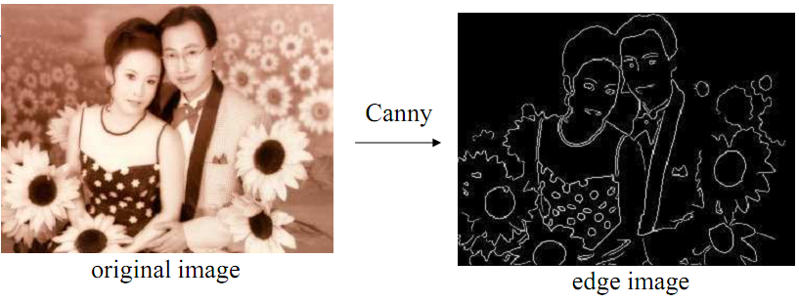
Low-Level Operations

Slide 21
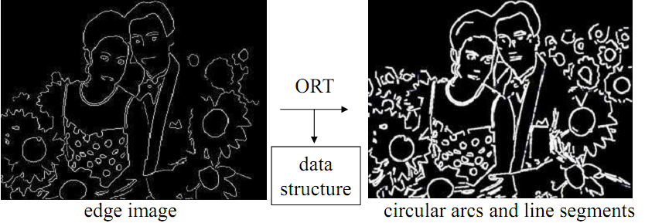
Mid-Level Operations

Slide 22
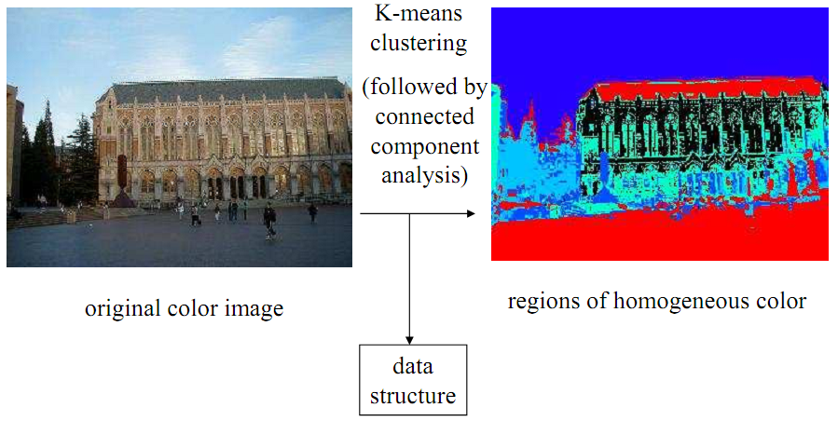
Mid-Level Operations

Slide 23
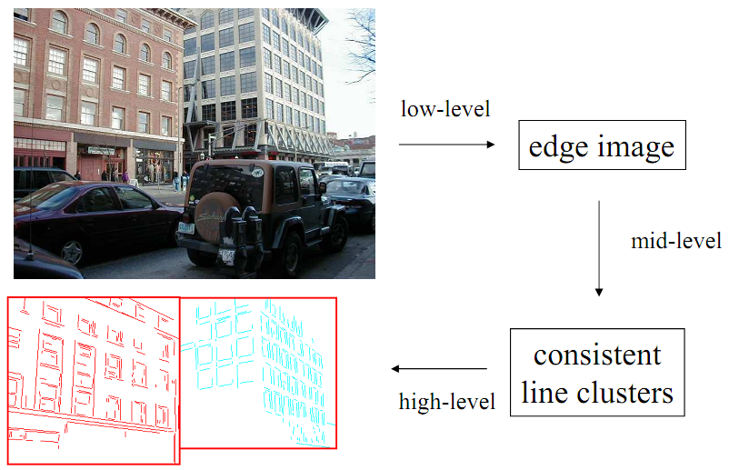
Low-Level to High-Level

Slide 24
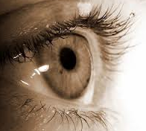
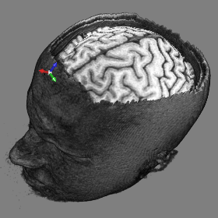
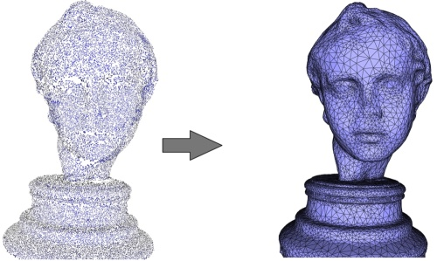
“Images” in this course
Photos: 2D arrays of intensities
3D range data: (x,y,z) locations of points
Volumetric medical images: 3D arrays of intensities
Occlusion and Projection
Occlusion

Slide 25
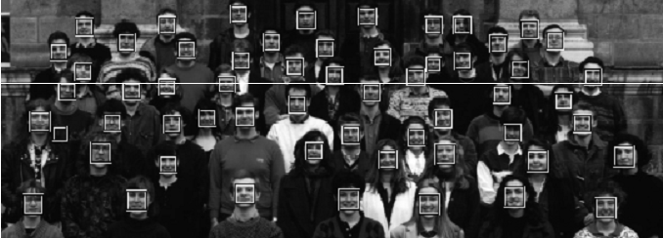
Example Problems
Given a photograph, automatically localize all faces in it

Slide 26
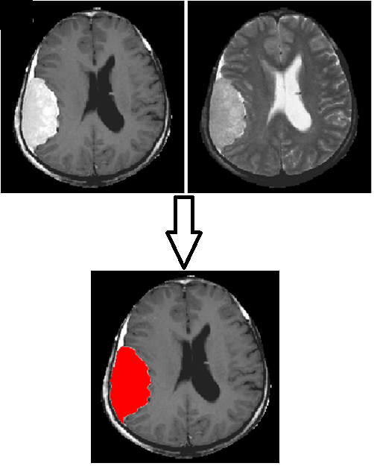
Example Problems
Given a set of brain MR images, automatically localize the brain tumor

Slide 27
Terminology
{ 3D, Computer, Machine, robot } vision
Image { processing, analysis, understanding, interpretation }
Medical Image { analysis, processing }
Signal Processing

Slide 28
Reference
L. G. Shapiro and G. C. Stockman, Computer Vision, Prentice Hall, 2001.
R. Szeliski, Computer Vision: Algorithms and Applications, Springer 2010. (local copy)
D. A. Forsyth and J. Ponce, Computer Vision: A Modern Approach, Prentice Hall, 2002.
R. C. Gonzalez and R. E. Woods, Digital Image Processing, 3rd edition, Prentice Hall, 2008.

Slide 29
Exams
3-4 projects
Final exam or project

