Slide 1

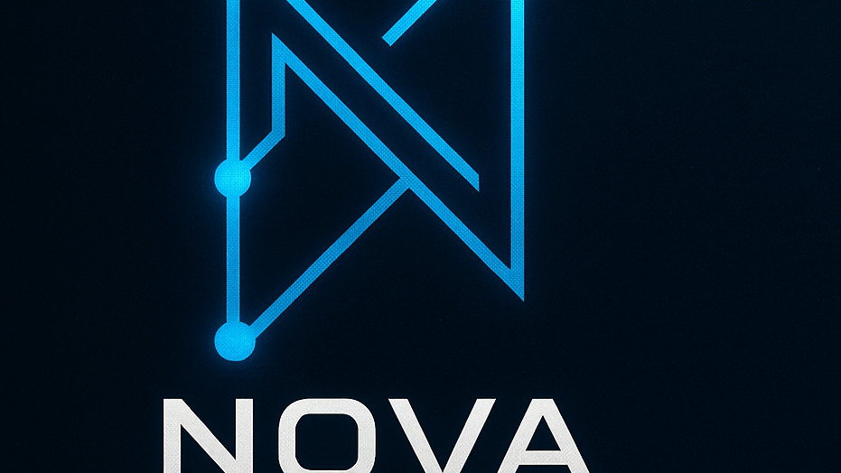

Novastack
Team: zak chapman, evan bonk, draysen Orosco, Fernando berry, Jacob kosswig, joseph bowman, gavin parra, Austin adams

Slide 2
Problem Statement
Organizations struggle with siloed tools and rigid dashboards that limit real-time visibility, operational agility, and data-driven decision-making. Critical functions like task management, event logging, accountability tracking, and system health monitoring are often spread across multiple disconnected platforms.

Slide 3
Solution statement
NovaStack is a customizable operations and productivity platform that puts every team in control of their own mission dashboard. Instead of being locked into rigid tools, users build the workspace with the tools that best increase their operational capacity using custom dashboards, components, and system names to match their actual workflows.

