Slide 1
IT Governance at Hospital
Based on COBIT 5 Framework
http://journals.telkomuniversity.ac.id/ijait
by Yeppy Mangun Puspitajudin

Slide 2
Good IT governance aligns decisions about the use of IT with desired behaviors and organizational objectives.
Notes:
The success of implementing effective governance in an organization associated with the right pattern or fit for the organization so that they can be a complement or supplement of organization's strategic focus
IT governance is not a static concept but rather processes inherent in the organization.

Slide 3
Why we need IT Governance in Hospital?

Slide 4
The existence of good IT governance at Hospitals is expected to provide improvement on quality, functionality, and ease of use of the service.
Notes:
Information Technology (IT) Governance in Hospitals describe how to create an IT governance process that increases the number of IT projects that support the strategy of a hospital and are completed on-time and on- budget.

Slide 5

Hopefully will…
Provide improved on quality, functionality, and ease of use of the service.
Speed up the process.
On an ongoing basis can improve the level of service against all expectations through the fulfillment of the relatively low cost of realization and efficient use of resources.

Slide 6
The framework…

Slide 7
By selecting the processes by the aims of the Organization, the frameworks COBIT 5 provides a guide how should those processes are planned, build, run, and evaluated.
Notes:
COBIT 5 frameworks can be used by an organization in implementing IT governance to support the achievement of the objectives.

Slide 8
Research methodology…

Slide 9
Design Science Research
Methodology (DSRM)
Problem Definition
Defining Solution
Design and Model Development Demonstrations
Notes:
1. Problem Definitions
The problem that focuses in this paper is how to give a guide for Hospital for implementing IT Governance.
2. Defining Solution
The solution is defining with a literature review related to papers or research related IT governance in Hospital. Solutions build the solution are developed based on the author's experiences while working on projects related to IT governance.
3. Design and Model Development Demonstrations
Design and model IT Governance for the hospital is development base on COBIT 5 framework. In this step, describe how IT governance implemented in Hospital.

Slide 10
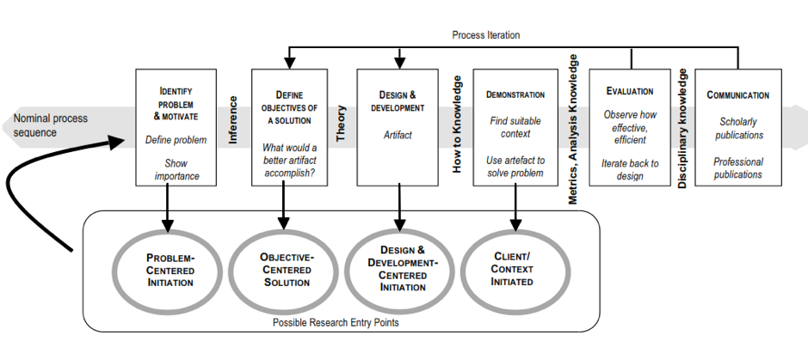

Slide 11
Related work…

Slide 12
Strong leadership becomes a success factor of IT governance in the organization. In addition, another important factor is the organizational ability to manage change.
Notes:
Currently, IT Governance in Hospitals and Health Systems is a must. Without a governance structure are useless, the budget IT is not consistent with the results obtained and in the end many different systems that are not functioning properly.

Slide 13
The goals…

Slide 14
Under the laws of the Republic of Indonesia Number 44 In 2009 About Hospital
The goals of the establishment are…
Organization of health services treatment and recovery by service standards the hospital
Maintenance and upgrading individual health through plenary health services second and third level corresponding medical needs
Organization of the education and training of human resources to increase skills in administering health services
Organization of research and development, as well as filtering technology in the health field order, increased health services with attention to ethics in science fields health.

Slide 15
COBIT 5 enablers…

Slide 16
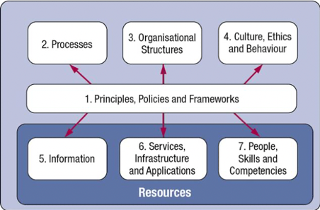
Notes:
The COBIT 5 framework is described 7 categories of enablers:
1. Principles, policies, and frameworks are the vehicles to translate the desired behavior into practical guidance for day-to-day management at Hospital.
2. Processes describe a Hospital set of practices and activities to achieve the objectives and produce a set of outputs to support and achieving overall IT- related goals.
3. Organizational structures are the key decision-making entities in a Hospital.
4. Culture, ethics, and behavior of individuals and the hospital as a success factor in governance and management activities.
5. Information is pervasive throughout any organization and includes all information produced and used by the hospital. Information is required for keeping the organization running and well governed, but at the operational level, information is very often the key product of the hospital itself.
6. Services, infrastructure, and applications include the infrastructure, technology, and applications that provide the hospital with information technology processing and services.
7. People, skills, and competencies are linked to people and are required for successful completion of all activities and for making correct decisions and taking corrective actions in a hospital.

Slide 17
THANK YOU ☺️

