Slide 1
Big Mountain Resort
How can we creatively price park services in order to increase revenue by at least 10% YoY of the new run for the coming fiscal year?
H
1
Context
4
Constraints within solution space
330 Ski-resort, 12 lifts, 2 T-bars, and 1 magic carpet for novice skiers. Also has expert hills that feature steep drops ~2300ft. And 3.3 mi long.
Pricing strategy has been to charge a premium above the average price of resorts in its market segment.
Operating costs increased by $1,540,000 since new lift installation
Risk of being overpriced in the market
Keep operational costs low
2
5
Stakeholders to provide key insight
Criteria for success
Director of Operations, Jimmy Blackburn
Alesha Eisen, the Database Manager
Marketing manager
Data Science Lead
BI Lead
Increase ticket price to generate higher revenue to cover for operational costs of new lifts.
Determine what services to close to reduce operational costs while optimizing revenue
3
Scope of solution space
6
Key data sources
Optimize pricing within given infrastructure/resources
Identify parks with low revenue and snowfall and close parks to reduce operational costs.
Keep low snowfall resorts and ideate new services in order to increase prices.
S3 bucket
SQL database
H
D
E
I
P
Notes:
Hypothesis: Create a Hypothesis with an emphasis on SMART principles. (S – Specific, M – Measurable, A – Achievable, R – Realistic, T – Timebound). If you cannot do this, you do not have a good grasp on the business problem.
Context: With context, we have clearly identified the problem at hand and have elucidated on how our initiative may solve this problem, alongside the commercial implications this will have on the business.
Criteria for Success: Clearly defining the criteria for success ensures that the scope of your work is clearly defined and understood. Otherwise, if this isn’t defined – your work will never end which will result in mismatched expectations.
Scope of Solution Space: Scoping out the solution space ensures that the business initiative is SPECIFIC for a certain segment or area. This prevents solutions that have been developed being scaled and applied for all other business units that the solution may not be responsible or scalable for.
Constraints within Solution Space: Looking forward, what are the foreseeable problems we are likely to encounter? Could this be stakeholder resistance? Could this be we don’t have access to the right data?
Stakeholders to provide key insight: Who are the people I need to speak to, to get the answers I need for my data analysis?
What key data sources are required?
Based off my discussions with the key stakeholders – can we clearly list out all the data sources we need so we can make a highly targeted request as opposed to a scatter-gun approach where we ask for a bit of everything?

Slide 2
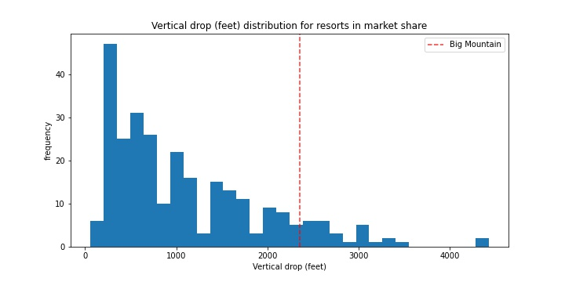
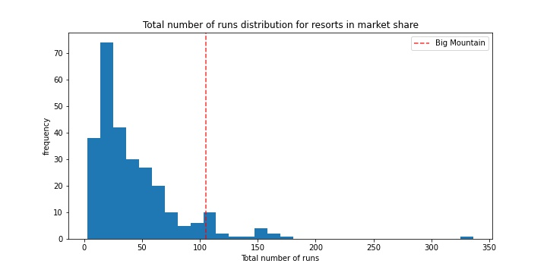
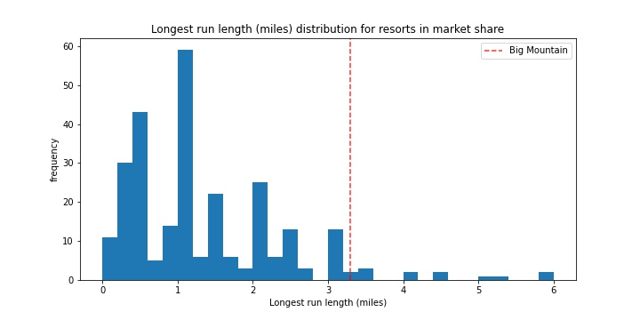
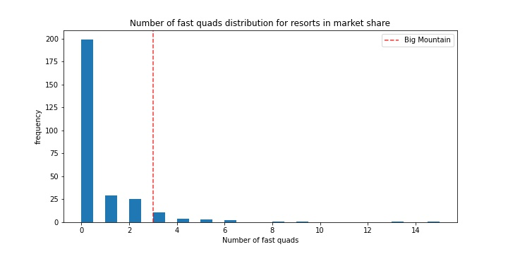
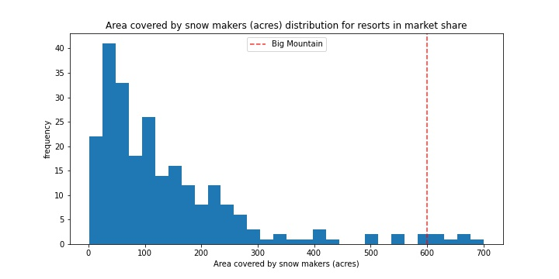
Findings and Recommendations part I
Key Observations
Features that drove park ticket price:
Vertical drop (ft.)
Artificial snow hills (acres)
Chairs/ski-lifts (count)
fastQuad tracks (count)
Runs (count)
Longest Runs (count)
Trams (count)
Skiable area (acres)
Findings
Projected ticket price -- $95.87 +/- 10.89
Actual ticket price -- $81.0
Scenario 1
Increase Runs by 1, Chair lifts by 1 and increase vertical drop by 150 ft.
Increase ticket price by $8.61
Revenue over season ~$15 million
Scenario 2
Scenario 1 + add 2 acres to existing artificial snow hills.
Increase ticket price by 9.90
Revenue over season ~$17 million

Slide 3
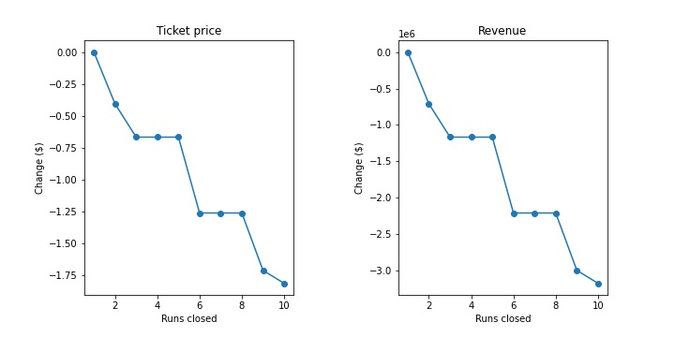
Findings and Recommendations part 2
Scenario 3
Close runs to decrease operational costs
Closing runs will likely lead to reduction in ticket price and revenue.
Closing 1 run does not affect the ticket price.
Projection of ticket price plateaus at 3 and 6 runs.
Re
Recommendation
Improving services, specifically, number of runs, chair lifts, vertical drop height, and increasing the artificial snow hills by 2 acres should allow us to increase Big Mountain’s ticket price by $9.90. The expected revenue over the season is ~$17 million.
Alternatively, closing a runs could help reduce operational costs as well. Closing one should not affect the ticket price negatively. However, if more runs are to be closed, the price and revenue will be negatively affected. Closing runs should be done with operational costs as well as the graphs in the previous section.

