Slide 1
Disaster Rescue
Disasters cause economic and social losses
Disaster response teams requires highly trained personnel
Using robots for the same has benefits
  Lesser human lives in danger
  Humans don’t enter disaster area blind
  Multiple robots provide functional diversity
  Groups of robots might be able to tackle certain simple rescue tasks
Notes:
As we covered in our mid term presentation

Slide 2
Literature Review
There has been work done in the area of utilizing robots for rescue
Tele operated robots have been used in disasters from the WTC to the more recent Fukushima
Robots have been used to map 3D surrounding using various techniques
  Laser scan reconstruction
  SLAM for autonomous vehicles
Extensive work has been done to help identify human beings from the data of a thermal map

Slide 3
Objective
Our goal is to provide a Co-operative SLAM strategy that hopes to
  Effectively use robotic Swarms for faster mapping
  Efficiently use the limited onboard power on the robot

Slide 4

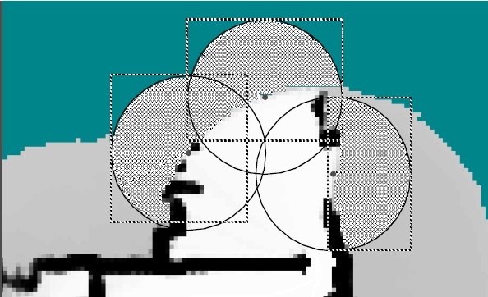
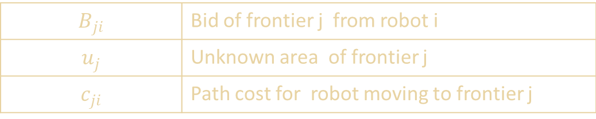
Cooperation Strategy
Deciding where individual robots go to achieve maximum area coverage quickly.
$$B_{ji}$$ | Bid of frontier j from robot i
$$u_{j}$$ | Unknown area of frontier j
$$c_{ji}$$ | Path cost for robot moving to frontier j
Notes:
-Mention we used euclidean distance for path cost
-In case there are lesser frontiers than robots we send multiple robots to a frontier as more frontiers might still be discovered

Slide 5
Cooperation Strategy
Robots in constant communication is not energy efficient
Robots send data on two occasions
  When another robot is within a certain range(direct to robot)
  To a Central Server at every Loop Closure
The server then relays the updated map to all other robots.
Notes:
-Mention Listening for Signals is Cheaper that transmitting constantly(after first point)

Slide 6
SLAM Strategy
Sub-division of Map through Cooperation
Particle SLAM (FAST SLAM)
Centralized map to best utilize robotic swarm
  Updated at every loop closure

Slide 7
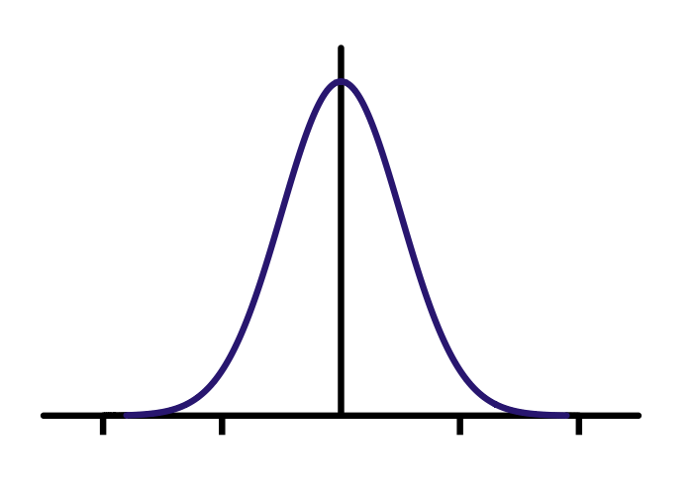
Simulation Environment
2D Grid World – resolution 0.1units
Circular robots with dimension 0.1 units
Obstacles denoted by black lines
Features marked by color
  Each feature is unique
Sensor – Modified Lidar(outputs range as well as color)
  Sensor also identifies each robot through a UID
Sensor Model -

Slide 8
Conclusion
The Co-operative SLAM works faster and provides accurate results
Semi-Central structure allows for Optimal Co-operation and Flexibility
Semi- Central approach also means faster times for significant updates
Minimal chatter should improve time spent by robots in field

