Slide 1
MAIN CONTRIBUTION
the edge devices have certain constraints on resources, especially storage and battery
1) how to store data in the network with limited storage optimally resource allocation strategy
2) how to reach consensus with low energy consumption in edge devices new PoS mechanism

Slide 2
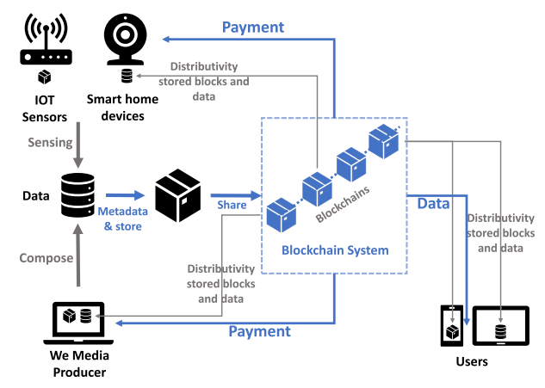
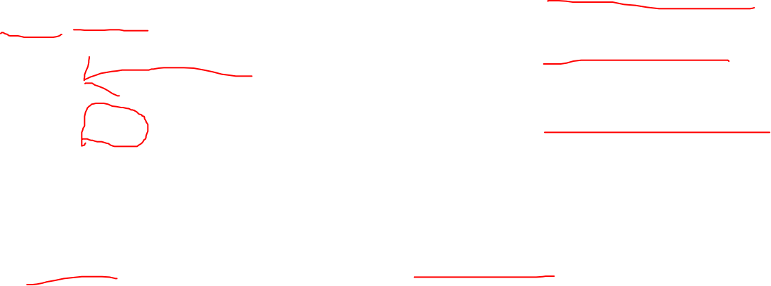
MODEL
Some devices generate data
Other nodes pay for data
Conducting micro-payment transactions
Some devices generate data such as self-generated for-profit data, and other nodes pay for data conducting micro-payment transactions

Slide 3
DEFFERENT
传统区块链系统：
不存储数据或只存储少量的数据
Key：1、保存所有的交易
2、保证完整、可用
3、全面，实际运用到生产中
该论文：
存储数据，量级很大
Key：1、合理的分配数据保存的位置，使保存成本和访问成本最小
2、不保存交易记录
3、不可用，目的只是解决边缘环境中的某个问题，对其他问题一概忽略

Slide 4

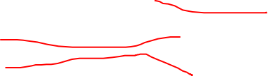

METADATA
1、generated alongside a data item from producer
2、broadcasted in the network
3、nodes will wrap received metadata items into blocks
4、 With the information in the metadata, the user can search what it demands, and request the data item from the nodes that store it
Data type; Time;
Location;
Producer[Producer signature];
Storing nodes; Valid Time;
(AirQuality/PM2.5; 11:00AM06-11-2018; NewYorkNY/40.72,-74.00;
17,[Signature of producer]; 10,11,12,15; 1440;)
Notes:
元数据存储在区块链上
数据存在node上

Slide 5
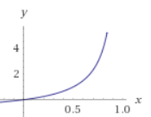

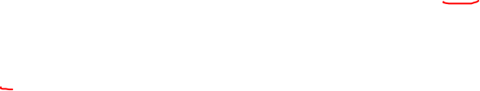

Fairness Degree Cost (FDC)
Fair storage
$w_{tol}(i)$is the total storage of node i,
w$(i)$is the storage used
Notes:
数据在node上怎么存，
存储更加，公平

Slide 6
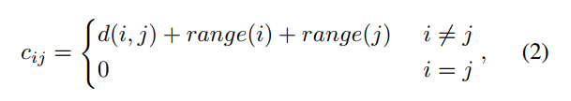
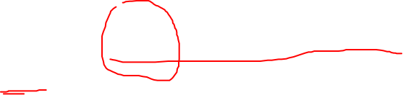

Range-Distance Cost(RDC)
$d_{ij}$ is the “distance” between two nodes
Range$(i)$ represents the mobility range of node i
Notes:
怎么得到数据，
访问更加，效率

Slide 7
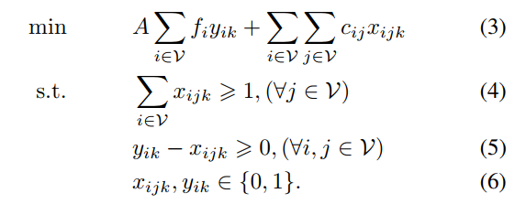
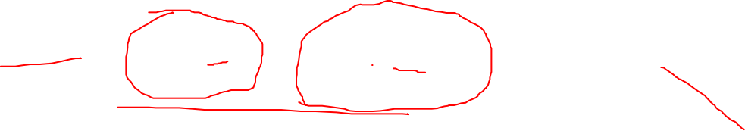
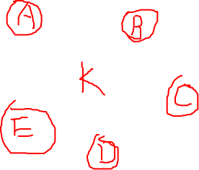

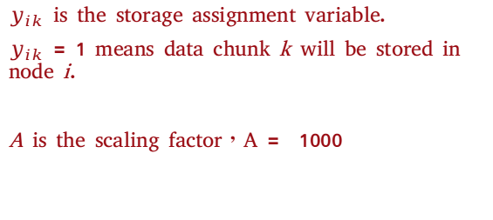
Problem formulation
$y_{ik}$ is the storage assignment variable.
$y_{ik}$ = 1 means data chunk k will be stored in node i.
A is the scaling factor，A = 1000
$x_{ijk}$ is the accessing assignment variable.
If $x_{ijk}$ = 1 node j will access data item k from node i.
Notes:
fi时工厂建造成本，cij是访问成本。
这是个NP问题，但是有很多近似解
这里采用的最近网络位置算法

Slide 8
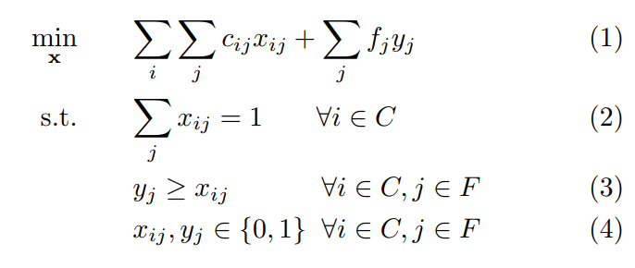
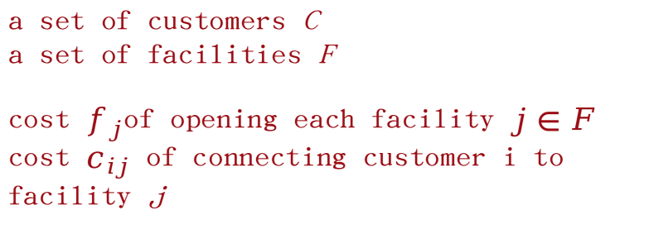
uncapacitated facility location problem
a set of customers C a set of facilities F
cost $f_{j}$of opening each facility $j∈F$ cost $c_{ij}$ of connecting customer i to facility j
Notes:
fi时工厂建造成本，cij是访问成本。
这是个NP问题，但是有很多近似解
这里采用的最近网络位置算法

Slide 9
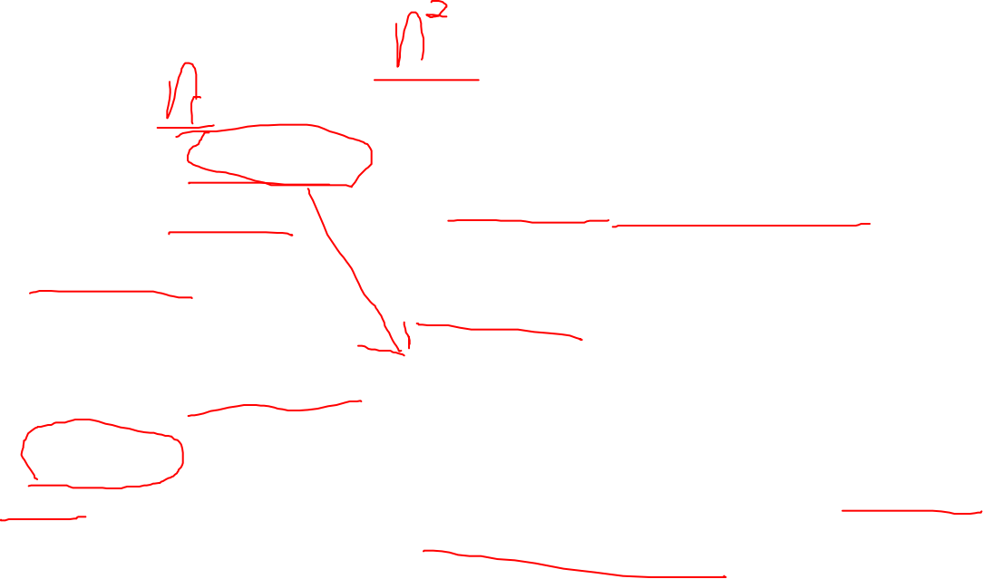
PROCESS
Producer ：
1. Generate a data item
2. Generate metadata
3. Broadcasts
The node which mines the next block :
1. Pack all received metadata items Along with the storing node information
into block
2. Broadcasts
Other nodes ：
1. Receives the metadata item 2. Calculates which set of nodes will store
Other nodes ：
1. Receive the block 2. If a node is chosen to be a storing
node, it gets the data from the producer and stores them
Notes:
fi时工厂建造成本，cij是访问成本。
这是个NP问题，但是有很多近似解
这里采用的最近网络位置算法

Slide 10
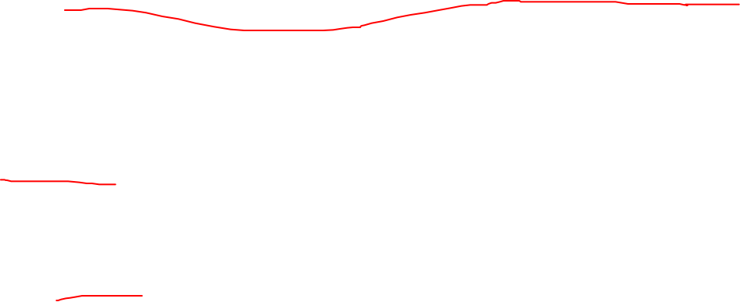
PROCESS
Block ：
1. Each new block will be assigned to store on some nodes
2. Storing nodes information are encoded in this block
3. The information of the block also contains where the previous block is stored
FIFO ：
Recent blocks of the blockchain are the most needed for potential temporary disconnection of nodes
Nodes are required to cache a certain number of most recent blocks and replace the blocks using FIFO.
Notes:
fi时工厂建造成本，cij是访问成本。
这是个NP问题，但是有很多近似解
这里采用的最近网络位置算法

Slide 11
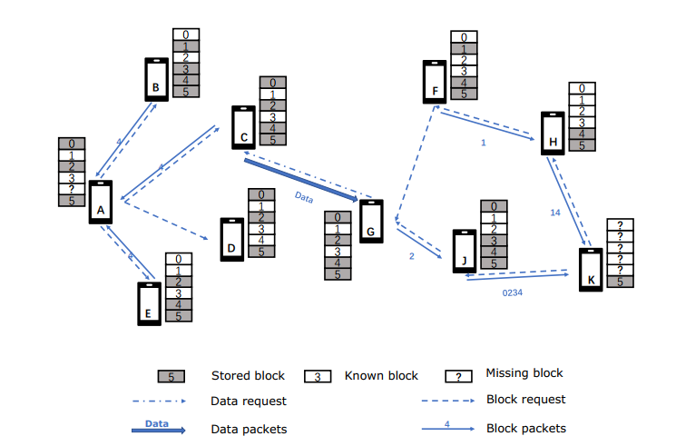

Data Items and Blocks Access Process
For a node needs a certain data
1、checks the metadata item 2、fetches nodes that store it 3、sends the data request 4、waits data back
Notes:
怎么得到数据，
访问更加，效率

Slide 12

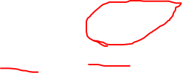
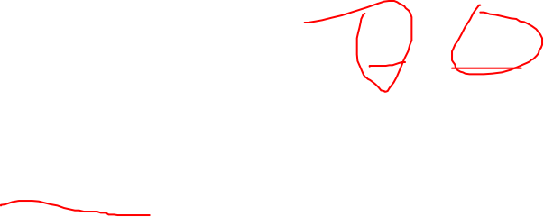
PoS
If a node has more token and stores more data and blocks, the node will have more advantages to mine blocks.

Slide 13
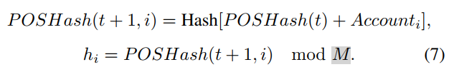
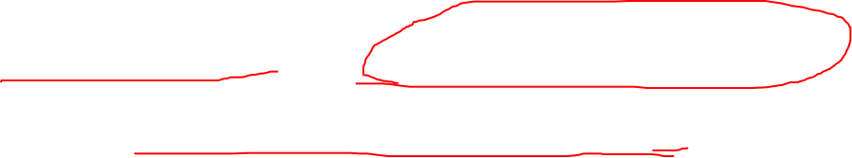
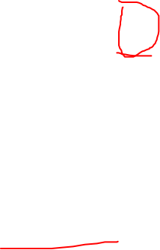
Mining Conditions
h : 随机数
M：最大随机数
Notes:
SHA-256

Slide 14


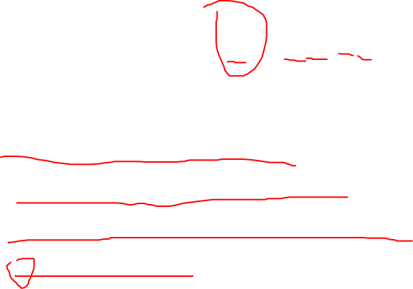
target value
Si denotes the token owned by node i.
Qi is the number of data items stored in node n.
t is the time passed from the previous block ☺in seconds
B is a number to adjust Ri to make sure that the average time mining a block throughout the network is as expected.

Slide 15
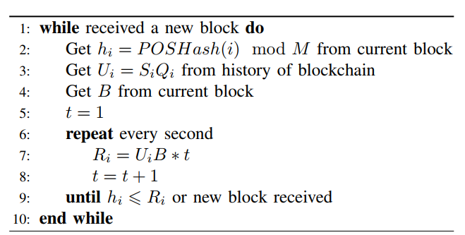
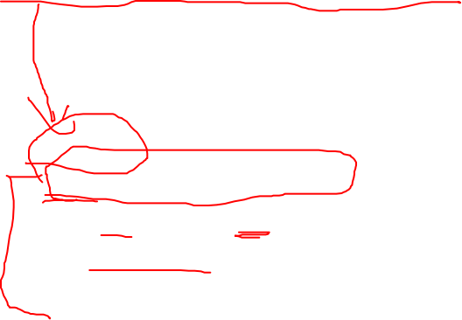

Mining Process for Nodes

Slide 16
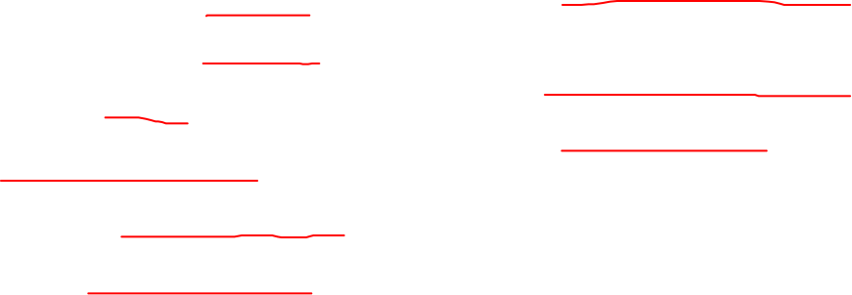
Some parameter
Implement the blockchain system using Node.js
The core code of the blockchain is the Naivechain
Simulate multiple nodes using Docker
All results are the average of 2 simulations.
All nodes are distributed in an area of 300m × 300m
The mobility of the nodes is within 30 meters ranges
Each node has the capability to store 250 data items or blocks
Average time for mining a block as 60 seconds
Each simulation runs over 500 minutes

Slide 17

我们要解决的问题
NaiveChain
1、As concise and simple implementation of a blockchain as possible
2、HTTP interface to control the node
3、Use Websockets to communicate with other nodes (P2P)
4、No pos or pow
具体工作
1、模拟sensor产出数据
2、实现一大堆的算法，部署到naivechain
a、nodejs or python
b、docker
c、UFL近似算法
d、new pos 算法
e、websocket通信
3、模拟用户数据请求
4、找到服务器做实验

