Slide 1
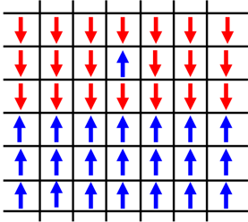
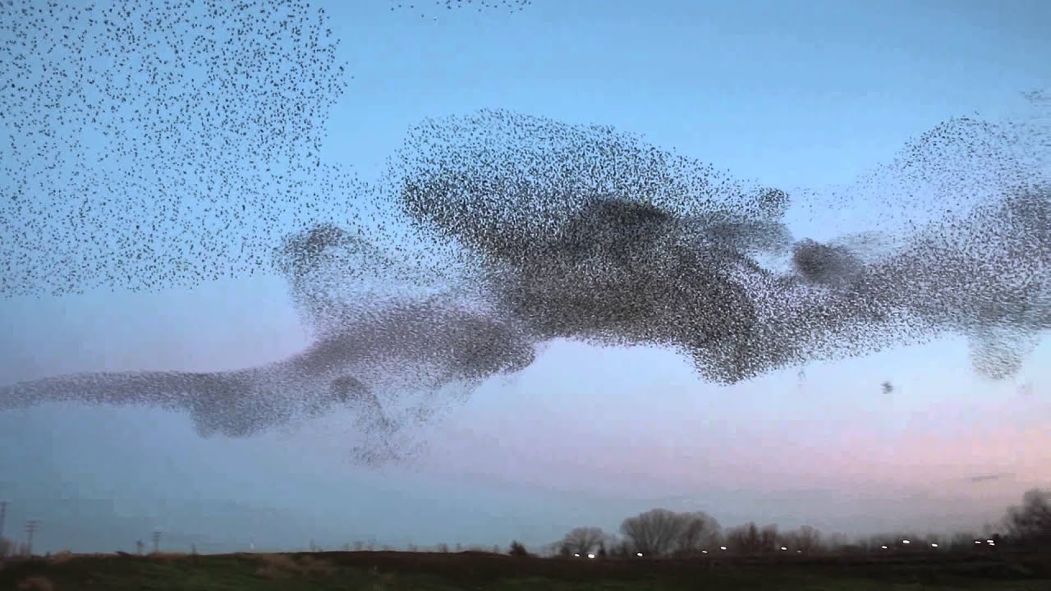
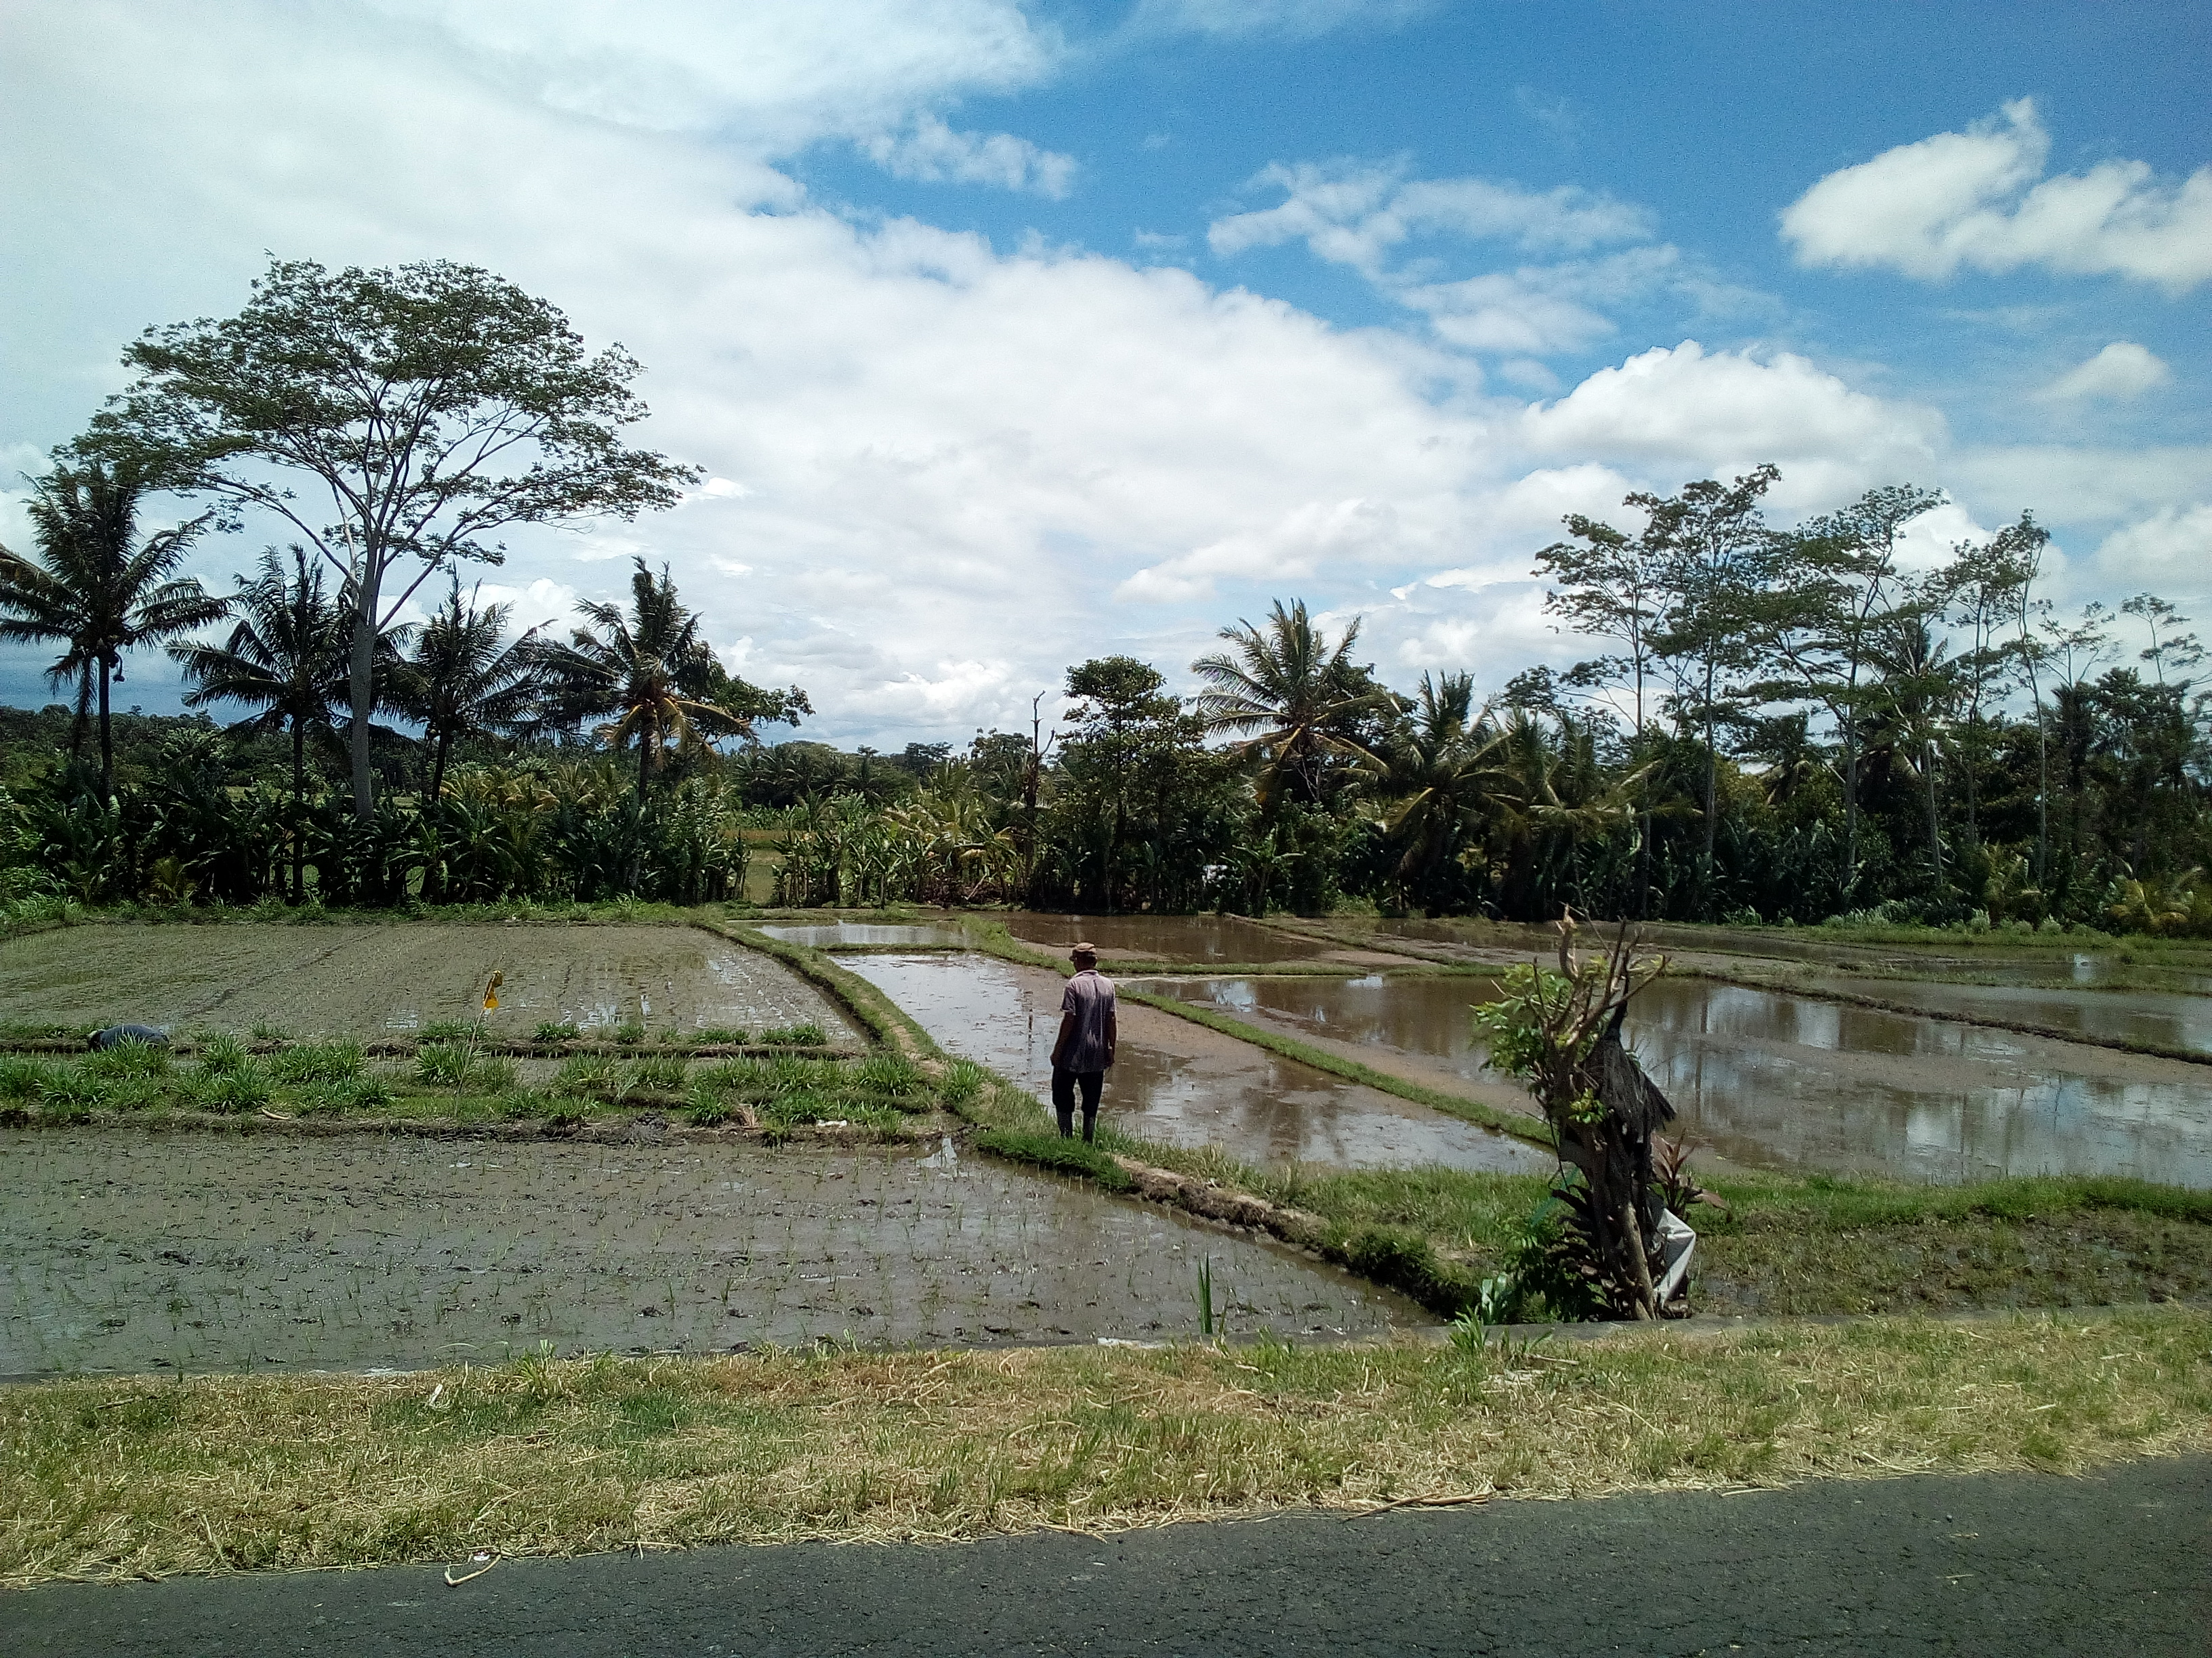

What do they have in common ?
Ferromagnetic magnetisation
Flocks of birds
Subaks rice fields. Bali-Indonesia
Spontaneous manifestation

